Slide 1
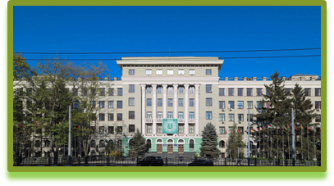
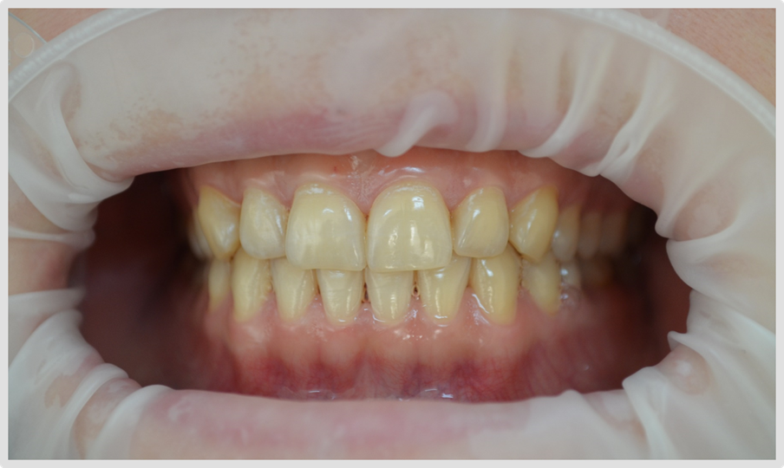
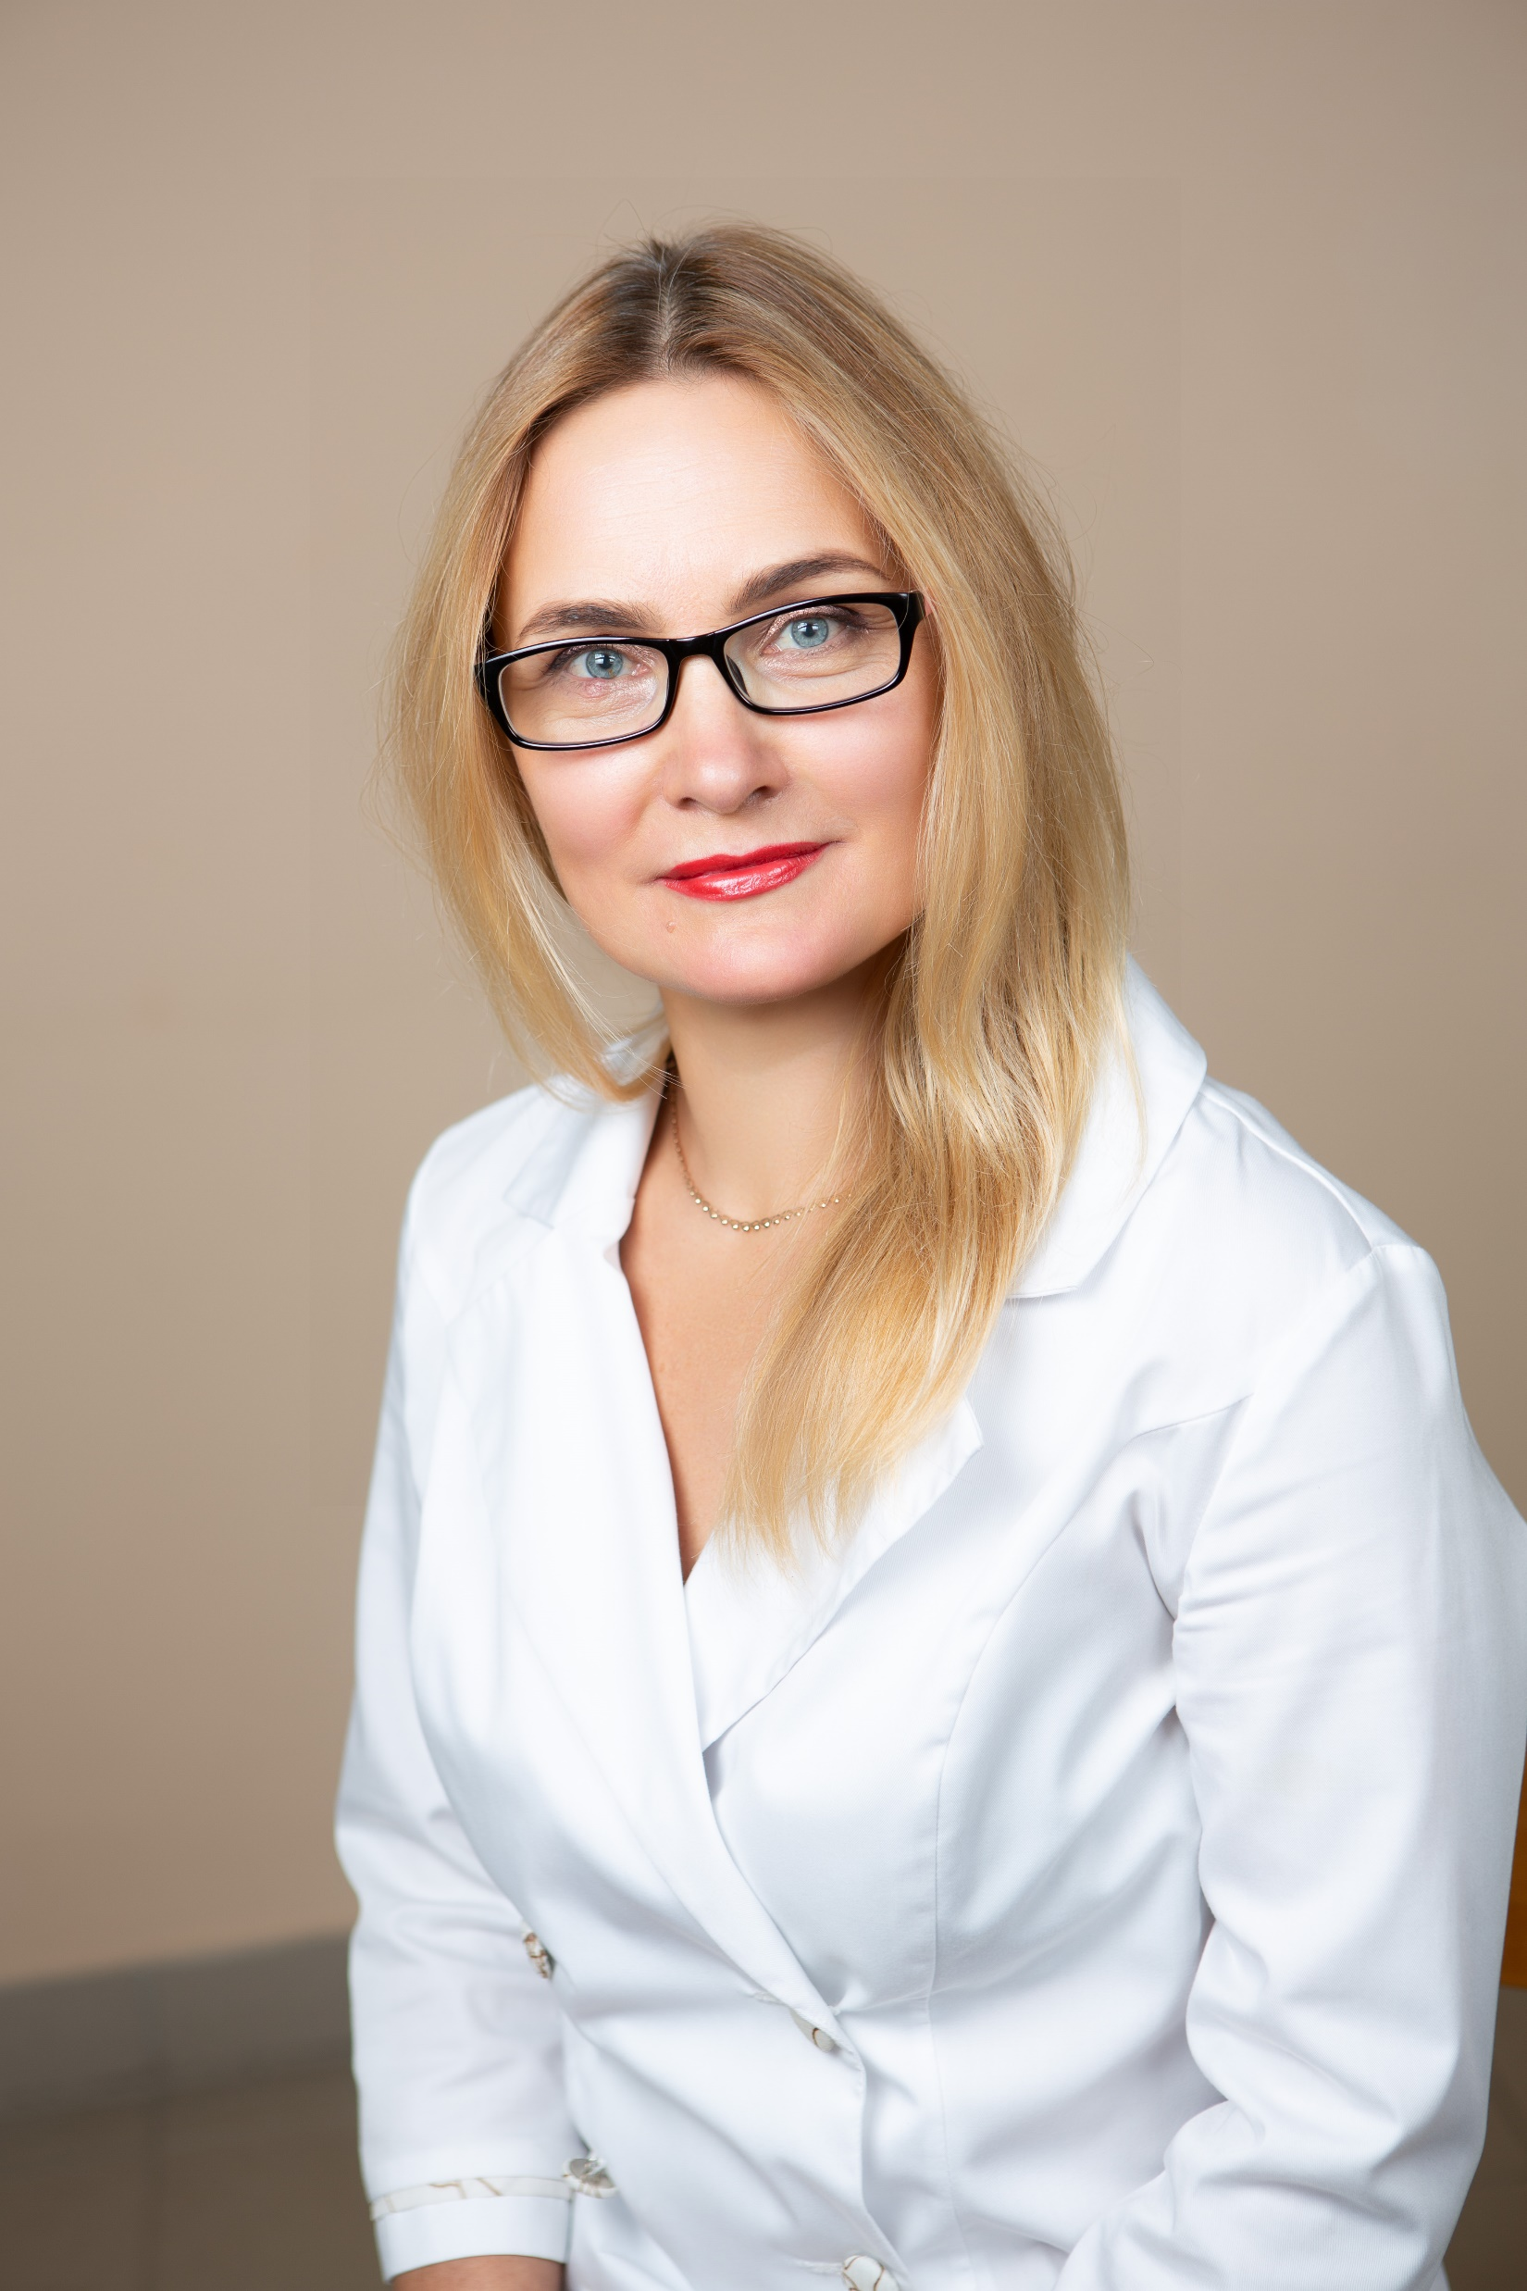

The use of an elixir that regulates the central nervous system in the complex treatment of patients with generalized periodontitis with symptoms of anxiety who are in a combat zone among the civilians
All-Ukrainian scientific and practical conference with international participation «Clinical immunology and allergology: new requirements and achievements in wartime»
Kharkiv National Medical University
4 – 6 March, 2026
department of Dentistry
Kharkiv national medical University
PhD, Associate of professor
Khudiakova Maryna Borisovna

Slide 2
Relevance
In the complex treatment of patients with generalized periodontitis, it is necessary to take into account the etiology and pathogenesis of dystrophic-inflammatory diseases of the periodontium, especially in case of significant influence on them of certain systemic factors [1].

Slide 3
Relevance
The reduction of the patient’s organism resistance is facilitated by systemic diseases, tobacco smoking, psychological stress, etc. [1,5,7]. The presence of stress has a significant influence on the organism resistance and, accordingly, on the development, course and treatment of periodontal diseases [1,5,7]. Its presence should be considered in the case of complex treatment of patients with generalized periodontitis.

Slide 4
Relevance
According to the Decree of the President of Ukraine “On Sustainable Development Goals of Ukraine for the Period until 2030” dated September 25, 2015, No. 70/1, one of the declared goals of sustainable development is to maintain and ensure a healthy lifestyle for the population and promote the well-being of every person regardless of age. In this context, the dental services of Ukraine, which are outside the primary level of medical care, play an important role in the therapeutic and diagnostic activities of medical institutions [2].
Dentistry is not included in the list of services that will be provided at the primary level of medical care in Ukraine. During the war, the National Health Service of Ukraine pays for pediatric and emergency dental care, and some dental institutions have access to state guarantee programs. Thus, dentistry in Ukraine currently remains without financial support from the state. Access to dental care has significantly decreased for socially vulnerable groups of the population. And in rural areas, it is practically impossible to obtain it [2].

Slide 5
Relevance
On February 24, 2022, martial law was imposed in Ukraine, dictating new approaches to the entire healthcare system in terms of providing medical, including dental, care to the civilian population. Since the start of the full-scale invasion of Ukraine by the Russian army, dentists have continued to provide professional care to patients, and in areas of active combat and adjacent territories, they have sought opportunities to organize such care when necessary. There is very little information in Ukrainian and international professional sources about the provision of outpatient dental care in a state of martial law. Combat operations in the eastern regions of Ukraine have been ongoing since 2014, but martial law has not been declared throughout the country, and the specifics of providing dental and periodontal care to the civilian population in areas of active combat operations have not been analyzed previously [3].

Slide 6
Relevance
The author summarizes the main factors that significantly limit the provision of specialized dental care in areas where hostilities are ongoing or in occupied territories. The main problems of state regulation of the domestic dental care system, which are responsible for its current state of crisis and stagnation, are identified. Attention is drawn to the fact that over the past five years, not a single dental office has been equipped and put into operation at public expense. All dental equipment in stationary and mobile offices of field hospitals and combat units is provided by volunteers. In addition, there are still no legislatively approved competitive “rules of the game” in the SDN system in the form of the development and approval of regulatory legal acts, as well as the approval of documents on the professional self-government of dentists, etc. [4]

Slide 7
Relevance
With this in mind, a medication regimen has been proposed for the treatment of patients with chronic GP of grade II severity with manifestations of anxiety in areas of active combat operations among the civilian population

Slide 8
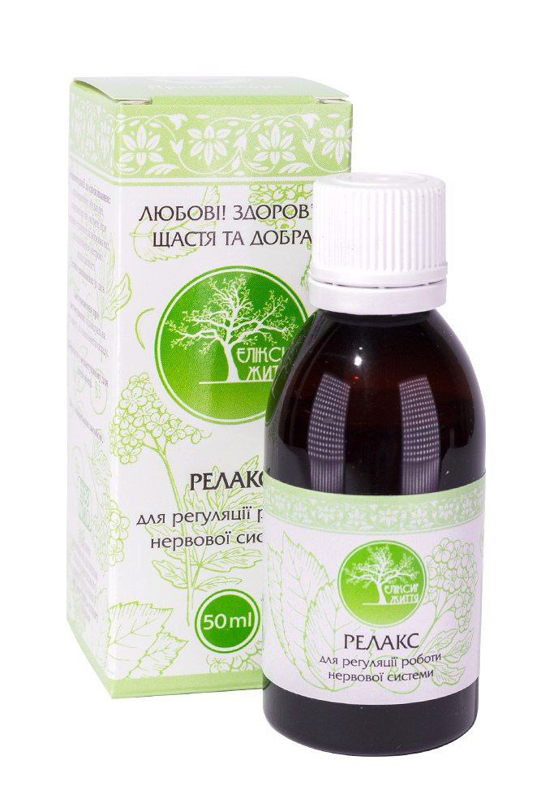
The aim of the study was to determine the results of the clinical efficacy of complex treatment of GP patients who are in areas of active combat operations with manifestations of anxiety against the background of the use of an elixir that regulates the central nervous system

Slide 9
Materials and methods
All participants underwent clinical periodontal examination using a periodontal probe with a WHO scale and X-ray (orthopantomogram) examination. The level of anxiety in patients was assessed using the DASS-21 and Spielberg-Hanin questionnaires. The presence of inflammation in the gums was detected and assessed using the Schiller-Pisarev test (1962). The level of gum bleeding was assessed using the RBI bleeding index (HR Mühlemann, S. Son, 1971).
The patients completed the Spielberger-Khanin questionnaire, which determined personal and situational anxiety. Subsequently, the responses were evaluated according to the keys and the total scores for all judgments were calculated separately for each of the scales (situational anxiety and personal anxiety).

Slide 10
research results and discussion
It has been established that the main reason for seeking periodontal care among patients in areas of active combat operations with signs of anxiety among the civilian population was the need for comprehensive treatment of periodontal disease

Slide 11
research results and discussion
To determine the effectiveness of the proposed method, clinical and laboratory examinations and treatment were conducted on 40 patients with stage II chronic GP with anxiety symptoms. These patients were divided into two equal subgroups: the main subgroup (30 patients) and the comparison subgroup (10 patients). Thus, the main (first) subgroup consisted of thirty (75.00%) patients with GP with anxiety symptoms, who received complex treatment with Relax elixir of the Prima Flora trademark (TM) at a dose of 10 drops 3 times a day after meals. which regulates the central nervous system and has the following components: valerian root extract, dog nettle herb extract, anise lofant herb extract, pomegranate fruit extract, oregano herb extract, St. John's wort extract, mint extract, tryptophan, nicotinamide (vitamin B3), magnesium, vitamin B6, folic acid. The comparison subgroup consisted of ten (25.00%) patients with GP with anxiety symptoms, who received complex treatment similar to that of the main subgroup, but without the use of Relax elixir

Slide 12
research results and discussion
Analysis of treatment results showed that the level of inflammation decreased in the gums of patients in both study subgroups, as evidenced by a negative Schiller-Pisarev test in patients in the main subgroup and in patients in the comparison subgroup. Determination of the quantitative value of the Schiller-Pisarev test according to the Svrakov iodine index showed that in patients of the main subgroup, it decreased in patients with grade II GP from 2.76±0.19 to 1.29±0.09 points. In the comparison subgroup, it decreased from 2.76±0.19 to 1.41±0.09 points in patients with grade II. The numerical values of the Schiller-Pisarev test in patients of both subgroups after treatment were statistically significantly different (p < 0.05). In patients with GP in the main subgroup, the PBI index decreased in patients with stage II from 2.74±0.19 to 0.65±0.06 points. In patients of the comparison subgroup, the PBI index decreased from 2.77±0.19 to 0.82±0.07 points. The data obtained in patients of the main subgroup and the comparison subgroup differed statistically significantly (p < 0.05).

Slide 13
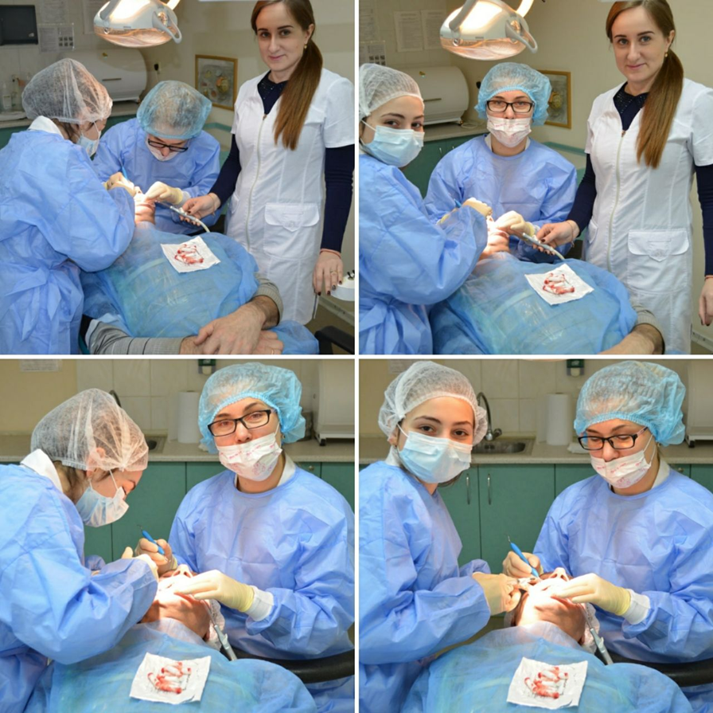
The basis of generally accepted local therapy for periodontal diseases (phase 1) consists of 3 operations
Removal of dental plaque from the entire surface of the teeth
Complete removal of supra- and subgingival dental deposits (closed and open curettage)
Anti-inflammatory therapy of periodontal pockets

Slide 14
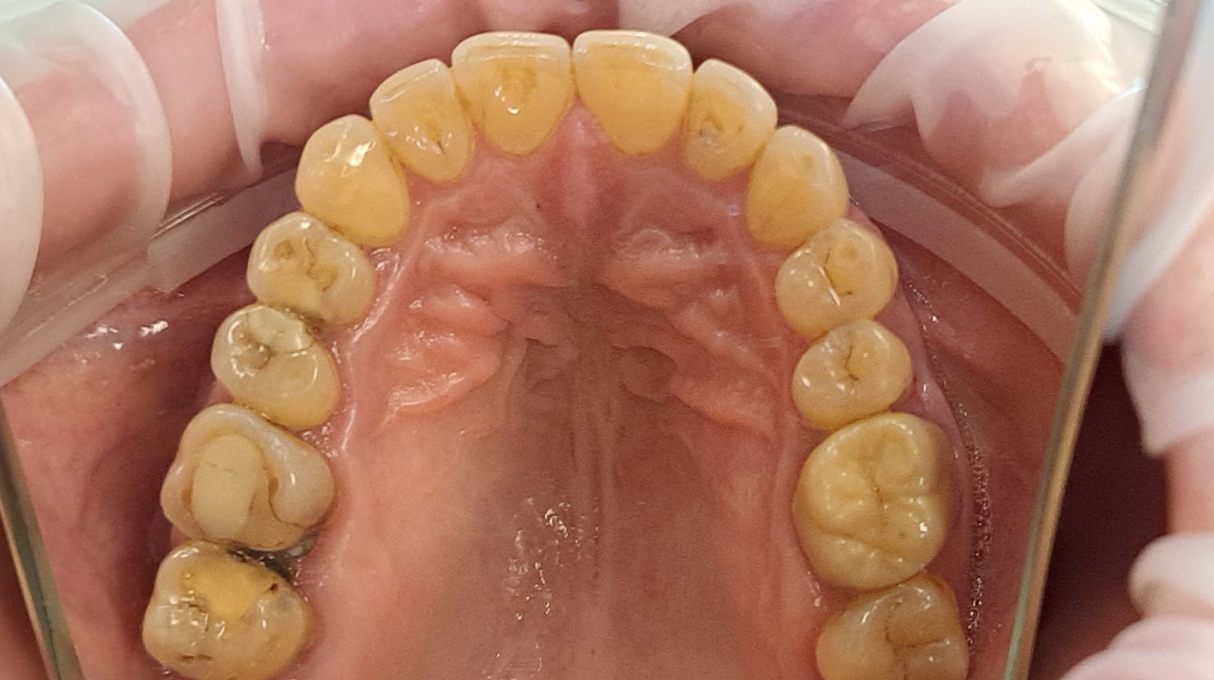
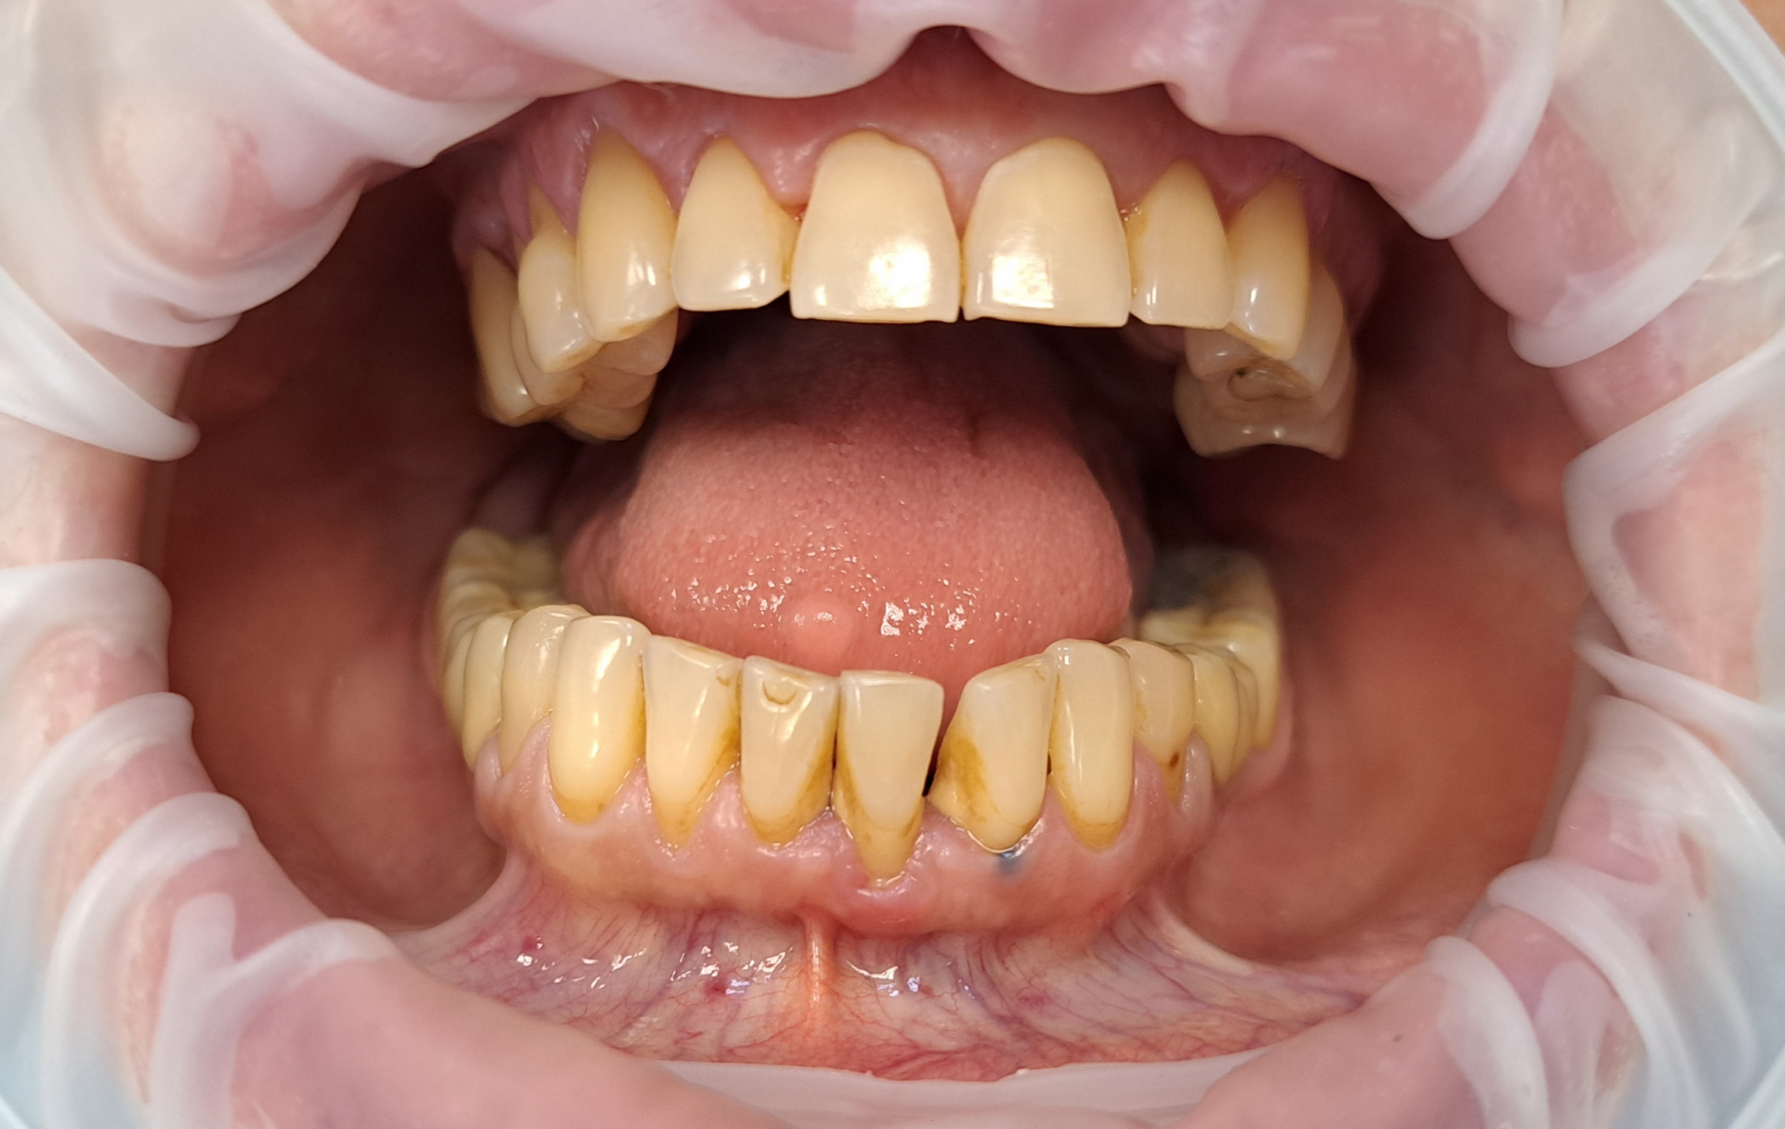
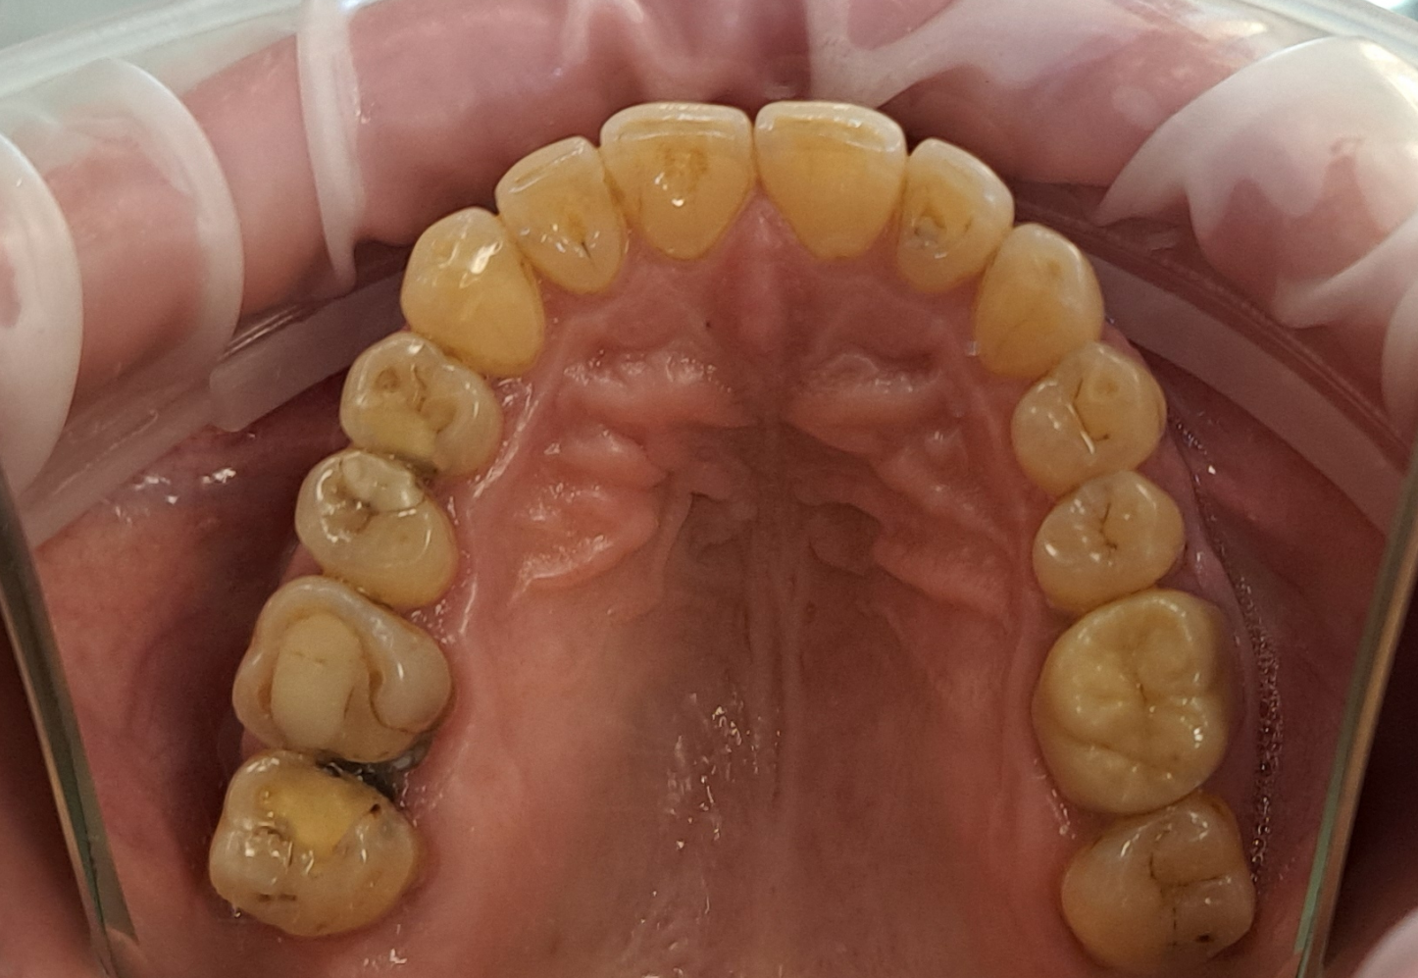
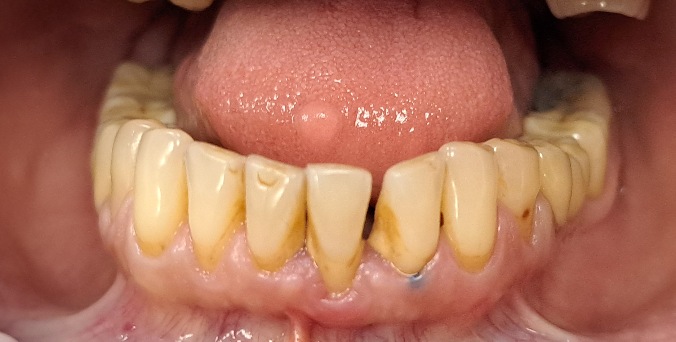
Basic subgroup

Slide 15
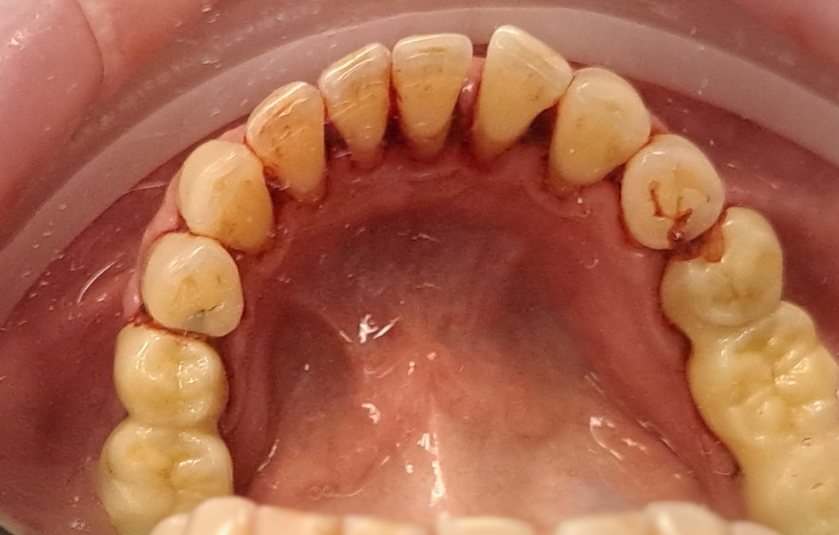
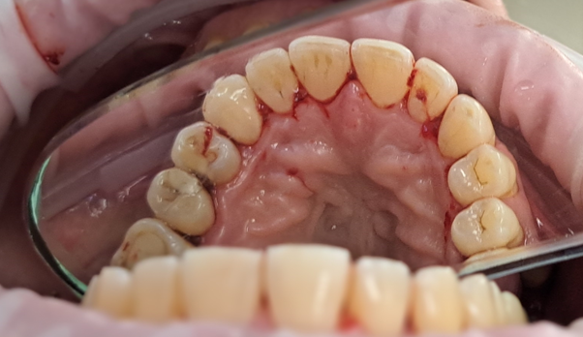
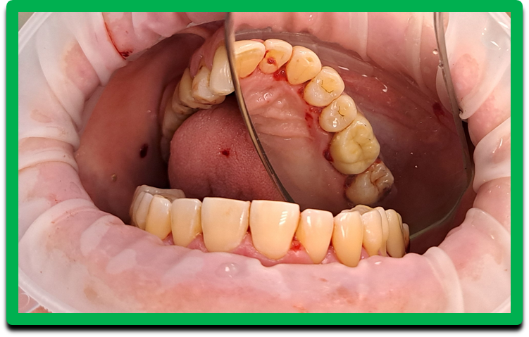
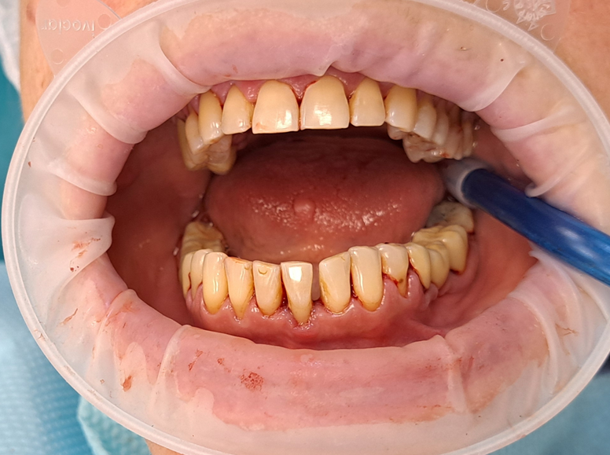
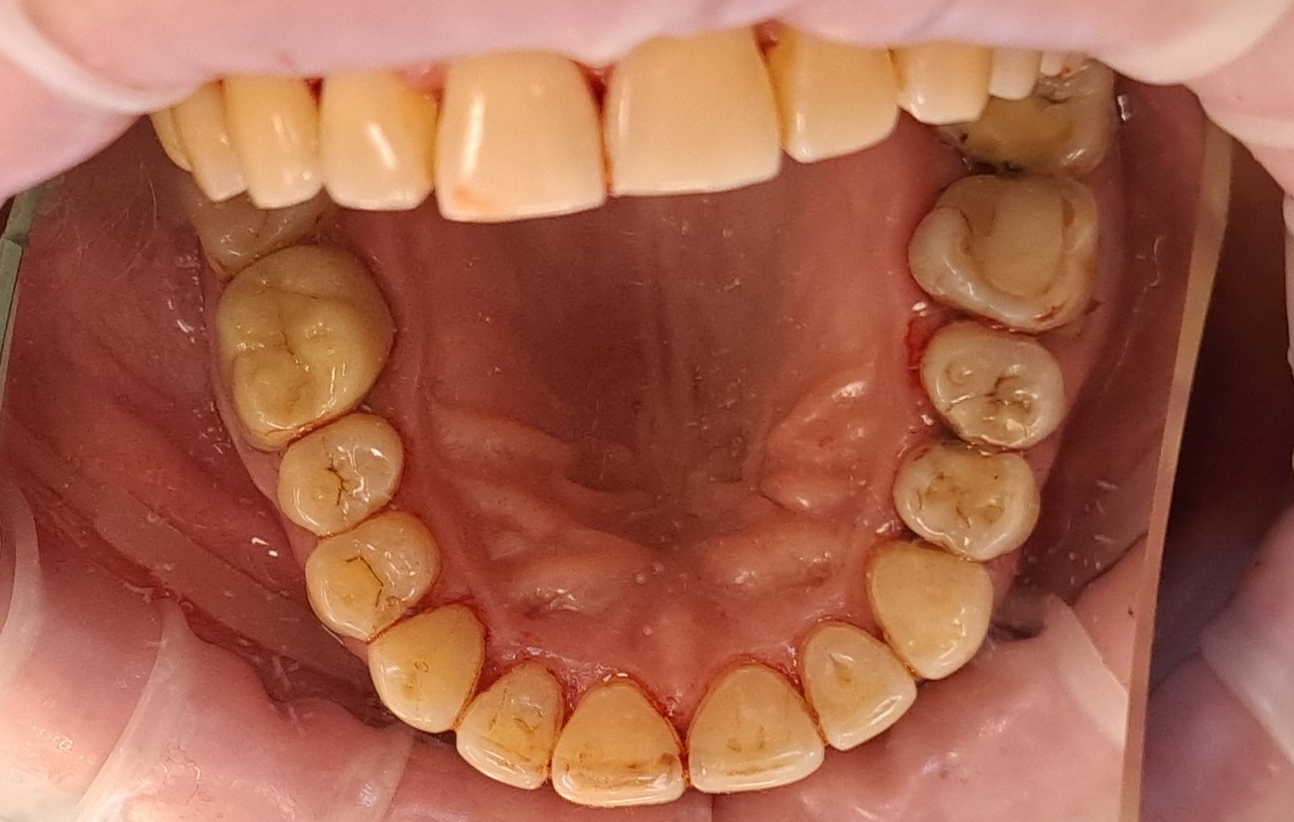
Basic subgroup

Slide 16
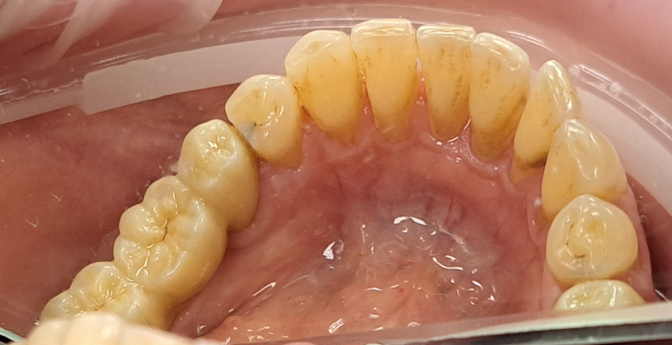
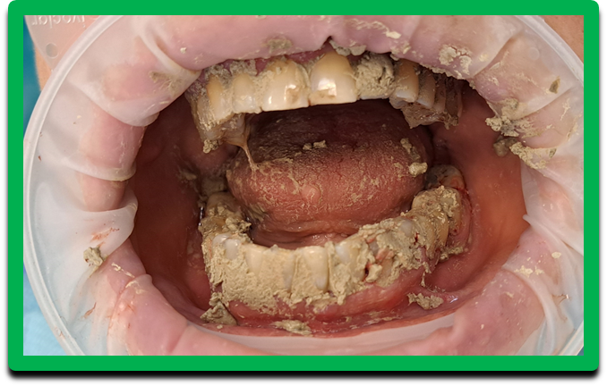
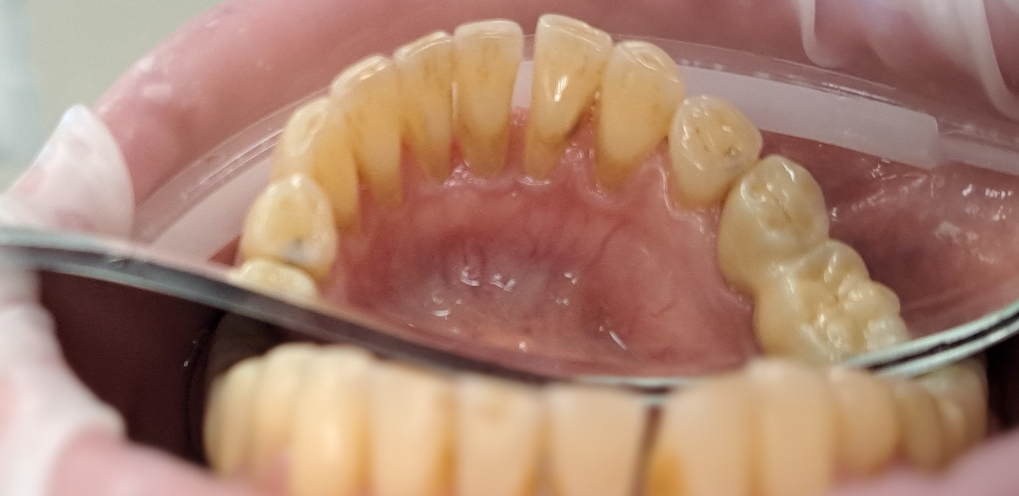
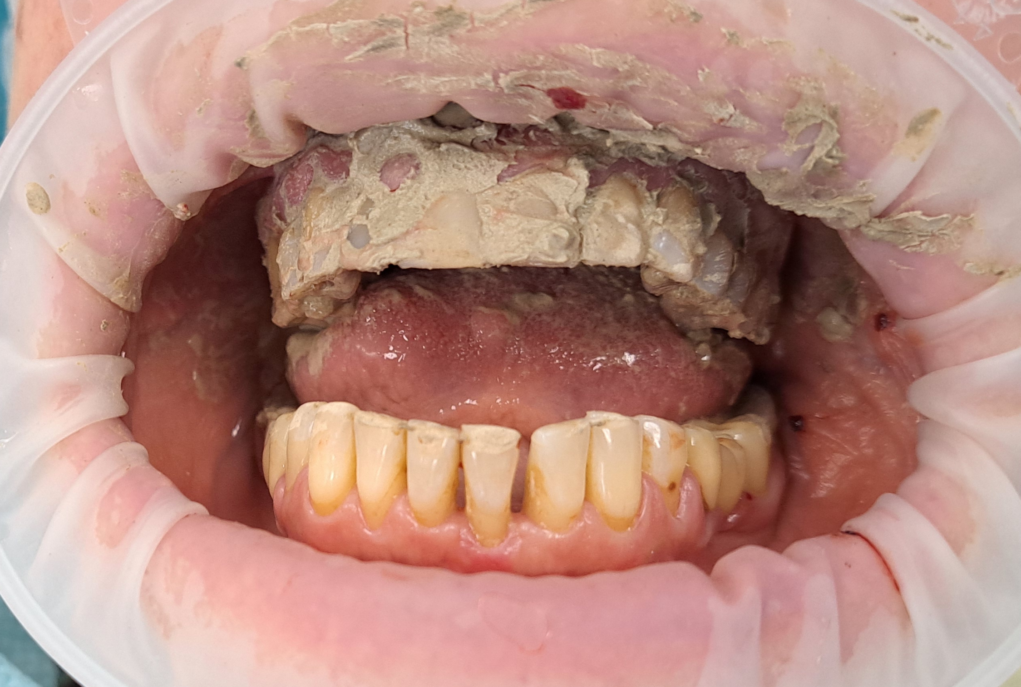
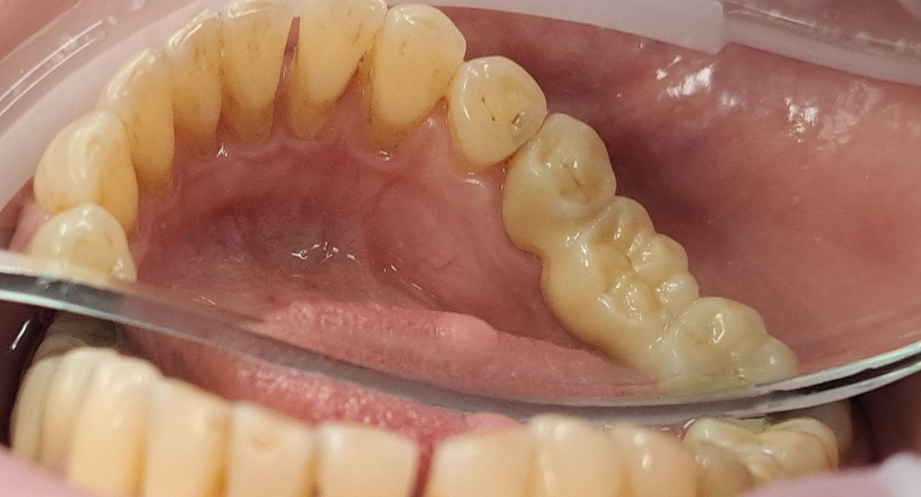
Basic subgroup

Slide 17
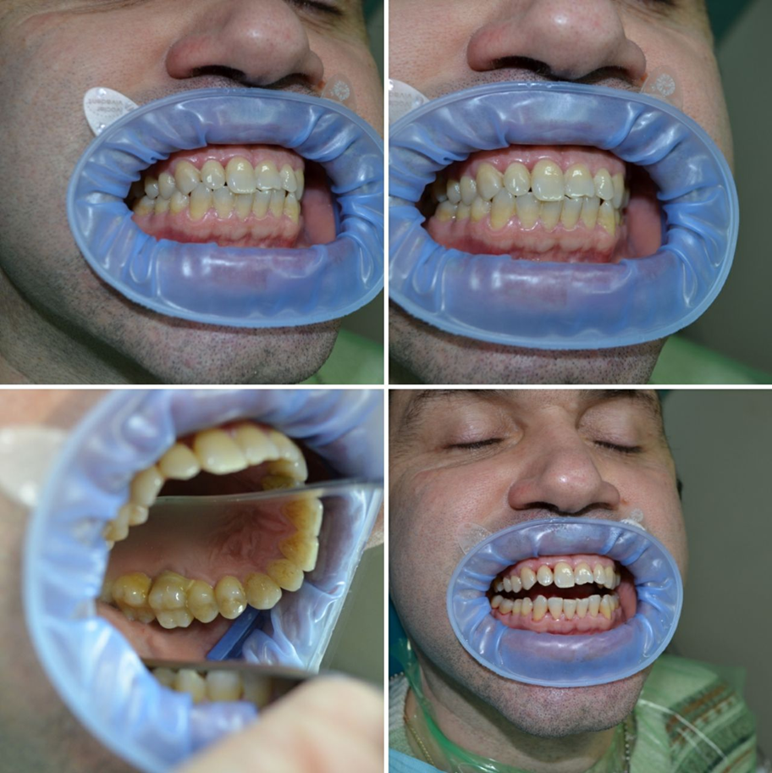
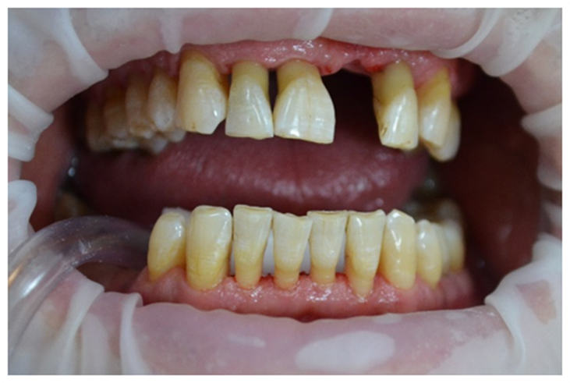
Basic subgroup

Slide 18
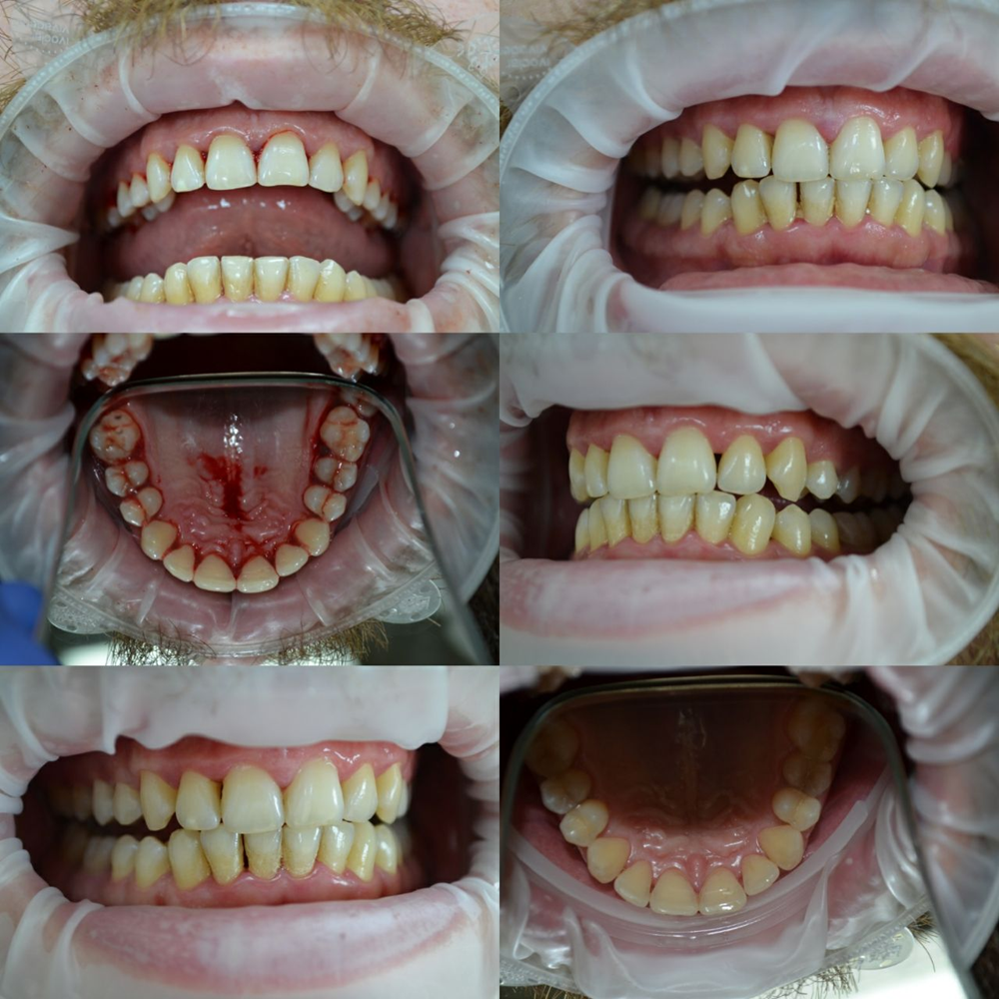
Comparison subgroup

Slide 19
ConclusIonS
The results of the studies indicate stabilization of the pathological process in the periodontium. All this together demonstrates the beneficial effect of the proposed method of complex treatment against the background of the use of an elixir that regulates the central nervous system, on the dystrophic-inflammatory process in the periodontium and indicates the effectiveness of its use in the comprehensive treatment of patients with generalized periodontitis who are in areas of combat operations with manifestations of anxiety.

Slide 20
references
1. Mazur I. Oral health, periodontal phenotype in patients with different mineral density (morphotypes) of bone tissue / I. Mazur, P. Mazur // PAIN, JOINTS, SPINE. – 2023. - № 13(3). – P.187–194. - https://doi.org/10.22141/pjs.13.3.2023.384.
2. Kryzyna N. State regulation of dental care provision in Ukraine / N. Kryzyna, O. Kryzyna // Scientific prospects. – 2023. - № 3(33). – P.85-98.
3. Kaniura ОА Experience in providing dental care under martial law / OA Kaniura, NV Bidenko, Yu G Kolenko, VV Filonenko, NS Khrol, D Yu Shpak // Modern dentistry. - 2022. - № 3-4. - С. 38-44. - Режим доступу: http://nbuv.gov.ua/UJRN/ss_2022_3-4_10
4. Makhinchuk N. V. Features of the institutional and legal mechanism of public management of the development of the dental care system for the population in Ukraine / N. V. Makhinchuk // Public administration and customs administration. - 2022. - № 1 (32). - С. 29−35. - URL: http://customs-admin.umsf.in.ua/archive/2022/1/6.pdf .- DOI https:// doi.org/10.32836/2310-9653-2022-1.6.
5. Kononova O. Features of treatment of patients with generalized periodontitis with manifestations of psychoemotional stress. / O. Kononova // Actual Dentistry. – 2019. - № (2). – P.32-35. - https://doi.org/10.33295/1992-576X-2019-2-32.
6. Borysenko A.V. New classification of periodontal diseases and periimplant conditions (2017) / A.V. Borysenko // Actual Dentistry. - 2019. - № (3). - P. 24. - https://doi.org/10.33295/1992-576X-2019-3-24
7. Horodnov E. Methods of researching the quality of life in patients with dental diseases / E. Horodnov // Current trends in scientific research development. Proceedings of the 2nd International scientific and practical conference / BoScience Publisher. - Boston, USA. - 2024. - Pp. 21-27. - URL: https://sci-conf.com.ua/ii-mizhnarodna-naukovo-praktichna-konferentsiya-current-trends-in-scientific-research-development-19-21-09-2024-boston-ssha-arhiv/.

Slide 21
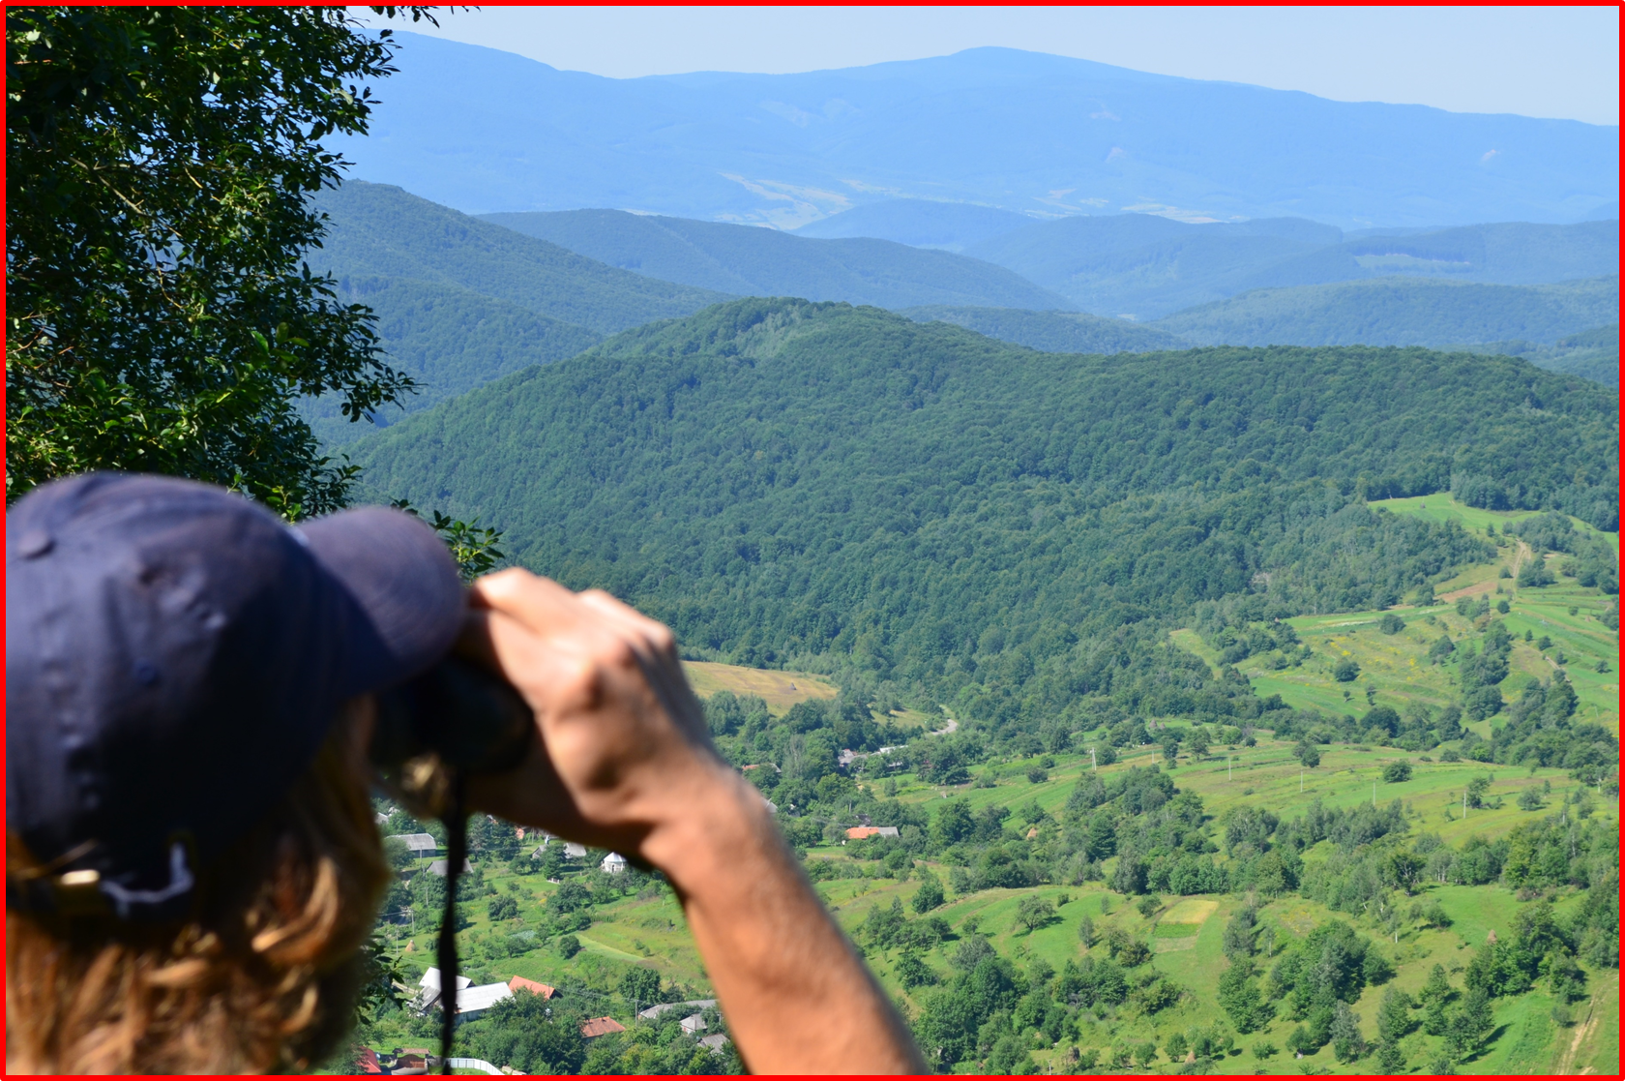
When you understand something, life becomes easier. And when you feel something, it becomes harder. But for some reason, you always want to feel, not understand!
Yevgeny Grishkovets
Thanks a lot!

