Slide 1
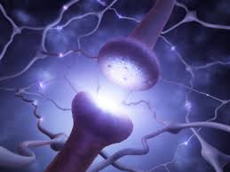
Adrenergic drugs
Ass. Aleksandrova A.V.

Slide 2
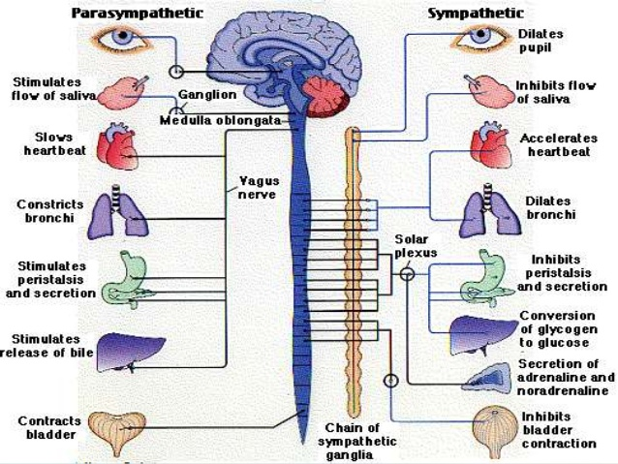

Slide 3
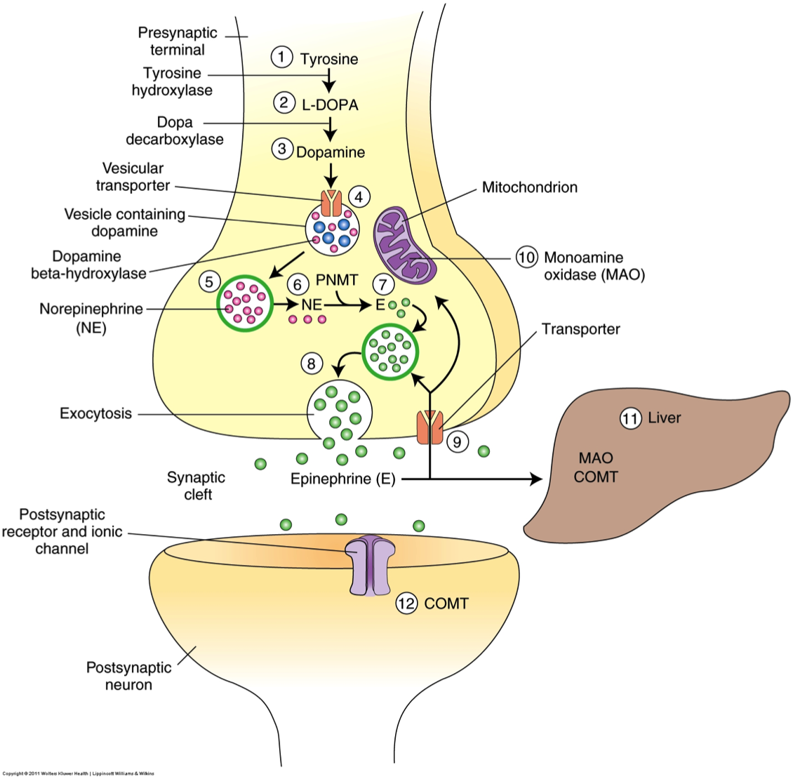
Adrenergic synapse

Slide 4
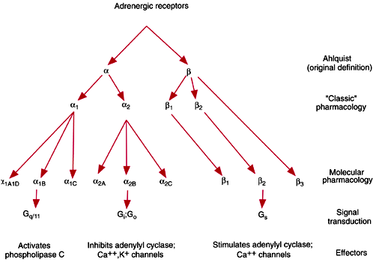
Adrenergic receptors

Slide 5
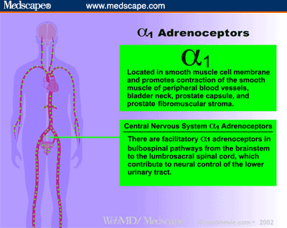
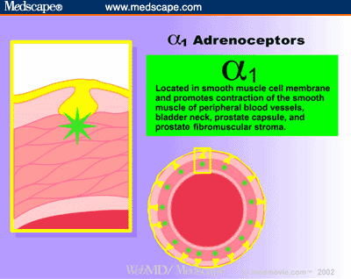
α1 adrenoceptors
(postsinaptic membrane)
1. Vessels (skin, mucous,)
2. Eye,
3. Urine bladder
4. Uterus
5. Prostate gland
6. CNS
Constriction, increase blood pressure,
Mydriasis
Increase of sphincter closure
Constriction
Constriction
Excitation

Slide 6
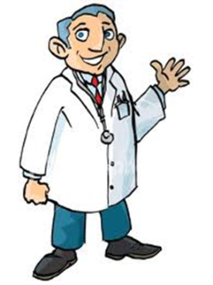
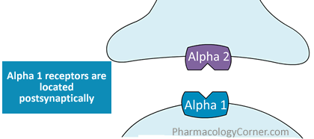
α2 adrenoceptors
(primarily presinaptic membrane)
1.Presinaptic membrane (feedback inhibition)
2. Vessels (noninnervated)
3.Vasomotor center
4. Pancreas
5. Fat tissue
6. CNS
Decrease releasing of Ach, NA
Constriction
Inhibition
Inhibition of insulin release
Lipolisis ↓
Sedative action

Slide 7
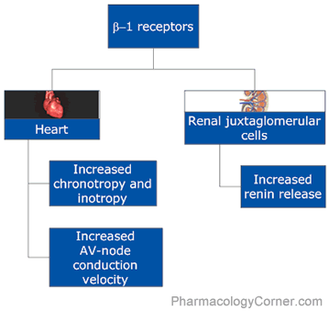
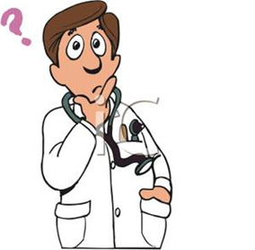
β1 adrenoceptors
+ Fat tissue – increase lipolisis

Slide 8
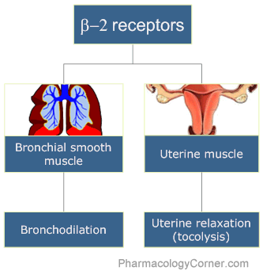
β2 adrenoceptors

Slide 9
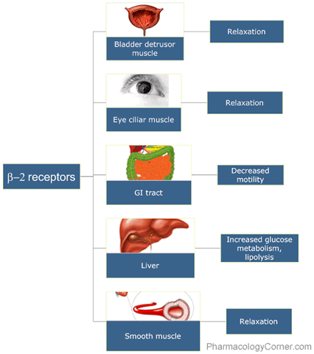
β2 adrenoceptors

Slide 10

Adrenomimetics
α and β adrenomimetics
Adrenaline (α1, α2, β1, β2)
Noradrenaline (α1, α2, β1)
α adrenomimetics
Phenylephrine (Mesatonum) (α1)
Naphazoline (Naphthyzinum) (α2)
Xylometazoline (Halazoline) (α2)
Oxymetazoline (α2)
Clonidine (Clophelinum) (α2)
Guanfacine (α2)
Sympatomimetics
Ephedrine
β adrenomimetics
Dobutamine (β1) Salbutamol (β2) Salmeterol (β2)
Isadrinum (β1, β2 ) Fenoterol (β2) Terbutaline (β2)

Slide 11
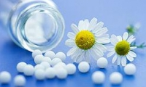
Phenylephrine (Mesatonum) (α1)
Pharmacological effects
* Constriction of vessels → Increasing of BP→ stimulation of baroreceptors → reflex bradycardia
* Mydriasis (reduced radial muscles) to the ciliary muscle has no effect (parasympathetic inervation)
USES
Acute and chronic hypotension
Prolongation of local anaesthesia
For producing midriasis
Decrease in edema of the mucous membrane in acute rhinitis or conjunctivitis
Side effects
Hypertension, headache, bradycardia, tissue ischemia, impaired urination

Slide 12

Naphazoline (Naphthyzinum)
Xylometazoline (Halazoline)
Clonidine (Clophelinum)
Oxymetazoline
α 2 adrenomimetics
Constriction of peripheral
vessels
Used for treatment rhinitis
Side effect
Tachyphylaxis
(after the abolition - nasal congestion due to rebound vasodilation) especially oxymetazoline and xylometazoline)

Slide 13
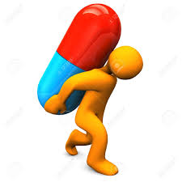
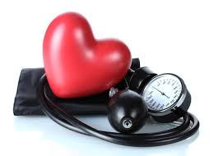
α 2 adrenomimetics
Clonidine, Guanfacine
Pharmacological effects:
Stimulation of α2 adrenoceptors in CNS→ decrease heart rate, dilatation of vessels→ BP↓
Stimulation peripheral α2 adrenoceptors→ also reduces the effect of sympathetic inervation on the heart and blood vessels → BP↓
- Sedative
- Potentiates the effect of alcohol
- Decreases the production of intraocular fluid and improves its outflow
Application
-Hypertension
-Hypertensive crisis (I.V. introduction can cause short-time ↑ blood pressure, due to the stimulation of extrasynaptic α2 - A / P
- Painkiller
- Glaucoma

Slide 14
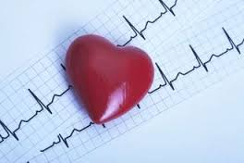
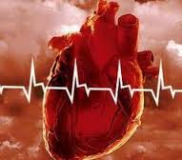
β₁ - adrenomimetics
Dobutamine, Dophamine
Stimulation of β₁ adrenoceptors
- in heart→ increase heart rate and force
- in kidney→↑ secretion of renin → formation of angiotensin 2 → BP↑
Dopamine stimulating D1receptors → vasodilation internal organs and kidney → prevents the development of the ischemia of internal organs in cardiogenic shock
Application
Cardiac acute heart failure
Side effect
Tachycardia, ↑ myocardial oxygen demand, increased cardiac arrhythmia

Slide 15
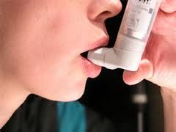
(β2) - adrenomimetics
Salbutamol Terbutaline
Fenoterol Salmeterol Formoterol
Stimulating extrasynaptic β2 a/r →
- relaxation of smooth muscles of the bronchi,
- decreased tone and contractile activity of the myometrium,
- blood vessels dilate (skeletal muscle, liver, coronary vessels)
Application
*bronchial asthma
* Risk of miscarriage, tocolytic agents

Slide 16
β1, β2 - adrenomimetics
Isoprenaline (Izadrin)
Pharmacological effects
- Increase heart rate, systolic blood pressure ↑
- Facilitating a.v. conductivity
- Increase automaticity,
- Vasodilatation, peripheral resistanse ↓, BP↓
- Reduction of bronchial tone
Application
*To enhance atrioventricular conduction
*Bronchodilator
Side effect
marked tachycardia, high myocardial oxygen demand,
high risk of arrhythmias

Slide 17
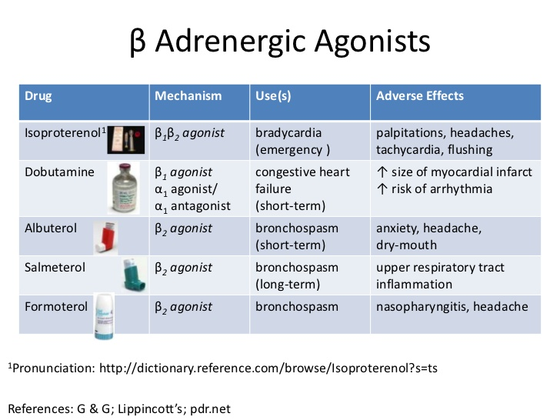

Slide 18
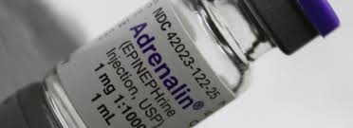
α and β- adrenomimetics
(Epinephrine)
Adrenaline hydrochloride (α1, α2, β1, β2)
Pharmacological effects
-constriction of vessels, PR ↑
- Heart rate ↑, stroke volume and cardiac output ↑, BP ↑
- Dilated pupils
- Reduces the intraocular pressure
- Relaxes the smooth muscles of the bronchi
- Reducing the tone and motility of the gastrointestinal tract, tone of the sphincter ↑
- Glycogenolysis ↑ → hyperglycemia
- Activation of lipolysis → free fatty acids in plasma ↑
- Improving the functional state of skeletal muscle

Slide 19
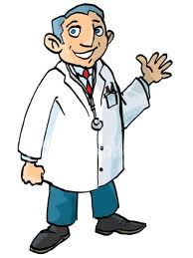
Use of adrenaline hydrochloride
*Anaphylactic shock
*Prevention of acute attack of BA
*Cardiac arrest
*Open-angle glaucoma
*Hypoglycemic coma
*Together with local anesthetics (to prolong their action and reducing their resorptive action)
Taking enterally is destroyed, used parenterally (s /c, i/m, i/v) and locally.
Acts briefly (i/v- 5 min; s/c- 30 min)

Slide 20



adrenaline hydrochloride
Side effect
- Sharp ↑ BP - possibly a brain hemorrhage
- Heart rhythm disturbances (at high doses)
- Stimulating effect on the central nervous system (anxiety, dizziness, headache, tremor, nausea)
Contraindication
Hypertension, angina pectoris
Expressed atherosclerosis, angle-closure glaucoma,
Diabetes, pregnancy
Can not be used in conjunction with some drugs for anesthesia (Halothane, Phtorotane), which increases the risk of arrhythmias

Slide 21
Noradrenaline hydrotartrate (α1, α2, β1, β2)
Pharmacological effects
1. Narrowing of blood vessels, PR ↑ → BP↑ (α- adrenergic stimulation)
(Unlike Adrenaline subsequent reduction in blood pressure is observed , because it has little effect on β2 - adrenergic receptors)
2. Increased blood pressure → reflex bradycardia → stimulation of the vagus nerve center → enhance its inhibitory effect on heart rate
3. Stimulating β1 - a/p of heart → heart force ↑, stroke volume ↑, but due to reflex decreasing in heart rate does not increase cardiac output.
4. On the smooth muscles of internal organs, metabolism and CNS has the same effect as adrenaline, but less pronounced

Slide 22
Noradrenaline hydrotartrate (α1, α2, β1, β2)
Application
In many states, accompanied by a sharp decrease in
blood pressure (trauma, surgery)
Side effect
Respiratory failure
headache
arrhythmia
Enterally it is destroyed, when use s/c - cause spasm of blood vessels at the injection site, is poorly absorbed, tissue necrosis

Slide 23

Sympathomimetics
(indirect adrenomimetics)
Ephedrine
Pharmacological effects
Very close to adrenaline
* on CNS - mild stimulating effect, reduces fatigue, the need for sleep, increases efficiency (less effective than amphetamine).
Application
- Bronchodilator
- increase blood pressure
- Allergies (hay fever, serum sickness)
- Rhinitis
- Narcolepsy (pathological sleepiness)
Side effect
*Repeated dose at short intervals (10-30 min) - addiction (tachyphylaxis)
Nervous agitation, insomnia, disturbances of blood circulation, limb tremor, urinary retention
Ephedrine belongs to doping agents and fobbiden for athletes

Slide 24
Adrenoblockers
These are drugs, which antogonize the receptor action of adrenaline and related drugs.

Slide 25
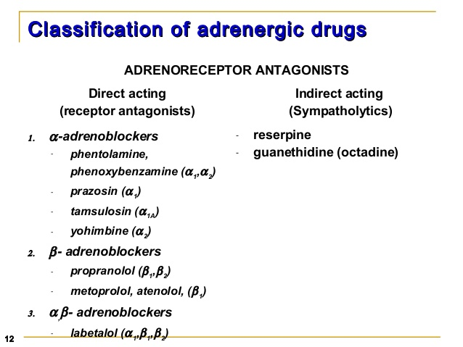
* 1. Ergotamine (α1,α2)

Slide 26
α 1, α 2 adrenoblockers
Nonselective:
*Phenoxybenzamine
*Phentolamine
Ergot alkaloids:
*Ergotamine
*Ergotoxine
Hydrogenated ergot alkaloids:
* Dihydroergotamine
* Dihydroergotoxine
Ergot alkaloids with nicotinic acide:
* Nicergoline

Slide 27

Phentolamine
Pharmacological effects:
* Pronounced vasodilator action
* Decrease in blood pressure
* Reflex tachycardia
* "Perverts" pressor effect of epinephrine
Application:
* For the diagnosis of pheochromocytoma
* Raynaud's disease,
* Occlusive disease
Side effects:
* Orthostatic hypotension, tachycardia, dizziness, nasal congestion, angina, arrhythmia,↑ secretion of HCl, diarrhea

Slide 28
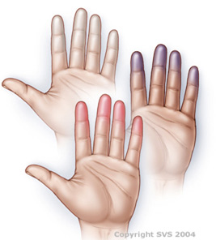
Ergot alkaloids:
Dihydroergotamine, Nicergoline
Pharmacological effects:
* Dilatation on of peripheral vessels, blood pressure ↓
* Regulating effect on vascular tone brain (dihydroergotamine agonist of serotonin 5-HT 1 receptor)
* Myotropic spasmolytic activity (Nicergoline)
Application:
* Migraine
* Chronic ischemic attacks
* Peripheral circulatory disorders

Slide 29
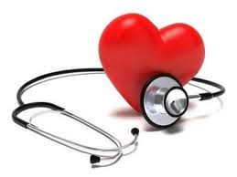
Selective α adrenoblockers
* Prazosin * Alfuzosin
* Doxazosin *Tamsulosin
* Terazosin
With the optional central action:
* Urapidil

Slide 30
Prazosin, Doxazosin, Terazosin
Pharmacological effects:
* Dilatation of arterial and venous vessels, PR and venous return to the heart ↓, BP ↓ → reflex tachycardia.
* Due to dilatation of the veins → orthostatic hypotension
Application:
* Hypertension,
* Raynaud's syndrome,
* Benign prostatic hyperplasia
Side effect:
"The phenomenon of the first dose": a sharp drop in blood pressure, and even the development of orthostatic collapse after the first dose
Prevention: receive a half dose before bedtime
frequent urination, nasal congestion, peripheral edema

Slide 31
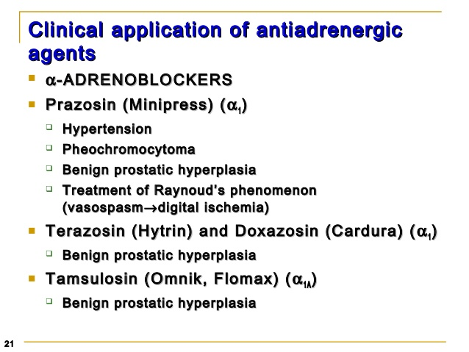

Slide 32
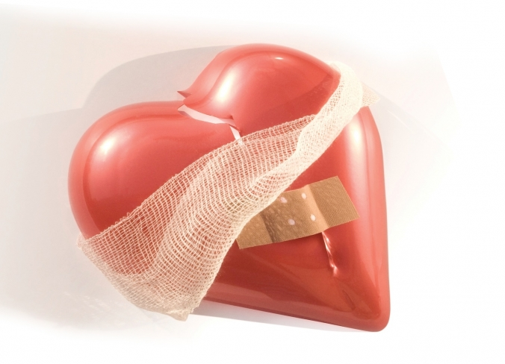
Β- adrenoblockers

Slide 33
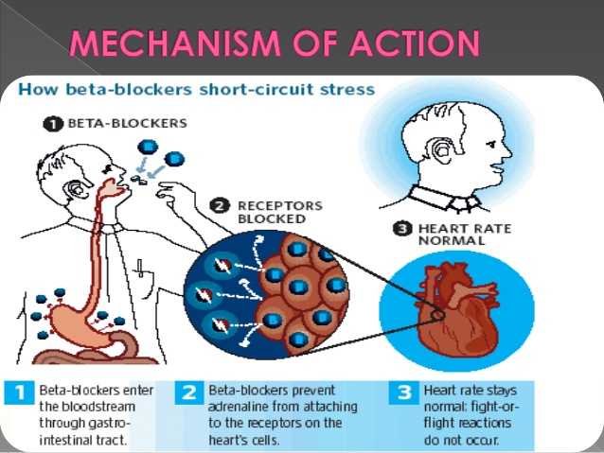

Slide 34
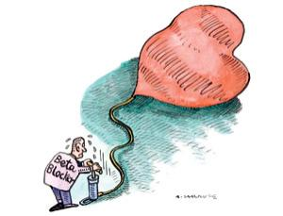
Blockade of β1-adrenoceptor
- The weakening of the heart
- Decrease in heart rate (due to the reduction of automatism in sinus node) ↓ cardiac output, myocardial oxygen demand↓
- Inhibition of atrioventricular conduction
- Reduction of automaticity in atrioventricular node
and Purkinje fibers
- β1 a/p in kidney → decrease
secretion of renin and angiotensin II

Slide 35
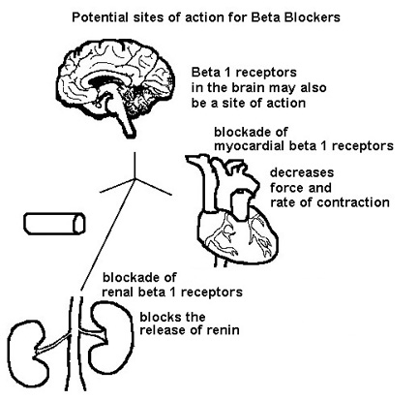

Slide 36
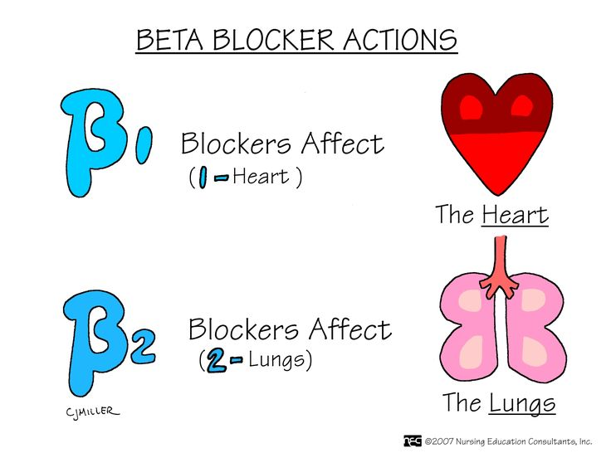
Blockade of β2-adrenoceptor
* Vasoconstriction
* Increasing tone of the bronchi
* Increasing the contractile activity of the myometrium
* Reducing the hyperglycemic action of adrenaline
(inhibit glycogenolysis:
reduced breakdown of
glycogen in the liver and
↓ levels of glucose in blood)

Slide 37
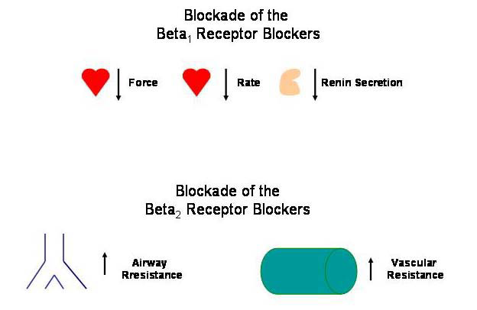

Slide 38
The main pharmacological effects of β adrenoblockers
The main effects | Basic mechanisms of development therapeutic effects | Indications
Hypotensive | Decreased cardiac output, recovery baroreceptor depressor reflex, reduced secretion of renin (reduced synthesis of angiotensin II) | Hypertension
Antianginal | Decreasing of heart rate – reducing of heart work, as a result – reducing oxygen demand in myocardium | Angina pectoris (stable)
Antiarrithmic | Depression automaticity of the sinus node, atrioventricular node conduction | Supraventricular tachicardia
 | Oppression automaticity of ectopic foci | Extrasistols
Decreasing of intraocular pressure | Reduce the formation of intraocular fluid | Open-angle glaucoma (Timolol,Betaxolol)

Slide 39
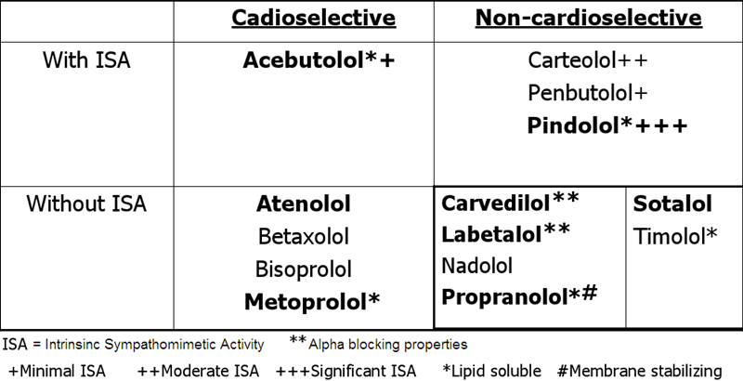
Classification of β - adrenoblockers

Slide 40
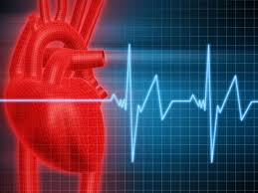
PROPRANOLOL (β1, β2)
(lipidsoluble, crosses the placental and blood-brain barrier, 90% of plasma protein binding)
Clinical uses
Hypertension
Angina pectoris
Cardiac arrhythmias
Myocardial infarction after the acute period
Thyrotoxicosis
For the prevention of migraine attacks
Essential tremor

Slide 41
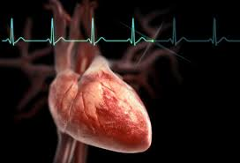
Side effects
- Heart failure (excessive reduction in cardiac output)
- Bradycardia,
- Atrioventricular block
- Bronchospasm
- Peripheral vascular spasm,
- Enhances hypoglycemia caused by drugs,
- Depression of CNS: lethargy, fatigue, drowsiness, depression. Nausea, vomiting, diarrhea
* Withdrawal syndrom - increased heart rate, increased frequency of angina attacks.

Slide 42
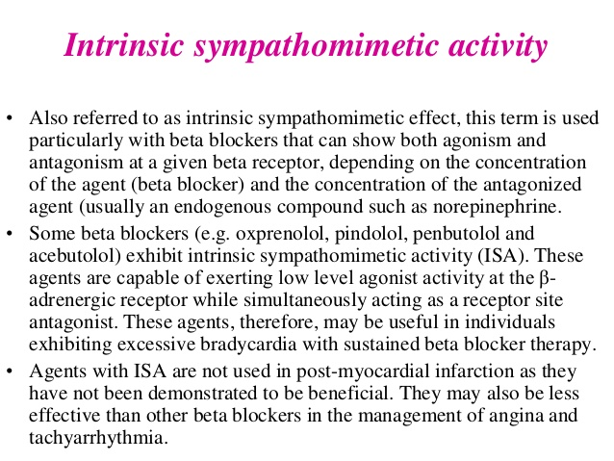

Slide 43
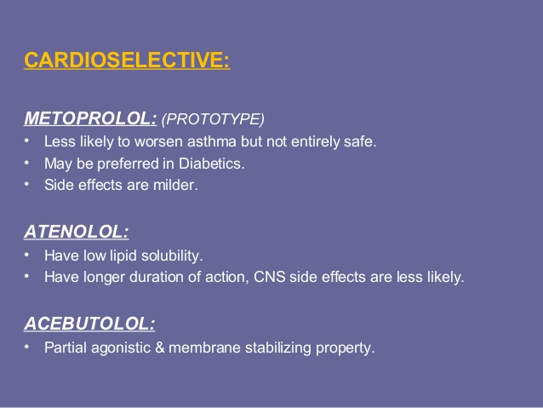
β adrenoblockers

Slide 44
Nonselective blockers of α and β adrenoceptors
Carvedilol
α1 – dilatation of peripheral vessels, ↓ PR
β1 - ↓ heart rate. Reduced pressure without causing tachycardia.
Has an antioxidant effect.
Application
Hypertension, angina pectoris, in complex treatment of chronic heart failure
Side effects
- Bradycardia (blockade β1)
- Orthostatic hypotension (blockade of α1)
- Bronchospasm (blockade β2)

Slide 45

Sympatholytics
* Reserpine * Guanethidine

Slide 46
RESERPINE
* Cumulated in the membranes of the vesicles,
* Violates entrance of dopamine in vesicles (as a result – violates of norepinephrine synthesis)
* Violates reuptake of norepinephrine by vesicles, depletes storage of catecholamines in granules, depletes storage of serotonin,
* Violates the interaction of norepinephrine with ATP → deposition of NA.

Slide 47
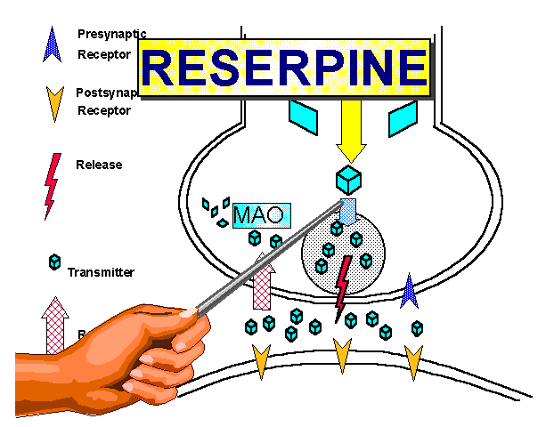

Slide 48
RESERPINE
* Makes sedative and weak antipsychotic effect.
* Enhances the effect of hypnotic and anesthetic drugs.
* Depression of respiration, body temperature ↓.
* Arterial blood pressure when administered reserpine gradually reduced (several days).
* Inhibition by reserpine adrenergic innervation leads to the predominance of cholinergic effects (bradycardia, increased secretory and motor activity of the gastrointestinal tract, miosis).

Slide 49
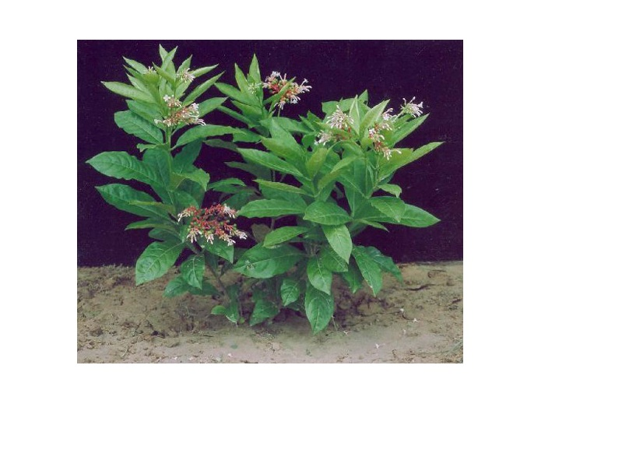
Clinical uses
Hypertension (in combination)
Weak antipsychotic action (neuroleptic)
Symptomatic treatment of thyrotoxicosis

Slide 50
Guanethidine (Octadinum)
* connects dofaminoksidase
* penetrates into the vesicles and displaces norepinephrine from vesicles.
* located in the cytoplasm free norepinephrine largely inactivated MAO
Oktadin has a little effect on the level of catecholamines in the central nervous system (does not penetrate the blood-brain barrier)

Slide 51


