Slide 1


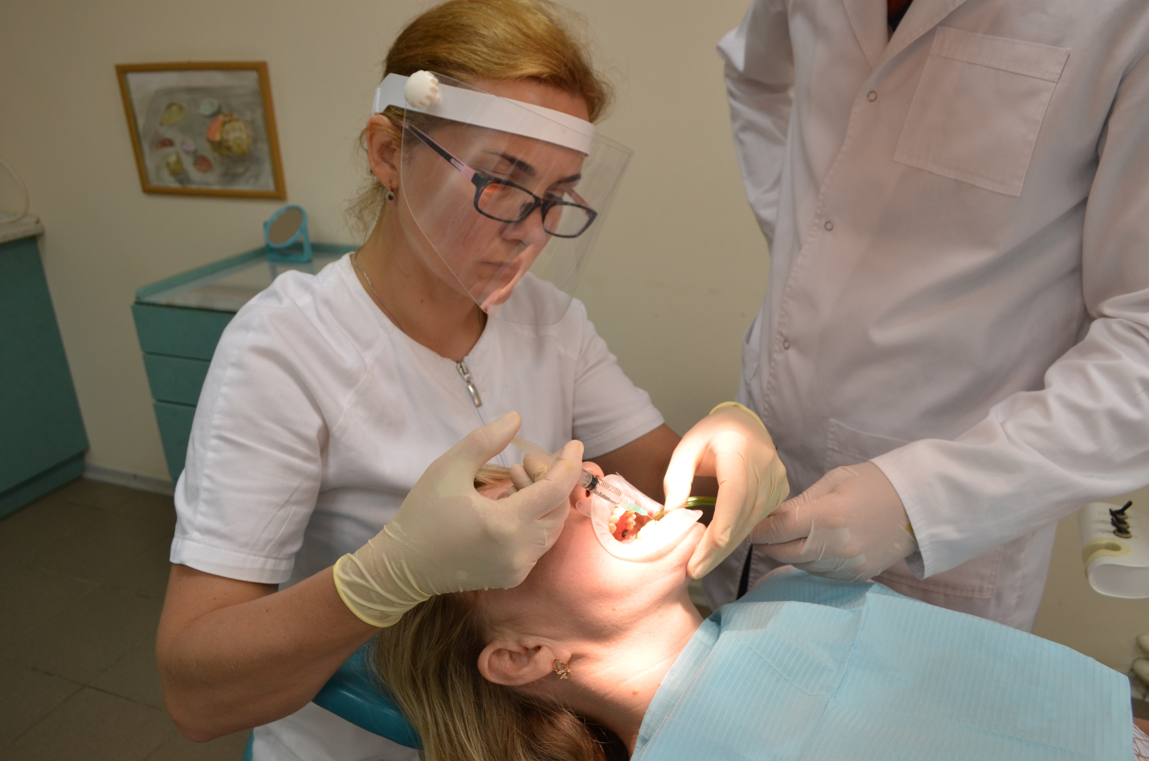
Regulation of cytokine levels during comprehensive treatment of patients with generalized periodontitis using various forms of quercetin
All-Ukrainian Scientific and Practical Conference with International Participation “Orthodontics Without Borders,” dedicated to the memory of Professor L.P. Grigorieva and the 105th anniversary
Poltava State Medical University
PhD, associate professor at the Department of Dentistry
Kharkiv Medical National University,
Khudiakova Maryna

Slide 2
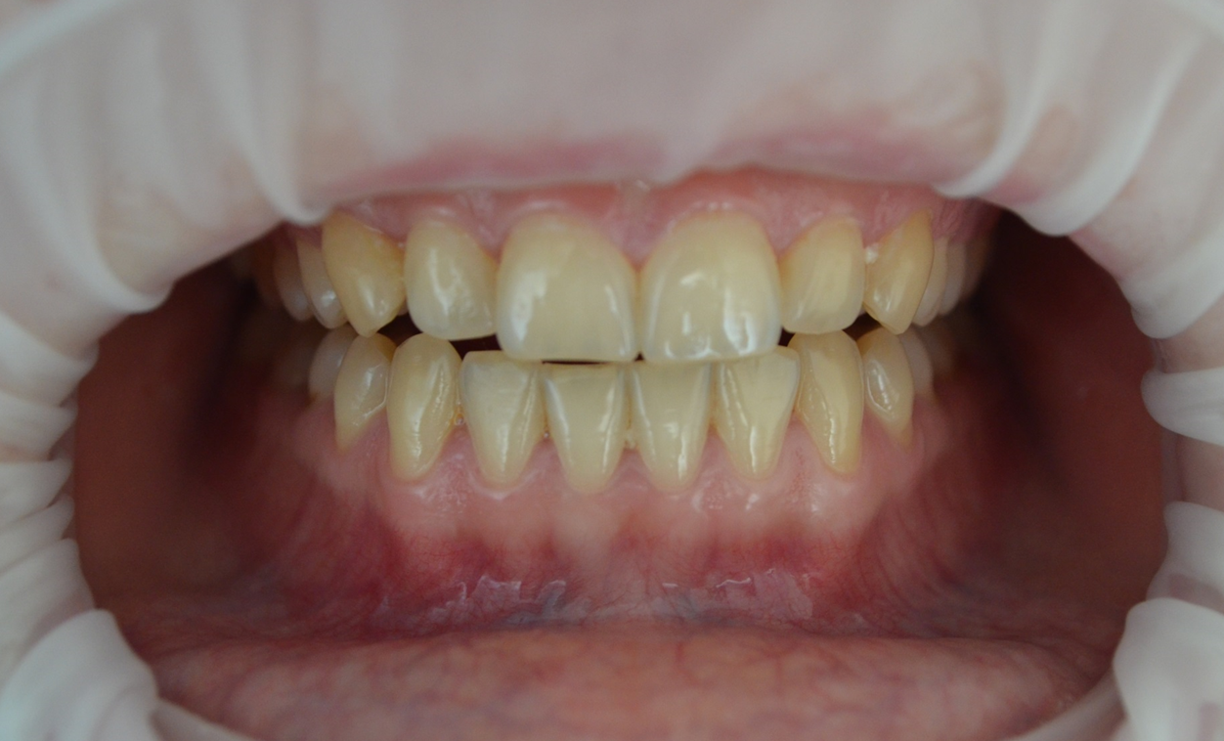
Free radical oxidation processes in the oral cavity play an important role in the development of generalized periodontitis
The main factors that provoke local activation of biomolecular peroxidation are local factors - dental plaque, microflora, etc.
However, inflammatory processes in periodontal tissues are secondary to systemic processes of maladaptation, in which a special role belongs to the mechanisms of free radical oxidation and insufficiency of the antioxidant protection system
Against the background of the development of generalized chronic periodontitis, depending on the severity, a significant decrease in the activity of superoxide dismutase, catalase and the level of SH-groups in the patients' oral fluid was revealed

Slide 3
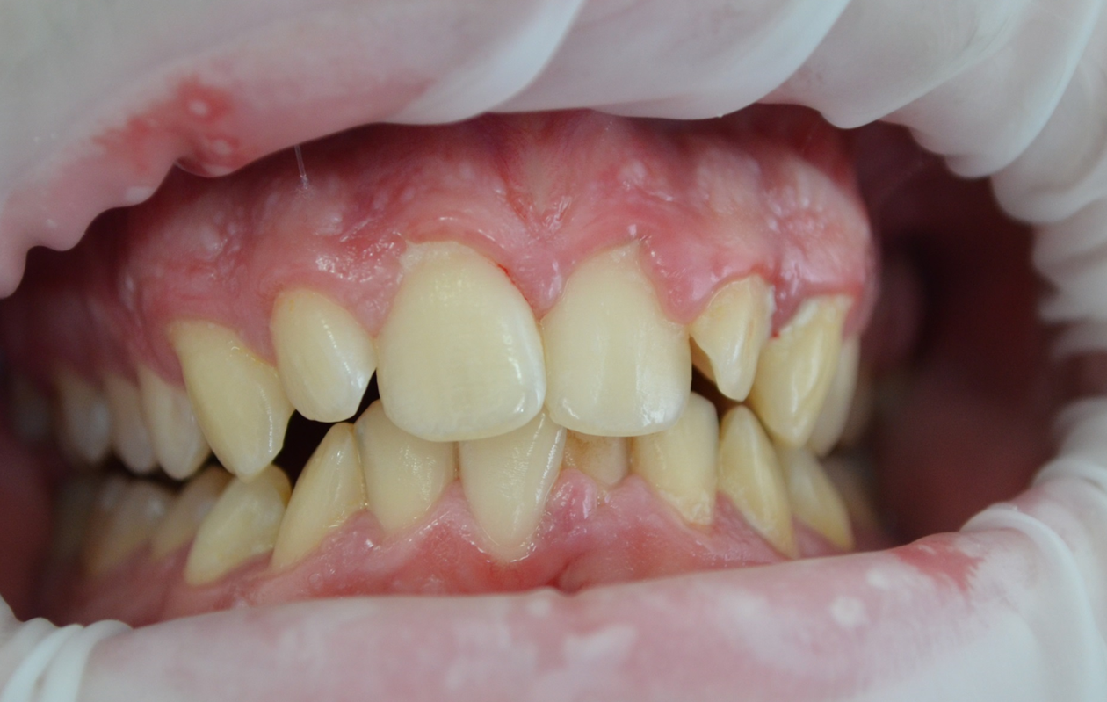
Cytokines play a major role in inflammatory and immune responses in periodontal tissues the patients with СGP. The misbalance between pro-inflammatory (TNF-𝛼) and anti-inflammatory (IL-4) mediators as being the cytokines for which there is the most substantial evidence for having a central role in cytokine networks in periodontal diseases

Slide 4
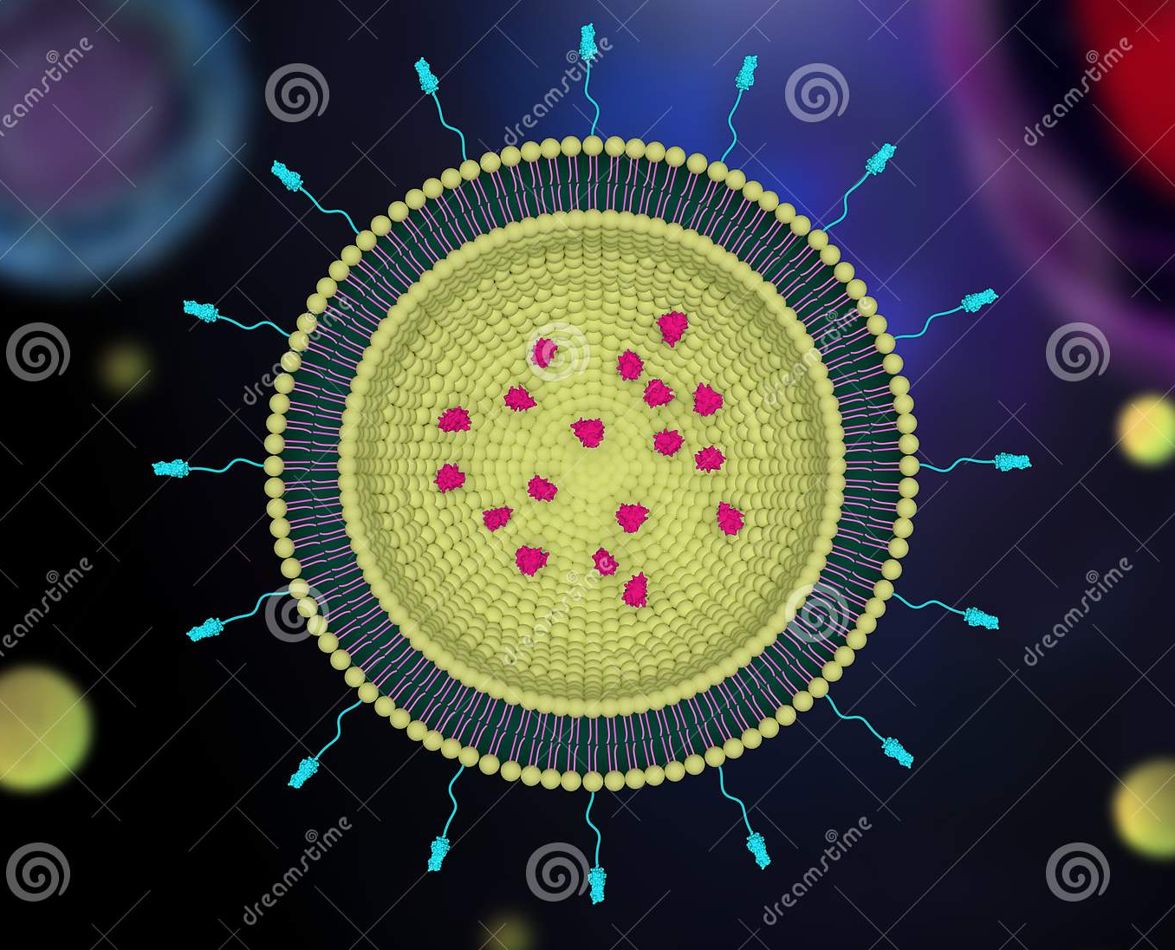
Being small, liposomes go through regions that other delivery systems might not get an access to. It is remarkable that liposomes are the most frequently used for drug delivery due to simple methods of preparation and easiness of scaling up

Slide 5
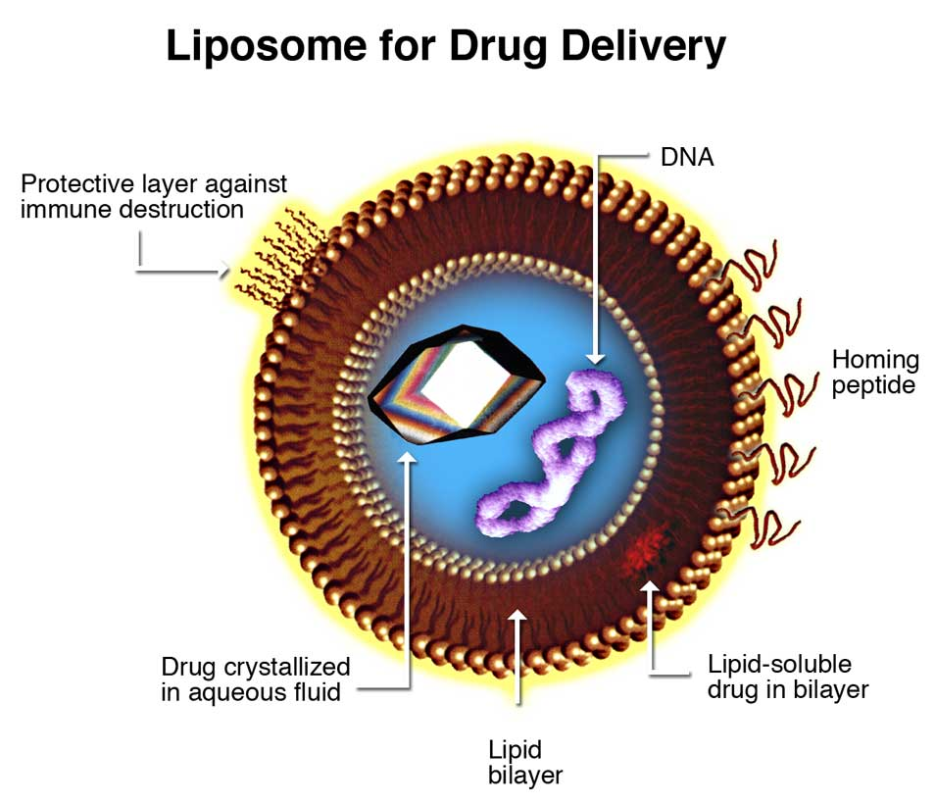
The aim of using liposomal carriers is generally, to increase the specificity towards cells or tissues, to improve the bioavailability of drugs by increasing their diffusion through biological membranes, to protect them against enzyme inactivation. These systems reduce the frequency of administration, further provide a uniform distribution of the active agent over an extended period of time

Slide 6
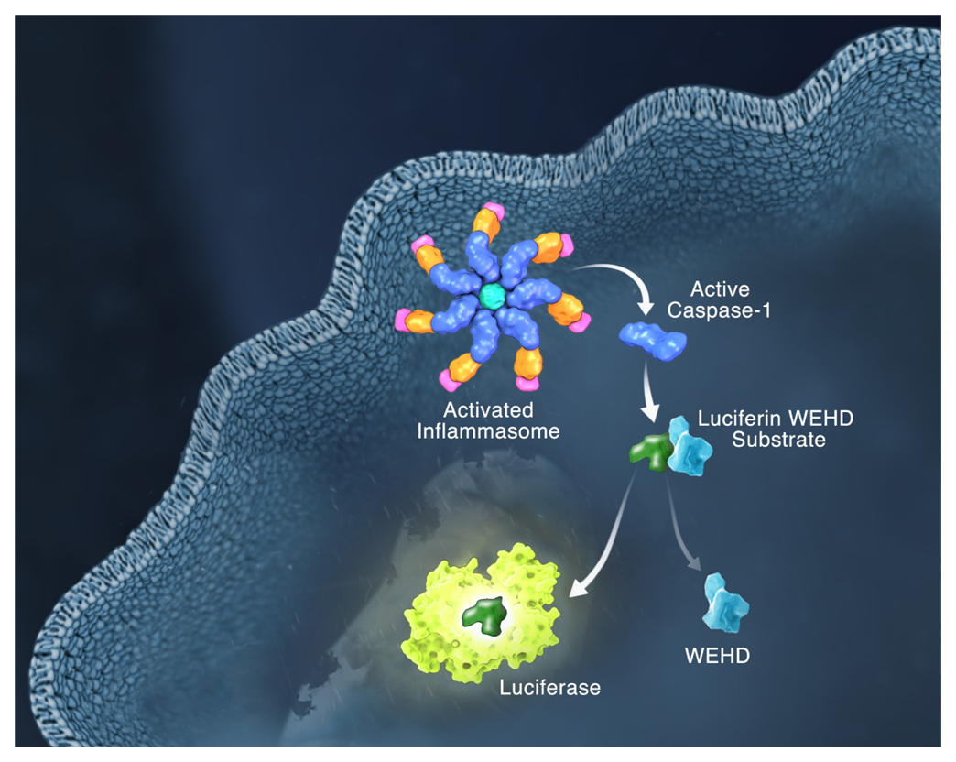
Hayward, J. A., Mathur, A., Ngo, C., & Man, S. M. (2018). Cytosolic Recognition of Microbes and Pathogens: Inflammasomes in Action. Microbiology and Molecular Biology Reviews, 82(4). doi:10.1128/mmbr.00015-18
Microbes from all walks of life, including bacteria, viruses, fungi and parasites, can cause infection
Infection is perceived by the host, often leading to activation of the inflammasome, a cytosolic macromolecular signaling platform
Host-mediated infection perception occurs when pathogens introduce or transfer pathogen-associated molecular patterns (PAMPs) into the cytoplasm or cause damage that triggers the cytosolic release of dangerous molecular patterns (DAMPs) in the host cell
Recognition of PAMPs and DAMPs by inflammatory sensors, including NLRP1, NLRP3, NLRC4, NAIP, AIM2 and Pyrin, initiates a cascade of events that result in inflammation and cell death
However, pathogens can deploy virulence factors that can minimize or evade host detection

Slide 7
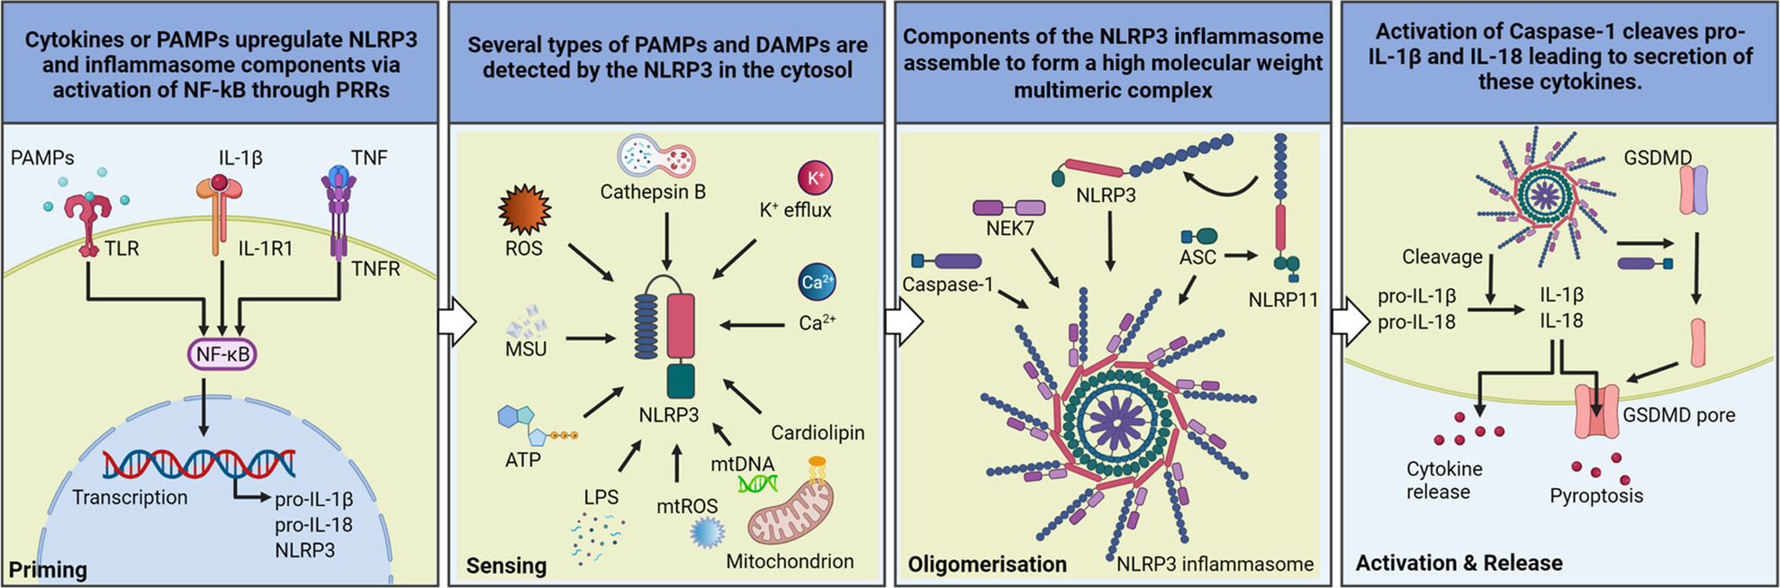

Slide 8
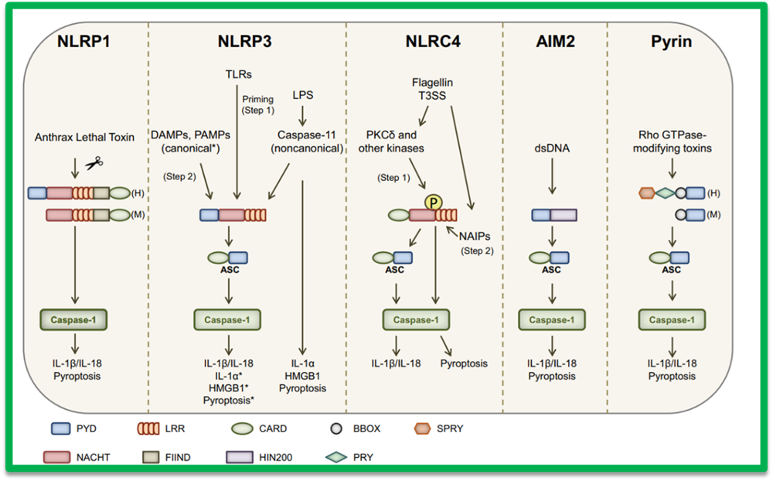
Saavedra Pedro H. V., Demon Dieter, Van Gorp Hanne Van Gorp, Lamkanfi Mohamed (2015) Protective and detrimental roles of inflammasomes in disease. Semin Immunopathol.
doi 10.1007/s00281-015-0485-5
Depending on the stimulus, certain inflammasomes assemble to recruit and activate procaspase-1, which will promote the induction of pyroptosis and the maturation of proinflammatory IL-1β and proinflammatory IL-18 to their secretory forms NLRP1 inflammasome is activated by the protease activity of Bacillus anthracis lethal toxin (BT)
The canonical NLRP3 inflammasome is triggered by several DAMPs and PAMPs
Non-canonical NLRP3 inflammasome is stimulated by intracellular LPS after caspase-11
Pyroptosis and secretion of HMGB1 and IL1α are autonomously relayed by caspase-11 in a non-canonical way
NLRC4 activation of the inflammasome occurs in 2 stages
First, cytosolic flagellin activates PKCδ and other kinases that can phosphorylate NLRC4Ser533Secondly, NAIP-mediated recognition of bacterial components promotes NAIP-NLRC4 oligomerization and activation of the inflammasome
The AIM2 inflammasome recognizes cytosolic dsDNA
Toxin-induced modifications of cellular RhoGTPs are perceived by PYRIN, leading to inflammasome activation

Slide 9
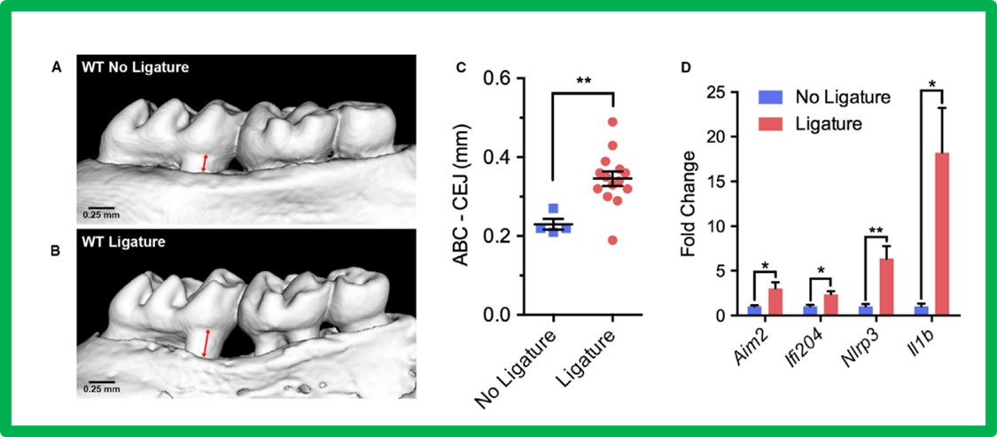
Julie T. Marchesan (2020) Role of inflammasomes in the pathogenesis of periodontal disease and therapeutics. Periodontology 2000; 82:93-114
Increased levels of inflammasome and IL-1b in modeling of experimental periodontitis
Inflammasome components increase in experimental periodontitis
Periodontitis was induced in mice using a ligature model for 10 days

Slide 10
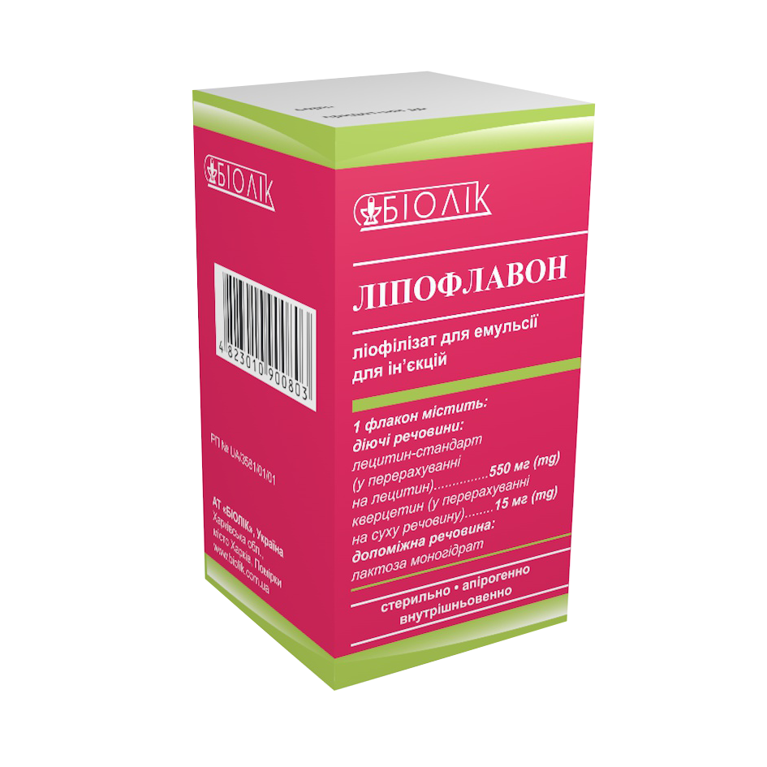
Anti-inflammatory characteristics of «Lipoflavon» (JSC „Biolek”, Kharkov), which contains lecithin liposomes and quercetin, are based on its marked аnti-leukotrienes effect. Quercetin inhibits production of inflammation-producing enzyme 5-lipoxygenase (LOX). The immunomodulating action of Quercetinum is known. Quercetinum differentiated regulates expression genes of Th-1 (IFNγ) and Th-2 (IL-4) of cytokines by the normal mononuclear cells of peripheral blood. Quercetinum increased of phenotypical expression of IFNγ mononuclear cells of peripheral blood and suppressed IL-4 are positive mononuclear cells of peripheral blood, that is compared with the results of determination of mRNC/protein

Slide 11
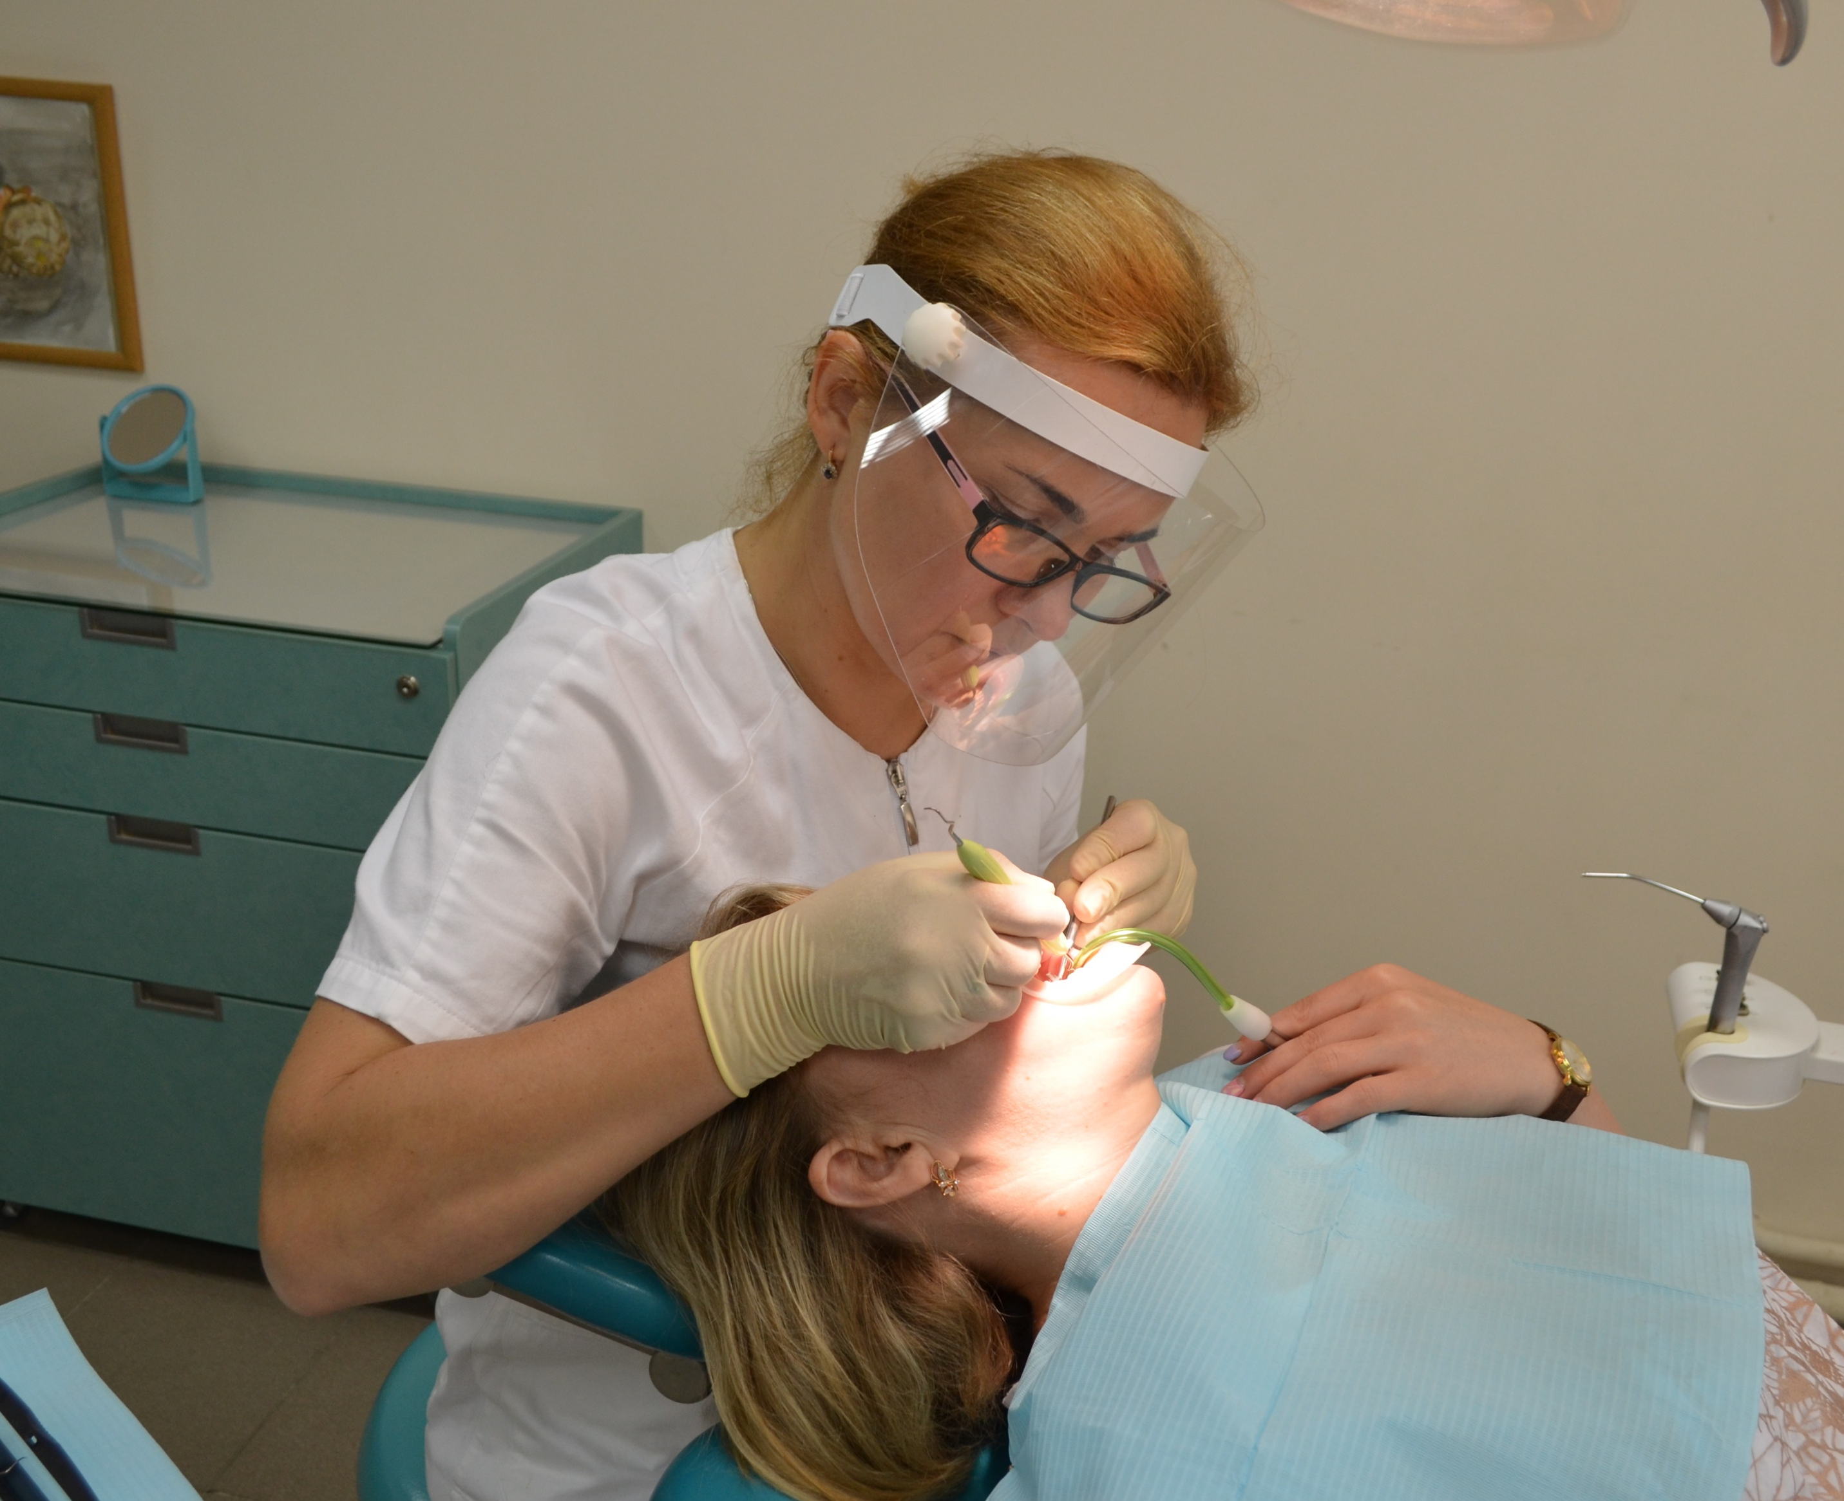
Efficiency of local application of medical drugs in periodontal tissues depends on the display of substances in the periodontal pocket (PP), choice of medical substances, method of his application, contact with the gingival oral mucosa and maintainance of this concentration. Therefore it is necessary advantage to give to the forms and pathways of medications with the controlled and long action

Slide 12
As a consequence, the considerate research of changes of pro-inflammatory TNF-α and anti-inflammatory ІL-4 cytokines might have considerable scientific and practical importance while treating patients with CGP of initial-I degrees of severity with gel from the granules of Quercetinum (GQ) and liposomal Quercetinum-lecithin complex (LQLC)
The purpose of study was to increase of efficiency of complex treatment the patients with CGP of initial-I degrees of severity with gel from the granules of GQ and liposomal LQLC due to the correction of cytokine levels

Slide 13
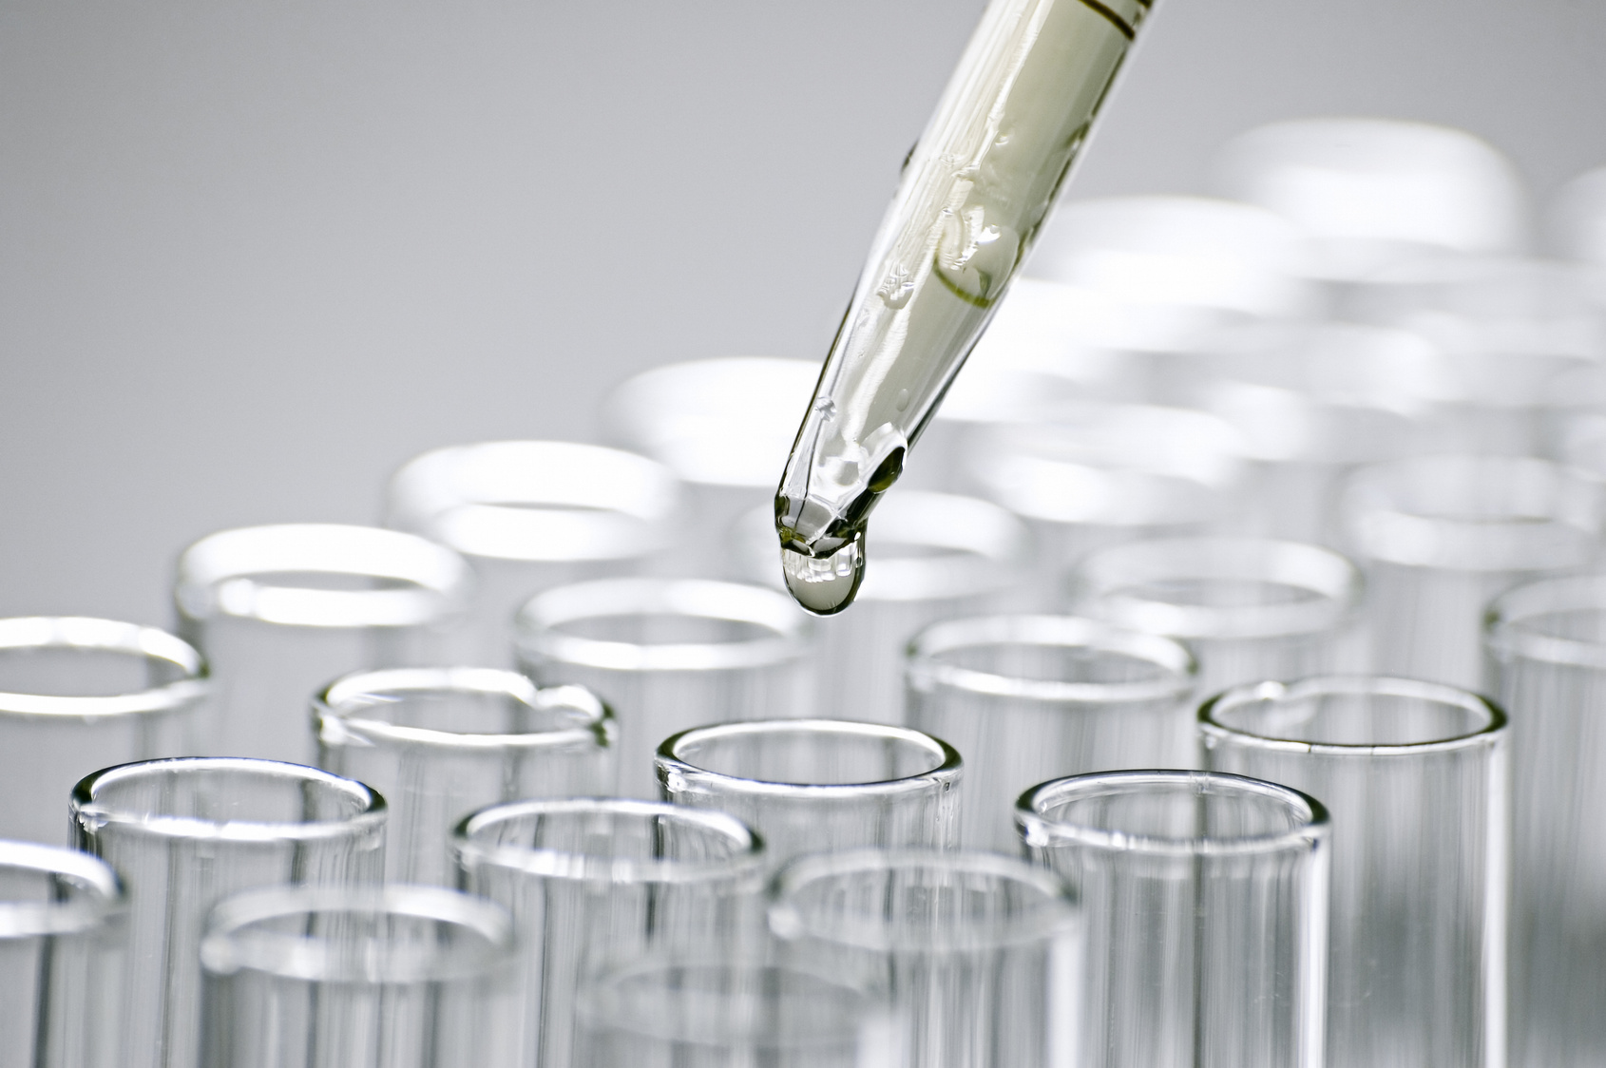
Material and Methods
Mouth liquid (ML) sampling of all observed patients was taken every morning before treatment and one, six and twelve months after the treatment for immunological researches. The patients of basic group recieved base therapy with the local application LQLC (injection form of «Lipoflavon») as a suspension, prepared ex tempore, containing 137.5 mgs of lecithin and 3.75 mgs of Quercetinum. This suspension was prepared by mixing 1/4 parts of content of the small bottle with 5 ml 0,9% solution of natrium chloride, warmed up to 38⁰

Slide 14
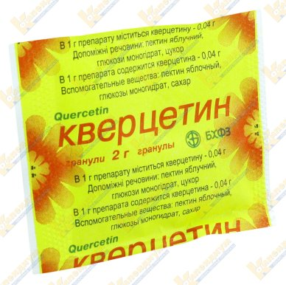
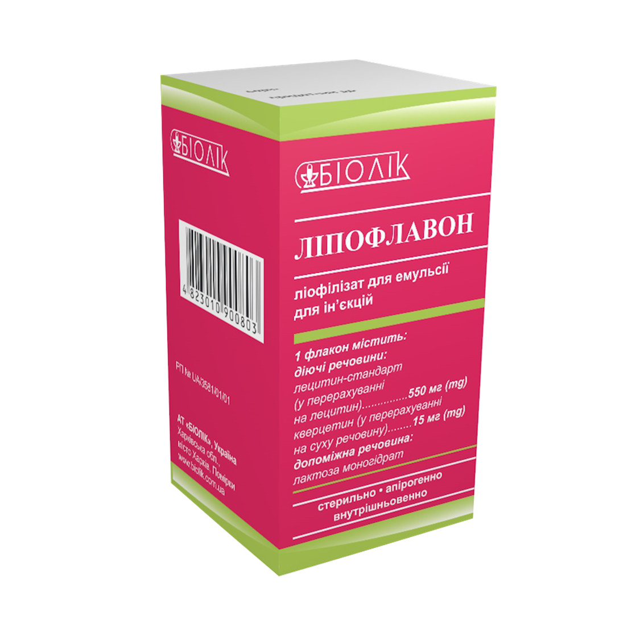
In accordance to treatment all patients were divided into 2 groups: I group – basic treatment with local application LQLC (18 patients) with the use of individual periodontal delivery tray; II group (group of comparison) – basic treatment with local application of gel from GQ (17 patients) with the use of individual periodontal delivery tray. The control group (C) included 14 healthy subjects without systemic inflammatory disease

Slide 15
While the exact contribution of each cell type remains to be elucidated, previous studies described that a hyper-reactive phenotype of phagocytes is related to increased pro-inflammatory cytokines production in CGP. The cytokine level of the patients of control group was TNF-α - 21,71 ± 2,95 pg/ml, where as that of the anti-inflammatory was ІL-4 - 243,5 ± 17,48 pg/ml. As such, numerous gingival crevicular fluid (GCF) constituents have been characterized to identify biomarkers that may be used to monitor the initiation and progression of gingival inflammation and the immune response.

Slide 16
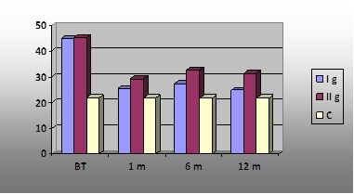
Fig. 1. Changes of cytokine level pro-inflammatory TNF-α in the ML before treatment and through 1, 6 and 12 months after treatment the patients with СGP of initial-I degrees of severity: I group (basic group) – basic treatment with local application LQLC; II group (comparison group) – basic treatment with local application of gel from GQ; C- control group

Slide 17
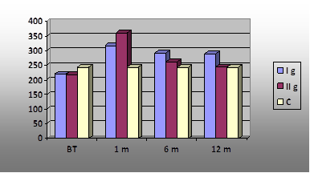
Fig. 2. Changes of cytokine level anti-inflammatory ІL-4 in the ML before treatment and through 1, 6 and 12 months after treatment the patients with СGP of initial-I degrees of severity: I group (basic group) – basic treatment with local application LQLC; II group (comparison group) – basic treatment with local application of gel from GQ; C- control group

Slide 18
Conclusions
1. The research in question demonstrates lipoflavon capability to normalize homeostasis of the oral cavity, normalize misbalance of cytokines in periodontal tissues, thus retarding process of inflammation and destruction of tissues and improving reparation of periodontal structures.
2. High (considerable) therapeutic efficacy of the liposomal quercetin-lecithin complex for treatment patients with chronic generalized periodontitis, especially that of initial and I degrees of severity is based on its marked anti-inflammatory, immunomodulating and periodontoprotecting effects.
3. This allows to recommend lipoflavon for local application as pathogenetically substantiated drug in treatment of generalized periodontitis.

Slide 19
References
Khudiakova, M. (2021) Correction of cytokine misbalance between pro-inflammatory TNF-α and anti-inflammatory IL-4 in patients with chronic generalized periodontitis. Abstract, mTalk and poster books: the 6th International USERN Congress and Prize Awarding Festival, Istanbul, 6th–13th of November 2021, 298.
Grigoryeva, G. S., Krasnopolsky, Yu. M. (2020). Liposomes per se: pharmacotherapeutic status. Pharmacology and Drug Toxicology, Vol.14, 14 (4), 264-271. https://doi.org/10.33250/14.04.264.
Krasnopolsky, Yu. M. (2020). Creation in Ukraine of technologies for obtaining pharmacologically active ingredients, medicinal and diagnostic preparations based on lipids. Bulletin of the National Technical University "KhPI", Series: Chemistry, chemical technology and ecology, 1, 53-68. https://doi.org/10.20998/2079-0821.2020.01.10

Slide 20
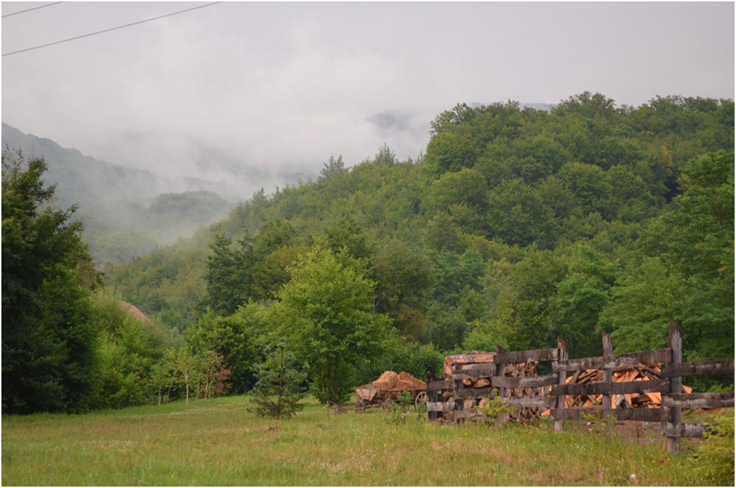
The world is yours to explore; conquer it.
Thanks a lot

