Slide 1

Electronic and on-line information resources of the scientific library for English medium students
Notes:
врпораооы

Slide 2
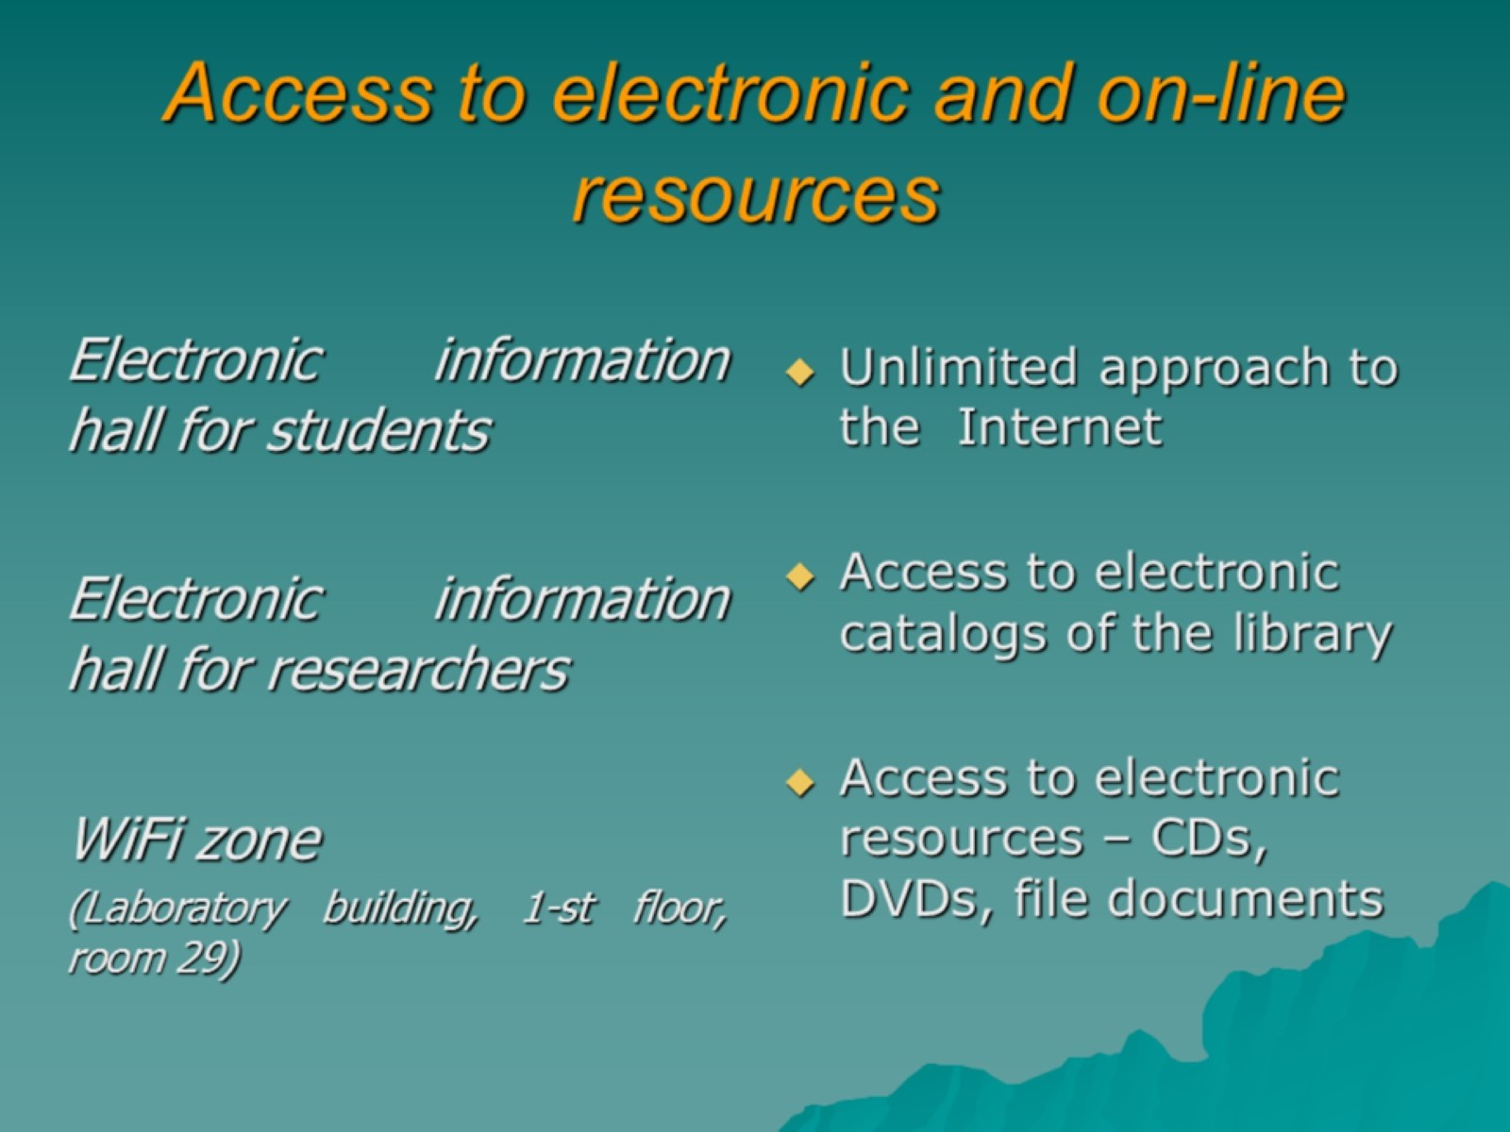
Access to electronic and on-line resources

Slide 3

Website
Scientific library of the Kharkiv National Medical University

Slide 4
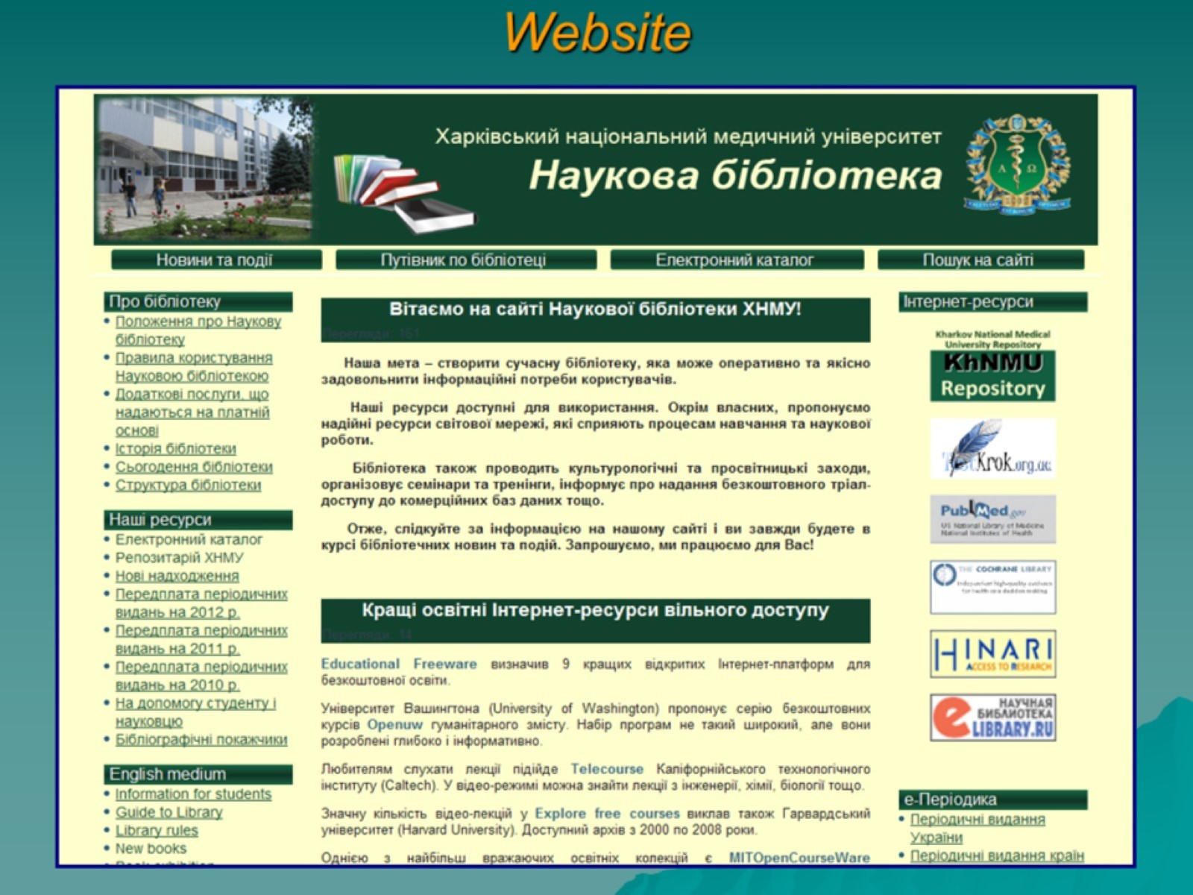
Website

Slide 5
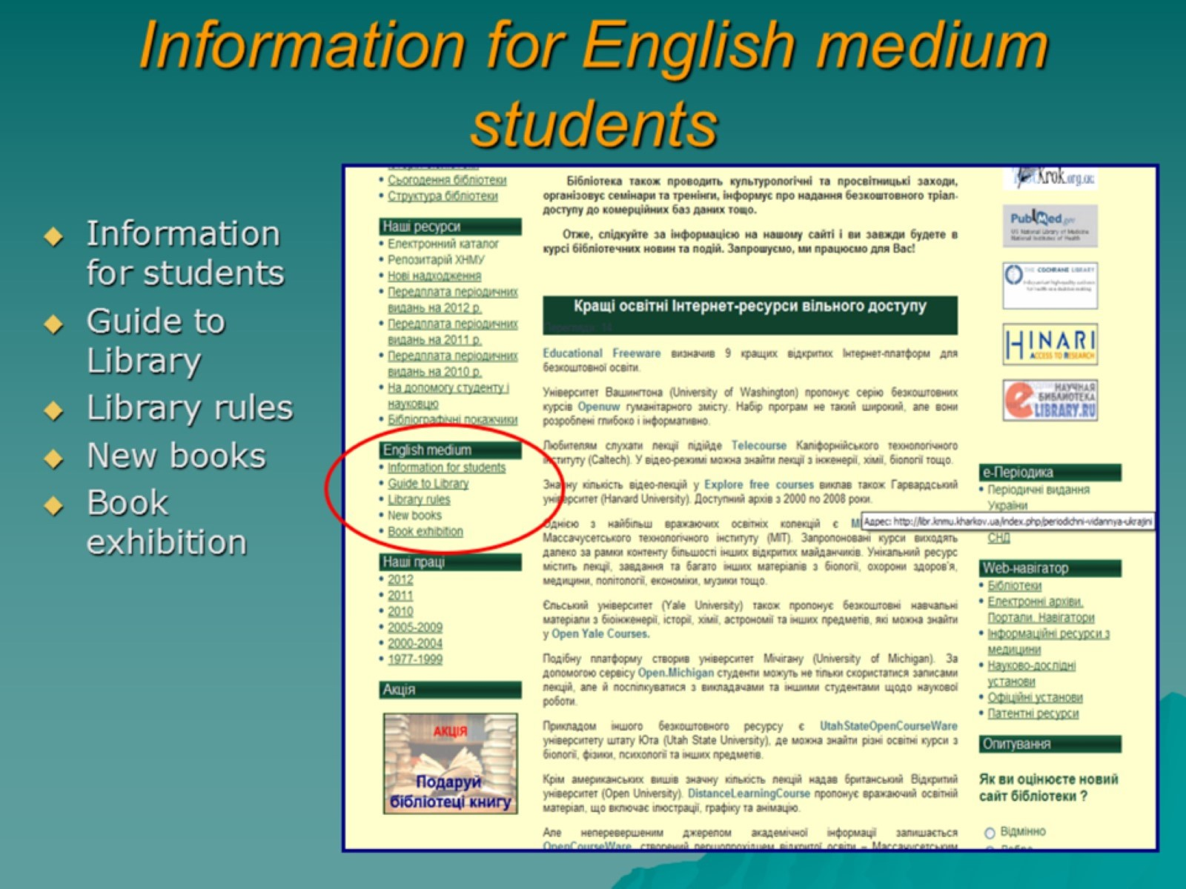
Information for English medium students

Slide 6
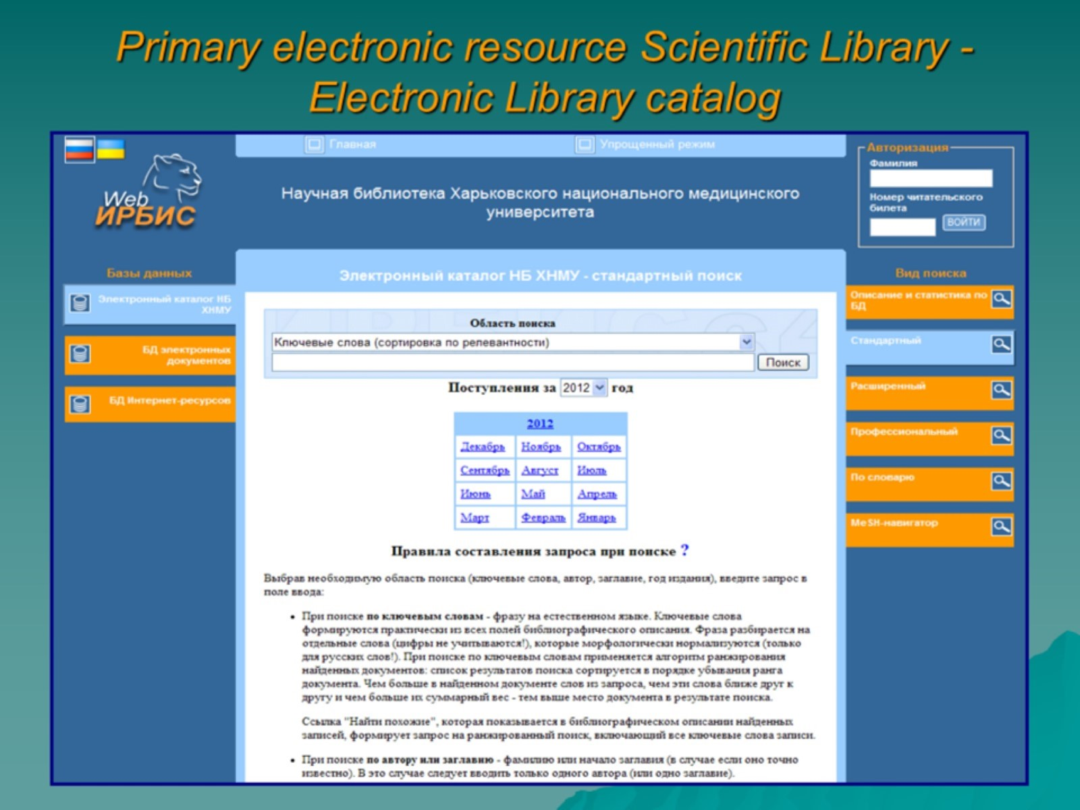
Primary electronic resource Scientific Library - Electronic Library catalog

Slide 7
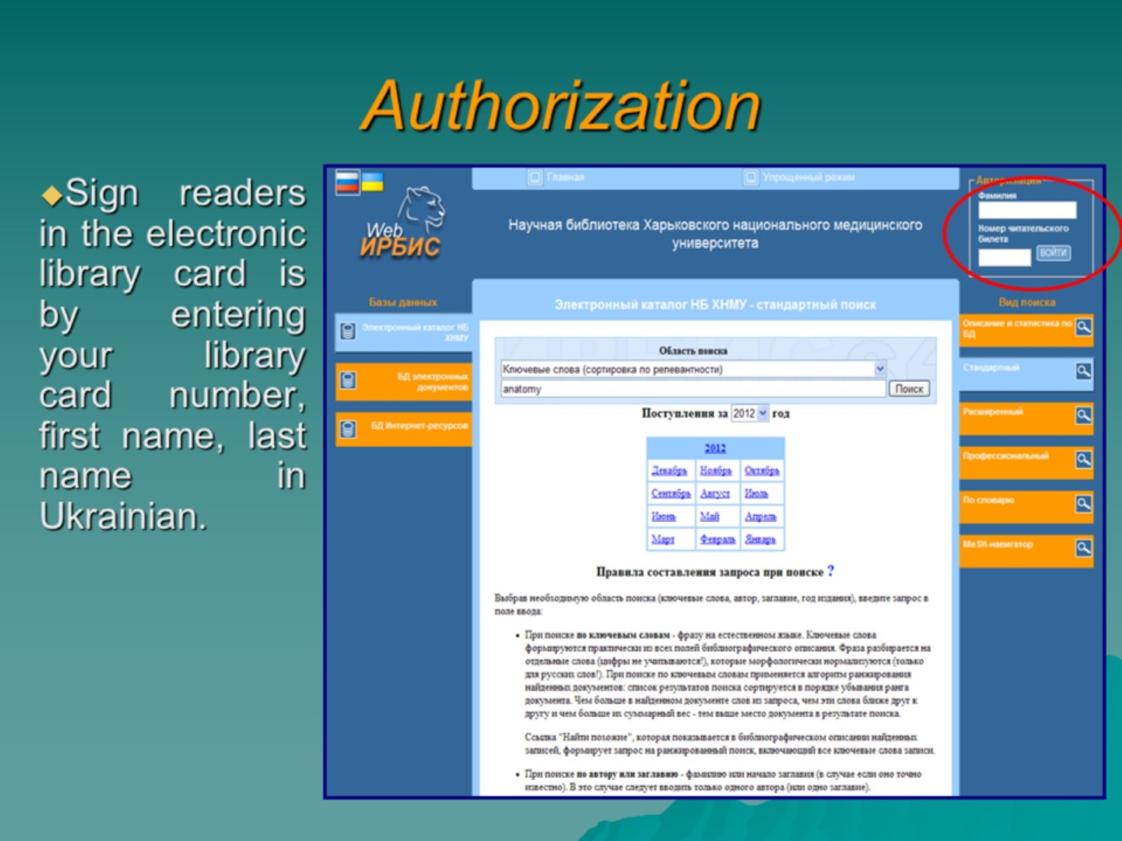
Authorization

Slide 8
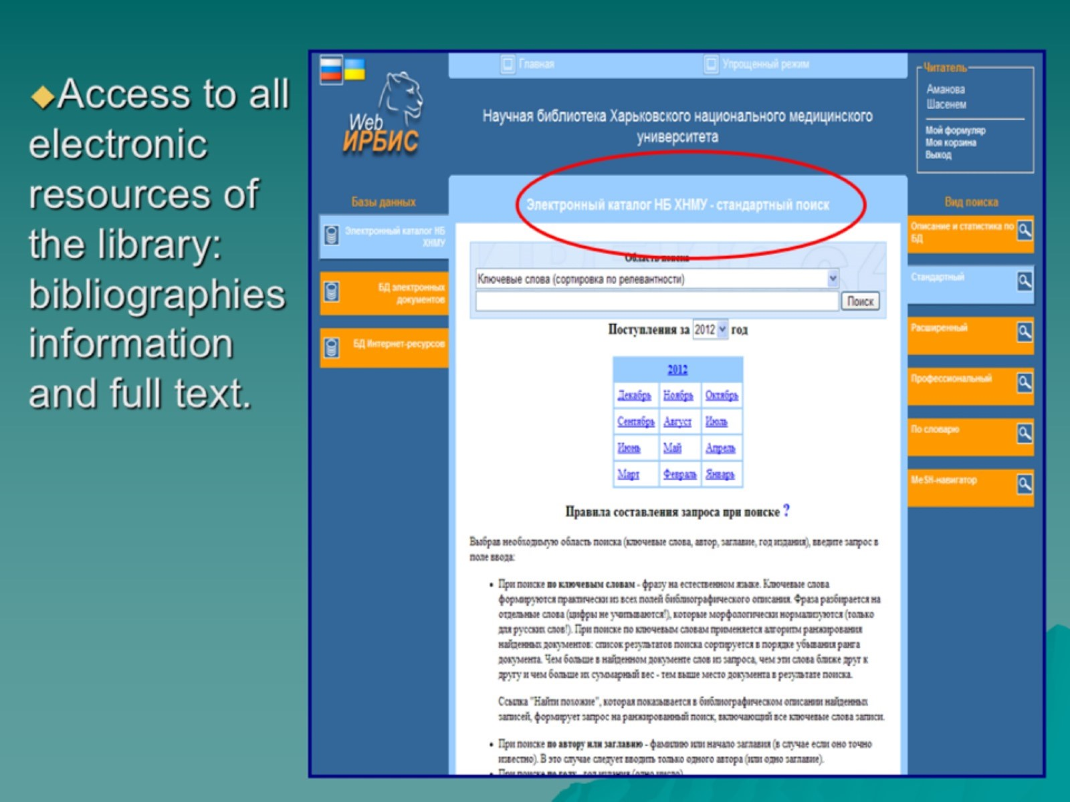

Slide 9
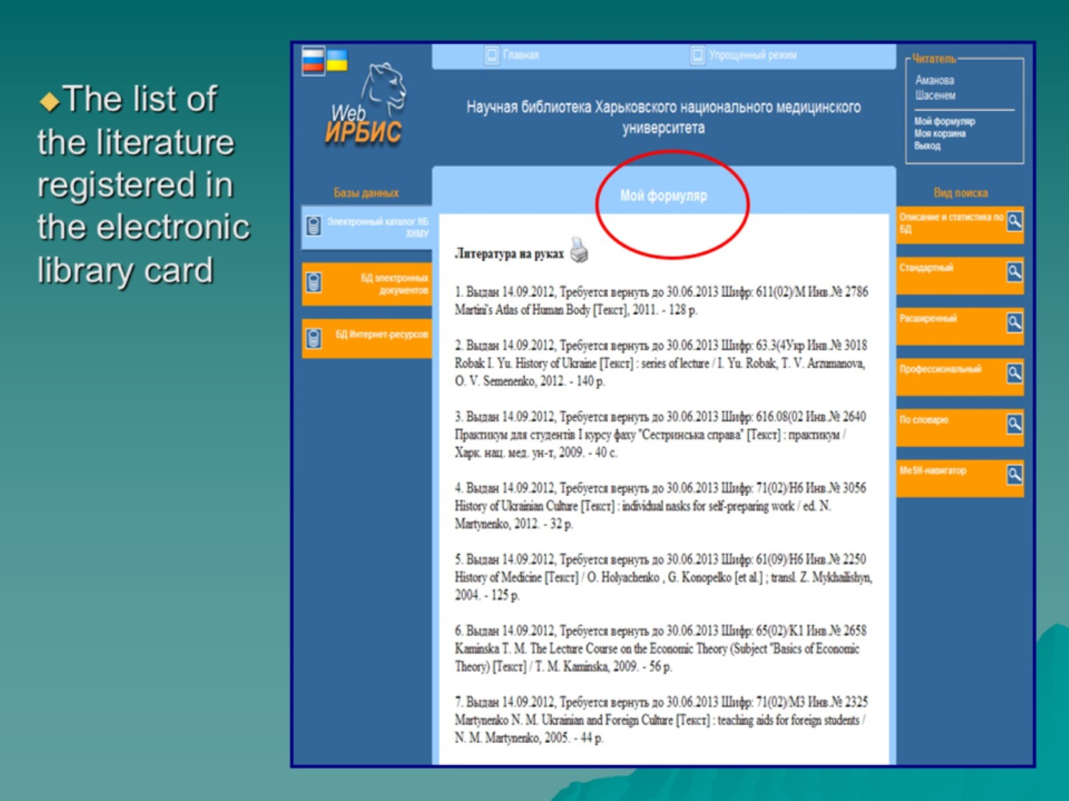

Slide 10
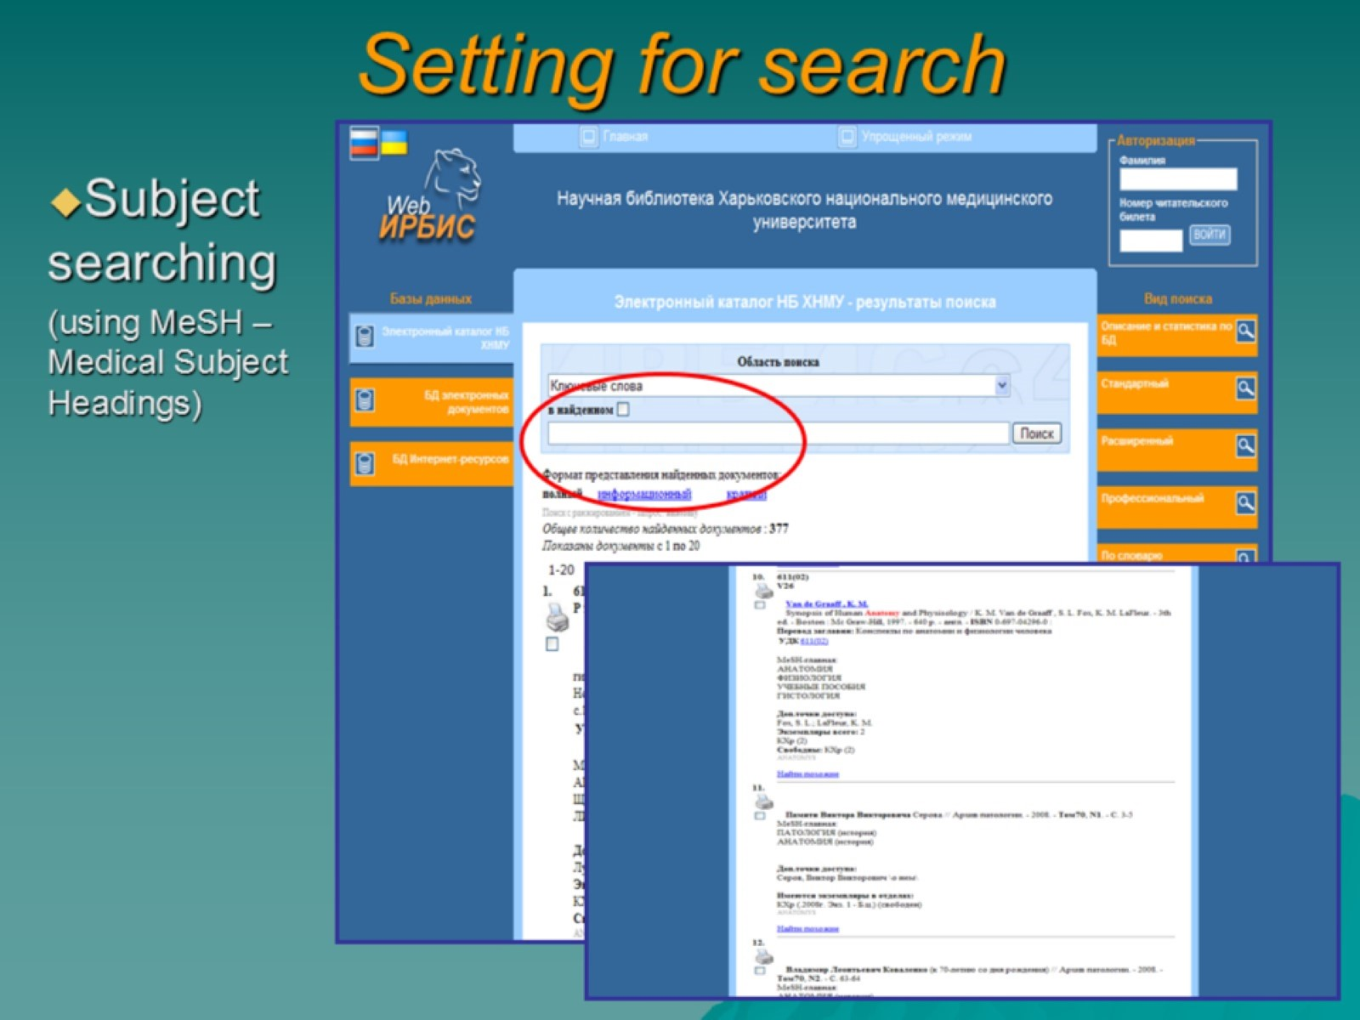
Setting for search

Slide 11
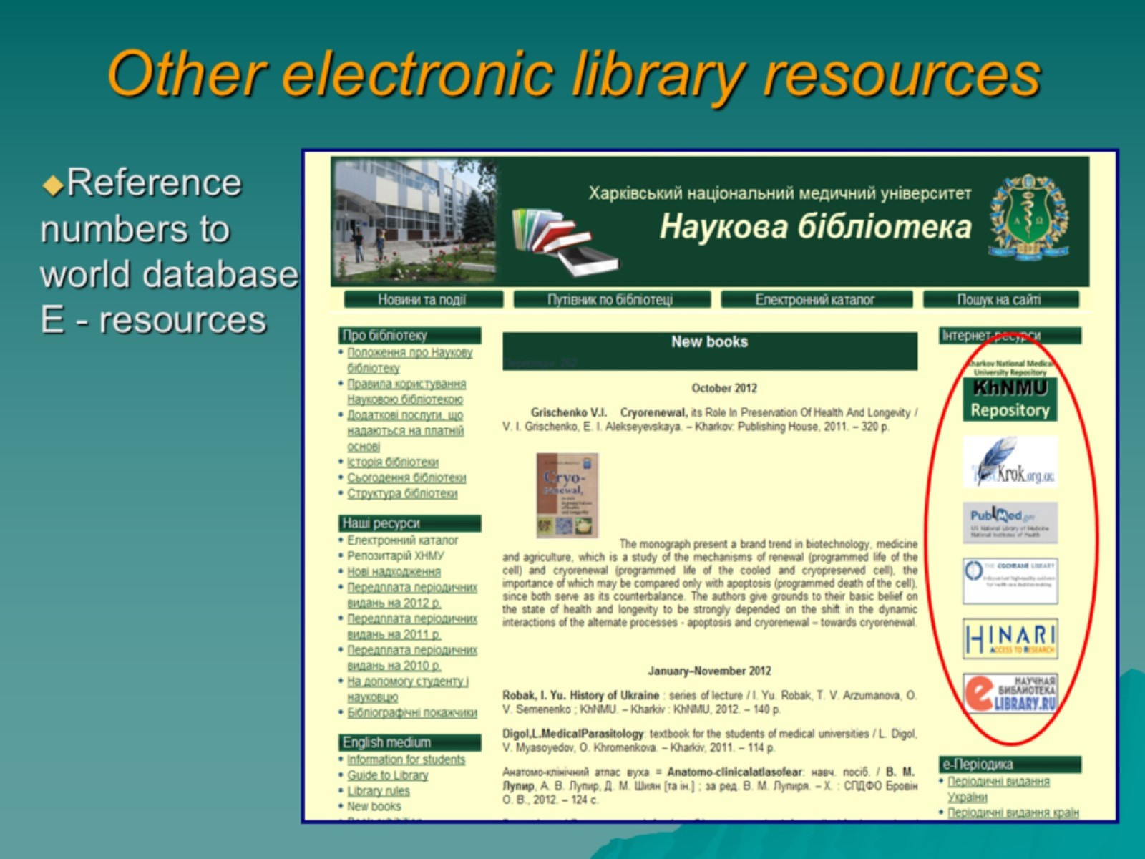
Other electronic library resources

Slide 12
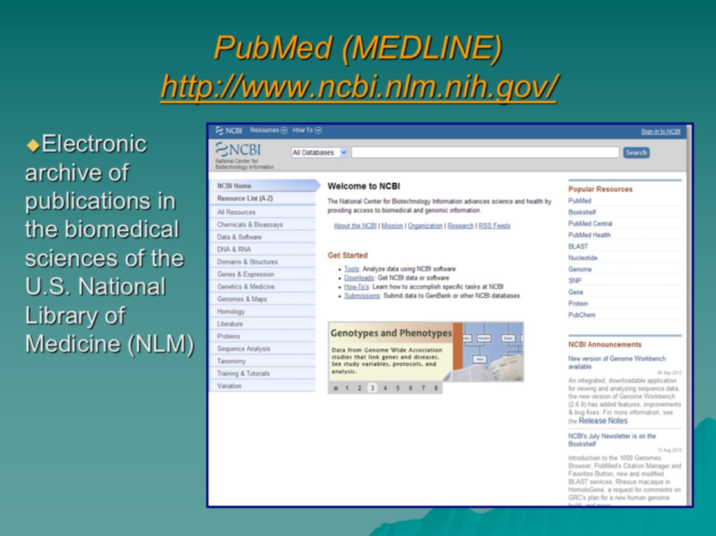
PubMed (MEDLINE) http://www.ncbi.nlm.nih.gov/

Slide 13
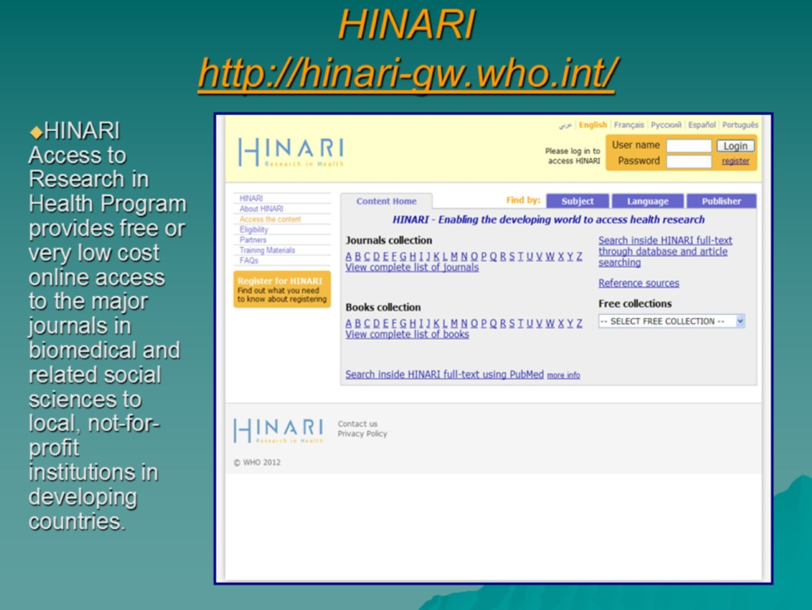
HINARI http://hinari-gw.who.int/

Slide 14
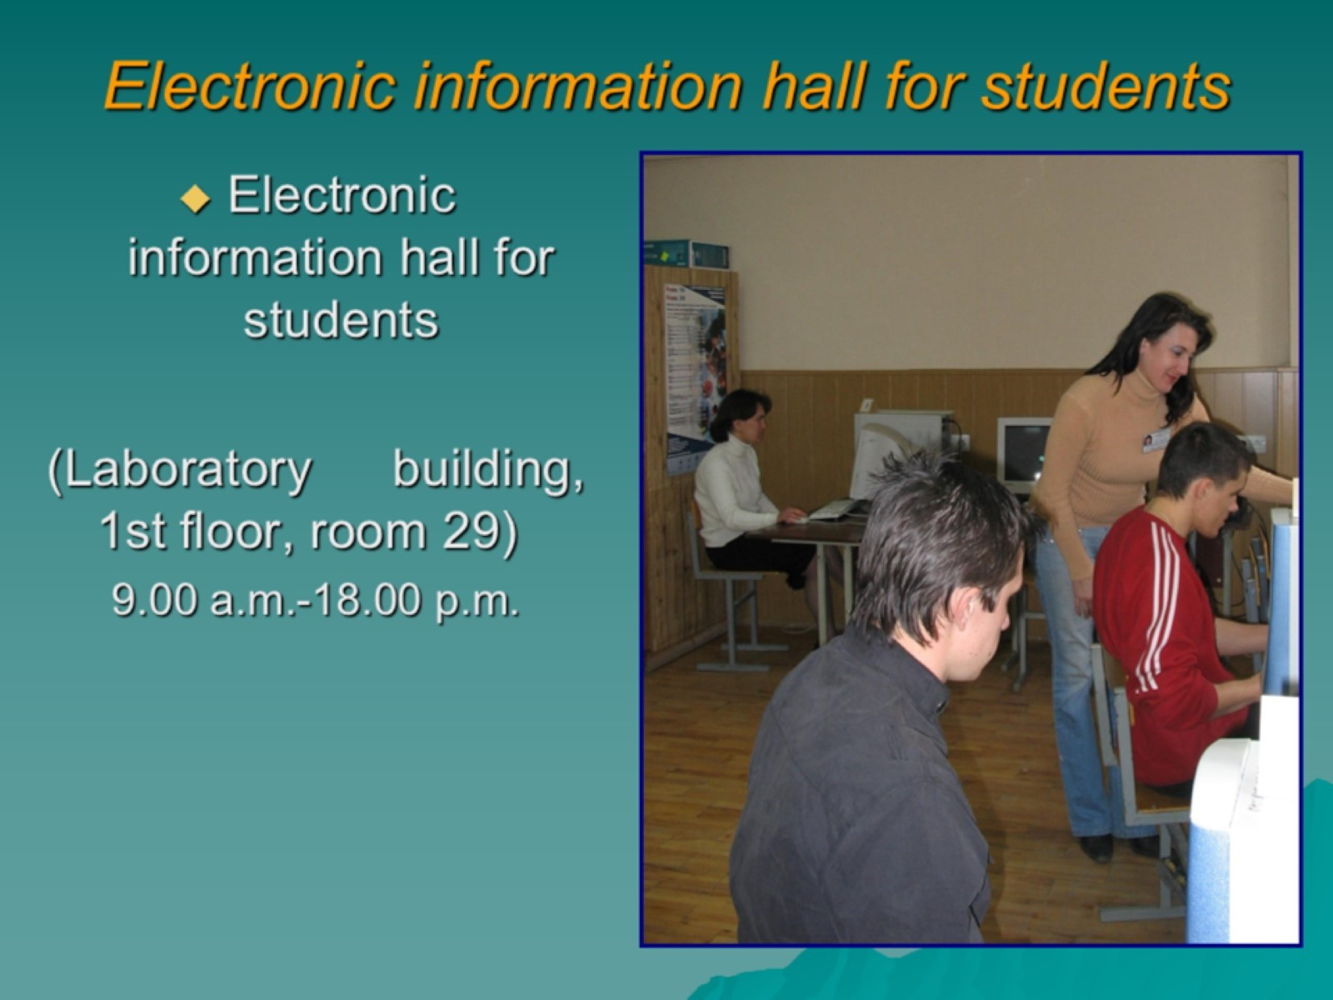
Electronic information hall for students

Slide 15


Slide 16


