Slide 1
Kharkov National
Medical University
LECTURE for dentistry students
Department of
Histology, cytology and embryology

Slide 2
TEETH
AND THEIR DEVELOPMENT

Slide 3
TOOTH HAS 4 PARTS:
WABeresford
1. ENAMEL
GINGIVA
2. DENTINE
4. PULP
3. CEMENTUM
PERIODONTAL LIGAMENT/ PDL
ALVEOLAR BONE

Slide 4
TOOTH DERIVES FROM ECTODERMAL ENAMEL ORGAN (ENAMEL) AND MESENCHYME (REST)
ENAMEL
ENAMEL ORGAN
DENTAL LAMINA
DENTINE
MESENCHYME
PULP
CEMENTUM
DENTAL PAPILLA
PDL
DENTAL SAC/FOLLICLE
A BONE
ALVEOLAR BONE

Slide 5
Oral ectoderm thickens and grows down to the mesenchyme forming Dental lamina
Mesenchyme
Oral ectoderm

Slide 6
ON THE INTERNAL SURFACE OF DENTAL LAMINA IS FORMED Bud
Formation of a BUD from the dental lamina
Odontogenic mesenchyme
Next step - formation of enamel organ from the bud

Slide 7
BUD EXPANDS AND BECOMES ENAMEL ORGAN
ENAMEL ORGAN
DENTAL LAMINA
UNDERLIING IT MESENCHYME
FORMS:
1. DENTAL PAPILLA
2. DENTAL SAC
3. ALVEOLAR BONE

Slide 8
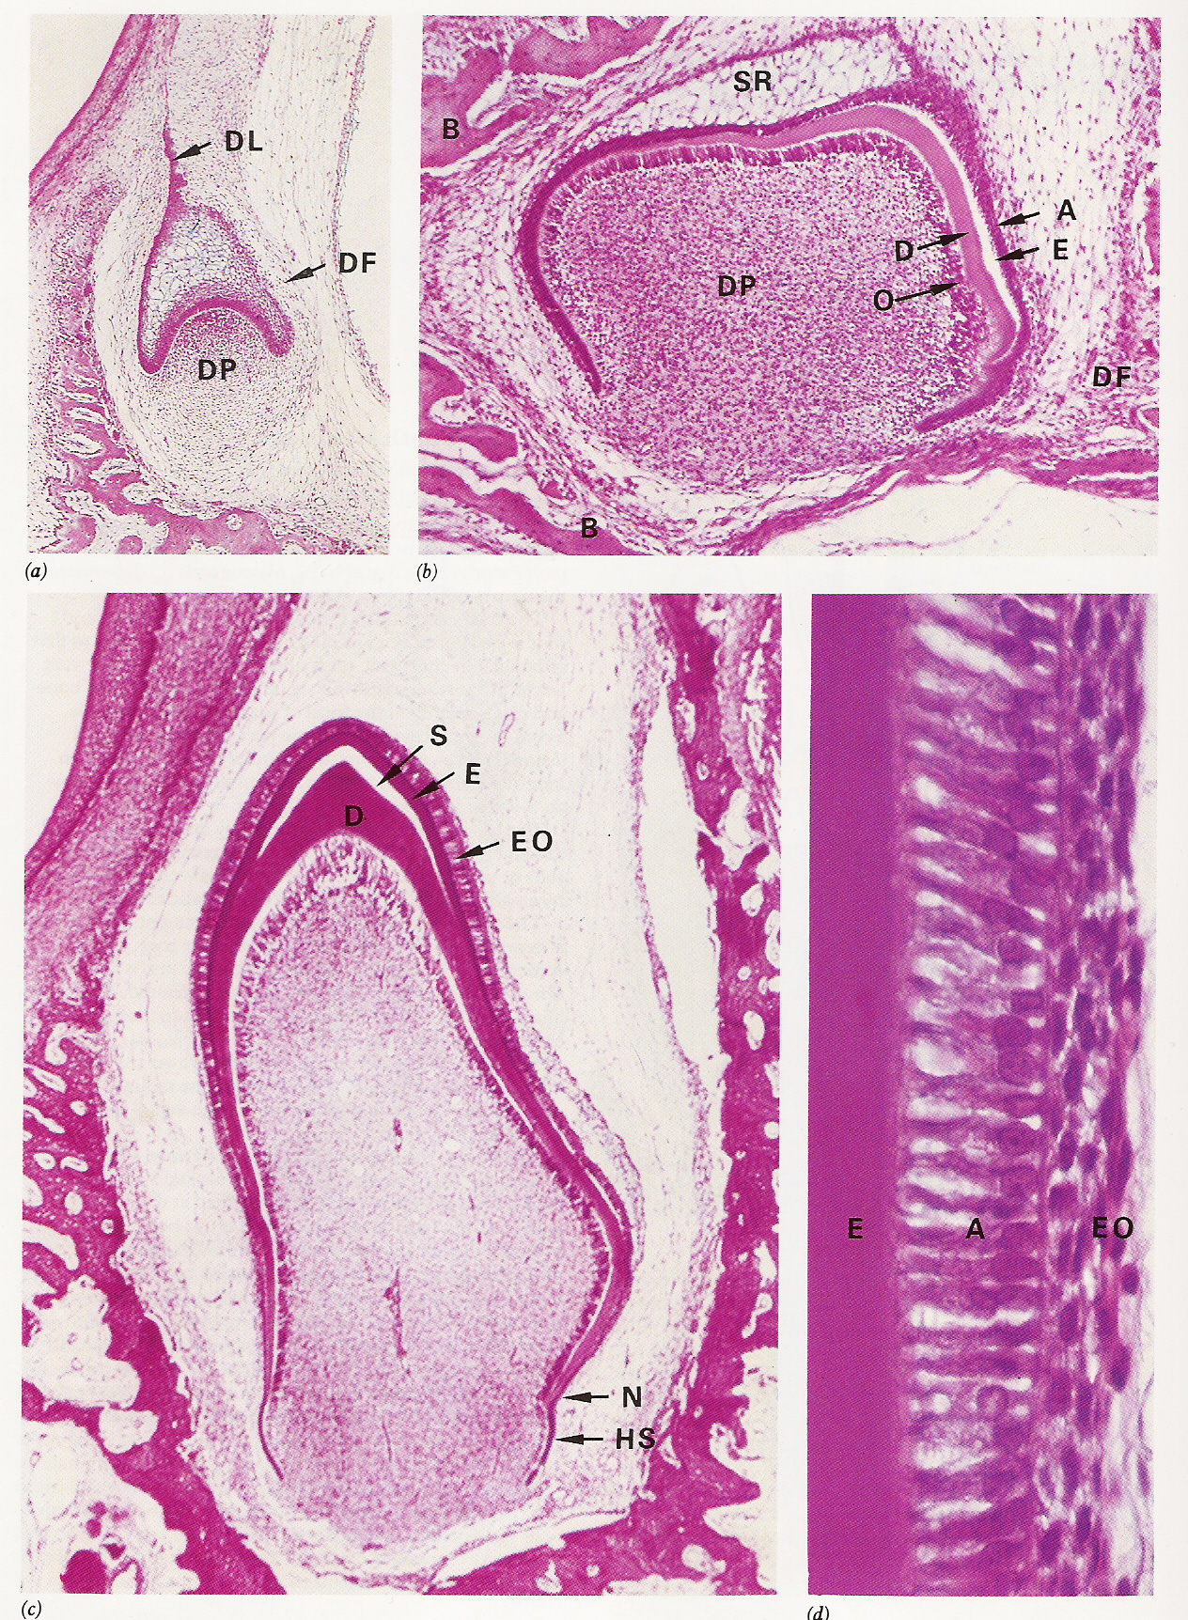
Tooth development
Enamel organ
Dental lamina
Dental papilla
Dental sac
Odontoblasts
Dentine
Ameloblasts
Enamel
Sheath of Hertwig

Slide 9
TOOTH GERM:
next steps
DENTAL LAMINA - upper degenerates , lower forms 2nd bud
outermost papilla cells have become Odontoblasts, producing dentine
DENTAL PAPILLA becomes pulp
DENTAL SAC FORMS CEMENTUM
Ingrowing pulp vessels

Slide 10
become
2.Inner cells of enamel organ become ameloblasts, producing
enamel
TOOTH GERM: next steps
1.Dentine is
produced by odontoblasts
DENTAL SAC still quiescent
Ingrowing pulp vessels

Slide 11
TOOTH GERM: all crown-forming elements present
Ameloblasts
Capillaries now close to synthesizing ameloblasts
enamel
odontoblasts
Dentine
DENTAL PAPILLA becoming pulp
DENTAL SAC
2nd

Slide 12
ENAMEL FORMATION - AMELOGENESIS
Ameloblast
Tomes’ process
Organic first deposits, + 30% mineral
organic materials digested; replaced by mineral to 96% - maturation
DEJ
DEJ
Ameloblasts are pushed up by thikening enamel and reduced by tooth eruption

Slide 13
ROOT FORMATION
REDUCED enamel organ
ENAMEL
CROWN
odontoblasts
DENTINE
PULP
HERTWIG’S ROOT SHEATH =
=
H. Root sheath breaks up, allowing sac mesenchymal cells to contact dentine and to produce cementum
Epithelial end of enamel organ

Slide 14
TOOTH & MANDIBLE DEVELOPMENT
Oral ectoderm
TONGUE
DENTAL SAC
1⁰ TOOTH
ALVEOLAR BONE
2⁰ TOOTH GERM
MECKEL’S CARTILAGE
ALVEOLAR NERVE

Slide 15
TOOTH ERUPTION
CUTICLE will wear away
GINGIVAL EPITHELIUM
still fusing with
REDUCED DENTAL EPITHELIUM
ENAMEL

Slide 16
LATE ERUPTING TOOTH
ENAMEL
Rests of Mallasser’s – en.organ
remnants of Root sheath
DENTINE
GINGIVA
CEMENTUM
PULP
PDL
H. ROOT SHEATH
Cementum starting as sheath breaks down!!
BONE

Slide 17
MANDIBULAR CENTRAL INCISORS at 2 y
Deciduous tooth
Gingiva
PDL FROM MESENCHYME
Permanent tooth
ALVEOLAR BONE
FROM MESENCHYME
BODY of MANDIBLE

Slide 18
Deciduous tooth
MANDIBULAR CENTRAL INCISORS at 2 y - Bone
Resorption of bone & deciduous root will start here
Permanent tooth
Spongy/ cancellous bone
Cortical plate dense bone

Slide 19
YOUNG CHILD’S ERUPTION SEQUENCE
YEARS
0
1
2
3
4
5
6
7
KEY
Time of emergence
Crown forming
Root forming
1⁰ 2nd Molar
Deciduous
Permanent
2⁰ Incisor
2⁰ Cuspid
2⁰ 2nd PreMolar

Slide 20
YOUNG CHILD’S ERUPTION SEQUENCE
YEARS
0
1
2
3
4
5
6
7
1⁰ Incisor
1⁰ Cuspid
1⁰ 2nd Molar
2⁰ Incisor
2⁰ Cuspid
2⁰ 2nd PreMolar

Slide 21
TOOTH STRUCTURE (decidious, permanent)
}
ENAMEL
CROWN
DENTINE
}
Cervix
CEMENTUM
ROOT
PULP

Slide 22
ENAMEL: Boundaries
Dentino-enamel junction DEJ
Cemento-enamel junction - CEJ

Slide 23
ENAMEL: Nature
Enamel is the dead, very hard
The dense packing, curved units = prisms composed of densely arranged mineral crystals,
ROD
Mineral is hydroxyapatite, with Ca²⁺, OH⁻, PO₄⁻⁻, etc, ions
ROD
Cross-section of rods

Slide 24
ENAMEL
Last enamel is NON-PRISMATIC
PRISMS/ RODS
between prisms is organic
Enamel is: 96% mineral, 3% water, 1% organic material
DEJ
First enamel is NON-PRISMATIC

Slide 25
AT GROWTH. On section
Contour lines of Retzius;
rhytmic mineralisation
S-shaped prisms form Hunter-Schreder bands

Slide 26
DEJ
DEJ is actually a little irregular,
E
ENAMEL SPINDLE
D
Odontoblast process stuck into enamel matrix and form nonmineralised spindles

Slide 27
ENAMEL: plates, bunches, spindles – low mineralised sites for infection
Plates, bunches
(tuft)
SPINDLE

Slide 28
DENTINE
is the major part of the tooth,
The inner d. is not calcified called predentine

Slide 29
DENTINE: Boundaries
Dentino-enamel junction DEJ
Pulp surface
Orally exposed - pathological
Dentino-cemental junction DCJ
APICAL FORAMEN

Slide 30
DENTINE consists of:
1. MATRIX of collagen fibrils, mineral crystals,
Tomes fiber
Odontoblasts
Penetrated by 2. DENTINAL TUBULES containing processes of cells - ODONTOBLASTS -whose bodies lie in the pulp

Slide 31
DENTINE: Composition
MATRIX
MATRIX
collagen fibrils and glycoproteins & proteoglycans 28% - Organic
mineral crystals 72% - Inorganic
TUBULE

Slide 32
DENTINE:
MATRIX subdivided into
1. Peritubular d. (without organic)
2. Inter-tubular d. (mineralised collagen fibrils)
TUBULES 1-3 μm wide

Slide 33
MATURE DENTINE: Varieties
MANTLE D. just below DEJ = radial Korff fibrils
CIRCUMPULPAL D.- main mass of dentine = perpendicular to tulules fibers- Ebner
{
PULP
Predentine - UNCALSIFIED
REPARATIVE D. - response to caries/erosion
* * Response relies on the pulp and the odontoblasts staying alive & active

Slide 34
MATURE DENTINE: Sites for defects
INTERGLOBULAR SPACES uncalcified
PULP
DEAD TRACT - wide, empty dentinal tubules easily colonized by bacteria
TOMES’ GRANULAR LAYER – the largest interglobular spaces
SCLEROTIC DENTINE - tubules filled with mineral

Slide 35
CEMENTUM: Boundaries
Cemento-enamel junction CEJ
Dentino-cemental junction DCJ
Ligamento-cemental junction
APICAL FORAMEN

Slide 36
CEMENTUM: Role
Cementum is the hard covering of the root that can:
CONNECTS TO periodontal- ligament BY fibers, and thus
attach the tooth to the alveolar bone.
It is itself a kind of bone

Slide 37
CEMENTUM: types
PULP
}
The cervical half is thin and acellular - no cementocytes
10 μm thick
At top cementum is cellular
700 μm thick
APICAL

Slide 38
CEMENTUM MATRIX
Fine collagen fibrils - intrinsic
PERIODONTAL LIGAMENT fibers (extrinsic) become imbedded in newly formed cementum
= Sharpey’s fibers
MATRIX PROPORTIONS
collagen fibrils and glycoproteins & proteoglycans –
30% Organic
mineral crystals -- 70% Inorganic

Slide 39
CEMENTUM: Defects
CORONAL CEMENTUM spurs, etc, on enamel
PULP
HYPERCEMENTOSIS -excess deposition
CEMENTICLES
IN PDL
CEMENTOCLASIA - eroded cementum (occurs normally in decidual-tooth shedding)

Slide 40
CEMENTICLES
Hard mineralized bodies found in the
periodontal ligament or partially
imbedded in cementum
PULP

Slide 41
TOOTH TISSUES: Pulp & its role
WABeresford
ENAMEL
GINGIVA
DENTINE
ALVEOLAR BONE
CEMENTUM
PERIODONTAL LIGAMENT/ PDL
PULP
Its Odontoblasts alive for slow renewal of the dentine
Provides antimicrobial defense for the dentine and itself
Provides sensory feedback from the dentine

Slide 42
PULP CHAMBER
CORONAL
ACCESSORY CANAL
ROOT CANAL
APICAL FORAMEN

Slide 43
PULP REGIONS
Outer layer -ODONTOBLASTS
Inner layer -loose c.t. with vessels and nerves

Slide 44
PULP
MATRIX -
Ground substance,
fibers
CELLS – Odontoblasts,
Fibroblasts Macrophages,
Mast cells Leukocytes
Blood vessels, Nerves Lymphatics

Slide 45
PULP ODONTOBLASTS
Sub-odontoblastic plexus in cell-poor zone of Weil
4
3
1
2
Nerves
1. PULP
2. ODONTOBLASTS
3. DENTINAL TUBULES
4. TOMES PROCESS
Nerves:
Blood vessels

Slide 46
DENTICLES/ PULP STONES
Hard mineralized bodies found in the pulp
PULP
TWO TYPES:
Both may show layering/lamellar patterns from incremental growth

Slide 47
WABeresford
PERIODONTIUM –supportive apparatus
ENAMEL
3. GINGIVA
2. ALVEOLAR BONE
1. PERIODONTAL LIGAMENT/ PDL
1- contains Scharpey’s perforating fibers from cementum to bone
2. Compact bone external, spongy - internal
3. Stratified slightly keratinized E, c.t.

Slide 48
PERIODONTIUM –supportive apparatus
Gingiva
PDL FROM MESENCHYME
ALVEOLAR BONE
FROM MESENCHYME
BODY of MANDIBLE

Slide 49
Sites for pathology –
Cysts, tumors
ENAMEL
Rests of Mallasser’s – en.organ
Root sheath
DENTINE
GINGIVA
CEMENTUM
PULP
PDL
RESTS OF
HERTWIG’S ROOT SHEATH
Cementum starting as
BONE

