Slide 1
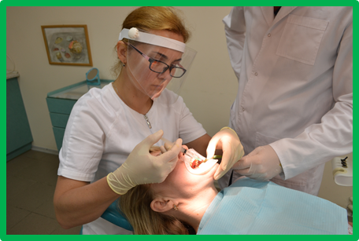
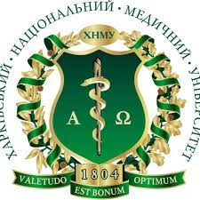

EFFECTIVENESS OF TREATMENT OF PATIENTS WITH GENERALIZED PERIODONTITIS WITH LIPOSOMAL QUERCETIN WITH CORRECTION OF THE ANTIOXIDANT PROTECTION SYSTEM
All-Ukrainian interdisciplinary scientific and practical conference with international participation
“Pathologies of the temporomandibular joint: diagnostics, treatment protocols”
Poltava State Medical University
May 21, 2024
PhD, associate of professor at the Department of Dentistry,
Khudiakova Maryna,
Kharkiv Medical National University,
Kharkiv, Ukraine

Slide 2
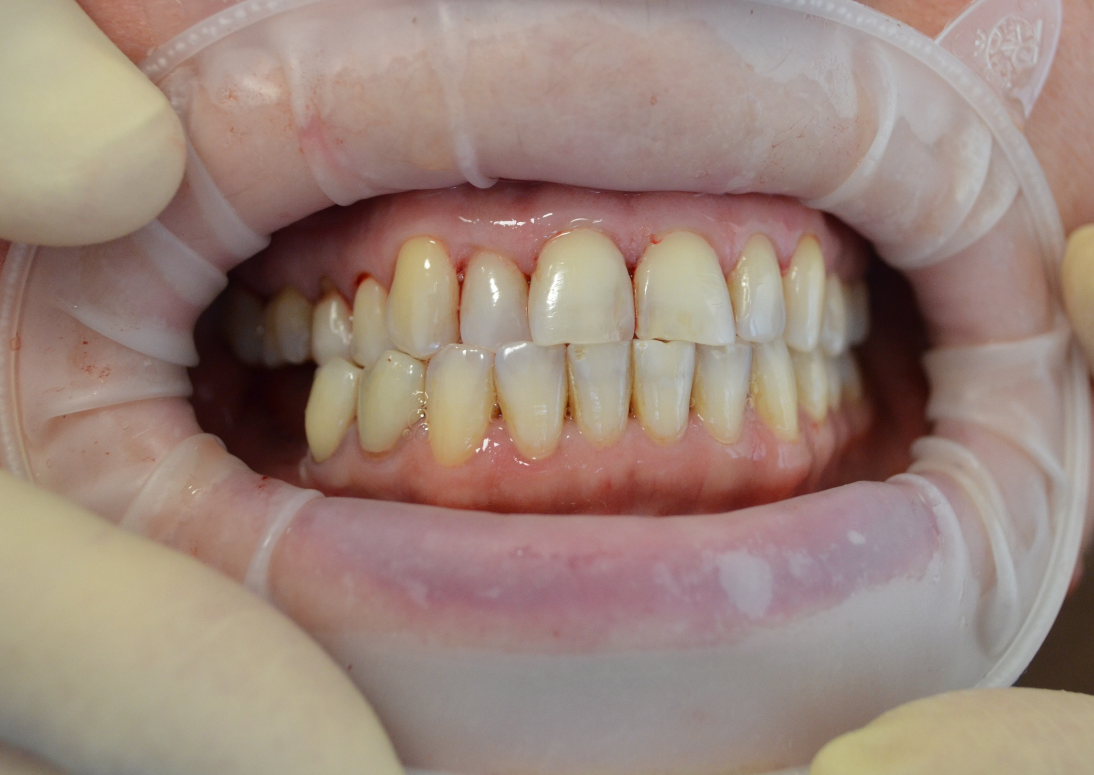
Free radical oxidation processes in the oral cavity play an important role in the development of generalized periodontitis
The main factors that provoke local activation of biomolecular peroxidation are local factors - dental plaque, microflora, etc.
However, inflammatory processes in periodontal tissues are secondary to systemic processes of maladaptation, in which a special role belongs to the mechanisms of free radical oxidation and insufficiency of the antioxidant protection system
Against the background of the development of generalized chronic periodontitis, depending on the severity, a significant decrease in the activity of superoxide dismutase, catalase and the level of SH-groups in the patients' oral fluid was revealed

Slide 3
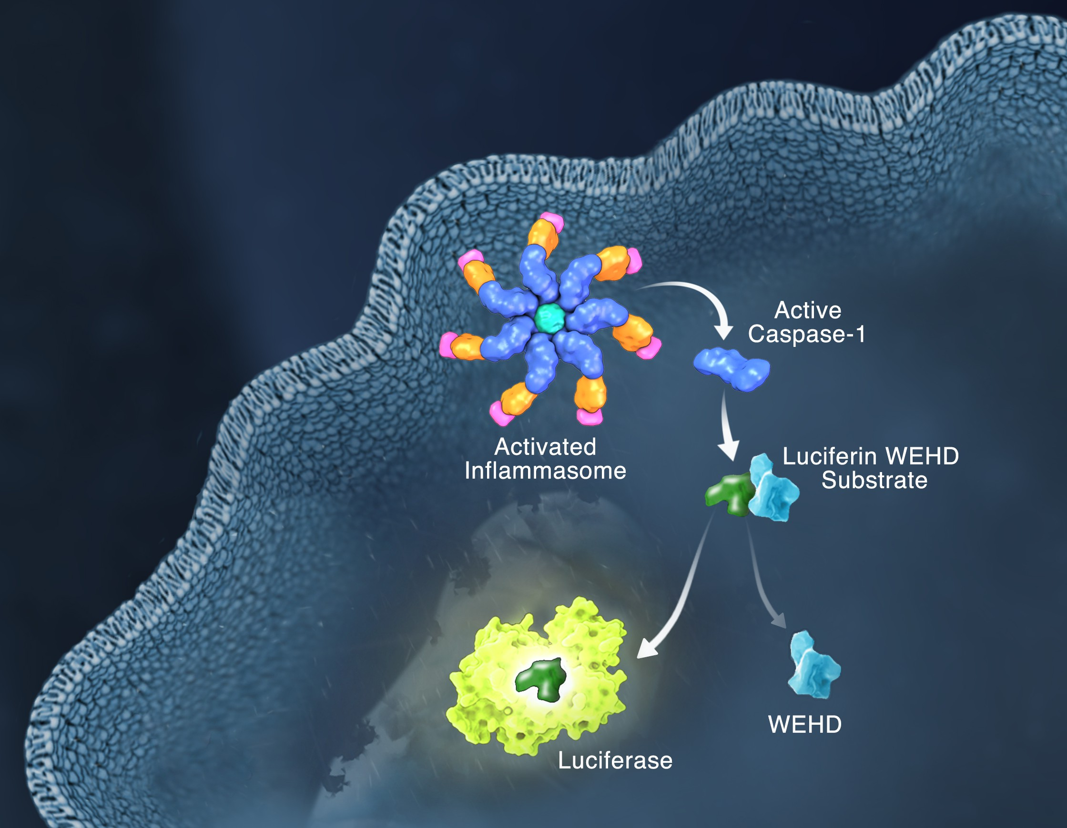
Hayward, J. A., Mathur, A., Ngo, C., & Man, S. M. (2018). Cytosolic Recognition of Microbes and Pathogens: Inflammasomes in Action. Microbiology and Molecular Biology Reviews, 82(4). doi:10.1128/mmbr.00015-18
Microbes from all walks of life, including bacteria, viruses, fungi and parasites, can cause infection
Infection is perceived by the host, often leading to activation of the inflammasome, a cytosolic macromolecular signaling platform
Host-mediated infection perception occurs when pathogens introduce or transfer pathogen-associated molecular patterns (PAMPs) into the cytoplasm or cause damage that triggers the cytosolic release of dangerous molecular patterns (DAMPs) in the host cell
Recognition of PAMPs and DAMPs by inflammatory sensors, including NLRP1, NLRP3, NLRC4, NAIP, AIM2 and Pyrin, initiates a cascade of events that result in inflammation and cell death
However, pathogens can deploy virulence factors that can minimize or evade host detection

Slide 4
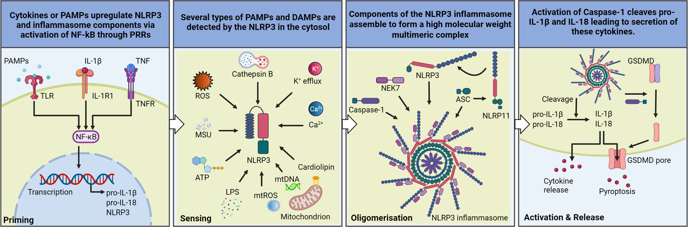

Slide 5
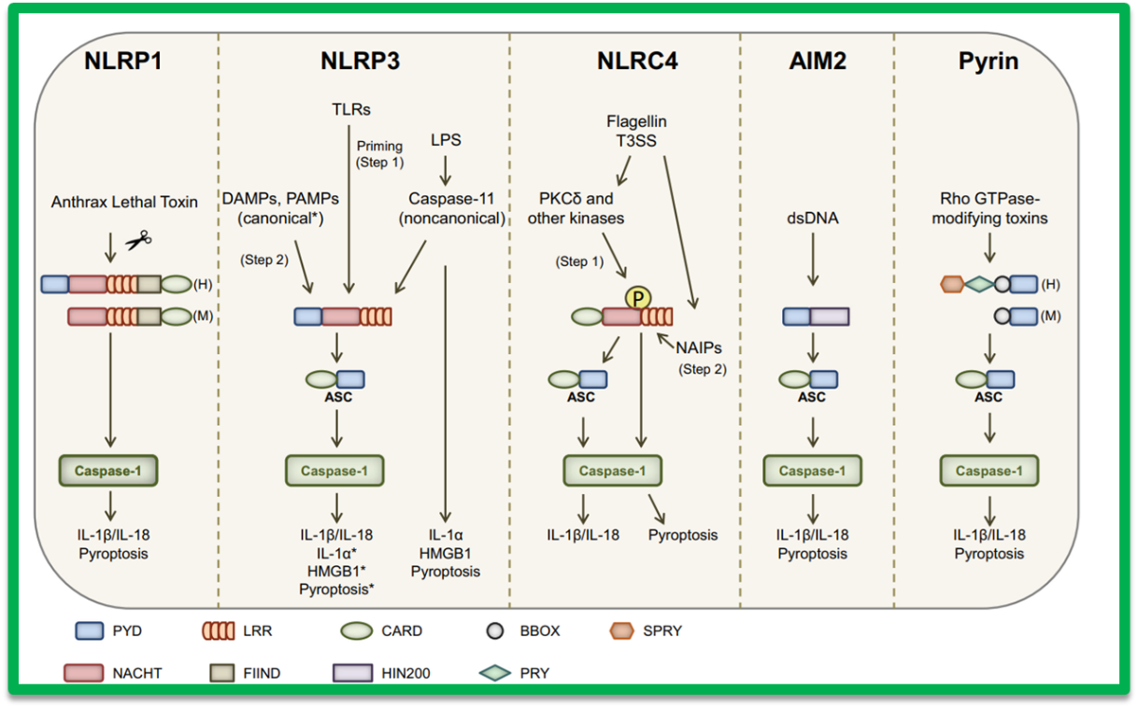
Saavedra Pedro H. V., Demon Dieter, Van Gorp Hanne Van Gorp, Lamkanfi Mohamed (2015). Protective and detrimental roles of inflammasomes in disease. Semin Immunopathol. doi 10.1007/s00281-015-0485-5
Depending on the stimulus, certain inflammasomes assemble to recruit and activate procaspase-1, which will promote the induction of pyroptosis and the maturation of proinflammatory IL-1β and proinflammatory IL-18 to their secretory forms NLRP1 inflammasome is activated by the protease activity of Bacillus anthracis lethal toxin (BT)
The canonical NLRP3 inflammasome is triggered by several DAMPs and PAMPs
Non-canonical NLRP3 inflammasome is stimulated by intracellular LPS after caspase-11
Pyroptosis and secretion of HMGB1 and IL1α are autonomously relayed by caspase-11 in a non-canonical way
NLRC4 activation of the inflammasome occurs in 2 stages
First, cytosolic flagellin activates PKCδ and other kinases that can phosphorylate NLRC4Ser533Secondly, NAIP-mediated recognition of bacterial components promotes NAIP-NLRC4 oligomerization and activation of the inflammasome
The AIM2 inflammasome recognizes cytosolic dsDNA
Toxin-induced modifications of cellular RhoGTPs are perceived by PYRIN, leading to inflammasome activation

Slide 6
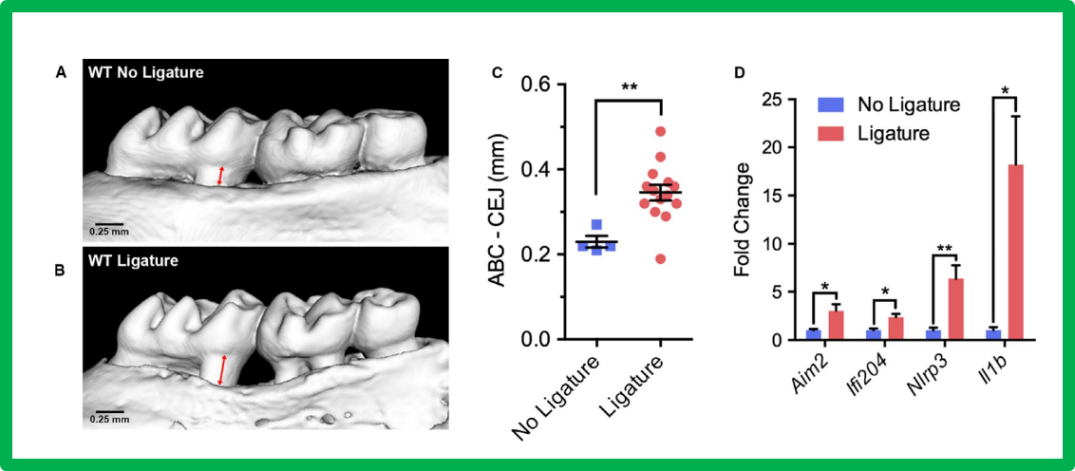
Julie T. Marchesan Role of inflammasomes in the pathogenesis of periodontal disease and therapeutics. Periodontology 2000. 2020;82:93-114
Increased levels of inflammasome and IL-1b in modeling of experimental periodontitis
Inflammasome components increase in experimental periodontitis
Periodontitis was induced in mice using a ligature model for 10 days

Slide 7
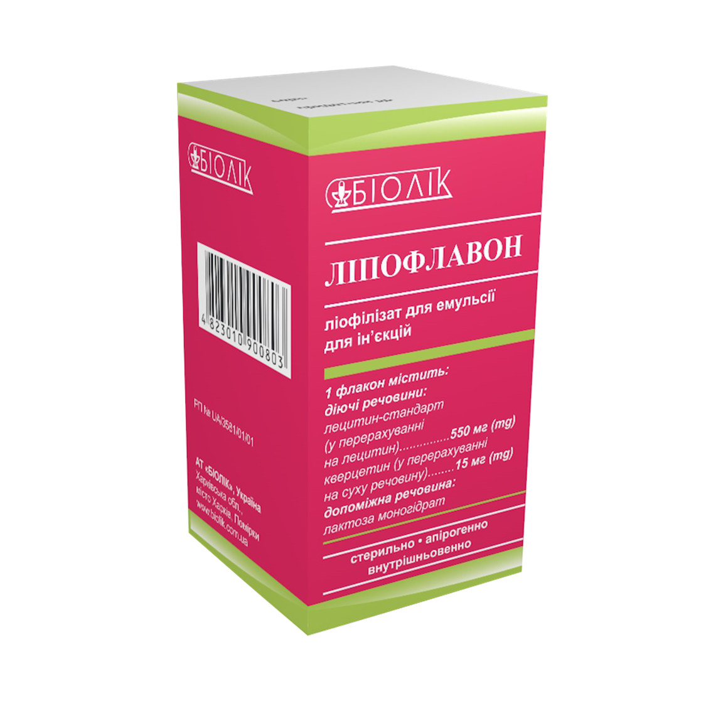
The possibilities of correcting the pathogenetic mechanisms of GP by using domestic drugs of natural origin with anti-inflammatory and antioxidant properties - liposomal quercetin-lectin complex (Lipoflavon, CJSC “Biolek”, Kharkiv, Ukraine) remain unexplored.
Additional research is needed to establish its role in the drug treatment of patients with GP

Slide 8
The aim of the study
The aim of the study was to evaluate the therapeutic effectiveness of the antioxidant effect of liposomal quercetin in the oral fluid of patients with generalized periodontitis of chronic course of initial-I severity in local treatment by the dynamics of changes in the antioxidant system: catalase activity, superoxide dismutase and the level of SH-groups

Slide 9

Materials and methods
The results of the work are based on the clinical examination, treatment and follow-up of 35 patients with chronic GP of initial-I severity who were treated at the University Dental Center of KhNMU
All patients were divided into 2 clinical groups depending on the method of treatment. The main group included 18 patients who, along with the basic treatment, were prescribed local LQLC
The comparison group consisted of 17 patients who received basic treatment with the local use of quercetin gel with periodontal caps

Slide 10
Research results and their discussion
The biochemical study showed that before treatment, the level of catalase activity ranged from 1.82 ± 0.19 to 2.8 ± 0.14 units. (normal 3.35 ± 0.08 units), SOD from 3.22 ± 0.16 to 4.3 ± 0.19 units (normal 4.73 ± 0.11 units), SH-groups from 2.82 ± 0.21 to 3.31 ± 0.26 μmol/l (normal 4.77 ± 0.16 μmol/l)
Local antioxidant therapy with liposomal quercetin increases the activity of enzymes and the non-enzymatic link of the antioxidant protection system. With the use of LQLC in 1 month, the activity of catalase at the initial stage was increased by 24 % (P < 0.001), the activity of SOD - by 34 % (P < 0.001), the level of SH-groups - by 16 % (P < 0.01)
After 1 year, in patients with initial-I degree GP, the activity of catalase in the oral fluid increased to 3.81 ± 0.12 units, which was 1% higher than in 6 months (3.76 ± 0.11 units)
The activity of SOD in the oral fluid increased to 5.42 ± 0.13 units, which was 2% lower than at the 6-month follow-up (5.51 ± 0.18 units). The level of SH-groups in the oral fluid increased to 5.32 ± 0.18 μmol/l, which is 1% higher than in 6 months (5.25 ± 0.19 μmol/l)

Slide 11
Conclusions
The antioxidant effects of the liposomal form of quercetin are superior to those of quercetin granules that are not involved in the liposomal membrane
This allows us to believe that the leading mechanism of quercetin's protective effects is its protection by the liposomal membrane from the action of various biological substances
The use of liposomal form of quercetin for local therapy by the method of directed transportation and the use of periodontal caps for prolonged action of drugs may be a new promising direction in the complex treatment of generalized periodontitis

Slide 12
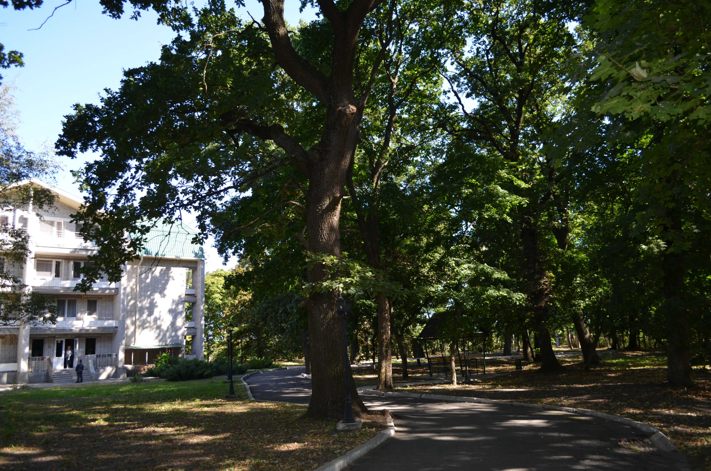
Thanks for your attention!!!

