Slide 1


KHARKIV NATIONAL MEDICAL UNIVERSITY
Department of Medical and Bioorganic Chemistry
«Medical Chemistry»
COMPLEX FORMATION IN Biological Systems
FUNDAMENTALS OF CHELATOTHERAPY
Lecture № 1
Head of Department:
Pharm.D., Professor Anna O. Syrovaya

Slide 2
PLAN OF LECTURE
Complex compounds (C.C.)
Complexing agents. Ligands. Structure of C.C. Bonding in C.C.
Equilibria in the solution of C.C.
Stability of C.C.
4. Classification of C.C.
5. Nomenclature C.C. (by IUPAC)
6. Structure and isomerism of C.C.
7. Complexonometry. Biocomplexes. Chelatotherapy.

Slide 3

We must to know:
The bulding of complex compounds (C.C.)
The role of C.C. in the metabolism of the organism
The application of C.C. in medicine
Name the C.C., nomenclature of C.C., classification of C.C.
Biocomplexes
Complexonometry
Chelatotherapy

Slide 4
Complex compounds (coordination compounds) (C.C.)
are a special class of compounds, in which the central metal atom or ion is surrounded by oppositely charged ions or neutral molecules more than its normal valency.
C.C.
minerals
Present in the
plants
animals
Play many important functions
In biological systems:
iron
cobalt
magnesium
Heme (hemoglobin) is coordination compound of
Vitamin B₁₂ is
coordination compound of
Chlorophyll is
coordination
compound of

Slide 5
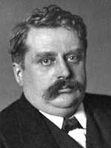
coordination theory, 1893
one of the ions in a molecule generally a positively charged one occupies a central position ‒ is called a complexing agent or central ion.
Alfred Werner
(1866-1919)
Nobel Prise (1913)
Complex compounds
By Werner
C.C. contains complex ion:
a central atom or ion (metal) and ligands (neutral molecules, ions)
[ central atom + ligands] - inner sphere of the complex (complex ion)
Today
Main valence - due to the formation of ionic and covalent bonds by the exchange mechanism
Incidental valence - form a covalent bond by the donor-acceptor mechanism.

Slide 6


structure of complex compound
complex ion, inner sphere
K₃[Fe(CN)₆]
[Ag(CN)₂]⁻ C.n. for Ag⁺ = 2
[Cu(NH₃)₄]²⁺ C.n. for Cu²⁺ = 4
[Co(NH₃)₃Cl₃] C.n. for Co³⁺ = 6
ions of the outside sphere
coordination number (C.n.)
is the number of ligands surrounding the central ion (is the total number of
Ϭ-bonds formed by
Сomplexing agent + Ligands
complexing agent
(central metal atom or ion)
is the atom or cation to which one or more neutral molecules or anions are attached
ligands
are neutral molecules or ions attached
to the complexing agent

Slide 7
complexing agent (central ion)
Alkaline metals, alkaline-earth metals and cations form unstable complexes
Must to have free atomic orbitals
d- (Cu, Fe, Pt) and f-elements and their cations (atoms and cations of elements have small atomic radius and a big nuclear charge, because easy to polarize anions and molecule ligands, made => C.C.; p-elements (Al).
Atoms Cr, Co, Ni, Fe, Mn;
Cations Ag⁺,Au⁺,Cu⁺,Cu²⁺,Hg²⁺,Cd²⁺,Zn²⁺,Cr³⁺,Fe²⁺,Fe³+,Co²⁺,Ni²⁺
Complex ion: [Ni(NH₃)₆]²⁺ : Ni ²⁺ - central ion
[Cu(NH₃)₄]²⁺
K[Ag(CN)₂]

Slide 8
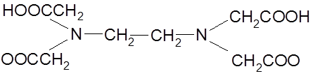
Ligands
are ions (anions)or neutral molecules attached to the complexing agent through coordinate bonds.
[Ni(NH₃)₆]²⁺
Central ion should have vacant orbitals.
The molecules of ammonia
are the ligands:
should have lone pairs of electrons in the outermost orbitals which can be donated to the central ion. The atom in the ligand which can donate the electron pairs is called donor atom.
Types of Ligands. Dentate of LIGANDS
How many σ-bonds building ligand by central ion?
monodentate (unidentate) ligands only one donor atom : (Cl-, F-, CN-, OH-) ions
(H₂O, NH₃, CO, С₆Н₆, С₆Н₅N) moleculs ;
bidentate ligands are two donor atoms and can coordinate to the central ion at 2 positions:
(NH₂ – CH₂ – CH₂ – NH₂), (CO₃²⁻, SO₄²⁻, С₂О₄²⁻), (Н₂N – NН₂)
Ethylenediamine ions Hydrazyn
polydentate ligands have more than 2 donor atoms
ethylenediaminetetraacetic acid is a tetradentate ligand (EDTA).
Bisodium salt of EDTA is used for treatment of hypercalcemia.

Slide 9
CLASSIFICATION OF COMPLEX COMPOUNDS
1. By electrically charge
Cationic complex is a complex ion which has a positive charge: [Co(NH₃)₆]³⁺, [Ni(NH₃)₆]²⁺
Anionic complex is a complex ion which has a negative charge: [Ag(CN)₂]⁻, [Fe(CN)₆]⁴⁻.
Neutral complex has not charge [Co(NH₃)₃Cl₃], [Ni(CO)₄], [Pt(NH₃)₂Cl₂].
2. By acidity of the aqueous solution:
● Complex acid H₂[SiF₆]→2H⁺+[SiF₆]²⁻
● Complex basices [Ag(NH₃)₂]⁺+OH⁻
● Complex salts [Zn(NH₃)₄]SO₄→[Zn(NH₃)₄]²⁺+SO₄²⁻

Slide 10
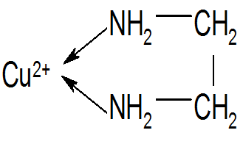
CLASSIFICATION OF COMPLEX COMPOUNDS
3. By nature the ligands
• Aquacomplexes contain water as the ligand: [Co(H₂O)₆]Cl₃
• Ammines has ammonia molecules [Ag(NH₃)₂]OH,
[Co(NH₃)₆]Cl₃;
and aminates –has amine molecules: CH₃NH₂ (methylamine),
C₂H₅NH₂ (ethylamine).
• Acidocomplexes ‒ Na₃[Ag(S₂O₃)₂] (acidic residues)
• Transition series : ligands= ions + neutral moleculs
[Pt(NH₃)Cl₃]
• Hydroxocomplexes: K₃[Al(OH)₆]
• Cyclic or chelate c. c. contain 2 or polydentate ligand

Slide 11
Coordination Sphere
My self work
Central metal atom and the ligands (molecules or ions) directly bonded to it is collectively known as coordination sphere. This part of the complex behaves as one unit and is non-ionizable. [Pt(NH₃)₄]²⁺ represents coordination sphere in the compound [Pt(NH₃)₄]Cl₂. The portion outside the square bracket (coordination sphere) is ionizable. Thus, the coordination compound [Pt(NH₃)₄]Cl₂ ionizes as:
[Pt(NH₃)₄]Cl₂ ↔ [Pt(NH₃)₄]²⁺ + 2Cl⁻
[Co(NH₃)₃Cl₃] does not ionize because there is no group outside the square bracket.

Slide 12
Charge of a Complex ion
is a algebraic sum of charges carried by the central ion and the ligands coordinated to it. [Ni(NH₃)₆]²⁺ carries a charge of +2 because Ni²⁺ ion carries a charge of +2 and ammonia molecule is neutral.
Oxidation number or oxidation state
of the central metal atom
Oxidation number of the central atom is the main factor affecting the coordination number (C.n.)!
The most characteristic C.n. in solutions and the charge of the central ion is given below:
Charge of the central ion +1 +2 +3 +4
C.n. 2 4,6 6,4 8
3) C.n. 6 is encountered in the complex compounds of Pt⁴⁺, Cr³⁺, Co³⁺, Fe³⁺,
C.n. 4 – Cu²⁺, Zn²⁺, Pd²⁺, Pt²⁺, C.n. 2 – Ag⁺ and Cu⁺.

Slide 13
Oxidation number (O.N.) the central metal atom
Knowing the charge of the complex ion, we can calculate the oxidation number of the central metal atom.
For example: [Cr (H₂O)₄Cl₂]⁺
x + 4⋅0 + 2⋅(-1) = +1
x + (-2) = +1
x = 3
О.N. of : Cr= +3
[Ni(NH₃)₆]²⁺: x+6(0)=+2 or x=+2 O.N. of Ni = +2
[Co(NH₃)₅Cl]²⁺: x+5(0)-1=+2 or x=+3 O.N. of Co =+3
[Fe(C₂O₄)₃]³⁻ : x+3(-2) =-3 or x=+3 O.N. of Fe =+3
K₄[Fe(CN)₆]: 4(+1)+x+6(-1) =0 or x= +2 O.N. of Fe =+2
[Ni(CO)₄]: x+4(0)=0 or x=0 O.N. of Ni =0
Coordination sphere
[Co(NH₃)₄Cl₂]Cl
Ionizable part
Central metal ion
Ligands
Coordination number
2+4=6

Slide 14
Nomenclature of Coordination Compounds (IUPAC)
1. Order of naming ions. In ionic complexes, the cation is named first and then the anion (as in NaCl: sodium chloride). Non-ionic complexes are given a one word name.
2. Naming the coordination sphere. In naming the coordination sphere, the ligands are named first and then the central metal ion.
3. Names of ligands. The names of negative ligands end in –o and names of positive ligands end in –ium. The neutral ligands are named as such:
negative ligands end in – o: Br⁻ bromo; OH⁻ hydroxo; NO₃⁻ nitrato;
CO₃²⁻ carbonato; NO₂⁻ nitro;
positive ligands end in –ium NO⁺ nitrosonium; NO₂⁺ nitronium;
neutral ligands are named as such NH₂CH₂CH₂NH₂ ethylenediamine, C₆H₅N pyridine.
However: H₂O aquo (aqua); NO nitrosyl ; NH₃ ammine; CO carbonyl

Slide 15
Nomenclature of Coordination Compounds (IUPAC)
4. Order of naming ligands. When more than one type of ligands are present, they are named in alphabetical order of preference without separation by hyphen: [Co(NH₃)₄Cl(NO₂)]⁺
The ligands are named in the order: ammine, chloro, nitro.
5. Numerical prefixes to indicate number of ligands. When more than one ligands are present in the complex, the prefixes di-, tri-, tetra, penta-, hexa-, are used to indicate
their number: two, three, four, five, six respectively.
6. Ending of names. When the complex is anionic ‒ the name of the central metal atom ends in –ate.
K[Pt(NH₃)Cl₅] Potassium amminepentachloroplatinate(IV)
When the complex is cationic and neutral complexes ‒ the name of the metal is written without any characteristic ending.
[Co(NH₃)₆]Cl₃ Hexaamminecobalt(III) chloride

Slide 16
Nomenclature of Coordination Compounds (IUPAC)
Latin names of central metals (for anionic complexes)
ferrate for Fe
cuperate for Cu
argentate for Ag
aurate for Au K₃[Fe(CN)₆] Potassium hexacyanoferrate(III)
• If the complex is cationic the name of the metal is given as such:
iron for Fe
copper for Cu
silver for Ag
gold for Au [Fe(CO)₅] Pentacarbonyl iron(0)
7. Oxidation state of central metal ion is designated by a Roman numeral in the brackets at the end of the name of the complex without a gap between the two. It may be noted that the gap should be only between cation and anion. The complex part should be written as one word:
[Ni⁰ (CO)₄⁰]⁰ – Tetracarbonylnickel (0)
[Pt⁺⁴(NH₃)₄⁰Cl⁻¹(NO₂)⁻¹]²⁺SO₄^{2—}Tetraamminechloronitroplatinum(IV) sulfate
Cu⁺²₂[Fe⁺² (CN)₆⁻¹]⁴⁻ – Copper hexacyanoferrate(II)
K⁺¹[Ag⁺¹(CN)₂⁻¹]¹⁻ – Potassium dicyanoargentate(I)

Slide 17
Bonding in Coordination Compounds (C.C.)
1.The complexing agent is usually a d-elements: have number of empty d-orbitals available for accepting of ligands electrons.
2. The central metal ion in the C.C. provides a number of empty orbitals for the formation of coordinate bonds with suitable ligands.
3. The appropriate atomic orbitals (s, p and d) of the metal hybridize to give a set of equivalent orbitals
Coordination number | Hybridisation | Geometry
4 4 6 | sp³ dsp² sp³d² or d²sp³ | Tetrahedral Square planar Octahedral

Slide 18
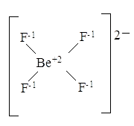
Bonding in Coordination Compounds (C.C.)
4. Each ligand has at least one orbital (of donor atom) containing a lone pair of electrons.
5. The empty hybrid orbitals of metal ion overlap with filled orbitals of the ligand to form metal-ligand coordinate covalent bonds.
Be²⁺ + 4 :F ‒ → [Be F₄]²⁻
acceptor donor tetrahedral geometry
sp³ hybridization

Slide 19

Stability of Complex Compounds
Primary dissociation – the solution of C.C. (ions bonds): the destruction of the crystal lattice (trellis) on the mechanism of dissociation of strong electrolytes
K₄[Fe (CN)₆] → 4K⁺ + [Fe (CN)₆]⁴⁻
[Ag (NH₃)₂] Cl → [Ag (NH₃)₂]⁺ + Cl⁻
Secondary dissociation – the ligands in the inner sphere are much more strongly bonded to the central atom and are detached only to a small degree covalent bonds. Mechanism of dissociation not strong (weak) electrolytes
[Ag(NH₃)₂]⁺ ↔ [Ag(NH₃)]⁺ + (NH₃)⁰
[Ag(NH₃)]⁺ ↔ Ag⁺ + (NH₃)⁰
Irreversible
process
Reversible
process

Slide 20
Stability of Complex Compounds. The instability constants K_{inst}:
Constants stability (K_{stab}) and instability K_{inst} mutually inverse values:
[Ag
+
][NH
]
2
K
=
3
=
6.8
⋅
10
−
8
inst
[[Ag(NH
)
]
+
]
3
2
[Ag(NO₂)₂]⁻ [Ag(NH₃)₂]⁺ [Ag(S₂O₃)₂]³⁻ [Ag(CN)₂]⁻
K _{inst}
1.3х10⁻³
6.8х10⁻⁸
1х10⁻¹³
1х10⁻²¹
Stability of the complex grows in going

Slide 21
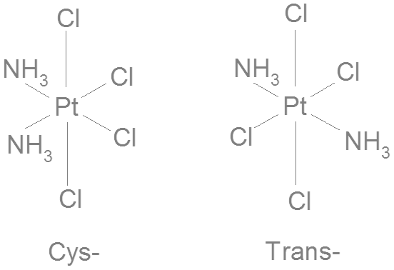
Spatial Structure and Isomerism in C. C.
Geometrics isomerism
For C.C. which have
C.N. 4 end 6
min 2 ligands
Optic isomerism
Write
D - isomer end L - isomer
Left
Solvate isomeris
Change allocations molecules of solvent between inner
and outer (outside) sphere
[Сr(H₂O)₆]Cl₃→[СrCl(H₂O)₅]Cl₂∙H₂O→[CrCl₂(H₂O)₄]Сl∙2H₂O
violet
light green
dark green

Slide 22
Ionization isomerism
Change allocations of ligands – acidic residues between inner and outside sphere
[СoBr(NH₃)₅]SO₄→[СoSO₄(NH₃)₅]Br
red-violet
red
Coordination isomerism
For compounds, which consists of a complex cations and complex anions, each can with hold anything from 2 complexing agent
[Co(NH₃)₆]⋅[Cr(CN)₆]→[Cr(NH₃)₆]⋅[Co(CN)₆]
[PtCl(NH₃)₃]⋅[PdCl₃(NH₃)]→[PdCl(NH₃)₃]⋅[PtCl₃(NH₃)]
Isomerism of chemical bonding
For C.C., which have ligands with 2 atoms (can associate with complexing agent)
[Сo(NH₃)₅NO₂)]Cl₂ [Сo(NH₃)₅ONO)]Cl₂

Slide 23
Spatial Structure and Isomerism in C. C.
Identical ligands are symmetrically arranged in the space around the central atom. The even coordination numbers 2,4, and 6 are encountered more often. The following geometrical configurations correspond to them:
linear configuration (C.N.=2)
tetrahedral (C.N.=4)
octahedral (C.N.=6), depicted schematically in the form:

Slide 24
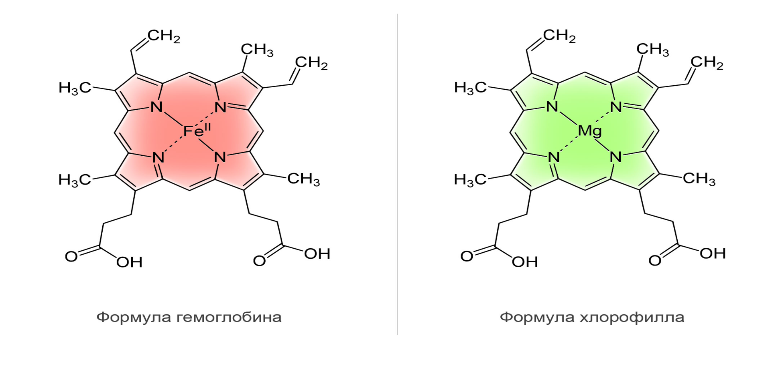
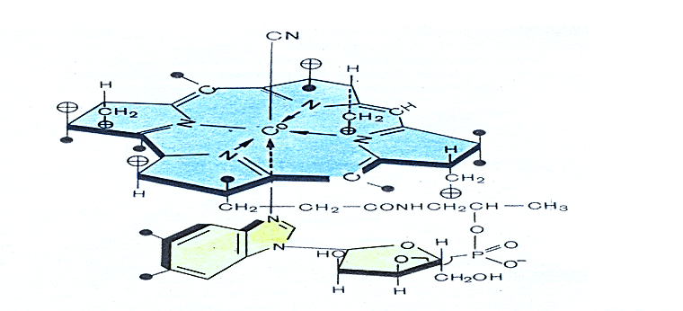
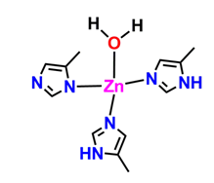
Heme
Chlorophyll
Vitamin B₁₂
Carboanhydrase

Slide 25
Metals coenzyme
Complex compound | Metal | Function
Hemoglobin, Myoglobin | Fe | Storage and transport of oxygen
Vitamin B₁₂ | Co | Regulation of hematopoiesis
Carbonic anhydrase | Zn | Regulation of blood acidity
Superoxide dismutase | Zn and Cu | Protection from toxic of free radical
Catalase Peroxidase | Fe | Decomposition of H₂O₂
Cytochromes | Fe | Transport of electrons in the electron transport chain of mitochondria
Alcohol dehydrogenase | Zn | Metabolism and oxidation of alcohols
Chlorophyll | Mg | Photosynthesis

Slide 26
Thank you for your attention!

