Slide 1
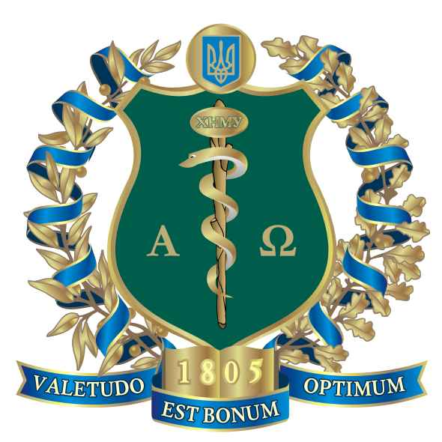
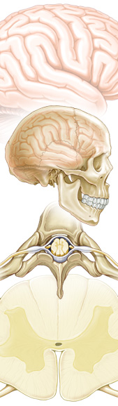
HISTORY OF NEUROSURGERY, INVESTIGATION METHODS
Kharkiv National
Medical University
Department of Neurosurgery

Slide 2
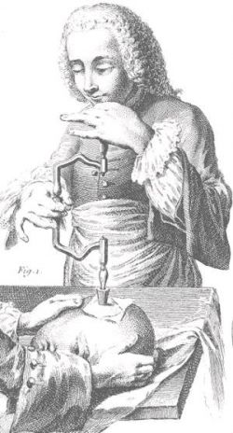
Craniotomy, was practiced in Africa 12,000 years, and in Europe, 6,000 years ago. However, these cuts were made in the skulls, mostly dead, and this was done, probably because of superstition, for example, to drive out evil spirits.
Already in the 1877 French anthropologist Paul Broca made the classification of the ancient transactions on the vault of the skull of man, which even today retains its value. He suggested that craniotomy was performed on living people sometimes - to heal them from certain diseases such as hysteria, epilepsy, convulsions, nervous - disease, the cause of which takes the existing in the head and was attributed to the special spirit resides there.
An artificial opening done in the skull, was intended to give vent to the spirit and so contribute to the liberation of the subject from the disease

Slide 3
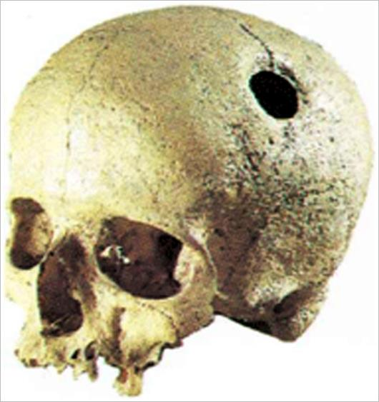
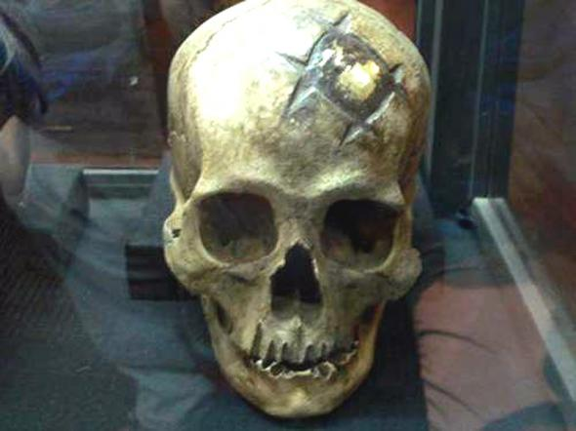
More recent studies of other trepan skulls have led to the discovery of a whole set of different methods of surgical technique and pointed out the striking fact is that half of these patients after craniotomy completely cured. This can be seen at the edges of the bone around the hole in the skull, they are completely covered with new bone tissue, smooth and round.
Scientists estimate that hundreds of trepan skulls found at present in Peru, exceed the amount of all known prehistoric trepan skulls in the world at large. For many centuries before the arrival of modern medicine in Peru, was born here neurosurgery...

Slide 4
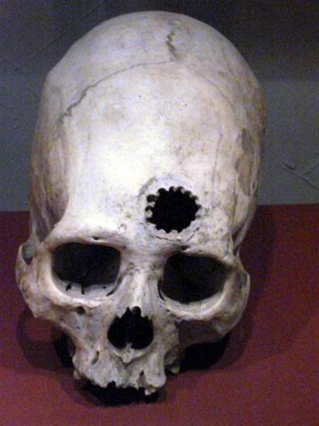
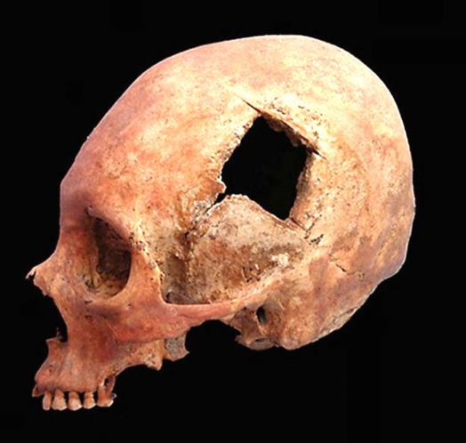
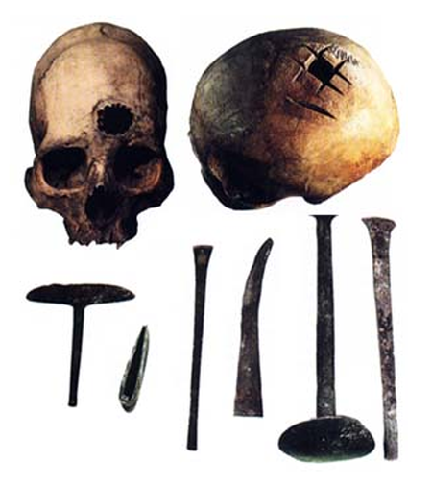
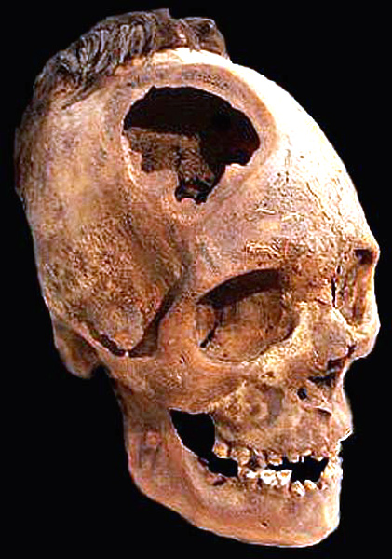
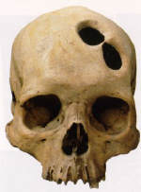
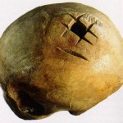

Slide 5
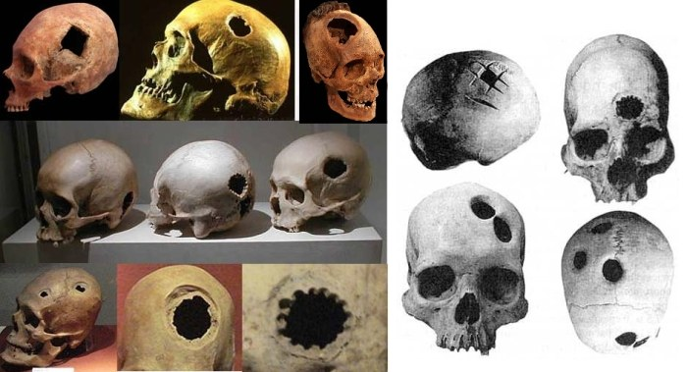
The Incas performed trepanation of the skull operations in approximately every third inhabitant of Cuzco. Of the 420 skulls found, there were 145 holes from prior operations. One skull has seven holes, which means that the patient was subjected to craniotomy seven times

Slide 6
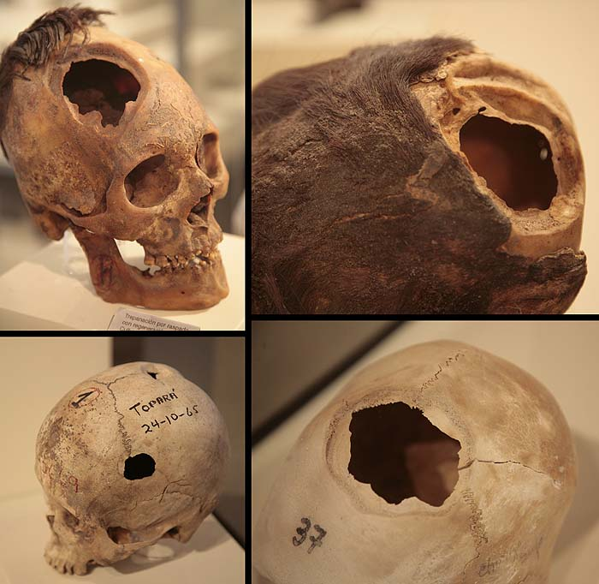
As a result of examination of the bones, found out that infectious diseases after operations have been extremely rare. Moreover, instead of antibiotics and pain medication, the Incas used a variety of herbs that act is no worse than modern drugs

Slide 7
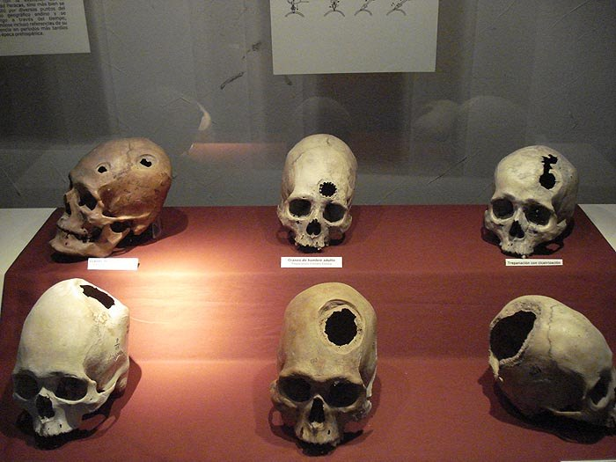
The word «trepan» (trypanon) - Greek in origin, it meant a special drill bit that were used to perforate the skull. Scalpel blade served as a strong scraper. In ancient times a wide variety of techniques were used - sawed square or right-angled plates, which are then taken out, drilled holes in a circle outlined by, or just the bone was cut

Slide 8
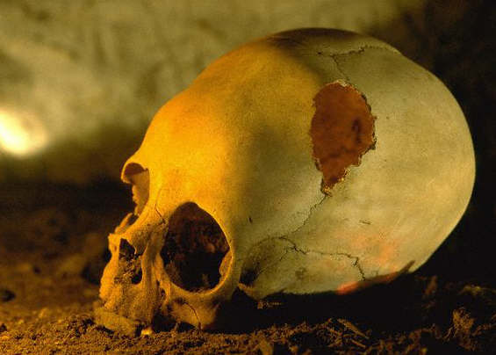
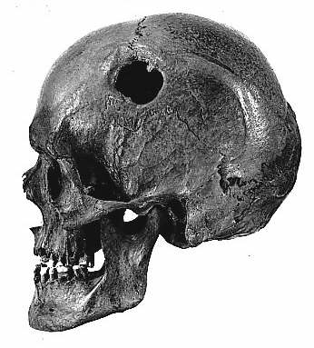
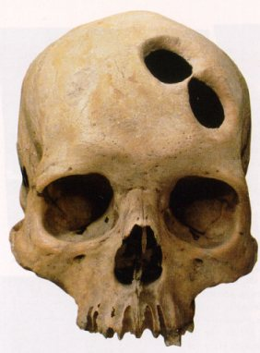
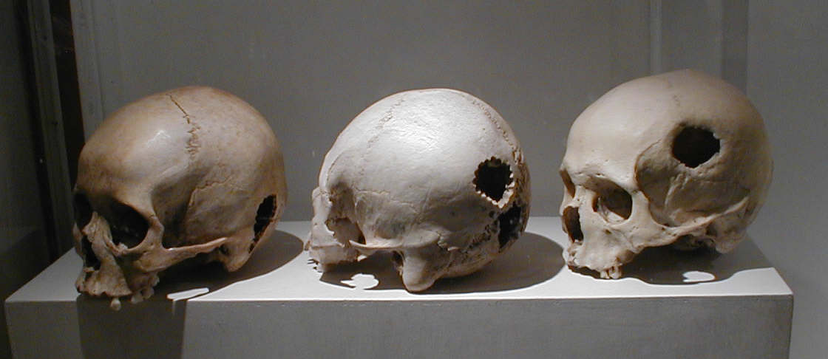
Trepanation was considered a promising treatment for migraines, epilepsy and mental disorders since the Neolithic

Slide 9
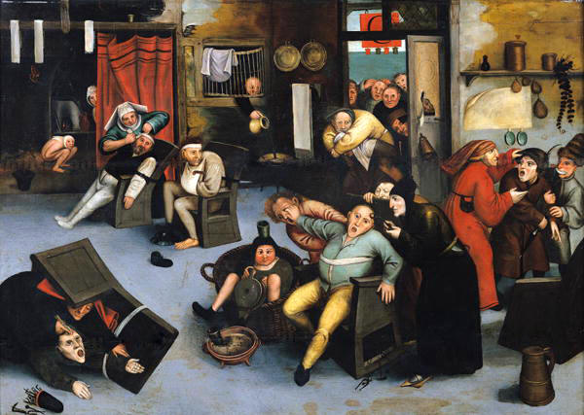
In the Middle Ages, and some time later, there was a belief that stupidity and other mental deviations due to the fact that the human mind have any extra stones, tumors (out Dutch expression "to have a stone in the head" - "to be stupid, insane, the head is not in place "). And if their removal make the person wiser immediately
Pieter Bruegel the Elder. "Removing a folly stone"

Slide 10
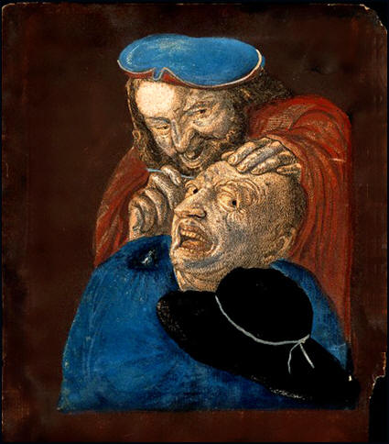
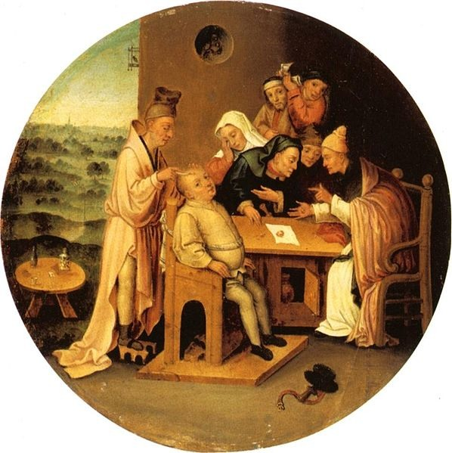
Indeed, there were charlatans who were engaged in such operations, - alone or with assistants, they wandered from city to city, and deceived the simple
David Teniers the Younger. «Surgical removal of stupidity stones», 1486

Slide 11
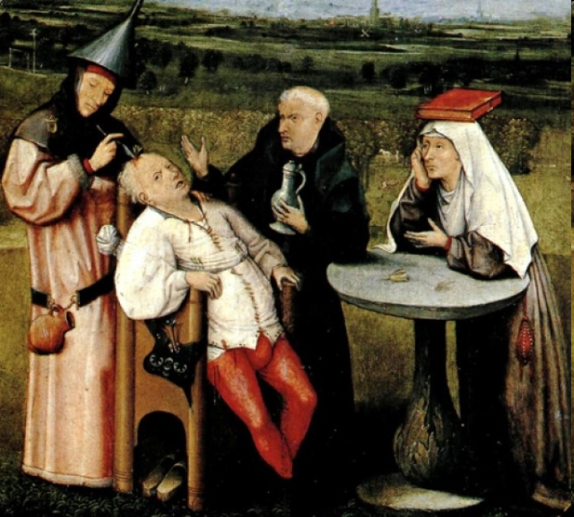
Hieronymus Bosch, "Extraction of stupidity stones", 1475

Slide 12
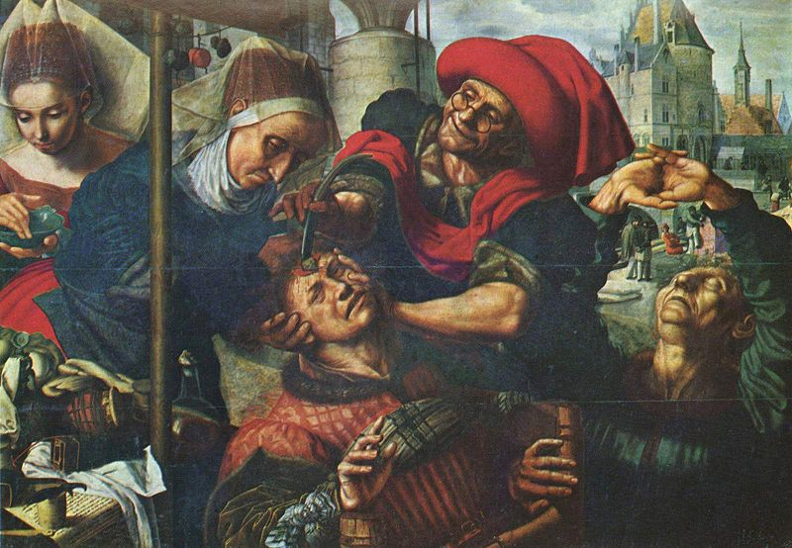
Jan Sanders van Hemessen, “Surgeon", 1560

Slide 13
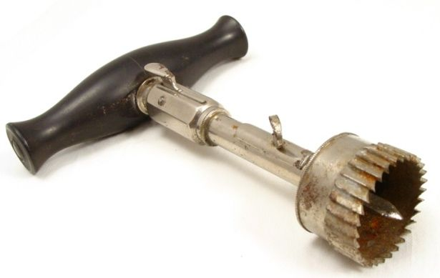
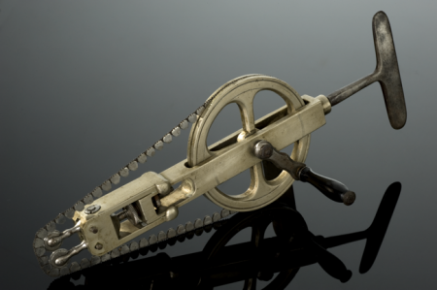
A device for opening the skull (19th century) Trephine (1800)
Saw cutting of the
skull (1830)

Slide 14
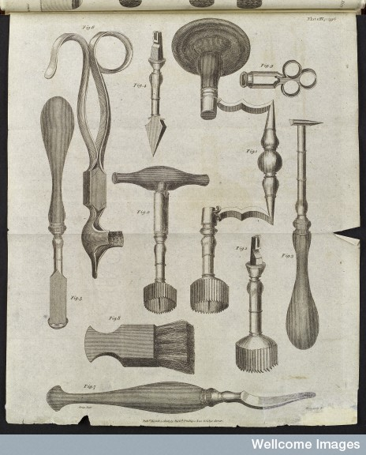
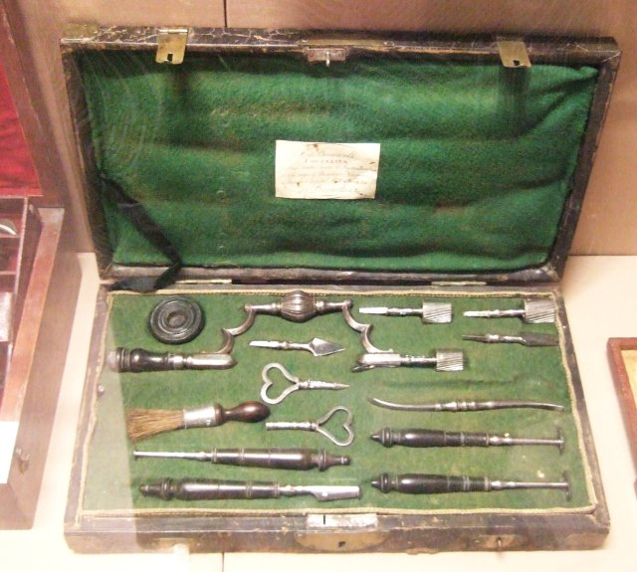
A set of tools for craniotomy (1806)

Slide 15
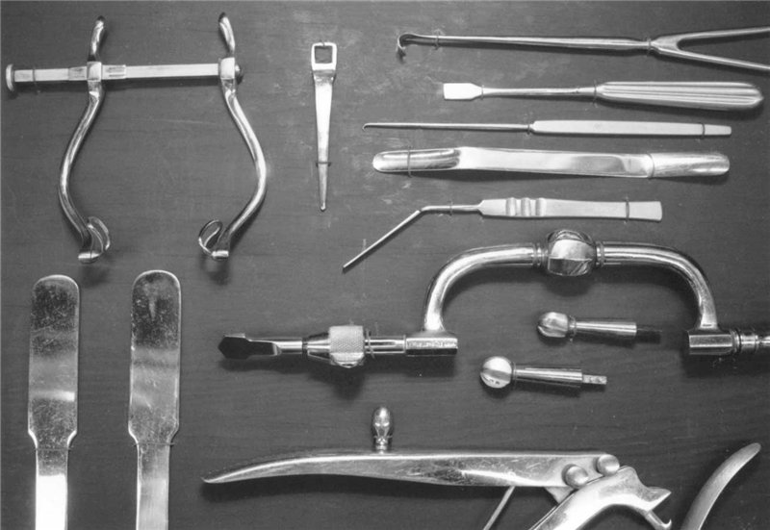
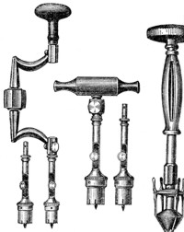
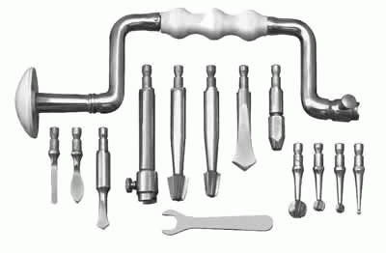

Slide 16
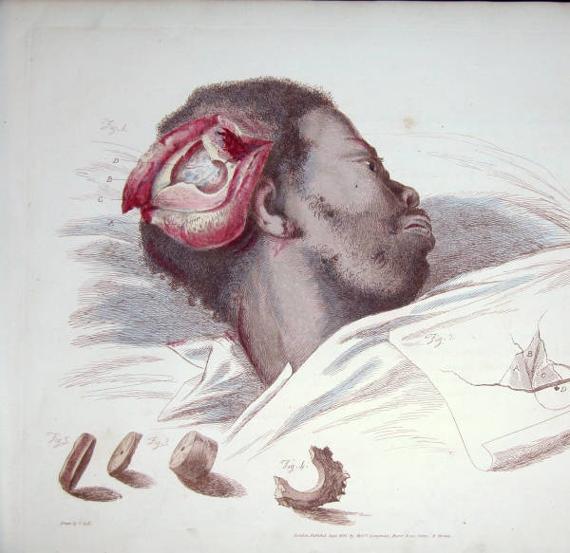
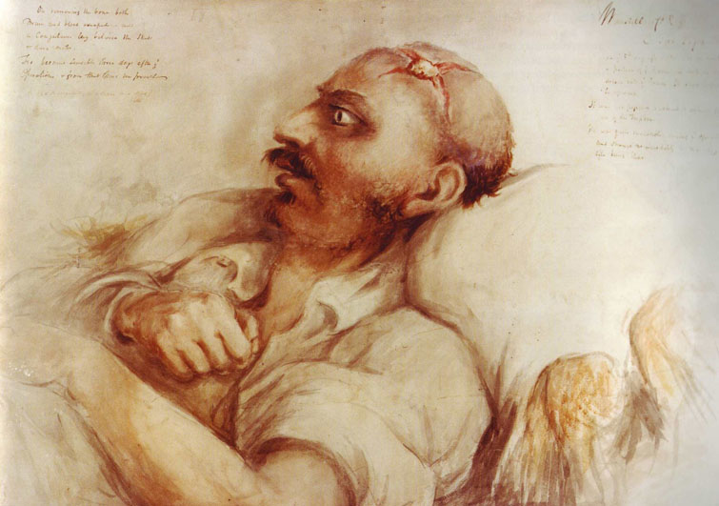
Charles Bell (The surgeon-artist) (1774-1842)

Slide 17
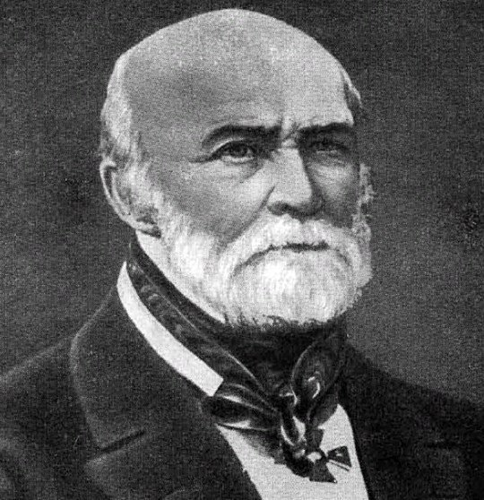
At Yur'ev got to know the pracies of the great Mikoli Ivanovich Pirogov, yakivin celebrated on a new level of defeat. The merit of M.N. Burdenko is the creation of new organizational foundations of neurosurgical settings, in which neurosurgeons practiced neuropathologists, neuroradiologists, neuroophthalmologists, otoneurologists, electrophysiologists, morphologists, and other fahivts; their activities were coordinated and focused on the development of sleeping and other nutrition of theoretical and clinical neurosurgery.

Slide 18
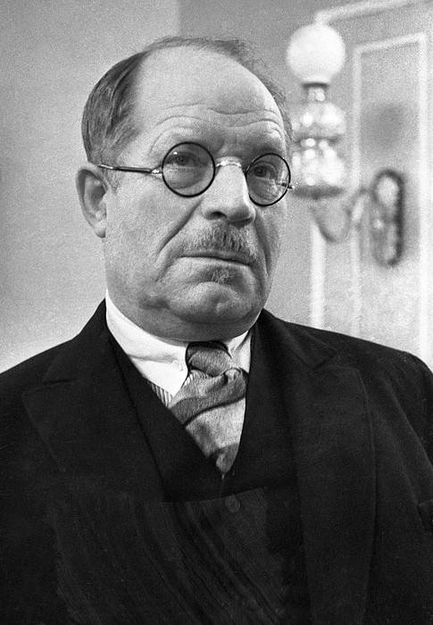
In 1937, M.N. Burdenko, the first in the world of specializations, the journal "Nutrition for Neurosurgery" appeared. Pіd hour of the ІІ Svіtovoї vіynya M.N. Burdenko developed rational methods of primary treatment of wounds of the skull and brain, the introduction of sulfanamide preparations and penicillin in case of infectious complications of wounds of the brain, the method of deaf suturing of primary wounds, which became the main one (due to the accumulation of antibiotics).
Him in detail developed methods of healing in case of aggravation of inflammable wounds to the brain. At the same time, M. Burdenko actively took part in the creation of a system of specialized assistance to those injured in the head and spine.

Slide 19
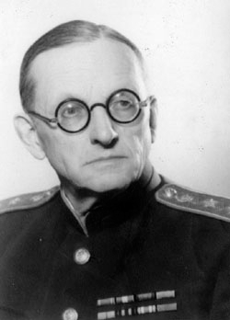
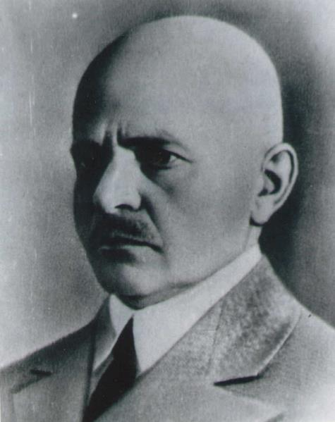
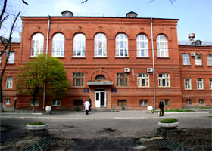
In Kharkov in 1930, professor Vladimir Shamov (1882-1962) opens the neurosurgical department at the base led them to the surgical clinic Medical Institute.
In 1931, in Kharkov Zahar Geymanovich organized at the Ukrainian Institute of psycho-neurological the clinic of neurosurgery.
In Kiev, the first neurosurgical department was opened in 1937.

Slide 20
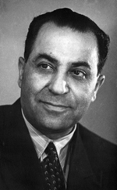
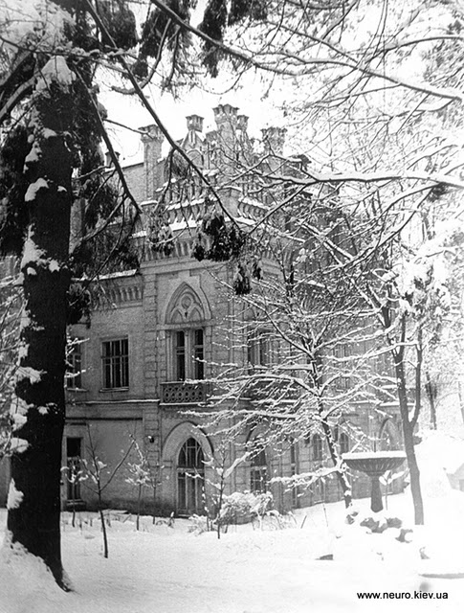
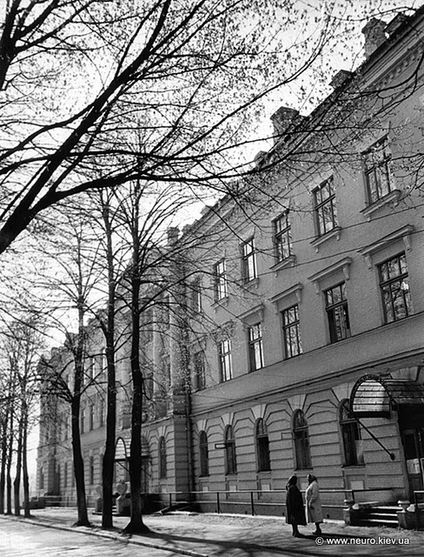
In the postwar period in Ukraine was paid to expanding the network of agencies and departments of neurosurgery. In Kiev in 1950 implemented a government decision in 1940 on the establishing neuropsychiatric institute at the Institute of Neurosurgery. Its creation was associated with the name of Alexander Arutyunov (1904-1975), who headed the agency and the Ukrainian school of neurosurgeons. From 1964 to 1975 A.Arutyunov headed the Institute of Neurosurgery

Slide 21
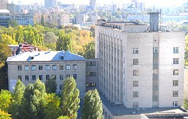
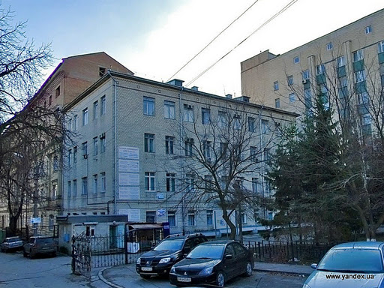
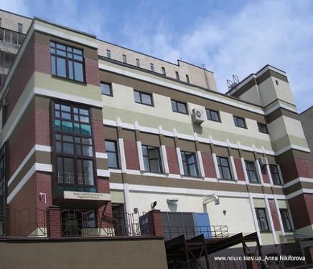
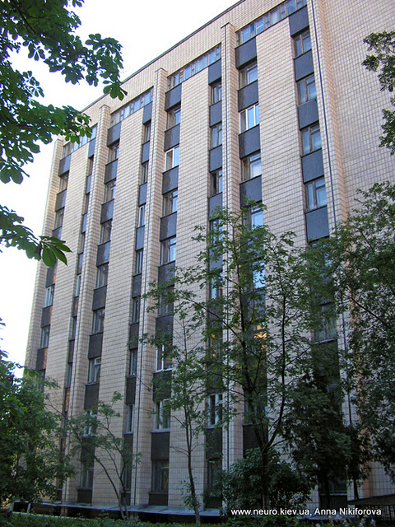
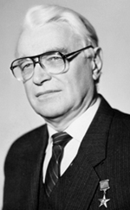
Institute of Neurosurgery A.Romodanova today

Slide 22
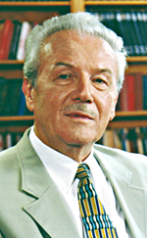
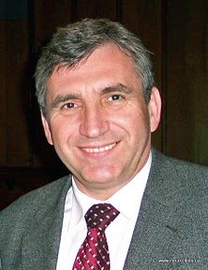
The heir of Academician AP Romodanova became a prominent Ukrainian neurosurgeon, Academician of the National Academy of Medical Sciences of Ukraine Yu.P. Zozulya (1927-2021), who led the institute for 20 years (from 1993 to 2013)
Today the Institute is headed by Academician of the National Academy of Medical Sciences of Ukraine Yevhen Heorhiyovych Pedachenko

Slide 23
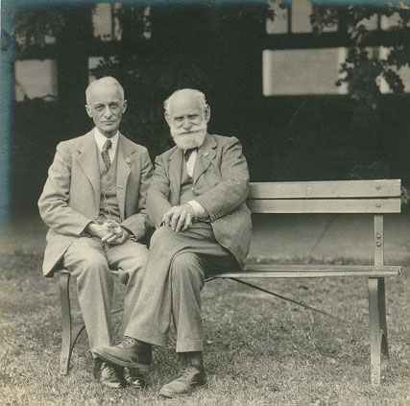
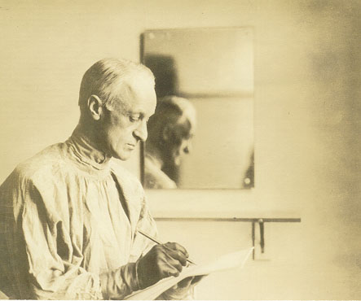
The development of neurosurgery at the beginning of the XX century closely associated with the activities of major American scientist Harvey Cushing (1869-1939) - one of the founders of modern neurosurgery, the creator of the famous school of neurosurgeons. His great merit is the development of rational methods of surgery on the brain and especially the methods of hemostasis (the use of clips, electrocoagulation, direct suction from the surgical wound), which greatly expanded the possibilities of treatment neurosurgical patients. Together with P.Beyli H.Kushing developed a classification of tumors of the nervous system, which despite its subsequent amendments, is the foundation of all modern classifications

Slide 24
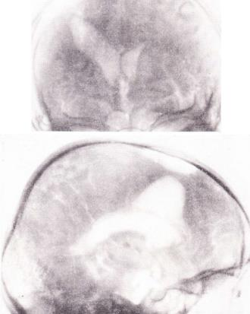







Developed diagnostic techniques in neurosurgery. This is suggested by the American neurosurgeon Walter Dandy (1886-1946) ventrikulography, myelography (1918), and then - pneumoencephalography (1919)

Slide 25








From the standpoint of modern neurosurgery even more important was the method of cerebral angiography, which was first developed and applied in practice, the Portuguese neurologist Egas Monish and the neurosurgeon in 1927. Diagnostic value of cerebral and spinal angiography increased, and now it is one of the most informative methods of auxiliary neurosurgical investigation. The second important contribution to the development of neurosurgery was lobotomy offered by E.Monish in 1935 for patients with various mental illnesses. For the development of this operation in 1949, he was awarded the Nobel Prize. From 1935 to 1978 the world was carried out 113,000 such operations on the brain

Slide 26

Central and peripheral nervous system
The human nervous system is classified into
on the conditions of formation and type of management as:
Lowest nervous activity
Higher nervous activity
by the method of information transfer as
Neurohumoral regulation
Reflex regulation
for localization as:
Central Nervous System
Peripheral Nervous system
of functional accessories like:
Somatic nervous system
The autonomic nervous system
(sympathetic nervous system,
parasympathetic nervous system)

Slide 27


Anatomy and physiology of the brain

Slide 28
The circulation of the cerebrospinal fluid

Slide 29


Slide 30


The total volume of cerebrospinal fluid in adults is approximately 150-200 ml, of which about 30 ml in the spinal subarachnoid space. Products of the daily-induces approximately 500ml CSF,respectively 20ml/h

Slide 32


Shells of the brain and spinal cord

Slide 33


Slide 34



Lining of the brain (meninges)

Slide 35

FALX CEREBRI AND TENTORIUM CEREBELLI

Slide 36


The system of cerebral ventricles

Slide 37


The position of the VA (Atlant part)

Slide 38

Involved in the formation of: 1) PSA 2) the initial segment of ACA (A-1), 3) of the ICA Supraklinoid 4) SAR 5) The initial segment of PCA (P-1), 6) distal portion of the basilar artery
Circle of Willis

Slide 39
Intracerebral branches of ACA and MCA
1 - cortical (frontal) branch of the ACA;
2 - cortical (frontal) branch of the MCA;
3 - cortical (temporal) branch of the MCA;
4 - AGR (part of the insula);
5 - anterolateral central artery (lateral branches);
6 - AGR (tapered part);
7 - anterolateral central artery (medial branch);
8 - the cortical part of the PCA;
9 - the internal carotid artery;
10 - posterior communicating artery;
11 - basilar artery;
12 - long central artery Gyubnera;
13 - PSA and PMA;
14 - anteromedial central artery

Slide 40

Vascularization of the subcortical structures

Slide 41

Yellow - ACA;
Pink - MCA;
Green - PCA;
Lilac - Anterior Ciliary Artery
Blue - Posterior Communicating Artery

Slide 42
The venous system of the occipital region
1 - deep cervical Vienna;
2 - vertebral artery;
3 - atlanto-occipital sinus (suboccipital venous plexus);
4 - condylar emissar Vienna;
5 - anastomosis of the atlanto-occipital sinus with the occipital vein;
6 - mastoid emissar Vienna;
7 - sigmoid sinus;
8 - occipital emissar Vienna;
9 - the transverse sinus;
10 - sinus discharge;
11 - superior sagittal sinus;
12 - parietal emissar Vienna;
13 - superficial temporal Vienna;
14,16 - occipital Vienna;
15 - posterior auricular Vienna;
17 - occipital sinus;
18 - internal jugular Vienna;
19 - Vienna vertebral

Slide 43



The system of venous sinuses

Slide 44
Methods of investigation in neurosurgery
NONINVASIVE
- Ehoencephaloscopy;
- Radiography of the skull and spine;
- Transcranial Doppler sonography;
- Electroencephalography;
- Electroneuromyography (surface and needle);
- Computed tomography of the brain and spine (with contrast);
- Magnetic resonance imaging of the brain and spinal cord (with contrast);
INVASIVE
- Lumbar puncture (liquorodynamic samples);
- Suboccipital puncture;
- Ventriculopunture;
- Cerebral and spinal angiography;
- Myelography (ascending and descending);
- Ventriculography (contrast fluid or pneumatic);
- Electrocorticography;
AUXILIARY
- Ophthalmologic examination;
- Otoneurologic survey

Slide 45

Echoencephalography
Echoencephalography was introduced into clinical practice in 1956 by a Swedish neurosurgeon pioneering research L.Leksella, who used a modified apparatus for industrial radiography, well-known in the art as a method of "nondestructive testing", and based on the ability of ultrasound reflected from the boundaries of media with different acoustic impedance

Slide 46


Electroencephalography - a method for studying brain activity, which is based on recording the total activity of the cells (neurons). EEG is a recording of the difference between the oscillations of bioelectric potentials of the living brain

Slide 47

The major indications for EEG recordings in neurological practice are:
assessment of epilepsy in a patient with recurrent seizures
suspicion of epilepsy in a new patient
assessment of the risk of epilepsy in a patient who has undergone intracranial surgery or following a severe head injury
as an aid in the diagnosis of herpes simplex encephalitis and Creutzfeldt-Jakob disease

Slide 48

ELECTROENCEPHALOGRAPHY (EEG)
(records the spontaneous electrical activity of the brain)

Slide 49



Electroneuromyography
(EMG) - a hardware method of research, which is determined by the degree of electrical activity in muscles and nerve conduction

Slide 50

EMG can help diagnose many muscle and nerve disorders, including:
muscular dystrophy
congenital myopathies
mitochondrial myopathies
metabolic myopathies
myotonias
peripheral neuropathies
radiculopathies
nerve lesions
amyotrophic lateral sclerosis
polio
spinal muscular atrophy
Guillain-Barre syndrome
ataxias
myasthenias
inflammatory myopathies

Slide 51
Patient during ENMG

Slide 52
EVOKED POTENTIALS
Stimulation of the sensory receptor will evoke a signal in the appropriate region of the cerebral cortex
Visual evoked potential
Brainstem auditory evoked potential
Somatosensory evoked potential

Slide 53
Craniography to diagnose:
1) Ossified intracranial hematoma

Slide 54





2) Fractures and defects of the skull bones;
3) Gematosinus;
4) Pnevmocephaly

Slide 55

3) Foreign bodies in the cranial cavity
Metal pipe
Metal Shard
Screw
Bullet

Slide 56

Myelography
1 - The spinal cord;
2 - The contrast in the subarachnoid space;
3 - Intervertebral disc;
4 - Cauda equina roots

Slide 57

Myelography
Partial block of cerebrospinal fluid
Full block of cerebrospinal fluid

Slide 58



CT of the brain allows you to visualize: 1) linear and depressed fractures of the bones of the skull

Slide 59




2) 3D CT Scull
Etched many fragmented fracture of the frontal bone with the transition to the roof of the left orbit
Condition after fracture repositioning of bone fragments

Slide 60




Epidural hematoma
3) Hematomas:
Subdural hematoma

Slide 61




4) Pnevmocephaly
5) Chronic subdural hematoma

Slide 62



7) Subarachnoid hemorrhage
6) Subdural hygroma

Slide 63


8) contusion
9) Intracerebral hematoma

Slide 64

A CT-myelogram sagittal 2D
reconstructed image shows the
expanding intraspinal low-density
mass (arrow) surrounding by
myelogram contrast.
A CT-myelogram coronal 2D
reconstructed image shows the intraspinal
lipoma (arrows). Note the displaced nerve
roots to the left of the conus. A Tarlov cyst
(nerve root sleeve cyst or diverticulum) of
left S3 is incidentally noted (arrowhead).
CT-myelography

Slide 65

Lumbar discography

Slide 66
MAGNETIC RESONANCE IMAGING
It is a valuable investigation in the following neurosurgical conditions:
Intracranial tumours — meningioma, acoustic neuromas, pituitary tumours, skull base tumours, metastases, lymphoma, meningeal infiltration, glioma
CNS infection — cerebral abscess, herpes simplex encephalitis
Arteriovenous malformations
Venous sinus thrombosis
Craniospinal abnormalities such as the Chiari malformation
Syringomyelia
Hippocampal or mesial sclerosis
Spinal tumours
Lumbar disc prolapse, lumbar canal stenosis
Cervical cord compression — cervical myelopathy, cervical central disc prolapse
Cervical disc prolapse
Thoracic disc prolapse

Slide 67
NORMAL MRI

Slide 68
MRI of the brain (intracerebral hematoma)

Slide 69

MRI-Myelography

Slide 70
MR angiography (axial view)

Slide 71
MR angiography (coronary view)

Slide 72



3D CT Angiography

Slide 73





Slide 74


Functional MRI of the brain (fMRI)
FMRI to determine the activation of specific brain areas during normal operation it under the influence of various physical factors (eg, movement of the body) and in various pathological conditions

Slide 75





Video EEG
High-resolution MRI
fMRI
PET

Slide 76
CSF can be obtained by:
Lumbar puncture
Cisternal puncture
Cannulation of the lateral ventricle

Slide 77
Lumbar puncture
The most common indications for CSF examination by lumbar puncture are:
Subarachnoid hemorrhage, meningitis
Neurological diseases such as multiple sclerosis
Spinal anesthesia
Intrathecal administration of antibiotics, chemotherapy
Cytological examination for neoplastic disease
Injection of contrast media for myelography or for cisternography
Measurement of intracranial pressure

Slide 78
CONTRAINDICATIONS
Absolute contraindications for lumbar puncture are the presence of infected skin over the needle entry site and the presence of unequal pressures between the supratentorial and infratentorial compartments. The latter is usually inferred from the following characteristic findings on computed tomography (CT) of the brain:
Midline shift
Loss of suprachiasmatic and basilar cisterns
Posterior fossa mass
Loss of the superior cerebellar cistern
Loss of the quadrigeminal plate cistern
Relative contraindications for lumbar puncture include the following:
Increased intracranial pressure (ICP)
Coagulopathy
Brain abscess
Indications for performing brain CT scanning before lumbar puncture in patients with suspected meningitis include the following[8] :
Patients who are older than 60 years
Patients who are immunocompromised
Patients with known CNS lesions
Patients who have had a seizure within 1 week of presentation
Patients with an abnormal level of consciousness
Patients with focal findings on neurologic examination
Patients with papilledema seen on physical examination, with clinical suspicion of an elevated ICP

Slide 79

Technique of lumbar puncture

Slide 80
Position the patient during lumbar puncture

Slide 81




Suboccipital puncture

Slide 82

Scheme lumbar, puncture and aspiration suboccipital through a large fontanelle
A - the position of the spinal cord in the spinal canal;
B - the sequence of passage of the needle during lumbar puncture;
B - lumbar puncture and measurement of cerebral fluid pressure;
G - suboktsipitalnaya puncture and puncture through the large fontanelle

Slide 83
COMPLICATIONS — LP is a relatively safe procedure, but minor and major complications can occur even when standard infection control measures and good technique are used. These complications include:
- Cerebral herniation
- Post-LP headache
- Infection
- Bleeding
- Minor neurologic symptoms such as radicular pain or numbness
- Late onset of epidermoid tumors of the thecal sac
- Back pain

Slide 84

Liquorodynamic probe
Probe Kvekkenshtedt (1) and Stukey (2)

Slide 86

CSF along the cerebrospinal axis

Slide 87



Slide 88

Cerebral angiography
The major indications for angiography are:
investigation of cerebral ischaemia due to carotid artery disease and intracranial atheroma
investigation of subarachnoid haemorrhage, e.g. cerebral aneurysm, arteriovenous malformation
investigation of venous sinus thrombosis
preoperative embolization of meningioma

Slide 89

Cerebral carotid angiography

Slide 90
Cerebral panangiography

Slide 91

Endoscopic surgery

Slide 92

THANK YOU!

