Slide 1
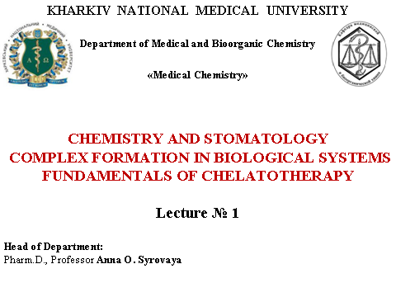

Slide 2
PLAN OF LECTURE
Complex compounds (C.C.)
Complexing agents. Ligands. Structure of C.C. Bonding in C.C.
Equilibria in the solution of C.C.
Stability of C.C.
4. Classification of C.C.
5. Nomenclature C.C. (by IUPAC)
6. Structure and isomerism of C.C.
7. Complexonometry. Biocomplexes. Chelatotherapy.

Slide 3

We must to know:
The bulding of complex compounds (C.C.)
The role of C.C. in the metabolism of the organism
The application of C.C. in medicine
Name the C.C., nomenclature of C.C., classification of C.C.
Biocomplexes
Complexonometry
Chelatotherapy

Slide 4
Complex compounds (coordination compounds) (C.C.)
are a special class of compounds, in which the central metal atom or ion is surrounded by oppositely charged ions or neutral molecules more than its normal valency.
C.C.
minerals
Present in the
plants
animals
Play many important functions
In biological systems:
iron
cobalt
magnesium
Heme (hemoglobin) is coordination compound of
Vitamin B₁₂ is
coordination compound of
Chlorophyll is
coordination
compound of

Slide 5


structure of complex compound
complex ion, inner sphere
K₃[Fe(CN)₆]
[Ag(CN)₂]⁻ C.n. for Ag⁺ = 2
[Cu(NH₃)₄]²⁺ C.n. for Cu²⁺ = 4
[Co(NH₃)₃Cl₃] C.n. for Co³⁺ = 6
ions of the outside sphere
complexing agent
(central metal atom or ion)
is the atom or cation to which one or more neutral molecules or anions are attached
coordination number (C.n.)
is the number of ligands surrounding the central ion (is the total number of
Ϭ-bonds formed by
Сomplexing agent + Ligands
ligands
are neutral molecules or ions attached
to the complexing agent

Slide 6
complexing agent (central ion)
Alkaline metals, alkaline-earth metals and cations form unstable complexes
Must to have free atomic orbitals
d- (Cu, Fe, Pt) and f-elements and their cations (atoms and cations of elements have small atomic radius and a big nuclear charge, because easy to polarize anions and molecule ligands, made => C.C.; p-elements (Al).
Atoms Cr, Co, Ni, Fe, Mn;
Cations Ag⁺,Au⁺,Cu⁺,Cu²⁺,Hg²⁺,Cd²⁺,Zn²⁺,Cr³⁺,Fe²⁺,Fe³+,Co²⁺,Ni²⁺
Complex ion: [Ni(NH₃)₆]²⁺ : Ni ²⁺ - central ion
[Cu(NH₃)₄]²⁺
K[Ag(CN)₂]

Slide 7
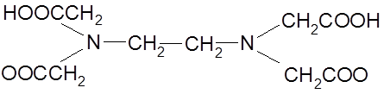
Ligands
are ions (anions)or neutral molecules attached to the complexing agent through coordinate bonds.
[Ni(NH₃)₆]²⁺
Central ion should have vacant orbitals.
The molecules of ammonia
are the ligands:
should have lone pairs of electrons in the outermost orbitals which can be donated to the central ion. The atom in the ligand which can donate the electron pairs is called donor atom.
Types of Ligands. Dentate of LIGANDS
How many σ-bonds building ligand by central ion?
monodentate (unidentate) ligands only one donor atom : (Cl-, F-, CN-, OH-) ions
(H₂O, NH₃, CO, С₆Н₆, С₆Н₅N) moleculs ;
bidentate ligands are two donor atoms and can coordinate to the central ion at 2 positions:
(NH₂ – CH₂ – CH₂ – NH₂), (CO₃²⁻, SO₄²⁻, С₂О₄²⁻), (Н₂N – NН₂)
Ethylenediamine ions Hydrazyn
polydentate ligands have more than 2 donor atoms
ethylenediaminetetraacetic acid is a tetradentate ligand (EDTA).
Bisodium salt of EDTA is used for treatment of hypercalcemia.

Slide 8
Coordination Sphere
My self work
Central metal atom and the ligands (molecules or ions) directly bonded to it is collectively known as coordination sphere. This part of the complex behaves as one unit and is non-ionizable. [Pt(NH₃)₄]²⁺ represents coordination sphere in the compound [Pt(NH₃)₄]Cl₂. The portion outside the square bracket (coordination sphere) is ionizable. Thus, the coordination compound [Pt(NH₃)₄]Cl₂ ionizes as:
[Pt(NH₃)₄]Cl₂ ↔ [Pt(NH₃)₄]²⁺ + 2Cl⁻
[Co(NH₃)₃Cl₃] does not ionize because there is no group outside the square bracket.

Slide 9
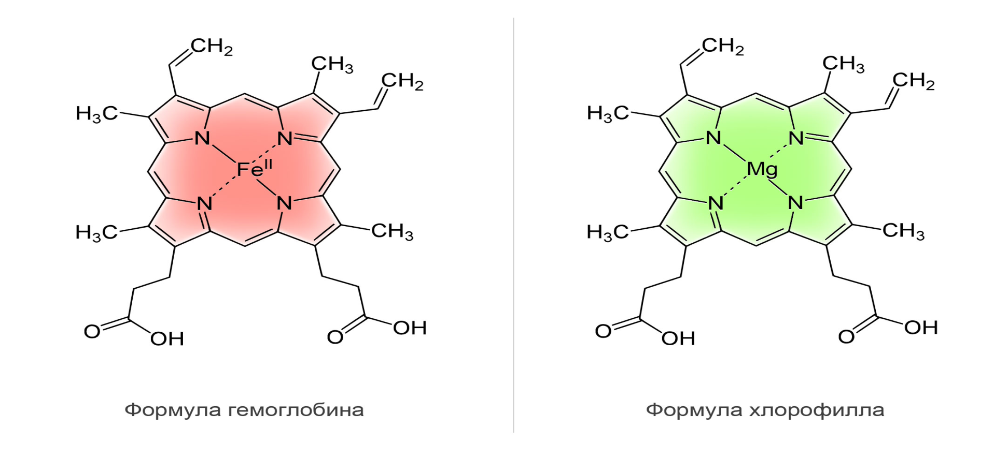
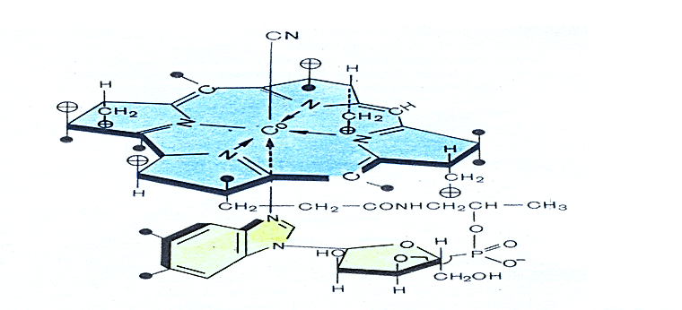
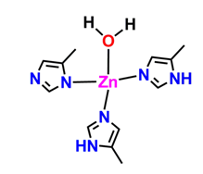
Heme
Chlorophyll
Vitamin B₁₂
Carboanhydrase

Slide 10
Metals coenzyme
Complex compound | Metal | Function
Hemoglobin, Myoglobin | Fe | Storage and transport of oxygen
Vitamin B₁₂ | Co | Regulation of hematopoiesis
Carbonic anhydrase | Zn | Regulation of blood acidity
Superoxide dismutase | Zn and Cu | Protection from toxic of free radical
Catalase Peroxidase | Fe | Decomposition of H₂O₂
Cytochromes | Fe | Transport of electrons in the electron transport chain of mitochondria
Alcohol dehydrogenase | Zn | Metabolism and oxidation of alcohols
Chlorophyll | Mg | Photosynthesis

Slide 11
Thank you for your attention!

