Slide 1
Trauma and ocular injuries

Slide 2
Classification of ocular trauma
EYELID TRAUMA
ORBITAL FRACTURES
TRAUMA TO THE GLOBE

Slide 3
Trauma can result in a wide spectrum of
tissue lesions of the globe, optic nerve,
and adnexa, ranging from the relatively
superficial to vision threatening

Slide 4
EYELID TRAUMA
A haematoma
is the most common result of blunt injury to the eyelid or forehead and is generally innocuous. It is, however, very important to exclude the following more serious conditions

Slide 5
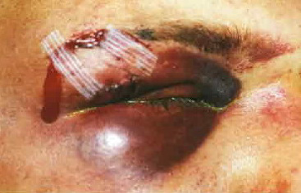
A) trauma to the globe or orbit. It is easier to examine the integrity of the globe before the lids become oedematous
EYELID TRAUMA (HAEMATOMA) causes

Slide 6
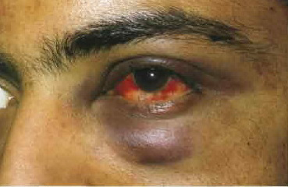
EYELID TRAUMA (HAEMATOMA) causes
B) Orbital roof fracture, if the haematomas eye is associated with a subconjunctival haemorrhage without a visible posterior limit

Slide 7
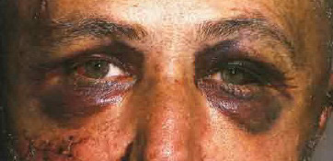
EYELID TRAUMA (HAEMATOMA) causes
C) Basal skull fracture, which may give rise to charac­teristic bilateral ring haematomas ('panda eyes’).

Slide 8
EYELID TRAUMA
II. Laceration
The presence of a lid laceration, however insignificant, mandates careful exploration of the wound and examination of the globe. Any lid defect should be repaired by direct horizontal closure whenever possible, even if under tension, since this affords the best functional and cosmetic results

Slide 9
EYELID TRAUMA
II. Laceration :
Superficial
Lid margin
Lacerations with tissue loss
Lacerations with extensive tissue loss
Canalicular lacerations

Slide 10
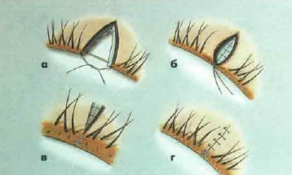
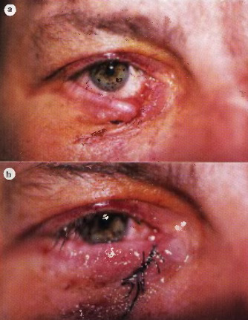
EYELID TRAUMA (Laceration)
Lid margin lacerations invariably gape and must therefore be very carefully sutured with perfect alignment to prevent notching.

Slide 11
Full thickness lid laceration, pre- and postoperatively – caused by a thrown glass

Slide 12
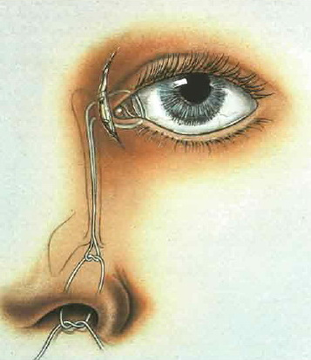
EYELID TRAUMA (Laceration)
Canalicular lacerations should be repaired within 24 hours. The laceration is bridged by silicone tubing, which is threaded down the lacrimal system and tied in the nose. The laceration is sutured. The tubing is left in situ for 3-6 months.

Slide 13
ORBITAL FRACTURES
Blow-out orbital floor fracture
Blow-out medial wall fracture
Roof fracture
Lateral wall fracture

Slide 14
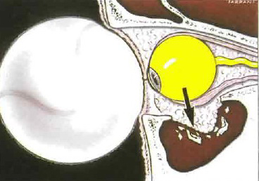
ORBITAL FRACTURES
Blow-out orbital floor fracture

Slide 15
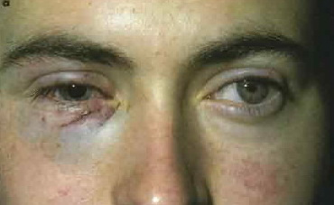
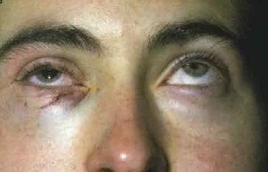
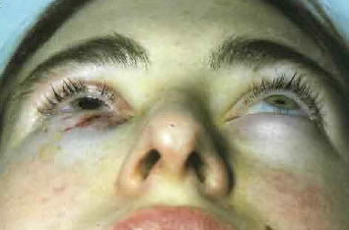
ORBITAL FRACTURES
Blow-out orbital floor fracture
Signs:
Periocular signs include variable ecchymosis, oedema and subcutaneous emphysema. Infraorbital nerve anaesthesia involving the lower lid, cheek, side of nose, upper lip, upper teeth and gums is very common because a blow-out fracture frequently involves the infraorbital canal. Diplopia, Enophthalmos

Slide 16
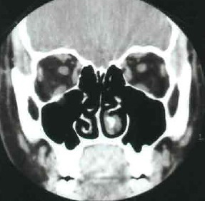
ORBITAL FRACTURES
Blow-out orbital floor fracture
Investigations:
CT with coronal sections

Slide 17
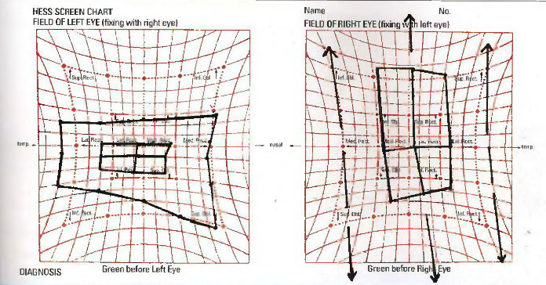
ORBITAL FRACTURES
Blow-out orbital floor fracture
Investigations: Hess test, Field of binocular vision

Slide 18
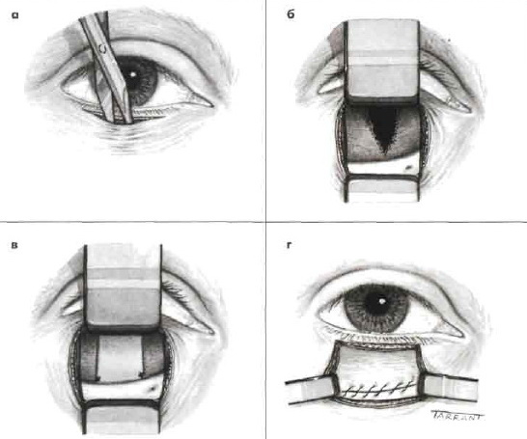
ORBITAL FRACTURES
Blow-out orbital floor fracture
Treatment:
Drugs (antibiotics)
Surgery

Slide 19
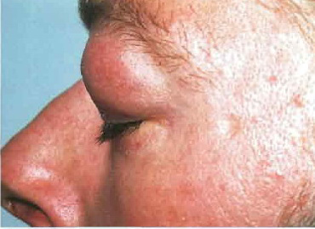
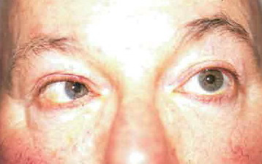
ORBITAL FRACTURES
Blow-out medial wall fracture
Signs:
Periorbital subcutaneous emphysema
Defective ocular motility involving adduction and abduction

Slide 20
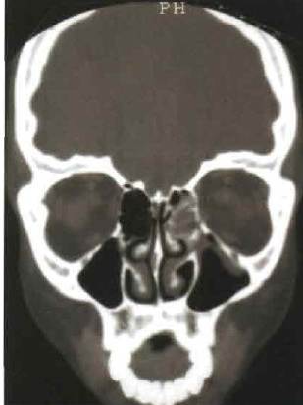
ORBITAL FRACTURES
Blow-out medial wall fracture
Treatment:
release of the entrapped tissue and repair of the bony defect.

Slide 21
ORBITAL FRACTURES
Roof fracture
Presentation is with a haematoma of the upper eyelid and periocular ecchymosis which develop after a few hours and may later spread to the opposite side.
Signs: inferior or axial displacement of the globe. Large fractures may be associated with pulsation of the globe unassociated with a bruit, best detected on applanation tonometry, if possible.
Treatment. Small fractures may not require treatment but it is important to observe the patient for the possibility of a CSF leak which may lead to meningitis. Sizeable bony defects with downwardly displaced fragments usually require reconstructive surgery.

Slide 22
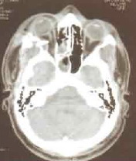
ORBITAL FRACTURES
Lateral wall fracture
Acute lateral wall fractures are rarely encoun­tered by ophthalmologists. Because the lateral wall of the orbit is more solid than the other walls, a fracture is usually associated with extensive facial damage.

Slide 23
TRAUMA TO THE GLOBE
Closed globe Open globe
Contusion Lamellar laceration
Laceration Rupture
Penetrating IOFB Perforating
IOFB - Intraocular foreign body

Slide 24
NB!
Precise determination of the zone of injury is frequently possible only after surgical exploration of the wound

Slide 25
OPEN GLOBE INJURY CLASSIFICATION
Type
A. Rupture
B. Penetrating
C. IOFB
D. Perforating
E. Mixed
Grade (Visual acuity)
A. 20/40
B. 20/50 to 20/100
C. 19/100 to 5/200
D. 4/200 to light perception
Pupil
A. Positive, relative APD in injured eye
B. Negative, relative APD in injured eye
Zones for open globe injury:
I. Cornea and limbus
II. Limbus to 5 mm posterior into sclera
III. Posterior to 5 mm from the limbus

Slide 26
CLOSED GLOBE INJURY CLASSIFICATION
Type
A. Contusion
B. Lamellar laceration
C. Superficial foreign body
D. Mixed
Grade (Visual acuity)
A. 20/40
B. 20/50 to 20/100
C. 19/100 to 5/200
D. 4/200 to light perception
Pupil
A. Positive, relative APD in injured eye
B. Negative, relative APD in injured eye
Zones for closed globe injury:
I. External (limited to bulbar conjunctiva, sclera,
cornea)
II. Anterior segment (includes structures of the
anterior segment and the pars plicata)
III. Posterior segment (all internal structures posterior
to the posterior lens capsule)

Slide 27
Etiology of GLOBE INJURY
Most of those injured are young with an average age around 30 years.
The workplace has traditionally been the most common site of ocular trauma.
Blunt objects are the most common cause for ocular trauma.
The typical objects are rocks, fists, baseballs, lumber, as opposed to fists, wood branches, rocks

Slide 28
and champagne corks

Slide 29

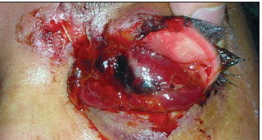
Firearms and guns are responsible for a very high percentage of serious ocular trauma

Slide 30
A. On the day of the injury B. Six weeks following the injury
Chorioretinitis sclopetaria in a 15-year-old boy after he was shot with an air gun from a distance of 15 meters.

Slide 31
TRAUMA TO THE GLOBE
General principles of management
Initial assessment should be performed in the following order:
Determination of the nature and extent of any life- threatening problems
History of the injury, including the circumstances, timing and likely object
Thorough examination of both eyes and orbits

Slide 32
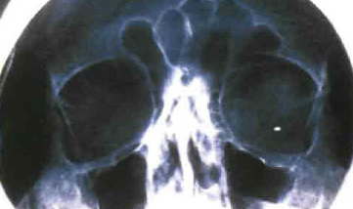
TRAUMA TO THE GLOBE
Special investigations:
plain radiographs

Slide 33
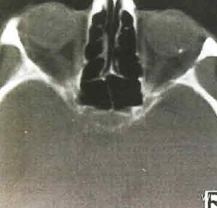
TRAUMA TO THE GLOBE
Special investigations:
CT
NB: MRI should never be performed if a metallic foreign body is suspected

Slide 34
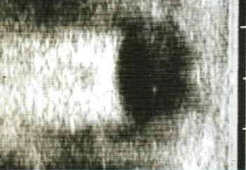
TRAUMA TO THE GLOBE
Special investigations:
Ultrasonography

Slide 35
Perforating wound due to a toy arrow fired from a crossbow

Slide 36
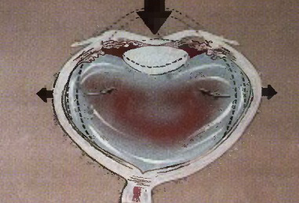
Blunt trauma
Anterior segment complications:
A corneal abrasion
Acute corneal oedema
Hyphaema
The anterior uvea
Ciliary shock
Cataract formation
Rupture of the globe

Slide 37
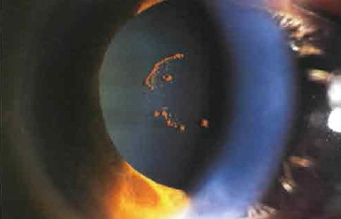
Blunt trauma
Anterior segment complications:
Pigment of iris imprinting on the anterior lens capsule (Vossius ring)

Slide 38
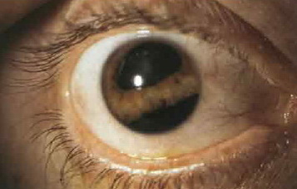
Blunt trauma
Iridodialysis is a dehiscence of the iris from the ciliary body at its root.

Slide 39
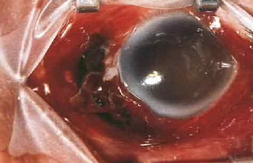
Blunt trauma
Anterior segment complications:
Rupture of the globe

Slide 40
Blunt trauma
Posterior segment complications:
Posterior vitreous detachment
Concussion of the sensory retina
Choroidal rupture
Retinal breaks
Optic neuropathy

Slide 41
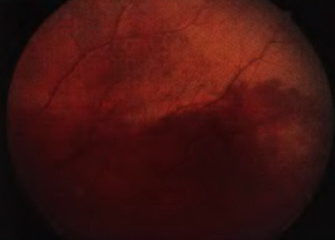
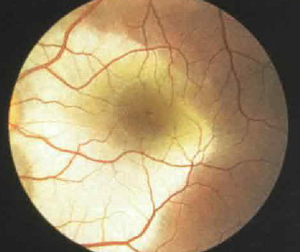
Blunt trauma
Posterior segment complications:
concussion of the sensory retina
Blunt trauma

Slide 42
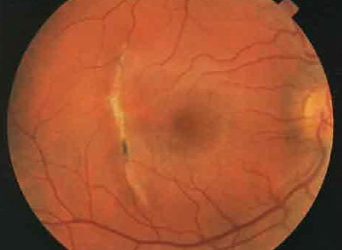
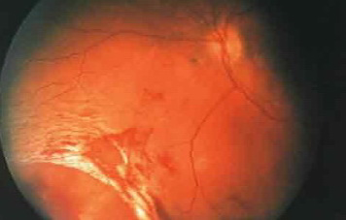
Blunt trauma
Posterior segment complications:
Retinal breaks

Slide 43
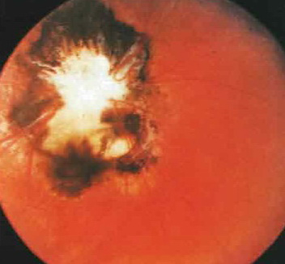
Blunt trauma
Posterior segment complications:
Optic neuropathy

Slide 44
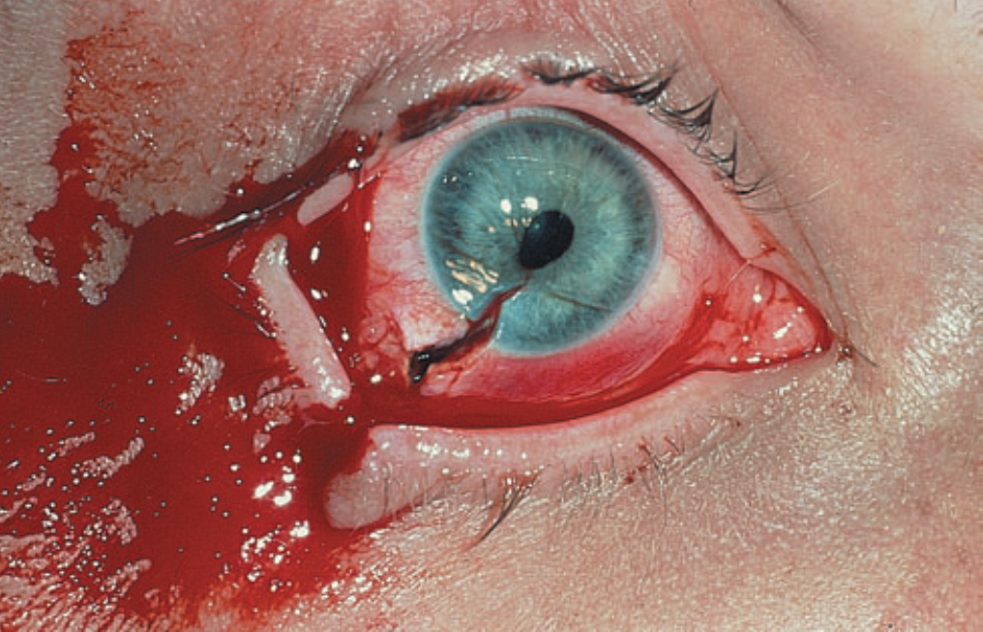
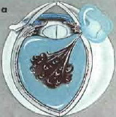
Penetrating trauma
Penetrating injuries are three times more common in males than females, and in the younger age group.

Slide 45
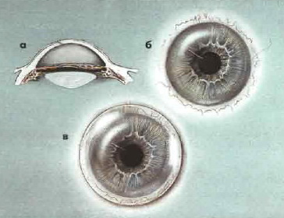
Penetrating trauma
Principles of primary repair:
a soft bandage contact lens using

Slide 46
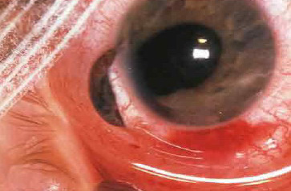
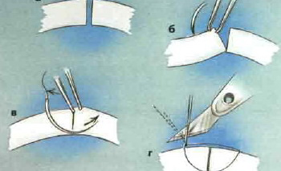
Penetrating trauma
Principles of primary repair:
Suturing of medium-sized corneal lacerations

Slide 47




Penetrating trauma before surgery after surgery

Slide 48
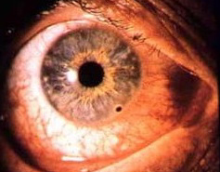
Extraocular foreign bodies

Slide 49
Extraocular foreign bodies
Management. Careful slit-lamp examination is essential to locate the exact position and depth of the foreign body. The foreign body is removed under slit-lamp visualization using a sterile needle. Magnetic removal may be useful for a deeply embedded metallic foreign body. A residual 'rust ring", is easiest to remove with a sterile ‘burr’. Antibiotic ointment is instilled together with a cycloplegic.

Slide 50
Conjunctival laceration and wooden fragments from a tree branch – be aware of underlying scleral rupture

Slide 51
Intraocular foreign bodies
An intraocular foreign body may traumatize the eye mechanically, introduce infection or exert other toxic effects on the intraocular structures. Once in the eye, the foreign body may lodge in any of the structures it encounters: thus it may be located anywhere from the anterior chamber lo the retina and choroid. Notable mechanical effects include cataract formation secondary to capsular injury, vitreous liquefaction, and retinal haemorrhages and tears. Stone and organic foreign bodies are particularly prone to result in infection. Many substances including glass, many plastics, gold and silver are inert. However, iron and copper may undergo dissociation and result in siderosis and chalcosis respectively.

Slide 52
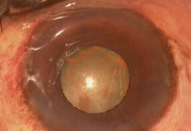
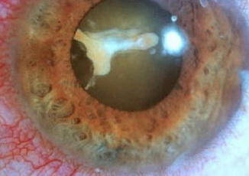
Siderosis

Slide 53
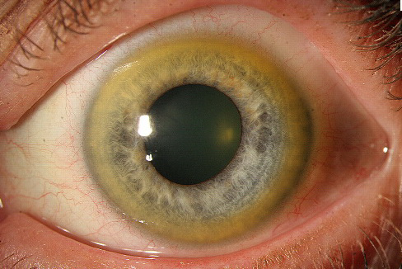
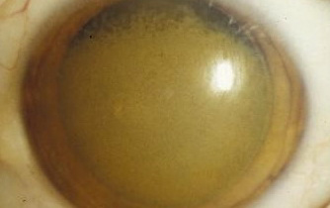
Chalcosis

Slide 54
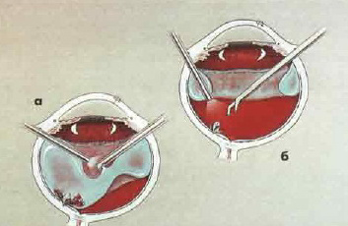
Intraocular foreign bodies
Technique of removal

Slide 55
Sympathetic ophthalmitis
Sympathetic ophthalmitis is a very rare, bilateral, granulo­matous panuveitis which occurs after penetrating ocular trauma usually associated with uveal prolapse or, less frequently, following intraocular surgery. The traumatized eye is referred to as the exciting eye and the fellow eye, which also develops uveitis, is called the sympathizing eye.

Slide 56
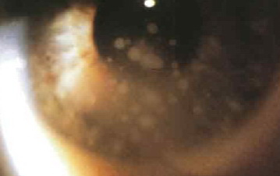
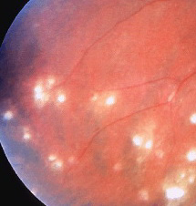
Sympathetic ophthalmitis
Signs.
Chronic granulomatous anterior uveitis with iris nodules and mutton fat keratic precipitates. Optic disc swelling and multifocal choroiditis involve the entire fundus

Slide 57
Sympathetic ophthalmitis
Treatment with systemic steroids is usually effective and the long-term visual prognosis good. A variety of steroid- sparing immunosuppressive agents are also beneficial.

Slide 58
CHEMICAL BURNS
Causes. Chemical injuries range in severity from trivial to potentially blinding. The majority are accidental and a few the result of assault. Two-thirds of accidental burns occur at work and the remainder at home. Alkali burns are twice as common as acid burns since alkalis are more widely used at home and in industry. Alkalis tend to penetrate deeper than do acids, which coagulate surface proteins, resulting in a pro­tective barrier.

Slide 59
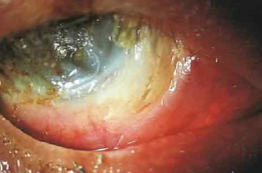
CHEMICAL BURNS
The most common involved alkalis are ammonia, sodium hydroxide and lime. Ammonia and sodium hydroxide may produce severe damage because of rapid penetration.

Slide 60
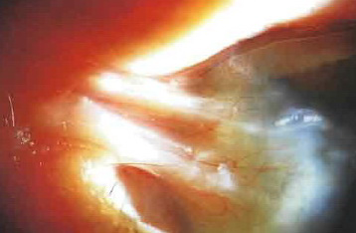
CHEMICAL BURNS
The commonest acids implicated are sulphuric, sulphurous, hydrofluoric, acetic, chromic and hydrochloric.
Hydrochloric aid used in glass etching and cleaning also tends to rapidly penetrate the eye, while sulphuric acid may be complicated by thermal effects and high-velocity impact after car battery explosions.

Slide 61
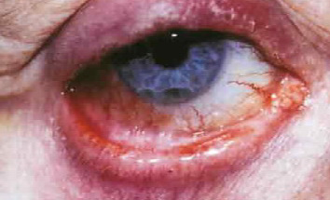
CHEMICAL BURNS
Grading of severity
Grade I: clear cornea and no limbal ischaemia (excellent prognosis).
Grade II: hazy cornea but with visible iris details and less than one-third (120°) of limbal ischaemia (good prognosis).
Grade III: total loss of corneal epithelium, stromal haze obscuring iris details and between one-third and half (120° to 180°) of limbal ischaemia (guarded prognosis).
Grade IV: opaque cornea and more than half (>180°) of limbal ischaemia (very poor prognosis).

Slide 62
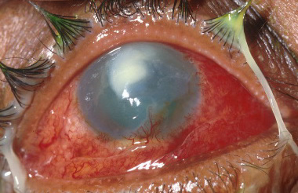
CHEMICAL BURNS
Medical treatment
Steroids
Ascorbic acid
Citric acid
Tetracyclines

Slide 63
CHEMICAL BURNS
Early surgery:
advancement of Tenon capsule and suturing to the lim­bus;
limbal stem cell transplantation;
amniotic membrane grafting.

Slide 64
CHEMICAL BURNS
Late surgery:
division of conjunctival bands and symblepharon;
conjunctival or mucous membrane grafts;
correction of eyelid deformities;
keratoplasty;
keratoprostheses.

Slide 65


