Slide 1
Kharkov National
Medical University
Department of
Histology, cytology and embryology

Slide 2
GENERAL HISTOLOGY
Study of Tissues
Epithelia and Glands
MUSCLE

Slide 3
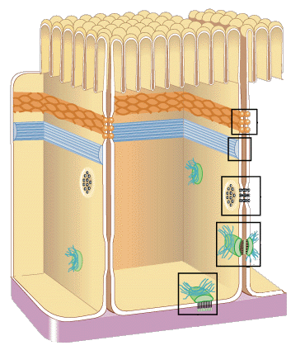
The Tissue is
The group of similar cells
having:
  common embryonic origin
  common function
  common structure

Slide 4
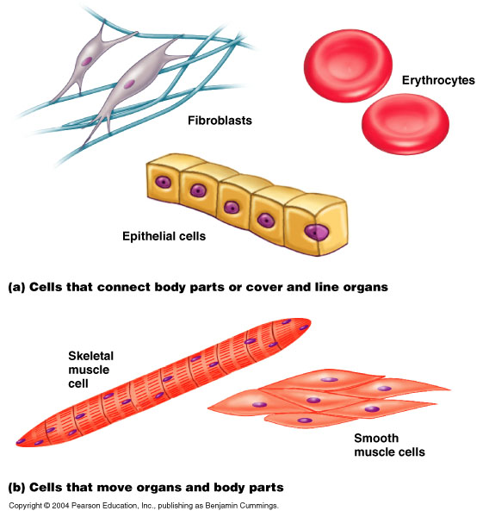
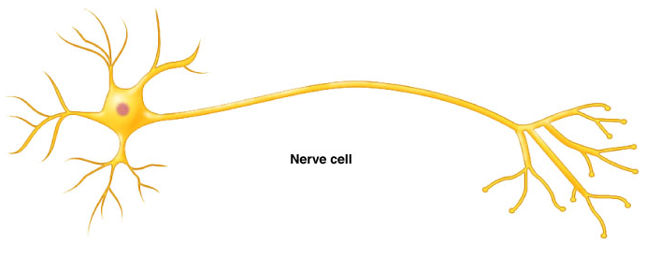
4 Basic Tissues
Epithelial Tissue
  covers surfaces, lines hollow
  organs, forms glands
Connective Tissue
  supports and feeds structures
  provides immunity to disease
Muscle Tissue
  produces movement
Nerve Tissue
  conducts nerve impulses

Slide 5
Epithelial Tissue
FITURES:
Closely packed cells that form sheets (of single or multiple layers) which are attached to a basement membrane
Polarity. Epithelial cells have an apical (free) surface, which is exposed to body cavity, or exterior of body, and a basal surface

Slide 6
Cell junctions are plentiful
Epithelia are avascular, blood vessels are located in the underlying connective tissue
Epithelia have a high capacity for renewal (high mitotic rate)

Slide 7
Embryonic origin :
Germ layers of the embryo
  endoderm
  mesoderm
  ectoderm

Slide 8
Epithelial functions:
protection
secretion
digestion
absorption
excretion
transportation
sensory reception

Slide 9
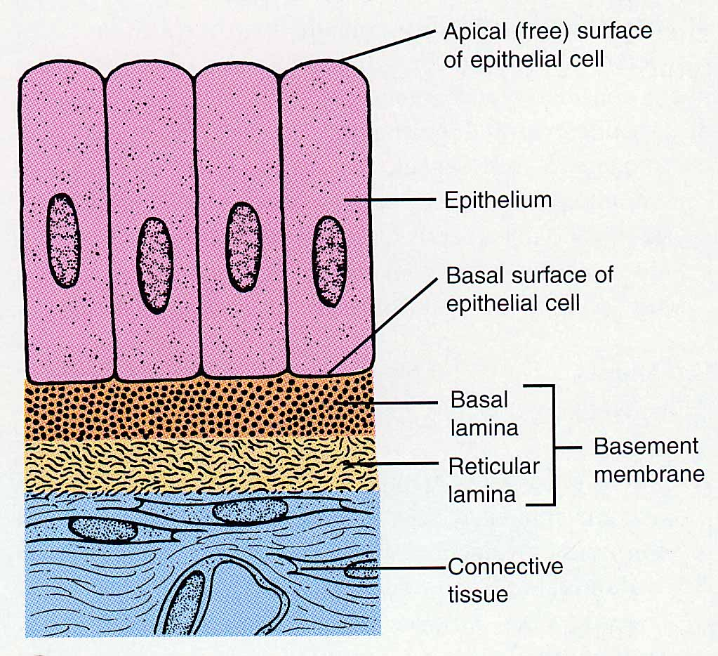
Epithelial Tissues and Their Basement Membrane

Slide 10
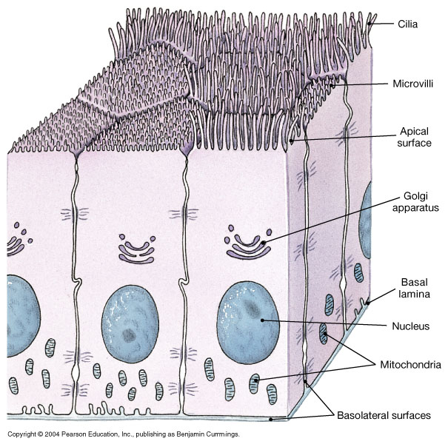
The Polarity of Epithelial Cells

Slide 11
Cells are connected with each other with junctions:
  Tight junctions
  Desmosomes
  Hemidesmosomes
  Gap junctions

Slide 12
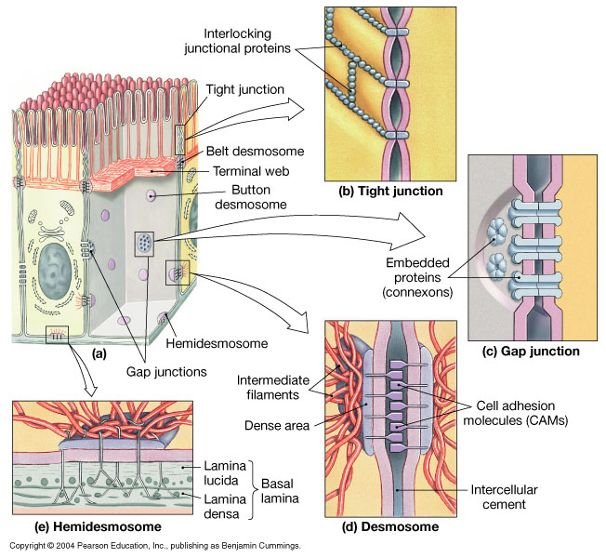
Intercellular junctions

Slide 13
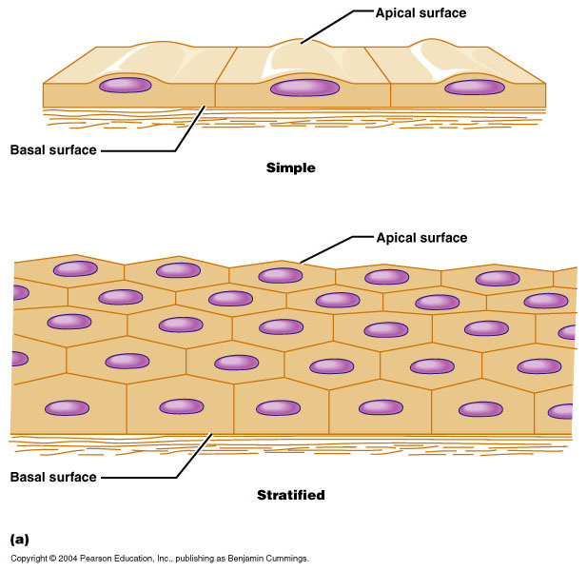
CLASSIFICATION OF E.
Cell layers
Simple epithelia
  Single cell layer
Stratified epithelia
  Two or more cell layers

Slide 14
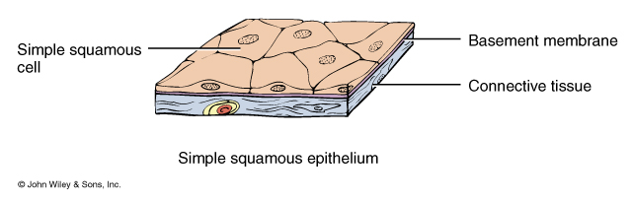
Simple Squamous E.
Single layer of flat cells
  lines blood vessels (endothelium), closed body cavities (mesothelium)
  very thin --- controls diffusion, osmosis

Slide 15
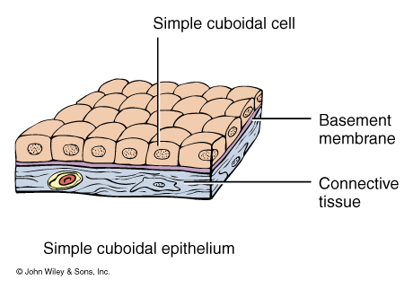
Simple Cuboidal E.
Single layer of cube-shaped cells.
- Kidneys, glands

Slide 16
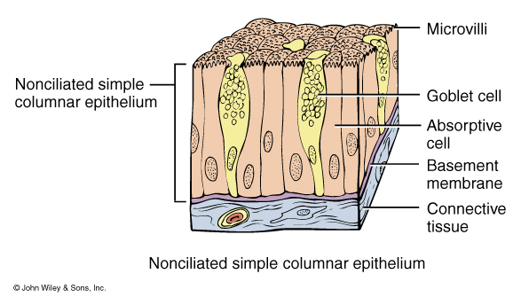
Simple Columnar E.
Goblet cells secrete mucus
  lubricate GI, reproductive and urinary systems
Microvilli = fingerlike projections of cell membrane
Absorption

Slide 17
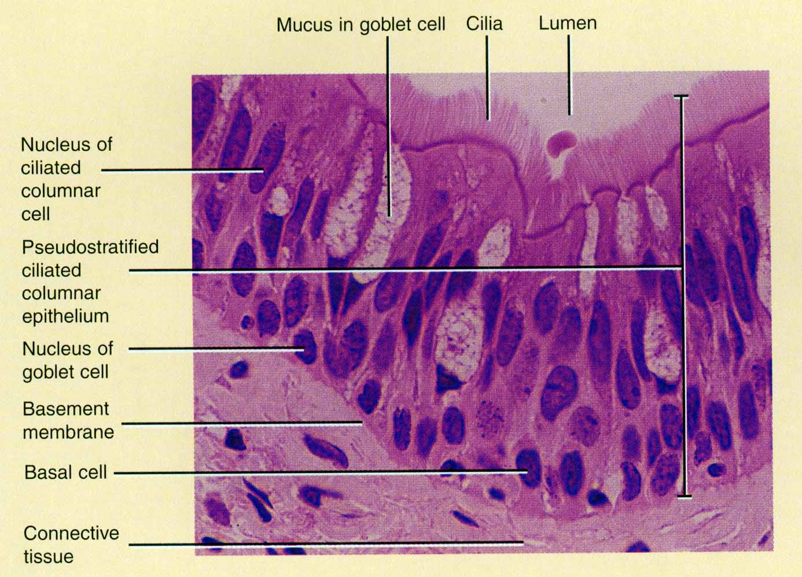
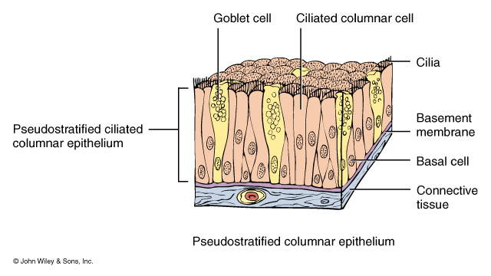
Pseudostratified Columnar E.
Single cell layer
All cells attach to basement membrane but not all reach free surface
Nuclei at varying depths
- Respiratory system

Slide 18
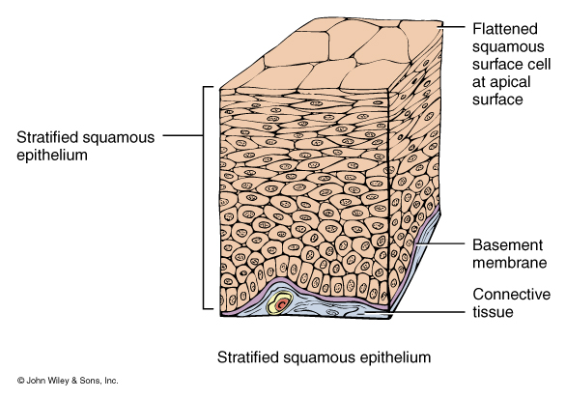
Stratified Squamous E.
Several cell layers thick
Surface cells flat
Keratinized = surface cells dead and filled with keratin
  Skin
Nonkeratinized = all cells are living
  Cornea, oral

Slide 19
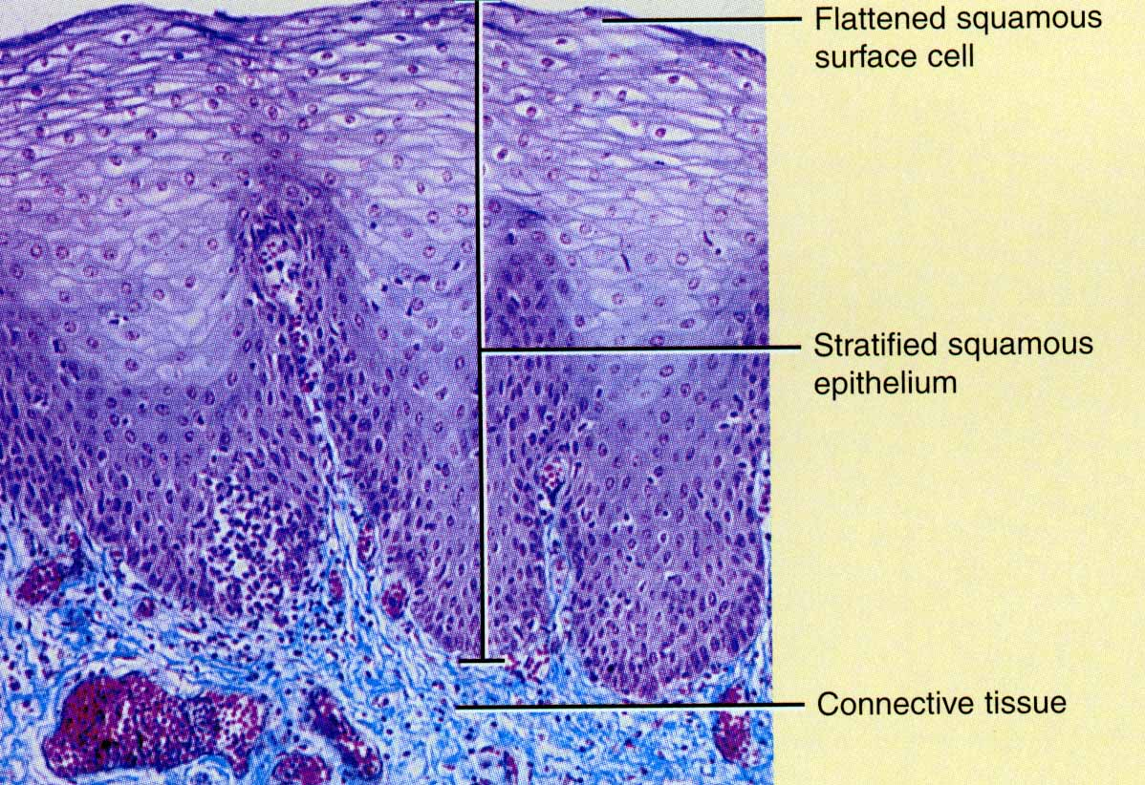
Example of Stratified Squamous
Section of vagina

Slide 20
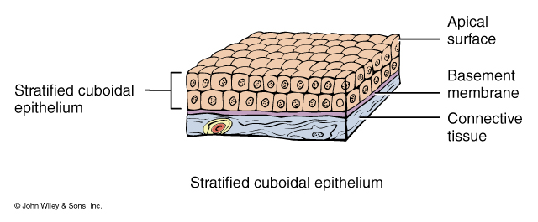
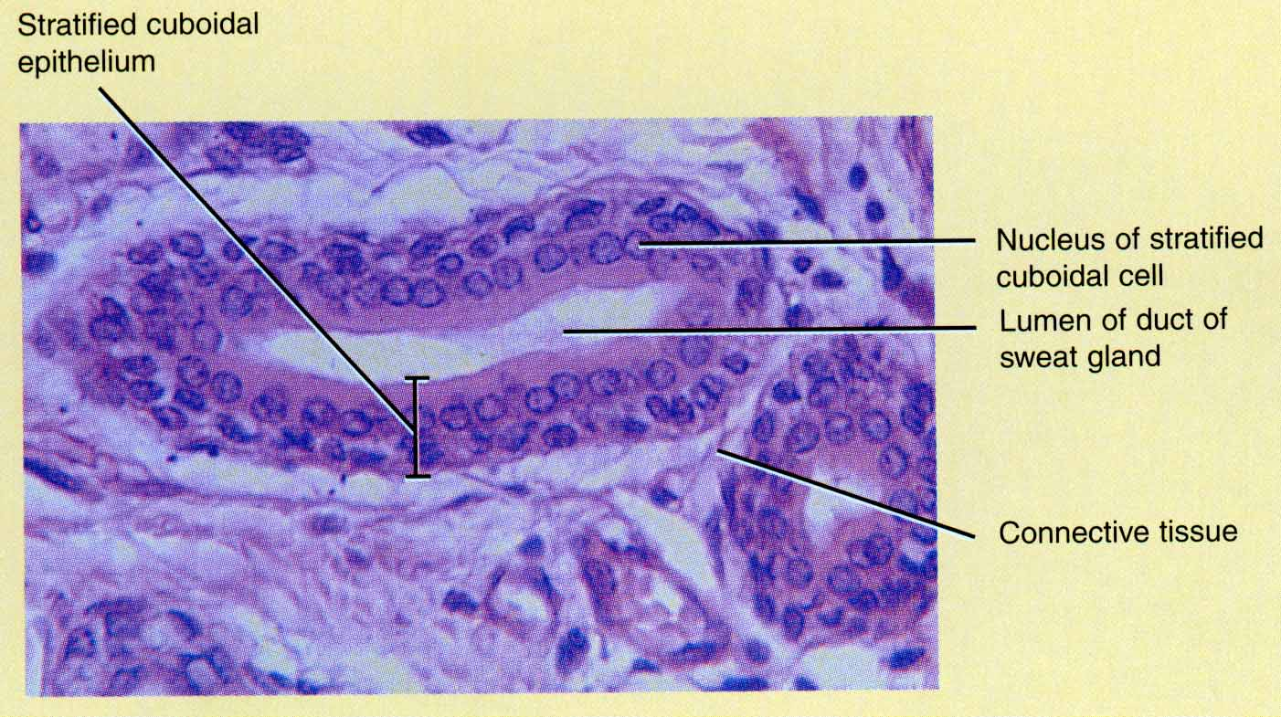
Stratified Cuboidal E.
Surface cells cuboidal
Only in sweat gland ducts & male urethra

Slide 21
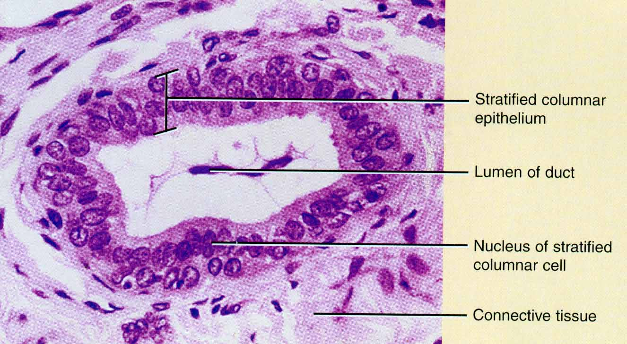
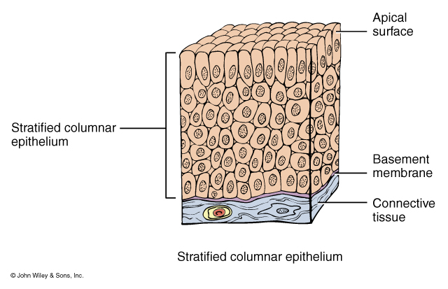
Stratified Columnar E.
Surface cells columnar
Rare (very large ducts & part of male urethra)

Slide 22
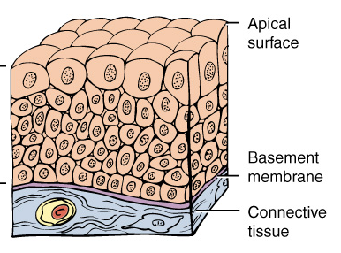
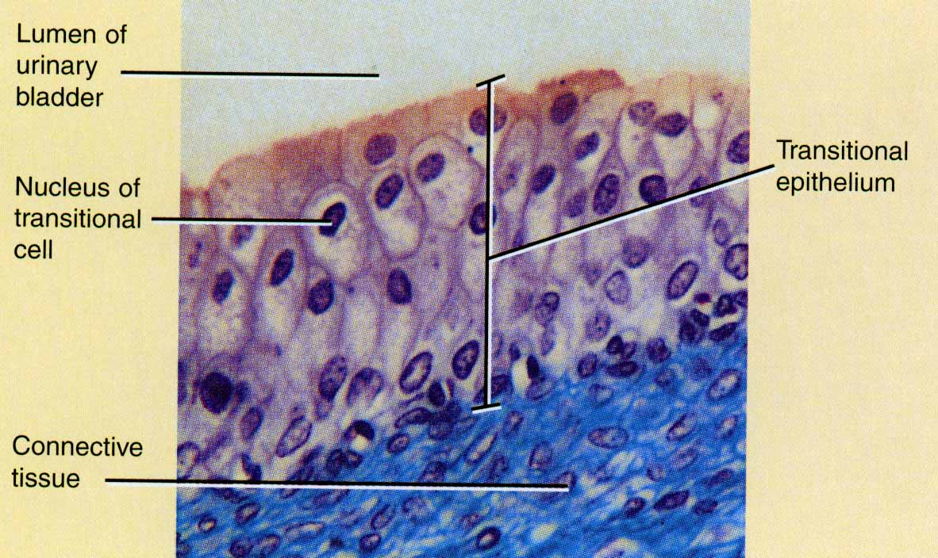
Transitional E.
Multilayered
Surface cells varying in shape from round to flat if stretched
- urinary tract

Slide 23
GLANDULAR E.
A gland consists of one or more cells that produce and secrete a product (secretion)

Slide 24
There are two types depending on how the
cells release the substances they
produce:
Exocrine glands and
endocrine glands

Slide 25
Endocrine glands
called “ductless glands” discharge their secretions into the blood.
These secretions are hormones,
which regulate some body functions.
(study later)

Slide 26
Exocrine glands secrete into ducts.
Their secretions include
mucus, sweat, oil, ear wax
and digestive enzymes.

Slide 27
Exocrine glands
Unicellular Gland:
Goblet cell
Goblet Shaped
In epithelia of
intestinal
and respiratory
tracts
Produce mucin
  Protects and
  lubricates

Slide 28
Exocrine glands
Multicellular Glands
Two parts:
  Excretory duct (branched - compound,
  unbranched – simple)
  Secretory unit (secretory portion, end piece)
  (branched, unbranched);
  (tubular, alveolar (acinar)

Slide 29
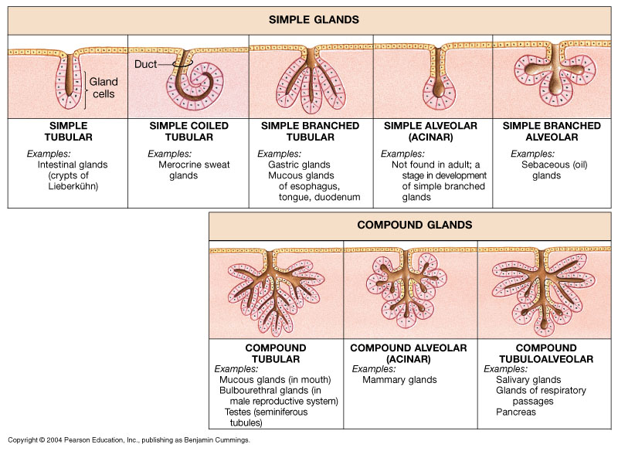
A Structural Classification of Exocrine Glands

Slide 30
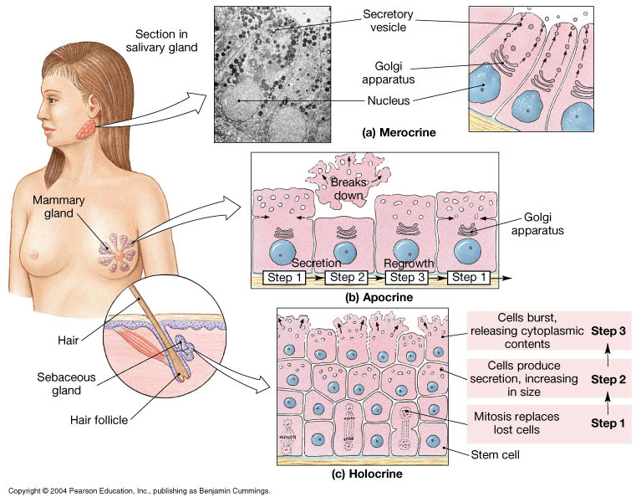
Mechanisms of Glandular Secretion

Slide 31
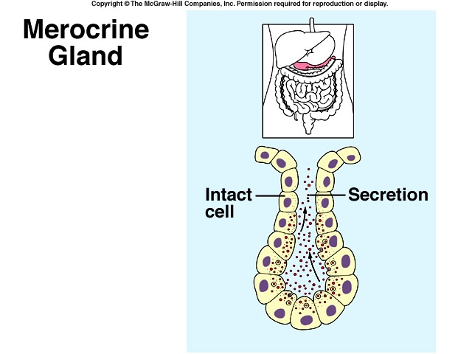

Slide 32
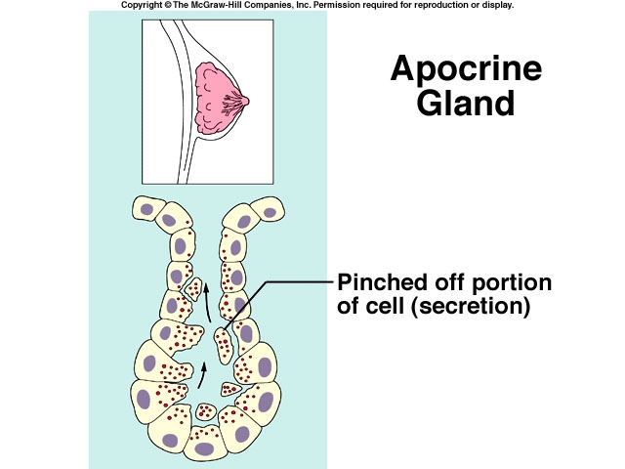

Slide 33
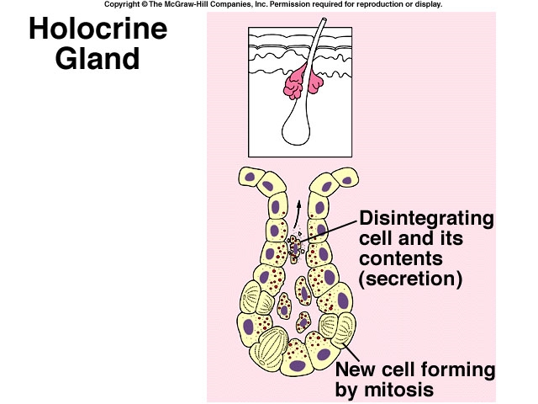

Slide 34
II. Muscle tissue
Cells that shorten
Provide us with motion, posture and heat
Types of muscle
  skeletal muscle striated
  cardiac muscle
  smooth muscle

Slide 35
Why do MUSCLES contract?
Muscle cells have contractile proteins -
actin and myosin,
and some another …

Slide 36
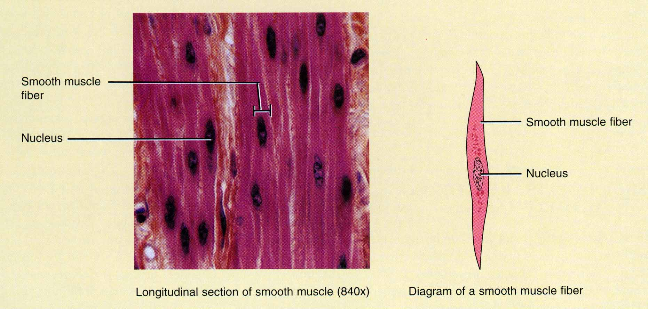
Smooth Muscle
Spindle shaped cells with a single central nuclei
Walls of hollow organs (blood vessels, GI tract, bladder)
Involuntary and nonstriated

Slide 37
Contraction
Can remain in a state of contraction for long periods.
Contraction is usually slow.

Slide 38
Origin
Smooth muscle cells arise from mesenchyme.
Regeneration
Very good regenerates.

Slide 39
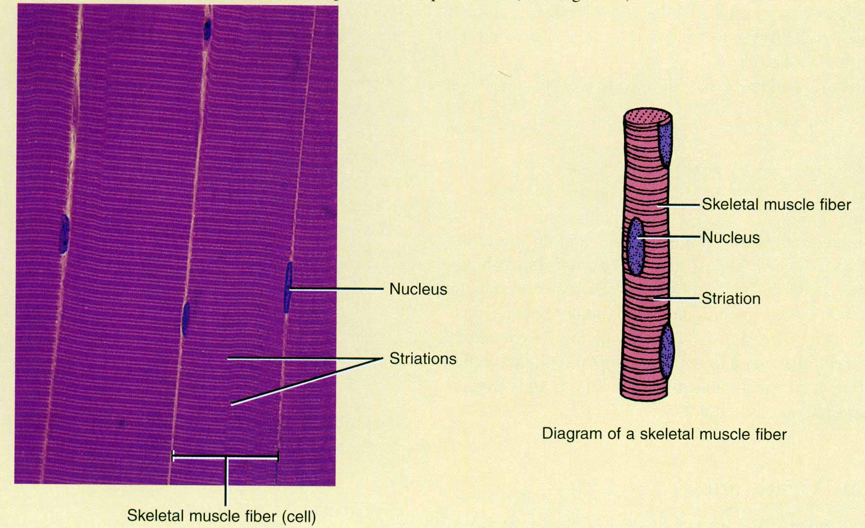
Skeletal Muscle
Cells are long cylinders (fiber – symplastum) with many
peripheral nuclei
Visible light and dark banding (striated)
Voluntary control

Slide 40
SKELETAL MUSCLE
Cross and
Longitudinal

Slide 41
Why do MUSCLES contract?
Actin and myosin form special organelles –
myofibrils,
responsible for muscle contraction

Slide 42
MF
has "bands“ :
I-band - actin filaments,
A-band - myosin filaments which overlap with actin filaments,
MF consists of units – sarcomeres
Each sarcomere shotens – the fiber contracts

Slide 43
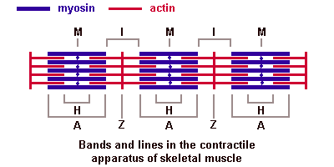
Mechanism of contraction
Sliding filaments model
From Z to Z is sarcomere

Slide 44
Types of fibers: red and white
Red contain large amounts of myoglobin and mitochondria.
Contraction is slow. Back muscles, posture. Resistant to fatigue.
White contain less myoglobin. ATPase activity is high, contraction is fast. Muscles of our fingers.

Slide 45
Origin of skeletal muscle
Originate from the paraxial mesoderm - myotome.
Regeneration by Satellite cells
Satellite cells are small cells are closely apposed to muscle fibers within the basal lamina which surrounds the muscle fiber.

Slide 46
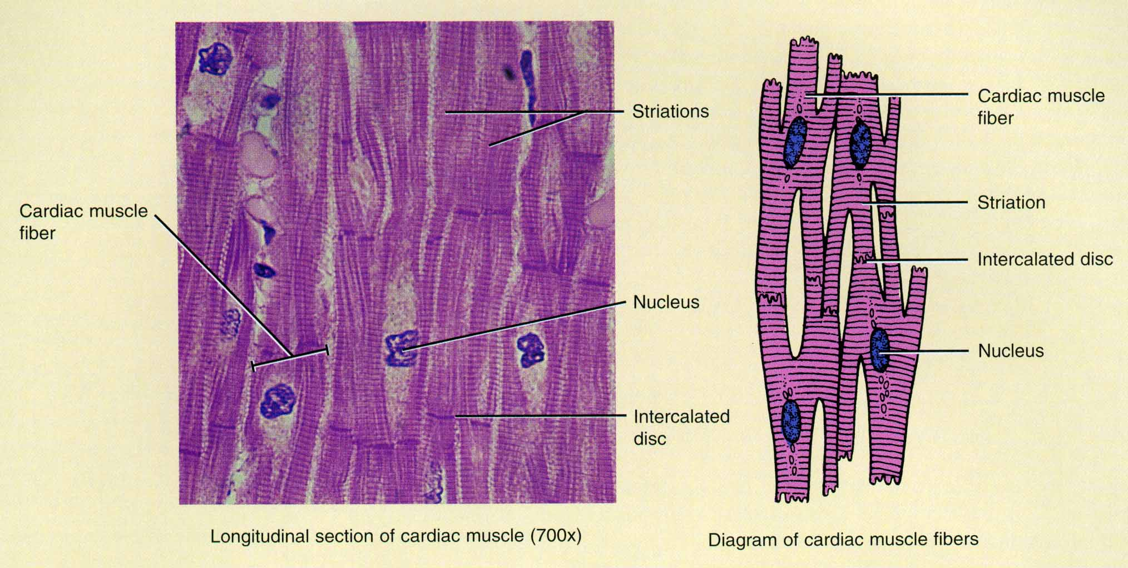
Cardiac Muscle
Cells are branched cylinders with one central nuclei
Involuntary and striated
Communicate with each other by intercalated discs and anastomoses

Slide 47
Cardiac muscle cells:
3 types:
Contractile,
Conducting
Secretory

Slide 48
Excitation in cardiac muscle is provided by:
Conducting myocytes
Or Purkinje fibres contain fewer myofibrils than contractile.
Purkinje fibres

Slide 49
CARDIAC MUSCLE
Regeneration – intracellular
Or
By connective tissue replacement

Slide 50
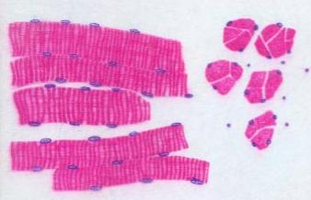
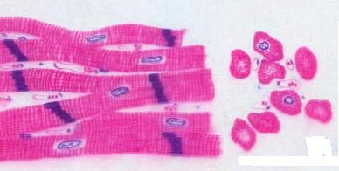
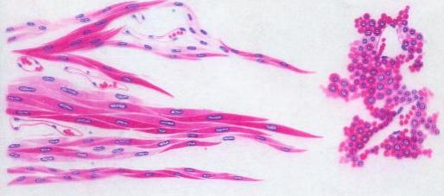
Comparison of 3 types
skeletal muscle cardiac muscle smooth muscle
Shape long cylindrical short cylindrical spindle
Nucleus many one(maybe2) one
at periphery at center at center
Cross-striation obvious dim none
Special structure triad intercalated disk dense pact, body
Nerve system cerebrospinal cerebrospinal autonomic autonomic

Slide 51
The End

