Slide 1



AUTOMATIC CREATION OF MASKS FOR MARKING MICROSCOPIC IMAGES OF THE EPITHELIUM OF THE PARANASAL SINUSES
Nechyporenko A.S., Hubarenko E.V., Gubarenko M.S.,
Kalnytska V.B., Alekseeva V.V., Gargin V.V.

Slide 2
Introduction
The results of the study in many sectors of medicine are based on a detailed study of images. Moreover, the correct assessment of the received data often depends on the large number of indicators. The need to evaluate medical images today is one of the priority tasks in radiology, pathomorphology, dentistry, otolaryngology and many other medical specialties. Such an assessment and interpretation of the results are most often carried out in manual mode.

Slide 3
The aim of our work
Was to propose software solution, which made it possible to radically reduce the time of creating masks for images and analyze the shortcomings of the automated creation of masks, as well as the directions of their solution

Slide 4
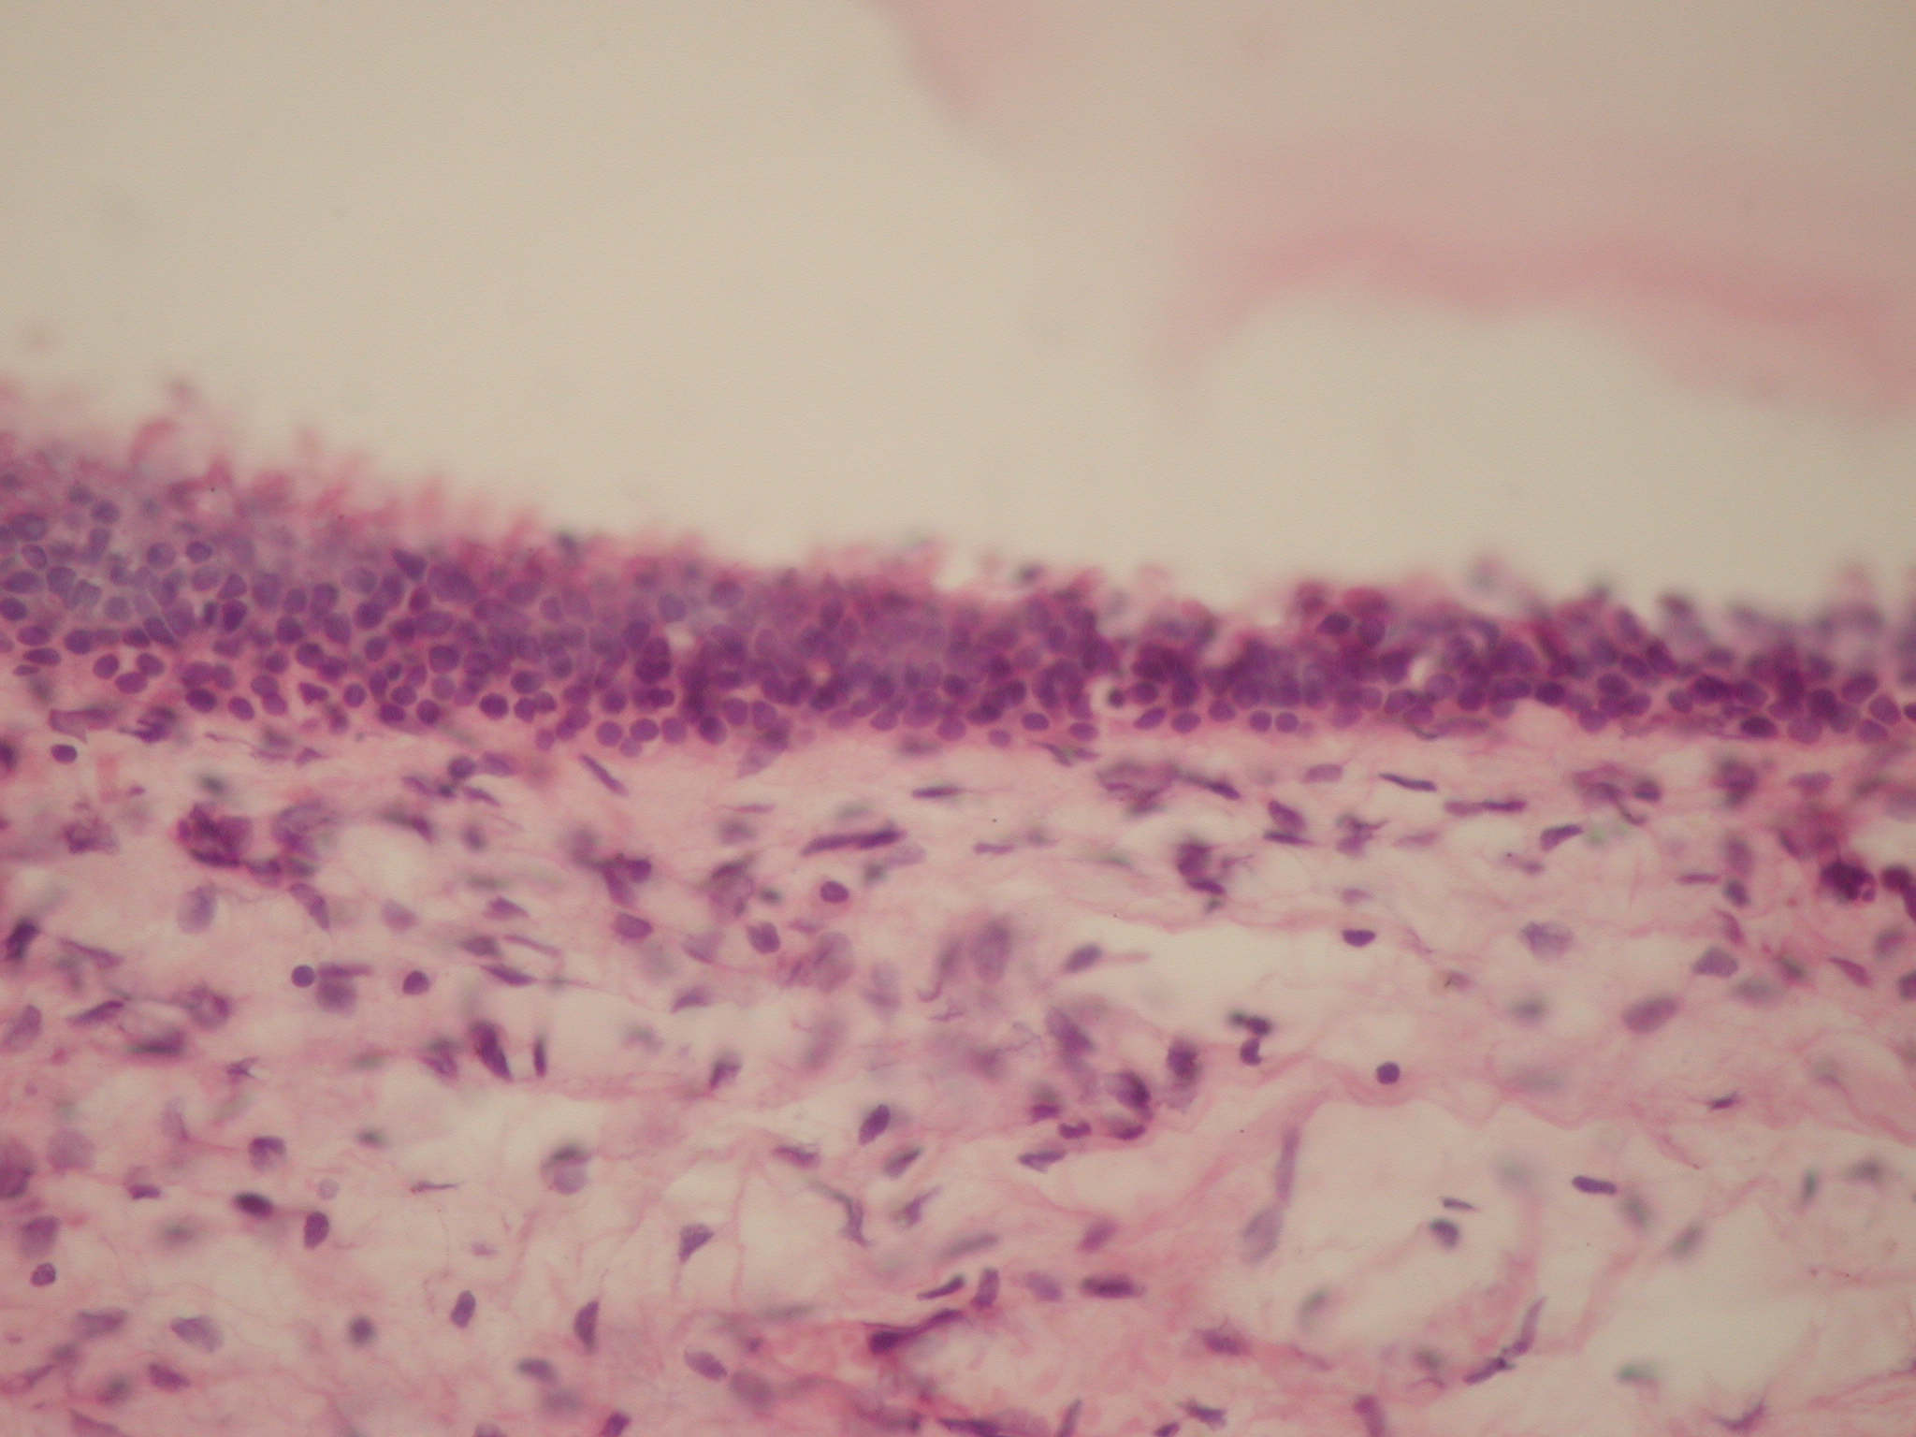
Material and methods
For the correct training of the neural network, it is necessary to organize its correct training. One of the ways of learning is to select an object in the image by using a mask or marking areas. Image Annotation is one of the main tasks in computer vision technology, and, consequently, in the development of artificial intelligence elements.
The study involved 25 male and female subjects who were distributed by sex and age according to the recommendations of the World Health Organization (WHO).
The specimens of soft tissues of the paranasal sinuses were stained with hematoxylin and eosin after the routine proceeding. The microscopic study was performed on an “Olympus BX-41” microscope with subsequent processing by “Olympus DP-soft version 3.2” software. Morphometric studies were performed in the zone of ostiomeatal complex which was chosen for morphological interpretation.
Figure1 : Mucous membrane of the paranasal sinus. H&E stain, x400.

Slide 5
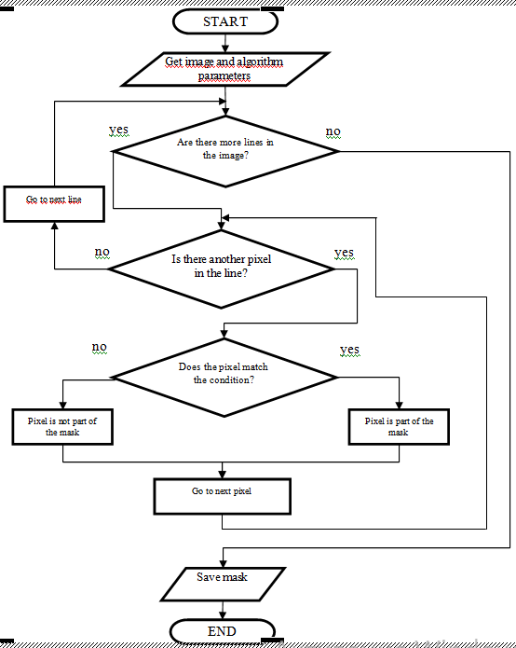
Material and methods
The image processing and mask creation method can be represented as a sequence of the following steps:
1. Determination of the preliminary characteristics of the image: resolution, color palette;
2. Setting the conditions for matching a pixel to a mask;
3. Iterating over all pixels of the image;
4. If the pixel meets the specified conditions, then it belongs to the mask, otherwise it is excluded from consideration.
The diagram of the algorithm for creating an image mask (Fig. 2) shows the algorithm of the software tool, however, the block “Does the pixel meet the condition?” needs further clarification. Based on the characteristics of the task and the images that form the DataSet, restrictions are imposed on the values ​​that the RGB (red, green, blue) channel parameters can take
Figure2: Diagram of the algorithm for creating an image mask

Slide 6
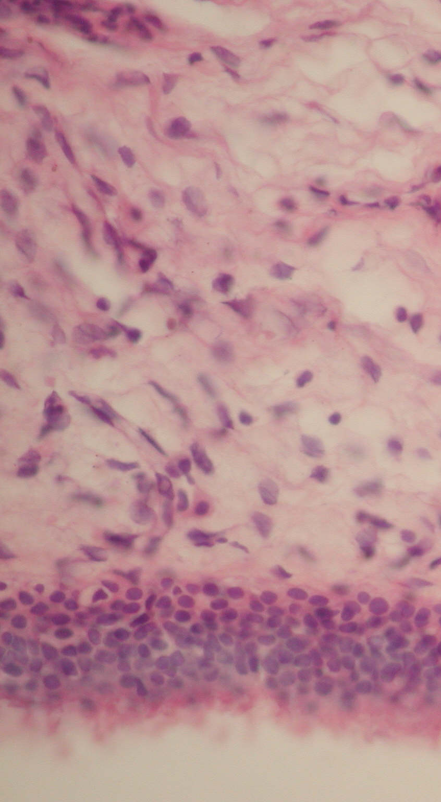
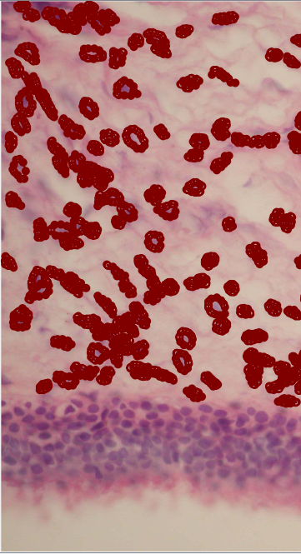
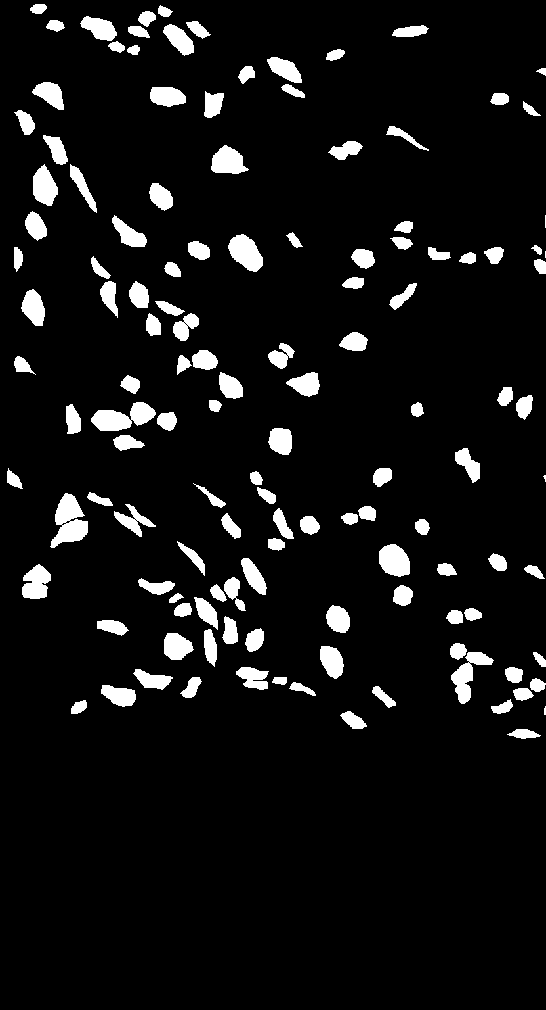
Results
Figure 3 shows: a – original image, b – labeling by a specialist, c – resulting mask.
Figure3: The result of obtaining an image mask for training a neural network.

Slide 7
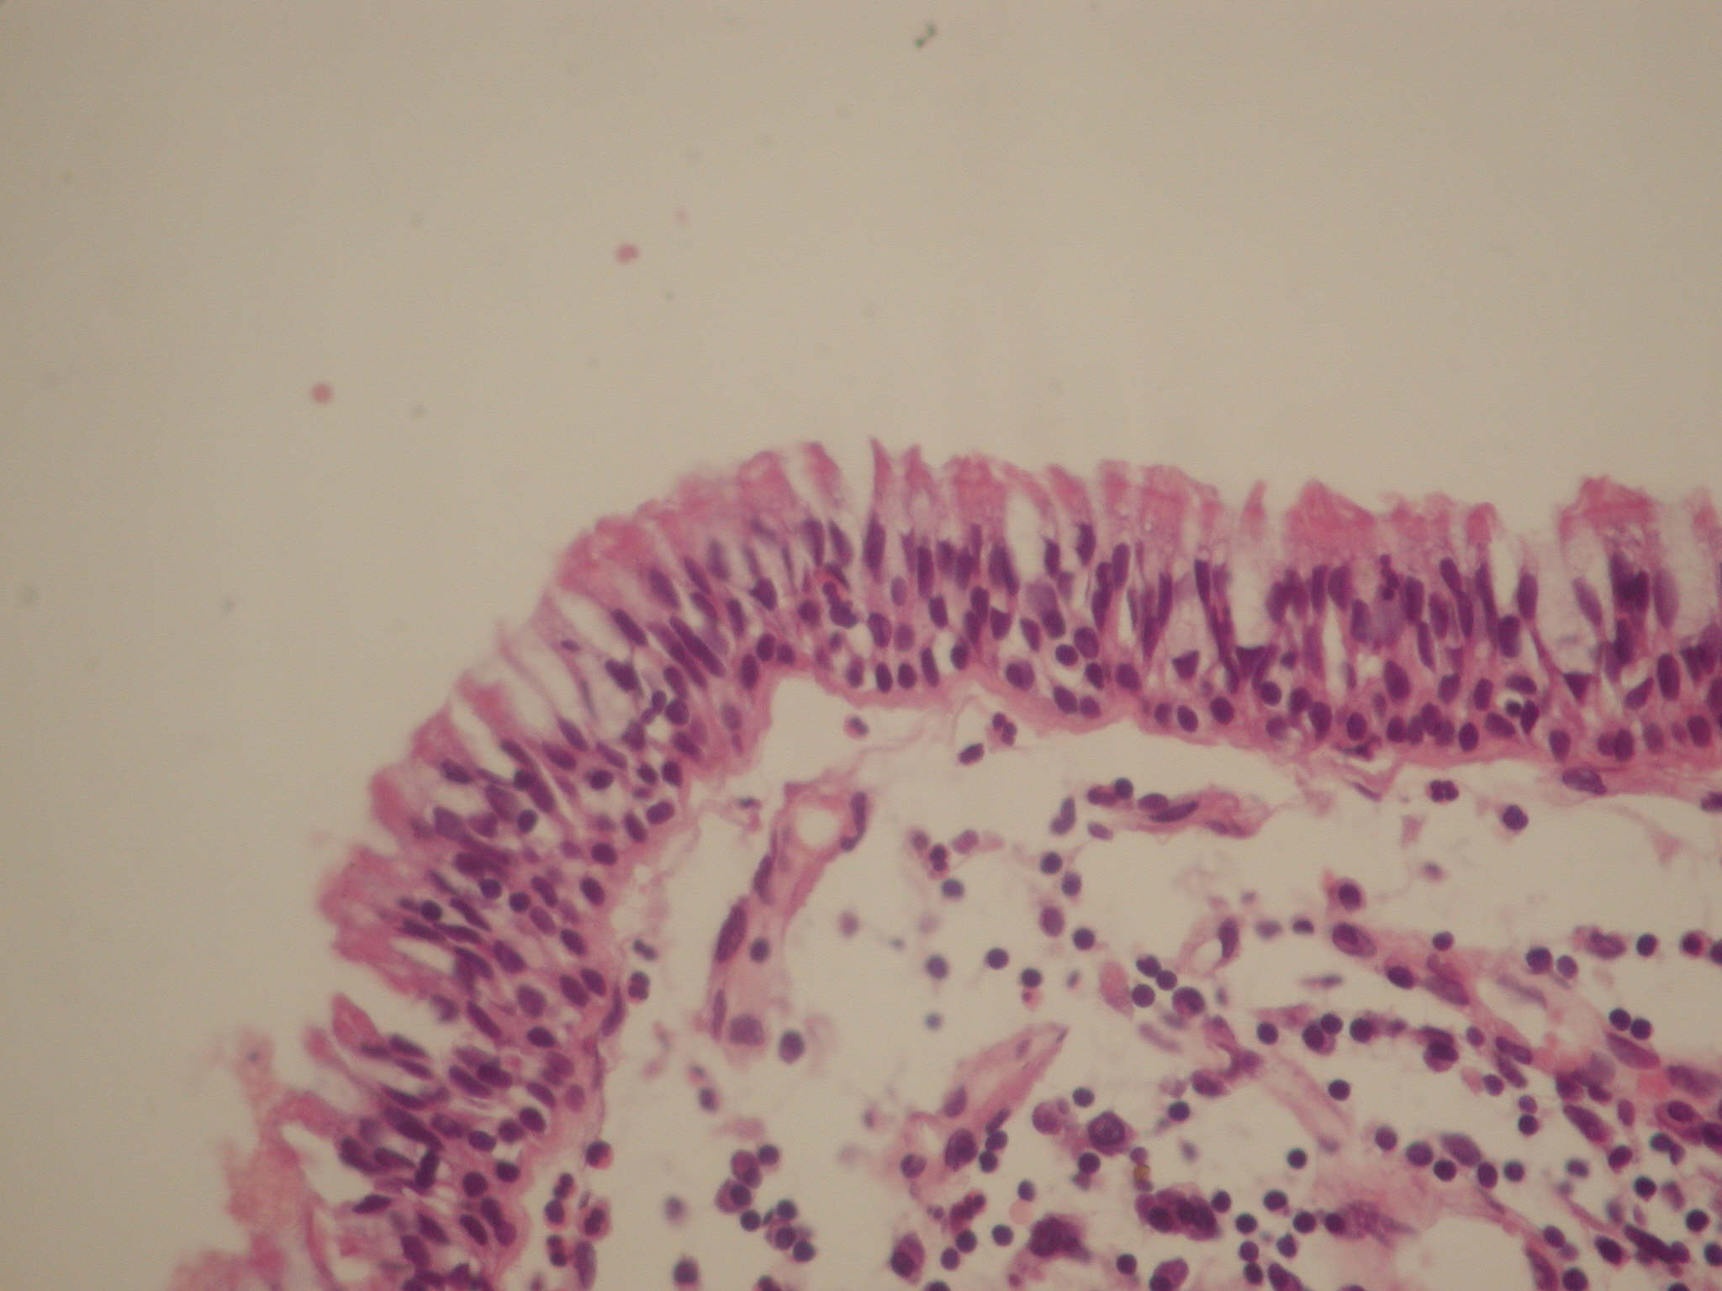
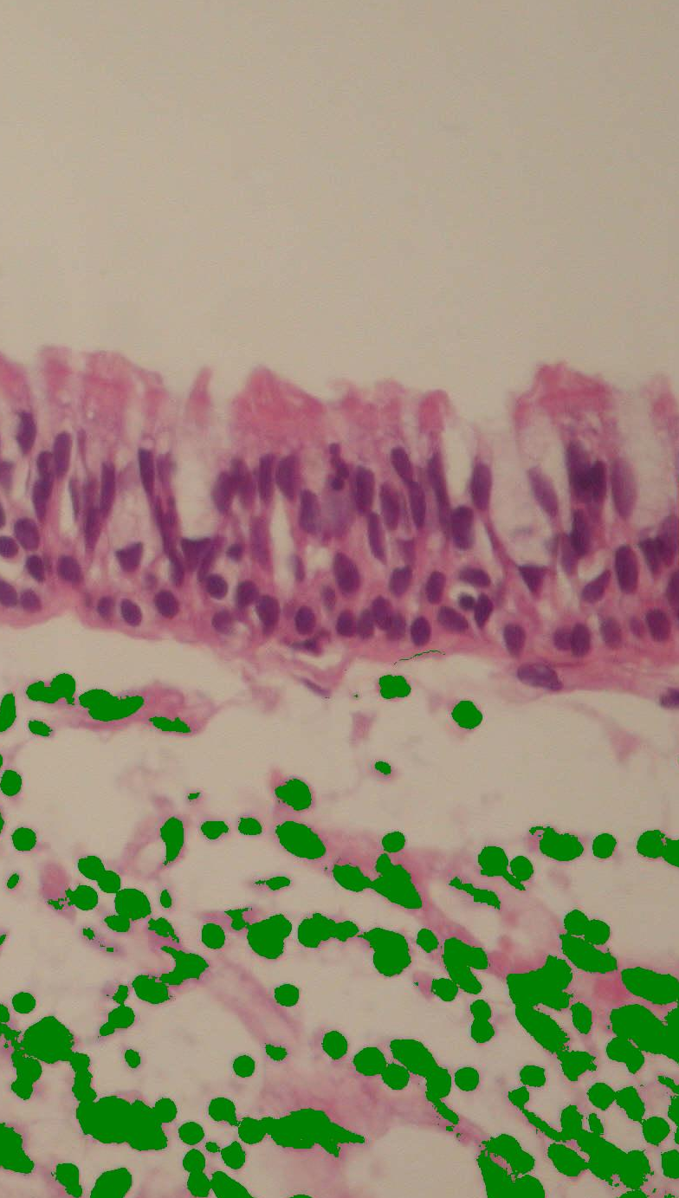
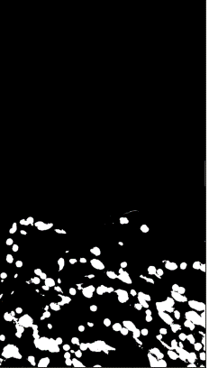
Results
Figure 4 shows the process of compiling an image mask for training a neural network using the developed software tool: a – the original image, b – labeling by a specialist, c – the resulting mask.
a)
b)
c)
Figure4: The result of obtaining an image mask for training a neural network using the developed software.

Slide 8


Results
Figure 5 shows the process of compiling an image mask for training a neural network using the developed software tool with a modernized algorithm: a – the original image, b – labeling by a specialist, c – the resulting mask
a)
b)
c)
Figure 5: The result of obtaining an image mask for training a neural network using the developed software tool with a modernized algorithm.

Slide 9
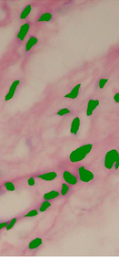
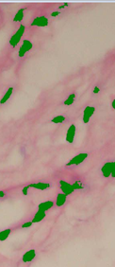
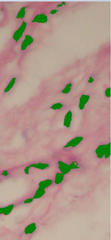
Results
Masks were made for 25 images. The result for various methods of obtaining image masks is shown in Fig. 6.
a)
b)
c)
Figure6: Comparison of masks a – mask made manually, b – mask made
with the help of software, c – mask made with the help of software during the upgrade.

Slide 10
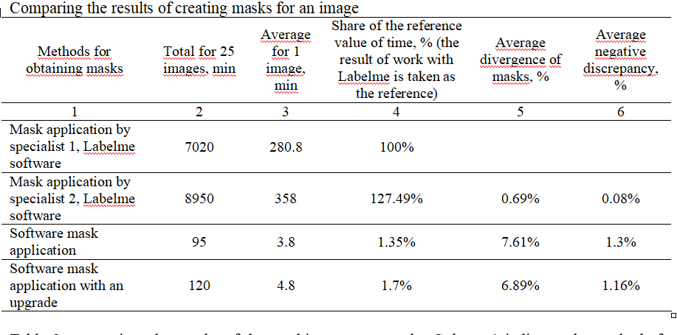
Results
Table 1
Table 1 summarizes the results of the masking process study. Column 1 indicates the methods for obtaining masks; two programs were taken that are usually used to create masks, the developed software and its modernization. The second column displays the total time it took to create masks for 25 images, the time is given in minutes. Column 3 provides average time spent processing one image, time given in minutes. Column 4 is the share of the reference value, % (the result of work with Labelme is taken as the reference), it is in the first position, clearly showing the savings in time and resources. Column 5 is the average discrepancy between the masks, the masks are compared pixel by pixel, and in case of a mismatch, such a pixel is taken into account as a discrepancy pixel, then the total number of discrepancy pixels is divided by the total number of image pixels.
Table 1

Slide 11
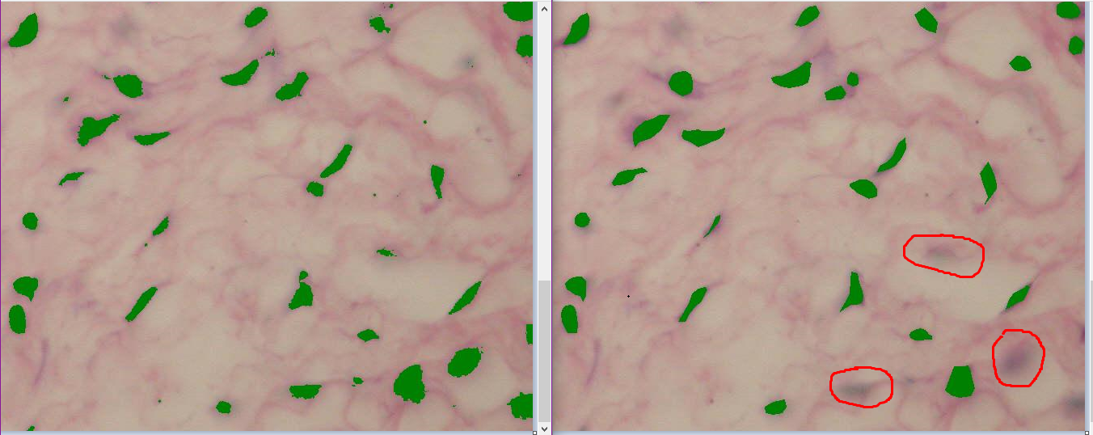
Results
However, if we correlate that in manual mode, one image is processed for about 5 hours, and for software, taking into account manual adjustment of the color palette, it was 3-5 minutes, given that there was no interface and we had to make changes directly to the code. If the interface is improved, then the loss of time due to the adjustment of the color palette can be reduced even more to 1-2 minutes, the average deviation is 7.61%.
.
a)
b)
Figure7: Variants of mask divergence: a – the mask was applied using software, b – the mask was applied manually.

Slide 12
Conclusions
In the course of the study, a basic algorithm was developed and put into practice for automatically creating masks for marking microscopic images of the epithelium of the paranasal sinuses. This method is distinguished by its information content and accuracy. It can greatly reduce the time it takes to process medical images.

