Slide 1
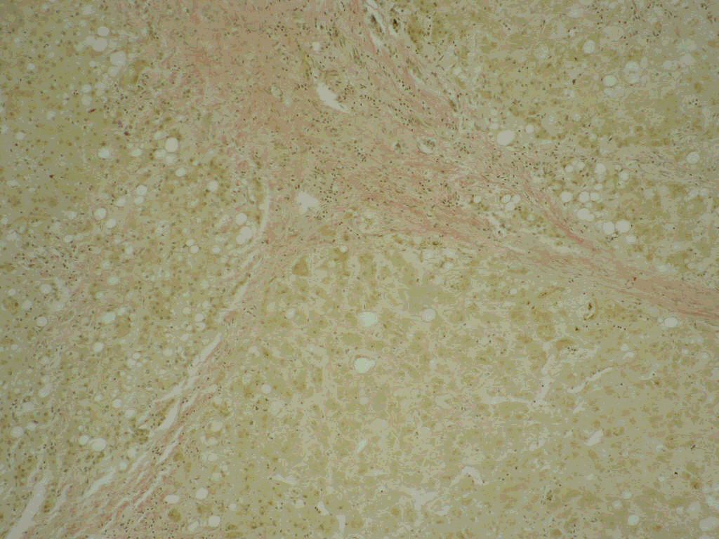
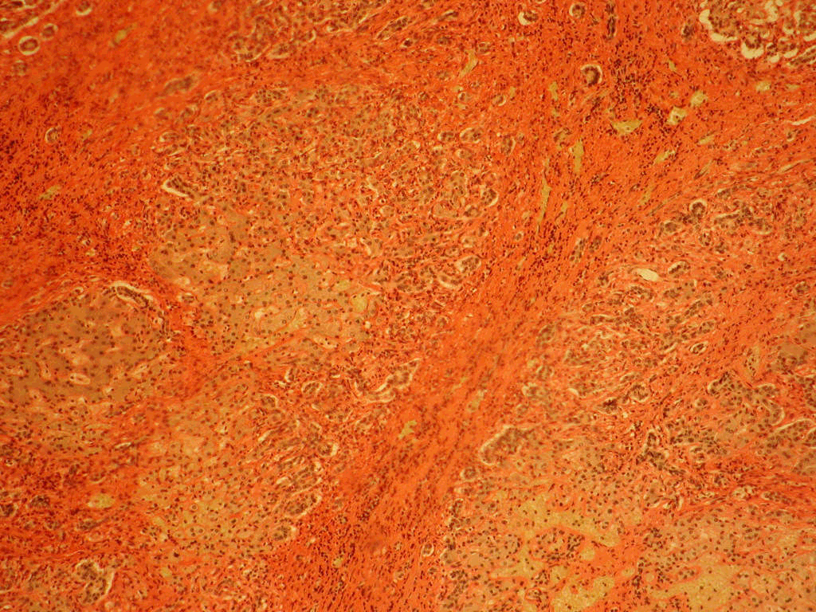
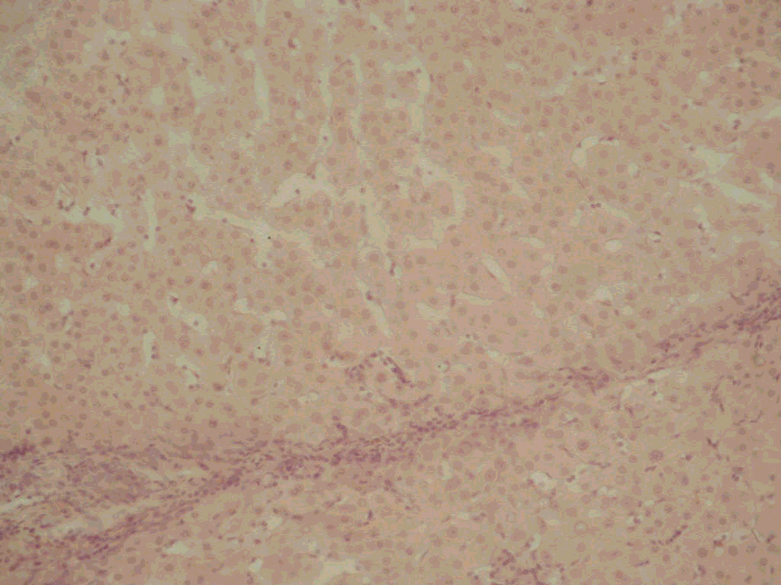
Risk factors and prognosis of acute-on-chronic liver failure during surgical treatment of patients with liver cirrhosis
O. G. Petiunin¹, V. O. Syplyviy¹, A. Y. Korolevska^{2,1}, V. I. Robak¹, V. O. Kurbatov¹
1 - Kharkiv National Medical University, Kharkiv, Ukraine
2- SI " Zaycev V. T. Institute of General and Urgent Surgery NAMS of Ukraine", Kharkiv, Ukraine.
Background: Acute-on-chronic liver failure (ACLF) is the most dangerous postoperative complication in liver cirrhotic patients, which is a most common cause of their death in early postoperative period.
Frequency of ACLF in early postoperative period was different for patients with A, B, C morphological types of cirrhosis (table 2).
  The purpose of our research was to improve the results of surgical treatment, based on the determination of risk factors and prognosis of ACLF at choice of surgical treatment method.
Methods: We included 137 patients with liver cirrhosis, at whom surgical treatment was performed. In 81(59,12%) cases was performed the distal splenorenal shunt by Warren, in 56 (40,88%)– devascularization surgery. Clinical and biochemical blood examinations, morphological examinations with morphometry of intraoperative liver biopsies by V. Syplyviy`s method, doppler ultrasound of portal blood vessels at admission by Moriyasu et al. method were done.
Results: On the basis of the analysis three (A, B, C) types of cirrhosis with statistically significant differences in area of unchanged hepatocytes, volume of dividing hepatocytes, connective tissue area, stroma to parenchyma ratio, volume of hepatocytes in the state of necrosis and/or necrobiosis were determined (fig. 1-3).
Тable 2. Clinical course of postoperative period in liver cirrhotic patients depending on type of morphological changes
Morphological type of a cirrhosis | Patients without postoperative complications | Patients with postoperative ACLF
А - type | 48 (35%) | -
B - type | 31 (47,7%) | 34 (52,3%)
C - type | 5 (20,84%) | 19 (79,16%)
ACLF occurred in different frequency depending on presence or absence of complications of liver cirrhosis and their character (table 3).
Тable 3. Frequency of postoperative ACLF depending on character of preoperatively present complications
Complications of a disease
Patients with postoperative
ACLF
Died
Fig. 1. Morphological A-type cirrhosis
Absent
11 (16,9%)
6 (9,23%)
Ascities
25 (47,16%)
14 (26,41%)
Esophageal hemorrhage
1 (11,1%)
1 (11,1%)
Ascities and esophageal hemorrhage
9 (90%)
5 (50%)
Fig. 2. Morphological B-type cirrhosis
The highest frequency of postoperative ACLF was in groups of patients with ascities and esophageal hemorrhage on a background of ascities. The postoperative mortality, caused by ACLF, had the highest levels in the same groups of patients.
Analysis of factors which were predisposing for postoperative ACLF in cirrhotic patients, revealed, that it occurred in cases, when portal vein and splenic vein diameters with portal congestion index becomes to be increased with simultaneous decrease of linear portal blood velocity (table 4).
Групи хворих
Fig. 3. Morphological C-type cirrhosis
Table 4. Clinical course of postoperative period depending on indices of portal blood vessels and portal hemodynamics
At transition of A-type cirrhosis into C-type volume of hepatic parenchyma becomes to be decreased, while volume of connective tissue becomes to be increased. This is accompanied by decrease in area of unchanged hepatocytes, increase in connective tissue area and stroma to parenchyma ratio (table 1).
Index | Patients without postoperative complications | Patients with postoperative ACLF
Portal vein diameter, cm | 1,22±0,013 | 1,5±0,026*
Splenic vein diameter, cm | 0,88±0,012 | 1,32±0,035*
Linear portal blood velocity, cm/sec | 14,5±0,86 | 10,8±0,48*
Volumic portal blood velocity, ml/min | 1024,65±61,65 | 997,57±72,11
Portal congestion index, cm×sec | 0,08±0,005 | 0,14±0,015*
Table 1. Morphometrical characteristics of intraoperative liver biopsies in cirrhotic patients
Index | А - type | В - type | С - type
Connective tissue area, μm ² | 66,73±1,71 | 126,69±12,5* | 240,16±13,4 *, **
Area of unchanged hepatocytes, μm ² | 234,13±11,5 | 205,34±13,8 | 178,69±18,7*
Stroma to parenchyma ratio | 0, 285±0,019 | 0,617±0,031* | 1,344±0,089*, **
Volume of hepatocytes in the state of necrosis and/or necrobiosis, % | 11,21±0,74 | 17,32±0,63* | 23,97±0,75*, **
Volume of dividing hepatocytes, % | 10,23±0,57 | 15,43±0,48* | 11,07±0,58*, **
*-differences are statistically significant
ACLF occurred at patients with portal vein diameter more than 1,5 cm, linear portal blood velocity less than 10,8 cm/sec, portal congestion index more than 0,14 cmхsec.
Differences are statistically significant :*- in comparison with А-type; **- in comparison with B-type.
CONCLUSIONS:
The highest risk of a ACLF is after shunting operations, at presence of ascities, combination of ascities and hemorrhage from esophageal and gastric variceal veins.
Morphological changes in liver at cirrhosis reflects it's functional reserves, risk of the postoperative ACLF is on the highest level in case of a C- type cirrhosis.
Patients with portal vein diameter more than 1,5 cm, linear portal blood velocity less than 10,8 cm/sec, portal congestion index more than 0,14 cmхsec are in risk of a ACLF

