Slide 1
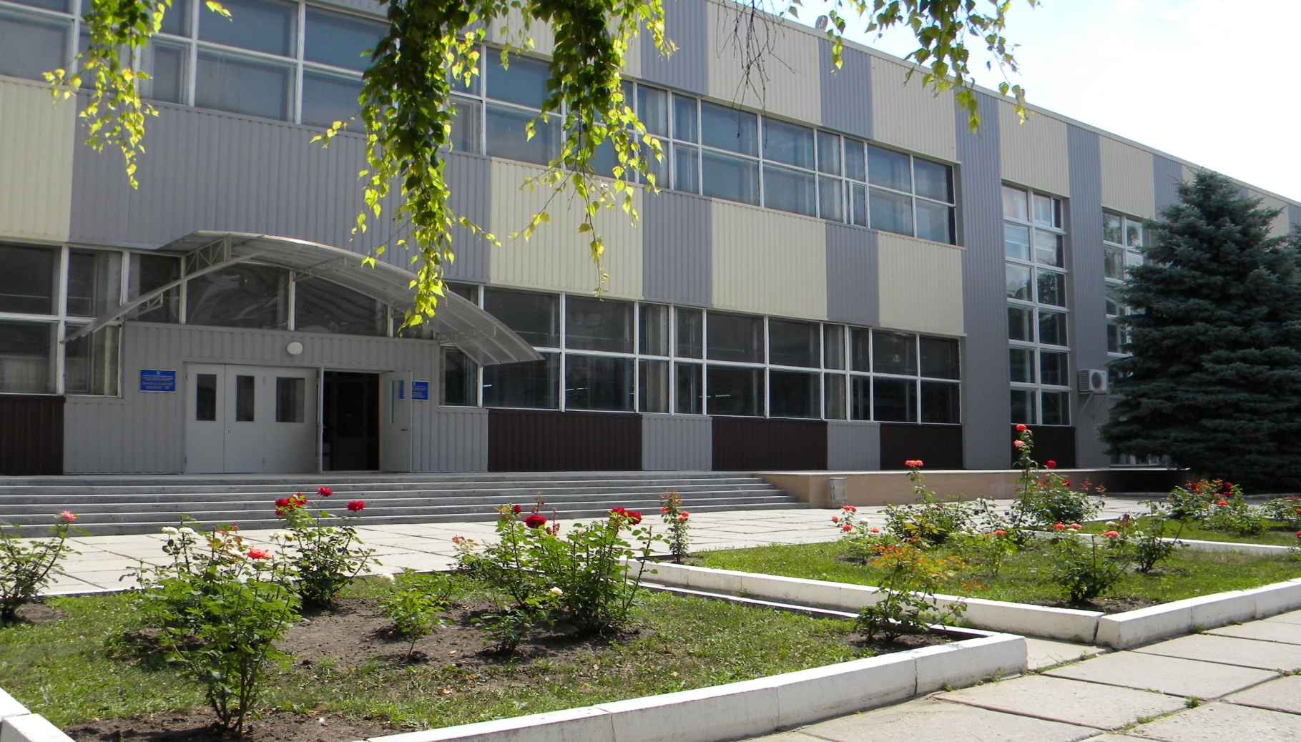
Getting to Know the Library
Building «B», ground floor
Notes:
Scientific library located in building “B”, ground floor.

Slide 2
Libraries - or media centers in high schools -
contain more information than any one person could learn in a lifetime
Notes:
Libraries - or media centers in high schools - contain more information than any one person could learn in a lifetime.

Slide 3
Library structure:
Departments:
document collection
scientific processing of documents and catalogue organization
educational literature service
scientific literature service
organization and storage of scientific literature
information bibliography work
literature in foreign languages
Notes:
Library consist of such departments:
--- document collection
----scientific processing of documents and catalogue organization
----educational literature service
----scientific literature service
----organization and storage of scientific literature
---information bibliography work
---literature in foreign languages

Slide 4
What the library provides?
textbooks, handbooks, methodological recommendations
encyclopedias, dictionaries, atlases
magazines, newspapers
electronic resources – CDs, DVDs, file documents
unlimited approach to the Internet, Wi-Fi zone, scanners, copiers.
Notes:
Library provides:
--textbooks, handbooks, methodological recommendations
--encyclopedias, dictionaries, atlases
--magazines, newspapers
--electronic resources – CDs, DVDs, file documents
--unlimited approach to the Internet, Wi-Fi zone, scanners, copiers.

Slide 5
Types of publications
educational
scientific social
economic literature
fiction
literature in foreign languages
rare publications
Notes:
In our library you can find
---educational
---scientific social
---economic literature
---fiction
---literature in foreign languages
---rare publications

Slide 6
The Library Catalog is your guide to locating the vast resources of the library
alphabetic
systemic
subject
topical and reference card indices
electronic index (since 1991)
electronic databases
Notes:
The Library Catalog is your guide to locating the vast resources of the library
Library has such catalogs :
---alphabetic
---systemic
---subject
---topical and reference card indices
--electronic index (since 1991)
--electronic databases

Slide 7
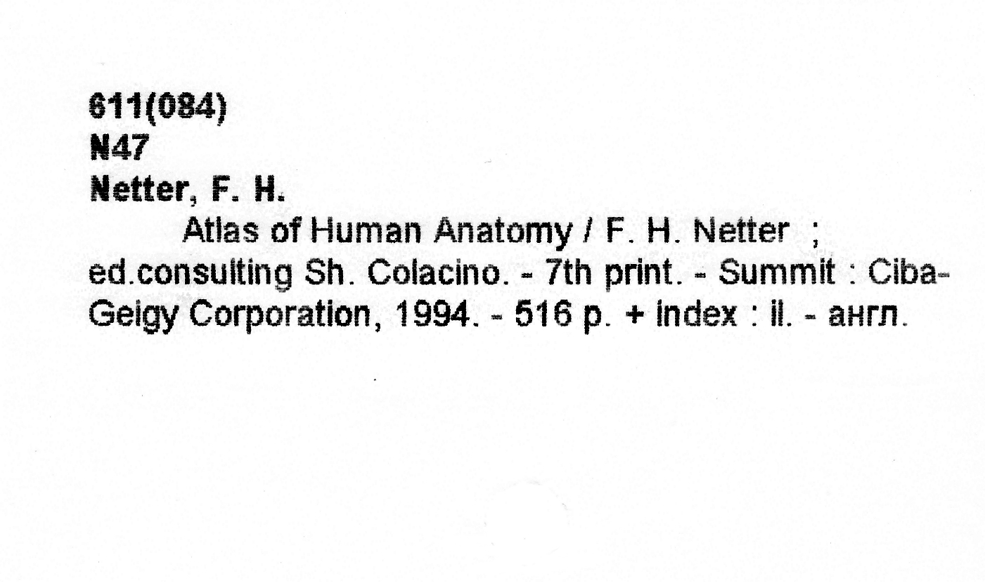
The card catalog
Call number of book
Author, title, data
(in style of final bibliography)
Notes:
The card catalog is the traditional key to the books in a library. There are cards entered under the name of the author, title, and one or more subjects. The call number indicates where you will find the book on the shelf.

Slide 8
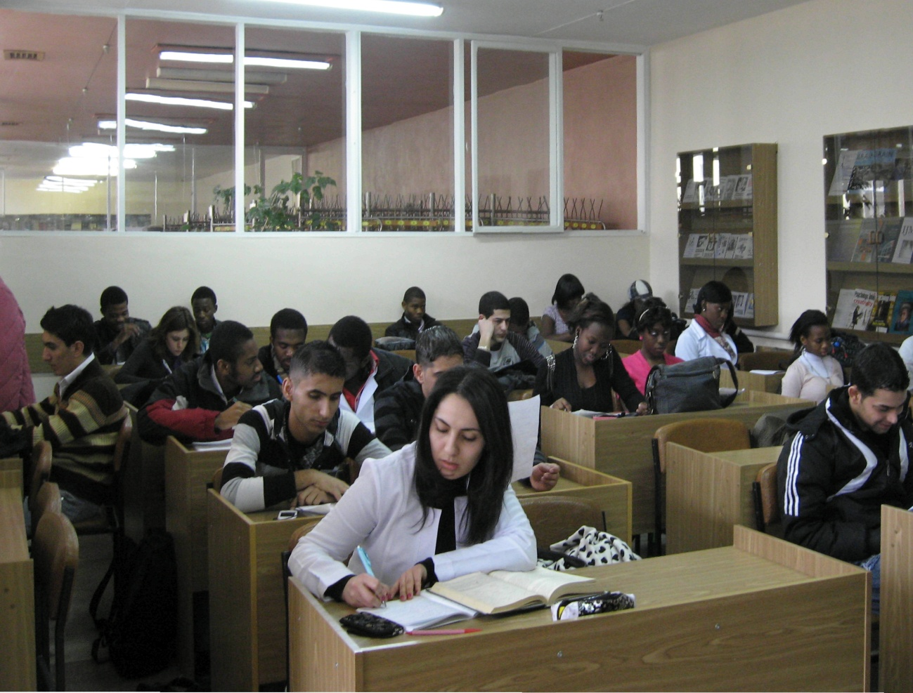
Library for
English medium students
This is a department of the Scientific library of the Kharkiv National Medical University
began its work by 01.02.2011
Notes:
Library for
English medium students.
This is a department of the Scientific library of the Kharkiv National Medical University, began its work by 01.02.2011.

Slide 9
LIBRARY FOR ENGLISH MEDIUM
STUDENTS
Building «B», ground floor
Work hours : 9.00 a.m. – 5.00 p.m., except Saturday and Sunday
Last Friday each month is
cleaning day
Notes:
LIBRARY FOR ENGLISH MEDIUM STUDENTS located in building “B”, ground floor. Work hours : 9.00 a.m. – 5.00 p.m., except Saturday and Sunday. Last Friday each month is cleaning day.

Slide 10
Fund of Foreign Literature
General Fund of Foreign Literature – 74 000,
including Educational Literature – 25 514
this literature, which is issued for the house
internationally known publications (books, manuals, atlases, reference books, etc.) for self-study students
Notes:
General Fund of Foreign Literature has 74 000 publications, including 25 514 copies of educational literature. Fund of educational literature is divided into literature, which is issued for the house and internationally known publications for self-study.

Slide 11
Today Users -
Number of total students – 1637,
from 72 countries
First-year students -272
Notes:
For today there are 1637 students, from 72 countries.

Slide 12
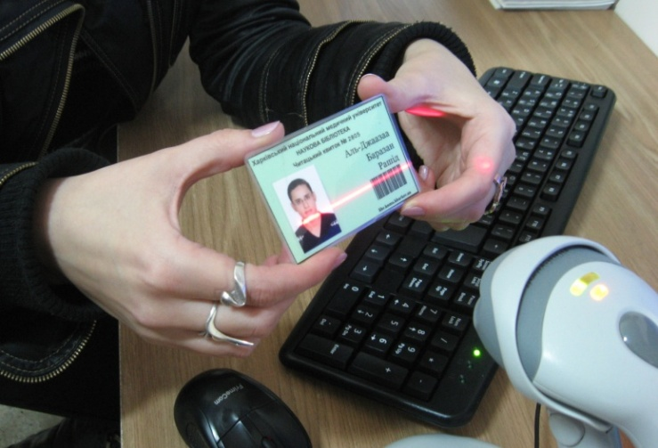
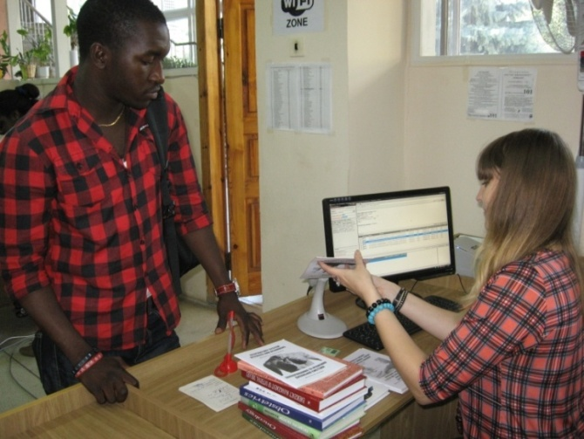
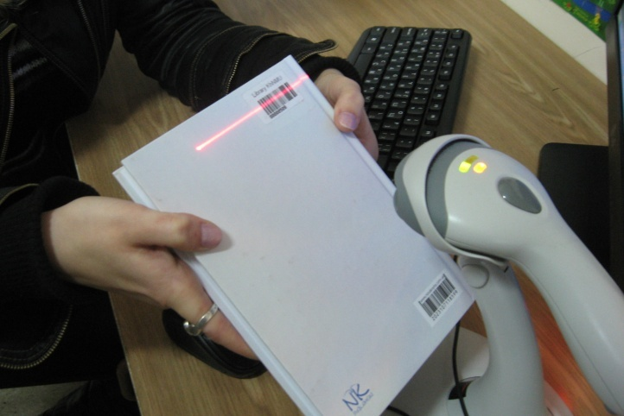
Electronic issuing of literature
Notes:
From September of this year began electronic issuing of literature.

Slide 13
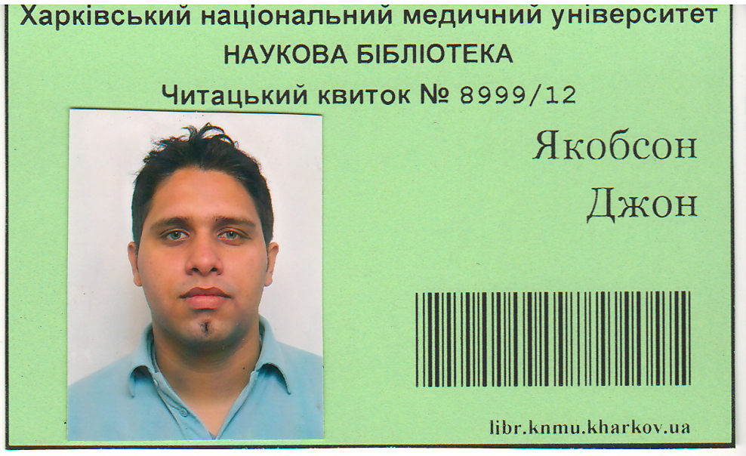
The User obtains an electronic card
Notes:
The user obtains an electronic library card, which is the only document giving the right to use library services.

Slide 14

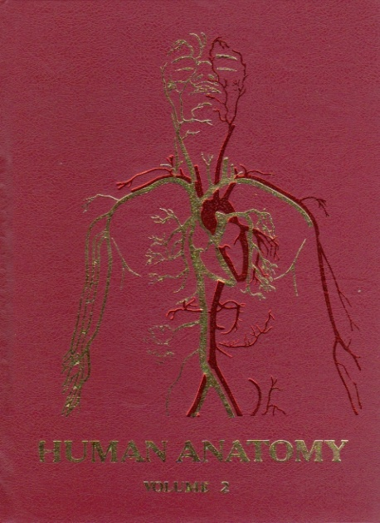

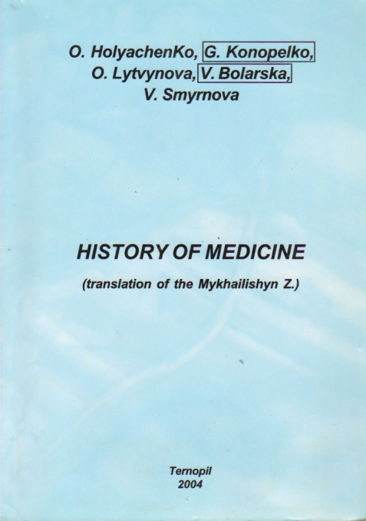
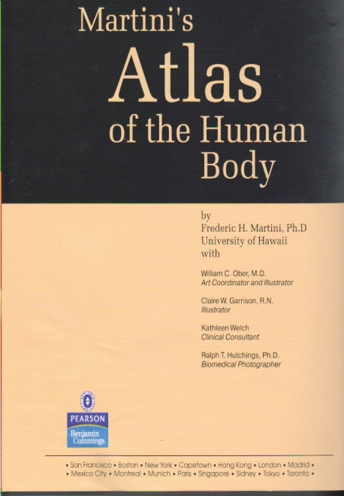
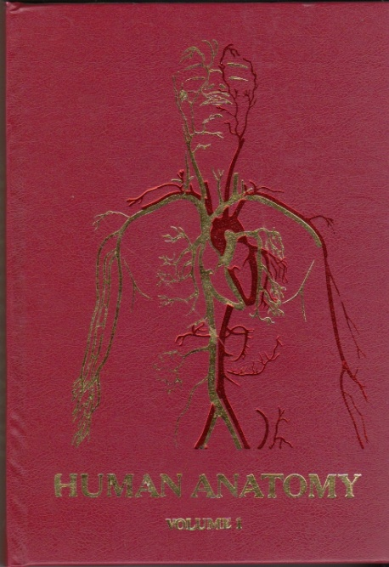



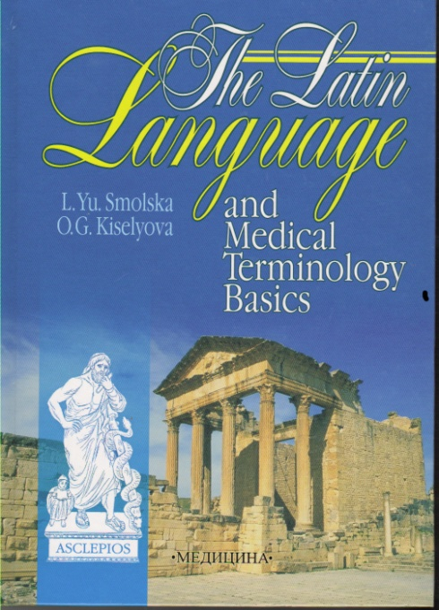
set of first-year textbooks
Notes:
There are set of textbooks for first-year students.

Slide 15




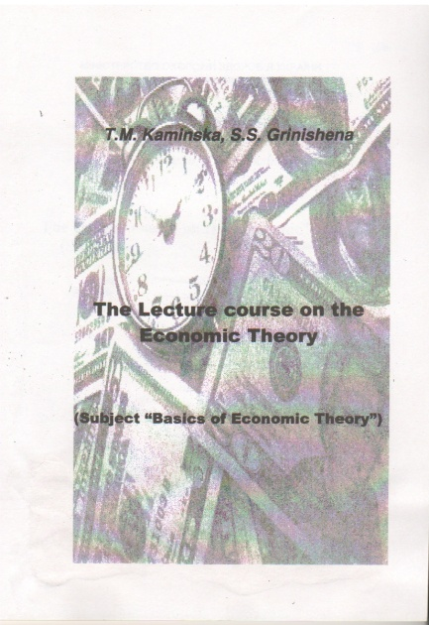

Methodical recommendation
Notes:
There are set of methodical recommendation for 1- st year students.

Slide 16
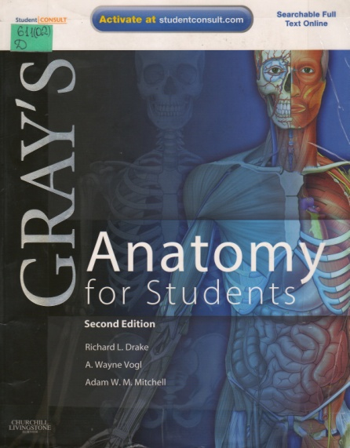
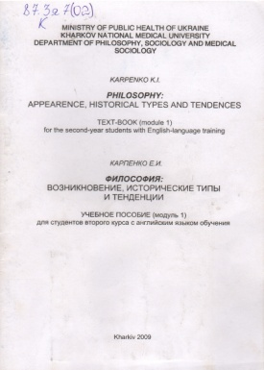
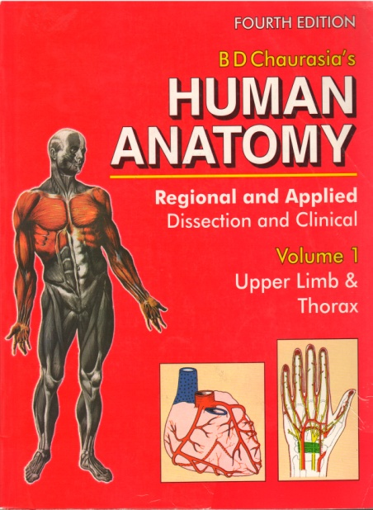


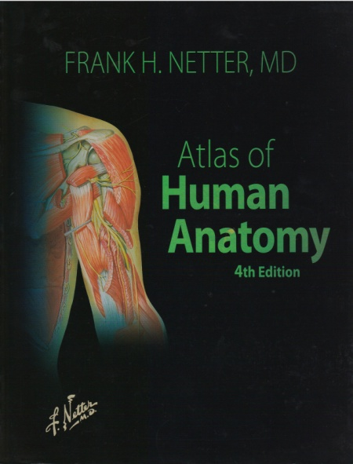
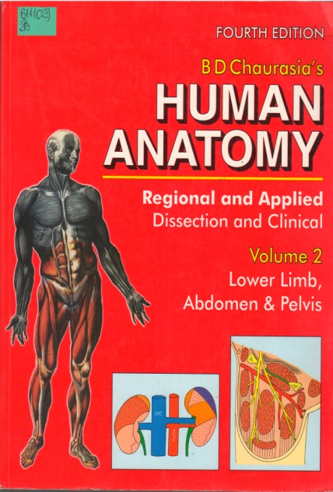
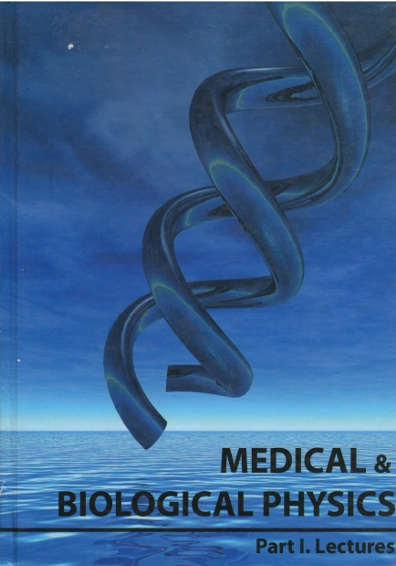
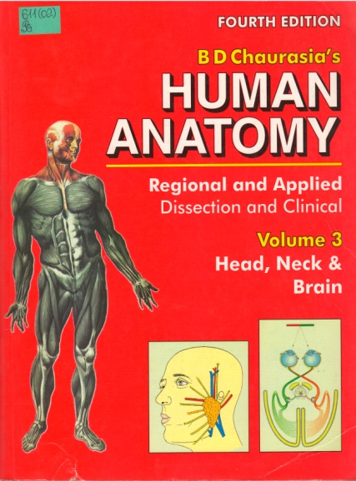

Well-known world editions in Medicine and other disciplines for self - study work in the reading room

Slide 17
Thank you for your attention!

