Slide 1
Uncertainty Calculation to Assess the Structural State of Bone Tissue
A.Nechyporenko, V.Reshetnik, N.Sukhonos, I.Muryzina, A.Lupyr, N.Yurevych, V.Alekseeva, V.Gargin
IEEE ELNANO-2022

Slide 2
INTRODUCTION
A systematic and comprehensive data processing and image evaluation provides the framework for any medical field.
There have been many studies related to the structure of bone tissue according to SCT data, most often based on the calculation of thickness, contrariwise to the use of SCT for assessment of bone density that is quite scarcely mentioned in medical sources, perhaps due to the cumbersome process of calculating this indicator itself.

Slide 3
The goal of our study
was to use and implement the calculation of uncertainty for assessing the structural and functional state of bone tissue of various localization, taking into account different time intervals.

Slide 4
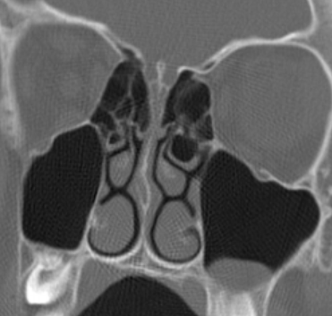
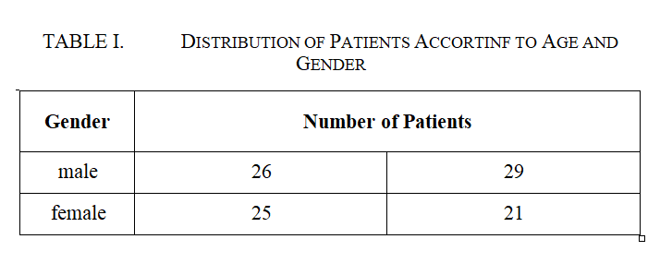
MATERIAL AND METHODS
The study included 101 males and females aged 20-44 years (see table. 1), who were diagnosed with chronic non- spinal maxillary sinusitis associated with a small maxillary sinus cyst (not exceeding 2x2 cm) located on the lower wall of the sinus and did not require surgical treatment (see Fig. 1). According to the WHO classification, all patients can be classified as young people.
Fig. 1. CT scan of a patient with a left maxillary sinus cyst.

Slide 5
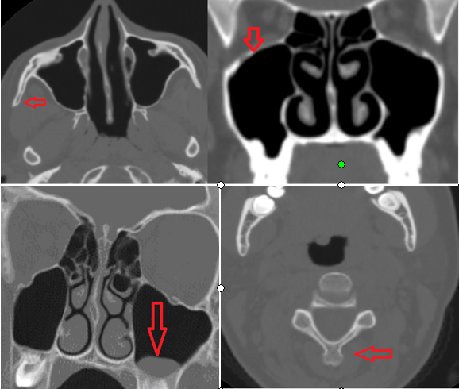
MATERIAL AND METHODS
Image evaluation included assessment of the density of the upper wall of the maxillary sinus (potentially dangerous for the spread of infection into the orbit).
In order to provide comparative features of the variability of the bone tissue in other sites, the density of the 1st cervical vertebra in the area of its arch and the density of the zygomatic bone were also determined.
The numbers 3, 2, 1 mark each measurement over time (every 3 years).
Fig. 2. Axial and coronal slices. SCT of the examined persons
(arrows show the zygomatic bone, 1 cervical vertebra,
the upper wall of the maxillary sinus).

Slide 6
MATERIAL AND METHODS
The uncertainty method was used to calculate the density indices. Uncertainty is an internationally recognized characteristic of measurement uncertainty. To determine it, a basic algorithm was used, which is described in detail in our previous works.
All contributions of the uncertainties of the input quantities form the standard uncertainty of the measured quantity u(Hн) the total standard uncertainty uc, calculated according to the dispersion summation rule.

Slide 7
MATERIAL AND METHODS
The total standard measurement uncertainty of the thickness of the walls of the paranasal sinuses Pн is calculated using the following formula:
where u_{A}(H_{Hi}) is the standard type A uncertainty, u_{B}(H_{Hi}) is the standard type B uncertainty.
The standard type A uncertainty is calculated using the following formula:
where H_{нi} is the i-th value of sample measurement, H_{н} is the mathematical expectation, n is the number of measurements in a sample. Standard type B uncertainty is calculated using the following formula:
where is a measurement error of the tool not exceeding 0.0001%.
Then the interval estimate of uncertainty is performed, namely, the expanded uncertainty U according to the following formula:
U=k ∙ uc
where k is the coverage factor.

Slide 8
RESULTS
As indicated in our previous works, at the first stage, the standard uncertainty of type A (uaa (X)) was determined, at the second the standard uncertainty of type B. The goal of the third stage was to determine the total standard uncertainty (us(HH)) and expanded uncertainty (U(HH).
The coverage factor depends on the distribution law of the measured value and the chosen level of confidence p. For these samples, the hypothesis about the normal distribution law is confirmed, therefore the coverage factor for the probability of 0.95 is assumed to be 2.
It is the expansion of uncertainty that makes it possible to neutralize the possibility of making technical errors, to choose the correct targets, because by calculating the parameters of the structure with this method, we obtain the whole range of values that are reliable for the targeted parameter.

Slide 9
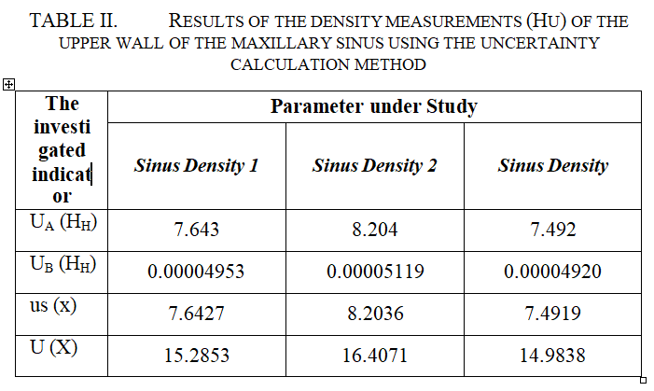
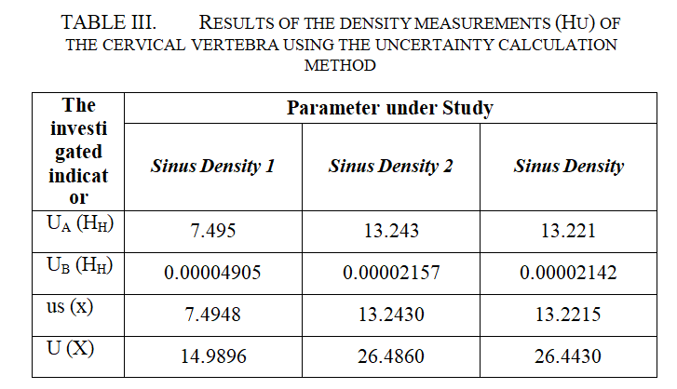
RESULTS
Results are present in tables 2-4

Slide 10
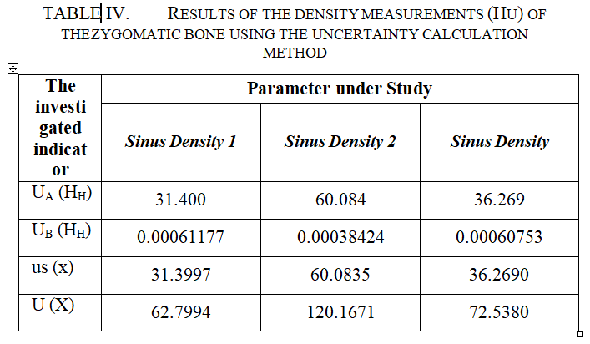
Results
It was revealed that along with majority of patients showing approximately the same density values, there were people with “extreme values”.

Slide 11
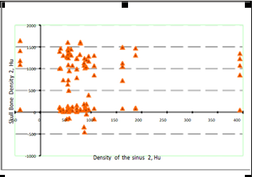
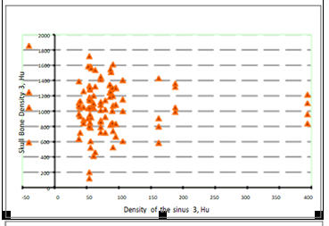
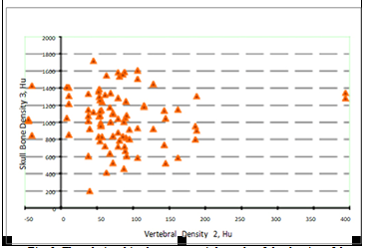
RESULTS
Fig. 3. The relationships between a triple study of the density of the zygomatic process, maxillary sinus and vertebra.

Slide 12
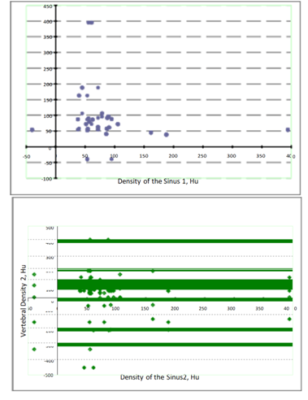
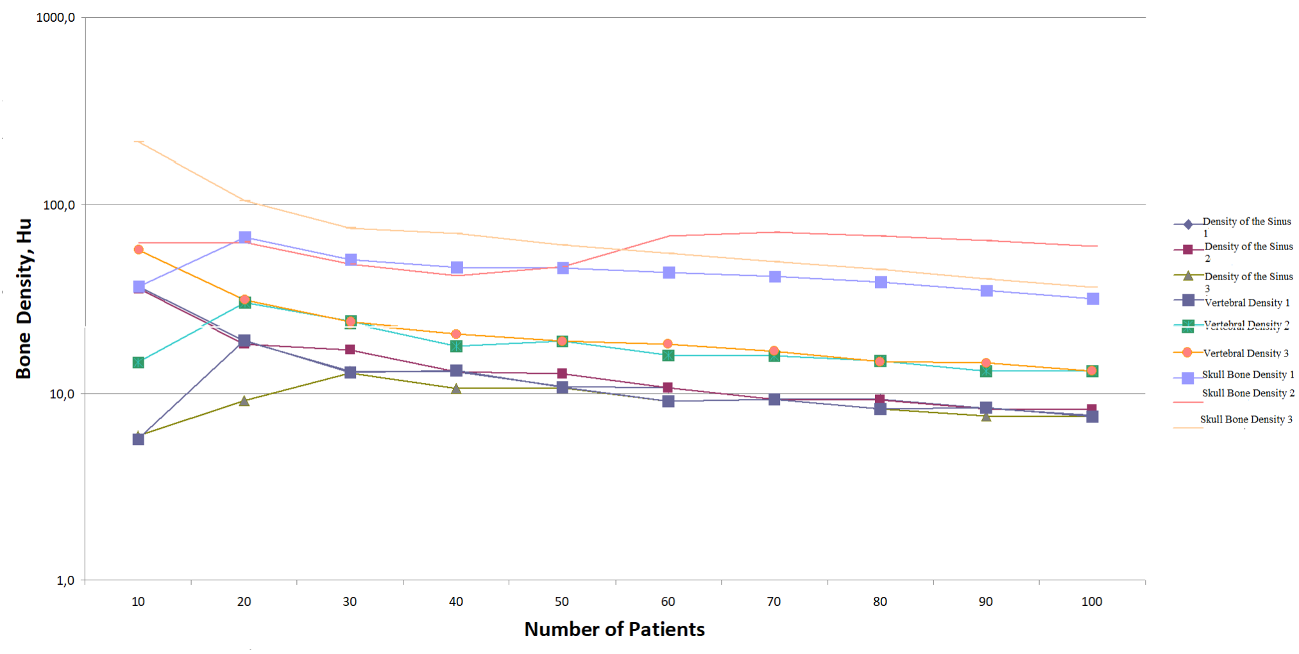
RESULTS
Figure 5 shows that with an increase in the number of tests in almost every targeted group of patients, the uncertainty of density indices decreases, which is consistent with the generally accepted results of calculating uncertainty. In addition, as can be seen from the figure, after 50 studies, the differences between almost all variables become minimal.
Fig. 5. Connection between the density of the studied parameters and the number of the examined persons.
Fig. 4. The Relationship between the sinus and vertebral density.

Slide 13
CONCLUSIONS
This study completed calculation of uncertainty of values to assess the structural and functional state of bone tissue in various targeted sites in within arbitrary chosen timeframe. It was determined that the bone tissue of the first cervical vertebra and the zygomatic bone is characterized by the most prominent variability. It was revealed that along with majority of patients showing approximately the same density values, there were people with “extreme values”. In addition, it was found that after 50 patients getting evaluated, the divergence between the graphs displaying each of the targeted value narrows to the very small difference between them, that give rise to the opinion that accurate and reliable data will be obtained after the study of 50 SCTs.

Slide 14
THANK YOU
FOR YOUR
ATTENTION

