Slide 1
Diabetes Mellitus in Children

Slide 2

Historical Data
1921 yr Banting & Best (USA) extracted INS
1923 yr Ins production and first injection to teenager (USA) and Ins industry “Lilly” (USA) & “Novo Nordisk” Danmark
1923 yr the Nobel Prize for Ins discovering
1936 yr Hagedorn synthesized firs prolonged Ins (with Zn)

Slide 3
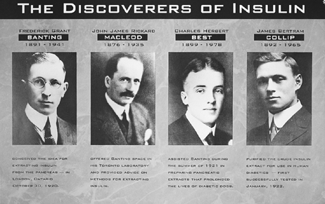

Slide 4
Types of the INS (Ins is non kind -specific hormone)
Bovine (differences from human Ins by 3 aminoacids)
Pig (differences from human Ins by 1 one)
Human (gene-engineering) -2 types:
Biosynthetic Semi-synthetic

Slide 5
Bovine and pig Ins lead to pathoimmune reactions, vessels damage, lypodistrophy
Human INS must be use
in childhood only

Slide 6
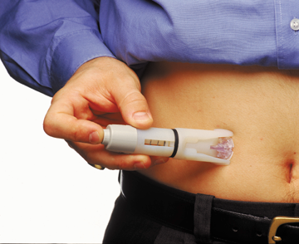
Techniques of Ins introduction
Subcutaneous injection

Slide 7
Syringe is a last century ?

Slide 8
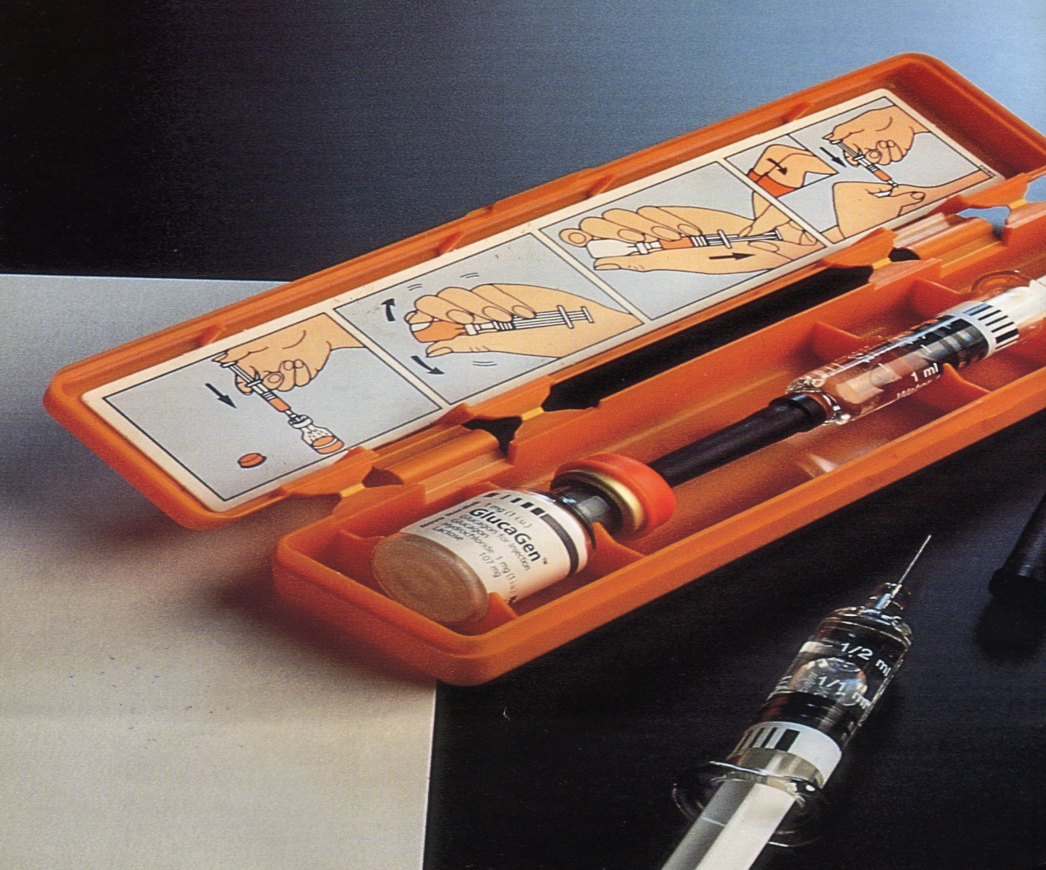
Nowdays using pen, Ins jet injectors and external Ins pumps, and implantable Ins pumps

Slide 10
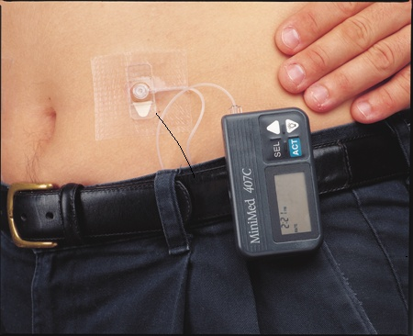
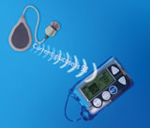

Slide 11
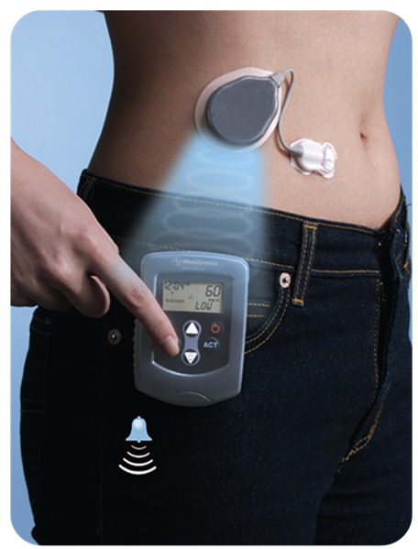

Slide 13
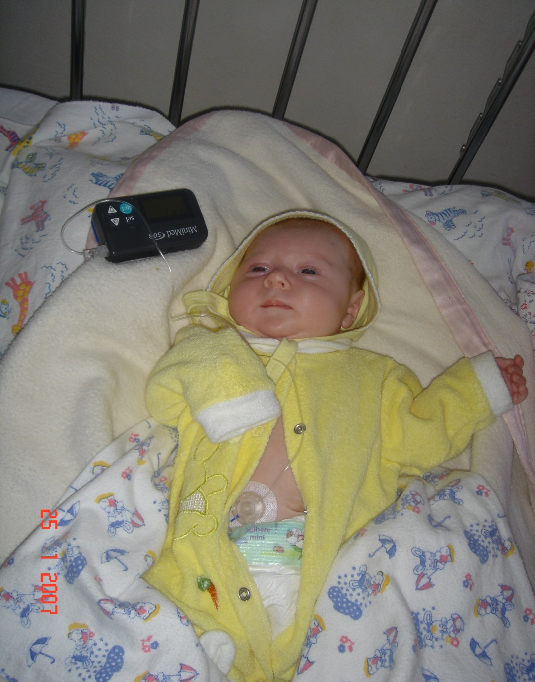

Slide 14
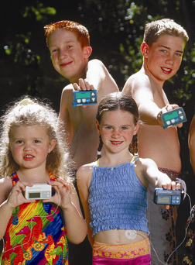
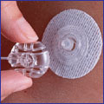

Slide 15
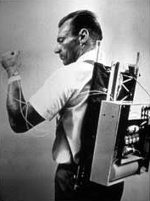

Slide 16
Ins regimen
Basis permanent Ins secretion (immitation by long acting Ins)
Bolus (immitation of stimulation Ins secretion) – short Ins

Slide 17

Duration of Ins acting
Very fast acting
Fast acting
Intermediate acting
Long acting
Ultra-long acting
Ins mixtures

Slide 18
Short – effect medication
Onset in 15 -30 min
Peak 1.5-3 hrs
Duration 4-6 hrs

Slide 19
Medium-effect medication
Onset in 1.5 hrs
Peak 4-12 hrs
Duration 12-18 hrs

Slide 20
Long-effect medication
Onset in 4-6 hrs
Peak 10-18 hrs
Duration 20-26 hrs

Slide 22
Ins doses
First DM (Debut) – 0.5-0.6 U/kg
Honeymoon period – 0.3-0.4 U/kg
Remission (compensated) - < 0.5 U/kg
Prolonged DM 0.7-0.8 U/kg
Ketoacidosis 1.0 -1.5 U/kg
Prepuberty period – 0.6-1.0 U/kg
Puberty period- 1.0 -2.0 U/kg

Slide 23
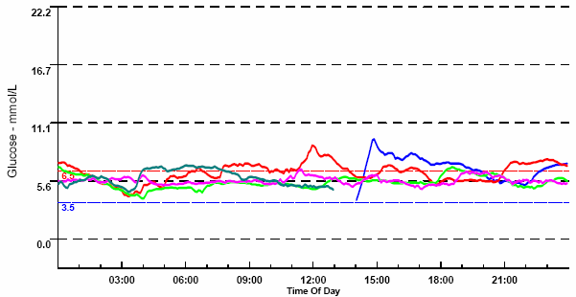
Honeymoon period

Slide 24
Manifestation of the DM if the 80-90% betta cells were destructed

Slide 25
Honeymoon period

Slide 26
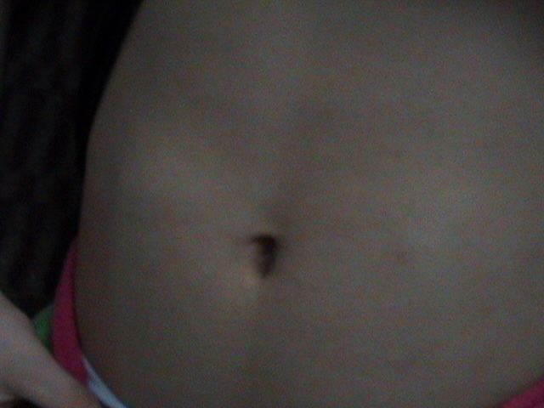

Slide 27
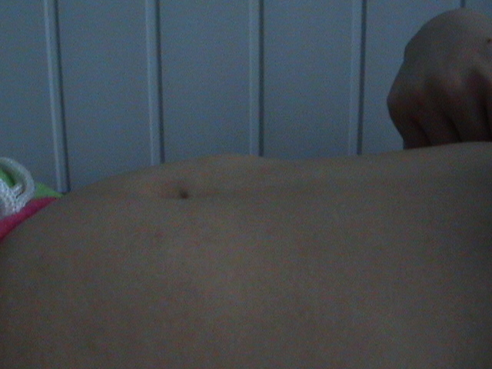

Slide 28
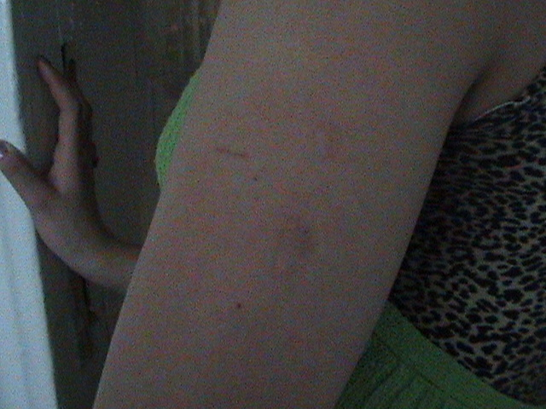

Slide 29
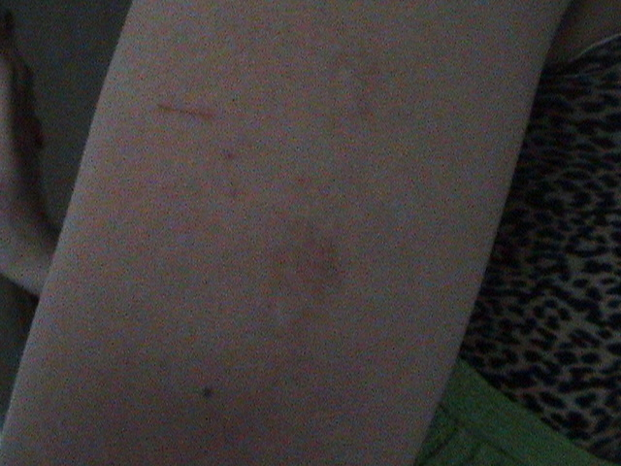

Slide 30
Diabetic Ketoacidosis
Treatment protocol
1st hour – 10-20 mL/kg i/v bolus 0.9% NaCl or Lactate Ringer Ins drip at 0.05-0.1 u/kg/hr (complications-brain edema due to increasing spread)
2nd hour until DKA resolution – 10 mL/kg 0.45% NaCl plus continue Ins drip 20 mEq/l Potassium 5% glucose if blood suger < 14 mmol/L
PH<7.0- Na bicarbonate 1-2 mmol/kg- 1-2 hrs
Oral intake with subcutaneus Ins

Slide 31
Rehydration
Fluid deficiency=Degree dehydration (%) + maintenance daily fluid
<1 year old (3-9 kg) – 80 mL/kg/hr
1-5 yrs old (10-19 kg) – 70 mL/kg/hr
6-9 yrs old (20-29 kg) – 60 mL/kg/hr
10-14 yrs old (30-50 kg) – 50 mL/kg/hr
>15 yrs old (>50 kg) – 35 mL/kg/hr

Slide 32
Causes of the Hypoglycemia
Delaying or skipping a meal
Taking too little food at a meal
Getting more exercise than usual
Taking too much diabetes medicine (Ins)
Drinking alcohol

Slide 33
Hypoglycemia

Slide 34
Hypoglycemia

Slide 35


Slide 36

Treatment of Hypoglycemia
Consciousness is present (1-2 tea spoons of sugar or honey or 5-6 pieces of hard candy, 1 cup of djuce or milk; in 15 min – sandwich, crackers)
Consciousness is absent Glucagon s/c or i/m < 5 yrs old 0.5 mg, >5 yrs old 1 mg,
20% Glucose 1 mL/kg -3 min, than 10% Glucose 2-4 mL/kg

Slide 37
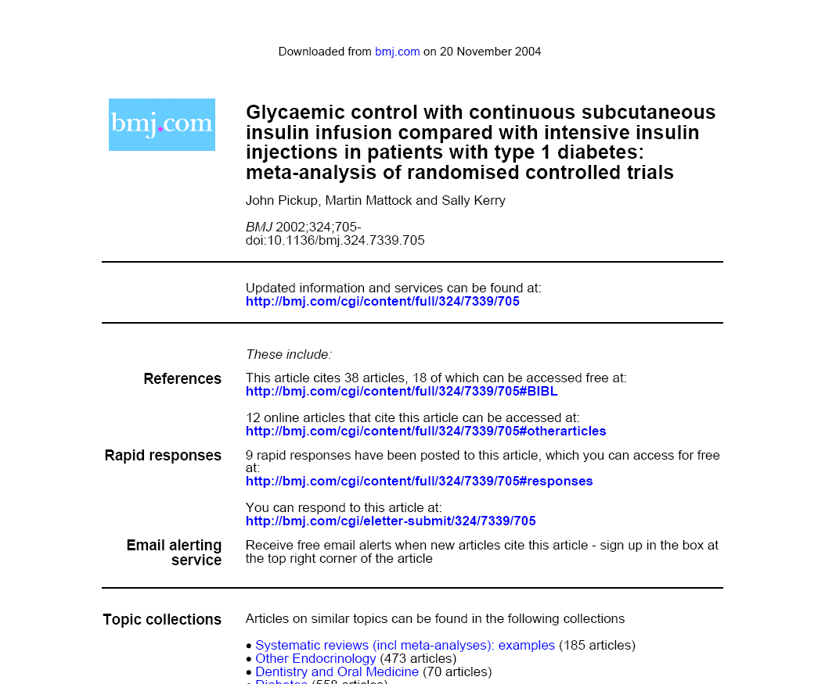
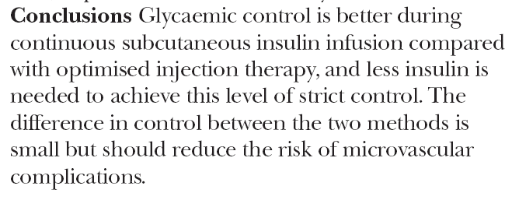

Slide 38

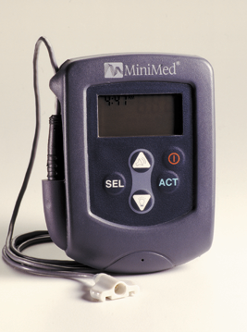

Slide 39
