Slide 1
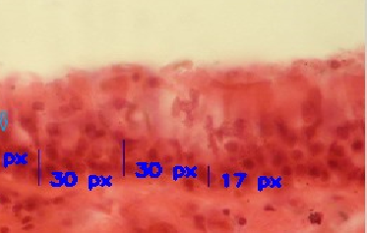
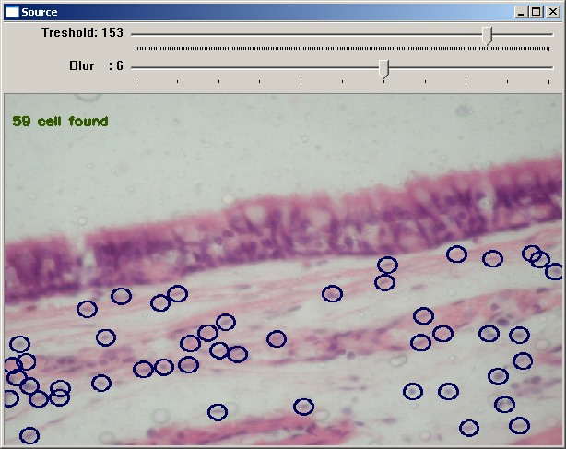
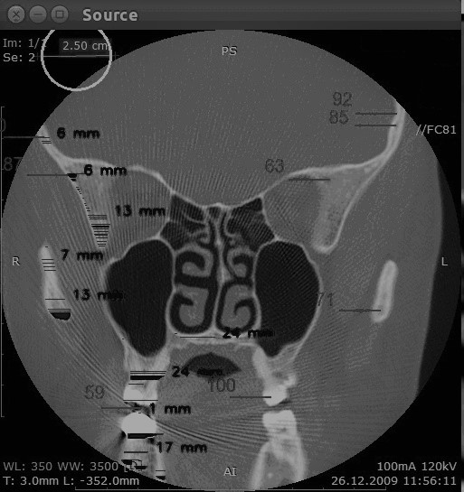
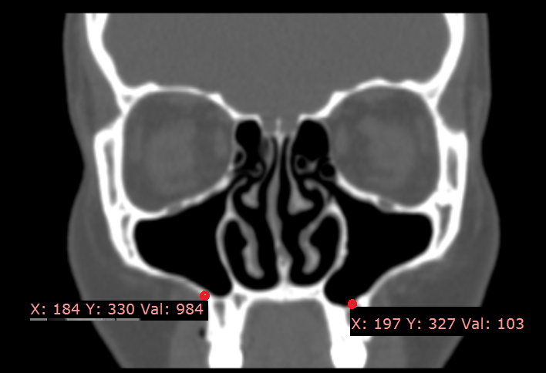
Complex Automatic Evaluation of the Medical Images of the Paranasal Sinuses
Radiy Radutny, Alina Nechyporenko, Victoriia Alekseeva, Nadiia Yurevych, Andrii Lupyr, Vitaliy Gargin

Slide 2
Introduction
Evaluation of medical images is of key importance in the work of medical staff today. In connection with the daily increasing load, the issue of automating the process is especially relevant, which would allow to analyze the images accurately, informatively and fastly. One of the areas of application of this technique can be the automation of the processing of histological images.

Slide 3
The aim of our work
was to design an automatic complex method for assessing the state of the human paranasal sinuses

Slide 4
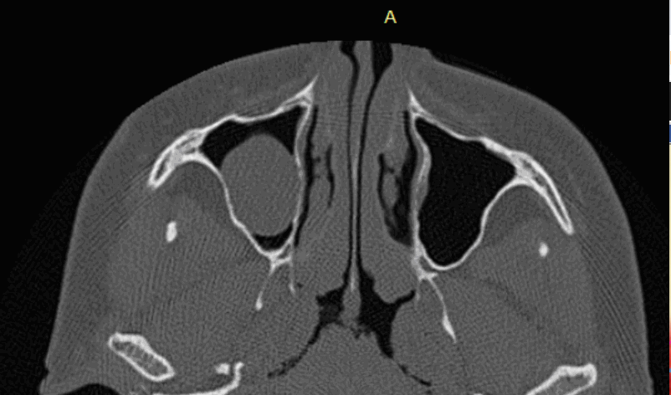
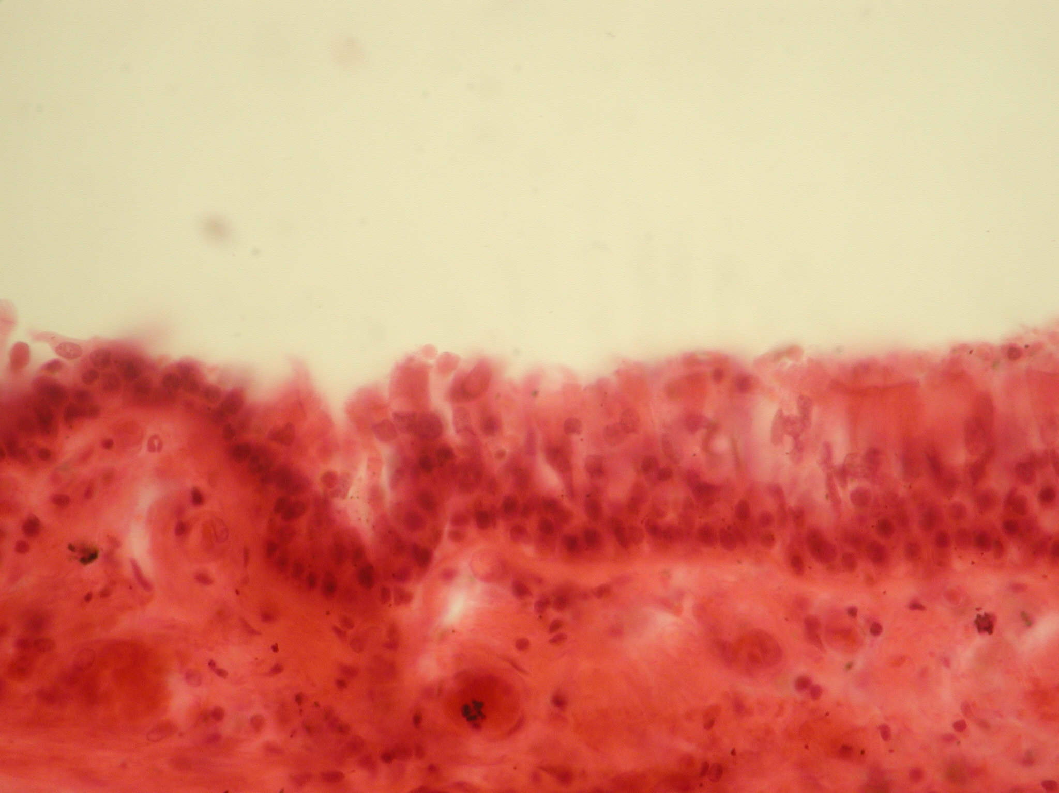
Material and methods
Our research included 10 people of different sex and age, who were divided into groups, taking into account the recommendations of the WHO for 2019-2021.The selection criterion for the examined persons was the presence of an unilateral cyst of the maxillary sinus, which was subsequently removed endoscopically. During the removal of the cyst and the enlargement of the natural anastomosis, samples of the mucous membrane of the maxillary sinus were taken
CT scan of the maxillary sinuses with a
cyst in the right one (axial projection)
Samples of the examined mucous
membrane of the paranasal sinuses
Distribution of the examined persons by
sex and age
Age | 25-44 | 45-60 | 61-75
Male | 1 | 2 | 3
Female | 2 | 1 | 1
Total | 3 | 3 | 4

Slide 5
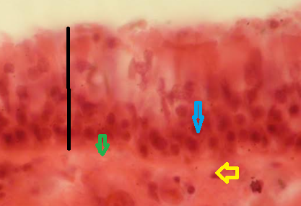
Material and methods
The study was performed on Toshiba Aquilion-4 CT scanner. SCT images were examined using RadiAnt DICOM viewer software, which allows the most accurate measurements in the study areas. Staining with hematoxylin and eosin is most widespread method for investigation in histology, pathologic anatomy, biology. Nuclei are stained in blue Staining with hematoxylin, cellular cytoplasm is stained in pink-red with eosin as result.
The location of the stained structures can be membranous, vascular, nuclear, cytoplasmic depending on the localization of receptors Our study is one of the first attempts to automatically assess such staining.
The investigated parameters of the structure of the nasal mucosa (black line - the thickness of the epithelium with the basement membrane, yellow arrow - the cell nucleus under the basement membrane, blue - above the basement membrane, green - basement membrane)

Slide 6
Results
During the work, the data of the studied signs of the structure of the mucous membrane were obtained both in manual and automatic modes
An example of automatic measurement of the thickness (px) of
various areas of the mucous membrane of the paranasal sinuses.
An example of automatic measurement of the number
of cells below the basement membrane

Slide 7
Results
The research results of indicators of the structure of the mucous
membrane of the maxillary sinus by the manual and automatic mode
Number | Basement membrane thickness, px |  | A number of cells above the basement membrane |  | A number of cells below basement membrane
 | Manu ally | Automa tically | Manu ally | Automa tically | Manu ally | Automa tically
1 | 27 | 17 | 200 | 123 | 66 | 55
2 | 24 | 14 | 201 | 120 | 67 | 54
3 | 23 | 13 | 99 | 119 | 45 | 59
4 | 28 | 18 | 206 | 102 | 49 | 46
5 | 24 | 15 | 153 | 114 | 68 | 51
6 | 22 | 14 | 176 | 145 | 69 | 53
7 | 20 | 13 | 187 | 172 | 70 | 52
8 | 20 | 11 | 154 | 134 | 71 | 51
9 | 18 | 19 | 139 | 155 | 75 | 62
10 | 21 | 17 | 112 | 198 | 65 | 64

Slide 8
Results
At the subsequent stages, automatic and manual measurements of the thickness and the density of the bone of the upper and lower walls of the maxillary sinus were carried out, as potentially dangerous for the development of the complications, according to the data of the spiral computed tomography.
Complex measurement of the thickness
and density by the automatic method
An example of the manual measurement
of the minimum density of the lower wall of the maxillary sinus.

Slide 9
Results
Research results of the thickness and density indicators on the example of the
lower wall of the maxillary sinus by the manual and automatic model
Number | Density, Hu |  | Thickness, mm
 | Manu ally | Automa tically | Manu ally | Automa tically
1 | 103 | 97 | 8 | 8,4
2 | 155 | 112 | 10 | 9,21
3 | 231 | 154 | 12 | 11,3
4 | 122 | 176 | 10 | 10,2
5 | 241 | 117 | 7 | 8,1
6 | 124 | 111 | 9 | 9,5
7 | 98 | 79 | 12 | 12,1
8 | 103 | 154 | 12 | 11,96
9 | 175 | 116 | 9 | 9,9
10 | 122 | 111 | 11 | 11,4

Slide 10
Results
In the presented research, an algorithm, for solving such a difficult task as the measuring density according to the SCT data, is shown, which is undoubtedly one of the key indicators of the structure of the bone tissue of the paranasal sinusesʾ walls.
It is also interesting that there is a slight difference in the calculation of parameters in manual and automatic modes, which allows us to make an assumption about the reliability of our proposed method. The most variable parameter with the most significant difference in results of automatic and calculation was bone density. This difference may be connected with difficulties in the calculation process.

Slide 11
Conclusions
In the course of our research, an algorithm was developed for the automatic assessment of the state of the mucous membrane of the maxillary sinus and its bone walls according to the data of the spiral computed tomography. The difference between obtained data in the manual and automatic mode is minimal. The obtained data shows minimal average related error in the most of cases in the automatic detection of the structure of mucosa of Maxillary sinus as well as in the structure of density and thickness of its walls. The most variable parameter with the biggest difference in results the manual and automatic calculation was bone density.

