Slide 1
Physico-chemistry of surface phenomena Fundamentals of adsorption therapy Chromatography

Slide 2
Surface phenomena
Surface phenomena are important primarily in relation to the cellular, subcellular, and molecular levels of organization of living systems. Various biological membranes separate the cell from its environment and secure its micro heterogeneity.
Living organism is a set of systems with highly developed interface - skin, blood vessel walls, cell membranes, etc.
the surface of human skin – 1,5 m²
the surface of lung alveoli \ air vesicle – 90 m²
the surface of red blood cells – 3000 m²
the total surface of the membrane – 15,000 m²

Slide 3
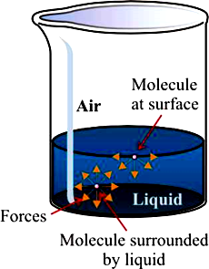
Surface energy and surface tension
The properties of the molecules forming
the surface are different from those in the bulk.
Phenomenon microscopically relates to Energy required to transport molecule from bulk to surface region.
Surface molecules tend to move inside the body of substance.
In order to overcome intramolecular interaction and to make a new interface work should be done.
Notes:
Именно высоким натяжением определяется форма капли, вода поднимается по капилярам растительных систем

Slide 4
Surface tension
Free Surface Energy –is the work per unit area done by the force that creates the new surface.
F = σ ∙ S
Surface Tension (σ) is a work required to form a unit of surface area of a liquid, J/m² or N/m.
σ = F / S
The surface tension occurs at the surface of separation of two immiscible phases (liquid-liquid, liquid-solid or liquid-gas).
Decreasing the surface area of a mass of liquid is always spontaneous (ΔG < 0) and can occur by two ways:
reducing surface area S (sphere has the minimal surface area)
reducing surface tension σ

Slide 5
Condition that affect surface tension
Surface tension σ for pure fluids depends on
their nature (polarity and the ability to form hydrogen bonds),
The stronger the intermolecular attractive forces, the higher the surface tension will be.
temperature (at boiling point σ = 0).
Raising the temperature of a liquid reduces its surface tension
- increases the average kinetic energy of the molecules
- the increased molecular motion makes it easier to
stretch the surface.
surface tension can be affected by dissolved substances
Chemicals that modify the bonding characteristics of the molecules
oxidation and the presence of impurities

Slide 6
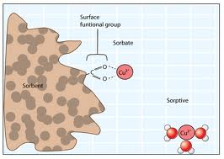
Sorption
Adsorption – is a surface phenomenon. It consists in a change in the concentration of one substance in a surface of another substance. Adsorption diminishes with the elevation of the temperature.
Absorption – is the accumulation of one substance in the entire volume of another substance (dissolving of gases in liquids).
Sorbate – the substance which is sorbed.
Sorbent – the substance which sorbes.
Adsorption
Absorption

Slide 7
There are two principal modes of adsorption of molecules on surfaces :
Physical adsorption takes place when the particles of the adsorbate are held on the surface of the adsorbent by the physical forces such as Van der Waals forces.
Chemical adsorption occurs when the molecules of the adsorbate are held on the surface of the adsorbent by the chemical forces. It is reversible and decrease as temperature increases.

Slide 8
Gibbs equation
Gibbs equation relates adsorption value (Г) to concentration of solute and surface tension (σ).
$\frac{Δσ}{Δс}$- surface activity (change of surface tension with concentration)
Г – adsorption, molecular excess or lack of solute for unit of a surface (1 cm³), [mole/cm³]

Slide 9
Adsorption
1.If the solution surface tension decreases it means that this solute adsorbs on the solution surface:
$\frac{Δσ}{Δс}$ < 0, Г > 0 Positive adsorption
2. If the increasing concentration of solute causes an increase of the solution surface tension it means that it is negative adsorption
$\frac{Δσ}{Δс}$ > 0, Г < 0 Negative adsorption
3. If the surface tension of the solution does not change with the increasing concentration of solute it means that no adsorption takes place in this system.
$\frac{Δσ}{Δс}$ = 0, Г = 0 No adsorption

Slide 10
Adsorption at Liquid-Gas interface
Surface Active Substances (SAS) – molecules and ions that accumulate at surfaces and decrease the surface tension of pure solvents.
E.g. organic compounds (alcohols, fatty acids, salts of fatty acids)
Surface Inactive Substances (SIS) – molecules and ions that accumulate in the bulk of solution and increase the surface tension of pure solvents.
E.g. strong electrolytes – inorganic acids, bases, salts.

Slide 11
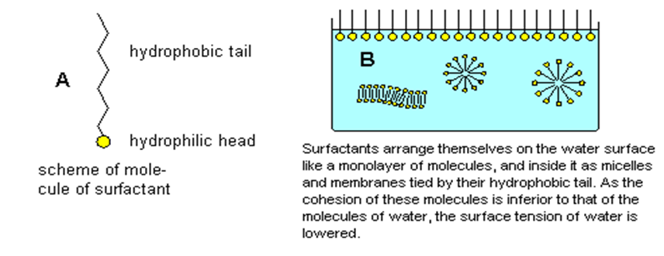
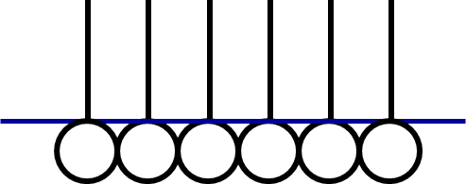
Surfactants
SAS molecule are dipolar:
polar (hydrophilic) group (-ОН, -NH₂, -COOH, -SO₃H, -SH), “head”
non polar (hydrophobic) hydrocarbon part, “tail”
SAS accumulate in the surface layer because of their dipolar nature.
SAS are positively adsorbed in the surface layer because this leads to the lowering of the surface tension.

Slide 12
Adsorption isotherm in solutions of a surfactant
Structure of surface layer: a- pure solvent;
b-unsaturated monomolecular layer of surfactant;
c-saturated monomolecular layer of surfactant

Slide 13
Traube's rule
Traube’s Rule gives a relationship between hydrocarbon chain length and surfactants activity.
It states that for every extra -CH₂ group in a surfactant molecule, the surface activity approximately triples.
e.g., surface activity of caproic acid (CH₃ – CH₂ – CH₂ – CH₂ – CH₂ –COOH) is 9 times more then that of propionic acid (CH₃ – CH₂ – COOH)

Slide 14
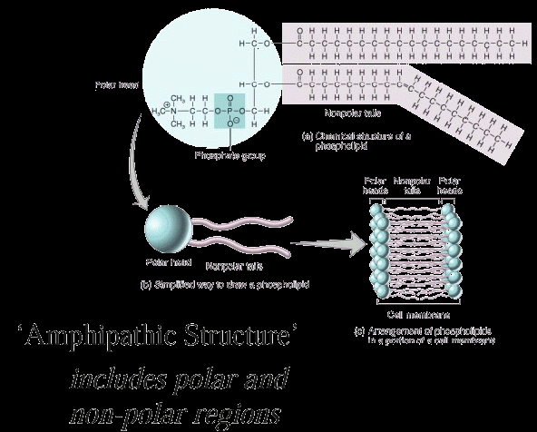
Structure of biological membrane

Slide 15
Adsorption of gases on solids
The amount of adsorbed substance grows with an increasing surface area of the adsorbent. Hence, to carry out adsorption process, it is very important to create highly porous adsorbents with a developed internal surface that is characterized by the specific surface area, i.e. surface area per gram of sorbent. The most important sorbents are activated carbon (charcoal) and silica gel (SiO₂). The specific area of charcoal reaches 1000 m²/g.
Unlike the surface of liquids, not all points of the solid surfaces are equivalent with respect to the adsorptive capacity. The extent of adsorption of a gas per unit mass of adsorbent depends on the pressure of the gas.

Slide 16
Langmuir’s theory
Adsorption is characterized by physico-chemical interaction of adsorbent and adsorbate.
Adsorption occurs on “active centers” of the adsorbent , which are individual atoms or groups of atoms on the surface.
Adsorption of gases occurs monomolecularly, i.e. each active center retains only one molecule of adsorbate and monomolecular layer forms on the surface of adsorbent.
Adsorption is in dynamic equilibrium with desorption.

Slide 17
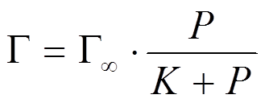
Adsorption on solid adsorbents
On the basis of this theory Langmuir proposed the equation of adsorption isotherm which explained the variation of Adsorption with pressure:
Γ – adsorption, Γ∞ - extreme value of adsorption when all active centers are filled,
P – pressure of adsorbate, K – constant of adsorption equilibrium: K=Kd/Ka,
Kd – rate constant of desorption, Ka – rate constant of adsorption.
The adsorption of gazes on solid surfaces depends on
nature of adsorbent, pressure and temperature.
Adsorption of gases depends on temperature. Elevation of temperature results in desorption of gases.
At low pressure the adsorption depends on P: if P→0 then Γ=Γ∞∙P
The extent of adsorption increases with increase in pressure and becomes maximum corresponding to equilibrium pressure:
if P→∞, $\frac{P}{K+P}$ = 1 and Γ = Γ∞
Notes:
Since desorption takes place simultaneously with adsorption at equilibrium pressure, the amount of gas adsorbed becomes equal to the amount of gas desorbed so that the extent of adsorption becomes constant.

Slide 18
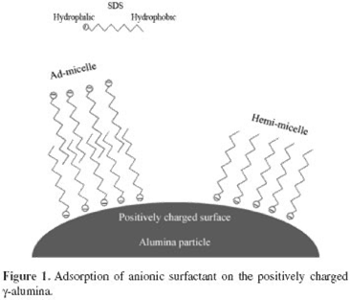
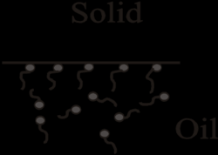
Molecular adsorption is an adsorption of non-electrolyte molecules of adsorbate
Ionic adsorption of strong electrolytes, when preferentially adsorbed one ion of electrolyte.
Adsorption from solution
Molecular Ionic

Slide 19
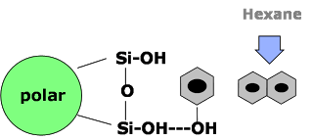
Adsorption from solution
Hydrophilic (polar) adsorbents - silica gel, clays. Used in adsorption from non-polar solvents.
Hydrophobic (non-polar) adsorbents – charcoal, graphite, talc, paraffin.
Adsorption strength increase with increased analyte polarity.
Interaction strength with adsorbent depends on the functional groups present in the structure of the analyte molecule, but also on steric factors.
Water Benzen
Carbon Silica gel

Slide 20
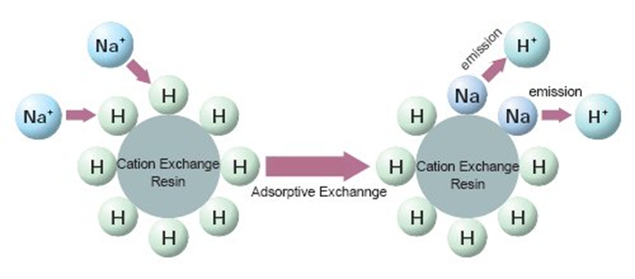
Electrolyte adsorption
Factors that influence ion adsorption:
nature of adsorbent (its charge);
nature of adsorbed ions (their charge, radius and degree of hydration);
pH.
Negatively charged adsorbents adsorb mainly cations,
Positively charged adsorbents - anions.

Slide 21
Selective adsorption
The rule of selective adsorption is given by K. Fajans and N. Peskov.
Ions identical to those forming the crystal lattice or similar to them are preferentially adsorbed on the surface of the crystals.
Ion adsorption capacity depends on the ions charge
Ions with higher valence are typically preferred by the ion exchange resin.
1. The higher is the ion charge – the greater is the adsorption ability:
Th⁴⁺> Fe³⁺ > Ca²⁺ > K⁺
Among ions having the same charge, the ions having the smallest hydrated diameter are preferred by the resin.
2. The larger is the radius of ion – the greater is its adsorption ability:
Cs⁺ > Rb⁺ > K⁺ > Na⁺ > Li⁺
Ba²⁺ > Sr²⁺ > Ca²⁺ > Mg²⁺
CNS⁻ > I⁻ > Br⁻ > Cl⁻
Notes:
Adsorption selectivity obeys the Paneth-Fajans rule which states that ions are preferably adsorbed on the surface of a solid that can complete the building up of its crystal lattice or form the most sparingly soluble compound with the ions in its lattice.

Slide 22
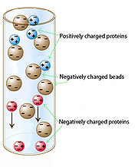
Ion exchange adsorption
Ion exchange resins are polymers with electrically charged sites at which one ion may replace another; porous beads with considerable external and pore surface where ions can attach.
Cation exchangers
[cation exchang.-H₂] + Ca²⁺ + SO₄²⁻ = [cat.exchang.-Ca] + 2H⁺ + SO₄²⁻
Anion exchangers: , where R – H, CH₃, C₂H₅
[anion exchang.-(OH)₂] + 2H⁺ + SO₄²⁻ = [anion exchang.-SO₄] + 2H₂O
Regeneration of the exchangers is accomplished with strong acids or bases

Slide 23
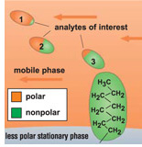
Adsorption phenomenon is the basis of chromatographic method of separation, purification, analysis and investigation of different substances which is widely used in biology, medicine and pharmacology.

Slide 24
The role of an ion exchange in biological systems.
cation-exchange resins are used for decalcifying of blood (its preservation)
liquid ion-exchange resins based on polyvinyl alcohol (PVA) and polyvinylpyrrolidone (PVP) used for prolongation of certain medicinal compounds
resins for the prevention and treatment of oedema due to cardiac decompensation
resins for detoxification in cases of poisoning by toxic electrolytes
cation exchangers are used as antacids, which reduces the acidity of gastric juice

Slide 25
Molecular adsorption by solids from solution is widely used in medicine.
Entherosorption, Hemo- and Lymphosorption, i.e. blood and lymph purification from toxic substances by perfusion via different adsorbents are used in case of renal and hepatic insufficiency, poisonings with hypnotics, neuroleptics, organophosphorous substances, etc. Activated charcoal is often used for this purpose.
Drug delivery. Enzymes, hormones, antibiotics immobilized on a solid support.
Hemosorbents.
Surfactants used as emulsifers, suspending, wetting, solubilizing and stabilizing agents.

Slide 26
Chromatography
Chromatography is a technique by which a mixture sample is separated into components.
Mobile phase = solvent moving through the column.
Stationary phase = substance that stays fixed inside the column.
Eluent = fluid entering the column.
Eluate = fluid exiting the column.
Gas Chromatography = gas carrier (hydrogen, helium, nitrogen)
Liquid Chromatography = liquid mobile phase
Eluent
In
Eluate
Out
Column

Slide 27
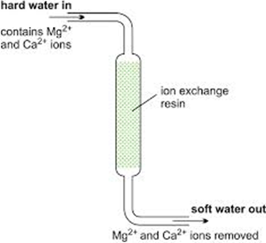
Chromatographic Separations
Column chromatography is purification technique where certain compounds of sample mixture can be separated based on a certain characteristics, such as charge, hydrophobicity, and size. The matrix of the column effects the criteria for which the mixture is separated. The matrix usually consist of a absorbent (silica gel (SiO₂) or alumina (Al₂O₃)) and a solvent.

Slide 28
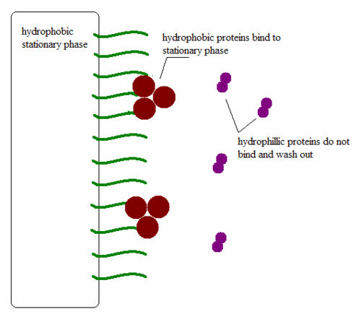
Gas
Column separation (gas-liquid, gas-solid) used for separating and analyzing compounds that can be vaporized without decomposition.
Column separation (liquid-liquid, liquid-solid) used for separating and analyzing compounds based on differences in their interaction with a stationary phase.
Adsorption, partition, ion exchange, molecular exclusion and affinity.

Slide 29
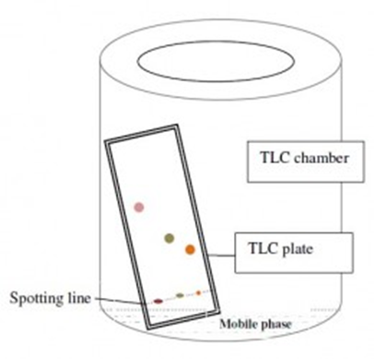
Thin Layer Chromatography (TLC)
Highly polar molecules interact fairly strongly with the polar SiOH groups at the surface of these adsorbents, and will tend to stick or adsorb onto the fine particles of the adsorbent while weakly polar molecules are held less tightly. Weakly polar molecules generally tend to move through the adsorbent more rapidly than the polar species.
Vitamin | RF | Color in UV-light
B1 (thiamine) | 0.4 | violet
B2 (riboflavin) | 0.3 | Yellow
B3 (niacin) | 0.36 | violet
B6 (pyridixine) | 0.49 | dark blue
C (ascorbic acid) | 0.1 | dark blue

Slide 30
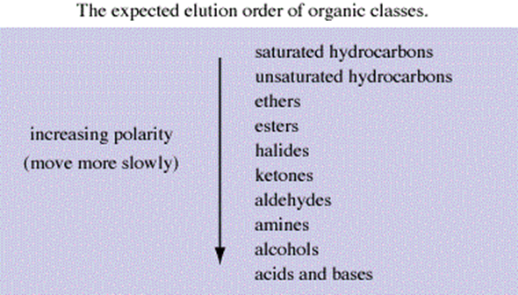
water – 0,0728 J/m²; blood plasma – 0,0454 J/m²;
СН₃СООН – 0,0276 J/m²; glycerin – 0,0647 J/m²;
ethanol – 0,0223 J/m²; olive oil – 0,0330 J/m².

