Slide 1
SOCIETY IN THE FOCUS OF PHILOSOPHY
Lecture 9

Slide 2
Social philosophy is the field of philosophy about society, principles of its functioning and development, questions about social behavior
Society is a historical form of the coexisting of people

Slide 3
In the Ancient Greece philosophy society was considered as the community, part of nature
In the Middle ages concept “society” was changed on some new – state
Only from the New times society was considered as the independent sphere of being with the specific principles of existence

Slide 4
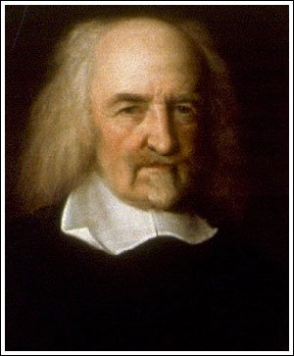
THOMAS HOBBES (1588-1679)
Society exists because of the “social contract”: individuals have consented, either explicitly or tacitly, to surrender some of their freedoms and submit to the authority of the ruler or magistrate (or to the decision of a majority), in exchange for protection of their remaining rights

Slide 5
Forms of the development of a society:
Revolution (sharp transitions from one condition to another - social, political, scientific, technological etc.)
Evolution (regime of slow changes)
Usually these forms change each other

Slide 6
Society went through some stages of development:
1) Pre-industrial: Food production is the main economic activity. These societies can be subdivided according to their level of technology and their method of producing food. These subdivisions are hunting and gathering, pastoral, horticultural, agricultural and feudal

Slide 7
2) Industrial society uses of technology to enable mass production, supporting a large population with a high capacity for division of labour
3) Postindustrial society is based on the provision of information, innovation, finance, and services

Slide 8
Concept “Risk society” (1980s):
This concept describes the modern society
Risk society is “a society increasingly preoccupied with the future and also with safety” (ANTHONY GIDDENS)
Risk society is “a systematic way of dealing with hazards and insecurities, where the ecological risks are dominant, and Chernobyl showed us this (ULRICH BECK)

Slide 9
Main spheres of a society:
Political (the sphere of power and submission, sphere of management)
Social (the sphere of social relations)
Economical (sphere of production of material welfares)
Spiritual (immaterial sphere of creation and mastering of spiritual values, discovering the essence of his/her being)

Slide 10
Political ideology is a certain set of ideals, principles, doctrines, myths or symbols of a social movement, institution, class, or large group that explains how society should work
A political ideology largely concerns itself with how to allocate power and to what ends it should be used

Slide 11
Political ideology has two dimensions:
Goals: how society should work (or be arranged)
Methods: the most appropriate ways to achieve the goals

Slide 12
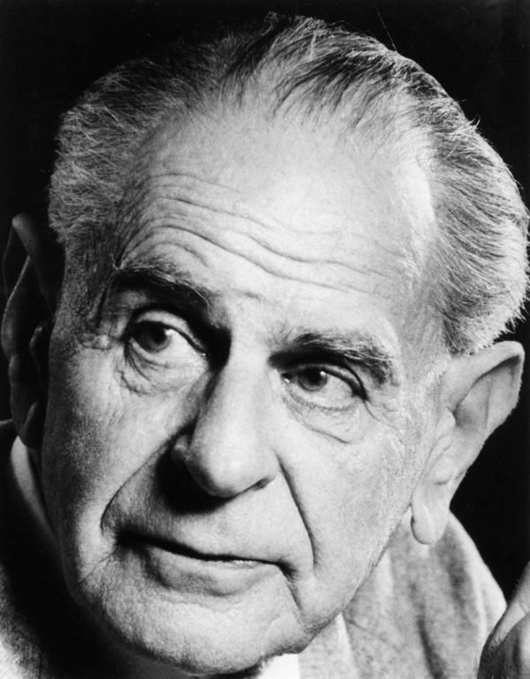
KARL POPPER (1902-1994)
In the book “The Open Society and Its Enemies” (1945) he criticized Platonism, Marxism, totalitarianism (the models of a “closed society”)
Open Society is based on democracy and critical thinking individuals, which are free from various taboos and make decisions as a result of agreement and consensus

Slide 13
Because the accumulation of a human knowledge is unpredictable, the political system should be flexible. In the Open Society the political elite does not have unlimited power and can be removed without bloodshed
Society must be open to multiple points of view and cultures, must be pluralistic and multicultural

Slide 14
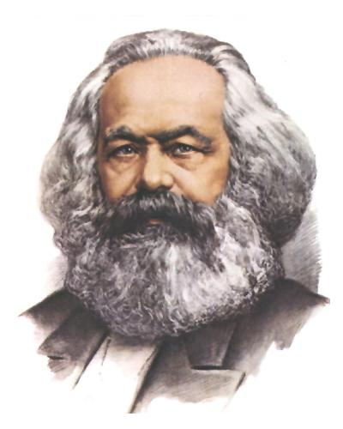
KARL MARX proposed base/superstructure model
of a society:
The base refers to the means
of producton of a society
The superstructure is formed on top of the base, and comprises that society's ideology, as well as its law system, political system…
The base (economics) determines the superstructure

Slide 15
Concept “Consumer society” ERICH FROMM, JEAN BAUDRILLARD)
Consumer society is a social and economical order that encourages the purchase of goods and services in ever-greater amounts

Slide 16
Elements of the spiritual sphere:
1) spiritual necessities (as a source of spiritual activity)
2) spiritual values (live in the form of ideas)
3) subjects of spiritual activity

Slide 17
The main forms of spiritual activity:
moral – the sphere of norms
religion (based on faith on supernatural forces)
science (based on rational cognition)
art

Slide 18
Spirituality can refer to an ultimate or an alleged immaterial reality; an inner path enabling a person to discover the essence of his/her being; or the “deepest values and meanings by which people live”
Social consciousness, or social awareness, is defined as consciousness shared by individuals within a society

