Slide 1
THEME 2.
Philosophy of the Ancient world
Philosophy of the Middle Ages
Philosophy of Renaissance

Slide 2
The Ancient Greek Philosophy covers a long stretch of the history from 7-th century BC to 5th century AD.
.

Slide 3
Why the Greeks in the first place?
1. In Greece, at least in certain city-states, reading and writing was something “everyone” did. By everyone we mean upper class males. Women, peasants, and slaves were discouraged from picking up the skill.
2.Greeks got into overseas trading early. This gets people to thinking.
3. The Greeks were divided into many small city-states. Each of them tried to prove their preferences.

Slide 4
Because the earliest Greek philosophers focused their attention upon the origin and nature of the physical world,
they are called cosmologists or naturalists

Slide 5
Ancient Greek Philosophy includes four periods
Presocratic Philosophy
Classical Philosophy
Hellenistic Philosophy
The imperial era

Slide 6
Presocratic philosophy occupies most of the sixth and fifth centuries bc Greek philosophy didn’t begin in Greece (as we know it); It began on the western coast of what is now Turkey, an area known then as Ionia

Slide 7
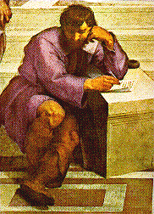
Thales (624-546).
His answer to the great question of what the universe is made of was water.

Slide 8
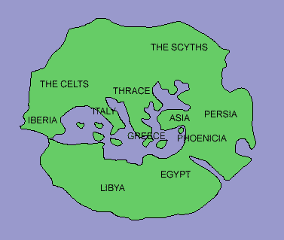
Anaximander (611-549)
also of Miletus. He is best known as having drawn the first known
Map of the inhabited world, which probably looked something like this:
According to him, world is developed out of the apeiron, something both infinite and indefinite (without distinguishable qualities). Within this apeiron something arose to produce the opposites of hot and cold. These at once began to struggle with each other and produced the cosmos.

Slide 9
Anaximenes of Miletus (second half of the 6th century BC), taught that air was the origin of all things.
The first three Greek philosophers have often been called hylozoists because they seemed to believe in a kind of living matter.

Slide 10
HERACLITUS (b. c. 540 – 480 B.C.)
Greek philosopher remembered for his cosmology, in which fire forms the basic material principle of an orderly universe.
Heracleitus wrote that the world order is an "ever-living fire kindling in measures and being extinguished in measures."

Slide 11
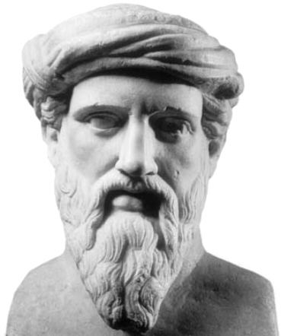
Pythagoras (582-500)
His philosophy was rooted in mathematics. He discovered the mathematical basis of music, and saw the same patterns in the movements of the planets. His followers believed in reincarnation, they were vegetarians, avoided wine, swearing by the gods, sexual misconduct, excesses and frivolity. Women were treated as equals.

Slide 12
Parmenides (540-470)
All things are One. Ultimate reality is constant. What we believe to be a world of things and motion and change is just an illusion

Slide 13
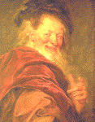
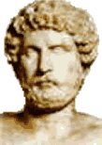
Democritus (460-370) of Abdera
There are only two fundamental principles of the physical world, empty space and filled space-the latter consisting of atoms
The soul is composed of small, smooth, round atoms

Slide 14
Protagorus (480-411),
He was a sofist (teacher of wisdom) and skeptic, believed that there were no ultimate truths, that truth is a relative, subjective thing. “Man is the measure of all things,” is his most famous quote, meaning that things are what we say they are.

Slide 15
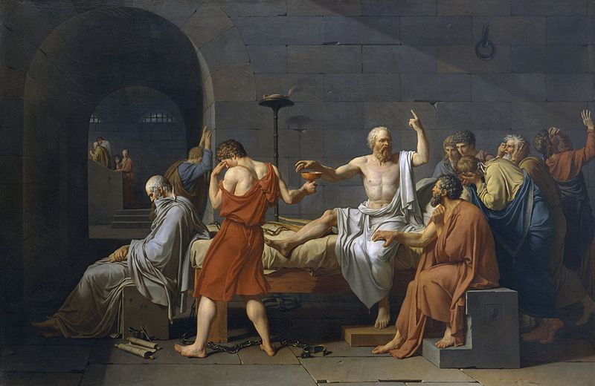
Socrates (469–399 bc)
shift the focus away from the natural world to human values
If you know what is good you will be a moral person.
"Know thyself!"
inscribed on the Temple of Apollo at Delphi
"

Slide 16
Plato (427-347 B.C.)
Plato was the founder of the consistent philosophical system of objective idealism.
According to Plato, all of the things that men perceive with their senses appear to be but very imperfect copies of the eternal Ideas. Their structure looks like pyramid. The most fundamental one of these is the Idea of the Good.
Human soul is immortal. Souls were created by demiurge.

Slide 17
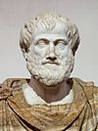
Aristotle (384-322 B.C.)
“Plato is dear to me, but dearer still is truth”.
Recognizing the objective existence of matter, he regarded it as eternal and impossible to create or destroy. Matter is passive. It contains merely the potential for the actual diversity of things, in the same way as marble hold the possibility of different statues.
In order to turn this possibility into reality, matter must be given the necessary form. The function of form-building is performed by mind, which is the prime mover.
Form is active creative factor preceding the thing and making it real. God is a Creator of Foms.

Slide 18
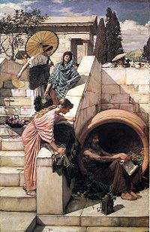
Hellenistic philosophy (down to the late fourth century bc )
This period is represented numerous small philosophical schools most of which were concerned with ethical problems
Diogenes of Sinope believed that virtue was better revealed in action than in theory. He used his lifestyle and behaviour to criticise the social values and institutions of what he saw as a corrupt society. He declared himself a cosmopolitan

Slide 19
The imperial era (80bc - AD300)
the job was to seek the correct interpretation of the ‘ancients’ by close study of their texts (Diogenes Laertius)
In this final phase of ancient philosophy, conveniently called ‘imperial’ because it more or less coincides with the era of the Roman empire (Plotinus)

Slide 20
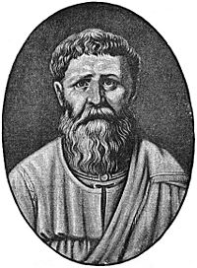
Augustine of Hippo (354-430)
Augustine attempted to provide rational solutions to three major problems:
the problem of free will and predestination
the existence of evil in a world created by a perfect and all-powerful God
the three persons in one nature attributed to God in the doctrine of the Trinity

Slide 21
The Scholastic debate is referred to 'the problem of universals':
Realists, following the tradition of Plato, maintained that each universal is an entity in its own right, existing independently of the individual things that happen to participate in it (Anselm).
Nominalists, pursuing a view nearer that of Aristotle, held that only particular things exist (Roscelin).

Slide 22
Thomas Aquinas (1225-1274)
the truths of faith and the truths of reason cannot conflict, but rather apply to different realms:
The truths of natural science and philosophy are discovered by reasoning from facts of experience.
The tenets of revealed religion—the doctrine of the Trinity, the creation of the world, and other articles of Christian dogma—are beyond rational comprehension, although not inconsistent with reason, and must be accepted on faith.

Slide 23
5 proofs of existence of the God
everything, that goes, movable something another. It defines {determines} necessity of existence of the first engine which the God is.
each phenomenon has the reason. Rising on "ladder" of the reasons, we come to idea about necessity of existence of the God as Supreme reason of all things and phenomena.
Casual depends from necessary, the first necessity is the God.
degrees of qualities which are everywhere therefore there should be a most advanced stage of perfection serve and it is the God.
All in the nature goes to the purposes, it is meaningful, utility. Hence, there is a Reasonable essence which directs all natural things to the purpose, and it is the God.

Slide 24
Mediaeval Islamic Philosophers
al-Kindi (c. 800-866), the first great Arab thinker
al-Farabi (c. 878-950) made use of the logical treatises of Aristotle and employed arguments for the existence of God; designed to provide a rational foundation for orthodox monotheism, many of these arguments made their way into the Christian tradition later in the 13th century.
Ibn Rushd (1126-1198), also known as Averroës, was a Spanish-Arab jurist and physician and the most noted Muslim philosopher of the Middle Ages.
He earned himself the title ‘the Commentator’ among the many Scholastics who came to regard Aristotle as the Philosopher.

Slide 25
Ibn Sina (980-1037)
learned of the Aristotelian system during his medical studies and from the work of al-Farabi; he combined elements from both sources into a comprehensive account of reality, with God as the central reality from which all else must be derived.

Slide 26
3. DOMINANT STRANDS OF RENAISSANCE PHILOSOPHY
The Renaissance mounted its revolt
against the church,
against authority,
against Scholasticism,
against Aristotle.

Slide 27
Three dominant strands of Renaissance philosophy:
(1) humanism,
(2) the philosophy of nature,
(3) political theory.

Slide 28
Humanism
philosophy based on the idea that people are rational beings who possess within themselves the capacity for truth and goodness; it emphasized the dignity and worth of the individual.

Slide 29
Pico della Mirandola (1463-1494), (Speech on human dignity)
the new emphasis upon man's personal responsibility and on the possibility of his self-creation as a work of art

Slide 30
Reformation
the great 16th century religious revolution which ended the ecclesiastical supremacy of the pope in Western Christendom and resulted in the establishment of the Protestant churches.

Slide 31
Martin Luther (1483-1546), the German monk and theologian and father of the Reformation
first defied the authority of the church
He is considered as the father of Protestantism.

Slide 32
John Calvin (1509-1564), a French theologian
insisted on further reforms, including the enforcement of a strict moral discipline in the community by the pastors and members of the church, and the excommunication of notorious sinners.
Calvin's church organization was democratic and incorporated ideas of representative government. Pastors, teachers, and deacons were elected to their official positions by members of the congregation.

Slide 33
Philosophy of Nature
Deism
God created the world but thereafter has exercised no providential control over what goes on in it. In the proper sense, a deist is someone who affirms a divine creator but denies any divine revelation, holding that human reason alone can give us everything we need to know to live a correct moral and religious life.
Pantheism
the view that Deity and Cosmos are identical. Theologically, it embraces divine immanence while rejecting divine transcendence.

Slide 34
Nicholas of Cusa (1401-64).
God is the "coincidence of opposites." Because he is infinite, he embraces all things in perfect unity; he is at once the maximum and the minimum.
The absolute truth escapes man; his proper attitude is "learned ignorance."

Slide 35
Andreas Vesalius, a Belgian physician (the mid-16th century)
was astounding all of Europe with the unbelievable precision of his anatomical dissections and drawings.

Slide 36
Copernicus (1473-1543), the Polish astronomer
developed the heliocentric model of the solar system in which the Sun is stationary at the center, and Earth moves around it.

Slide 37
Giordano Bruno (1548-1600)
He expressed the idea that nature and the number of worlds in the universe were infinite. He was condemned in heretical ideas and because of this he was burned at stake on16-th of February, 1600.

Slide 38
Galileo (1564-1642), the Italian physicist and astronomer
brought attention to the importance of applying mathematics to the formulation of scientific laws.
In the history of culture, Galileo stands as a symbol of the battle against authority for freedom of inquiry.

Slide 39
Political theory
New forms of political organization and behavior were expressed in purely ‘natural’ and nonreligious terms

Slide 40
Niccolò Machiavelli (1469-1527) Italian statesman and writer
He focused on how to establish a state capable of resisting foreign attack
In his most famous work, Il principe (The Prince), Machiavelli describes the method by which a prince can acquire and maintain political power:
the end justifies the means, that a ruler is not bound by traditional ethical norms, was bluntly expressed in this work; and it reflects the degree to which the new political environment had changed popular thinking.

Slide 41
Michel de Montaigne (1533-1592), the French philosophical essayist.
His Essays gave prominent place to skeptical arguments.
investigation of institutions, opinions, and customs, and opposition to all forms of dogmatism.
he emphasized the contradictions and incoherences inherent in human nature and behavior.

