Slide 1
Department of human anatomy
Lecture
“clinical anatomy of peritoneum”
Lecturer: MD, PhD mr. Oleg Vovk

Slide 2
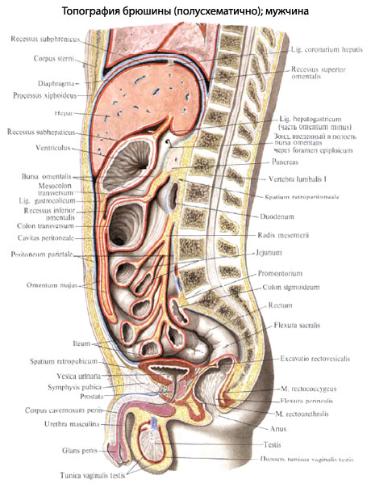
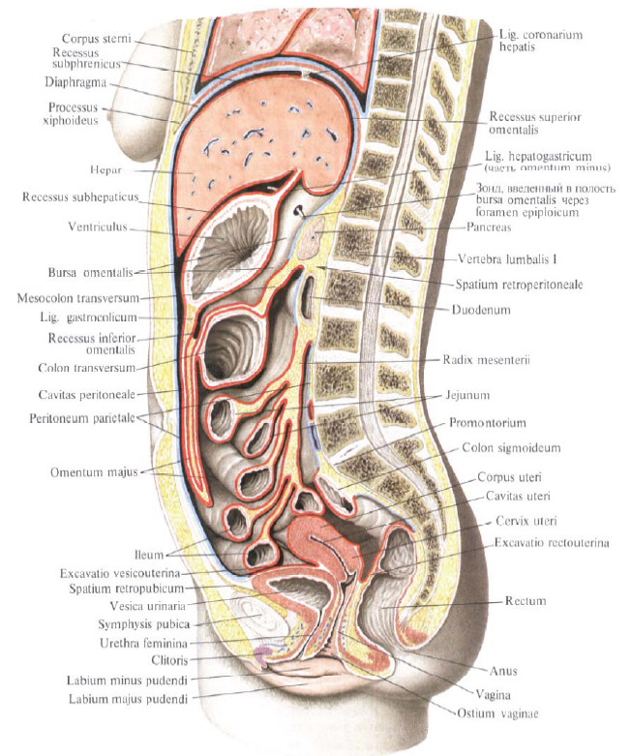
Anatomy of the peritoneum

Slide 3
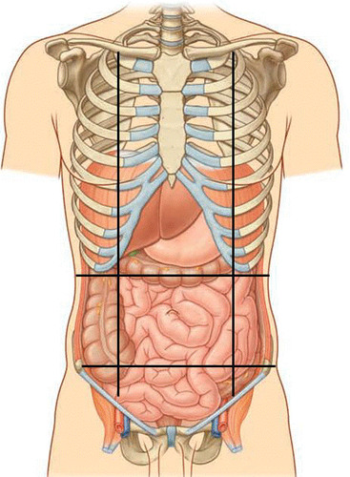
Divisions of peritoneal cavity
Upper floor (storey)
Middle floor (storey)
Lower floor (storey)

Slide 4
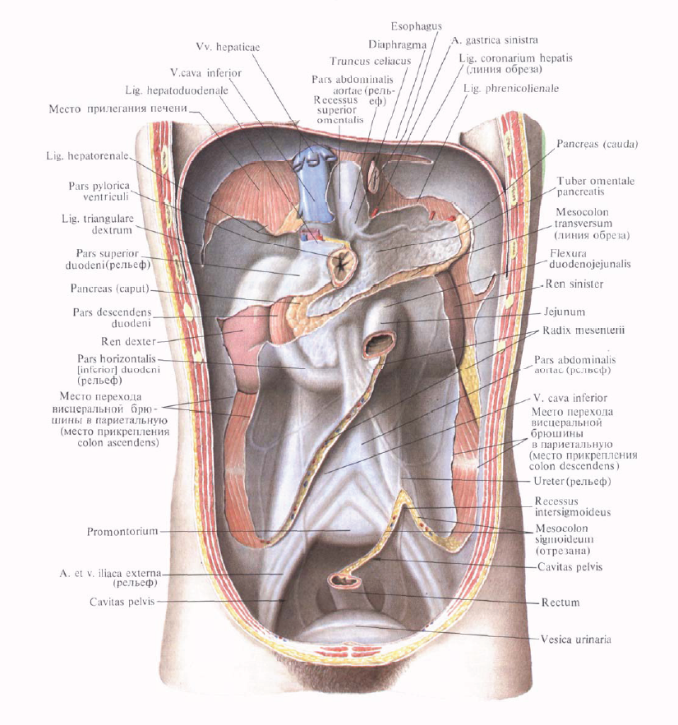
Parietal peritoneum (posterior wall of abdominal cavity)

Slide 5
Parietal peritoneum (Internal surface of anterolateral abdominal wall)

Slide 6
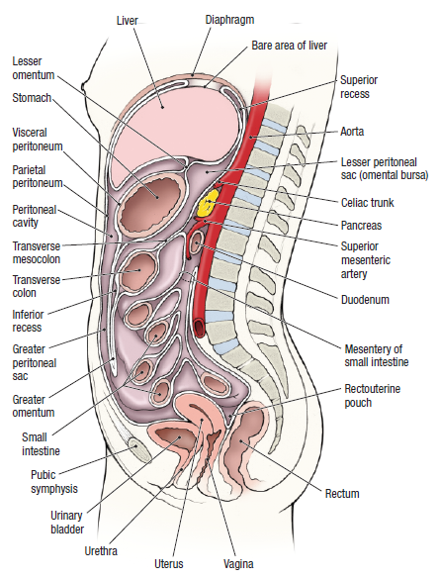
Anatomy of the peritoneum

Slide 7
How does a peritoneum cover organs?
Completely (From all sides)
From three sides
Only from one sides
Intraperitoneal
Mesoperitoneal
Extraperitoneal
(retro-; infra-)
Stomach, jejunum, ileum,
cecum with appendix,
transverse & sigmoid colon,
spleen, fallopian tube,
upper third of the rectum
Liver, ascending &
descending colon,
uterus,
urinary bladder (full),
middle third of the rectum
Pancreas, duodenum,
kidney, adrenal gland,
ureters,
urinary bladder (empty),
lower third of the rectum

Slide 8
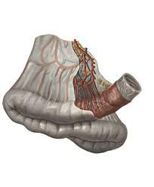
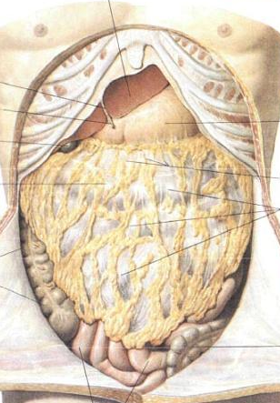
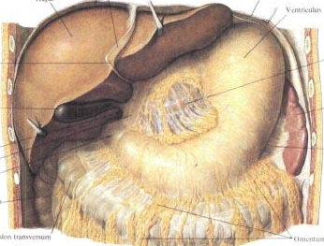
Derivatives of peritoneum
Spaces
Structures
Bursa`s
Sinuses
Canals (gutters)
Recesses
Pouches
Omentums
Mesenteries
Ligaments

Slide 9
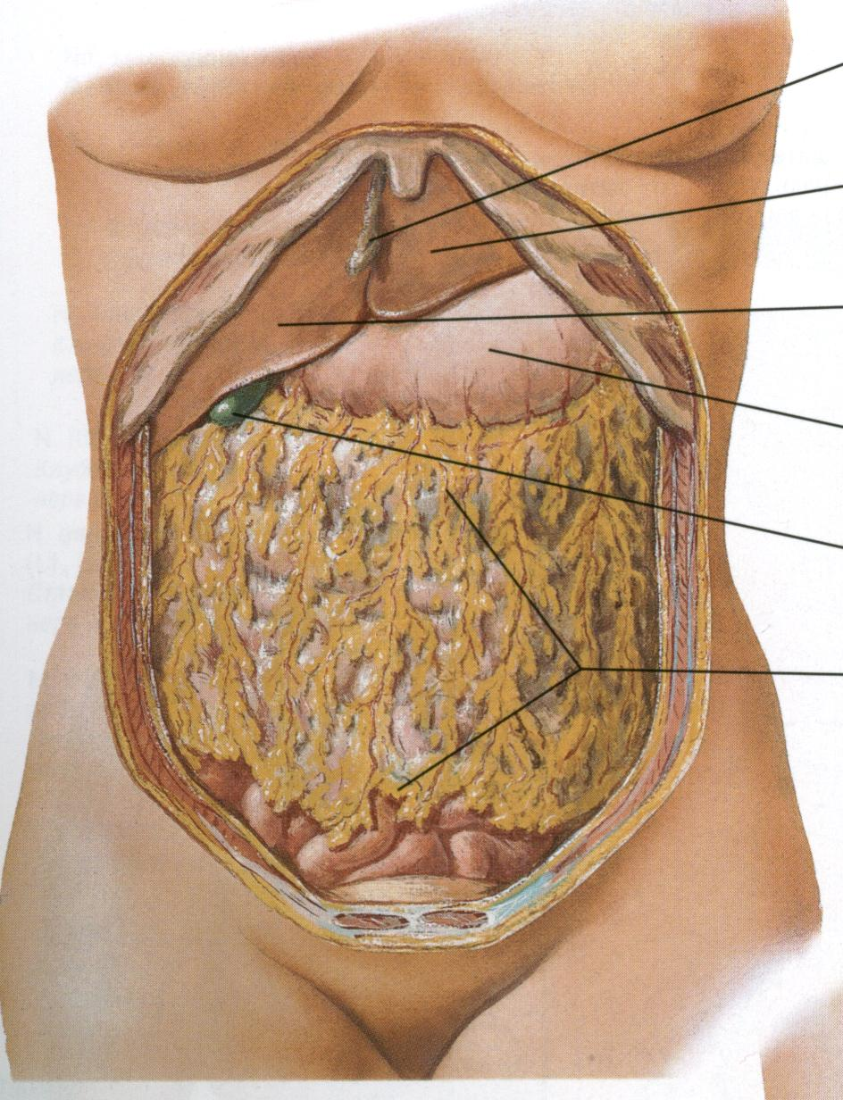
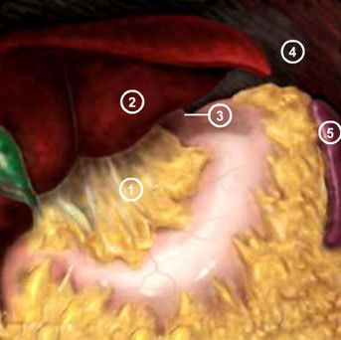
Omentums

Slide 10
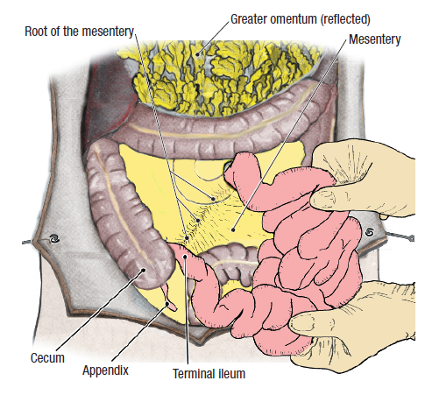
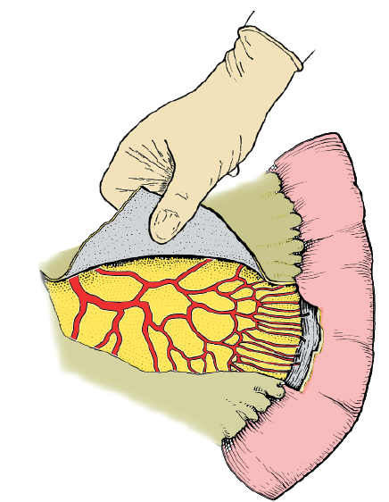
Mesentery

Slide 11
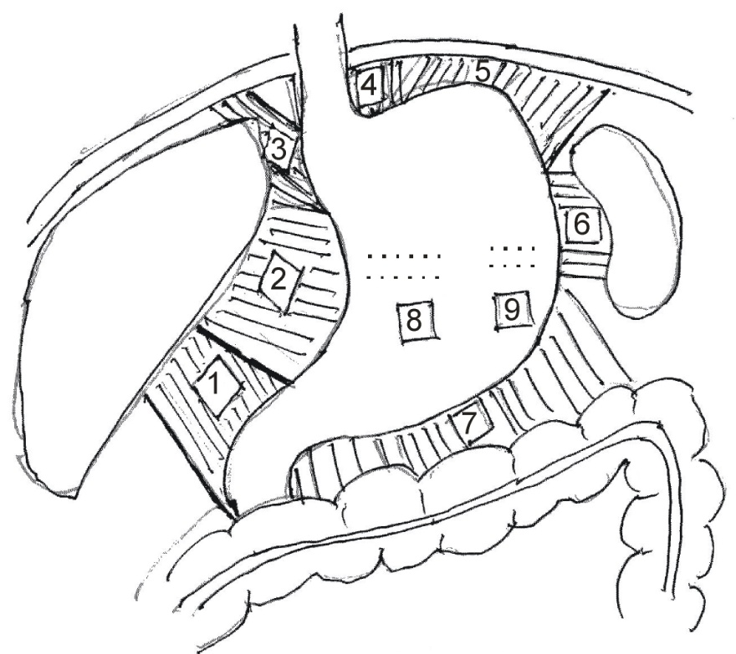
Ligaments of stomach

Slide 12
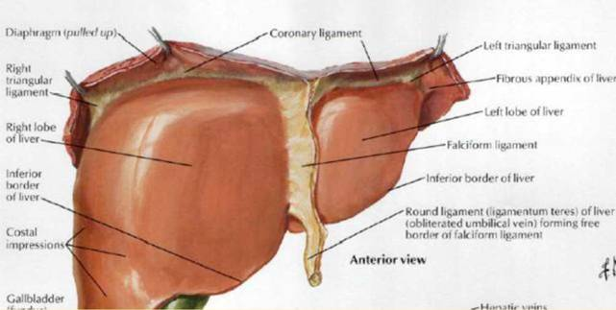
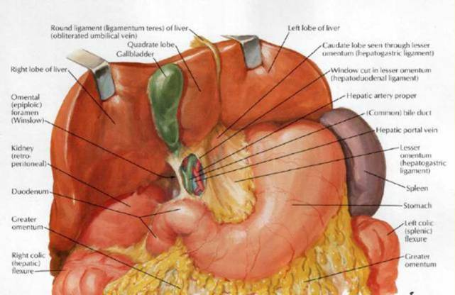
Ligaments of the liver

Slide 13
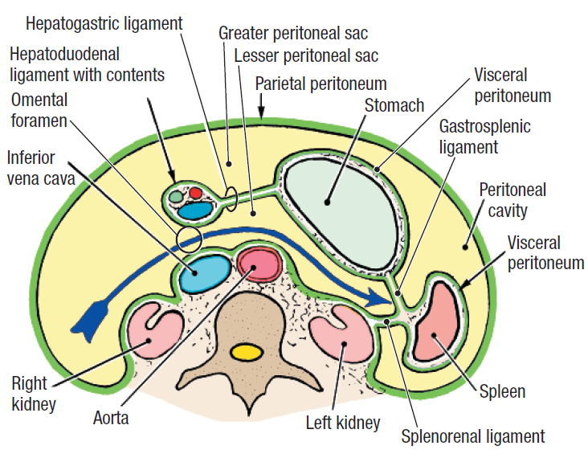
Omental bursa

Slide 14
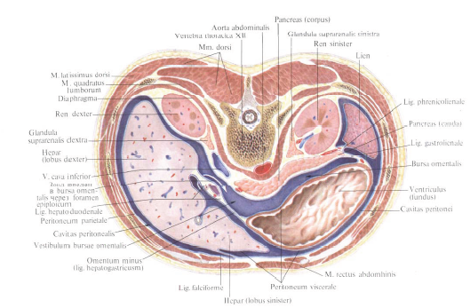
Omental bursa

Slide 15
Anatomy of the peritoneum

Slide 16
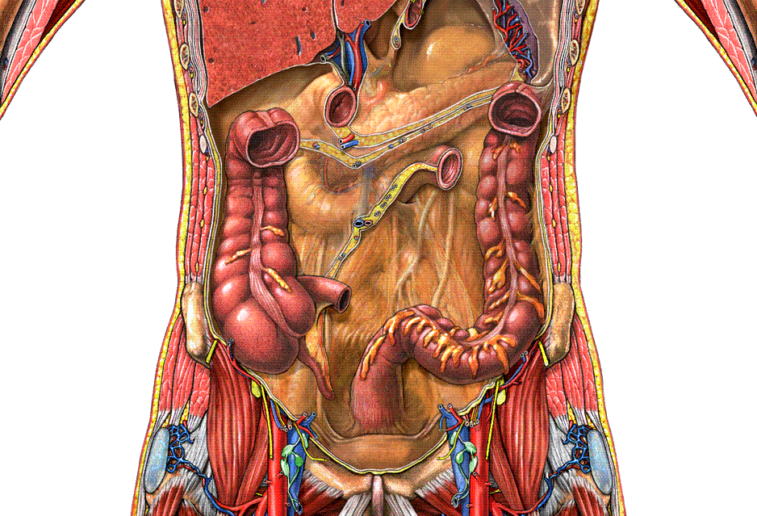
Mesenteric sinuses

Slide 17
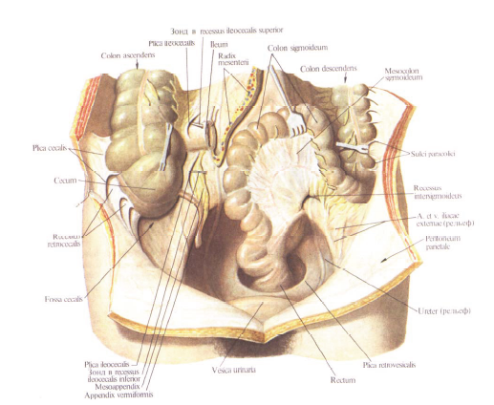
Organs of the lower floor (storey) of the abdominal cavity

Slide 18
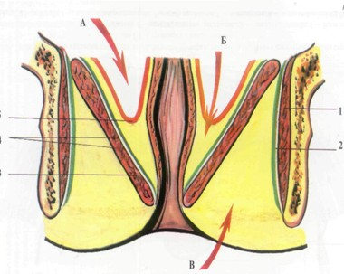
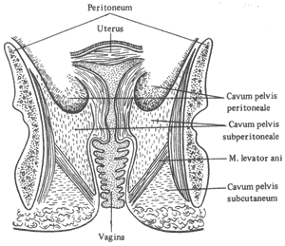
Peritoneal floor (storey) of the pelvis

Slide 19
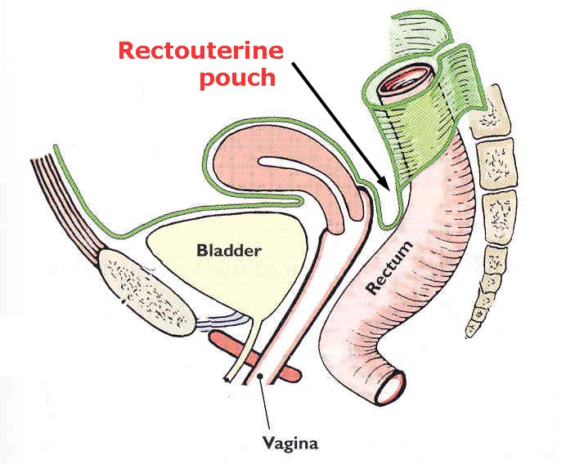
The Douglas pouch

