Slide 1
Department of human anatomy
Lecture
“introduction to human anatomy.
Osteology & Syndesmology ”
Lecturer: MD, PhD mr. Oleg Vovk

Slide 2
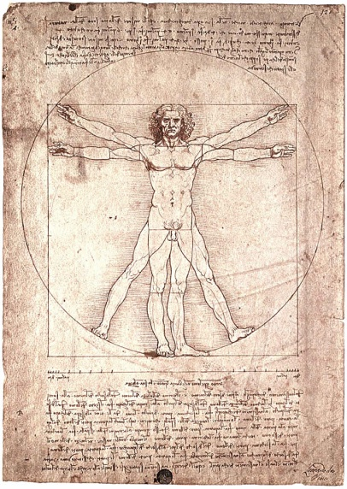
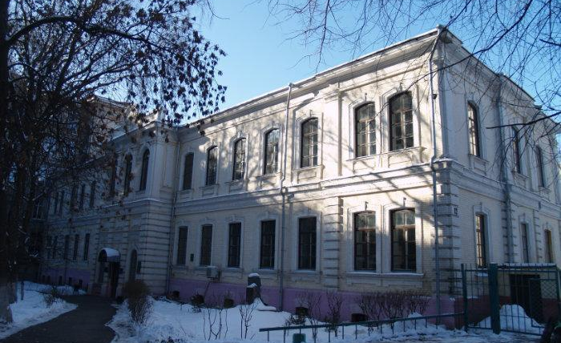
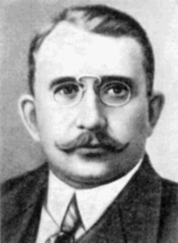
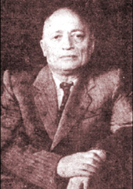
Welcome to Human anatomy!
Prof. Vorobiev V.P.
Prof. Sinelnikov R.D.

Slide 3
Introduction to anatomy
Anatomy is the scientific study of the structure of human bodies
In relation to the size of the parts studied, anatomy is usually divided into (1) macroscopic or gross anatomy, and (2) microscopic anatomy or histology (now used synonymously).
In general, works dealing with human anatomy are arranged either (1) systemically, that is, according to the various systems of the body (skeletal, muscular, digestive, etc.) or (2) regionally, that is, according to the natural, main subdivisions of the body (head and neck, upper limb, thorax, etc.).

Slide 5
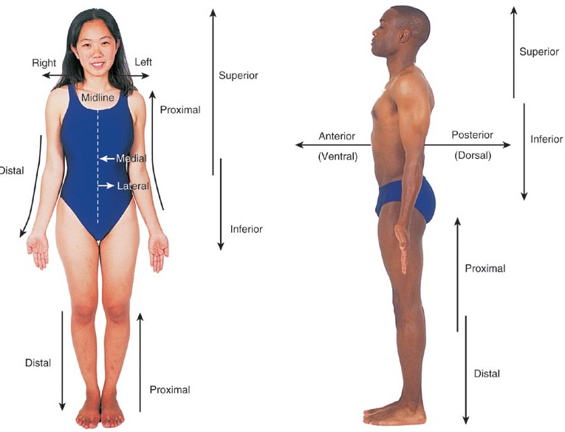

Slide 6
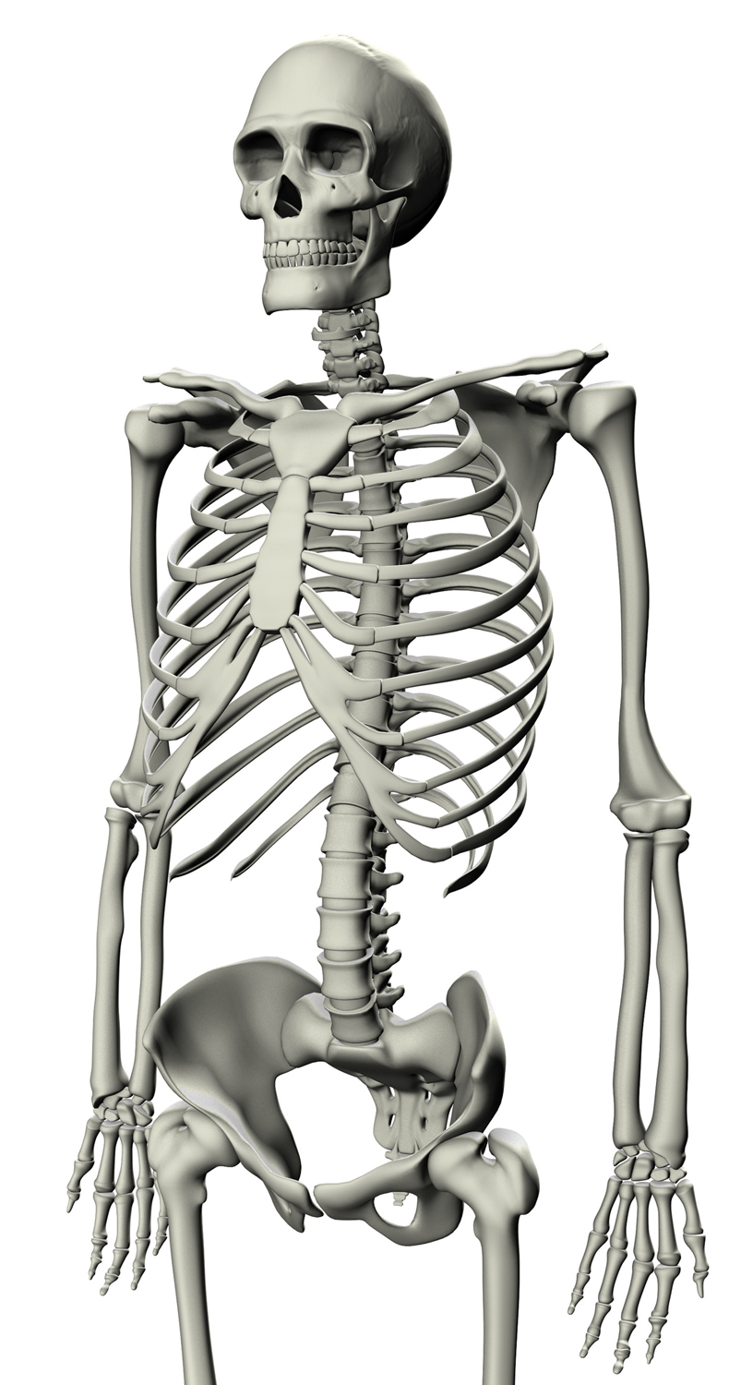
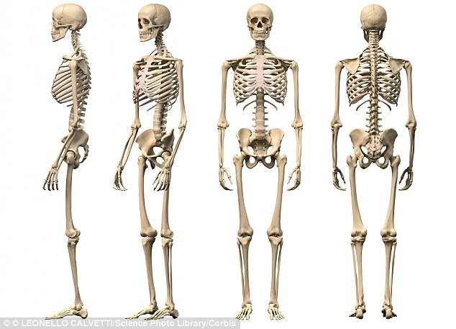
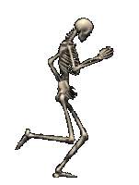
Osteology is the scientific study of bones

Slide 7
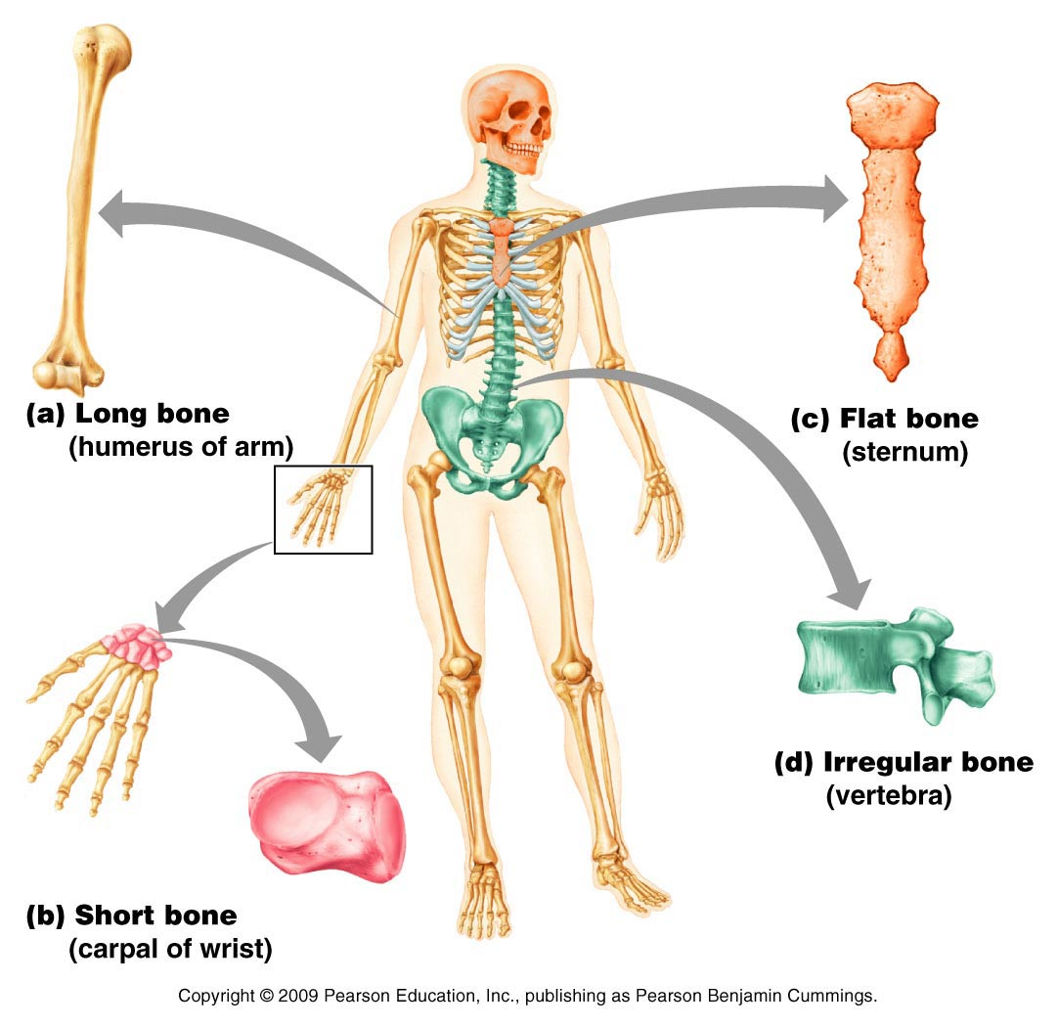
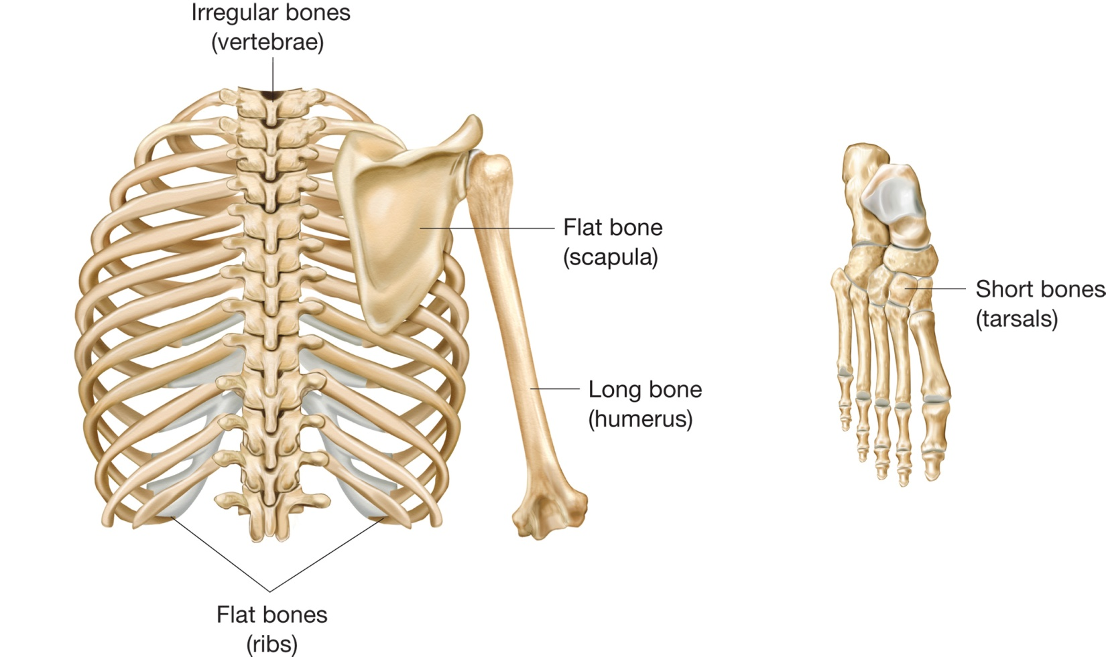
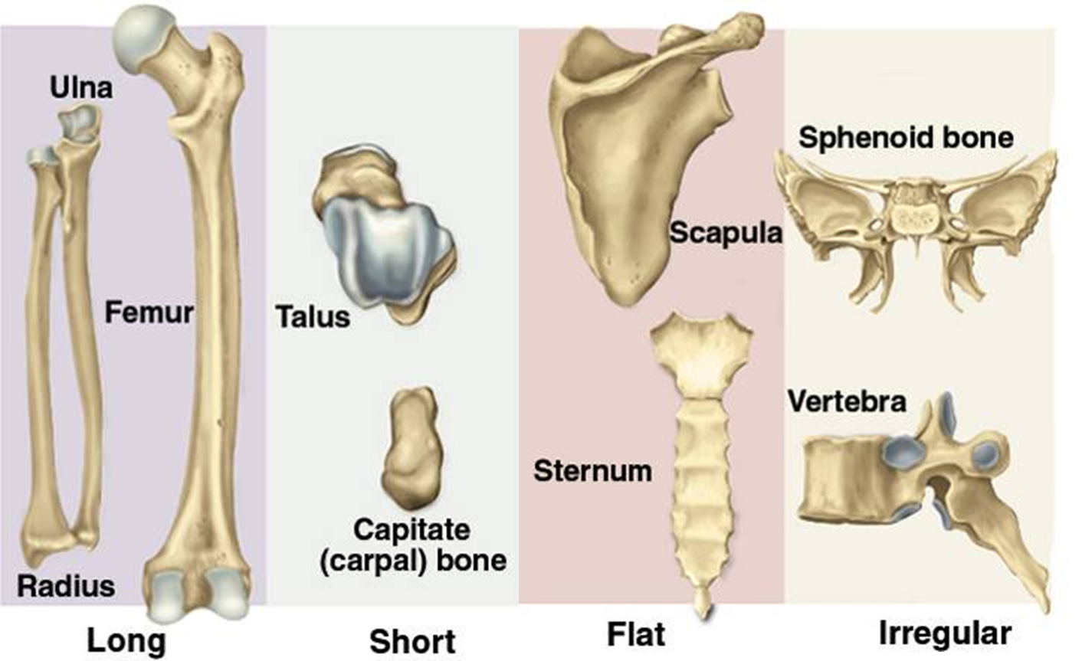
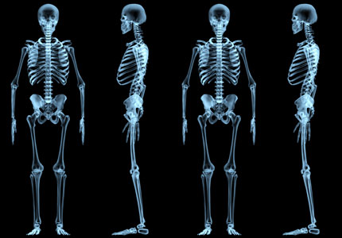
Bones
classification

Slide 8
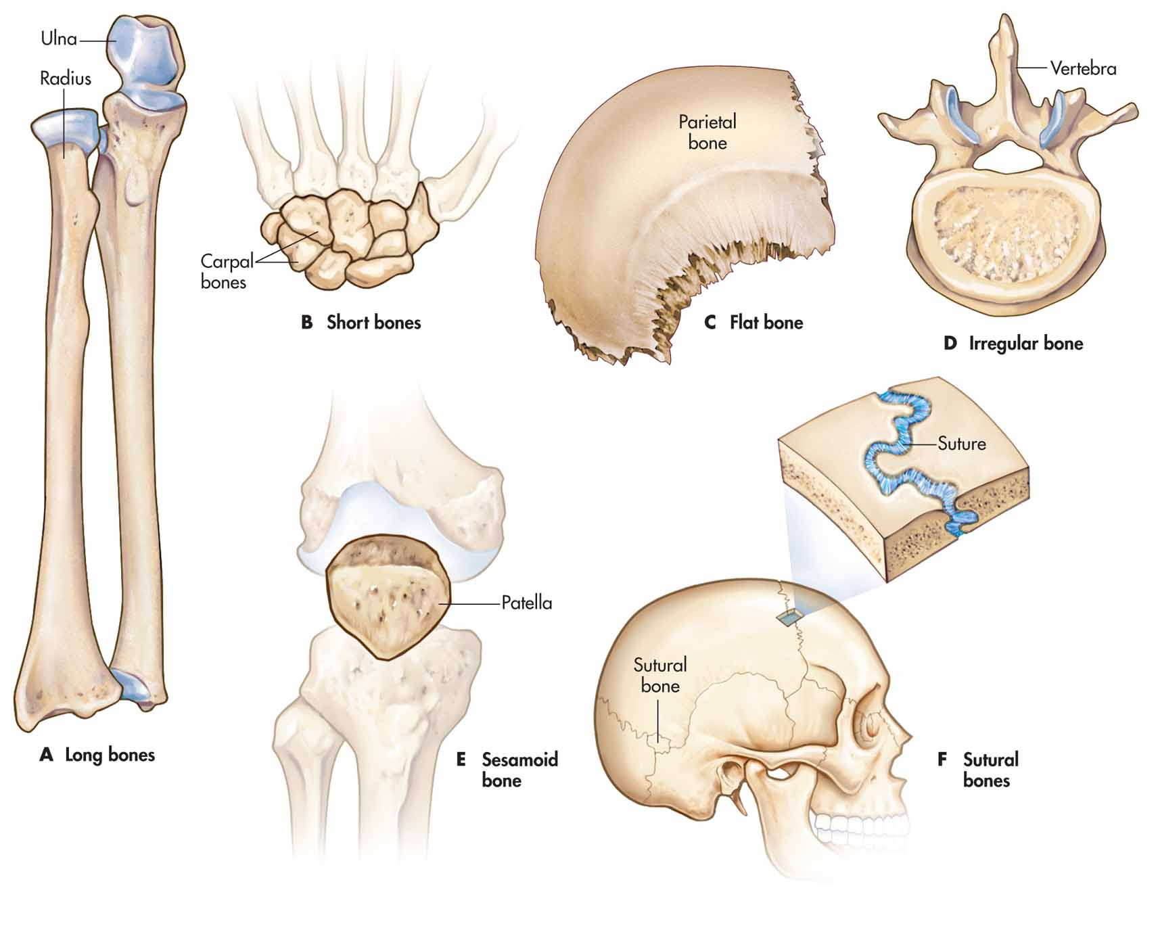

Slide 9
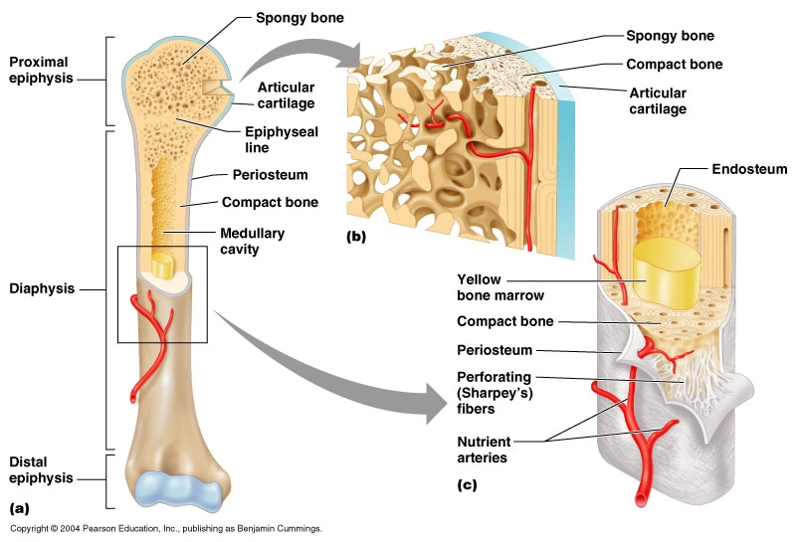

Slide 10
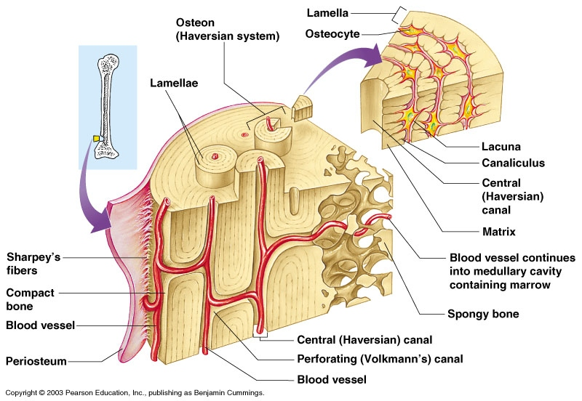

Slide 11
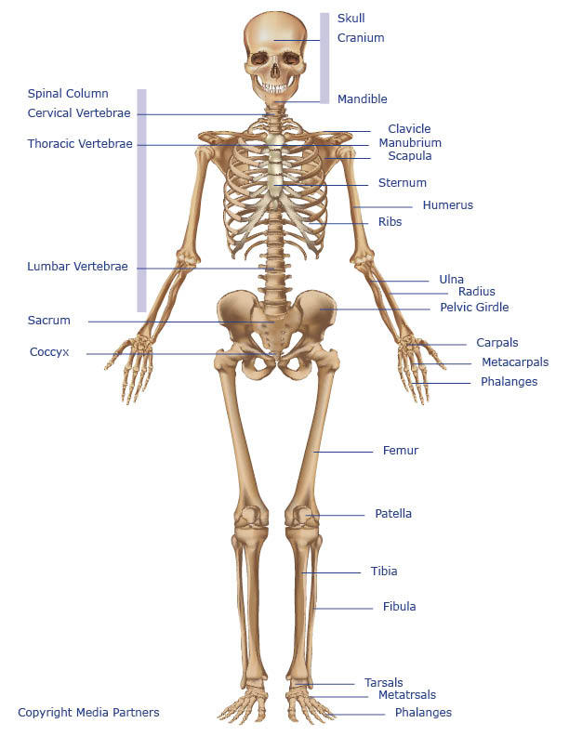
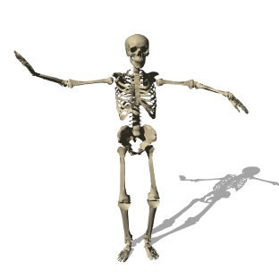

Slide 12
Bones of the hand

Slide 13
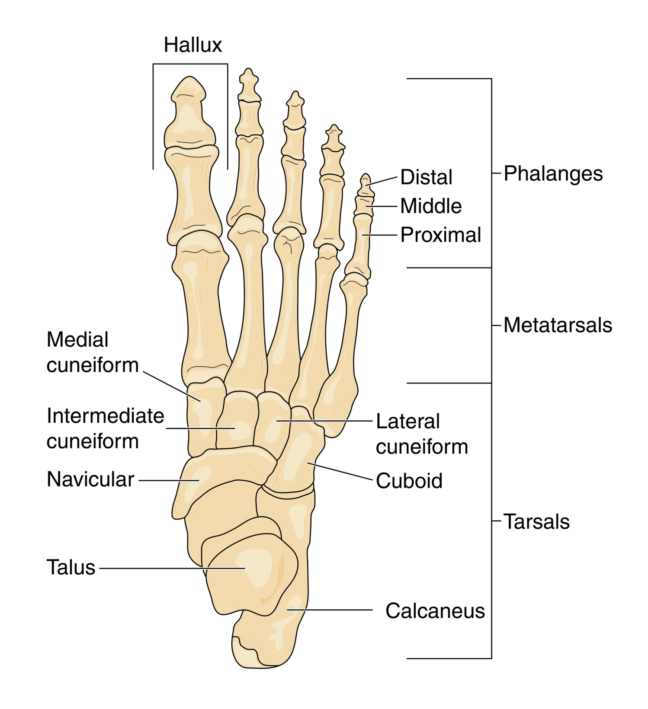
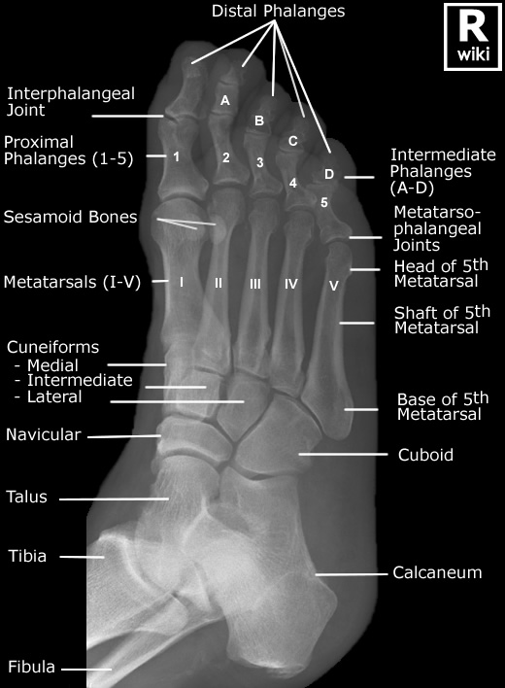
Bones
of the foot

Slide 14
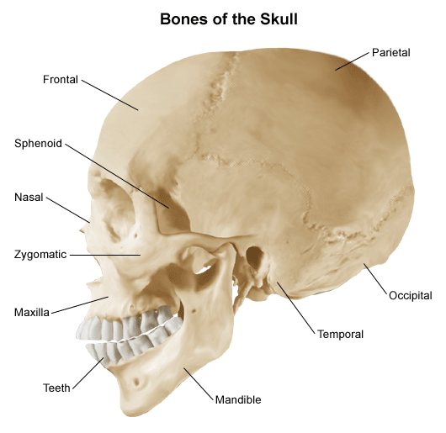
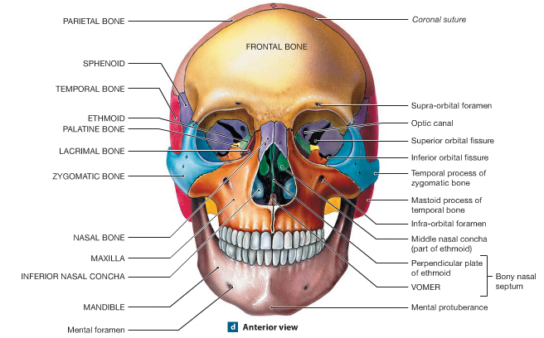
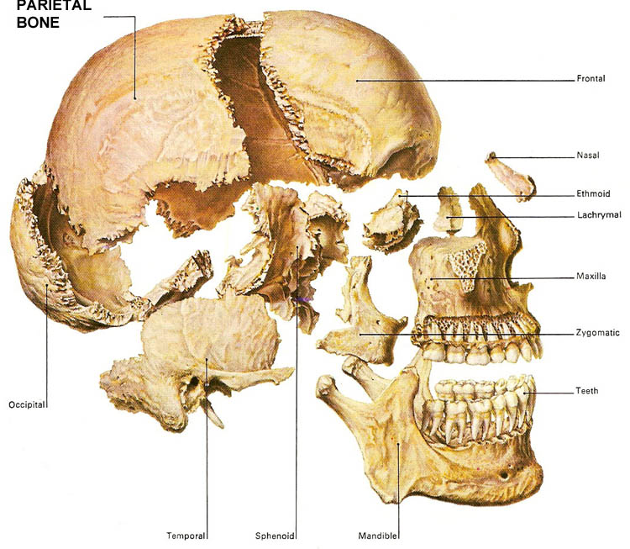
Bones of the skull

Slide 15
Syndesmology the branch of anatomy dealing with joints and their components

Slide 16
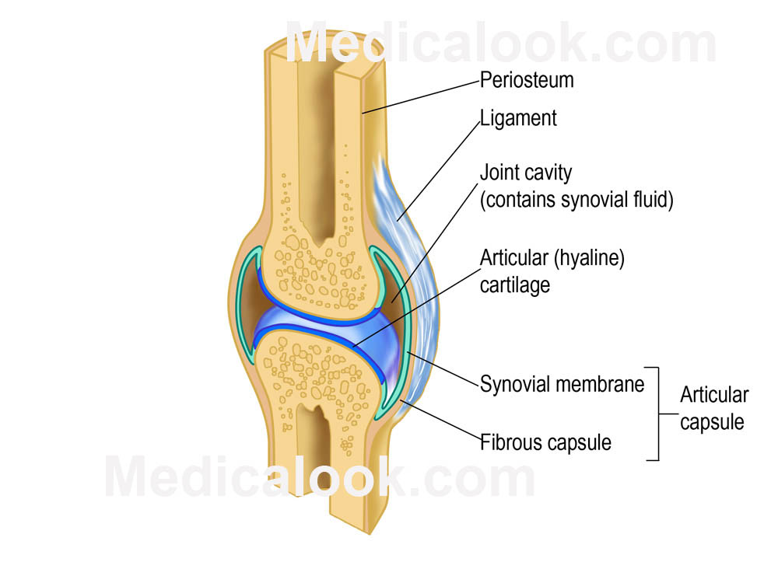
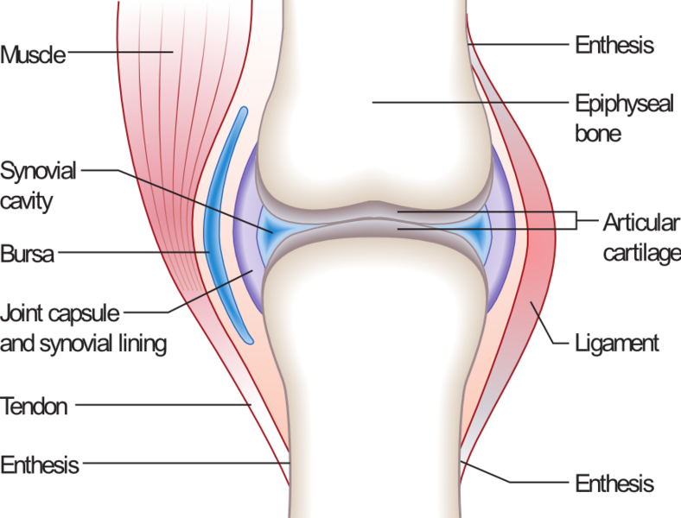
Syndesmology the branch of anatomy dealing with joints and their
components

Slide 17
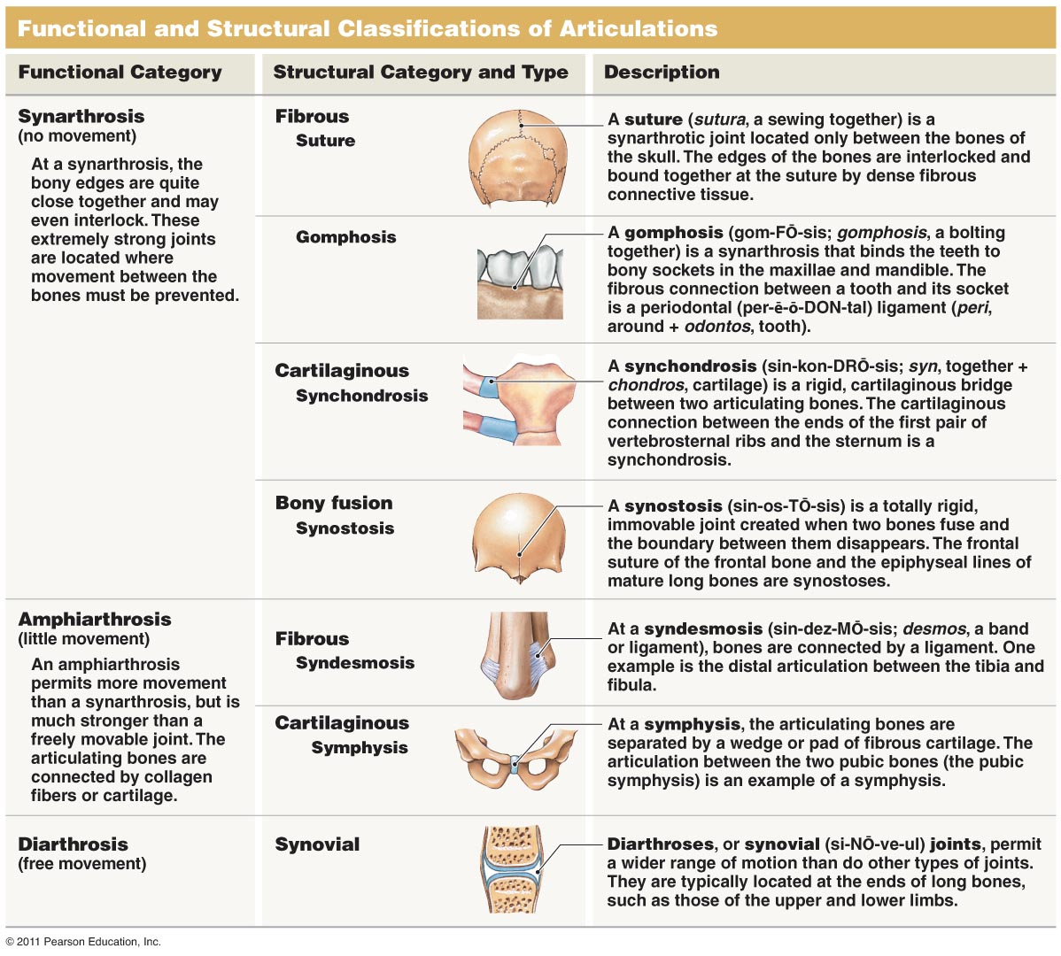

Slide 18
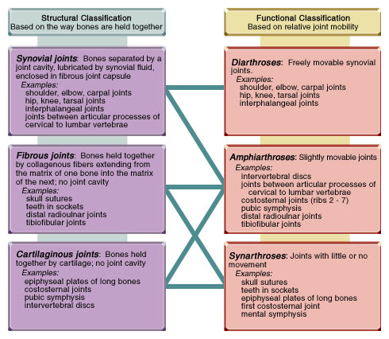

Slide 19
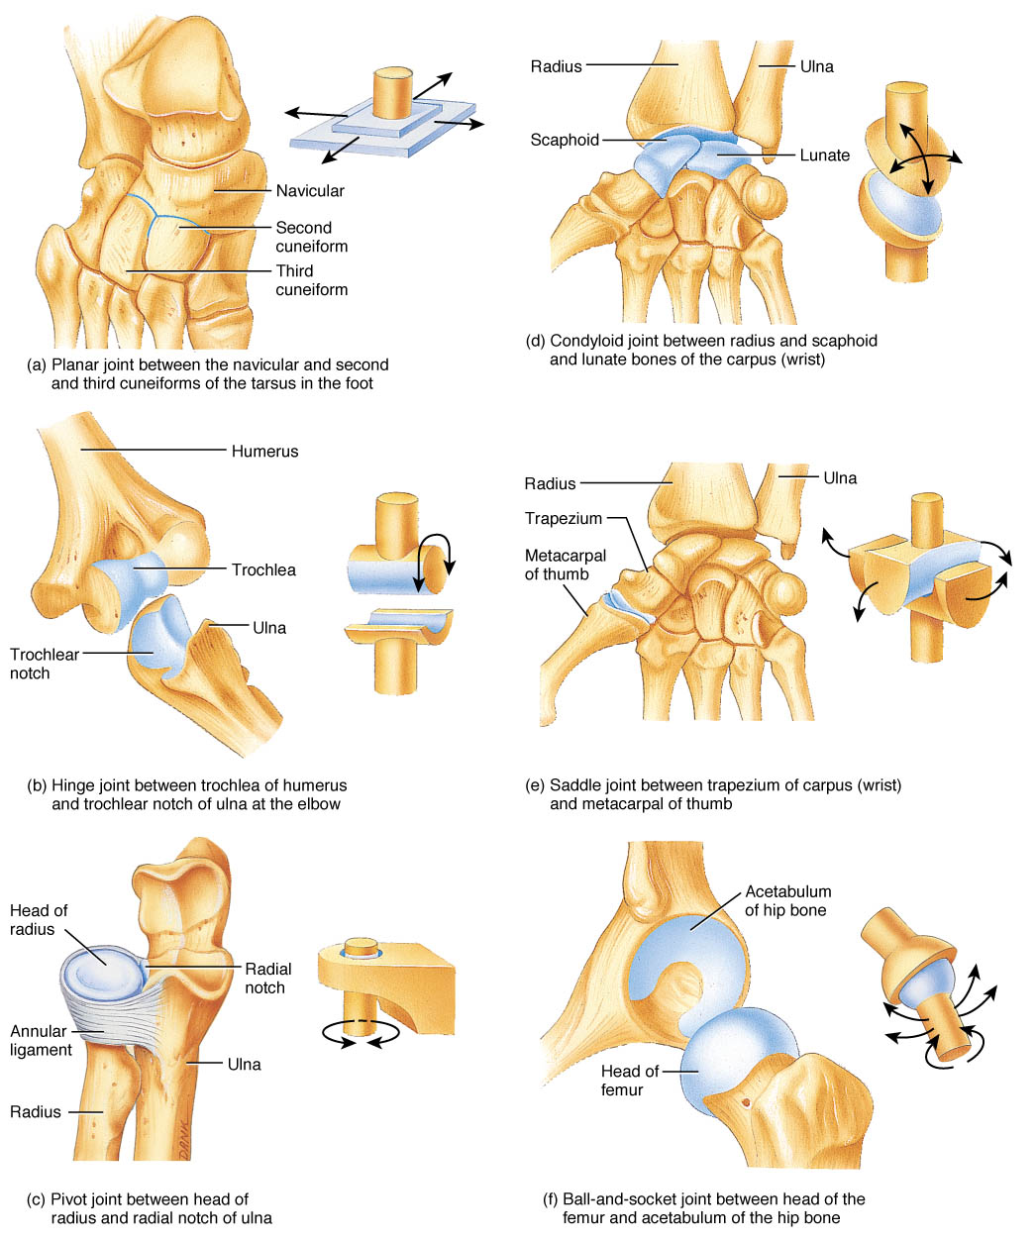
Types of joint

Slide 20
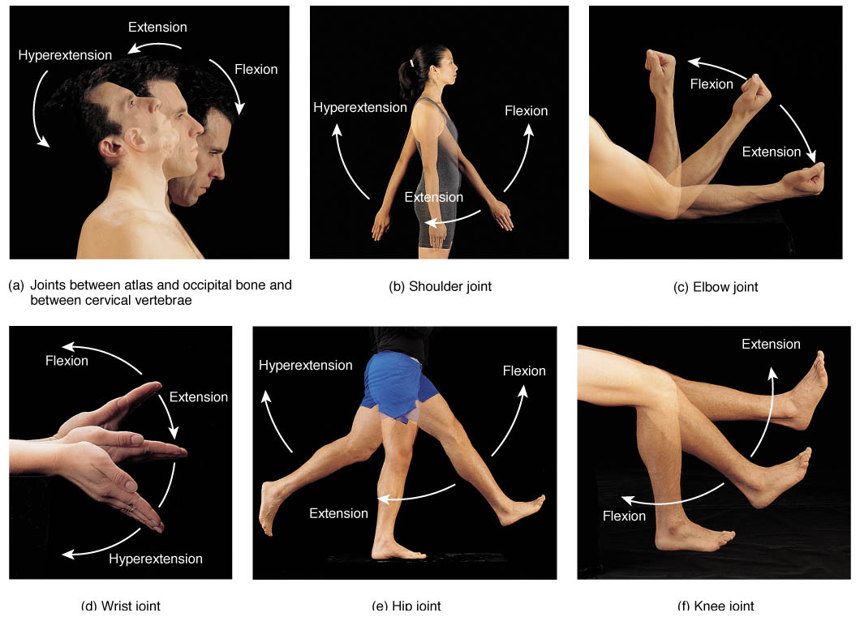

Slide 21
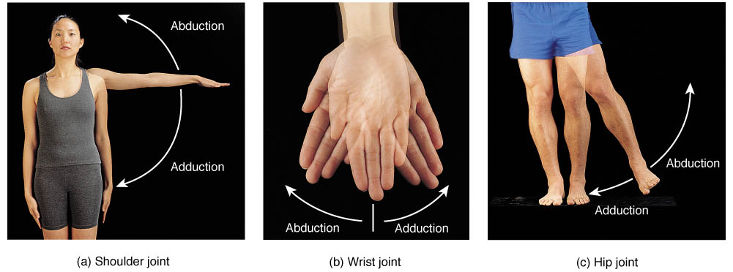
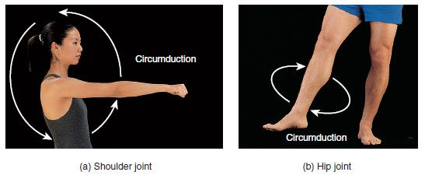

Slide 22
