Slide 1
Department of Human Anatomy KNMU Anatomy of the endocrine glands
Slide-lecture for students of the 6 Faculty of Medicine
Lector – associate professor Zharova Nataliya
2015

Slide 2
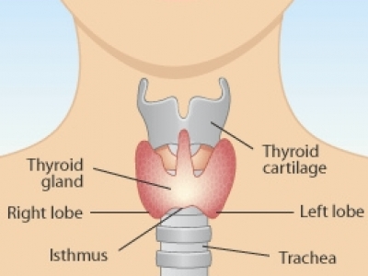
THE THYROID GLAND

Slide 5
Anatomy of and organ- topography
The thyroid gland is a butterfly-shaped organ and is composed of two cone-like lobes or wings, lobus dexter (right lobe) and lobus sinister (left lobe), connected via the isthmus. The organ is situated on the anterior side of the neck, lying against and around the larynx and trachea, reaching posteriorly the esophagus and carotid sheath. It starts cranially at the oblique line on the thyroid cartilage (just below the laryngeal prominence, or “Adam’s apple”), and extends inferiorly to approximately the fifth or sixth tracheal ring.

Slide 6
External structure
The thyroid gland is covered by a thin fibrous sheath (capsula glandulae thyroidea), composed of an internal and external layer. The external layer is anteriorly continuous with the pretracheal fascia and posteriorolaterally continuous with the carotid sheath. The gland is covered anteriorly with infrahyoid muscles and laterally with the sternocleidomastoid muscle. On the posterior side, the gland is fixed to the cricoid and tracheal cartilage and cricopharyngeus muscle by a thickening of the fascia to form the posterior suspensory ligament of Berry. The thyroid gland's firm attachment to the underlying trachea is the reason behind its movement with swallowing. In variable extent, Lalouette's Pyramid a pyramidal extension of the thyroid lobe, is present at the most anterior side of the lobe. In this region, the recurrent laryngeal nerve and the inferior thyroid artery pass next to or in the ligament and tubercle.
Between the two layers of the capsule and on the posterior side of the lobes, there are on each side two parathyroid glands.

Slide 7
Histology
At the microscopic level, there are three primary features of the thyroid:
Feature | Description
Follicles | The thyroid is composed of spherical follicles that selectively absorb iodine (as iodide ions, I⁻) from the blood for production of thyroid hormones, and also for storage of iodine in thyroglobulin. 25% of the body's iodide ions are in the thyroid gland. Inside the follicles, in a region called the follicular lumen, colloid serves as a reservoir of materials for thyroid hormone production and, to a lesser extent, acts as a reservoir for the hormones themselves. Colloid is rich in a protein called thyroglobulin.
Thyroid epithelial cells (or "follicular cells") | The follicles are surrounded by a single layer of thyroid epithelial cells, which secrete T₃ and T₄. When the gland is not secreting T₃ and T₄ (inactive), the epithelial cells range from low columnar to cuboidal cells. When active, the epithelial cells become tall columnar cells.
Parafollicular cells (or "C cells") | Scattered among follicular cells and in spaces between the spherical follicles are another type of thyroid cell, parafollicular cells, which secrete calcitonin.

Slide 8
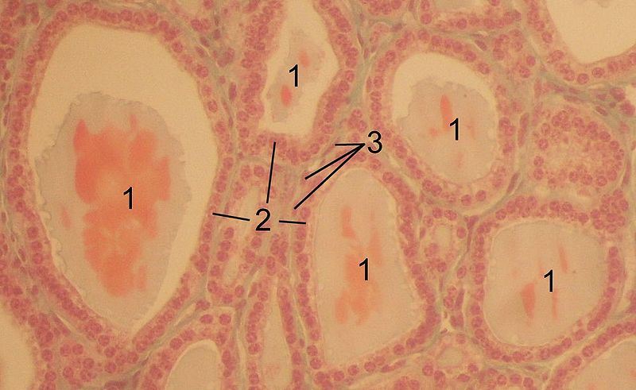
1 follicles, 2 follicular epithelial cells, 3 endothelial cells

Slide 10
Physiology
The primary function of the thyroid is production of the hormones T₃, T₄ and calcitonin. Up to 80% of the T₄ is converted to T₃ by organs such as the liver, kidney and spleen. T₃ is several times more powerful than T₄ ,which is largely a prohormone, perhaps four or even ten times more active.
Thyroid hormones play a particularly crucial role in brain maturation during fetal development.
Regulation of actin polymerization by T₄ is critical to cell migration in neurons and glial cells and is important to brain development.
The hormone calcitonin participates in calcium (Ca²⁺) and phosphorus metabolism. In many ways, calcitonin counteracts parathyroid hormone (PTH).

Slide 11
T₃ and T₄ regulation
The production of thyroxine and triiodothyronine is regulated by thyroid-stimulating hormone (TSH), released by the Anterior pituitary. The thyroid and thyrotropes form a negative feedback loop: TSH production is suppressed when the T₄ levels are high. The TSH production itself is modulated by thyrotropin-releasing hormone (TRH), which is produced by the hypothalamus and secreted at an increased rate in situations such as cold exposure (to stimulate thermogenesis).
TSH production is blunted by somatostatin (SRIH), rising levels of glucocorticoids and sex hormones (estrogen and testosterone), and excessively high blood iodide concentration.

Slide 12
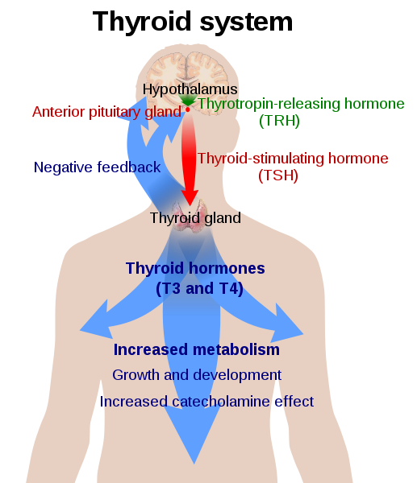

Slide 13
Pathology
Thyroid disorders include:
Hyperthyroidism (abnormally increased activity) - is due to the overproduction oft he thyroid hormones T₃ and T₄, which is most commonly caused by the development of Graves' disease, an autoimmune disease in which antibodies are produced which stimulate the thyroid to secrete excessive quantities of thyroid hormones.
Hypothyroidism (abnormally decreased activity) - disorders may occur as a result of:congenital thyroid abnormalities (Thyroid deficiency at birth,autoimmune disorders such as Hashimoto's thyroiditis, iodine deficiency (more likely in poorer countries) or,the removal of the thyroid following surgery to treat severe hyperthyroidism and/or thyroid cancer.

Slide 14
Thyroiditis (inflammation of the thyroid)- There are two types of thyroiditis where initially hyperthyroidism presents which is followed by a period of hypothyroidism; (the overproduction of T₃ and T₄ followed by the underproduction of T₃ and T₄). These are Hashimoto's thyroiditis and postpartum thyroiditis.
Thyroid nodules, which are generally benign thyroid neoplasms (tumors), but may be thyroid cancers.
All these disorders may give rise to a goiter, that is, an enlarged thyroid.

Slide 15
PARATHYROID GLAND OVERVIEW OF PARATHYROID GLAND
Four parathyroid glands are found near the posterior aspect of the thyroid gland.
They are small (20-40 mg) and have a beanlike shape.
These 4 glands produce parathyroid hormone (PTH), which helps to maintain calcium homeostasis by acting on the renal tubule as well as calcium stores in the skeletal system and by acting indirectly on the gastrointestinal tract through the activation of vitamin D.
The parathyroid glands have a distinct, encapsulated, smooth surface that differs from the thyroid gland, which is has a more lobular surface, and lymph nodes, which are more pitted in appearance. The color of the parathyroid glands is typically light brown to tan, which relates to their fat content, vascularity, and percentage of oxyphil cells within the glands.^{[1]} The yellow color may be confused with surrounding fat. A distinct hilar vessel is also present that can be seen if the surrounding fat does not obscure the glands' hila.
The superior parathyroid glands are most commonly located in the posterolateral aspect of the superior pole of the thyroid gland at the cricothyroidal cartilage junction. They are most commonly found 1 cm above the intersection of the inferior thyroid artery and the recurrent laryngeal nerve (see the image below). The inferior parathyroid glands are more variable in location and are most commonly found near the lower thyroid pole of the thyroid.
Recurrent laryngeal nerve and parathyroid relationship.

Slide 18
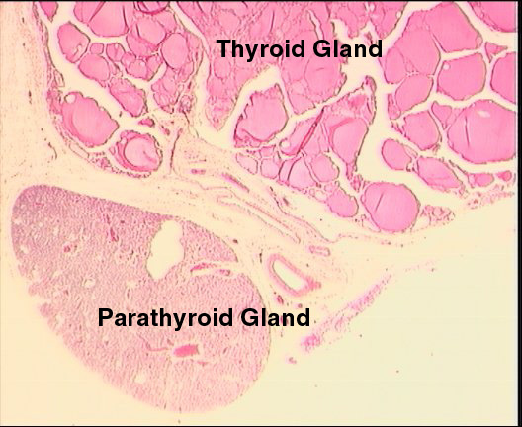

Slide 19
BLOOD SUPPLY AND VASCULAR ANATOMY
Because the inferior thyroid arteries provide the primary blood supply to the posterior aspect of the thyroid gland where the parathyroid glands are located, branches of these arteries usually supply the parathyroid glands. However they may also be supplied by the branches of the superior thyroid arteries; the thyroid ima artery; or the laryngeal, tracheal and esophageal artery. Parathyroid veins drain into thyroid plexus of veins of the thyroid gland.
The inferior parathyroid gland is supplied by the inferior thyroid artery from the thyrocervical trunk. Studies have shown that in approximately 10% of patients, the inferior thyroid artery is absent, most commonly on the left side. In these cases, a branch from the superior thyroid artery supplies the inferior parathyroid gland.^{[3]}Inferior parathyroid glands that descend into the anterior mediastinum are usually vascularized by the inferior thyroid artery. If a parathyroid is positioned low in the mediastinum, it may be supplied by a thymic branch of the internal thoracic artery or even a direct branch of the aortic arch.^{[4]}
The superior parathyroid gland is also usually supplied by the inferior thyroid artery or by an anastomotic branch between the inferior thyroid and the superior thyroid artery. Several studies have indicated that in 20-45% of cases, the superior parathyroid glands receive significant vascularity from the superior thyroid artery. This is usually in the form of a posterior branch of the superior thyroid artery given off at the level of the superior pole of the thyroid

Slide 21
DEVELOPMENT OF PARATHYROID GLANDS
The parathyroid glands develop from the endoderm of the third and fourth pharyngeal pouches. The thymus is also derived from the third pharyngeal pouch. The inferior parathyroid glands are derived from the dorsal part of the third pharyngeal pouch, and the thymus arises from the ventral part of the third pharyngeal pouch. As the inferior parathyroid glands and the thymus migrate together toward the mediastinum, they eventually separate. In most cases, the inferior parathyroid glands become localized near the inferior poles of the thyroid, and the thymus continues to migrate toward the mediastinum.
The superior parathyroid glands are derived from the fourth pharyngeal pouch and migrate together with the ultimobranchial bodies. The ultimobranchial bodies also develop from the fourth pharyngeal pouch, and, during the fifth week of development, these cells detach from the pharyngeal wall and fuse with the posterior aspect of the main body of the thyroid as it descends into the neck. These cells differentiate into the parafollicular cells (C cells) that secrete calcitonin.^{[2]} The superior parathyroid glands migrate a shorter distance than the inferior glands, which results in a relatively more constant location in the neck.
Because the superior parathyroid glands travel with the ultimobranchial bodies, they remain in contact with the posterior part of the middle third of the thyroid lobes.

Slide 22
FUNCTIONS OF PARATHYROID GLANDS
The major function of the parathyroid glands is to maintain the body's calcium level within a very narrow range, so that the nervous and muscular systems can function properly.
Parathyroid hormone (PTH, also known as parathormone) is a small protein that takes part in the control of calcium and phosphate homeostasis, as well as bone physiology. Parathyroid hormone has effects antagonistic to those of calcitonin.
Calcium. PTH increases blood calcium levels by stimulating osteoclasts to break down bone and release calcium. PTH also increases gastrointestinal calcium absorption by activating vitamin D, and promotes calcium conservation (reabsorption) by the kidneys.
Phosphate. PTH is the major regulator of serum phosphate concentrations via actions on the kidney. It is an inhibitor of proximal and also distal tubular reabsorption of phosphorus. Through activation of Vitamin D the absorption of Phosphate is increased.

Slide 23
DISEASES AND LYMPHATIC DRAINAGE
Many conditions are associated with disorders of parathyroid function. These can be divided into those causing hyperparathyroidism, and those causing hyperparathyroidism.
Lymphatic vessels from the parathyroid glands drain into deep cervical lymph nodes and paratracheal lymph nodes.

Slide 24
SURGERY AND SURGERY PROCEDURE FOR PARATHYROID GLANDS
Parathyroid surgery is usually performed when there is hyperparathyroidism. This condition causes many diseases related with calcium reabsorption, because the principal function of the parathyroid hormone is to regulate it. Parathyroid surgery could be performed in two different ways: first is a complete parathyroidectomy, and second is the auto transplantation of the removed parathyroid glands. There are various conditions that can indicate the need for the removal or transplant of the parathyroid glands. Hyperparathyroidism is a condition caused by overproduction of PTH, and can be divided into three types.
Primary hyperparathyroidism happens when the normal mechanism of regulation by negative feedback of calcium is interrupted, or in other words the amount of blood calcium would ordinarily signal less production of PTH. Most of the time this is caused by adenomas, hyperplasia or carcinomas.]
Secondary hyperparathyroidism normally occurs in patients that suffer renal disease. Poor kidney function leads to a mineral disequilibrium that causes the glands hypertrophy in order to synthesize and release more PTH.
Tertiary hyperparathyroidism develops when the hyperplastic gland of secondary hyperparathyroidism constantly releases PTH, independent of the regulation systems.
Another condition is hypercalcemia, which refers to a calcium level above 10.5 mg/dL. Consequences of this are heart rhythm diseases, and extra production of gastrin that causes peptic ulcers.
Parathyroid transplant is recommended if the parathyroid glands are removed accidentally during a thyroidectomy. They are autotransplanted to the nearby sternocleidomastoid muscle, or to the forearm so that another intervention would be less risky. A biopsy is recommended to be sure that the transplanted tissue is parathyroid and not a lymph node with metastatic disease. During parathyroid surgery if there is an adenoma the transplantation is not recommended; instead it is cryopreserved for research an if there is a recurrent hypoparathyroidism.
The surgery is indicated for all patients that are diagnosed with hyperparathyroidism with or without symptoms, especially in younger patients. In some cases the surgery works as therapy for nephrolithiasis, bone changes, and neuromuscular symptoms

Slide 25
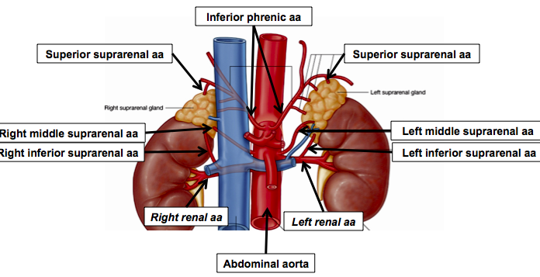
SUPRARENAL GLANDS
Paired organs situated in the extraperitoneal space on the upper poles of kidneys. -Right suprarenal gland has a shape of triangular pyramid and the left is crescent shaped. - size: 50x30x5 mm - weigh: about 12g - each gland has: anterior; posterior and renal surfaces delimited by posterior and medial borders. -the anterior surface contains the hilium of gland.

Slide 26
TOPOGRAPHY
-They reside at the level of Th 11- Th 12 - The right gland neighbors the lumbar part of diaphragm posteriorly, the visceral surface of liver and ascending part of duodenum anteriorly, the upper pole of kidney inferiorly, and the inferior vena cava medially. -The left gland neighbors the descending aorta -medially, the tail of pancreas and cardial part of stomach -anteriorly, the diaphragm -posteriorly and the upper pole of the left kidney -inferiorly. - Each adrenal gland has two distinct structures, the outer adrenal cortex and the inner medulla, both of which produce hormones.

Slide 27
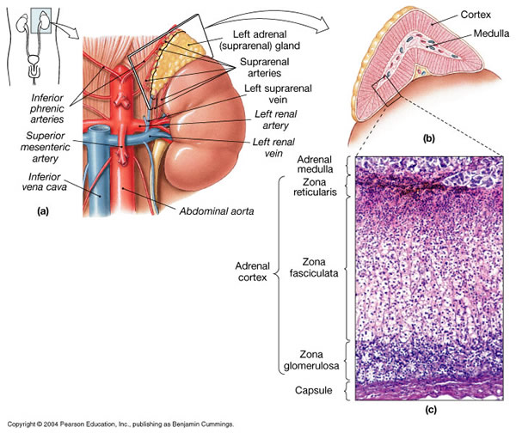
STRUCTURES
Yellowish and covered with connective
tissue capsule. The adrenal cortex comprises three zones, or layers: Zona glomerulosa, fasciculata and reticularis.
- Zona glomerulosa: produces mineralocorticoid hormone e.g: aldosterone -Zona fasciculatta: involves in production of glucocorticoid hormones e.g : cortisol -Zona reticumaris: produces androgens.
Consist of Medulla, -The medulla is the core of the adrenal gland, and is surrounded by the adrenal cortex. -It secretes approximately 20% noradrenaline (norepinephrine) and 80% adrenaline (epinephrine). -The chromaffin cells of the medulla, named for their characteristic brown staining with chromic acid salts, are the body's main source of the circulating catecholamines adrenaline and noradrenalinethat are precursor to testoterone.

Slide 28
HYSTOLOGY OF SUPRARENAL GLANDS
1-Cortex -develops from interrenal tissue which arises from mesoderm and appears as cell aggregation residing in area of dorsal mesentery root.
-In the process of development , the primary primordia of cortex become enfolded by secondary mesodermal cell aggregation.
-During the embryonic stage, the cells of primary cortex grow to form the most part of gland.
-After birth, the primary cortex involutes and becomes replaced by definitive tisuue, which functions through the rest of individuals’ life.
2- Medulla -develops from ectodermal cells, which generally from the sympathetic ganglia (sympathoblasts). -A part of cells from developing ganglia travel in direction of cortical substance and accumulate inside it to form the medulla. -As a far as the medulla migrates to the cortex its tissue gained the name adrenal ( kidney) -The adrenal tissue is well stainable zith chromium salts and thus gained another name: chromaffin tissue possessing affinity to chromium.

Slide 29
FUNCTIONS OF SUPRARENAL GLANDS
1-CORTEX -Production of a large number of hormones generally called corticosteroids. -The corticosteroids are subdivided into three groups: Glucocorticoids, mineralocorticoids and gonadocorticoids (sex hormones). - These hormones infmuence metabolism of proteins and carbohydrates, inhibit immunity ( cortisone and cortycosterone), regulate sodium and potassium turnover (aldosterone) and influence also reproductive system ( androgens, estrogens and progesterones)
2-MEDULLA -produces two related hormones : epinephrine and norepinephrine, which exert the effects similar to effects produced by sympathetic part of ANS (elevation of blood pressure and acceleretion of heart rate). -During stress situation accompanied by strong emotional reactions ( fear or orage); increased secretion of epinephrine and norepeinephrine is obsreved. -epinephrine counteracts insulin action and is able to influence metabolism of proteins, lipids and carbohydrates.

Slide 30
PATHOLOGIES 0F SUPRARENAL GLANDS
1-Hypercortisolism (Cushing Syndrome) This disorder is caused by any condition that produces elevated glucocorticoid levels. Cushing syndrome can be broadly divided into exogenous and endogenous causes. 2-Addison’s disease This disease is characterized by a failure to produce adequate levels of cortisol. This can be caused by a disorder of the adrenal glands, autoimmune disorder. The disorder causes the body’s immune system to gradually destroy the adrenal cortex 3- Pheochromocytoma It is a tumor of special cells that arises inside the “adrenal glands’ chromaffin cells. 4-Hyperaldosteronism There is a primary and secondary condition. -Primary hyperaldosteronism are conditions in which the adrenal gland releases too much of the hormone aldosterone -Secondary hyperaldosteronism is generally related to high blood pressures, it also can be related to: cirrhosis of the liver, heart failure and nephritic syndrome. 5- Adrenal hyperglycemia: This disorder can be caused by elevation of blood glucose level due to epinephrine emission caused also by emotional stress.

Slide 31
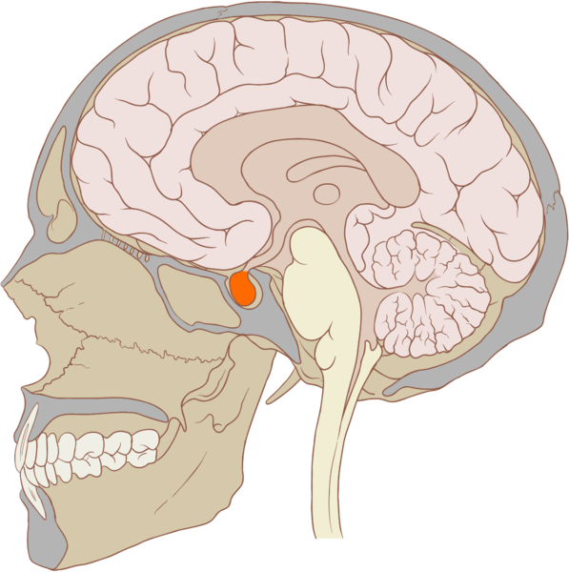
The Hypophysis Cerebri
The hypophysis cerebri, commonly known as the pituitary gland, is a pea-sized gland with an endocrine function. Life isn’t sustainable without the pituitary gland so it is highly protected in the brain. This gland sits essentially in the part of middle of the brain called the sella turcica . It occupies the hypophyseal fossa of the sphenoid bone. The fossa is roofed by the diaphragma sellae, which is a fold derived from the meningeal layer of Dura mater and extends from the tuberculum sellae and middle clinoid processes in front to the upper margin of the dorsum sellae and posterior clinoid precesses behind. The capsule of the gland is adherent to the meninges of the fossa; hence the gland is not surrounded by a film of cerbro-spinal fluid. The pituitary gland contols multitudes of important functions in the body. This gland was for a long time , referred to as “the master gland” because It regulates the secretory activity of many other endocrine glands and tissues; however it is now known that the hypophysis itself is under the control of the hypothalamus.

Slide 32
STRUCTURE OF THE HYPOPHYSIS CEREBRI
The hypophysis consists of an anterior lobe(adeno-hypophysis) and a posterior lobe(neuro-hypophysis) which differ from one another in their mode of development and in their structure.
The Anterior Lobe:
The anterior lobe is larger and is somewhat kidney-shaped, the concavity being directed backward and embracing the posterior lobe. The adeno-hypophysis consists of three parts—pars anterior, pars tuberalis and pars intermedia. It is highly cellular and occasionally presents an intra-glandular cleft. The part of the gland behind the cleft is known as pars intermedia which is rudimentary in man and embraces the front and side of the posterior lobe. It extends onto the neighboring parts of the brain; it contains few blood vessels and consists of finely granular cells between which are small masses of colloid material. The part extending upward along the infundibular stem is known as pars tuberalis. The rest of the gland in front of the cleft is called pars anterior (pars distalis). The cells constituting the anterior lobe of the pituitary gland are embryologically derived from an outpouching of the roof of the pharynx, known as Rathke’s pouch. The pars anterior is extremely vascular and consists of epithelial cells of varying size and shape, arranged in cord-like trabeculæ or alveoli and separated by large, thin-walled blood vessels.

Slide 33
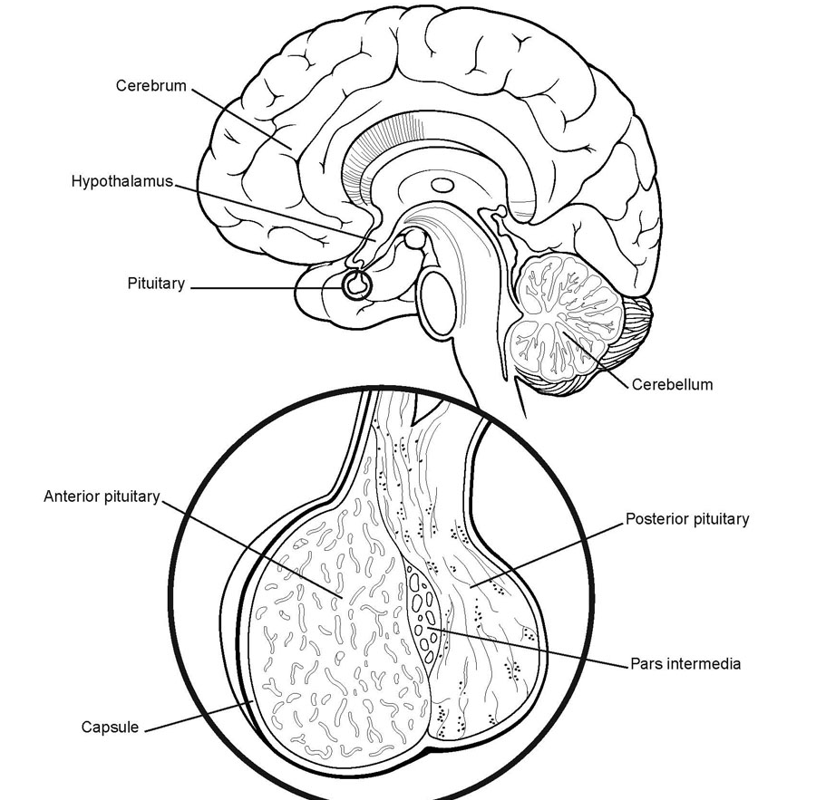
While the cells appear to be relatively homogeneous under a light microscope, there are in fact five different types of cells, each of which secretes a different hormone or hormones. The thyrotrophs synthesize and secrete thyrotropin (thyroid-stimulating hormone; TSH); the gonadotrophs, both luteinizing hormone (LH) and follicle-stimulating hormone (FSH); the corticotrophs, adrenocorticotropic hormone (ACTH; corticotropin); the somatotrophs, growth hormone (GH; somatotropin); and the lactotrophs, prolactin.
Somatotrophs are plentiful in the anterior pituitary gland, constituting about 40 percent of the tissue. They are located predominantly in the anterior and the lateral regions of the gland and secrete between one and two milligrams of GH each day.

Slide 34
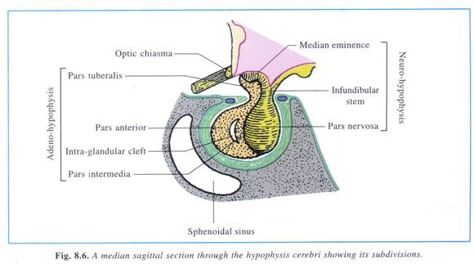
The Posterior Lobe
It is continuous above with the infundibulum which extends downward and forward from the floor of third ventricle and enters the hypophyseal fossa through an aperture in diaphragma sellae. The neuro-hypophysis consists of three parts— median eminence of tuber cinerium, infundibular stem and pars nervosa. The infundi-bular stem possesses an anterior covering of pars tuberalis and rest belongs to the neuro-hypophysis. Although of nervous origin the posterior lobe contains no nerve cells or fibers. It consists of neuroglia cells and fibers and is invaded by columns which grow into it from the pars intermedia; imbedded in it are large quantities of a colloid substance histologically similar to that found in the thyroid gland. In certain of the lower vertebrates, e.g., fishes, nervous structures are present, and the lobe is of large size. The posterior pituitary consists mainly of neuronal projections (axons) of magnocellular neurosecretory cells extending from the supraoptic and paraventricular nuclei of the hypothalamus. These axons store and release neurohypophysial hormones oxytocin and vasopressin into the neurohypohyseal capillaries, from there they get into the systemic circulation (and partly back to the hypophyseal portal system).

Slide 35
FUNCTIONS OF THE PITUITARY GLAND
The pituitary, a pea-sized gland at the base of the brain, produces a number of hormones. Each of these hormones affects a specific part of the body (a target organ or tissue). The anterior lobe of the pituitary produces and releases (secretes) six main hormones:
Growth hormone, which regulates growth and physical development and has important effects on body shape by stimulating muscle formation and reducing fat tissue
Thyroid-stimulating hormone, which stimulates the thyroid gland to produce thyroid hormones
Adrenocorticotropic hormone (ACTH, also called corticotrophin, which stimulates the adrenal glands to produce cortisol and other hormones
Follicle-stimulating hormone and luteinizing hormone (the gonadotropins), which stimulate the testes to produce sperm, the ovaries to produce eggs, and the sex organs to produce sex hormones (testosterone and estrogen)
Prolactin, which stimulates the mammary glands of the breasts to produce milk
The anterior lobe also produces several other hormones, including one that causes the skin to darken (beta-melanocyte–stimulating hormone) and ones that inhibit pain sensations and help control the immune system (endorphins).
The posterior lobe of the pituitary produces only two hormones: antidiuretic hormone and oxytocin. Antidiuretic hormone (also called vasopressin) regulates the amount of water excreted by the kidneys and is therefore important in maintaining water balance in the body (see see About Body Water). Oxytocin causes the uterus to contract during childbirth and immediately after delivery to prevent excessive bleeding. Oxytocin also stimulates contractions of the milk ducts in the breast, which move milk to the nipple (the let-down) in lactating women.
The hormones produced by the pituitary are not all produced continuously. Most are released in bursts every 1 to 3 hours, with alternating periods of activity and inactivity. Some of the hormones, such as ACTH, growth hormone, and prolactin, follow a circadian rhythm: The levels rise and fall predictably during the day, usually peaking just before awakening and dropping to their lowest levels just before sleep. The levels of other hormones vary according to other factors. For example, in women, the levels of luteinizing hormone and follicle-stimulating hormone, which control reproductive functions, vary during the menstrual cycle.

Slide 36
PATHOLOGY OF THE PITUITARY GLAND
The pituitary gland can malfunction in several ways, usually as a result of developing a noncancerous tumor (adenoma).
Pituitary adenomas are tumors that occur in the pituitary gland, which account for 15% of intracranial neoplasms. There are many different types of adenomas, like corticotropic adenoma, somatotropic adenoma, gonadotrophic adenoma, thyrotrophic adenoma, and null cell adenoma. In such cases, the symptoms will depend on the region of pituitary gland affected, like corticotropic adenoma will lead to Cushing's syndrome, while somatotropic adenoma will lead to acromegaly. The biggest risk that can occur with a pituitary adenoma is a pituitary apoplexy, that is infarction due to hemorrhage of the gland. Pituitary gland can also enlarge as a result of internal bleeding into the gland, or in response to underlying ailments, like sarcoidosis, which results in the formation of granulomas in various parts of the body, or the Cushing's syndrome, which develops when the pituitary gland secretes adrenocorticotropic hormone (ACTH) in excess. Slight enlargement of this gland is also associated with thyroid disorder at times. In fact, secondary hypothyroidism is primarily caused when the pituitary gland fails to release thyroid-stimulating hormone (TSH) or thyrotropin-releasing hormone (TRH). Vision problems are relatively common in this case as the pituitary gland tends to press on the optic nerve passing above it as it enlarges. At times, it can even result in loss of vision.
Swelling of the pituitary gland caused as a result of pituitary adenoma may or may not affect hormone production. When it does affect the hormone production, it reflects in the form of obvious symptoms, like headache, lethargy, nausea, vomiting, double vision, drooping eyelids, problems with sense of smell, etc.

Slide 37
The pituitary gland can malfunction in several ways, usually as a result of developing a noncancerous tumor (adenoma).
Pituitary adenomas are tumors that occur in the pituitary gland, which account for 15% of intracranial neoplasms. There are many different types of adenomas, like corticotropic adenoma, somatotropic adenoma, gonadotrophic adenoma, thyrotrophic adenoma, and null cell adenoma. In such cases, the symptoms will depend on the region of pituitary gland affected, like corticotropic adenoma will lead to Cushing's syndrome, while somatotropic adenoma will lead to acromegaly. The biggest risk that can occur with a pituitary adenoma is a pituitary apoplexy, that is infarction due to hemorrhage of the gland. Pituitary gland can also enlarge as a result of internal bleeding into the gland, or in response to underlying ailments, like sarcoidosis, which results in the formation of granulomas in various parts of the body, or the Cushing's syndrome, which develops when the pituitary gland secretes adrenocorticotropic hormone (ACTH) in excess. Slight enlargement of this gland is also associated with thyroid disorder at times. In fact, secondary hypothyroidism is primarily caused when the pituitary gland fails to release thyroid-stimulating hormone (TSH) or thyrotropin-releasing hormone (TRH). Vision problems are relatively common in this case as the pituitary gland tends to press on the optic nerve passing above it as it enlarges. At times, it can even result in loss of vision.
Swelling of the pituitary gland caused as a result of pituitary adenoma may or may not affect hormone production. When it does affect the hormone production, it reflects in the form of obvious symptoms, like headache, lethargy, nausea, vomiting, double vision, drooping eyelids, problems with sense of smell, etc.

Slide 38
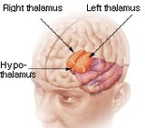
THE HYPOTHALAMUS
The hypothalamus is a portion of the brain that contains a number of small nuclei with a variety of functions.
One of the most important functions of the hypothalamus is to link the nervous system to the endocrine system via the pituitary gland (hypophysis).

Slide 39
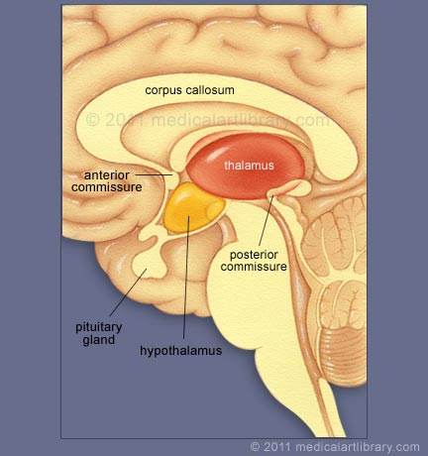
TOPOGRAPHY
Directionally, the hypothalamus is inferior to the thalamus. It is posterior to the optic chiasm and bordered on the sides by the temporal lobes and optic tracts.
The thalamus is a midline symmetrical structure of two halves, within the vertebrate brain, situated between the cerebral cortex and the midbrain.
The optic chiasm or optic chiasma is the part of the brain where the optic nerves (CN II) partially cross. The optic chiasm is located at the bottom of the brain immediately below the hypothalamus.

Slide 40
The rostral boundary of the hypothalamus is the lamina terminalis, a thin membrane that extends ventrally from the anterior commissure to the rostral edge of the optic chiasm and represents the anterior boundary of the third ventricle
The lamina terminalis separates the hypothalamus from the more rostrally located septal nuclei. Superiorly, the hypothalamus is bounded by the hypothalamic sulcus, a shallow groove that separates the hypothalamus from the dorsal thalamus
The lateral boundary of the hypothalamus is formed rostrally by the substantia innominata and caudally by the medial edge of the posterior limb of the internal capsule
Medially, the hypothalamus is bordered by the inferior portion of the third ventricle.
Caudally, the hypothalamus is not sharply demarcated, merging instead into the midbrain tegmentum and the periaqueductal gray.
Externally, the boundary between the hypothalamus and the midbrain is represented by the caudal edge of the mammillary body. This is an especially good landmark to use when viewing a sagittal magnetic resonance image in the diagnosis of hypothalamic lesions.

Slide 41
INTERNAL STRUCTURE
The hypothalamus is a portion of the brain that contains a number of small nuclei.
The structure of the hypothalamus in three representative coronal sections showing the general arrangement of the nuclei at these levels and the relationships of immediately adjacent fiber bundles and nuclei.

Slide 42
HISTOLOGY
Two of the most prominent hypothalamic nuclei (because their neurons are large) are the paraventricular nucleus and supraoptic nucleus. Upon appropriate stimulation, cells in these nuclei secrete (release) two hormones into the bloodstream. Oxytocin causes uterine contraction during birth and induces milk release in females with young. Antidiuretic hormone (ADH) travels to the kidneys to help the body retain water by decreasing urinary output.
Several other hypothalamic nuclei, mostly located in the anterior area, respond to several different hormones circulating in the body. When hormone levels change, cells in these nuclei release peptide signaling molecules into a special system of blood vessels that carry them to the anterior lobe of the pituitary. These peptides cause pituitary cells to either increase or decrease the secretion of one of about eight specific hormones into the bloodstream. This basic mechanism regulates blood levels of growth hormone, adrenocorticotropic hormone (for response to stress), thyrotropin (regulating basal metabolism), and the several hormones that regulate the reproductive organs and sexual behavior.
In the preoptic area at the front end of the hypothalamus are cells that use several of the hormonal mechanisms already described to drive and regulate the menstrual cycles and other aspects of reproductive organ function and behavior. Finally, a range of behaviors characterized as rage or aggression represent physiological responses to stress; these can be seen following experimental stimulation of the dorsomedial nucleus of animals. Blood pressure and heart rate are elevated, muscles are tensed, the animals show signs of strong internal, emotional feeling.

Slide 43
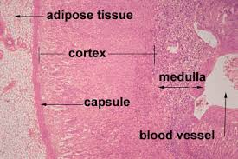
HISTOLOGY
Also in the anterior hypothalamus, the tiny suprachiasmatic nuclei sit atop the optic chiasm. A few optic nerve fibers from the eyes end here, informing these cells about cycles of light and darkness. Through their expansive projections to other brain areas, especially the pineal organ, these cells evoke release of the hormone melatonin into the bloodstream and thus help to regulate the body's circadian rhythms. Circadian rhythms are the cyclic, often subtle, fluctuations in many body functions that reoccur at intervals of about twenty-four hours.
Cells in the anterior and posterior hypothalamic areas detect blood temperature and have connections that allow them to adjust abnormal body temperature. Neural activity in the anterior area activates systems for heat loss, dilating blood vessels of the skin and causing sweating and panting. Neurons in the posterior hypothalamus help to preserve heat by constricting blood vessels of the skin, causing shivering and slowed breathing. Still other hypothalamic nuclei work together to balance food intake. Activity in the lateral hypothalamic area encourages eating while the ventromedial nucleus (VMN) suppresses food intake. Damage to the VMN results in animals (and humans) that overeat to excess and become obese.

Slide 44
FUNCTIONS
The hypothalamus controls the autonomic nervous system.
The autonomic nervous system is the portion of the nervous system responsible for maintaining homeostasis.
Thus, damage to the hypothalamus results in severe imbalances in the internal environment.
The hypothalamus contains the thirst center, the hunger center and the body's thermostat.
Thus, damage to the hypothalamus frequently results in water, glucose and temperature imbalances.
The hypothalamus controls the hypophysis (pituitary gland).
The hypophysis is the most important endocrine gland in the body and is often referred to as the "master gland".
The hypohysis is referred to as the master gland because it controls most of the other endocrine glands in the body such as the thyroid, adrenal gland, testis and ovaries.
By controlling the hypophysis the hypothalamus exerts control over most endocrine glands.
The control of the hypophysis by the hypothalamus is the best example in the human body of the big boss nervous system (hypothalamus) controlling the little boss endocrine system (hypophysis).

Slide 45
PATHOLOGY
Hypothalamic Diseases: Neoplastic, inflammatory, infectious, and other diseases of the hypothalamus. Clinical manifestations include appetite disorders; AUTONOMIC NERVOUS SYSTEM DISEASES; SLEEP DISORDERS;
behavioral symptoms related to dysfunction of the LIMBIC SYSTEM; and neuroendocrine disorders.

Slide 46
DYSAUTONOMIA (NSD)
The symptoms of dysautonomia are numerous and vary widely from person to person. Since dysautonomia is a full-body condition, a large number of symptoms may be present that can greatly alter a person's quality of life. Each patient with dysautonomia is different—some are affected only mildly, while others are left completely bed-ridden and disabled.
The primary symptoms present in patients with dysautonomia are:
Excessive fatigue
Excessive thirst (polydipsia)
Lightheadedness, dizziness or vertigo
Heat Intolerance
Rapid heart rate or slow heart rate
Orthostatic hypotension, sometimes resulting in syncope (fainting)

Slide 47
THANK YOU VERY MUCH FOR YOUR ATTENTION!!!

