Slide 1
GENERAL FARMACOLOGY
Ass. Aleksandrova A.V.

Slide 2
General Pharmacology studies the main principles of interaction between drug and body. It has two parts: 1. Pharmacokinetics 2. Pharmacodynamics

Slide 3
Pharmacokinetics includes the following processes:
Absorption
Distribution
Metabolism
Excretion

Slide 4
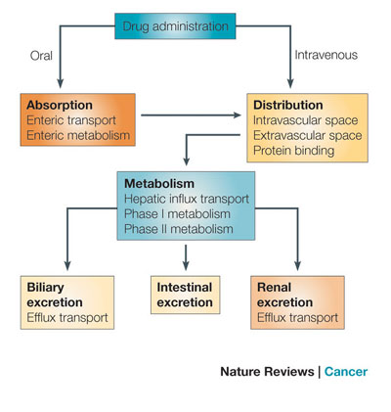

Slide 5
The main routes of drug administration
Enteral (through gastrointestinal tract -GIT) | Parenteral (by- passing GIT).
*Oral *Sublingual *Transbuccal *Rectal | *Intramuscular *Intravenous *Subcutaneous *Inhalational *Topical *Transdermal *Intraarterial and other

Slide 6
ORAL administration - the most simple, natural and comfortable for the patient path, does not require sterilization and medical assistance. Oral drugs are used in various dosage forms: powders, granules, tablets, capsules, dragees, solutions, infusions, decoctions, suspensions. Peculiarities of drugs usage inside: - The influence of hydrochloric acid of the gastric juice (penicillin, erythromycin, epinephrine). - The influence of food on absorption: slowing due to changes in pH, increasing intestinal motility, or formation of complexes that are not absorbed. - Low bioavailability as a consequence of first-pass metabolism - inactivation of the mucous membrane enzymes of small intestine and liver before entering the drug into the systemic circulation. - Irritant and ulcerogenic effect of drugs on the stomach and intestines (non-steroidal anti-inflammatory drugs, chlorpromazine, reserpine). - Impossibility to use inside (resection of the digestive organs, severe diseases that are accompanied by malabsorption syndrome); contraindications (peptic ulcer, gastritis); vomiting, unconscious state.

Slide 7
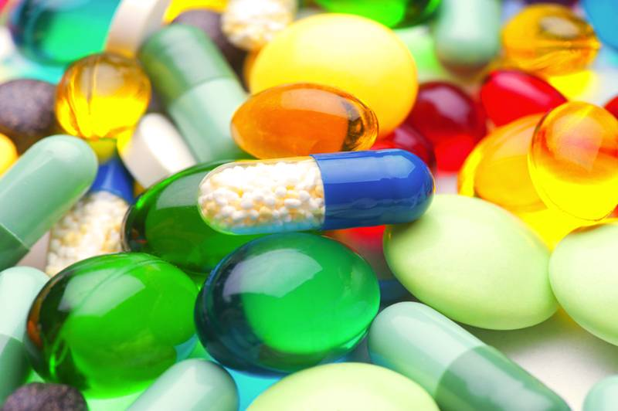
Sublingual and transdermal - absorption of drugs very fast (when placing them under the tongue and behind the cheek). In this route of administration drugs are not destroyed by digestive enzymes and hydrochloric acid. Drugs enters directly into the systemic circulation bypassing the liver. In this way prescribed drugs only with high activity and high lipid solubility - (validol, nitroglycerin in relieving angina, nifedipine - with relief of hypertensive crisis).

Slide 8
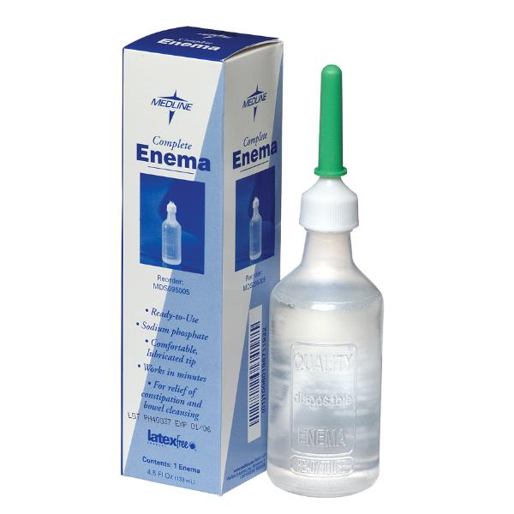
Rectal A considerable part of the substance (50%) enters the bloodstream, bypassing the liver, in addition with this route of administration the substance is not destroyed by enzymes of the digestive tract.
Rectally administered drugs in the form of suppositories or as enemas (50-100 ml).

Slide 9
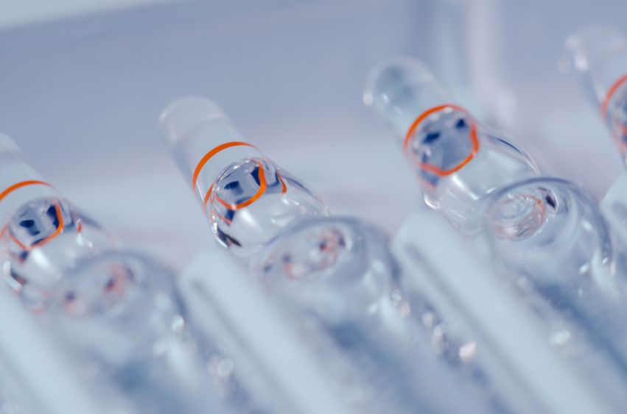
Administration by injection Subcutaneous important in emergency medical practice (injection of antidotes, during anesthesia), and vaccination. The volume of solution is administered not more than 1-2 ml, effect occurs within 15-20 minutes after injection.

Slide 10
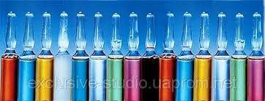
Intramuscular Applied sterile isotonic aqueous or oily solutions, suspensions. This route of administration is less painful than an injection into the subcutaneous tissue. Effect in 10-15 minutes. The volume should not exceed 10 ml. The absorption of the drug from muscle can be accelerated by applying a body warmer, or conversely, slow down, using ice.

Slide 11
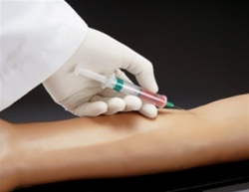
Intravenous Applied sterile aqueous solutions, permitted introduction of hypertonic solutions (not more than 20-40 ml). Intravenous injection is carried out by introducing a one-time or drip method. Within a short time achieves maximum drug concentration in the heart, high concentration – in CNS and only then is the distribution in the body. To eliminate the toxic effects, injections of potent and toxic drugs should be carried out slowly and before this, substances should be dissolved in solution of sodium chloride or glucose.

Slide 12
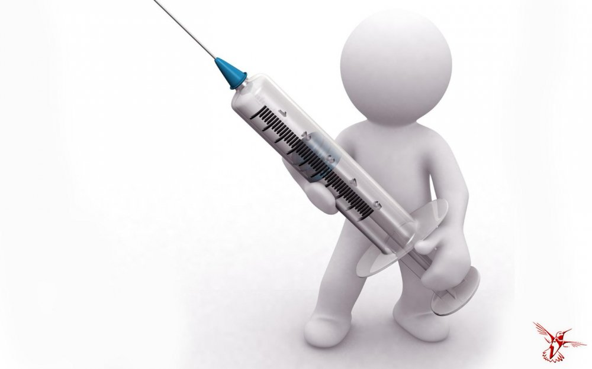
For intra-arterial administration resorted when you need to make a greater concentration of the drug (antibiotic, anticancer drugs) or have an effect on the vascular wall (introduction of vasodilators for treatment of endarteriite limbs).
Intraarterial

Slide 13
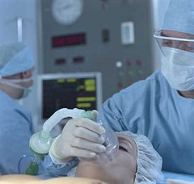
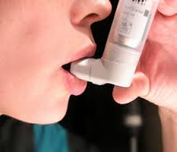
This way makes inhalation anesthesia, for topical use aerosols of bronchodilators, corticosteroids, local anesthetics, antibiotics. The depth of penetration into the respiratory tract depends on the size of the drug particles.
Inhalational

Slide 14
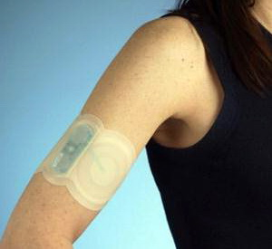
Transdermal (cutaneous) Used to direct action on the pathological process or to obtain a reflex response of the internal organs. Therefore, drugs must penetrate to a sufficient depth that determines the basis of ointments, pastes, liniments.
Now began to apply the transdermal therapeutic systems for prolonged drug absorption from surface of skin for the getting of resorptive action.
Medicine also administered in eye, nasal s, ear drop, and applied to the nasal mucosa.

Slide 15
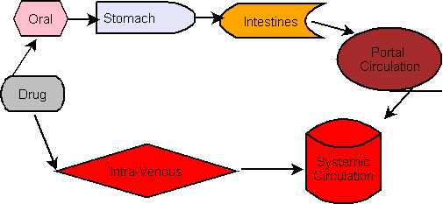

Slide 16
Absorption of drugs is the penetration of drug into the blood from the site of administration. During the absorption drug crosses cell membranes. There are such kinds of this crossing as a: - passive diffusion - filtration - carrier-mediated active transport - endocytosis and exocytosis.

Slide 17
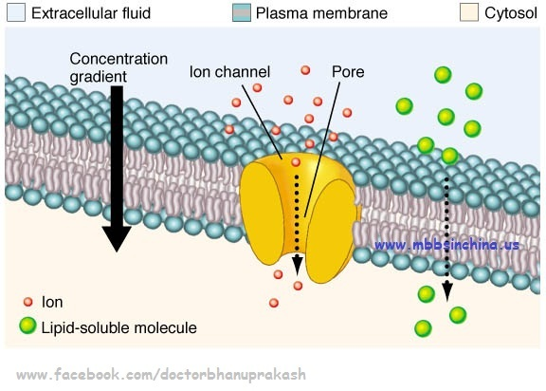
Passive diffusion - occurs along the concentration gradient of the zone with a higher concentration in the lower concentration zone ( penetrate low weight lipid soluble and non ionized molecules).
Filtration - drug through the pores of cell membranes (epidermis or mucous membranes of the gastrointestinal tract, the capillary endothelium) occurs with the flow of water depending on the hydrostatic and osmotic pressures (n this way penetrate the water molecules, urea, glucose, some ions).

Slide 18
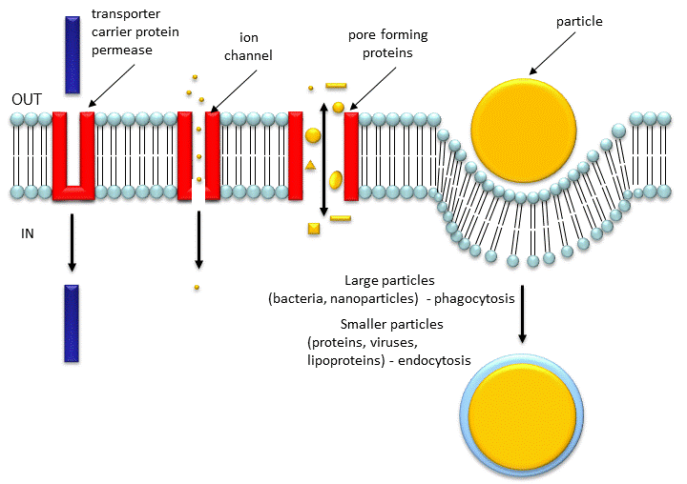
Carrier-mediated transport (CMT)-movement of substances across the plasma membrane by protein carrier molecules used when molecule cannot cross membrane or crosses very slowly, protein carrier molecules are embedded in lipid, and have site which specifically binds the molecules). There are two forms of CMT: active transport and facilitated diffusion
Active transport requires a direct expenditure of energy, whereas facilitated diffusion
is not energy dependent. Active transport canmove substances against a concentration gradient, facilitated diffusion cannot.

Slide 19
*In exocytosis, materials are exported out of the cell via secretory vesicles. *Endocytosis, on the other hand, is the process by which materials move into the cell. There are three types of endocytosis: phagocytosis, pinocytosis, and receptor-mediated endocytosis.
Endocytosis and exocytosis.
The movement of macromolecules such as proteins or polysaccharides into or out of the cell is called bulk transport. There are two types of bulk transport, exocytosis and
endocytosis, and both require the expenditure of energy (ATP).

Slide 20
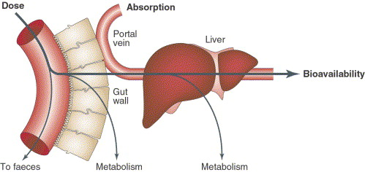
Bioavailability of a drug is the fraction of administered dose that reaches the systemic circulation.
Factors influencing on the bioavailability
- Route of administration
- The individual organism (age, gender)
- The state of the gastrointestinal tract, liver, kidney, cardiovascular system
- Pharmaceutical factors (adjuvants, especially of production technologies)

Slide 21
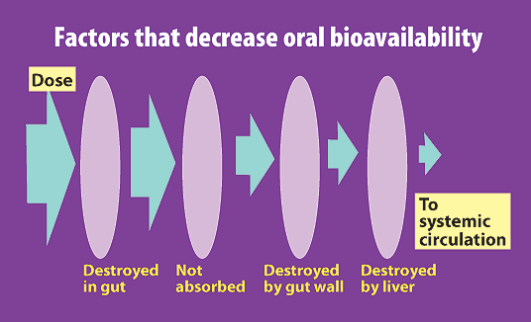
Bioavailability is one of the principal pharmacokinetic properties of drugs. When a drug is administered intravenously, its bioavailability is 100%, however, when a drug is administered by other routes (such as orally), its bioavailability generally decreases (due to incomplete absorption and first-pass metabolism) or may vary from patient to patient.

Slide 22
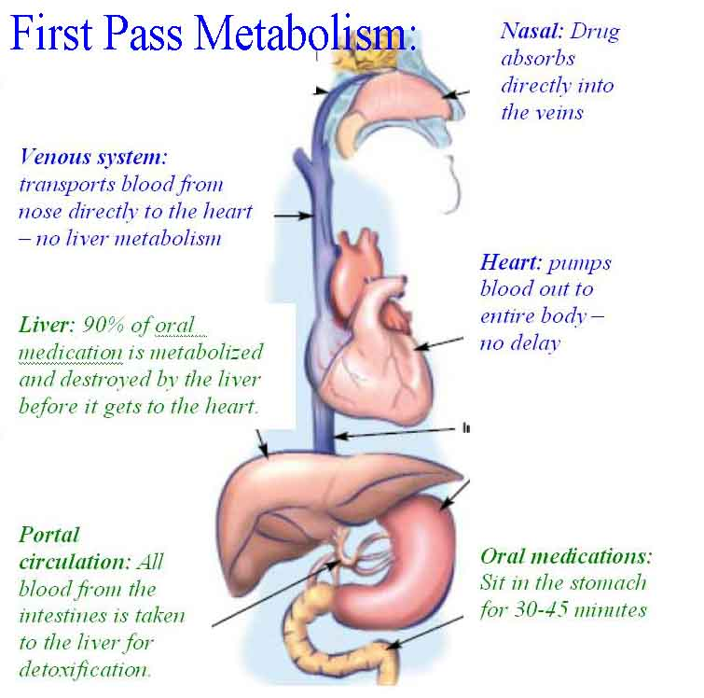
the intestinal and hepatic degradation or alteration of a drug or substance taken by mouth, after absorption, removing some of the active substance from the blood before it enters the general circulation.

Slide 23
Distribution of drugs in the body Distribution of the drug in tissues and organs depends on various factors: - The size and shape of the molecule. - Solubility in lipids. - The intensity of regional circulation. - The degree of protein binding. - Competition for binding with plasma proteins. - Protein concentrations in plasma. - Biological barriers (walls of capillaries, cell (plasma membrane), the blood-brain barrier and other).

Slide 24
Metabolism of drugs
this is a complex of physical, chemical or biochemical transformations
of drugs in the body. The main organ for drug metabolism is the liver.
Phase I reactions:
(nonsynthetic)
1. Oxidation
2. Reduction
3. Hydrolysis
4. Cyclization
Phase II reactions:
(synthetic)
1. Glucuronidation
2. Methylation
3. Sulfation
4.Acetylation

Slide 25
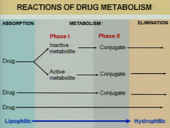
*The result of stage I is formation of active or inactive products which enter the stage II reactions. *Stage II reactions lead to the formation of inactive metabolits excreted from the body.

Slide 26
Biotransformation of drugs can changes due to various factors:
- Features of drug metabolism.
- Comorbidities.
- Hunger (diet).
- Bad habits (smoking, alcohol, drugs).
- Age.
- Gender.
- Genetic features.

Slide 27
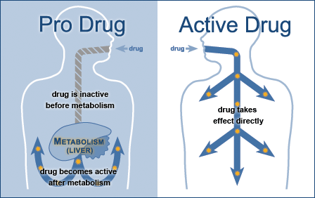
Prodrug - an inactive substance that is converted to a drug within the body bythe action of enzymes or other chemicals.

Slide 28
Drugs which increase the activity of microsomal enzymes in the liver are named inductors of microsomal oxidation. (barbiturates, antiepileptics - benzonal, phenytoin, carbamazepine, tranquilizers, corticosteroids, anabolic steroids, testosterone, antibiotics - griseofulvin, rifampicin).
*Usage of these drugs will decrease the efficiency of the drugs, which metabolized with the participation of cytochrome P-450.
Drugs which decrease the activity of microsomal enzymes in the liver are named inhibitors of microsomal oxidation.
*Result of this can be cumulation or prolongation of action.
(antidepressants, antiarrhythmics – qui.nidine, preparations female sex hormones, contraceptives, anticancer drugs, antibiotics - chloramphenicol, erythromycin, teturam).

Slide 29
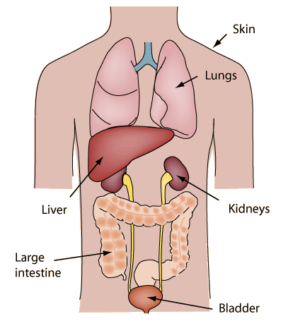
EXCRETION
The final stage of the pharmacokinetic process of drug and is occurs through the excretory system of the body:
Kidney (glomerular filtration, tubular reabsorption, tubular secretion);
Liver (with bile);
- Intestines;
- Lungs;
- Exocrine glands (salivary, sweat, mammary gland).
The majority of drugs are excreted by the kidneys. Hydrophilic may be excreted throught the kidney in unchanged form; lipophilic drugs are converted into hydrophilic metabolites which are excreted with urine.

Slide 30
Clearance (Cl) of a drug is the volume of plasma from which the drug is completely removed per unit of time. The amount of eliminated drug is proportional to its concentration in the blood CL=rate of elimination/C
Some terms of pharmacokinetics
Half-life (t1/2) of a drug is the time taken for plasma drug concentration to reduce to half its peak level.
Volume of Distribution (Vd) is dose administered i.v divided by plasma concentration. Drugs that are highly lipid soluble have a very high volume of distribution. Drugs that are lipid insoluble remain in the blood, and have a low Vd.

Slide 31
Pharmacodynamics is the study of the biochemical and physiologic effects of drugs and their mechanisms of action. It describes: - Effects - The mechanism of action - Drugs interactions - Doses - Dose-effect dependence - Factors influencing a drug action
Pharmacological effect - it changes the functions of organs and systems of the body caused by the drug substance. (Increased heart rate, lower blood pressure, decrease in body temperature)

Slide 32
Pharmacological effects: * Stimulation- it is selective enhancement of the level of activity of specialized cells (adrenaline stimulates heart, pilocarpine – salivary glunds) * Depression- it is selective diminution of activity of specialized cells (barbiturates depress CNS, quinidine depresses heart). * Replacement- this refers to the use of natural metabolites, hormones or their congeners in deficiency states (levodopa in parkinsonism, insulin in diabetes mellitus, iron in anemia). * Irritation- this connotes a nonselective, often noxious effect and is particularly applied to less specialized cells. Mild irritation may stimulate associated function (bitters increase salivary and gastric secretion). But strong irritation results in inflammation, corrosion, necrosis and morphological damage. This may result in diminution or loss of function. * Cytotoxic effect- for invading parasites or cancer cells attenuating them without significantly affecting the host cells is utilized for cure/palliation of infections and neoplasms (chloroquine, mebendazole, cyclophosphamide).

Slide 33
Types of drugs action
Local (in the site of administration) |  | Resorbtive (after the absorption into the blood)
Direct (in the organ with target cells) | Indirect (in other organs but due to the action on the target organ) |  | Reflexive (by reflex)
Non selective (on all cells) |  | Selective (on celected cells and tissues)
Reversible (with restoration to the initial state after the elimination of the drug) |  | Irreversible (without restoration to the initial state after the elimination of the drug)
Main effects (for which the drug is used) |  | Side effects (unwanted effects of a therapeutic dose of the drug)
The factors influencing drug action are the age, weight, gender, physiological state, illnes, genetic factors.

Slide 34
The mechanisms of drug action
Mechanism of action | Characteristics | Example
Receptor interaction | Interacts with specific receptors | Cholinergic, adrenergic, histaminic drugs.
Action on ion channels | Blockade or activation of sodium, potassium, calcium and chloride channels | Local anesthetics, blockers of Ca2+ channels
Action on enzymes | Amplification or suppression of the activity of different enzymes | ACE inhibitors COX inhibitors
Effect on transport systems (transport protein) | that carry substances across cell membranes | Sympatholytics
Effect on the permeability of cell membranes | Stabilization or violation of the permeability of cell membranes | Steroidal, NSAI, antiallergic drugs
Effect on the function of genes | Increase or decrease gene expression, as well as the replacement of the mutant gene | Under basic research
Direct chemical action | Direct chemical interaction | Antidotes Antacides

Slide 35
DRUG RECEPTOR
A macromolecular component of a cell with which a drug interacts to produce a response
LIGAND
Molecules that binds to a receptor

Slide 36
Types of receptors
In accordance with the receptor-effector linkage:
*Type 1- coupled to an ion channel (nicotinic, GABA, glutamate-receptors),
*Type 2 – coupled to effector system via
G-protein (muscarinic, NA- receptor),
*Type 3 - directly linked to tyrosine kinase (insulin, growth hormone),
*Type 4 – soluble cytosolic or intranuclear proteins (receptors for steroid and thyroid hormones, for vit A and D).

Slide 37
G-proteins have 3 main targets of its action: - adenylate cyclase, - phospholipase “C ” - ion channel. The effects may be either activating or inhibiting depending on G-protein type. Activation of adenylate cyclase results in formation of cyclic adenosine monophosphate (cAMP), activation of phospholipase “C” results in cleavage of phospholipids into diacylglycerol (DAG) and inositol (1,4,5)-triphosphate (iP3). All three substances (cAMP, DAG and iP3) play the role of “second messengers “, exerting regulatory effects on many functions of cells
G-protein coupled receptors (GPCRs)

Slide 38
Targets for G-proteins
Adenyl cyclase : cAMP formation
Phospholipase C : IP3 and DAG formation
Ion channels : Ca2+ and K+ channels
cGMP

Slide 39
Affinity (from Lat. Affinis - related) – it is ability of the drug to combine with receptor, resulting in the formation of a complex "substance-receptor."
Intrinsic activity - the ability of a substance to activate the receptor consequent to receptor occupation.

Slide 40
Agonists - occupy receptors, produce a conformational change which leads to receptor activation and thus efficacy (adrenalin, histamin). Antagonists - occupy receptors, produce no conformational change and prevent the action of agonists (Naloxone). Partial agonists - have affinity and submaximal intrinsic activity (Nalorphine).
Agonist-antagonist – is the drug which stimulates one subtype of the receptor, but blocks another one (Pentazocine).

Slide 41
Types of drugs doses
The DOSE is the ammount of drug administered into the body
The dose may be:
Single (for single administration) | Daily (for the day of treatment) |  | Total (for the course of treatment)
Threshold (minimal dose which begins to act)
Therapeutic (minimal, average, maximal) the dose which has therapeutic action
Toxic (minimal, average, maximal) the dose which causes toxic action
Mortal the dose which causes the death of animals in experiment
Striking (a large dose at the start of treatment) |  | Supporting dose (an individual dose for supporting a therapeutic effect during long-term treatment)

Slide 42
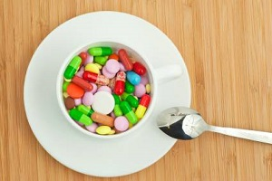
DRUGS INTERACTION is the action of one drug on another one.

Slide 43
EFFECTS OF REPEATED DOSES OF DRUGS
Cumulation
Tolerance
Tachyphylaxis
Drug dependence
Withdrawal syndrome (abstinence)

Slide 44
Cumulation it is accumulation of the drug or its effect
Material
Functional
The increase in blood and / or tissue concentrations of a substance after each new introduction in comparison with the previous concentration
Enhancing effect of a substance when its applied repeatedly but without increasing of its concentration in the blood and / or tissues
For example: hypnotic drugs from the group of barbiturates,
cardiac glycosides
For example, ethyl alcohol, MAO inhibitors

Slide 45
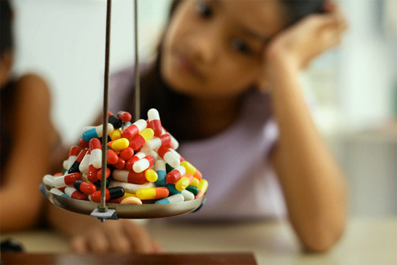
Tolerance (habituation) - is a decrease of drug‘s action after its repeated administration in the same dose. (tolerance to hypnotic, alcohol, nitroglycerine).
Tachyphylaxis
reducing the effect of the drug when it is frequent use for short period (rapid form of tolerance).
(tachyphylaxis to ephedrine)

Slide 46
DRUG DEPENDENCE its irresistible aspiration to take the drug for euphoria or improvement of condition.
There are two types of drug dependence:
*Physical dependence – if the patients want to take the drug for altering general state and mood.
(ethyl alcohol, barbiturates and narcotic analgesics may cause physical dependence).
*Psychological dependence – if the patient wants to take the drug for altering the mood (for euphoria).
(psyhomotor stimulants can cause this type of drug dependence)

Slide 47
The physical and mental discomfort when the drug is not used.
Withdrawal syndrome (abstinence)
For example: increase in blood pressure after the abolition of antihypertensive agent; acute attack of angina after the abolition of antianginal drugs.
To prevent withdrawal syndrome drugs should be discontinued gradually!

Slide 48
COMBINED ACTION OF DRUGS is the action of two or more co-administered drugs on the organism.
SYNERGISM( the strengthening of effect) .
Can be two types:
ADDITION ( C = A+B)
(Example: vasoconstrictor and hypertensive effects of norepinephrine and phenylephrine, which stimulate α- adrenergic receptors of peripheral vessels).
POTENTIATION (C > A+B)
(Example: chlorpromazine (antipsychotic drug) potentiates the effect of drugs for general anaesthesia).
Practical purpose
Achieving pharmacological effect by reducing the dose of drug substance

Slide 49
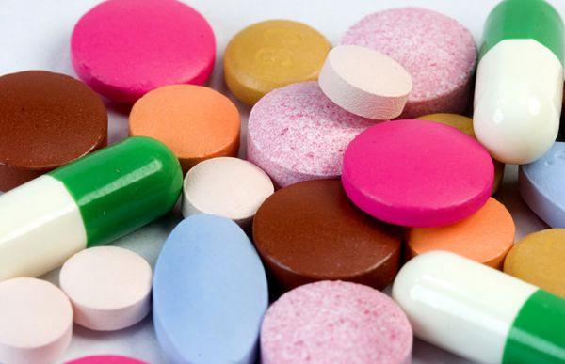
Antagonists - occupy receptors, produce no conformational change and prevent the action of agonists.

Slide 50
ANTAGONISM
Chemical
Physical
Physiological
The two drugs react chemically and form an active product
Based on the physical property of the drugs
The functional effects of drug substances
Direct
(stimulants and blockers of β adrenoseptors)
Competitive (morphine and naloxone)
Indirect (Aceclidine and papaverine)
For example:
Acids and alkalis
(neutralization)
For example:
Activated charcoal and alkaloids, cardiac glycosides, heavy metals (absorption)

Slide 51
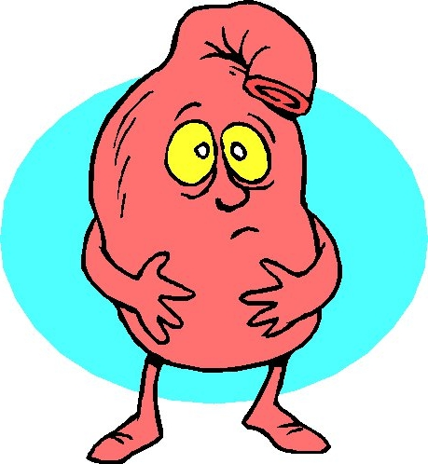
SIDE EFFECTS are non-useful effects of drugs in therapeutic doses
Direct toxic effects (nefrotoxicity, ototoxicity and neurotoxicity of streptomycin)
Allergic reactions as immune reactions of hypersensitivity (anaphylaxis caused by penicillin)
Idiosyncrasy as an abnormal reaction occurred after the first drug administration and caused by generic factors (hemolysis of erythrocytes after the use of quinine in patients deficient on glucose-6-phosphate dehydrogenase)
Embryotoxic, fetotoxic and teratogenous effects as a negative influence on the embrio and the fetus during pregnancy (hypoplesia of tooth enamel caused by tetracyclin)
Canserogenous and mutagenous action as the ability to provoke the development of malignant tumors (secondary malignancy caused by leukopoiesis inhibitors).

Slide 52
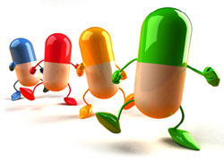
Types of pharmacotherapy
☺ Preventive
☺ Etiotropic
☺ Replacement
☺ Symptomatic
☺ Pathogenetic

Slide 53
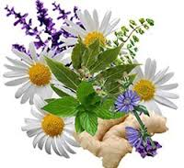
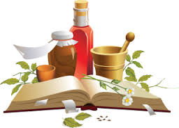
Aims to prevent certain diseases or relapse and prevention of complications of medical treatment. Example: the appointment of antimalarials
Preventive therapy
Etiotropic
The elimination of the causes of a pathological condition.
Example: assignment of antibacterial agents.

Slide 54
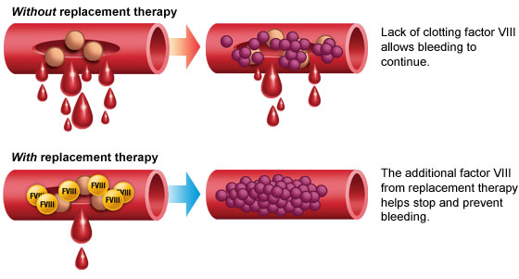
Replacement Insufficient function involved in the pathological process of organs and systems requires substitution treatment. For example, atrophic gastritis, diabetes mellitus.

Slide 55
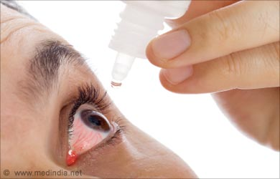
The elimination of symptoms can alleviate the patient's condition and course of the disease, but can not eliminate the cause. This type of treatment is palliative and can not be regarded as basic.
Symptomatic
Pathogenetic
The use of drugs affecting various parts of the mechanism of the disease
Example: enalapril in hypertension.

