Slide 1
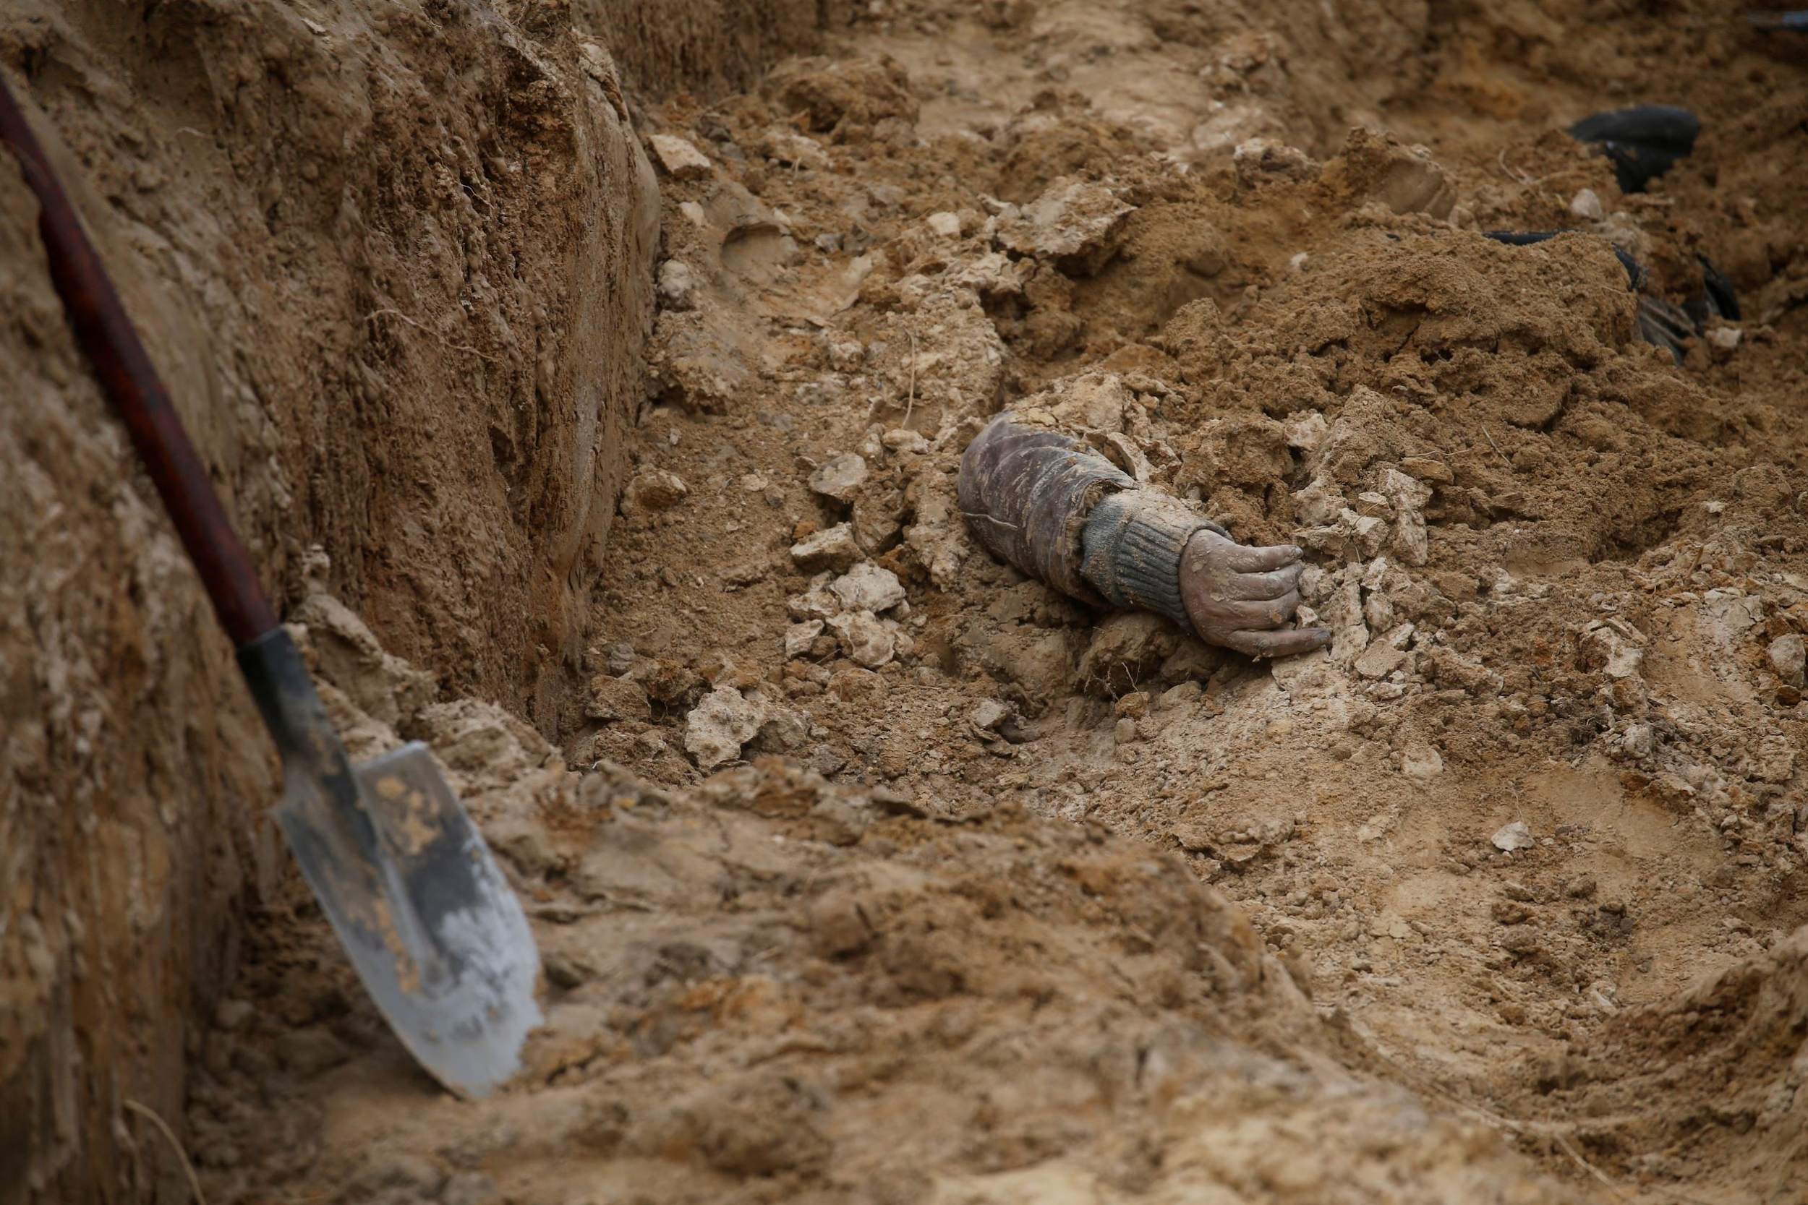
Identification of Personality Based on the Sphenoid Sinus Structure Using Machine Learning
Prof. Alina Nechyporenko
Prof. Marcus Frohme
Prof. Vitaliy Gargin
Prof Andrii Lupyr
Vladyslav Omelchenko
Dr. Viktoriia Alieksieieva
REUTERS, PHOTO BY VALENTYN OGIRENKO

Slide 2
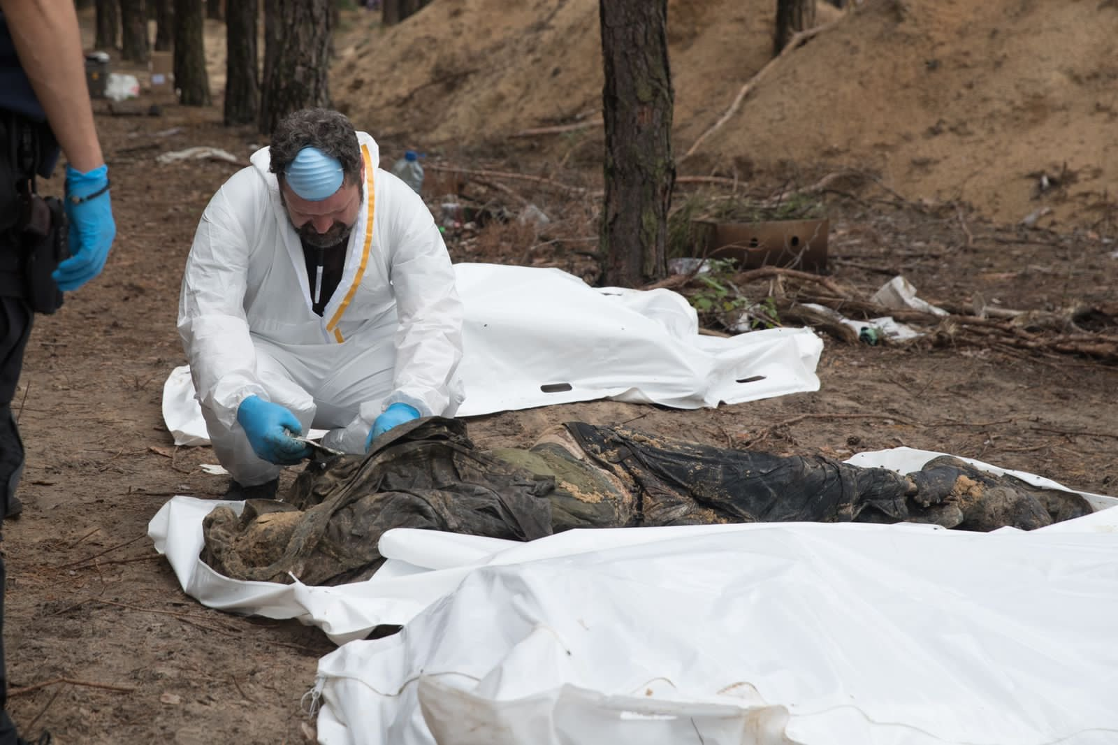
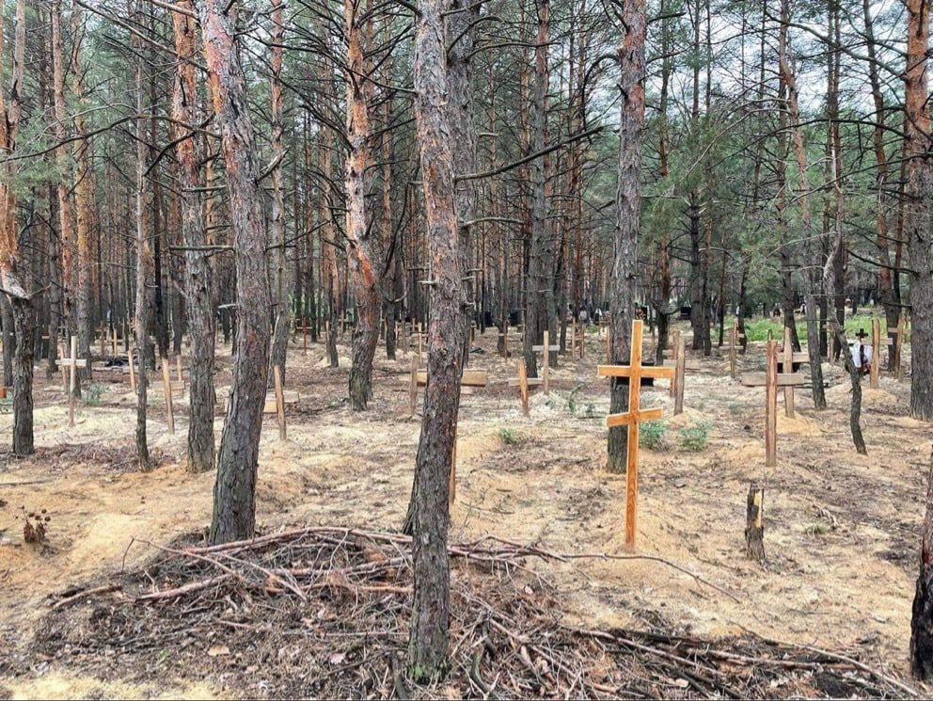
Background
Millions of Ukrainians have become victims of the war, losing their health or even their lives.
Photo Facebook
Izium. Unmarked “mass graves”

Slide 3
State of the art
Types of identification
1. Burned bodies or deaths may have occurred a long time ago. It may no longer be possible to identify them by fingerprints.
1. Fingerprints
disadvantages
2. Retina
disadvantages
1. Can be damaged by various factors that cause human death.
2. Autolysis
disadvantages
1. Complicated to obtain DNA samples from relatives of the deceased.
2. No DNA database in Ukraine
2. Requires more time and effort
3. Expensive
3.DNA
limb bones
disadvantages
distruction
4. Computer Tomography
(According to the statistics about 70% of adult Ukrainians have done CT)
Skull bones
Unique Spenoid Sinus

Slide 4
The aim of our study
develop a new approach for the identification of humans` personality based on the results of sphenoid sinuses` Computer Tomography

Slide 5
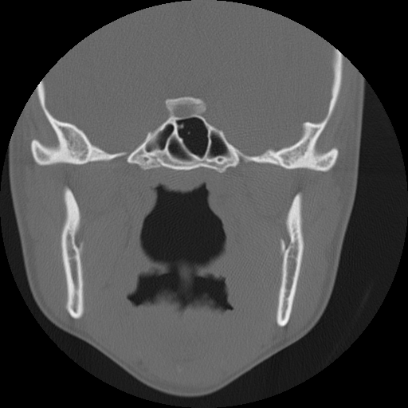
Material and Methods
pilot study
100 CT of people of different ages and genders
Segmentation of sphenoid sinuses with U-Net
Fig. 3 CT section of Sphenoid Sinus
Notes:
Segmentation is one of the most challenging tasks in medical image analysis, providing important information about the morphology of organs and tissues

Slide 6
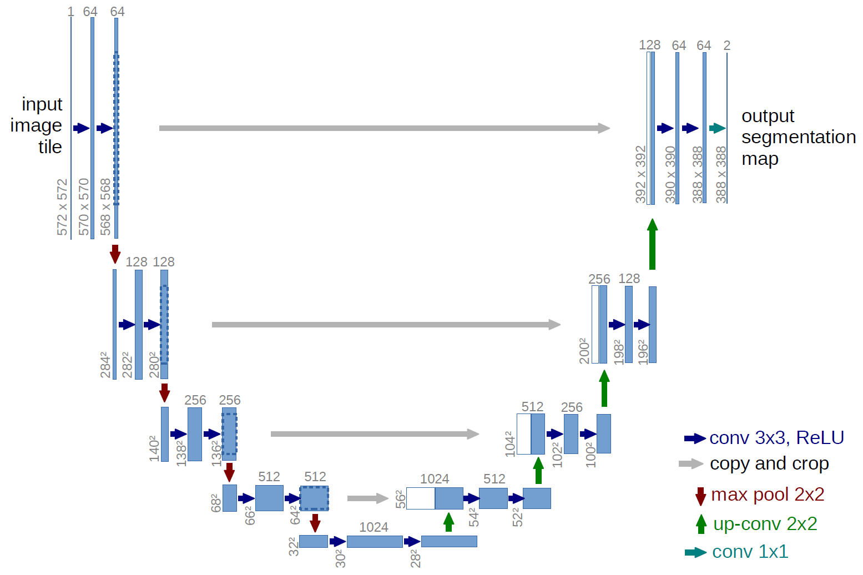
U-Net architecture

Slide 7
Parameters
Technology stack
batch size
amount of epochs
validation split
number of convolutional layers
number of filters in convolutional layers
size of the convolution kernel
image size
number of image channels
augmentation
Docker
Python
U-Net

Slide 8
Experiment scheme
PNG
prediction
JSON
masks
model

Slide 9
1st and 2nd experiments
layer | filters number | kernel size | dropout | strides
c1 | 16 | (3, 3) | 0.1 | (1, 1)
c2 | 32 | (3, 3) | 0.1 | (1, 1)
c3 | 64 | (3, 3) | 0.2 | (1, 1)
c4 | 128 | (3, 3) | 0.2 | (1, 1)
c5 | 256 | (3, 3) | 0.3 | (1, 1)
c6 | 128 | (3, 3) | 0.2 | (1, 1)
c7 | 64 | (3, 3) | 0.2 | (1, 1)
c8 | 32 | (3, 3) | 0.1 | (1, 1)
c9 | 16 | (3, 3) | 0.1 | (1, 1)
p1 |  | (2, 2)
p2 |  | (2, 2)
p3 |  | (2, 2)
p4 |  | (2, 2)
u6 | 128 | (2, 2) |  | (2, 2)
u7 | 64 | (2, 2) |  | (2, 2)
u8 | 32 | (2, 2) |  | (2, 2)
u9 | 16 | (2, 2) |  | (2, 2)
name | batch size | epochs | validation split
modelA_5_10_10 | 5 | 10 | 10
modelA_5_10_33 | 5 | 10 | 33
modelA_5_15_10 | 5 | 15 | 10
modelA_5_15_33 | 5 | 15 | 33
modelB_10_10_10 | 10 | 10 | 10
modelB_10_10_33 | 10 | 10 | 33
modelB_10_15_10 | 10 | 15 | 10
modelB_10_15_33 | 10 | 15 | 33
modelC_20_10_10 | 20 | 10 | 10
modelC_20_15_33 | 20 | 10 | 33
modelC_20_15_10 | 20 | 15 | 10
modelC_20_15_33 | 20 | 15 | 33

Slide 10
3rd experiment
layer | filters number | kernel size | dropout | strides
c1 | 32 | (2, 2) | 0.1 | (1, 1)
c2 | 32 | (3, 3) | 0.1 | (1, 1)
c3 | 64 | (3, 3) | 0.2 | (1, 1)
c4 | 128 | (3, 3) | 0.2 | (1, 1)
c5 | 256 | (3, 3) | 0.3 | (1, 1)
c6 | 128 | (3, 3) | 0.2 | (1, 1)
c7 | 64 | (3, 3) | 0.2 | (1, 1)
c8 | 32 | (3, 3) | 0.1 | (1, 1)
c9 | 16 | (3, 3) | 0.1 | (1, 1)
p1 |  | (2, 2)
p2 |  | (2, 2)
p3 |  | (2, 2)
p4 |  | (2, 2)
u6 | 128 | (2, 2) |  | (2, 2)
u7 | 64 | (2, 2) |  | (2, 2)
u8 | 32 | (2, 2) |  | (2, 2)
u9 | 16 | (2, 2) |  | (2, 2)
name | batch size | epochs | validation split
modelA_5_10_10 | 5 | 10 | 10
modelA_5_10_33 | 5 | 10 | 33
modelA_5_15_10 | 5 | 15 | 10
modelA_5_15_33 | 5 | 15 | 33
modelB_10_10_10 | 10 | 10 | 10
modelB_10_10_33 | 10 | 10 | 33
modelB_10_15_10 | 10 | 15 | 10
modelB_10_15_33 | 10 | 15 | 33
modelC_20_10_10 | 20 | 10 | 10
modelC_20_15_33 | 20 | 10 | 33
modelC_20_15_10 | 20 | 15 | 10
modelC_20_15_33 | 20 | 15 | 33

Slide 11
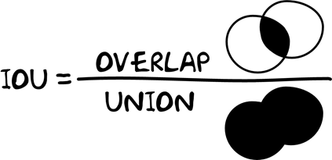
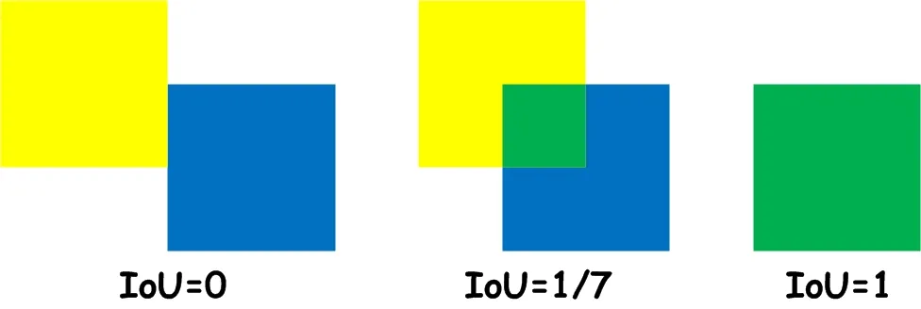
Evaluating an image segmentation model
Images is created by Oleksii Sheremet with Microsoft Visio
Intersection over union (IoU)
our result:
IoU = 91,0134%

Slide 12
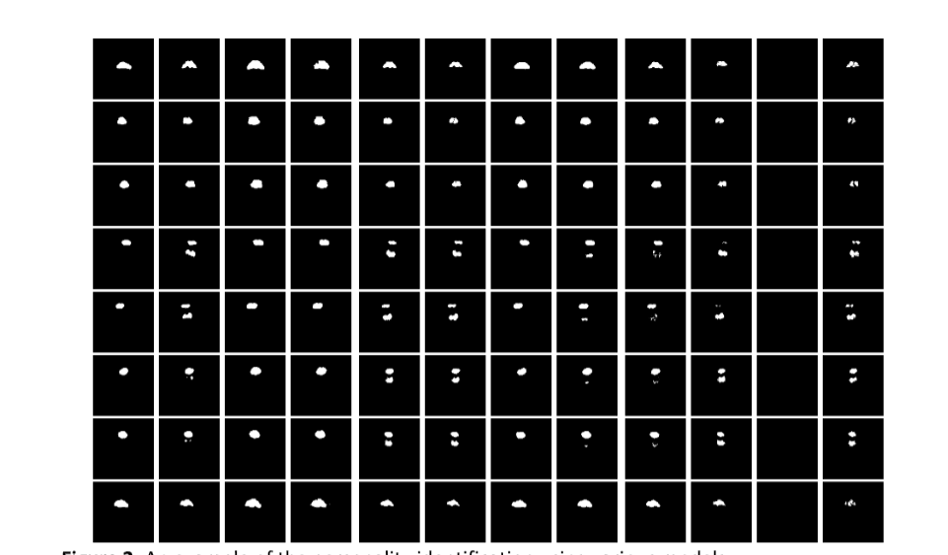
Problems:
The septa between the cells are not always defined
Segmentation of sinuses that are small in volume is not always possible
Sometimes additionally a nasopharynx is also identified

Slide 13
Perspectives:
increase the number of a CT images
change parameters of a model
try another CNN architectures
3D segmentation

Slide 14
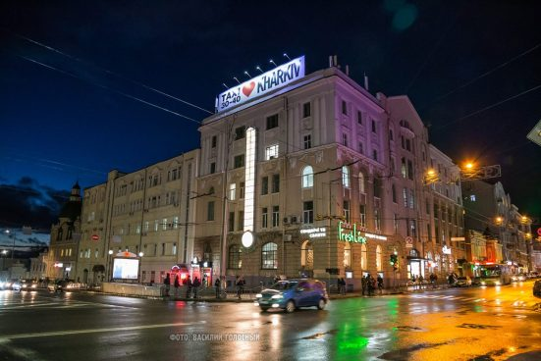
Thank you for your attention!

