Slide 1
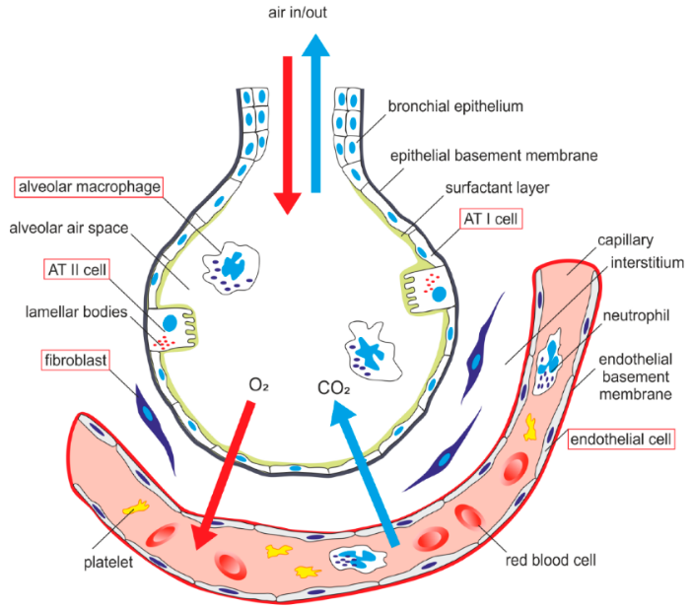
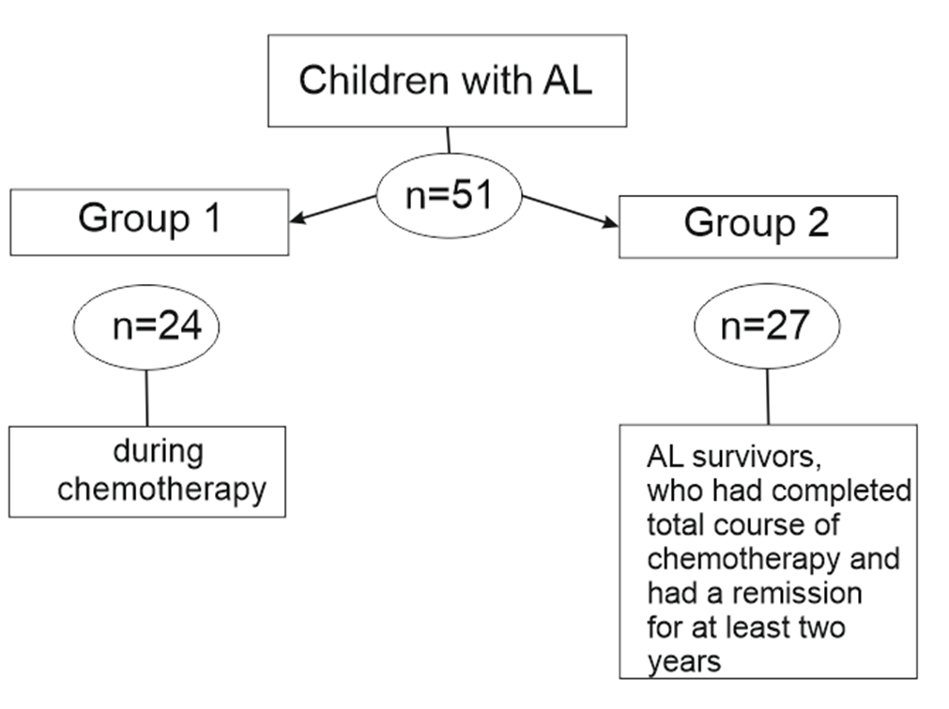
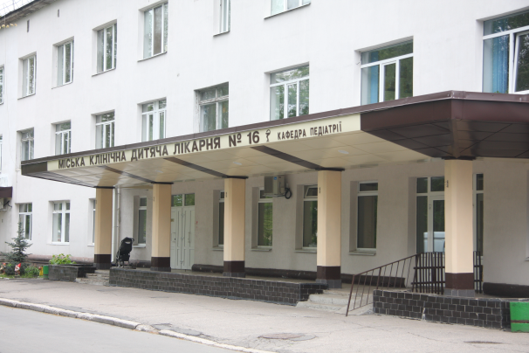
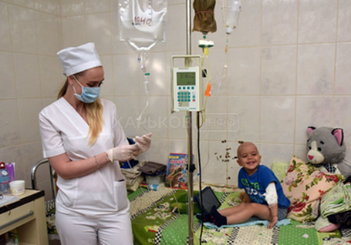
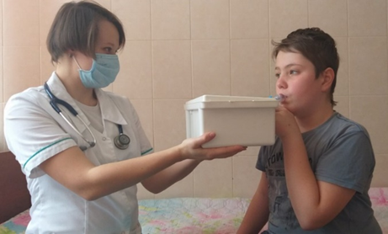
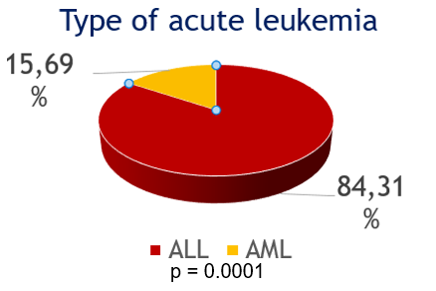
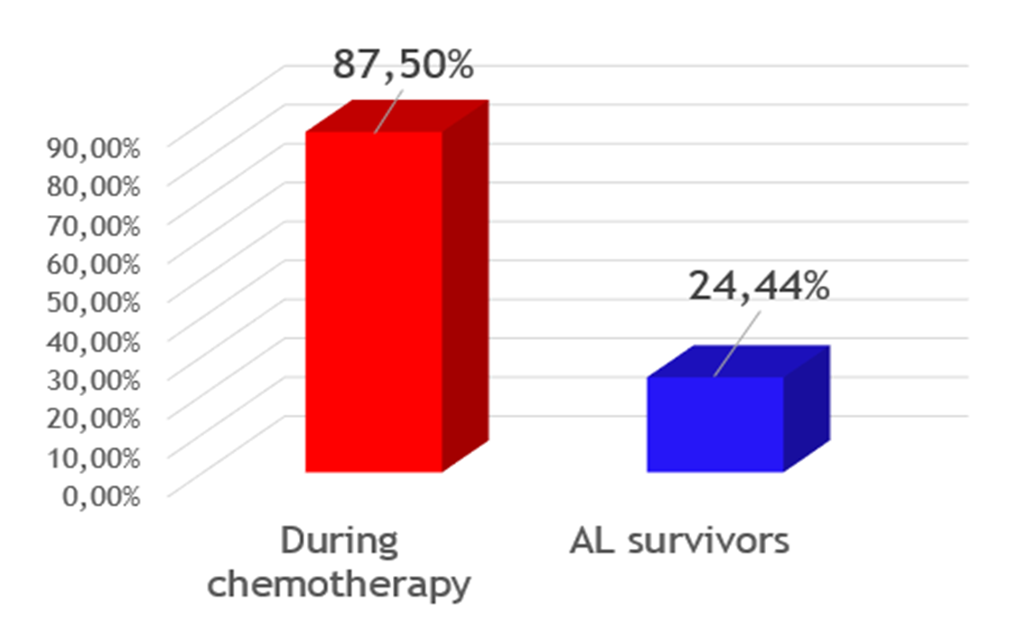
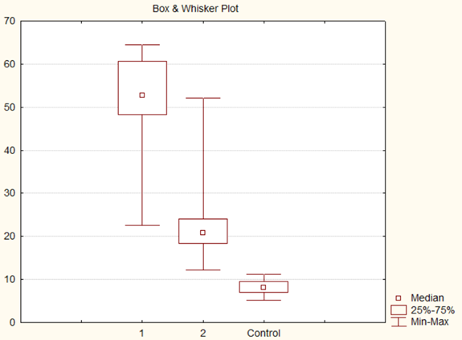
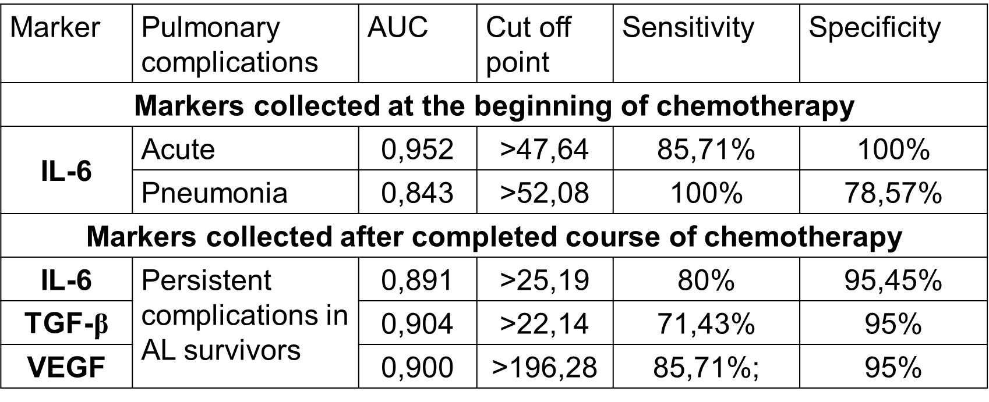
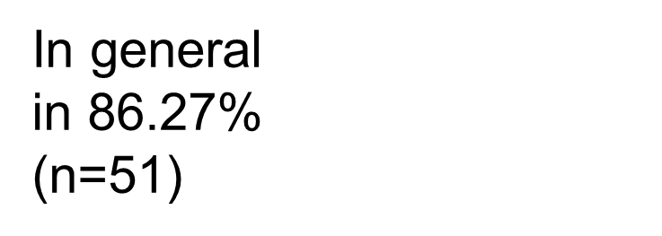
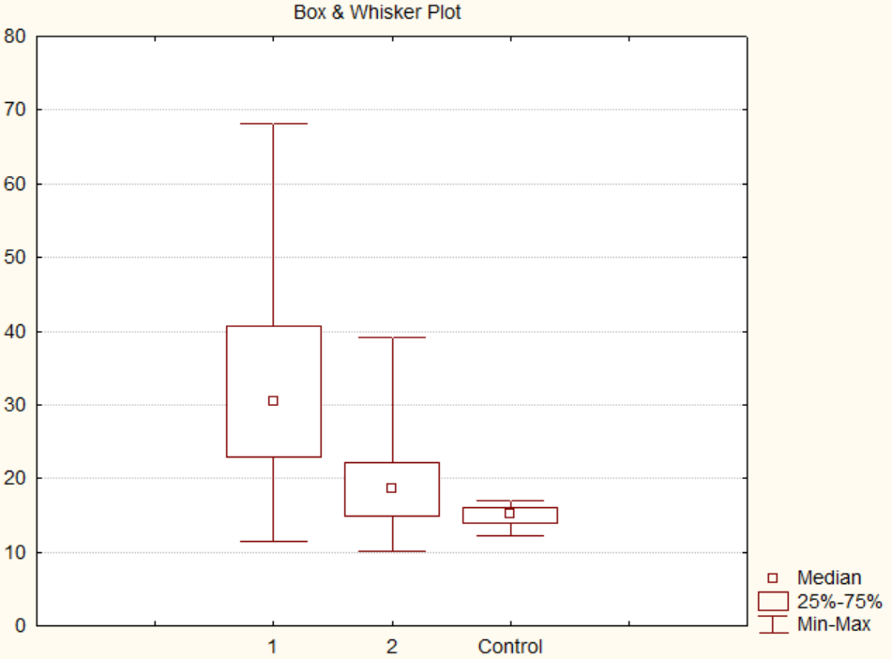
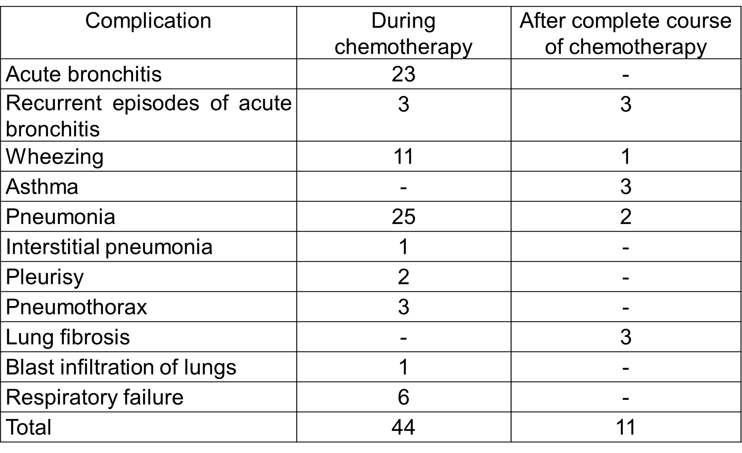
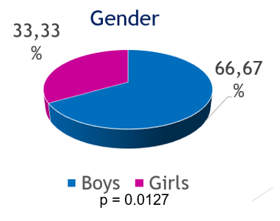
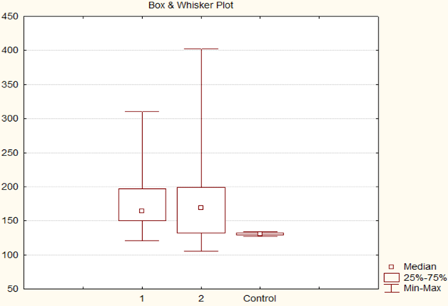
Kharkiv National Medical University, Department of pediatrics N2
State of the Blood-Air Barrier in Pediatric Acute Leukemia patients: prognosis for pulmonary complications
Nataliia Makieieva, Victoria Koval
Kharkiv National Medical University, Department of pediatrics N2
Objective
Acute leukemia (AL) is the
most common cancer in children.
Pulmonary complications can be
present both during the acute
phase of the disease and in survivors.
They can influence the prognosis
of the disease and the quality of
life of patients.
The objective of the study is to assess the levels of damage markers of epithelial (IL-6), interstitial (TGF-β), and endothelial (VEGF-A) components of blood-air barrier (BAB) and their prognostic significance in children with AL.
.
Methods
Our study included 51 children aged 6-17 years with AL and 15 healthy children for the control group.
The presence of congenital or chronic diseases of the respiratory system before the debut of AL and diagnosed
primary immunodeficiency were exclusion criteria.
Diagnosis and treatment of AL were according to Berlin-Frankfurt-Münster protocols.
The level of IL-6 and TGF-β in exhaled breath condensate (EBC), VEGF-A in blood serum were investigated by ELISA.
Statistical analysis was made by Statistica 8 and MedCalc 17.2.
Structure of blood-air barrier, which is composed of epithelial, interstitial, and endothelial components.
Kharkiv City Children's Clinical Hospital №16, clinical base of Department of pediatrics N2, KhNMU
Treatment process at hematological department of Kharkiv City Children's Clinical Hospital №16
Collecting of EBC by a special device, , modified on the basis of the Department of Pediatrics N2 of KhNMU
(patent No. 108795).
.
Division of examined children with acute leukemia into groups.
Results
Conclusions
Studied markers IL-6, TGF-β in EBC and serum VEGF-A are increased both during protocol treatment and in long-term remission, which proves BAB damage in children with AL.
Levels of IL-6 and TGF-β in EBC and VEGF-A in serum can be predictive for lung complications in pediatric acute leukemia patients.
Assessment of BAB damage markers can be useful for the management of children with AL to provide timely and effective care.
IL-6, pg/ml
Results of ROC-analysis
Group 1: 52,71 (48,28; 60,71)
Group 2: 20.74 (18.34; 24.08)
Control: 8.12 (7.02; 9.45)
Kruskal-Wallis H= 52,36248; p =0,0000
Mann–Whitney U-test: p_{1-C}=0.000000;
p_{2-C}=0.000000; p₁₋₂= 0,000007
TGF-β, pg/ml
15 of children belonged to a high-risk group (HR)
5 of children had a relapse of acute leukemia
Group 1: 30.46 (22.90; 40.65)
Group 2: 18.55 (14.91; 22.14)
Control: 15.22 (13.88; 16.00)
Kruskal-Wallis H=31,92150; p =0,0000
Mann–Whitney U-test: p_{1-C}= 0,000002;
p_{2-C}= 0,011302; p₁₋₂= 0,000013.
Level of IL-6 in EBC collected at the beginning of chemotherapy >47,64 pg/ml can be predictive for acute pulmonary complications with sensitivity 85,71%; specificity 100%); >52,08 pg/ml can predict pneumonia with sensitivity 100%; specificity 78,57%.
Level of IL-6 in EBC >25.19 pg/ml after total course of chemotherapy can be predictive for pulmonary complication in long-term remission with sensitivity 80%; specificity 95,45%.
Level of TGF-β >22,14 in EBC after completed course of chemotherapy can be predictive for pulmonary complication in AL survivors sensitivity 71,43 %; specificity 95%.
Serum VEGF >196,28 pg/ml after total course of chemotherapy can be prognostic for pulmonary complication in AL survivors with sensitivity 85,71%; specificity 95%.
VEGF, pg/ml
Key words: acute leukemia, children, pulmonary complications, pneumonia, blood-air barrier, cytokines, interleukin-6, transforming growth factor β, vascular endothelial growth factor
Group 1: 164.12 (150.18; 197.08)
Group 2: 169.11 (132.15; 198.66)
Control: 130.65 (129.45; 132.15)
Kruskal-Wallis H=16,90223; p =0,0002
Mann–Whitney U-test: p_{1-C}=0,000041;
p_{2-C}= 0,001184; p₁₋₂=0,623648.

