Slide 1
IS LEVEL OF PHOSPHOLIPIDS IN EXHALED BREATH CONDENSATE PREDICTIVE FOR PULMONARY COMPLICATIONS IN CHILDREN WITH ACUTE LEUKEMIA?
Kharkiv National Medical University
Department of pediatrics №2
Kharkiv, Ukraine
PhD Student Victoria Koval
Supervisor:
prof. Nataliia Makieieva

Slide 2
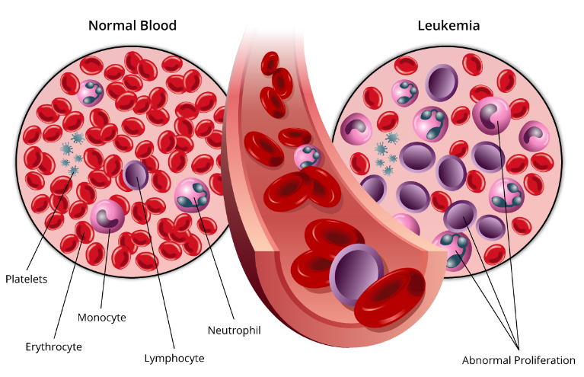
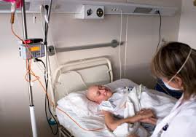
Introduction
Acute leukemia (AL) is a most common cancer in children.
In Ukraine the incidence of AL among children is 4.7:100,000, and mortality from AL is 0.9:100,000 [1].
In resent decades there has been an improvement in the quality of treatment of this pathology [2].
However, the course of the disease itself and the treatment of hl with the use of chemotherapeutic drugs cause serious complications, including pulmonary ones.
Bulletin of National Cancer Registry of Ukraine. Cancer in Ukraine 2020 - 2021: Incidence, mortality, prevalence and other relevant statistics. 2022, 23:66
Surveillance, Epidemiology, and End Results (SEER), USA, 2022.

Slide 3
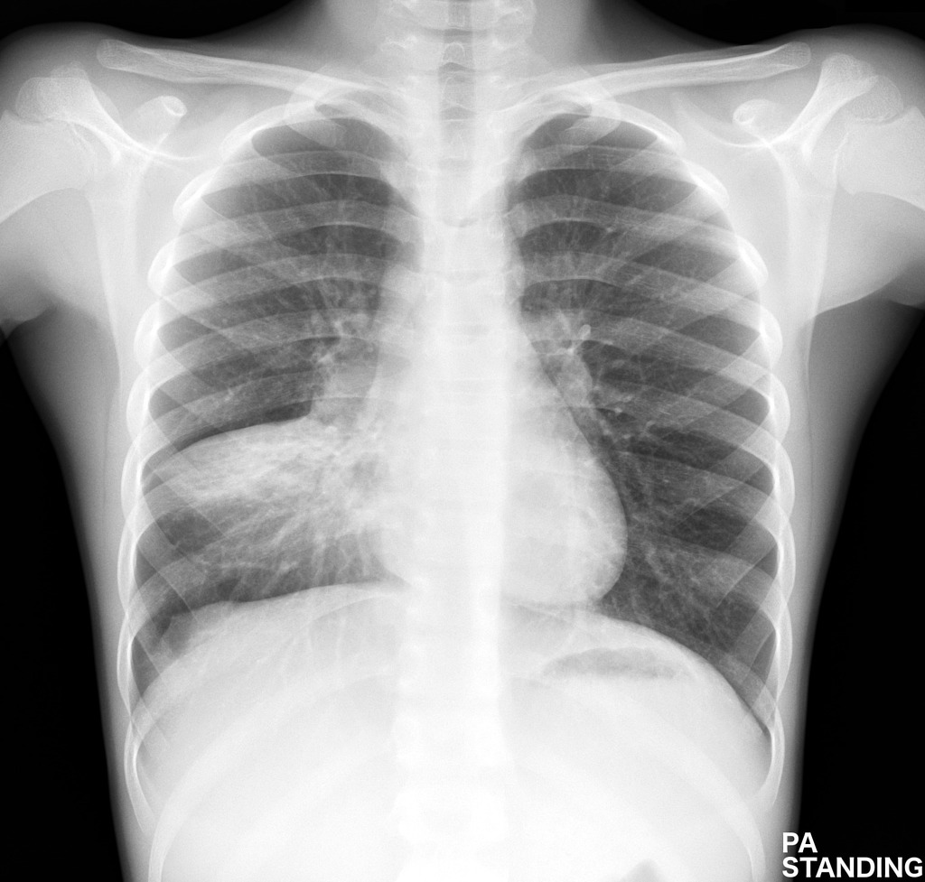
Pulmonary complications
Associated both with the course of the underlying disease and with the side effects of the treatment.
Acute pulmonary complication, including, lung infections are common during chemotherapy protocols and can influence on prognosis of AL.
Some pulmonary complications are still persist in the long term period among pediatric cancer survivors.

Slide 4
PHOSPHOLIPIDS
Blood-air barrier
Phospholipids (PL) are the main component of pulmonary surfactant, as well as the structural element of alveolocytes.
The assessment of PL level in exhaled breath condensate (EBC) can be useful for a more detailed understanding of pathological processes in the lungs and its relations with pulmonary complications in children with AL
Nova Z, Skovierova H, Calkovska A. Alveolar-Capillary Membrane-Related Pulmonary Cells as a Target in Endotoxin-Induced Acute Lung Injury. International Journal of Molecular Sciences. 2019; 20(4):831. https://doi.org/10.3390/ijms20040831

Slide 5
The aim of the study
To assess the level of phospholipids in EBC in children with acute leukemia and its prognostic value

Slide 6
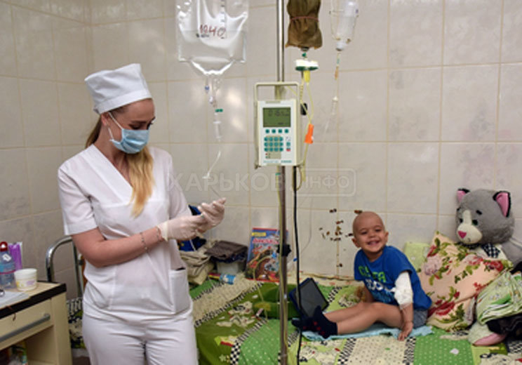
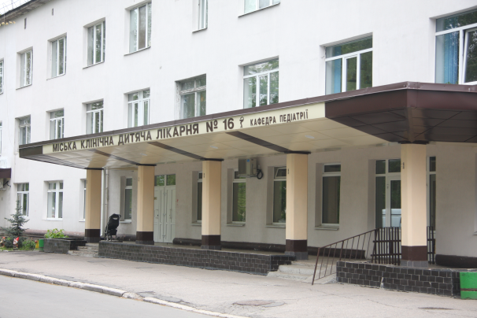
Materials and methods
Our study included 51 children aged 6-18 years with acute leukemia and 15 healthy children for the control group.
Children with AL were divided into 2 groups:
1st group – during chemotherapy (n = 24)
2nd group – AL survivals, who had completed total course of chemotherapy and had a remission for at least two years (n= 27).
Diagnosis and treatment of AL were according to BFM protocols

Slide 7
The criteria for inclusion:
verified diagnosis of AL
age 6-17 years
signed consent from parents, and/or patients.
The criteria for exclusion:
refusal of the parents or/and patients to sign the consent
age less than 6 years or problems in following instructions during EBC collection
diagnosed chronic pulmonary diseases before the debut of AL
any hereditary diseases that lead to changes in the structure and functioning of the respiratory system, including cystic fibrosis;
proven hereditary immune deficiency.

Slide 8
assessment of PL level in EBC
The levels of PL in the EBC were investigated by spectrophotometric thin layer chromatography using an SPh 46 spectrophotometer.
The EBC was taken using the developed EBC collection device, modified on the basis of the Department of Pediatrics No. 2 of Kharkiv National Medical University (patent No. 108795).
EBC was collected:
1st group - between the 7th and 14th day of chemotherapy in a period without signs of pulmonary complications and critical neutropenia.
2nd group - during their planned visit to the hematological department

Slide 9
.
Statistical analysis.
Data analysis was performed using Statistica 8 and Medcalc 17.2
Ethics approval and consent to participate.
Each study participant and his /her parents were informed about the nature of the study. Informed consent for participation in the study from the parents of all patients and from patients aged 14-18 was obtained. The study was approved by the ethics and bioethics committee of Kharkiv National Medical University, Ukraine (protocol no. 8 of 5th October 2016) and was conducted according to Helsinki declaration (1975).

Slide 10
Results
15 of children belonged to a high-risk group (HR)
5 of children had a relapse of acute leukemia
There was a significant prevalence of boys than girls (p = 0.0127).

Slide 11
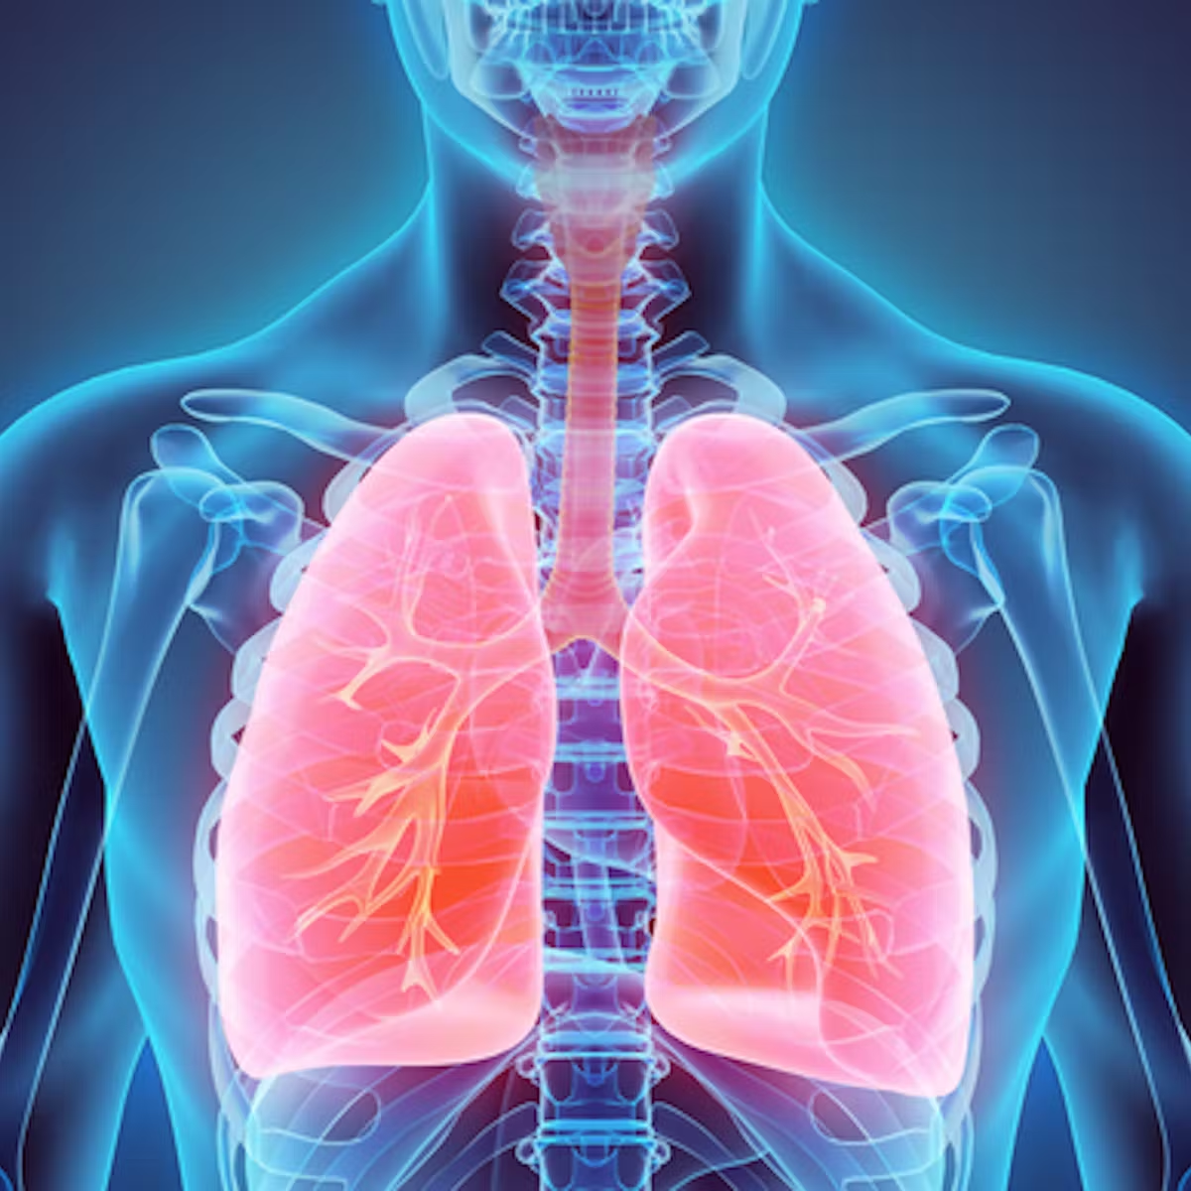
Pulmonary complications
Pulmonary complications were recorded in 86.27% % of children with acute leukemia
Acute pulmonary complications were presented in 87.50% of children during chemotherapy (group 1).
In 24,44% of children pulmonary complications persisted during the long-term remission after the complete course of chemotherapy (group 2).

Slide 12
Pulmonary complications in children with AL (n=51)
Complication | During chemotherapy | After complete course of chemotherapy
Acute bronchitis | 23 | -
Recurrent episodes of acute bronchitis | 3 | 3
Wheezing | 11 | 1
Bronchial asthma | - | 3
Pneumonia | 25 | 2
Interstitial pneumonia | 1 | -
Pleurisy | 2 | -
Pneumothorax | 3 | -
Lung fibrosis | - | 3
Respiratory failure | 6 | -
Total | 44 | 11

Slide 13
Phospholipids level in EBC
Despite the differences in treatment protocols and received chemotherapeutic drugs in different types of leukemia and risk groups we have not received any statistically significant differences in PL levels in children with different types of AL (p_{ALL-AML}= 0,468196) and different risk groups (p=0.9132).
Any significant differences in PL levels in accordance to gender have been found (p=0.9132).

Slide 14
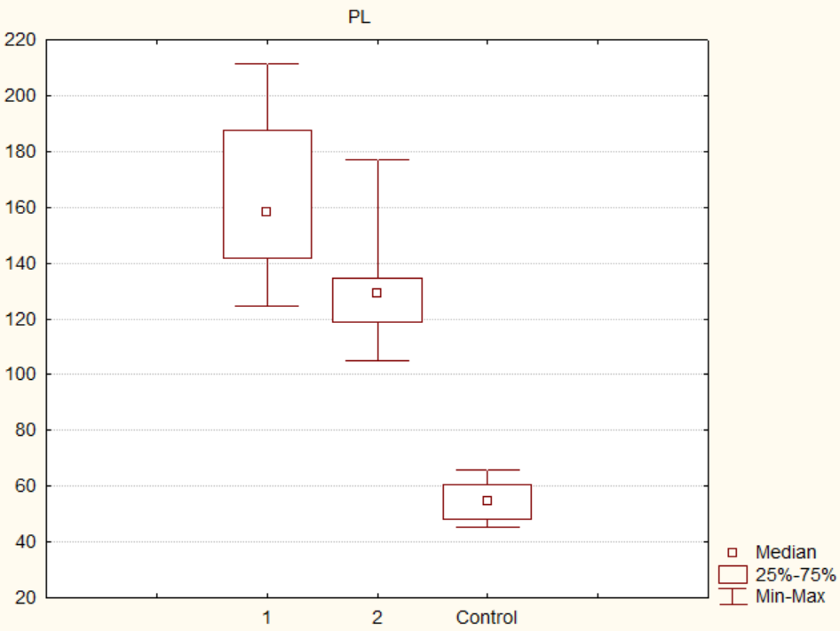
Phospholipids level in EBC
The increased levels of PL in 1st group (158.29 (141.72; 187.67) mmol/l) and 2nd group (129,08 (118,65; 134,72) mmol/l) compared with control (54.80 (54.80; 60.80) mmol/l) were found:
p_{1-C}=0.0000; p_{2-C}=0.0000.
Children with AL during chemotherapy (group 1) had higher levels of phospholipids in EBC than AL survivors after completed course of chemotherapy (group 2):
p₁₋₂= 0,000007.

Slide 15
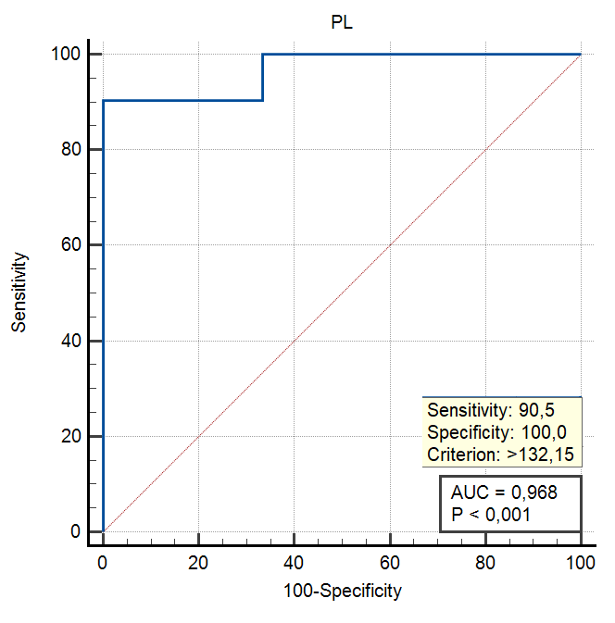
ROC-analysis
Phospholipids level in EBC collected during the induction phase of chemotherapy >132.15 mmol/l can be predictive for acute pulmonary complications (AUC 0.968; sensitivity 90.48%; specificity 100.00%).

Slide 16
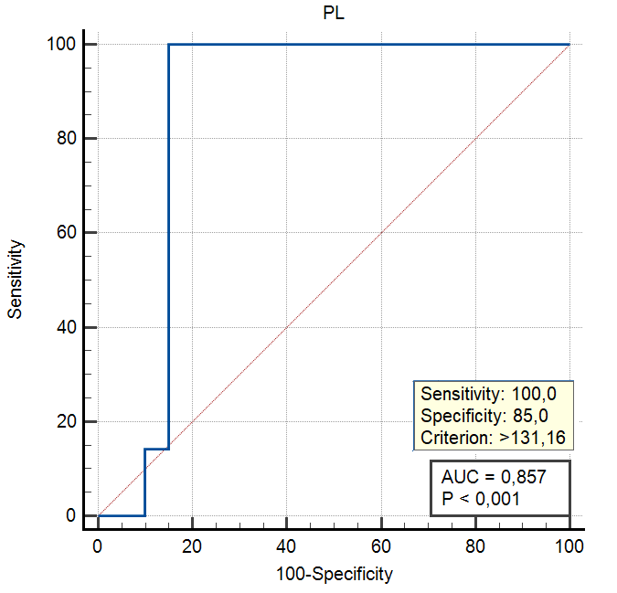
ROC-analysis
Phospholipids level in EBC after the completed chemotherapy >131.16 mmol/l can be predictive for persistent pulmonary complications (AUC 0.857; sensitivity 100.00%; specificity 85.00%).

Slide 17
Conclusion
Children with AL can be classified as a risk group for the development of pulmonary pathology, both during the period of chemotherapy treatment and in long term remission after completion of chemotherapy.
The level of phospholipids in EBC can be considered a possible predictor of pulmonary complications in children with acute leukemia.

Slide 18
Thank you for your attention!

