Slide 1
Deep Learning Based Image Segmentation for Detection of Odontogenic Maxillary Sinusitis
Alina Nechyporenko, Marcus Frohme, Dmytry Sytnikov,
Victoriia Alekseeva, Vitaliy Gargin, Maryna Hubarenko
IEEE ELNANO-2022
Notes:
Hello to everybody! My name is Victoriia Alekseeva and it’s my honor to present data of our research “Deep Learning Based Image Segmentation for Detection of Odontogenic Maxillary Sinusitis.”

Slide 2
Parts of Presentation
The issue of detection of odontogenic maxillary sinusitis
The process of segmentation of medical images
Description of the experiment and analysis of the results
Notes:
There are three major parts in my presentation.
First of all, I'd like to emphasize how important to recognize odontogenic maxillary sinusitis in time. Then I will outline overall procedural steps to complete an image segmentation process. After that I’ll share with you objectives and results of the study and our insights with this regard.
So, let's move on to the first task

Slide 3
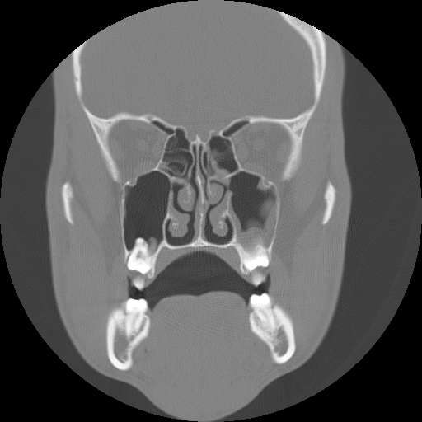
Relevance of the topic
The aim of this study is to develop a new approach for Computed Tomography (CT) image segmentation based on Convolutional Neural Network (CNN) for detection of Odontogenic Maxillary Sinusitis (OMS).
Notes:
The aim of this study was to develop a new approach for Computed Tomography image segmentation based on Convolutional Neural Network for reliable recognition of Odontogenic Maxillary Sinusitis.

Slide 4
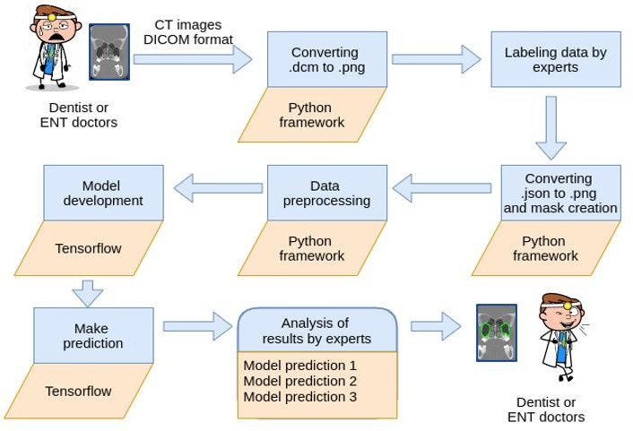
The process of segmentation of medical images
Notes:
Medical image segmentation is step-by-step process of automatic detection of boundaries within 2D or 3D images aimed to identify the pixels of regions of interests from background medical images such as CT or MRI images.
In order to support and facilitate the segmentation task within the entire workflow, we developed a Standard Operating Procedure. This flowchart shows the overall procedural steps to accomplish an image segmentation process.
Roughly it was divided into three stages. The first stage included preparation of CT images, their conversion and creation of masks. At the second stage the models for the experiment were built. For this purpose, the popular library Tensorflow was used. Ultimately the experiment was carried out with results collated.

Slide 5
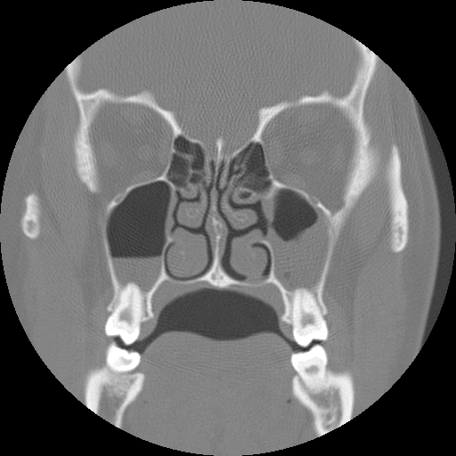
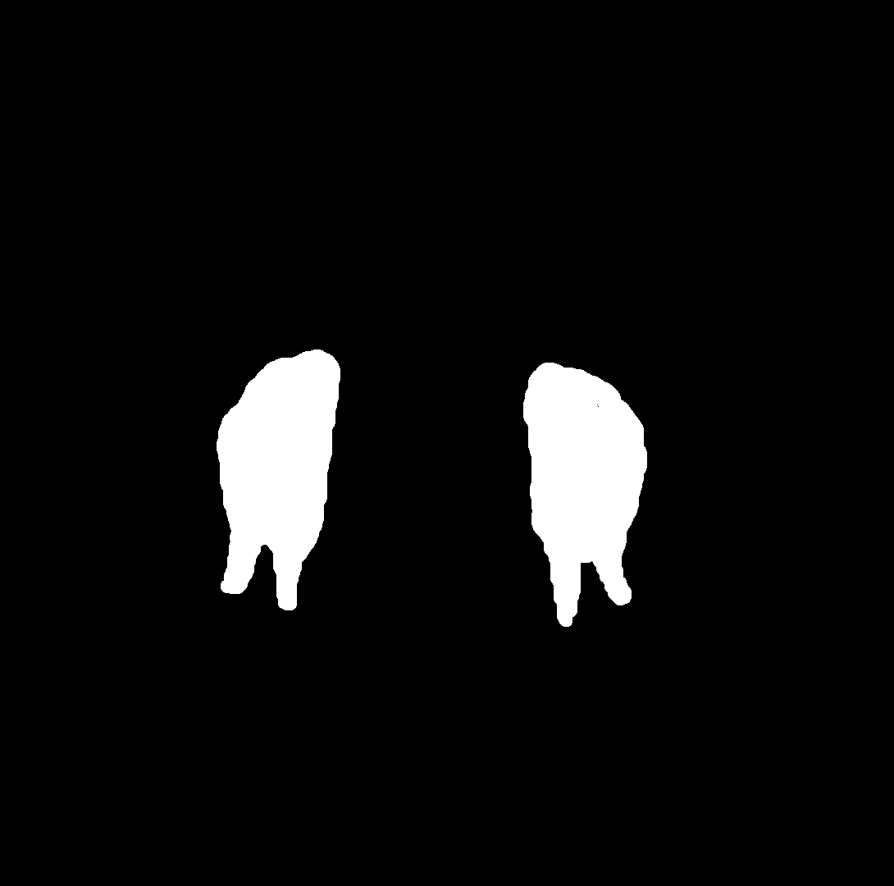
The process of segmentation of medical images
The first stage was the preparation of CT images, their conversion and creation of masks.
Image
Mask
Notes:
Using the RadiAnt software, we selected tomographic scans on which the location of the roots of the teeth in the maxillary sinus was clearly visualized. Therefore, the dataset contains 320 images (taken at the base of CT of 100 people).
Each scan includes the patient identity information, namely patient's name, age, sex, birth date, occupation, referring physician, study date, and DICOM Unique Identifiers.
Modern algorithms for medical image segmentation tasks are generally based on a supervised learning approach. It is known that supervised methods require a large, curated, and representative training data sets with precisely labelled regions of interest that are annotations performed by medical experts.
Therefore, it refers to an appropriate choice of image annotation tool. Such tool should comply with the best discriminating characteristics as well as clinical relevancy. Considering this, the Labelme tool has been selected.

Slide 6
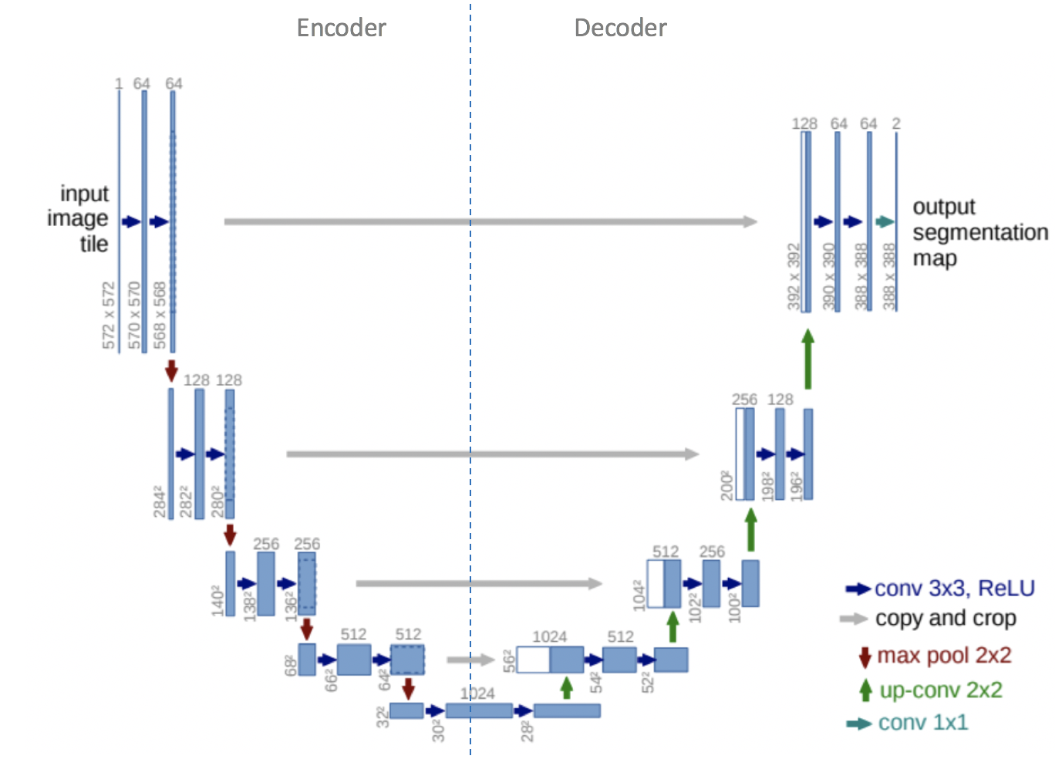
The process of segmentation of medical images
The second stage was the construction of models for the experiment.
Notes:
As the best choice for biomedical image segmentation the U-Net architecture has been selected. This model is built upon the fully convolutional network architecture, which comprises two paths of analysis and synthesis. U-Net takes its name from the architecture, which appears similar to the letter U.
Input images are obtained as a segmented output map. The network does not have a fully-connected layer. Only the convolution layers are used. Each standard convolution process is activated by a ReLU activation function [9]. The most important properties of U-Net are the shortcut connections between the layers of equal resolution from the analysis path to the expansion path. These connections provide essential high-resolution features to the deconvolution layers. Among other advantages of U-Net are computationally efficiency, ability to train with a small data- set and end-to-end training.

Slide 7
The process of segmentation of medical images
The third stage was conducting the experiment and comparing the results.
Six models of U-NET architecture have been developed for our experimental research.
Different values of hyperparameters such as batch size, epochs, validation split were set for each model. Adam was chosen as the learning rate optimizer in all models.
Notes:
Six models of U-NET architecture have been developed for our experimental research. Different values of hyperparameters such as batch size, epochs, validation split were set for each model. Adam was chosen as the learning rate optimizer in all models. This selection was based on the fact that it was the most effective optimization algorithm in learning neural networks. As the loss function, the binary cross- entropy has been used.

Slide 8
Results
Model Name | Batch Size | Epochs | Validation Split | Accuracy, %
Model_1 | 16 | 50 | 0.1 | 87,14
Model_2 | 32 | 100 | 0.2 | 84,52
Model_3 | 64 | 500 | 0.3 | 83,13
Model_4 | 128 | 1000 | 0.1 | 79,67
Model_5 | 8 | 50 | 0.1 | 91,17
Model_6 | 2 | 500 | 0.1 | 93,78
Notes:
Experimental data are presented in the Table 1. It includes model’s hyperparameters and accuracy of image segmentation. The comparative analysis shows that decreasing the Batch size value increases the accuracy of the model with a small number of epochs. This fact reduces the time required to train the neural network.
The results of segmentation are presented in Fig.5. With almost 94% the highest accuracy has been achieved on 224 training and 96 validation images with proper resolution by model 6. The Batch size and Epochs values were 2 and 500 respectively.

Slide 9
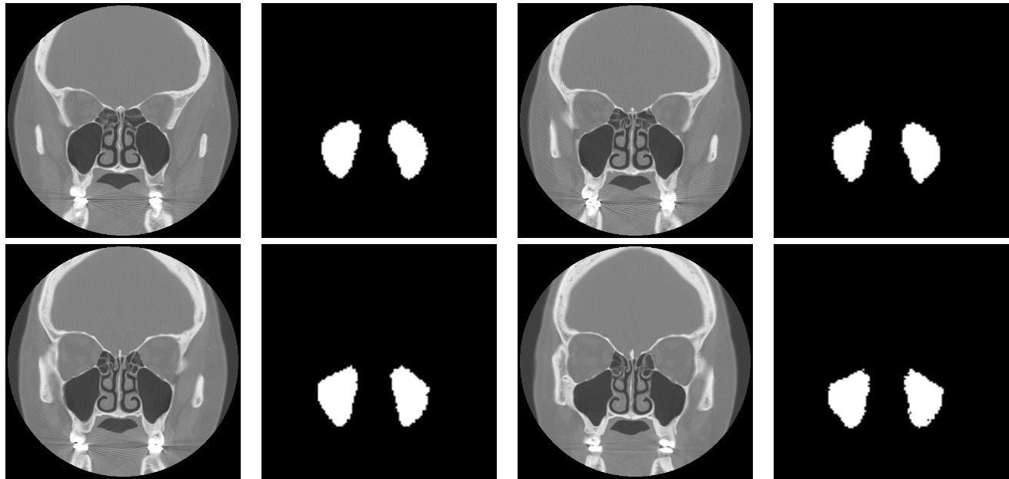
Results
Notes:
The figure on the slide represents the result of image segmentation by the developed software.

Slide 10
Conclusion
The current study is one of the first, which can allow, based only on the results of SCT and using Dl-based image segmentation, to establish the presence or absence of the odontogenic nature of maxillary sinusitis.
This study might help to develop an automate process of the detection of OMS, which is extremely important in the face of an increasing workload on medical staff every day.
Another important feature of our work is in the application of the described method and its ability to decrease the risks of errors associated with the human factor during the processing of CT.
Notes:
Coming to the end I will voice a conclusion that medical image segmentation is a powerful approach that enables diagnostic imaging test to improve efficiency and accuracy. The current study appears as some sort of pioneer in the field of recognition of maxillary sinusitis of odontogenic nature in the very beginning or contrariwise dismissal of this suspicion definitely, based solely on SCT and using Dl-based image segmentation. This is a key leverage for the choice of the best treatment of the case.
The study provides tools to unify the results of tomographic test by the most accurate assessment of an expert’s conclusion; moreover, in controversial cases it is capable to draw definitive conclusions about the nature of the disease, level the human factor and make a suggestion about the state of human maxillary sinus and features of interposition with dental roots.

Slide 11
Thank you for your attention!
Notes:
Thank you for your attention and questions are very welcome

