Slide 1
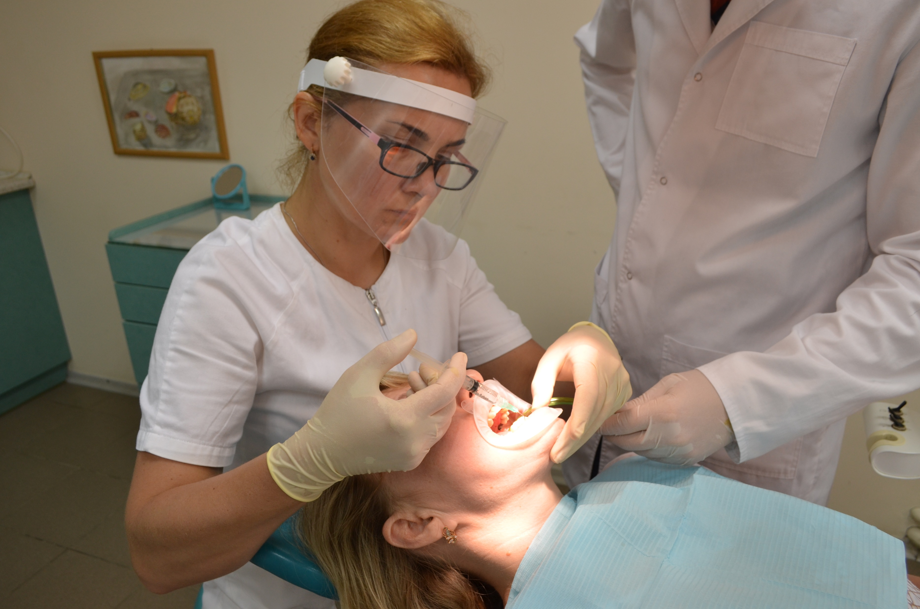
CORRECTION OF CYTOKINE MISBALANCE BETWEEN PRO-INFLAMMATORY TNF-𝛼 AND ANTI-INFLAMMATORY ІL-4 IN PATIENTS WITH CHRONIC GENERALIZED PERIODONTITIS
Khudiakova Maryna, Kharkiv Medical National University, Candidate of Medical Sciences, associate professor at the Department of Dentistry

Slide 2
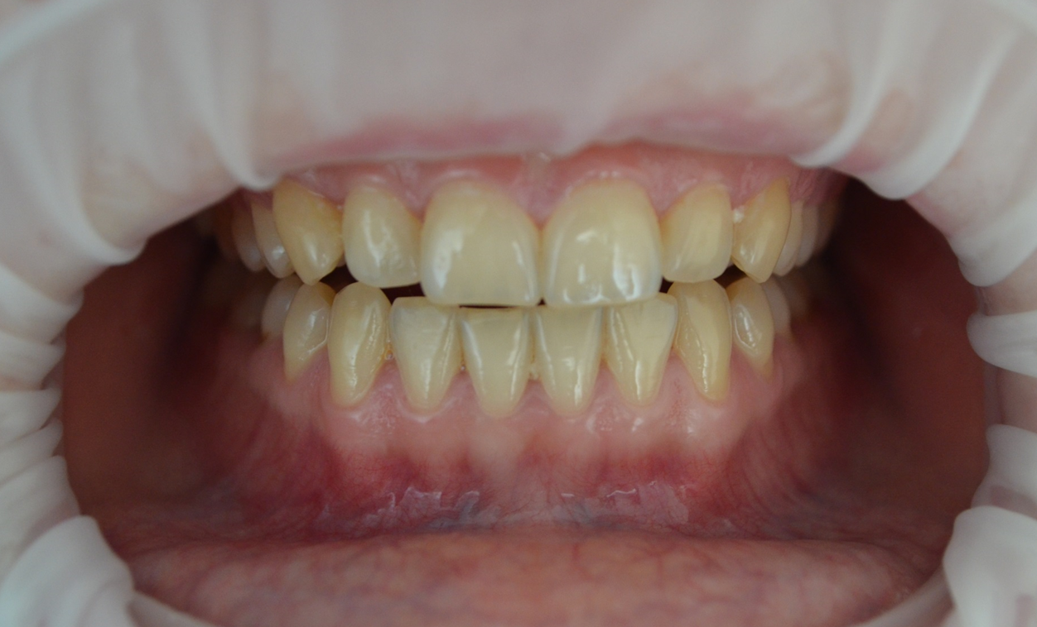
Development and application high-efficiency and safe facilities of drug therapy of chronic generalized periodontitis (СGP) the last years legally considered one of priority directions of native and foreign researchers. Medical local therapy is inalienable part of complex treatment of CGP

Slide 3
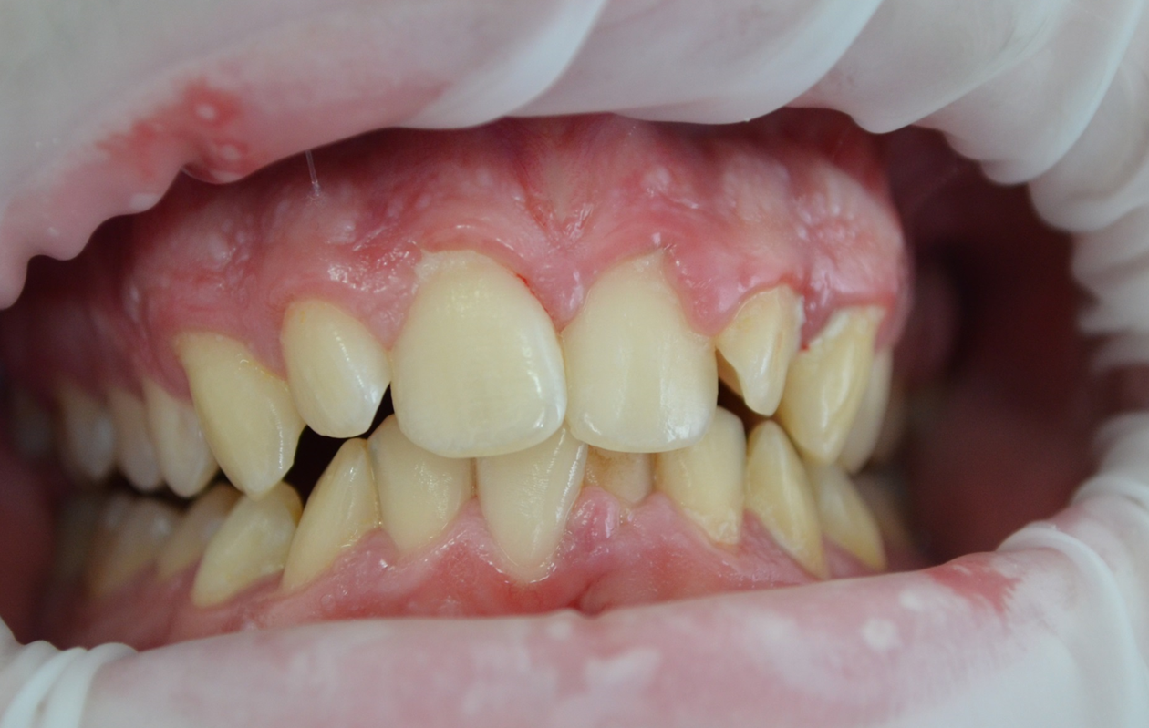
Cytokines play a major role in inflammatory and immune responses in periodontal tissues the patients with СGP. The misbalance between pro-inflammatory (TNF-𝛼) and anti-inflammatory (IL-4) mediators as being the cytokines for which there is the most substantial evidence for having a central role in cytokine networks in periodontal diseases

Slide 4
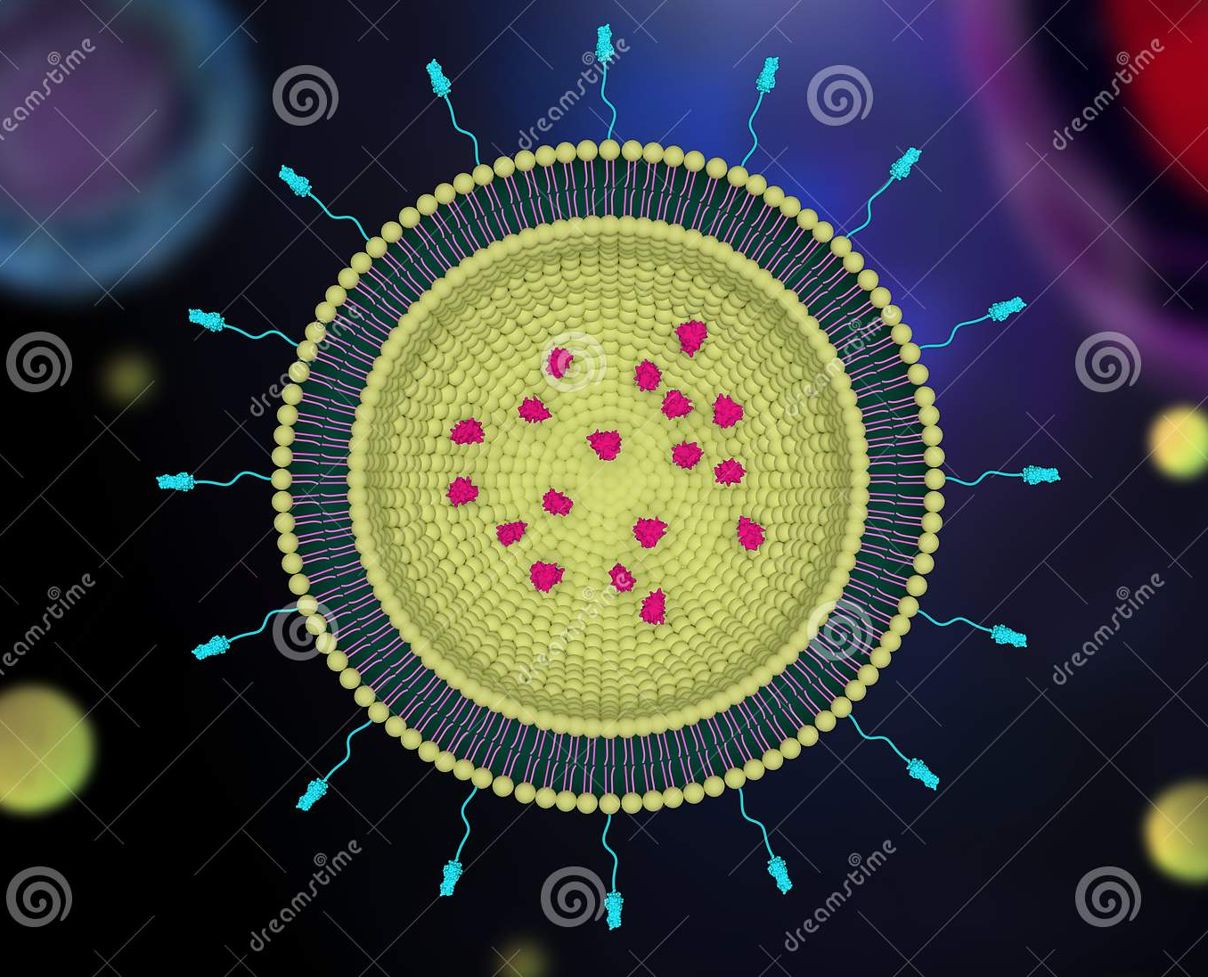
Being small, liposomes go through regions that other delivery systems might not get an access to. It is remarkable that liposomes are the most frequently used for drug delivery due to simple methods of preparation and easiness of scaling up

Slide 5
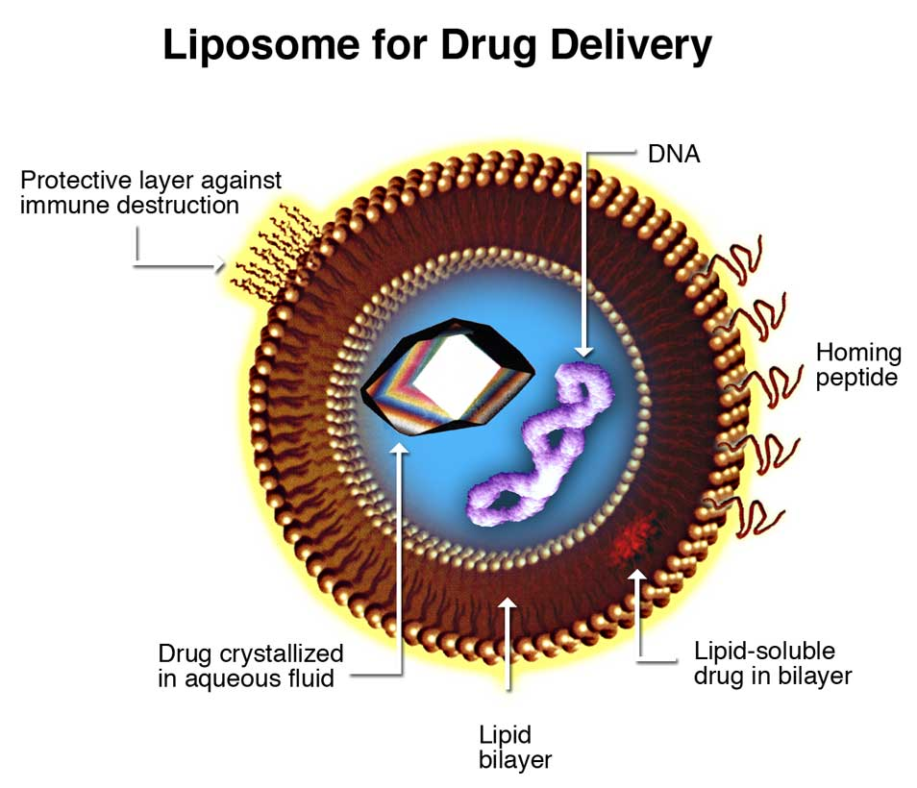
The aim of using liposomal carriers is generally, to increase the specificity towards cells or tissues, to improve the bioavailability of drugs by increasing their diffusion through biological membranes, to protect them against enzyme inactivation. These systems reduce the frequency of administration, further provide a uniform distribution of the active agent over an extended period of time

Slide 6
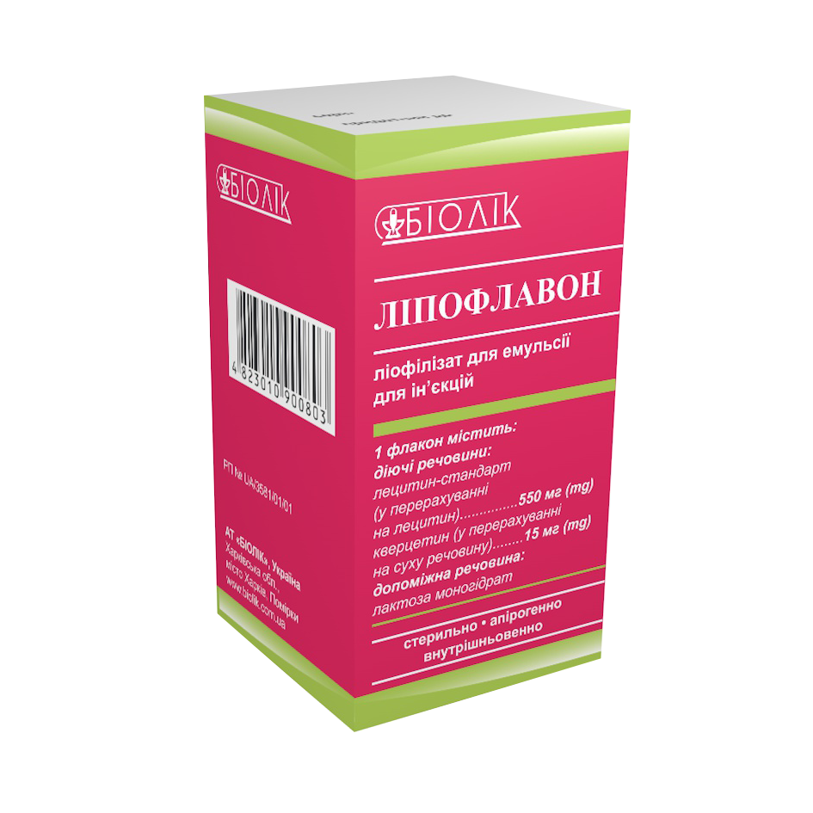
Anti-inflammatory characteristics of «Lipoflavon» (JSC „Biolek”, Kharkov), which contains lecithin liposomes and quercetin, are based on its marked аnti-leukotrienes effect. Quercetin inhibits production of inflammation-producing enzyme 5-lipoxygenase (LOX). The immunomodulating action of Quercetinum is known. Quercetinum differentiated regulates expression genes of Th-1 (IFNγ) and Th-2 (IL-4) of cytokines by the normal mononuclear cells of peripheral blood. Quercetinum increased of phenotypical expression of IFNγ mononuclear cells of peripheral blood and suppressed IL-4 are positive mononuclear cells of peripheral blood, that is compared with the results of determination of mRNC/protein

Slide 7
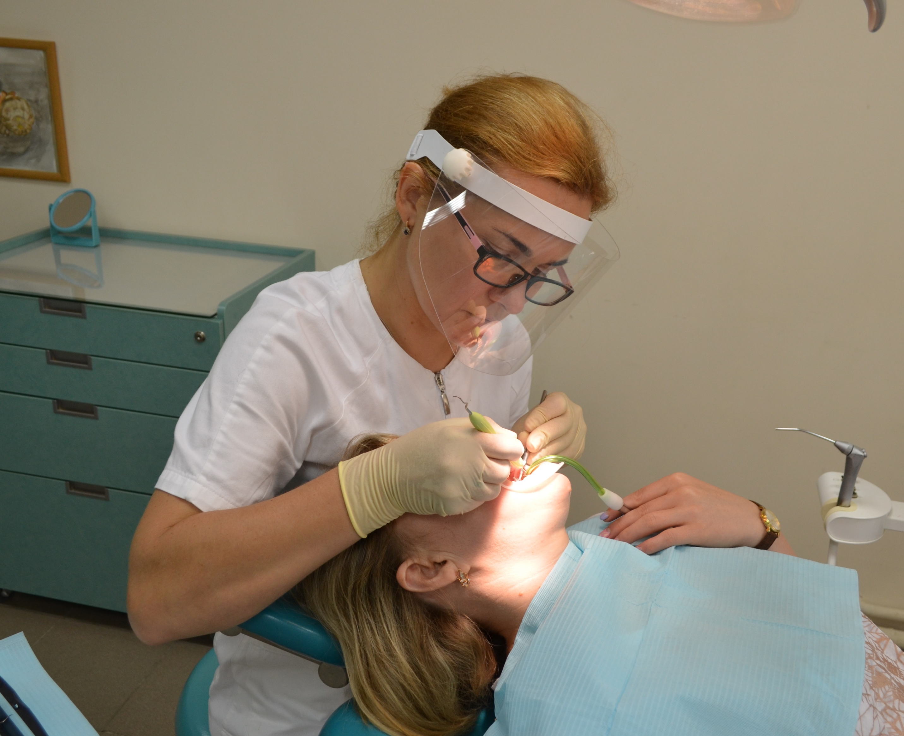
Efficiency of local application of medical drugs in periodontal tissues depends on the display of substances in the periodontal pocket (PP), choice of medical substances, method of his application, contact with the gingival oral mucosa and maintainance of this concentration. Therefore it is necessary advantage to give to the forms and pathways of medications with the controlled and long action

Slide 8
As a consequence, the considerate research of changes of pro-inflammatory TNF-α and anti-inflammatory ІL-4 cytokines might have considerable scientific and practical importance while treating patients with CGP of initial-I degrees of severity with gel from the granules of Quercetinum (GQ) and liposomal Quercetinum-lecithin complex (LQLC)
The purpose of study was to increase of efficiency of complex treatment the patients with CGP of initial-I degrees of severity with gel from the granules of GQ and liposomal LQLC due to the correction of cytokine levels

Slide 9
Material and Methods
Mouth liquid (ML) sampling of all observed patients was taken every morning before treatment and one, six and twelve months after the treatment for immunological researches. The patients of basic group recieved base therapy with the local application LQLC (injection form of «Lipoflavon») as a suspension, prepared ex tempore, containing 137.5 mgs of lecithin and 3.75 mgs of Quercetinum. This suspension was prepared by mixing 1/4 parts of content of the small bottle with 5 ml 0,9% solution of natrium chloride, warmed up to 38⁰

Slide 10
In accordance to treatment all patients were divided into 2 groups: I group – basic treatment with local application LQLC (18 patients) with the use of individual periodontal delivery tray; II group (group of comparison) – basic treatment with local application of gel from GQ (17 patients) with the use of individual periodontal delivery tray. The control group (C) included 14 healthy subjects without systemic inflammatory disease

Slide 11
While the exact contribution of each cell type remains to be elucidated, previous studies described that a hyper-reactive phenotype of phagocytes is related to increased pro-inflammatory cytokines production in CGP. The cytokine level of the patients of control group was TNF-α - 21,71 ± 2,95 pg/ml, where as that of the anti-inflammatory was ІL-4 - 243,5 ± 17,48 pg/ml. As such, numerous gingival crevicular fluid (GCF) constituents have been characterized to identify biomarkers that may be used to monitor the initiation and progression of gingival inflammation and the immune response.

Slide 12
Fig. 1. Changes of cytokine level pro-inflammatory TNF-α in the ML before treatment and through 1, 6 and 12 months after treatment the patients with СGP of initial-I degrees of severity: I group (basic group) – basic treatment with local application LQLC; II group (comparison group) – basic treatment with local application of gel from GQ; C- control group

Slide 13
Fig. 2. Changes of cytokine level anti-inflammatory ІL-4 in the ML before treatment and through 1, 6 and 12 months after treatment the patients with СGP of initial-I degrees of severity: I group (basic group) – basic treatment with local application LQLC; II group (comparison group) – basic treatment with local application of gel from GQ; C- control group

Slide 14
Conclusion
1. The research in question demonstrates lipoflavon capability to normalize homeostasis of the oral cavity, normalize misbalance of cytokines in periodontal tissues, thus retarding process of inflammation and destruction of tissues and improving reparation of periodontal structures.
2. High (considerable) therapeutic efficacy of the liposomal quercetin-lecithin complex for treatment patients with chronic generalized periodontitis, especially that of initial and I degrees of severity is based on its marked anti-inflammatory, immunomodulating and periodontoprotecting effects.
3. This allows to recommend lipoflavon for local application as pathogenetically substantiated drug in treatment of generalized periodontitis.

