Slide 1
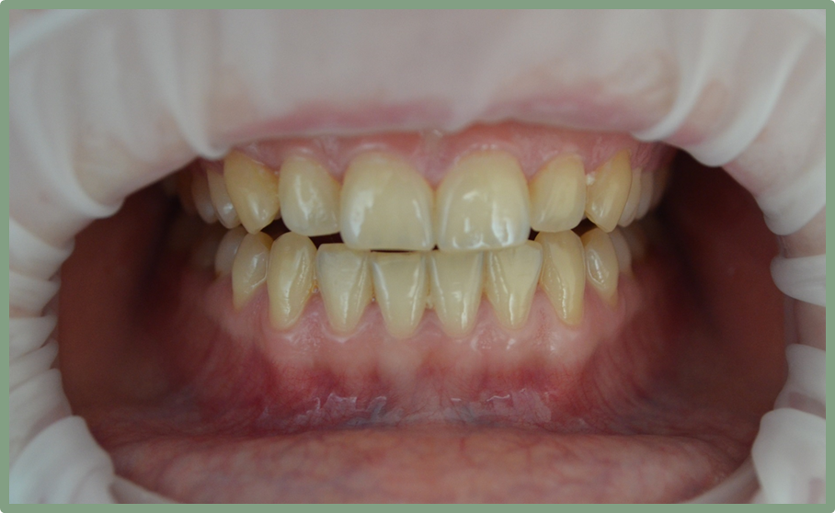
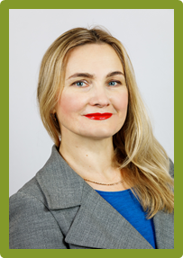
POSSIBLE PROGNOSTIC BIOMARKERS OF PERIODONTITIS IN ORAL FLUID
Khudiakova Maryna, Kharkiv Medical National University, Candidate of Medical Sciences, associate professor at the Department of Dentistry

Slide 2
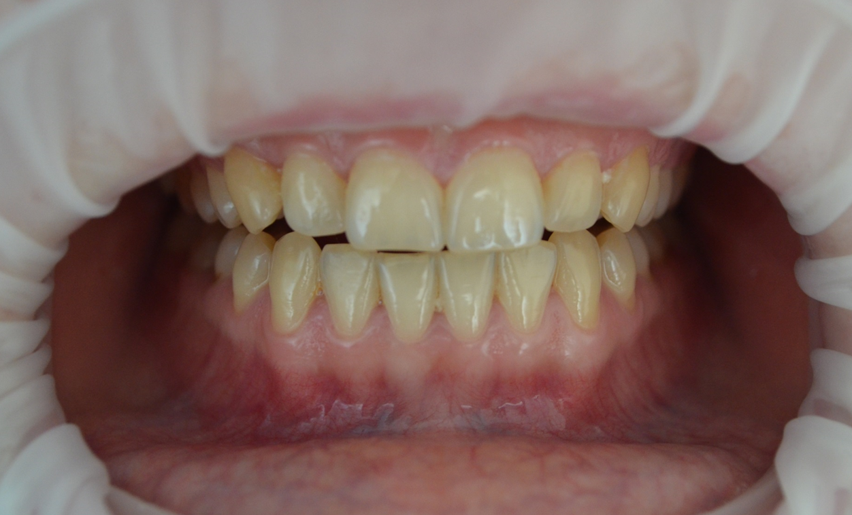
INTRODUCTION. Periodontitis is an inflammatory disease affecting approximately 10% of the population. In essence, it is the destruction of periodontal tissues, and supporting tissues of the tooth. It is progression results in the loss of alveolar bone and premature tooth loss. Subsequently, external factors play a role, as well as the body’s response. Thus, the disease is a complex of interactions between pathogenic microorganisms and the host immune response [1, 2, 3, 4].

Slide 3
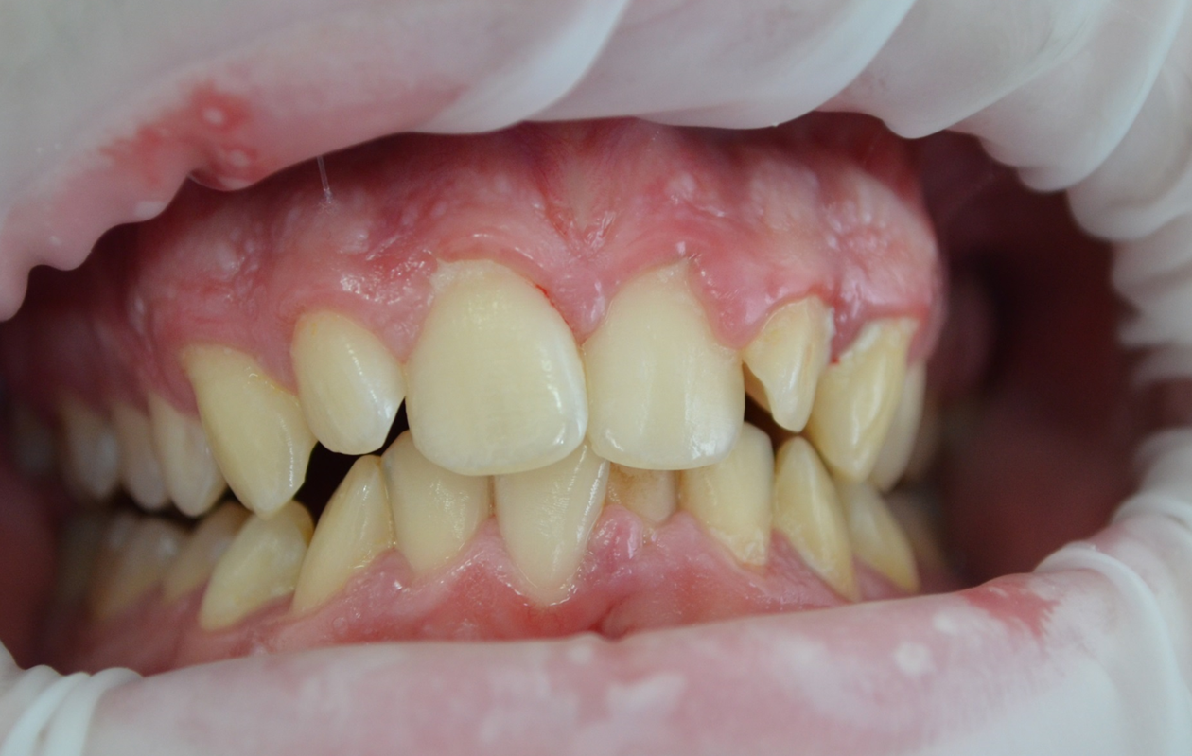
The role of oxidative stress in periodontitis has been studied for decades. The main source of reactive oxygen species is thought to be neutrophils, which are the first line of defense against bacteria. During the process of respiratory inflammation, a superoxide radical is formed. This may then be released into the phagosomal and extracellular space causing the subsequent formation of other radical and non-radical derivatives [1, 2].

Slide 4
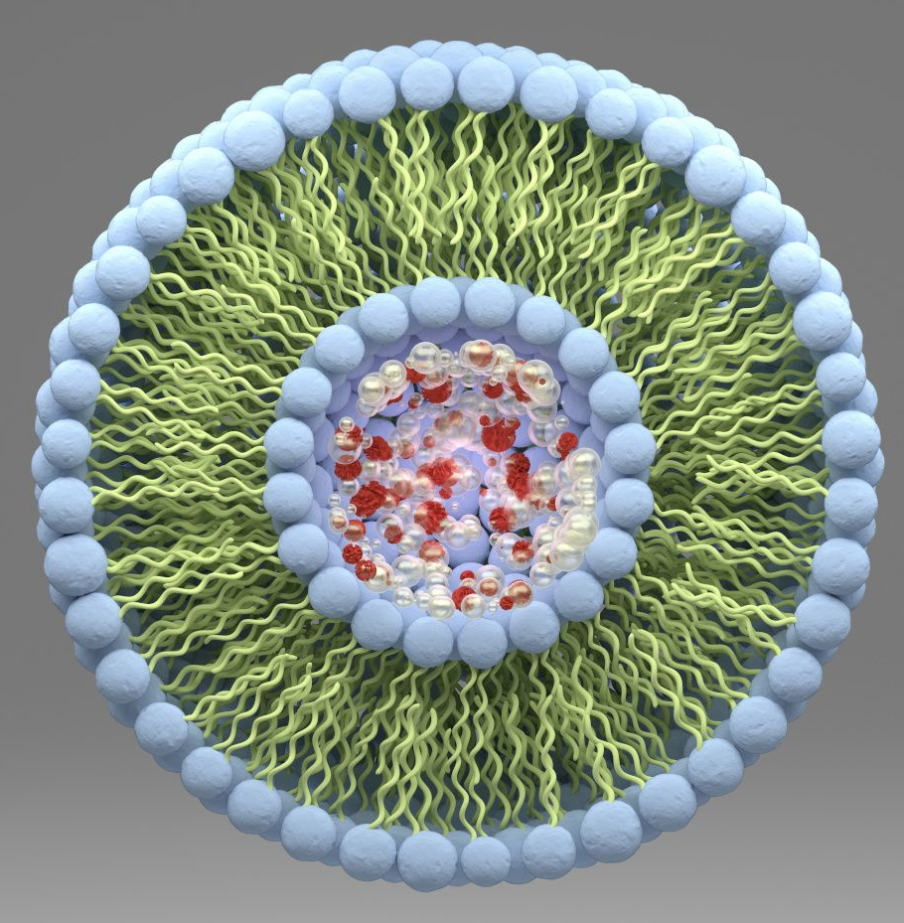
Modern predominant perception of the nanoscale lipid artefacts - liposomes as drug delivery systems (DDS), based on the ability of universal incorporation of active pharmaceutical ingredients (APhI). Liposomes are nano- and micro-structured vesicles with a bilayered phospholipid membrane. In addition to these features, liposomes can be designed to increase the bacterial interaction by modification of superficial vesicle compounds [5, 6].

Slide 5
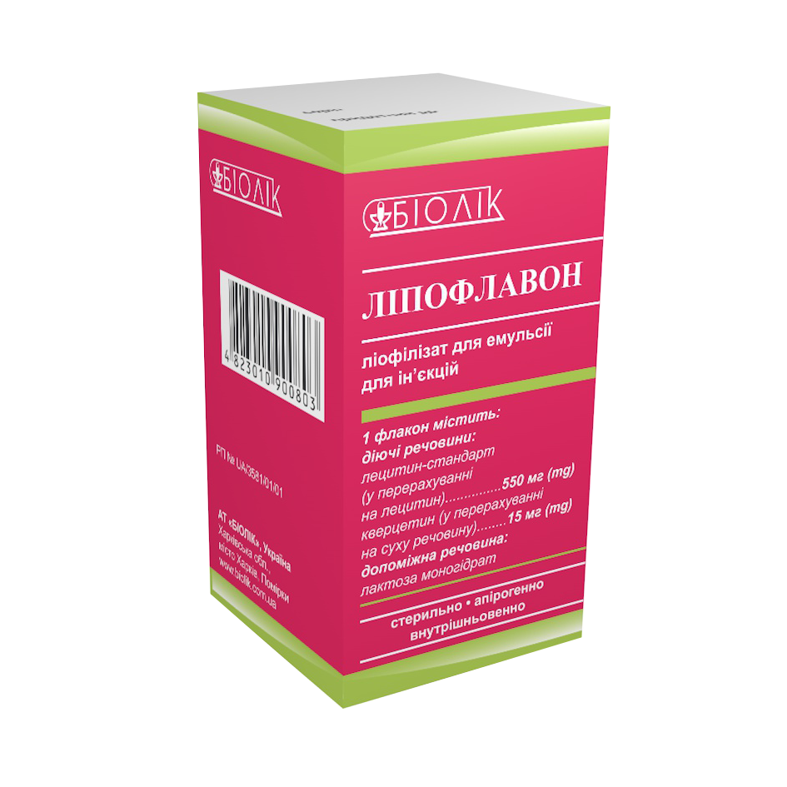
The efficacy and safety of Lipoflavon for systemic and local use in different clinic branches reflect the versatility of the mechanism of action of phospholipid liposomes and quercetin with an emphasis on antioxidant, antihypoxic, membraneprotective and immunomodulatory activity, pro-surfactant effect.

Slide 6
The aim of this study
The aim of this study is to measure malondialdehyde (MDA) as an end product of oxidative stress and enzyme antioxidant activity catalase (CAT) in patients with CGP of initial-I degrees of severity and assess the influence of periodontal treatment with gel from the Granules of Quercetin (GQ) and Liposomal Quercetin-Lecithin Complex (LQLC) on these parameters.

Slide 7
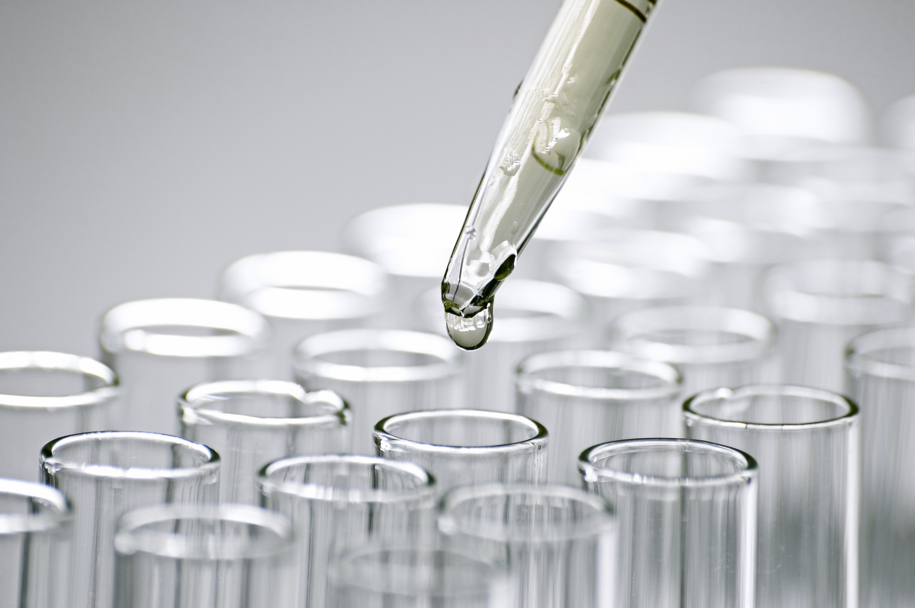
Material and Methods
Oral fluid (OF) sampling of all observed patients was taken every morning before treatment and one, six and twelve months after the treatment for biochemical researches. The state of prooxidant-antioxidant protection was determined by the level of MDA and CAT. Level determination MDA was performed by the method Uchiyma M. & Michara M. in the modification of Volchegorsky I.A. et al. according to the test with thiobarbituric acid. The determination of CAT activity was determined by the method, which is primed with water peroxide (H₂O₂) to dissolve a stable poisoning complex from molybdenum salts.

Slide 8
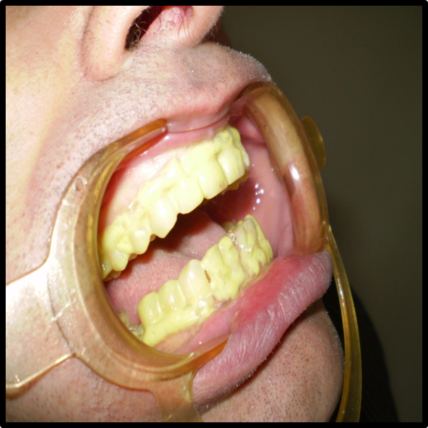
The patients of basic group (BG) recieved base therapy with the local application LQLC (injection form of «Lipoflavon») as a suspension, prepared ex tempore, containing 137.5 mgs of lecithin and 3.75 mgs of Quercetinum. This suspension was prepared by mixing 1/4 parts of content of the small bottle with 5 ml 0,9% solution of natrium chloride. The patients of comparison group (CG) were treated with base therapy providing local application of gel from GQ with the use of individual periodontal delivery tray during 40 minutes 2 times per a day during 10 days. The 35 patients with CGP of initial-I degrees of severity were kept under observation. The control group (C) included 14 healthy subjects without systemic inflammatory diseases.

Slide 9
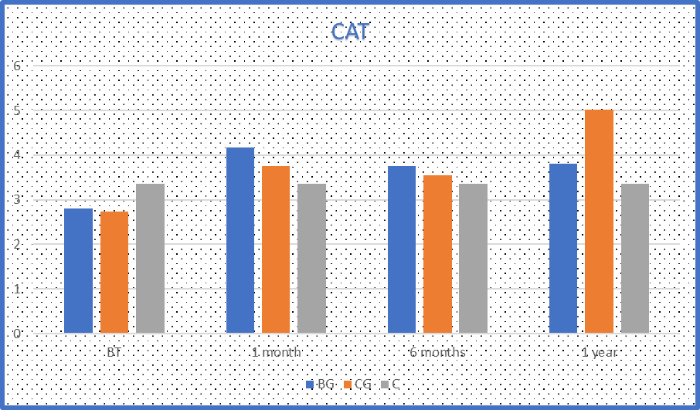
Fig. 1. Changes of CAT level in OF before treatment and through 1, 6 and 12 months after treatment the patients with СGP of initial-I degrees of severity: BG – basic treatment with local application LQLC; CG – basic treatment with local application of gel from GQ; C- control group

Slide 10
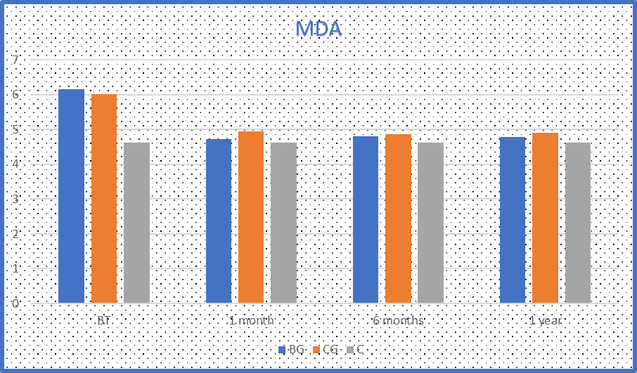
Fig. 2. Changes of MDA level in OF before treatment and through 1, 6 and 12 months after treatment the patients with СGP of initial-I degrees of severity: BG – basic treatment with local application LQLC; CG – basic treatment with local application of gel from GQ; C- control group

Slide 11
Conclusion
Considerable therapeutic efficacy of the LQLC for treatment patients with CGP, especially that of initial and I degrees of severity is based on its marked anti-inflammatory and periodontoprotecting effects.

Slide 12
References
1) Cherian, D. A., Peter, T., Narayanan, A., Madhavan, S. S., Achammada, S., Vynat, G. P. (2019). Malondialdehyde as a Marker of Oxidative Stress in Periodontitis Patients. J Pharm Bioallied Sci., 11 (Suppl 2), 297-300. doi: 10.4103/JPBS.JPBS_17_19
2) Kluknavská, J., Krajčíková, K., Bolerázska, B., Mašlanková, J., Ohlasová, J., Timková, S., Drotárová, Z., Vašková, J. (2021). Possible prognostic biomarkers of periodontitis in saliva. Eur Rev Med Pharmacol Sci., 25(8), 3154-3161. doi:10.26355/eurrev_202104_25724
3) Franco, R., Barlattani, A. Jr., Perrone, M.A., Basili, M., Miranda, M., Costacurta, M., Gualtieri, P., Pujia, A., Merra, G., Bollero, P. (2020) Obesity, bariatric surgery and periodontal disease: a literature update. Eur Rev Med Pharmacol Sci., 24(9), 5036-5045. doi: 10.26355/eurrev_202005_21196
4) Punj, A., Shenoy, S., Kumari, N. S., & Pampani, P. (2017). Estimation of Antioxidant Levels in Saliva and Serum of Chronic Periodontitis Patients with and without Ischemic Heart Disease. International journal of dentistry, 2017, 1965697. https://doi.org/10.1155/2017/1965697
5) Grigoryeva, G. S., Krasnopolsky, Yu. M. (2020). Liposomes per se: pharmacotherapeutic status. Pharmacology and Drug Toxicology, Vol.14, 14 (4), 264-271. https://doi.org/10.33250/14.04.264
6) Krasnopolsky, Yu. M. (2020). Creation in Ukraine of technologies for obtaining pharmacologically active ingredients, medicinal and diagnostic preparations based on lipids. Bulletin of the National Technical University "KhPI", Series: Chemistry, chemical technology and ecology, 1, 53-68. https://doi.org/10.20998/2079-0821.2020.01.10

