Slide 1
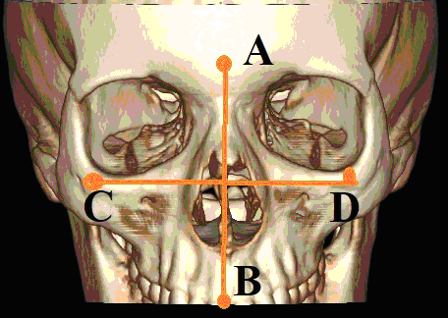
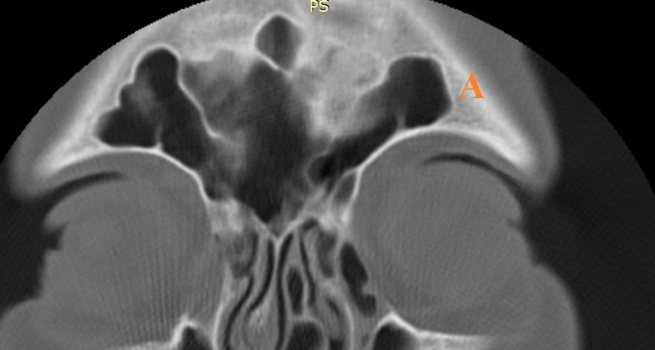
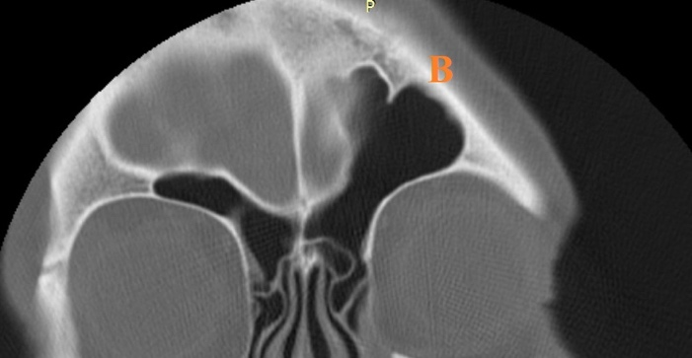
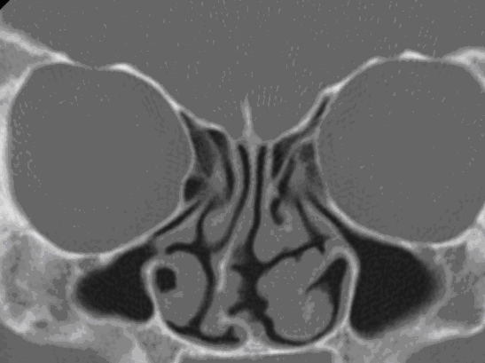
Biometric Recognition of Personality based on Spiral Computed Tomography Data
Alina Nechyporenko, Victoriia Alekseeva, Rozana Nazaryan, Vitaliy Gargin

Slide 2
Introduction
The problem of identification of a person occupies a significant place in forensic science.
In this context one of the crucial tasks is to collect datasets for different individuals or patient groups.
The main contributions of this work can be summarized as follows:
- collecting the data set that consists of individuals' SCT data
- obtaining the particular characteristics of paranasal sinuses as attributes for person identification and the assessment of obtained indicators using variation statistics
- development of workflow of data processing
- elaboration of a system for biometric recognition based on convolutional neural network (CNN) architecture.

Slide 3
The aim of our work
detect features of the paranasal sinuses( PNSs) structure in recognition of a person.

Slide 4
Material and methods
Biometric systems have been constantly evolving over the past few years with a dramatic progress in the field of Deep learning technologies that can be used in automatic systems for identifying a person’s identity. In particular, the use of AlexNet architecture, VGG convolutional neural network and ResNet enable the image classification and detection for identification purposes. The overall process that allows for personal identification according to the parameters of the paranasal sinuses scan should be divided into the 4 subprocesses:
-SCT image acquisition
-selection of image parameters to form a reference series
-preprocessing and labeling of SCT images by experts in order to mark the particular features corresponding to individual person characteristics
-decision-making based on CNN model.

Slide 5
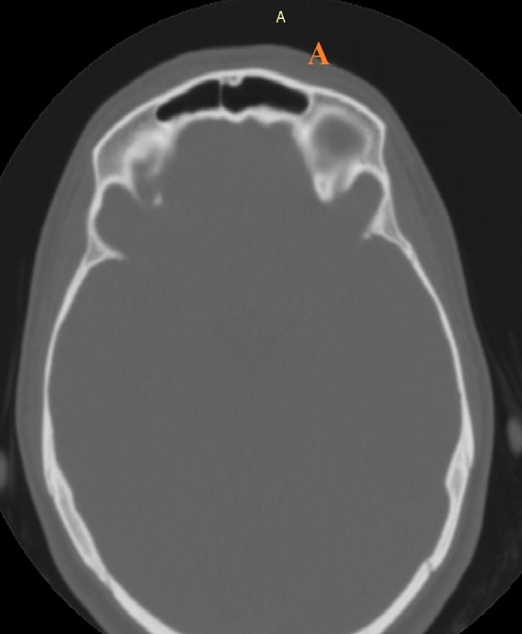
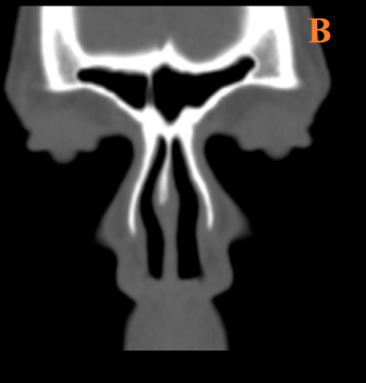
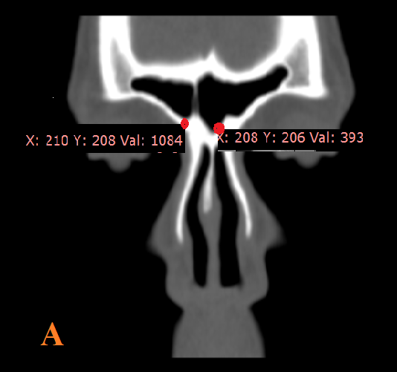
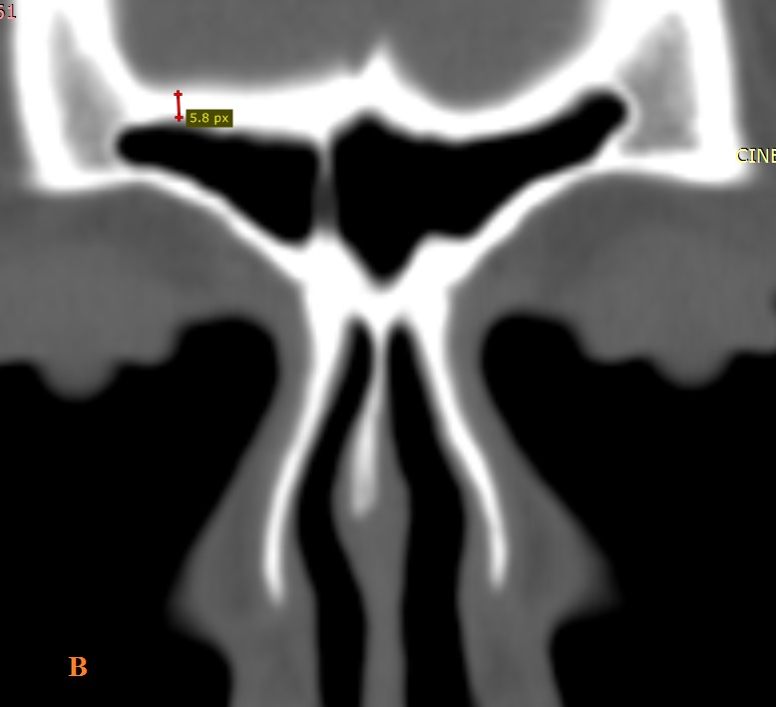
Material and methods
The study involved 332 male and female patients without complaints concerning the function of ENT organs.
The study was performed on Toshiba Aquilion-4 CT scanner. SCT images were examined using RadiAnt DICOM viewer software, which allows the most accurate measurements in the study areas. The study involved an assessment of axial projections and their coronary reconstructions (Fig. 1). In order to define the particular attributes for person identification the following indicators were studied: upper facial index followed by determination of human facial type (Fig. 3), sinus shape, thickness, length of anterior (frontal), posterior (cerebral), lower (orbital-cerebral) and internal (membranes between sinuses) walls, as well as their density (Fig. 2 A and B).
Fig.1 SCT of a patient. Axial section (A).
Coronary reconstruction.
Fig.3 An example of measuring the upper
facial index (АВ/СD)
Fig.2 Example of measuring the density (A) and bone thickness (B), given that 1 pixel is equal to 0.264 cm.

Slide 6
Material and methods
Nest phase implies image preprocessing and labeling of SCT images. Regarding image preprocessing techniques it is common to implement a set of filtering and smoothing algorithms in order to remove noises and enhance a contrast of SCT data. Labeling of images is a time-consuming process, which requires an expertise and efforts of physicians.
To collect and process SCT data the recognition system has been developed. In general, designing and implementing a biometric system is a challenging task and a number of factors that have a great influence on the overall performance need to be addressed. The major issues for the designer is definition an appropriate biometric traits as well as providing an efficient data processing and integration workflow. The block diagram of proposed system is presented in Fig.4.
Fig.4 A block diagram of paranasal sinuses recognition system
The last phase is decision, where a classifier can be used to compare all stored data patterns to the received images and return an identity based on a measure of similarity or dissimilarity.

Slide 7
Results
This article discusses the issues of personal identification by the parameters of the paranasal sinuses.
Following calculations aimed at determining the upper facial index, most of the studied cases were found to have the upper facial index, typical for mesens (271 people, 81.6%). 6.33% (21 patients) had a predominance of skull height over width with an index less than 49.9 and a structure typical for euryenes. Besides, 40 studied patients (12.05%) had a predominance of width over height with an index greater than 55 and the structure typical for leptens. The average value of the index for this parameter was 53.35 ± 2.02. It should be noted that women were more likely to have a predominance of length over width. Only in 11 cases (3.3% of the total, and in 27.5% of all leptens) in females there was a predominance of width over height and the structure typical for leptens. Only 5 cases out of all euryenes (1.5% of the total, and 23.8% of all euryenes) were men.
Table 1. Distribution of subjects according to upper facial index
Group | Type
 | Euryenes | Mesens | Leptens
Upper facial index | 48.186±2.53 | 53.4±1.2 | 55.795±0.9

Slide 8
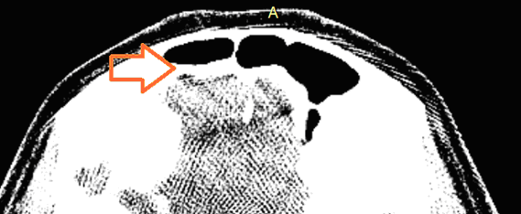
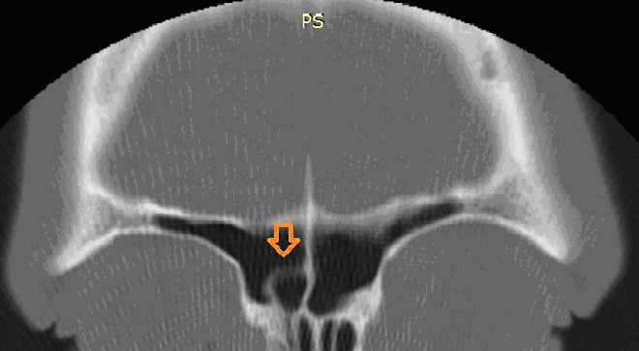
Results
In 18 cases (5.42%) unilateral aplasia of the frontal sinus was observed, and in 7 cases (2.11%) it was bilateral (see Fig. 5).
Some patients (36 patients - 10.84%), on the contrary, were found to have hyperpneumatization of the frontal sinus, sometimes the sinus even reached the level of the lateral part of the arcus supraorbitalis (see Fig. 7). This type of structure was typical only for leptens, with an average volume of 10.03±0.96 mm3. Moreover, in all cases, except 4 (1.2% of the total number of subjects), such a structure was one-sided (see Fig. 7 B). Remaining cases (see Fig. 7 A) were shown to have bilateral hyperpneumatization.
In 11 patients (3.32%) unilateral localization of an additional cell in the frontal sinus was observed, its volume was 1.37 ± 0.15 mm3 (see Fig. 8).
Fig.5 Bilateral aplasia of the frontal sinuses
Fig.6 Right and left frontal sinuses
Fig.7 Features of pneumatization of the frontal sinuses
Fig.8 Additional cell in the structure of the right
frontal sinus (indicated by an arrow)

Slide 9
Results
At the next stage of the study, the walls of the sinuses were examined, namely their thickness and density. As the minimum indicators are potentially dangerous, attention was paid to the minimum indicators of these parameters. As can be seen from Table 3, the thickest are the walls of the sinuses of the euryens, which have the smallest sinus volume. The next step was to determine a significant (p = 0.041 strong) (r = 0.73) direct correlation between sinus volume and lower wall thickness.
Table III. The Minimal Thickness of the Walls of the Frontal Sinus Depending on the Upper FacialIndex
Table IV. The Minimal Density (Hu) of the Walls of the Frontal Sinus
Depending on the Upper FacialIndex
Studied groups |  | Walls
 |  | Anterior | Posterior | Lower | Apper
Lepten | Male | 1.01±0.22 | 0.15±0.032 | 0.75±0.13 | 0.75±0.04
 | Female | 1.9±0.11 | 0.132±0.041 | 0.65±0.2 | 0.66±0.11
Mesen | Male | 1.97±0.17 | 0.12±0.05 | 0.79±0.147 | 0.62±0.12
 | Female | 2.03±0.2 | 0.097±0.21 | 0.73±0.11 | 0.71±0.19
Euryenes | Male | 1.73±0.34 | 0.11±0.013 | 0.6±0.1 | 0.53±0.024
 | Female | 2.75±0.2 | 0.09±0.022 | 0.61±0.18 | 0.529±0.05
Studied groups |  | Walls
 |  | Anterior | Posterior | Lower | Apper
Lepten | Male | 111.65±23.2 | 29.5±1.2 | 94±21.11 | 103±33.4
 | Female | 129±17.6 | 49.8±11.03 | 33.07±12 | 122.7±31.9
Mesen | Male | 383.43±36 | 55.73±33.19 | 112±44.1 | 174.18±71
 | Female | 243.22±22.4 | 32.3±0.5 | 105.55±32 | 115.44±22
Euryenes | Male | 302.18±45.3 | 75±22.12 | 112.81±11.04 | 134.22±17.7
 | Female | 283±34 | 320.07±15 | 108±15.21 | 145±62

Slide 10
Results
Of particular note is the medial wall, which forms the membrane between the right and left sinuses. This wall has a significant variability of location and is often shifted. Although the central location of the membrane is still typical for most of the patients (239 patients 71.99%). In 31 subjects (9.3%) it was shifted to the right and in 62 (18.67%) to the left.
As can be seen from Tables 3 and 4, the thickest and densest bones were observed in male leptens. Female euryens were found to have the thinnest bones with low density. The study found that men have larger sinuses with thicker and denser sinuses, whereas females have smaller, thin-walled sinuses. It should be noted that the thickness of the posterior wall (r = 0.73) and the volume of the sinus have a direct positive strong correlation.
A moderate direct positive correlation was determined between lower and posterior wall density and sinus volume (r = 0.58).

Slide 11
Conclusions
In this paper a new approach for biometric identification based on parameters of paranasal sinusitis has been proposed. The paranasal sinuses are one of possible human body part which could be used for identification of a person according to efficiency existing convolutional neural network architectures and large databases of SCT images as well as attributes of identity that allow to avoid the redundancy and improve the process of recognition.
In order to ensure the identification process both workflow for processing the SCT data and recognition system based on CNN have been developed. A robust and fast biometric recognition system will enable identification of a person by processing SCT data using a CNN model to classify meaningful features into one of many classes.

