Slide 1
CARDIOTONICS. CARDIAC GLYCOSIDES. ANTIARRHYTMIC DRUGS
KHARKIV NATIONAL MEDICAL UNIVERSITY DEPARTMENT OF PHARMACOLOGY AND MEDICAL PRESCRIPTION
Assistant Doroshenko Oksana N.

Slide 2
Plan of the lecture:
I. Inotropic Drugs
II. Antiarrhythmic Agents

Slide 3
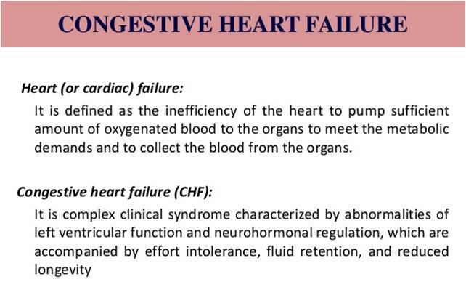
I. INOTROPIC DRUGS
- are preparations increase the force of myocardium contraction and
cardiac output without a significant increase in oxygen consumption.
Pathogenesis of the Heart Failure
By further progressing of the disease the compensatory mechanism is exhausted and cardiac insufficiency comes into the decompensation stage characterized by tachycardia, increase of the circulating blood volume, increase of the venous pressure, hemostatic phenomena in the systemic circulation, the lower extremities edema, as well as cyanosis and dyspnoea.
Causes:
PRIMARY CAUSES:
Cardiomyopathy
Coronary artery disease
Hypertension
SECONDARY CAUSES:
High salt intake
Noncompliance with treatment
Side effects of drug therapy
Kidney failure
Infection and inflammation
Cigarette smoking
Obesity

Slide 4
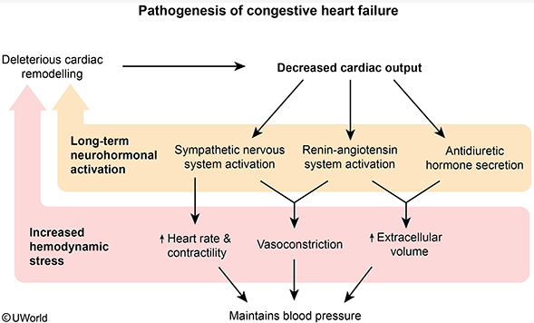
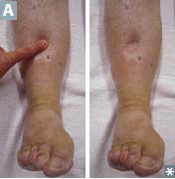
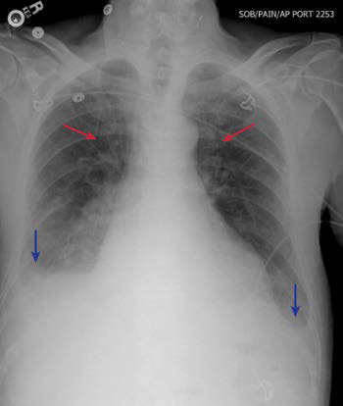
CONGESTIVE HEART FAILURE
Congestive Heart Failure – clinical syndrome of cardiac pump dysfunction leading to congestion and low perfusion, types:
Systolic Dysfunction:
reduced ejection fraction (EF), increased end-diastolic volume (EDV), decreased contractility often due to ischemia/MI or Dilated Cardiomyopathy
2) Diastolic Dysfunction:
preserved EF, normal EDV, decreased compliance often due to Myocardial Hypertrophy, right HF most often results from left HF, cor pulmonale refers to isolated right HF of pulmonary origin

Slide 5
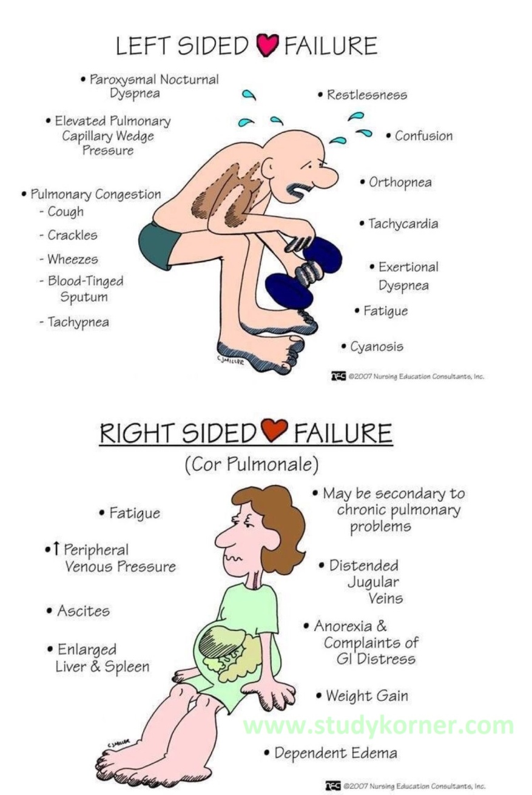
CONGESTIVE HEART FAILURE
presentations:
Left Heart Failure: orthopnea (shortness of breath when supine due to increased venous return from redistribution of blood, i.e. immediate gravity effect, that exacerbates pulmonary vascular congestion), paroxysmal nocturnal dyspnea (breathless awakening from sleep due to increased venous return from redistribution of blood and reabsorption of peripheral edema), pulmonary edema (increased pulmonary venous pressure leading to pulmonary venous distension and transudation of fluid), hemosiderin-laden macrophages (“HF cells”) in lungs
Right Heart Failure: hepatomegaly (nutmeg liver, increased central venous pressure leads to increased resistance to portal flow, rarely leads to “cardiac cirrhosis”), jugular venous distention (JVD, increased venous pressure), peripheral pitting edema (increased venous pressure leads to fluid transudation), auscultation findings: S3, exam also shows rales

Slide 6
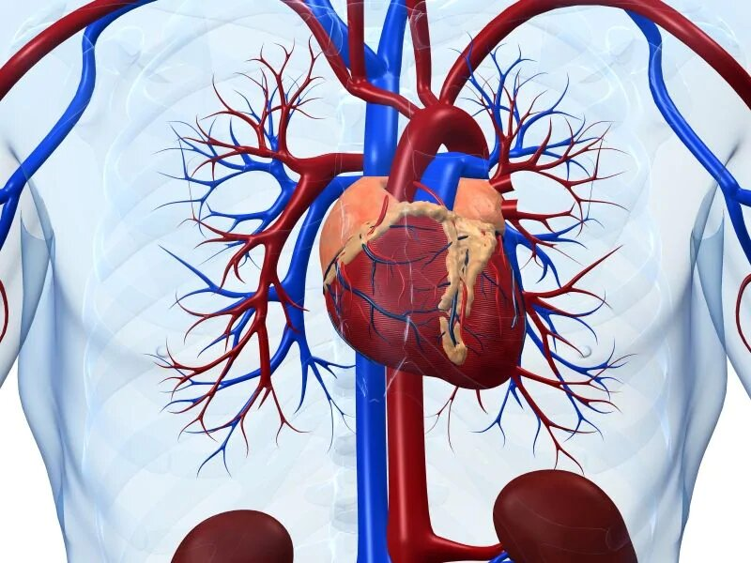
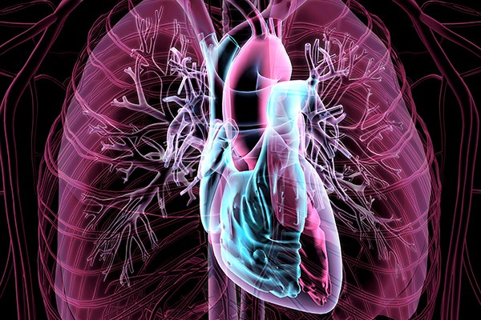
ACUTE HEART FAILURE
Acute heart failure is a sudden, life-threatening condition in which the heart is unable to do its job. The heart is still beating, but it cannot deliver enough oxygen to meet the body's needs. This condition requires emergency medical care.
Acute heart failure (AHF) is a syndrome defined as the new onset (de novo heart failure (HF)) or worsening (acutely decompensated heart failure (ADHF)) of symptoms and signs of HF, mostly related to systemic congestion.
In the presence of an underlying structural or functional cardiac dysfunction (whether chronic in ADHF or undiagnosed in de novo HF), one or more precipitating factors can induce AHF, although sometimes de novo HF can result directly from the onset of a new cardiac dysfunction, most frequently an acute coronary syndrome.

Slide 7
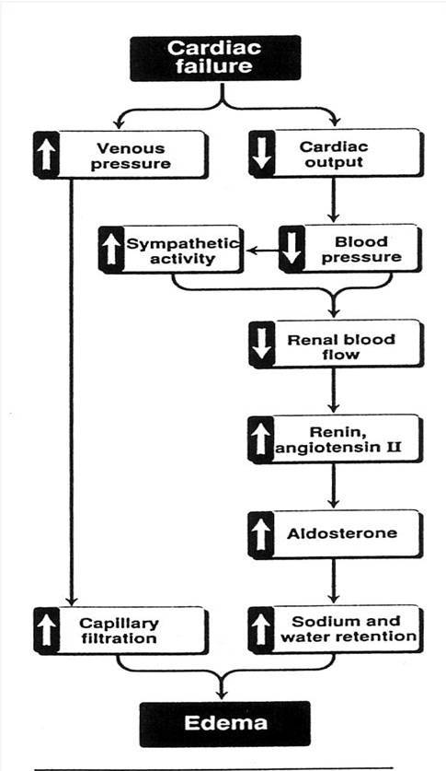
Main symptoms of the Heart Failure
Reduced force of cardiac contraction
Reduced cardiac output
Increased peripheral vascular resistance
Cyanosis
Edema
Dyspnea

Slide 8
CLASSIFICATION OF INOTROPIC DRUGS
Steroidal inotropic drugs
(Cardiac Glycosides)
Non-steroidal
inotropic drugs
Long-acting:
DIGITOXIN
Intermediate-acting:
DIGOXIN
CELANIDUM
(LANTOSIDUM C)
Short-acting:
STROPHANTHINE -K
STROPHANTHINE G (QUAVABAIN)
CORGLYCON
1. Selective PDE III
(Phosphodiesterase III) inhibitors
Amrinone
Milrinone
2. Adrenomimetics
Dobutamine (β1)
Dopamine (α,β,D)
3. Calcium sensitisers
Levosimendan

Slide 9
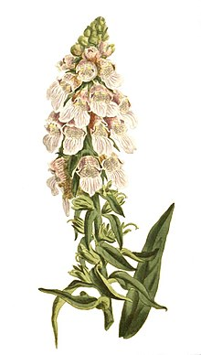
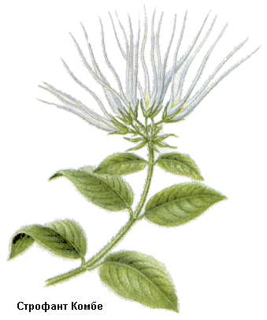
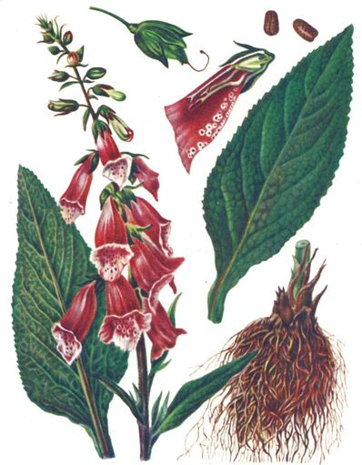
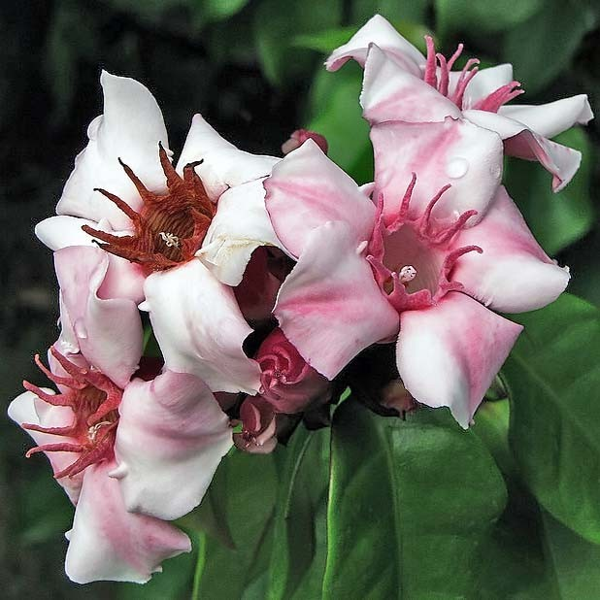
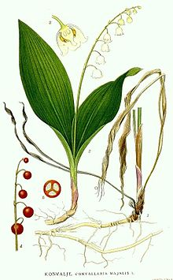
ORIGIN OF CARDIAC GLYCOSIDES
Cardiac glycosides are obtained from plants:
DIGITOXIN from
Digitalis purpurea
2. DIGOXIN from
Digitalis lanata
3. STROPHANTIN-K from Strophanthus Kombe
4. STROPHANTIN-G from Strophanthus gratus
5. CORGLICON from
Convallaria majalis
6. ADONISIDUM from
Adonis vernalis

Slide 10
Pharmacokinetic of CGS
CGs consist of a non-saccharine part (aglycone or genine)
and a saccharine (glycone) part.
The cardiotonic effect of these medicines is connected with aglycone. The main chemical structure of aglycone is cyclopentan-perhydrophenantren nucleus bound to the unsaturated lactone ring.
The saccharine part affects the glycosides solubility, their absorption, bioavailibility and other pharmacokinetic peculiarities.

Slide 11
Pharmacokinetic of CGs
Comparative characteristic
Lipophylic
(Digitoxin)
Hydrophylic
(Strophanthine)
Mixed
hydrophylic
-lipophylic
(Digoxin ,etc.)
Poor absorbtion from the GIT
are not almost bound to plasma proteins,
they are eliminated quickly and do not accumulate.
They are introduced parenterally and are used in ACUTE HF
are well absorbed from the GIT and
bound actively to blood plasma proteins, eliminate slowly and accumulate.
They are introduced perorally and are used in CHRONIC HF.
have an intermediate position by their physical and chemical properties and that is why they can be introduced both perorally and parenterally.

Slide 12
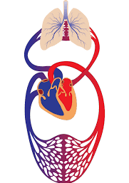
PHARMACODYNAMIC OF CGs
CARDIAC effects of CGs
a positive inotropic effect
(increase in force of systole and in myocardial tone)
a negative chronotropic effect
(the prolongation of diastole, slowing of heart rate)
a negative dromotropic effect
(decrease of conductivity)
a positive bathmotropic effect
(an increase in myocardial excitation)
the improvement of blood circulation
a decrease in venous pressure,
normalization of arterial blood pressure
an increase in renal blood flow,
that increase in diuresis and decrease in oedema

Slide 13
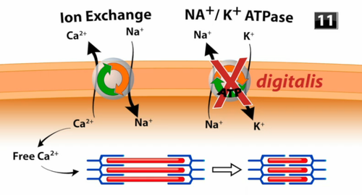
PHARMACODYNAMIC OF CGS
Mechanism of action
The mechanism of the positive inotropic effect of the CGs is connected with their ability to increase the content of Ca²⁺ ions in the cardiomyocytes mainly due to the blockade of SH-groups of Na+,K+-ATP-ase enzyme. The increase of the Ca²⁺ ions concentration leads to the increase of the contractile proteins activity and as a consequence to the increase of the heart contraction force:
increased cardiac output;
decreased cardiac size;
decreased venous pressure and blood volume;
diuresis and relief of edema.

Slide 14
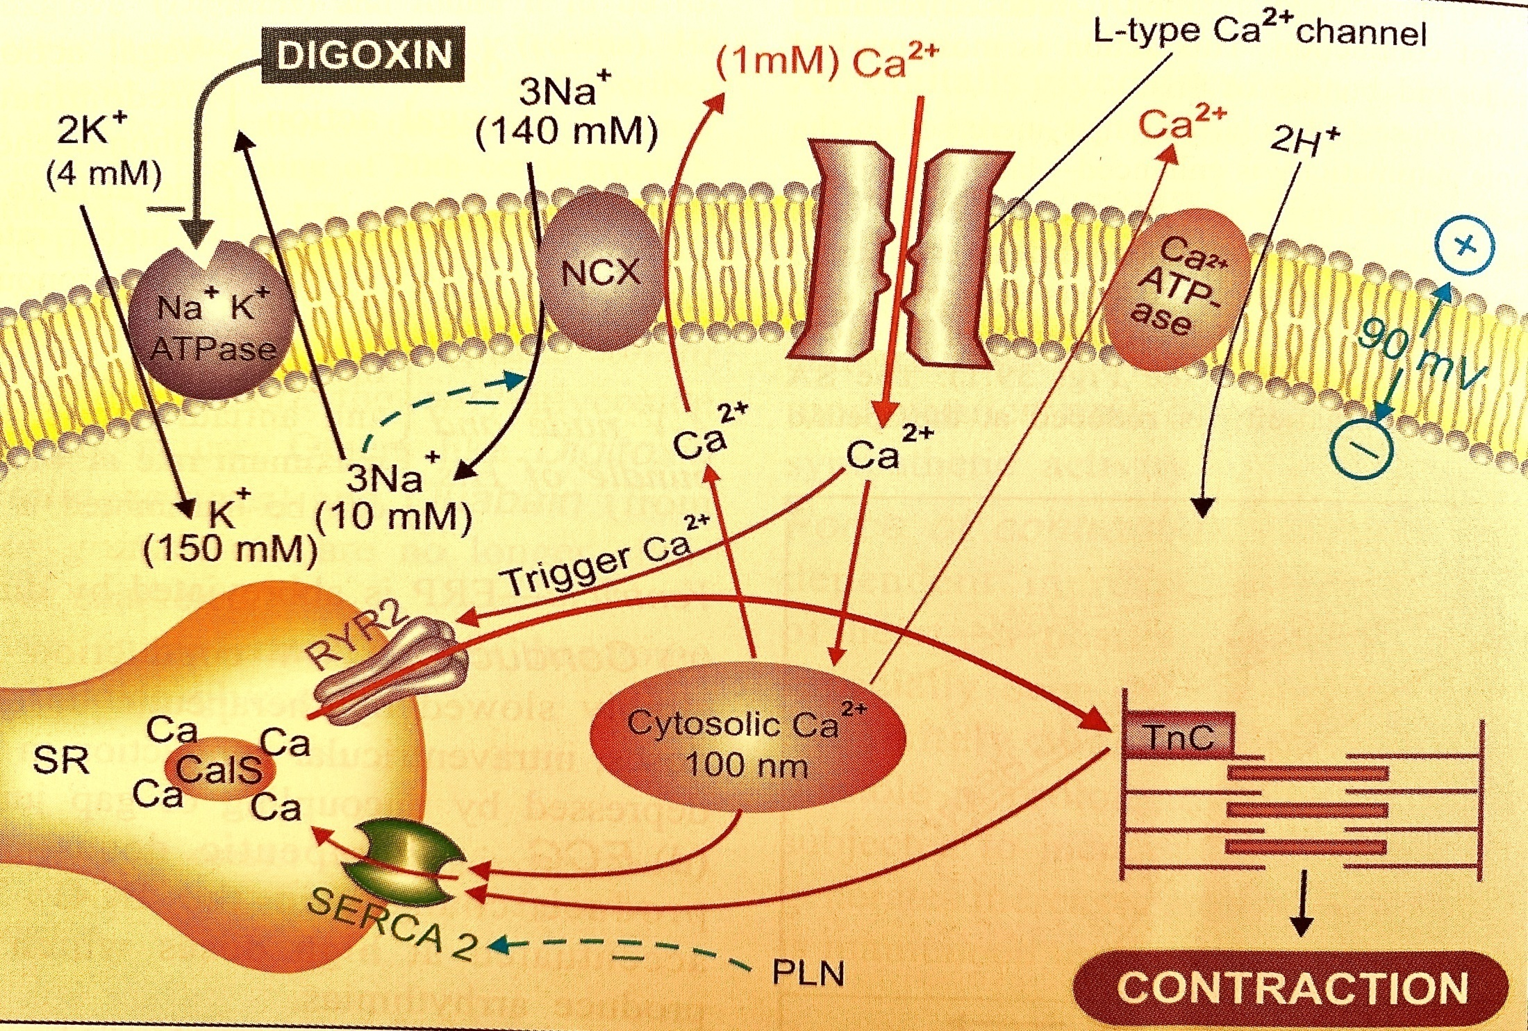
MOLECULAR MECHANISM OF THE POSITIVE INOTROPIC EFFECT OF CGS

Slide 15
THE NEGATIVE CHRONOTROPIC EFFECT OF CARDIAC GLYCOSIDES (THE DIASTOLE’S PROLONGING OR SLOW THE ACCELERATED HEART RATE) OCCURS VIA TWO MECHANISMS.
A vagal effect and an extravagal effect:
The vagal action is due to the reflex and direct stimulation of the nervus vagus center;
The extravagal action is due to the direct inhibition of SA and AV (atrioventricular) nodes and hypersensitization of SA node to acetylcholine.
Slowing of the conduction and prolongation of the refractory period of the AV node!!!

Slide 16
Pharmacodynamic of CGs
negative dromotropic effect -
the decrease of the impulse conducting through the heart’s conductive system.
Cardiac glycosides, exerting a direct inhibitory effect on the cardiac conduction system and toning the vagus nerve, reduce the rate of excitation conduction (negative dromotropic action). The refractory period of the atrioventricular node and the atrioventricular bundle (His bundle) increases. The P-Q interval becomes longer. In toxic doses, cardiac glycosides can cause atrioventricular block.
positive batmotropic effect -
the increase of the myocardial excitability (manifests as extrasystoles in the overdose of cardiac glycosides).
In large doses, cardiac glycosides increase the automatism of the heart. This leads to the formation of ectopic foci of excitation, generating impulses independently of the sinus node.
Judging by experiments on animals, in small doses, cardiac glycosides increase the excitability of the myocardium (positive batmotropic action). This is manifested in a decrease in the threshold of myocardial excitability in response to stimuli coming to it.
In large doses, cardiac glycosides reduce the excitability of the heart muscle.

Slide 17
Pharmacodynamic of CGs
Extracardiac action of CGs
Diuretic;
Sedative;
Stimulating influence on smooth muscles.
Cardiac Glycosides reduces venous pressure as a result of improved circulation and tissue perfusion produced by the enhanced myocardial contractility (decreased blood volume);
This in turn relieves congestion;
Ventricular end-diastolic volume (VEDV) is reduced.
Cardiac Glycosides cause relief of HF-induced edema!!!
This depends on the improved blood circulation that increases renal blood flow and consequently glomerular filtration rate is increased;
This results in down-regulation of the renin-angiotensin-aldosterone (RAA) system that is stimulated in HF;
Hence, the edema (pulmonary and peripheral) is decreased in response to CGs as a result of the inhibition of the RAA-induced water and salt retention.

Slide 18
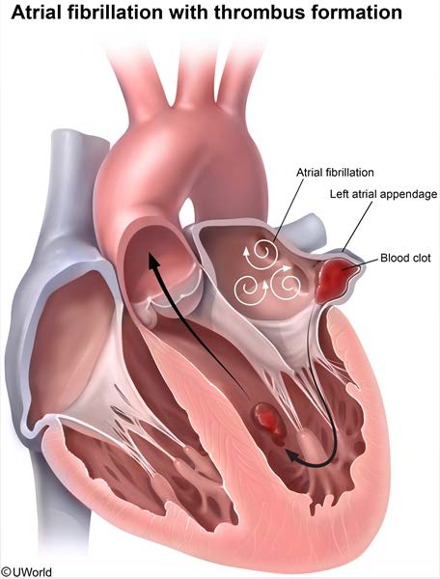
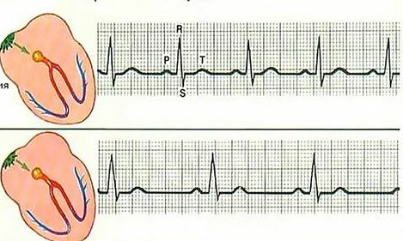
Indications for Cardiac Glycosides
Chronic and acute heart failure;
Tachyarrhythmias;
Treatment of atrial fibrillation and flutter by slowing SA nodal firing rate as well as AV conduction preventing the occurrence of the life-threatening ventricular arrhythmias.

Slide 19
Principles of digitalis therapy
Therapeutic tactics of the glycosides treatment includes two phases:
The phase of digitalization is saturation of organism by cardiac glycosides (1-7 days). The medicine is administered in a full therapeutic dose until the therapeutic effect without the symptoms of intoxication is achieved. The twenty-four hours dose of digitalis medicines is 2-2.5 mg, the dose of strophanthin is 0.6-1 mg.
The phase of supporting therapy provides stabilization of the achieved level of the therapeutic effect by prescribing a medicine in the maintaining dose (supporting a stable concentration in blood).
NB!!! Heart rate should not be less than 60 per 1 minute !!!

Slide 20
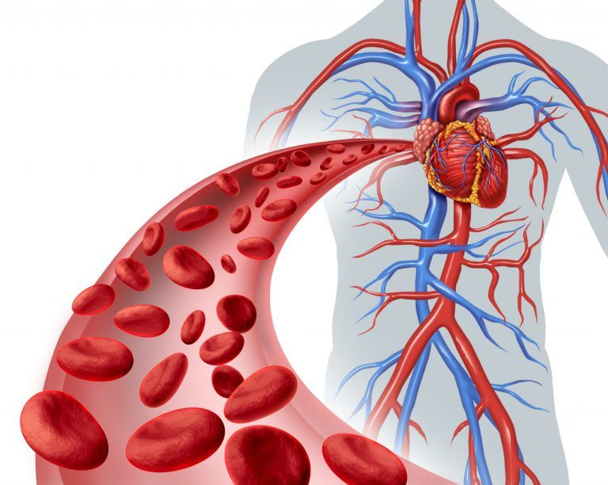
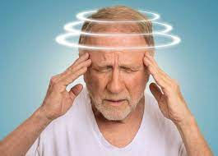
Adverse Effects of Digitalis Glycosides
Digoxin is well tolerated BUT it has very narrow therapeutic index
Stimulation of the vagal centre and chemoreceptor trigger zone (CTZ) results in nausea, vomiting, diarrhea & anorexia
bradycardia
neurological SE: headache, dizziness, fatigue, depression
Gynecomastia may occur in men either due to peripheral estrogenic actions of cardiac glycosides or hypothalamic stimulation
trombocytopenia
headache
dizziness
fatigue

Slide 21
Toxicity of Digitalis Glycosides
With increasing cardiac glycoside concentrations, free intracellular [Ca²⁺] reaches toxic levels
This high [Ca²⁺] concentration saturates the sarcoplasmic reticulum sequestration mechanisms resulting in oscillations in [Ca²⁺] levels due to Ca²⁺-induced [Ca²⁺] release leading to membrane potential oscillations (oscillatory after potentials)
Arrhythmias resulting from oscillatory after potentials include single and multiple ventricular premature beats and tachyarrhythmias
nausea, vomiting, diarrhea & anorexia
blurred vision, yellowish vision (xanthopsia)
headache
dizziness
fatigue
hallucinations

Slide 22
Treatment of Digitalis Toxicity
Digitalis should be immediately withdrawn, toxicity symptoms may persist for some time due to slow elimination;
K⁺ Supplementation (Potassium chloride, Panangin) Digitalis treatment usually results in myocardial K⁺ loss;
Hence, intravenous administration of K⁺ salts usually produces immediate relief, since K⁺ loss is the probable cause of dysrhythmias;
K⁺ supplementation would raise the extracellular K⁺ decreasing the slope of phase-4 depolarization and diminishing increased automaticity;
However K⁺ supplementation may lead to complete A-V block in cases of depressed automaticity or decreased conduction NB!!!(contraindicated with digitalis-induced second- and third-degree heart block)!!!
SH –group donator (Unithiolum);
Lidocaine or phenytoin is effective against K⁺ digitalis-induced dysryhthmias;
Atropine sulfate to reduce vagal influence on the heart
Digoxin antibodies (Digibind)
Digoxin antibodies (Digibind) are used safely for the treatment of the life-threatening cardiac glycosides-induced arrhythmias and heart block!!!

Slide 23
NON-STEROIDAL INOTROPIC DRUGS
1. PHOSPHODIESTERASE III (PDE-III) INHIBITORS:
Amrinone,
Milrinone.
2. ADRENOMIMETICS:
Dobutamine (β1-adrenomimetic);
Dopamine (β1-adrenergic agonist);
Isoprenaline (β1-, β2- adrenergic agonist);
Ephedrine (α-, β- adrenergic agonist).
3. CALCIUM SENSITISERS:
Levosimendan.
Amrinone is the first member of a new class of inotropic drugs chemically and pharmacologically distinct from digitalis and catecholamines.
1. PD III inhibitors
Agents in this class include: Amrinone and Milrinone.
Inhibition of myocardial phosphodiesterase III (PD-III), the enzyme responsible for cAMP degradation, results in +ve inotropism via cAMP-PKC cascade.
Are suitable only for acute HF after surgery on heart because they can induce life-threatening arrhythmias on chronic use.
It is a bipyridine derivative, Selective phosphodiesterase III (PDE III) inhibitor.
The two most important actions of amrinone are positive inotropic and direct vasodilatative: has been called an 'inodilator'.
It increases the rate of development of tension in myocardial fibres as well as the peak tension.
Systemic vascular resistance is reduced.

Slide 24
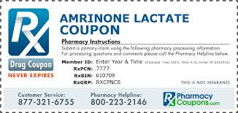
Pharmacodynamics of Amrinone
In CHF patients i.v. amrinone action starts in 5 min and lasts 2-3 hours;
It increases cardiac index, left ventricular ejection fraction and decreases peripheral vascular resistance,
Central venous pressure (CVP), left ventricular end diastolic volume and pressure accompanied by mild tachycardia and slight fall in BP.
The vasodilator action may be playing an important role in the beneficial haemodynamic effects.
Its inotropic effects are additive with digoxin.
Adverse effects of Amrinon
Thrombocytopenia is the most prominent and dose related side effect. It is mostly transient and asymptomatic.
Nausea, diarrhea, abdominal pain, liver damage, fever and arrhythmias.
Milrinone
related to Amrinone
Has similar action but at least 10 times more potent. Thrombocytopenia is not significant but it is probably more arrhythmogenic. It is preferred over amrinone for short term use.

Slide 25
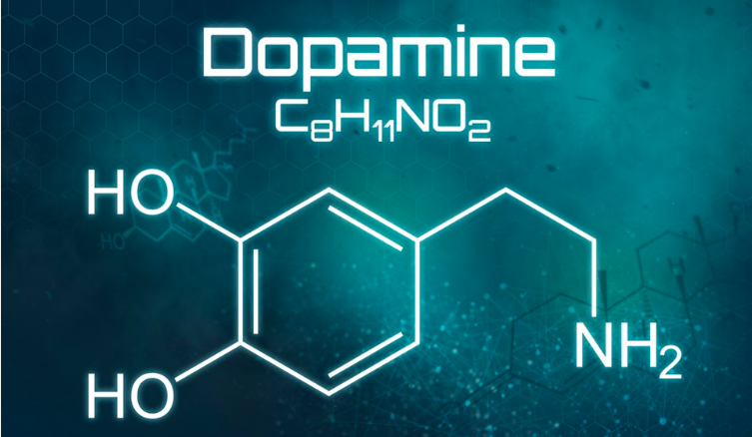
2. Adrenomimetics
Dopamine
Receptors: α, β1>β2, D agonist;
Vascular effects: Vasoconstriction at higher doses
Cardiac effects at lower doses:
Increase in cardiac output;
Increase in heart rate.
Uses:
Septic and other types of Shock;
Renal failure.
Side effects:
Dysrhythmia – atrial fibrillation;
Vasoconstriction.

Slide 26
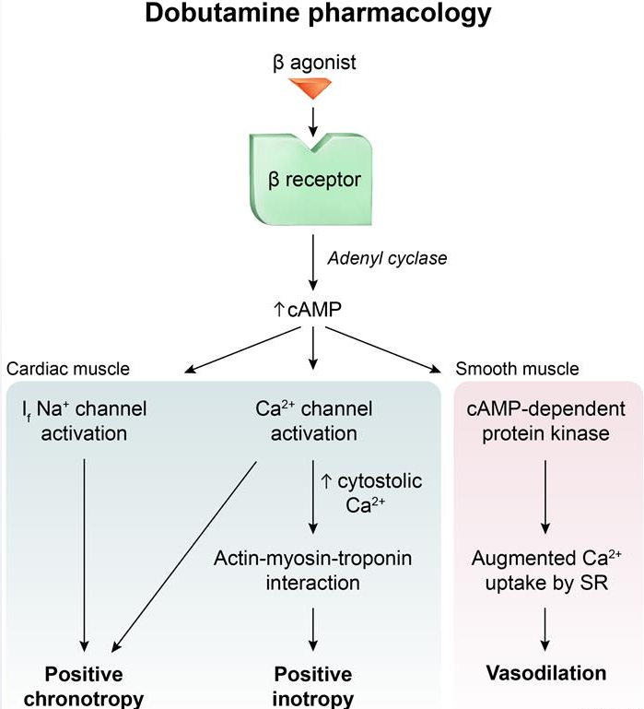
Dobutamine
Relatively selective β1 agonist with prominent inotropic action.
Uses:
Acute congestive heart failure;
MI with heart failure;
Cardiac surgery.

Slide 27
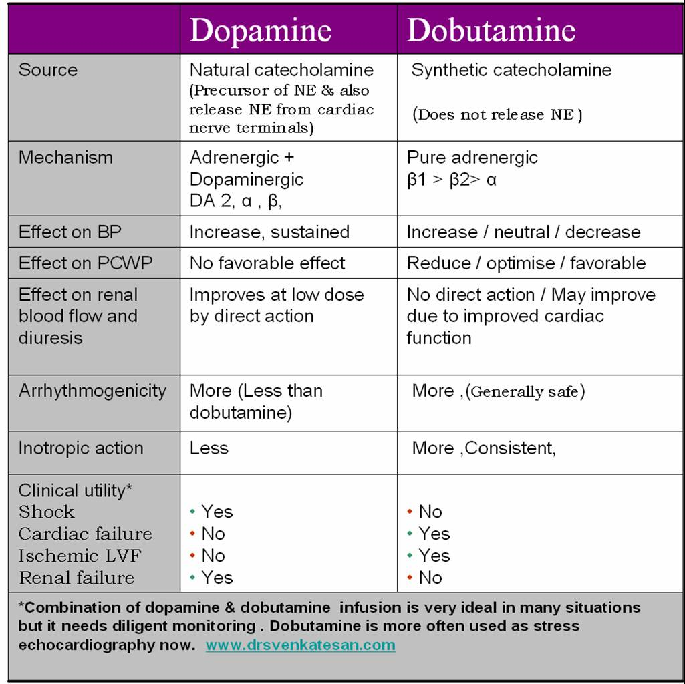

Slide 28
3. Calcium sensitisers
Levosimendan
1. It exerts its positive inotropic effect by increasing calcium sensitivity of cardiomyocytes by binding to cardiac troponin C in a calcium-dependent manner.
2. It also has a vasodilatory effect, by opening ATP-sensitive
potassium channels in vascular smooth muscle to cause smooth muscle relaxation.
3. The combined inotropic and vasodilatory actions result in an increased force of contraction, decreased preload and decreased afterload.
4. By opening also the mitochondrial (ATP)-sensitive potassium channels in cardiomyocytes, the drug exerts a cardioprotective effect.
Common side effects (about 1%): headache, hypotension, arrhythmias, myocardial ischemia, hypokalemia and/or nausea.

Slide 29
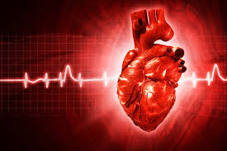
II. Antiarrhythmic preparations Arrhythmia
Heart condition where disturbances in:
Pacemaker impulse formation;
Contraction impulse conduction;
Combination of the two.
Results in rate and/or timing of contraction of heart muscle that is insufficient to maintain normal cardiac output (CO).
!!! To understand how antiarrhythmic drugs work, need to understand electrophysiology of normal contraction of heart !!!
IONIC BASIS OF MEMBRANE ELECTRICAL ACTIVITY
Transmembrane potential of cardiac cells is determined by the concentrations of the ff. ions:
Sodium, Potassium, Calcium;
The movement of these ions produces currents that form the basis of the cardiac action potential.

Slide 30
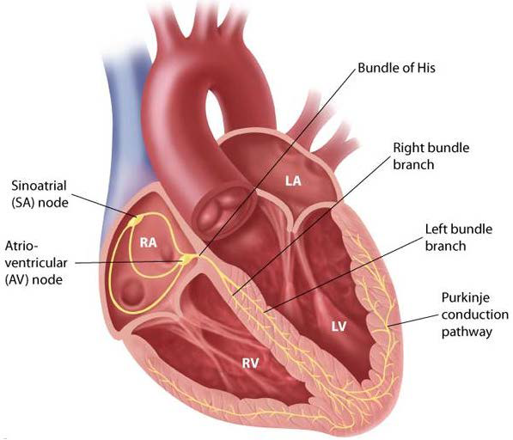
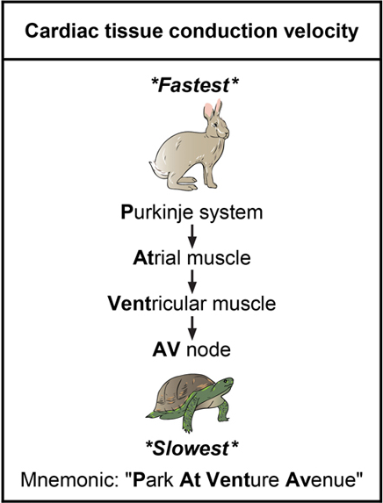
II. Antiarrhythmic preparations

Slide 31
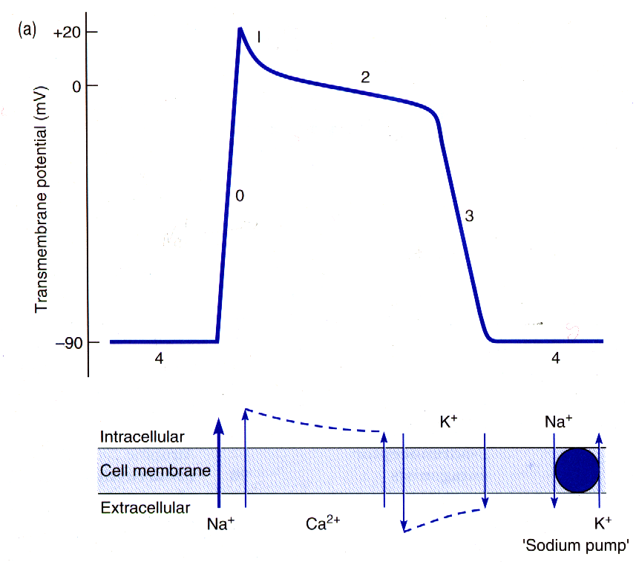
Rapid repolarization
Plateau
Final repolarization
Depolarization
Spontaneous
depolarization
Resting potential

Slide 32
PHASES OF cardiac ACTION POTENTIAL
PHASE 1
>Limited depolarization
>Inactivation of fast
Na+ channels → Na+
ion conc. equalizes
> ↑ K+ efflux & Cl- influx
PHASE 2
>Plateau Stage
>Cell less permeable to Na+
>Ca++ influx through slow Ca++ channels
>K+ begins to leave cell
PHASE 3
>Rapid repolarization
>Na+ gates closed
>K+ efflux
>Inactivation of slow Ca++ channels
PHASE 0
>Rapid depolarization
>Opening fast Na+
channels → Na+ rushes in →depolarization
PHASE 4
>Resting Membrane Potential
>High K+ efflux
>Ca++, Na+ influx

Slide 33
CLASS I: Sodium Channel Blocking Drugs
THE VAUGHAN WILLIAM’S
CLASSIFICATION OF AAD
CLASS III: POTASSIUM CHANNEL BLOCKERS
IA - lengthen AP duration
- Intermediate interaction with Na+ channels
- Quinidine, Procainamide, Disopyramide
IB - shorten AP duration
- slow interaction with Na+ channels
- Lidocaine, Mexiletene, Tocainide, Phenytoin
IC - no effect or minimal ⁭ AP duration
- strong interaction with Na+ channels
- Flecainide, Propafenone, Moricizine
Prolong effective refractory period by prolonging Action Potential
Amiodarone
Ibutilide
Bretylium - Dofetilide
Sotalol
CLASS II: BETA-BLOCKING AGENTS
CLASS IV: CALCIUM CHANNEL BLOCKERS
Blocks cardiac calcium currents
→ slow conduction
→ increase refractory period
*esp. in Ca++ dependent tissues (i.e. AV node) Verapamil, Diltiazem.
Increase AV nodal conduction
Increase PR interval
Prolong AV refractoriness
Reduce adrenergic activity
Propranolol, Esmolol, Metoprolol, Sotalol
NB! Miscellaneous:
ADENOSINE → inhibits AV conduction & increases AV refractory period.
MAGNESIUM → Na+/K+ ATPase, Na+, K+, Ca++ channels.
POTASSIUM → normalize K+ gradients.

Slide 34
Quinidine (Class IA) (moderate inhibition of Na channels)
Generally useful in supraventricular arrhythmias (decreases automaticity, increases refractory period);
Atropine-like properties (may promote AV conduction - paradoxical tachycardia);
Mild adrenergic blockade (hypotension);
High doses promote bizarre cardiac arrhythmias, torsades des pointes.
Cinchonism: GI upset, tinnitus, loss of hearing, blurred vision, headache, diplopia, delirium, psychosis, rarely thrombocytopenia.
Torsades de pointes –
polymorphic ventricular tachycardia with a twisting axis on the ECG

Slide 35
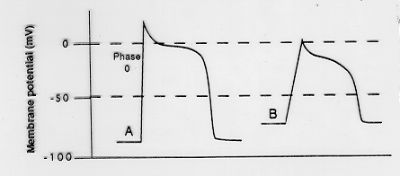
Quinidine decreases membrane responsiveness (moderate inhibition of Na channels)
QUINIDINE

Slide 36
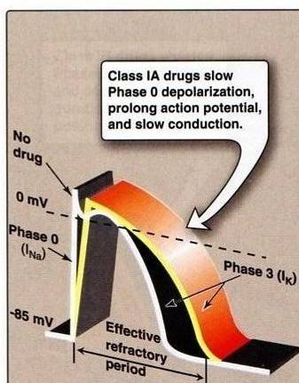
Procainamide (Class IA) (moderate inhibition of Na channels)
Generally useful in ventricular arrhythmias;
Little or no atropine-like properties;
Pharmacokinetic: Oral, IV, IM;
N-acetylprocainamide (NAPA) → major metabolite;
Metabolism: hepatic;
Elimination: renal;
t½ = 3 to 4 hrs.
ADRs: Cardiac toxicity, hypotension, CNS effects, rarely agranulocytosis or systemic lupus erythematosus (SLE)-like syndrome.

Slide 37
Class IB Drugs
Class IB
lidocaine
mexiletine
tocainide
They shorten Phase 3 repolarization;
↓ the duration of the cardiac action potential;
They suppress arrhythmias caused by abnormal automaticity;
They show rapid association & dissociation (weak effect) with Na⁺ channels with appreciable degree of use-dependence;
No effect on conduction velocity.
Notes:
37

Slide 38
Agents of Class IB
LIDOCAINE
Used IV because of extensive 1st pass metabolism;
Lidocaine is the drug of choice in emergency treatment of ventricular arrhythmias;
Has CNS effects: drowsiness, numbness, convulsion, and nystagmus;
MEXILETINE
These are the oral analogs of lidocaine;
Mexiletine is used for chronic treatment of ventricular arrhythmias associated with previous myocardial infarction.
ADVERSE EFFECTS:
1- neurological effects
2- negative inotropic activity
Uses
They are used in the treatment of ventricular arrhythmias arising during myocardial ischemia or due to digoxin toxicity;
They have little effect on atrial or AV junction arrhythmias (because they don’t act on conduction velocity);

Slide 39
Class IC Drugs
Class IC
flecainide
propafenone
They markedly slow Phase 0 fast depolarization;
They markedly slow conduction in the myocardial tissue;
They possess slow rate of association and dissociation (strong effect) with sodium channels;
They only have minor effects on the duration of action potential and refractoriness;
They reduce automaticity by increasing the threshold potential rather than decreasing the slope of Phase 4 spontaneous depolarization.
USES:
Refractory ventricular arrhythmias;
Flecainide is a particularly potent suppressant of premature ventricular contractions (beats).
TOXICITY AND CAUTIONS FOR CLASS IC DRUGS:
They are severe proarrhythmogenic drugs causing:
severe worsening of a preexisting arrhythmia;
de novo occurrence of life-threatening ventricular tachycardia.
In patients with frequent premature ventricular contraction (PVC) following MI, flecainide increased mortality compared to placebo.
NOTICE: CLASS IC DRUGS ARE PARTICULARLY OF LOW SAFETY AND HAVE SHOWN EVEN INCREASE MORTALITY WHEN USED CHRONICALLY AFTER MI

Slide 40
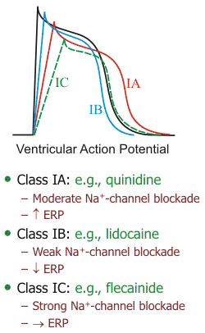
COMPARE BETWEEN CLASS IA, IB, AND IC DRUGS AS REGARDS EFFECT ON Na⁺ CHANNEL & ERP
SODIUM CHANNEL BLOCKADE: IC > IA > IB
INCREASING THE ERP: IA>IC>IB (lowered)
Because of K⁺ blockade

Slide 41
Class II ANTIARRHYTHMIC DRUGS (β-adrenergic blockers)
Mechanism of action:
Negative inotropic and chronotropic action;
Prolong AV conduction (delay);
Diminish phase 4 depolarization → suppressing automaticity (of ectopic focus).
Uses
Treatment of increased sympathetic activity-induced arrhythmias such as stress- and exercise-induced arrhythmias.
Atrial flutter and fibrillation.
AV nodal tachycardia.
Reduce mortality in post-myocardial infarction patients.
Protection against sudden cardiac death.
Propranolol (nonselective): was proved to reduce the incidence of sudden arrhythmatic death after myocardial infarction.
Metoprolol:
reduce the risk of bronchospasm.
Esmolol:
Esmolol is a very short-acting β₁-adrenergic blocker that is used by intravenous route in acute arrhythmias occurring during surgery or emergencies.

Slide 42
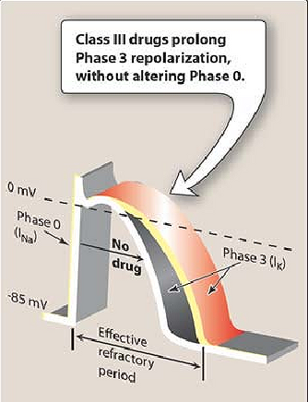
Class III ANTIARRHYTHMIC DRUGS K⁺ blockers
Prolongation of phase 3 repolarization without altering phase 0 upstroke or the resting membrane potential;
They prolong both the duration of the action potential and ERP;
Their mechanism of action is still not clear but it is thought that they block potassium channels;
Class III
sotalol
amiodarone
ibutilide
Uses:
Ventricular arrhythmias, especially ventricular fibrillation or tachycardia;
Supra-ventricular tachycardia;
Amiodarone usage is limited due to its wide range of side effects.

Slide 43
Amiodarone (Cordarone)
It is extensively taken up by tissues, especially fatty tissues (extensive distribution;
t_{1/2} = 60 day;
Potent P-450 inhibitor;
Amiodarone antiarrhythmic effect is complex comprising class I, II, III, and IV action
Dominant effect: Prolongation of action potential duration and refractorines;
It slows cardiac conduction, works as Ca²⁺ channel blocker, and as a weak β-adrenergic blocker;
TOXICITY:
Most common include GI intolerance, tremors, ataxia, dizziness, and hyper-or hypothyrodism;
Corneal microdeposits may be accompanied with disturbed night vision;
Others: liver toxicity, photosensitivity, gray facial discoloration, neuropathy, muscle weakness, and weight loss;
The most dangerous side effect is pulmonary fibrosis which occurs in 2-5% of the patients.

Slide 44
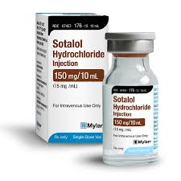
Sotalol (Sotacor)
Sotalol also prolongs the duration of action potential and refractoriness in all cardiac tissues (by action of K⁺ blockade);
Sotalol suppresses Phase 4 spontaneous depolarization and possibly producing severe sinus bradycardia (by β blockade action);
The β-adrenergic blockade combined with prolonged action potential duration may be of special efficacy in prevention of sustained ventricular tachycardia;
It may induce the polymorphic torsades de pointes ventricular tachycardia (because it increases ERP).
Ibutilide
Used in atrial fibrillation or flutter;
IV administration;
May lead to torsade de pointes;
Only drug in class three that possess pure K⁺ blockade.

Slide 45
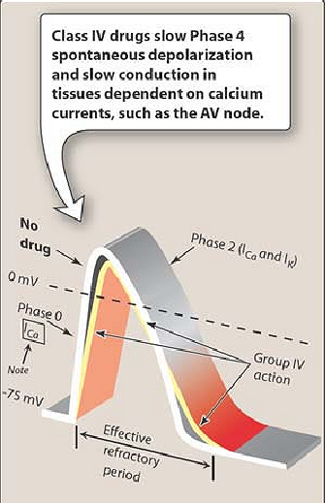
Class IV ANTIARRHYTHMIC DRUGS (Calcium Channel Blockers)
Calcium channel blockers decrease inward Ca²⁺ currents resulting in a decrease of phase 4 spontaneous depolarization (SA node);
They slow conductance in Ca²⁺ current-dependent tissues like AV node;
Examples: Verapamil & Diltiazem.
(Because they act on the heart only and not on blood vessels)
!!!Dihydropyridine family are not used because they only act on blood vessels!!!
Mechanism of action of CLASS IV
They bind only to depolarized (open) channels → prevention of repolarization;
They prolong ERP of AV node → ↓conduction of impulses from the atria to the ventricles;
Uses:
treatment of supra-ventricular tachycardia preventing the occurrence of ventricular arrhythmias.
Treatment of atrial flutter and fibrillation.
Side effects:
cause bradycardia, and asystole especially when given in combination with β-adrenergic blockers

Slide 46
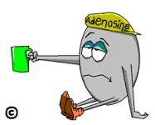
Miscellaneous Antiarrhythmic Drugs
Adenosine:
Activates A₁-purinergic receptors decreasing the SA nodal firing and automaticity, reducing conduction velocity, prolonging effective refractory period, and depressing AV nodal conductivity.
It is the drug of choice in the treatment of paroxysmal supra-ventricular tachycardia.
It is used only by slow intravenous bolus.
It only has a low-profile toxicity (lead to bronchospasm) being extremly short acting for 15 seconds only.

Slide 47
