Slide 1
3D TECHNOLOGIES FOR IMPROVEMENT OF SCIENTIFIC AND PEDAGOGICAL PROCESSES IN OTOLARYNGOLOGY
Zhuravlov A., Avrunin O.,
Filzow M., Kalashnyk Y.
Kharkiv National Medical University
Kharkiv National University of Radioelectronics
Institute for Multiphase Processes of Leibniz University of Hannover

Slide 2
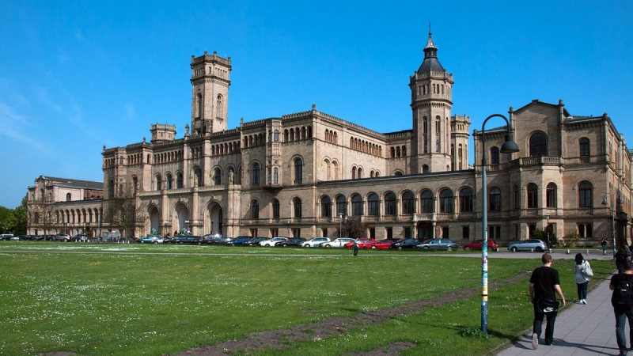
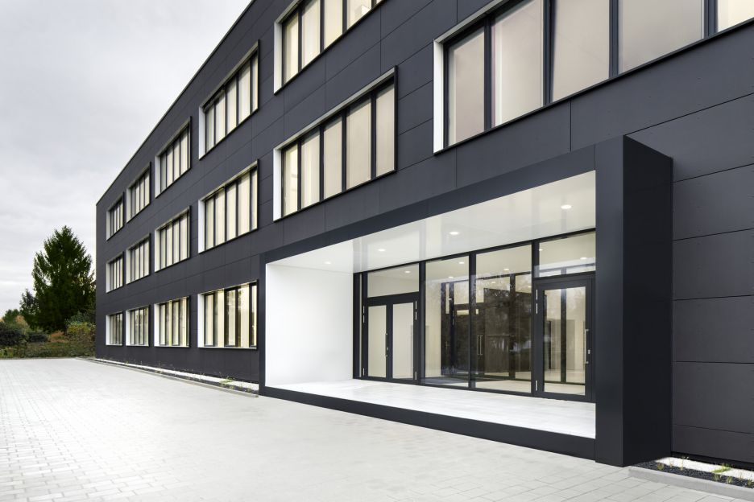
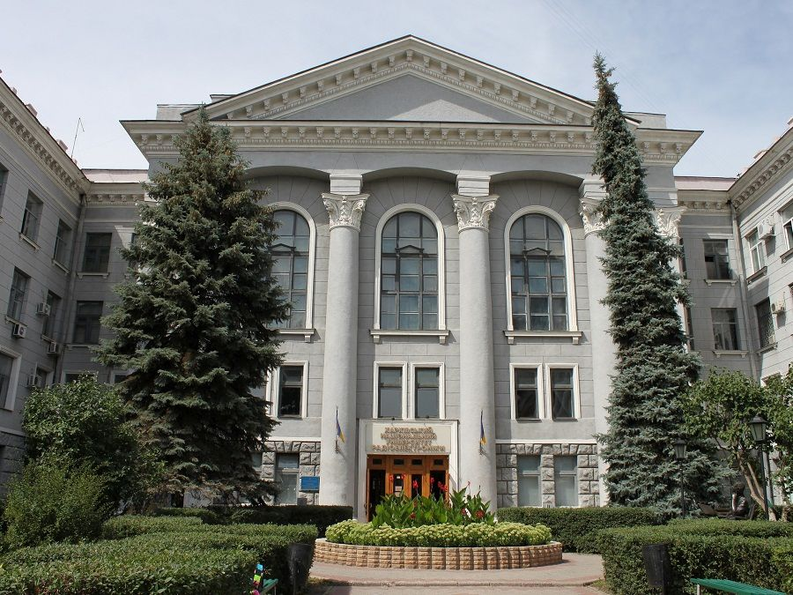
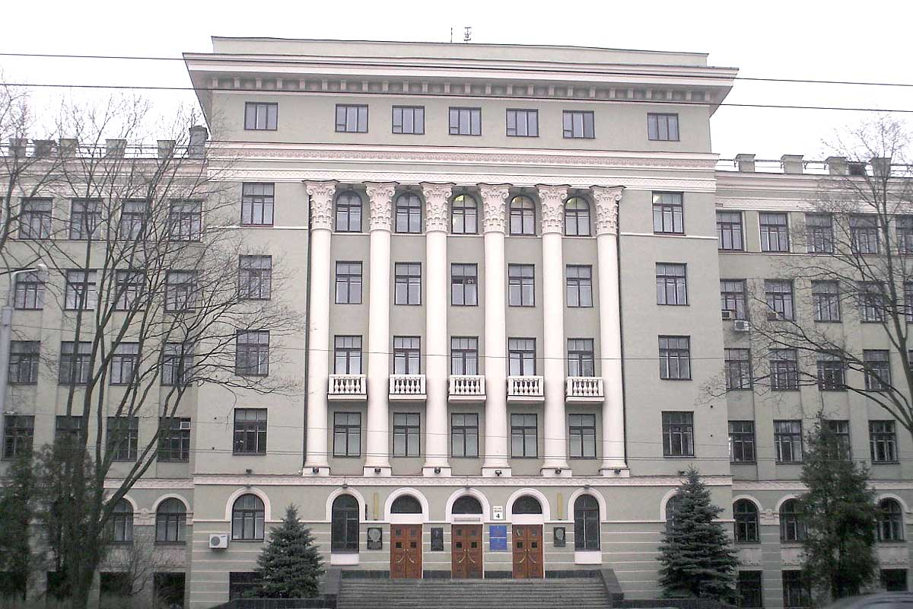
International cooperation

Slide 3
Project highlights
Aim:
Development the technology for producing 3D-model of nasal cavity and paranasal sinuses for medical training and analysis
Tasks:
Planning recovery rhinosurgery in patients
Training of medical students and internist using 3D-models
Producing of 3D-models and training on the preoperative stage
Justification the optimal parameters of 3D-models for nasal aerodynamics researching according to individual variability

Slide 4
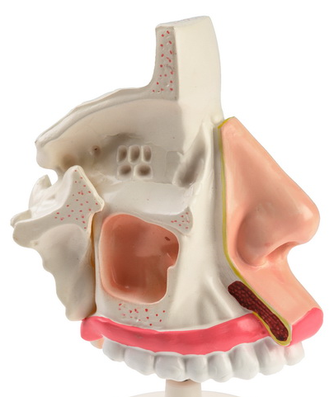
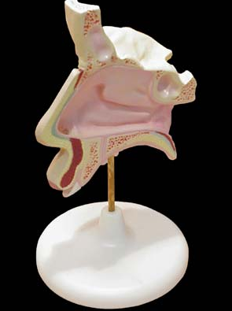
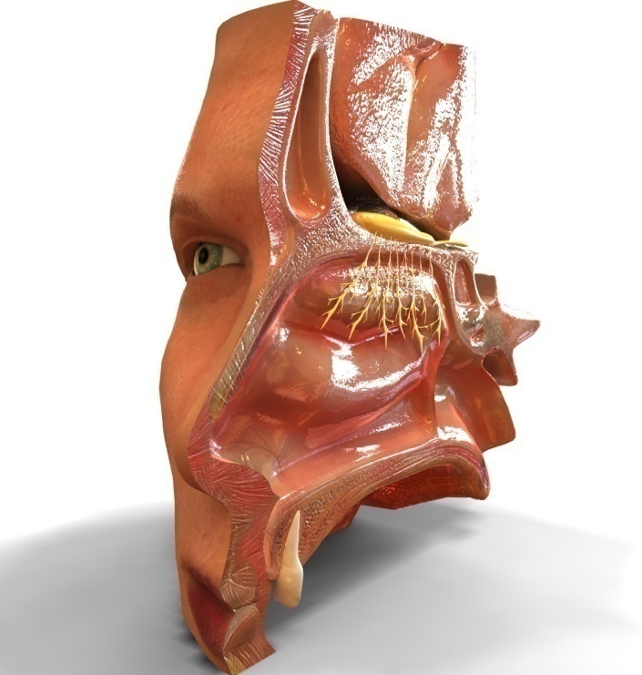
Conventional 3D models
of upper respiratory tract

Slide 5
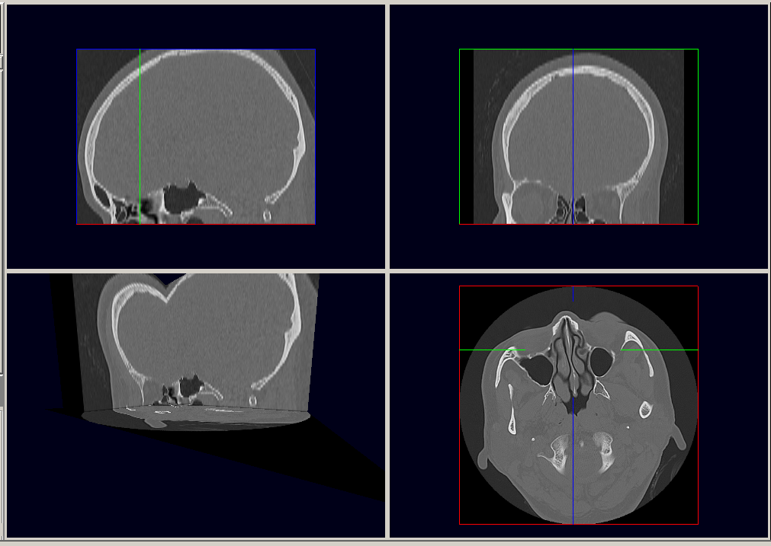
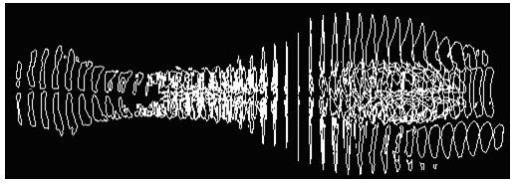
CT recordings
Different views of CT recordings
Slices of nasal cavity

Slide 6
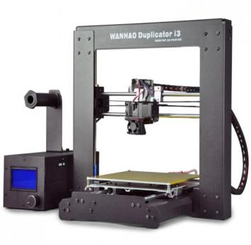
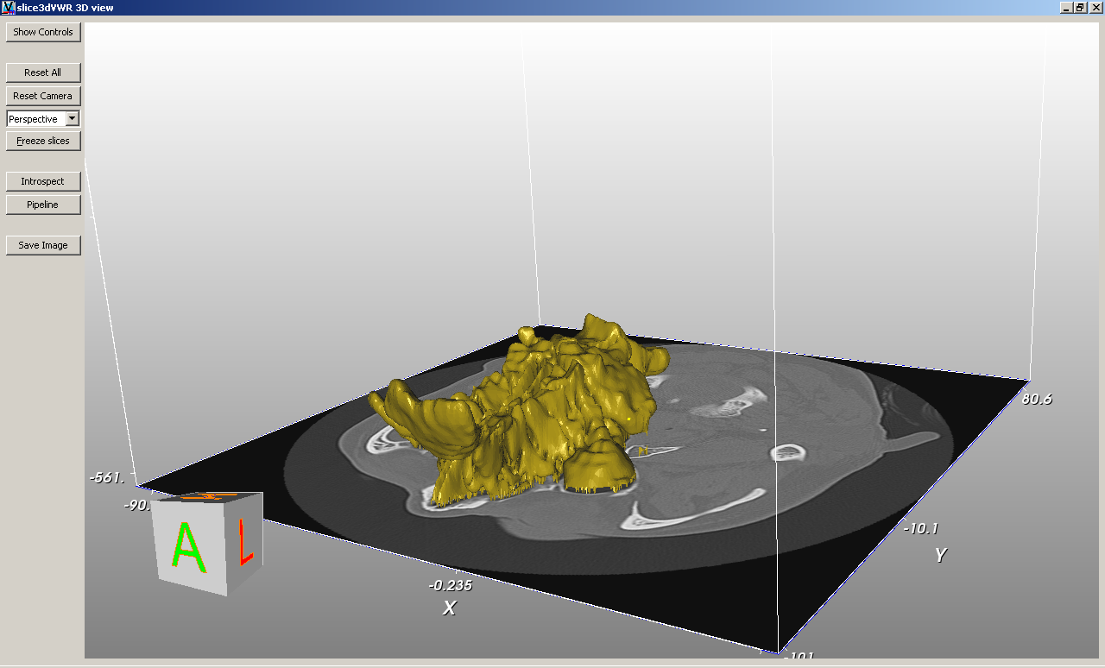
3D-prototyping simulation of nasal cavity and paranasal sinuses
WANHAO Duplicator i3:
Fused Filament Fabrication
200 x 200 x 180 mm
0.1 – 0.4 mm
PL A, ABS, PVA, etc.
Cura Software

Slide 7
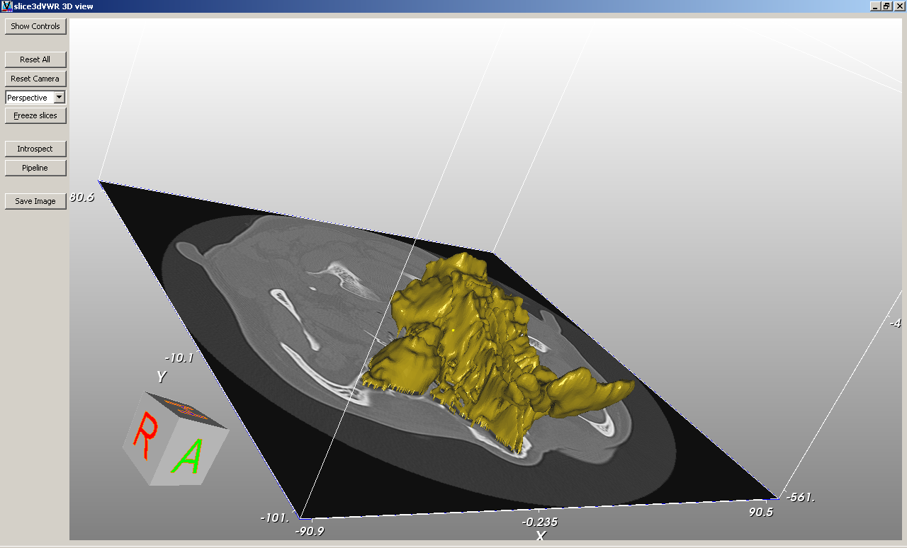
3D-prototyping simulation of nasal cavity and paranasal sinuses

Slide 8
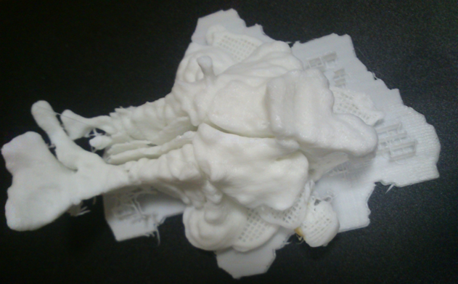
3D-prototyping printing process
Final 3D-printed model

Slide 9
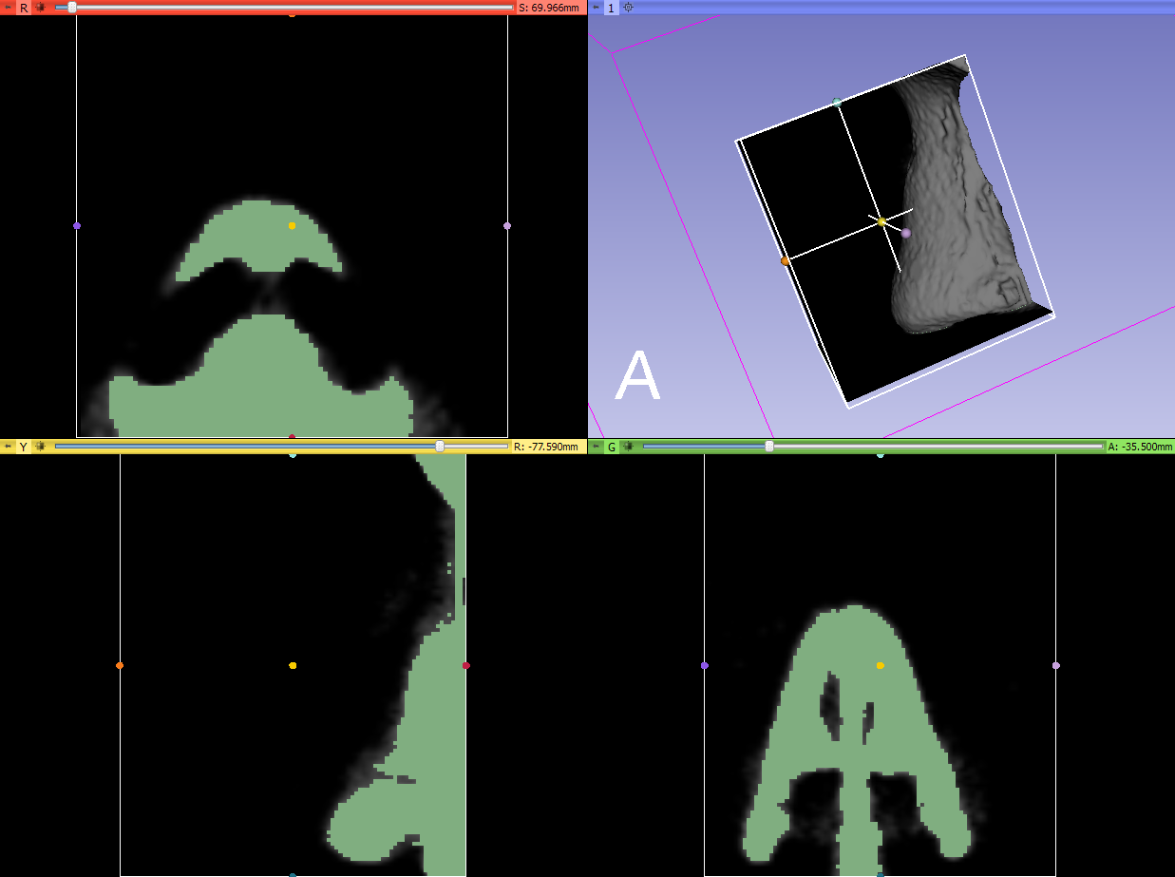
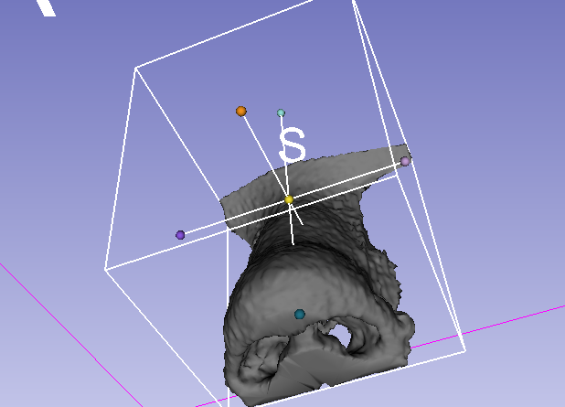
Reconstruction of nasal cavity and external nose

Slide 10
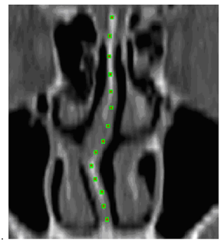
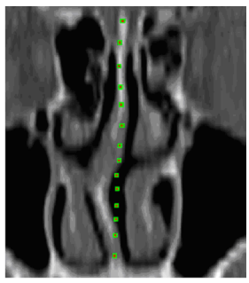
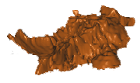
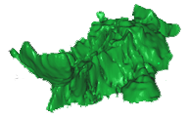
Mathematical, virtual and natural models of structures

Slide 11
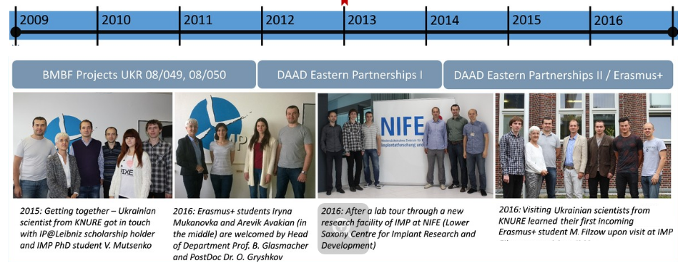
Timeline of cooperation between Germany and Ukraine

Slide 12
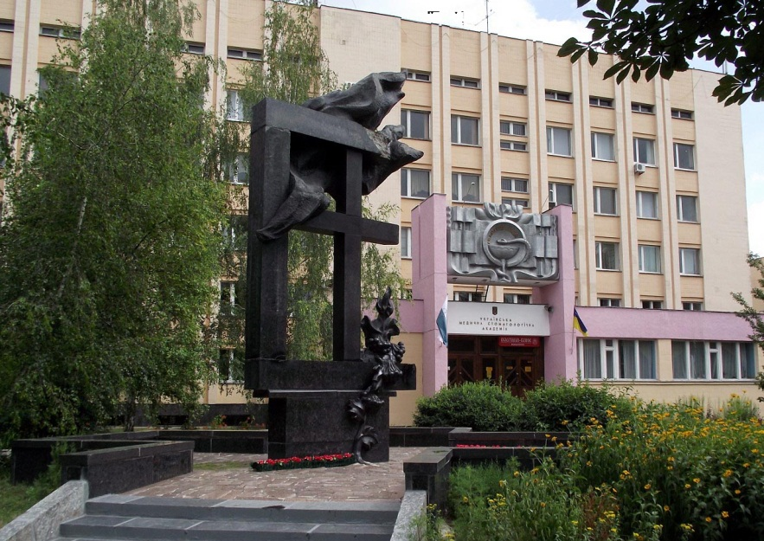
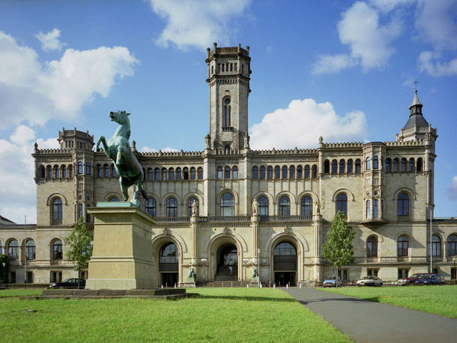
Agreement between Universities from Kharkiv, Poltava and Hannover
Kharkiv National University of Radioelectronics
Kharkiv National Medical University
Poltava Ukrainian Medical & Stomatological Academy
Leibniz University of Hannover

Slide 13
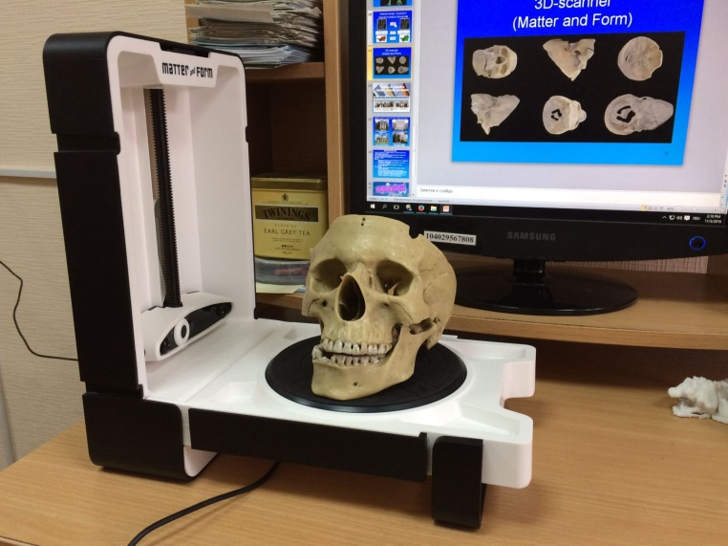
3D-scanner

Slide 14
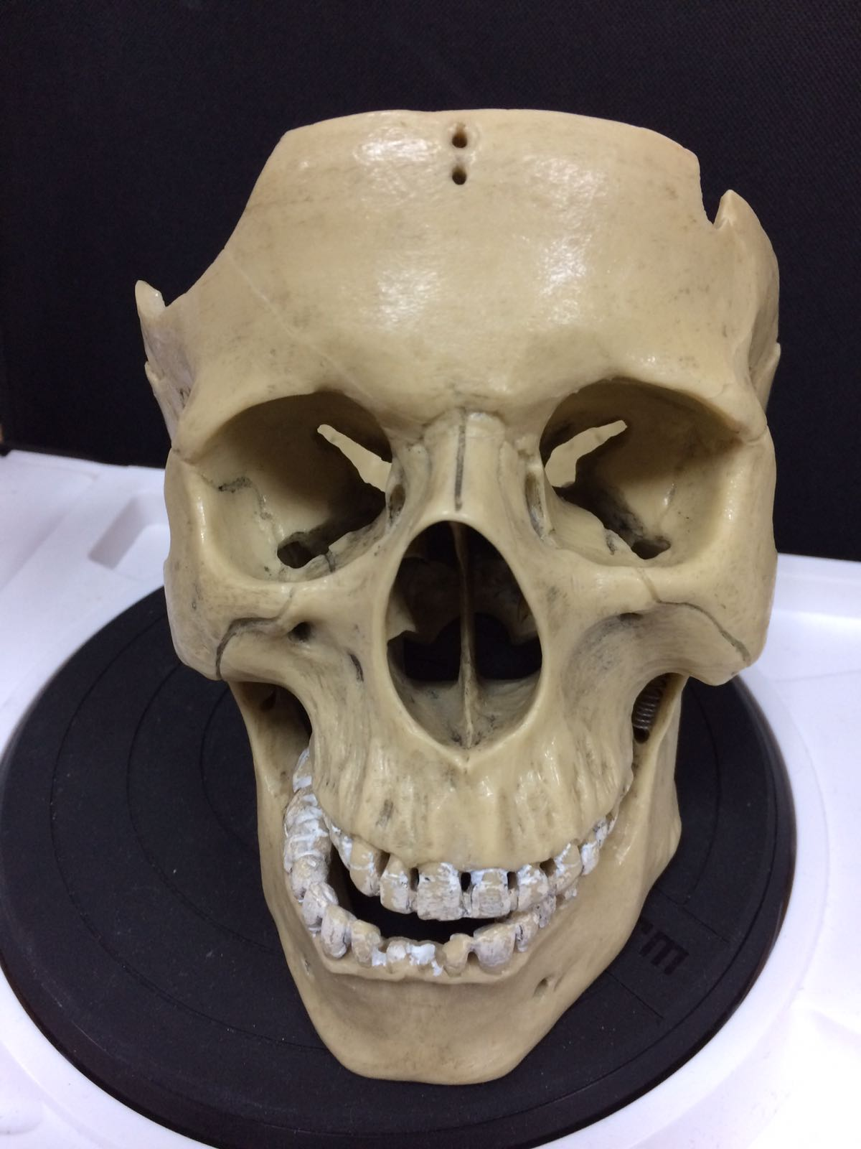
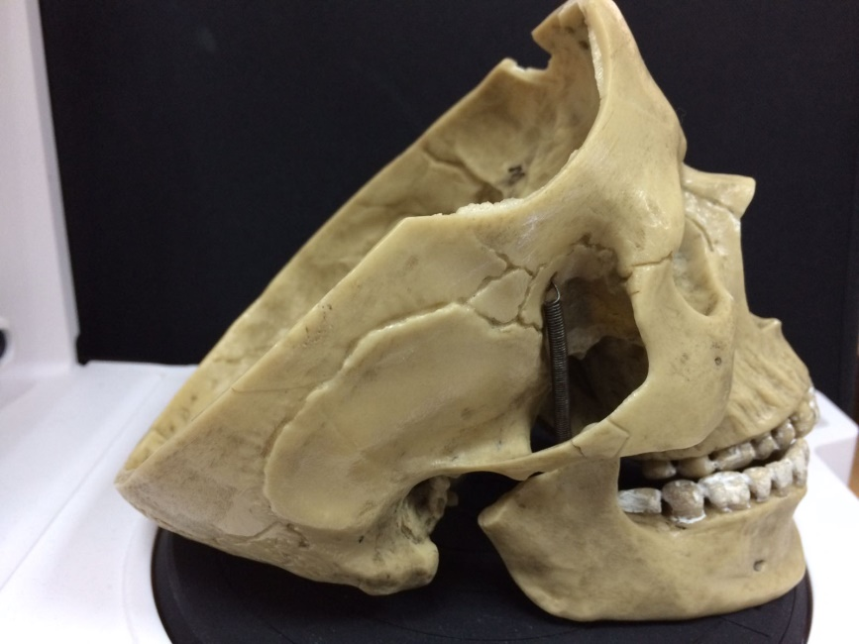
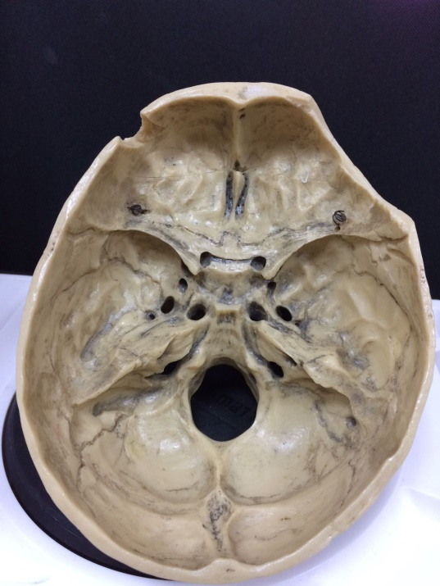
3D-Scanner (Skull)

Slide 15
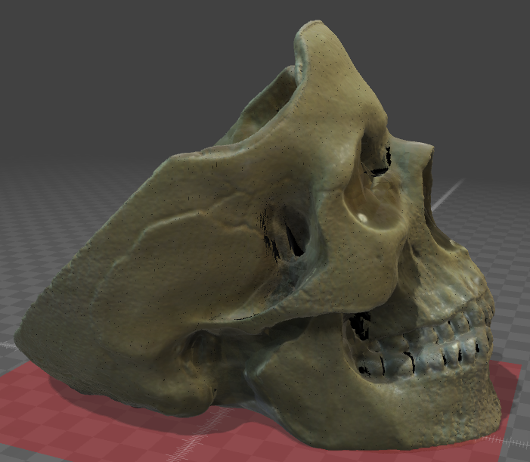
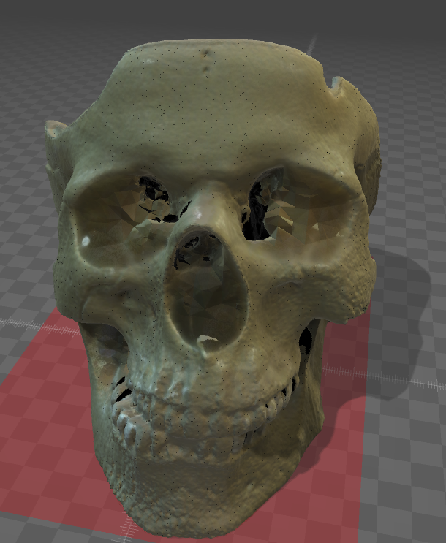
3D-Scanner (Automated Scan)

Slide 16
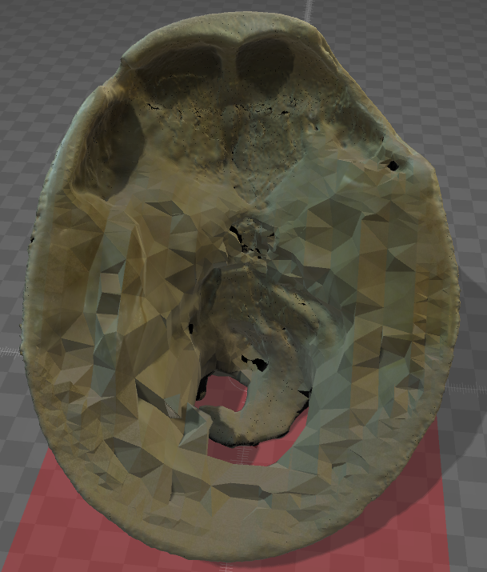
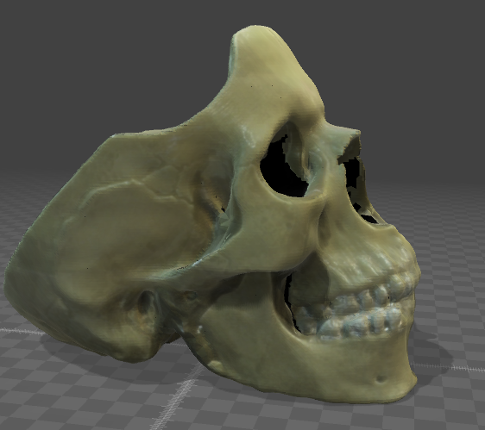
3D-Scanner (Automated/Combine
Scan)

Slide 17
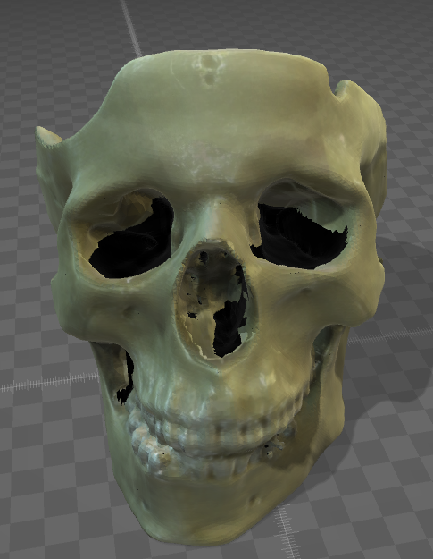
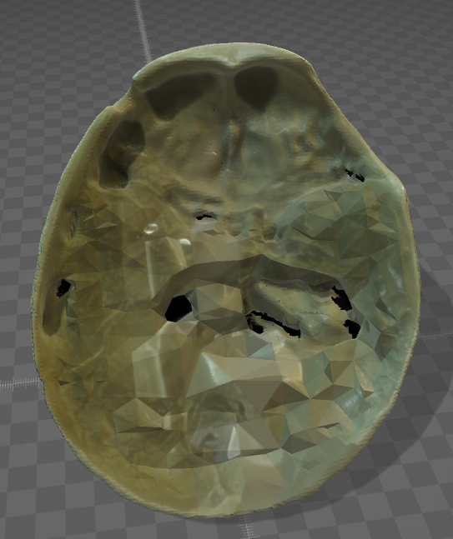
3D-Scanner (Combine Scan)

Slide 18
СПАСИБО ЗА ВНИМАНИЕ!

