Slide 1
DIALECTICS AND ITS ALTERNATIVES
Lecture 7

Slide 2
Dialectics is a branch of philosophy about the most general laws of development of nature, society and thinking, also is a special understanding of the world when the different things are considered in variety of their connections

Slide 3
In the history of philosophy there were 3 historical forms of dialectics:
1. Elemental dialectics of ancient thinkers
2. Idealistic dialectics of German classical philosophy
3. Materialistic philosophy

Slide 4
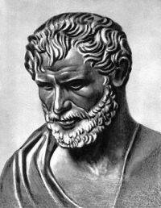
The basic idea of dialectics was presented by HERACLITUS who held that all is in constant change, as a result of inner strife and opposition

Slide 5
First dialectics was understood as the art to discuss.
SOCRATES: the dialectics is a method of dialogue for the purpose of searching for truth (as the result of a struggle of different opinions).

Slide 6
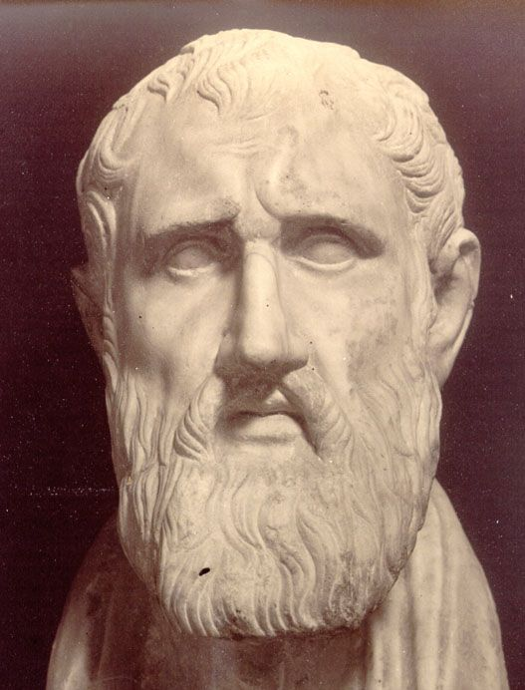
ZENO (founder of the subjective dialectics)
The dialectics of Zeno means a technique of dialogue or an oratory – a technique of pointing out and refuting the contradiction in the words of an opponent during a dialogue

Slide 7
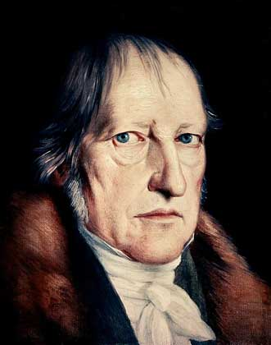
The concept of dialectics was given new life by HEGEL. According to him, dialectic is the method by which human history unfolds;
History progresses as a dialectical process

Slide 8
Hegelian dialectic consist of three dialectical stages of development:
a thesis, giving rise to its reaction,
an anthithesis which contradicts or negates the thesis,
and the tension between the two being resolved by means of a synthesis

Slide 9
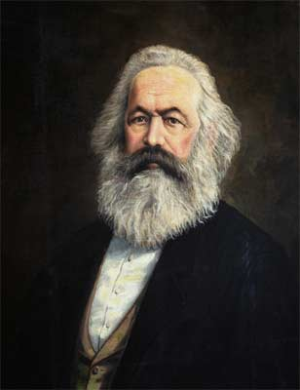
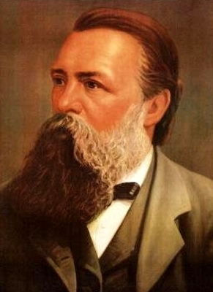
Two followers of Hegel, KARL MARX and FREDERICK HENGELS, took Hegel's ideas and transformed them into a philosophical tool for analyzing history, nature, and making social change (dialectical materialism)

Slide 10
Categories of dialectics:
Categories are extremely general, fundamental concepts reflecting the most essential, law-governed connections and relationships of reality:
individual and particular
part and whole
form and content, etc.

Slide 11
The Principles of Dialectics:
The principle of universal connection.
Nothing in the world stands by itself. Every object is a link in an endless chain and is thus connected with all the other links. Investigation of the forms of connections is the primary task of cognition

Slide 12
The principle of development. Nothing in the world is final and complete. Everything is on the way to somewhere else. Development is a definitely oriented, irreversible change of the object, from the old to the new, from the simple to the complex, from a lower level to a higher one

Slide 13
Dialectics is based on 3 concepts:
everything is made out of opposing forces
gradual changes lead to turning points where one force overcomes the other
change moves in spirals not circles

Slide 14
Three laws of the dialectics:
1. Unity and contradiction of opposites (it shows the source of development, the relations between opposites are source of self-development of objects and process)

Slide 15
2. Law of transformation from quantity to quality and vice versa. It shows on mechanism of development.

Slide 16
3. Law of negation of negation (it shows on directness and progressiveness)
Negation of negation: The first element is negated by the second, which is in turn negated by the third. And in each case the third element, the negation of negation, has features of the original element, but is at a higher level of meaning

Slide 17
Metaphysics:
ALTERNATIVES OF DIALECTICS:
is a branch of philosophy that denies development as the main principle of existence of the world.
To analyze the reality as something hardening” and very stable, only with quantitative increasing of objects without their qualitative changing is the main methodological position of it

Slide 18
Dogmatism – it is a method of adopting of knowledge when one or another thesis is perceived as final truth or as dogma even when it contradicts to reality
Sophistic – it is a method of reasoning, where the position about truth depends on the concrete wish and point of view of a person
Eclectics – it is mechanical uniting a variety of principle different elements, positions, views

