Slide 1
Ukrainian philosophy
Lecture 4

Slide 2
The specific of Ukrainian philosophy:
Ukrainian philosophical thought has more than one thousand years history
During long period of time writers and poets rather than philosophers were the propagators of philosophical ideas
It has been preoccupied with practical rather than theoretical problems
It is often called “The philosophy of heart”

Slide 3
The Kyiv-Mohyla Academy (1637):
It educated practically all Ukrainian political and intellectual elite of 17th-18th centuries
Philosophy, studied here, was mainly religious, but idealism and materialism, empiricism and rationalism coexisted in it
It played an important role in transmitting Renaissance ideals from Western Europe through Poland to Ukraine

Slide 4
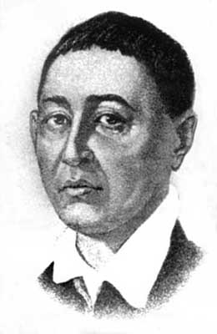
HRYHORII SCOVORODA (1722-1794):
He conveyed his ideas mostly through imagery, metaphors, fables, parables and proverbs
The purpose of his philosophy is practical – to show the way to happiness
Happiness is an inner state of joy, peace and confidence

Slide 5
Key principle: what is necessary is easy, what is difficult is unnecessary
Happiness requires self-fulfillment – the active pursuit of one`s God-given innate calling or congenial task (“srodnoe delo”)
Only if you find the congenial task, you will be happy
“Srodnoe delo” is the way to social harmony

Slide 6
Scovoroda divides the reality into three worlds:
the macrocosm (Universe)
and two microcosms – Human and Bible
Each world consists of:
an inner higher ideal nature that is spiritual, eternal and immutable
and an sensible nature that is material and changing

Slide 7
MACROCOSM:
inner nature is God
sensible nature is a physical universe
HUMAN:
inner nature is a soul
sensible nature is a body
BIBLE:
inner nature is its symbolic meaning (the purpose of Bible stories is to lead the reader to higher knowledge)
sensible nature is a book as the form

