Slide 1
Department of human anatomy
Lecture
“Sensory and motor tracts
of the spinal cord and brain”
Lecturer: MD, PhD Mr. Oleg Vovk

Slide 2
Introduction

Slide 3
Sensory and Motor tracts

Slide 4
Sensory and Motor tracts

Slide 5
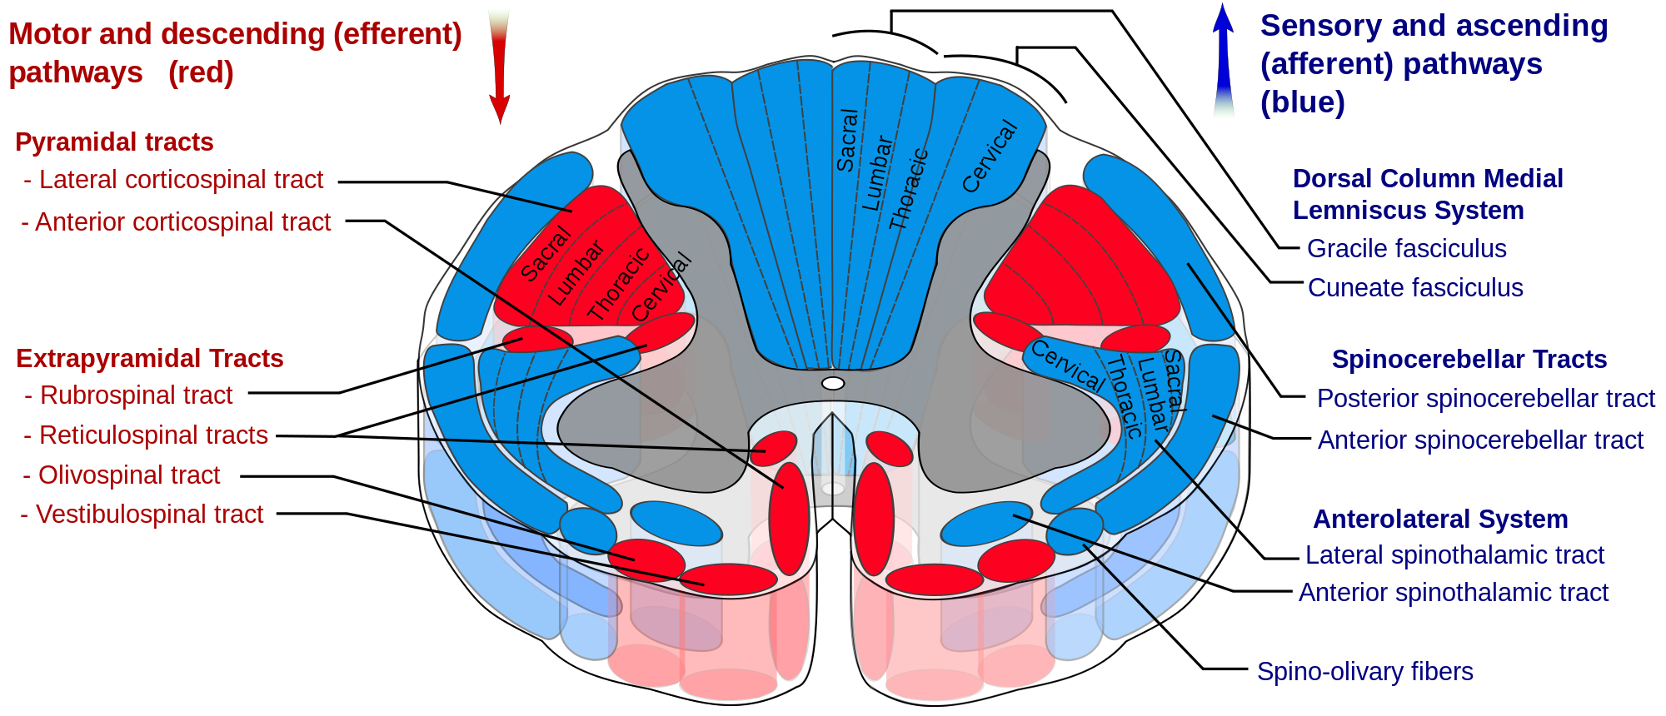
Sensory tracts
Additional
sensory tracts:
Spinoolivar
Spinoreticular
Spinotecticular

Slide 6
Sensory tracts

Slide 7
The posterior column tract

Slide 8
The posterior column tract

Slide 9
The Spinothalamic & Spinocerebellar tracts

Slide 11
The Spinocerebellar tract

Slide 12
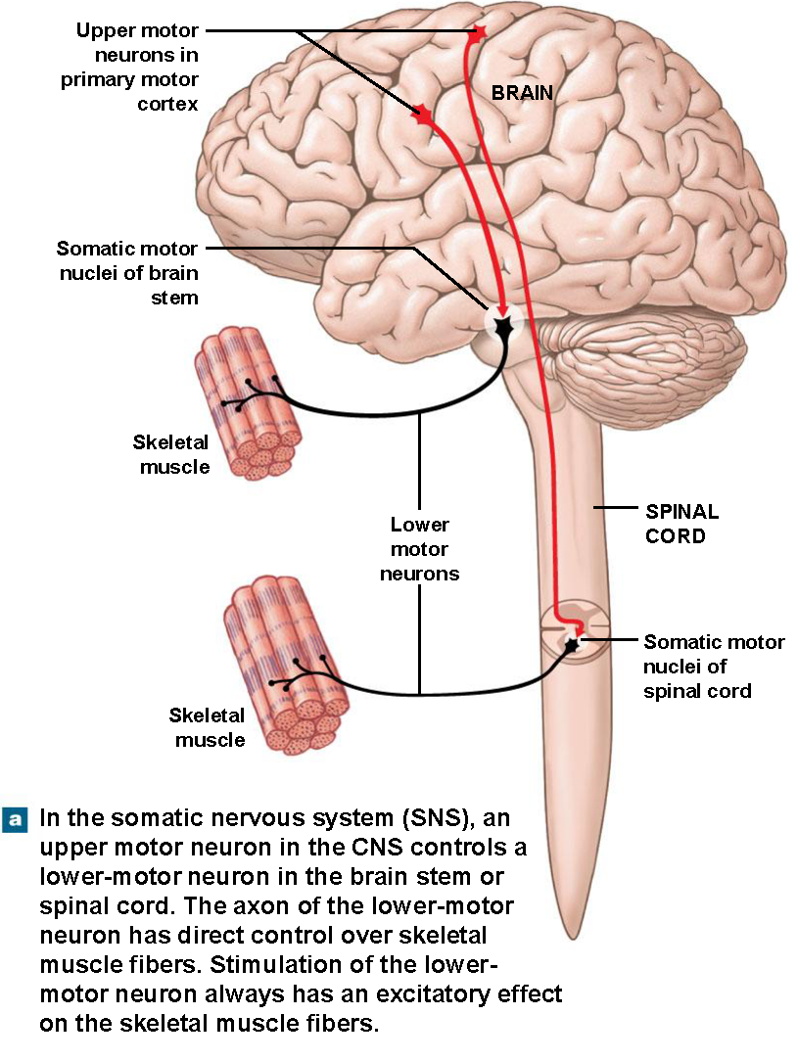
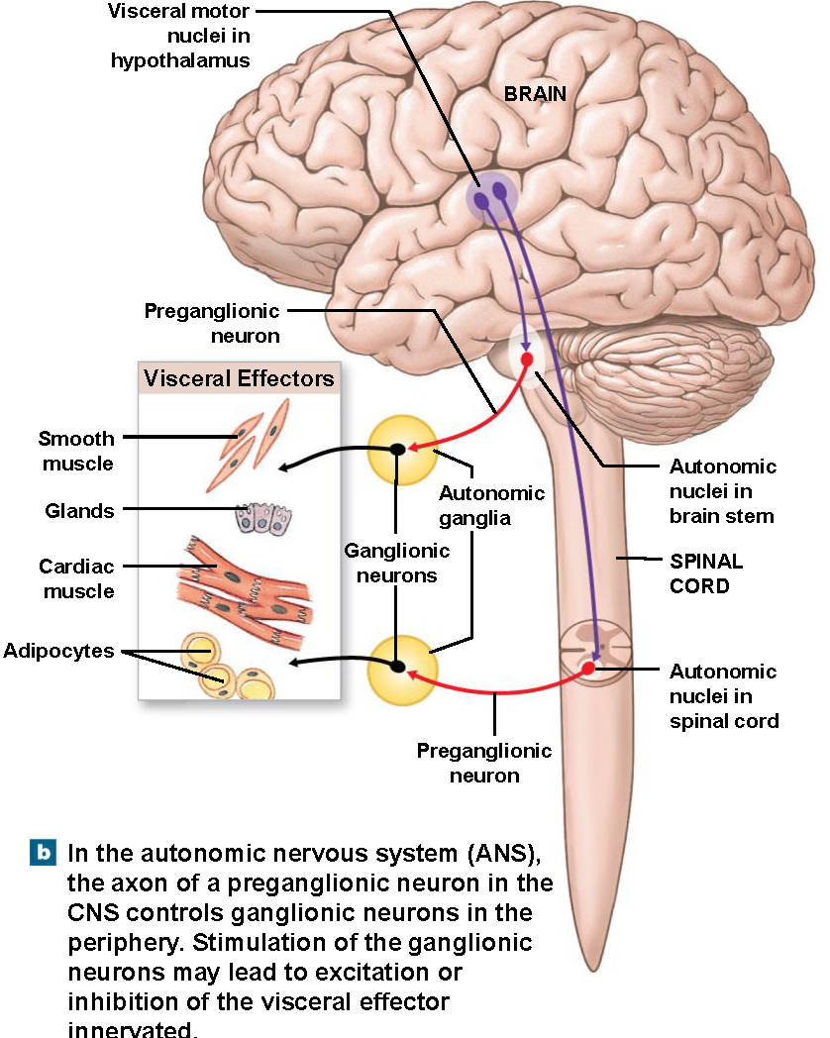

Slide 13
The Motor tracts

Slide 14
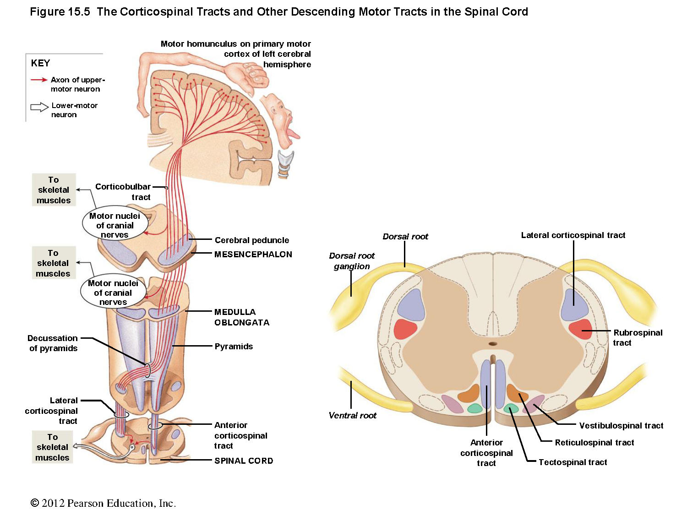

Slide 16
The subconscious motor tracts

Slide 17
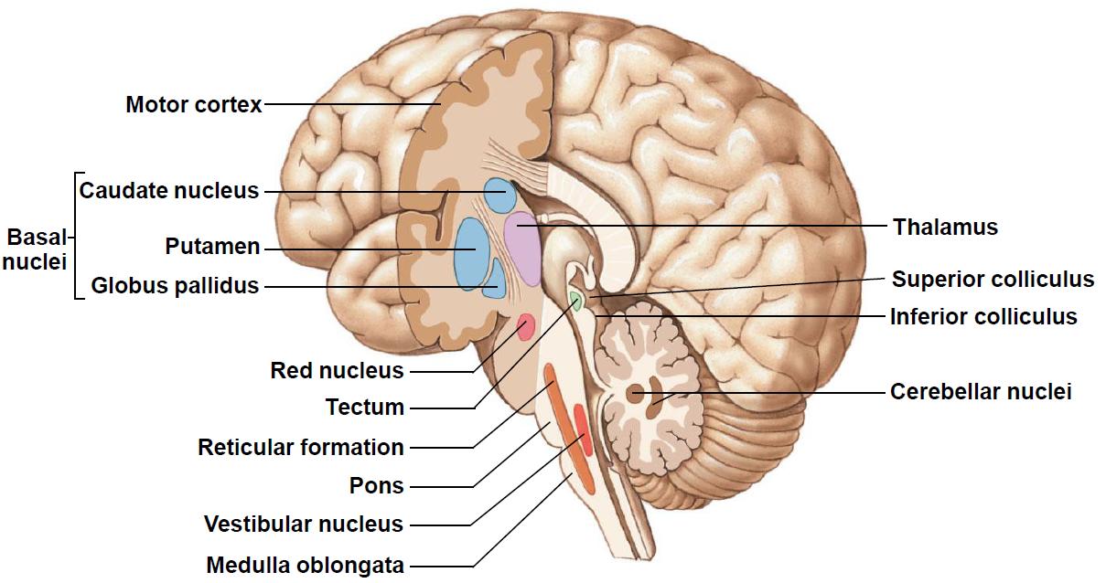
Nuclei of Subconscious Motor Pathways

Slide 18
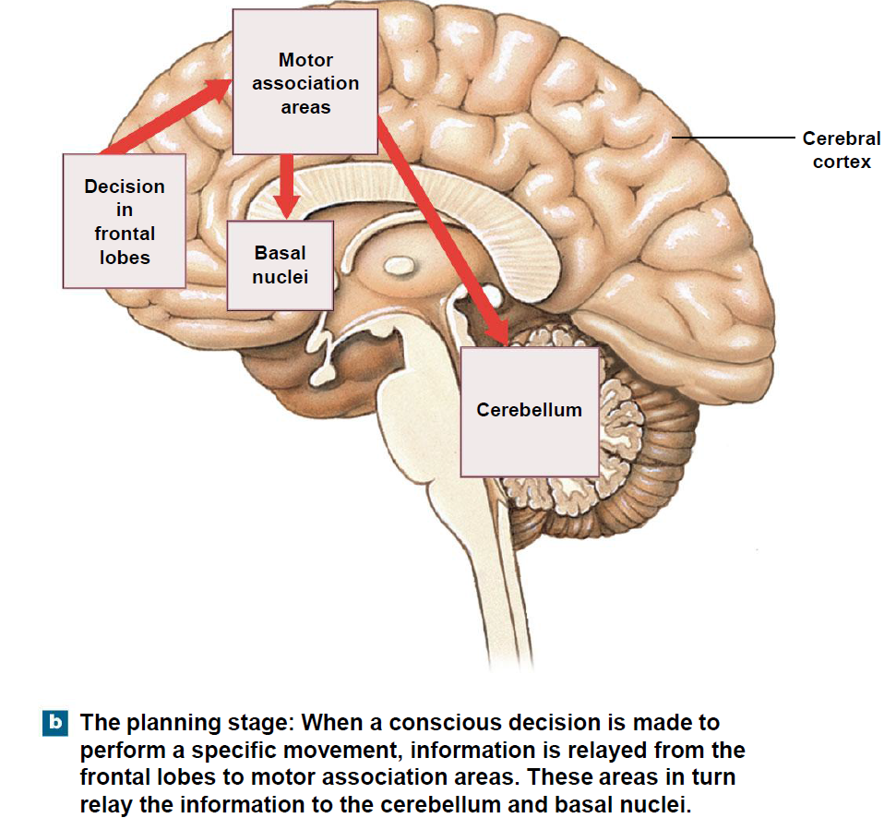
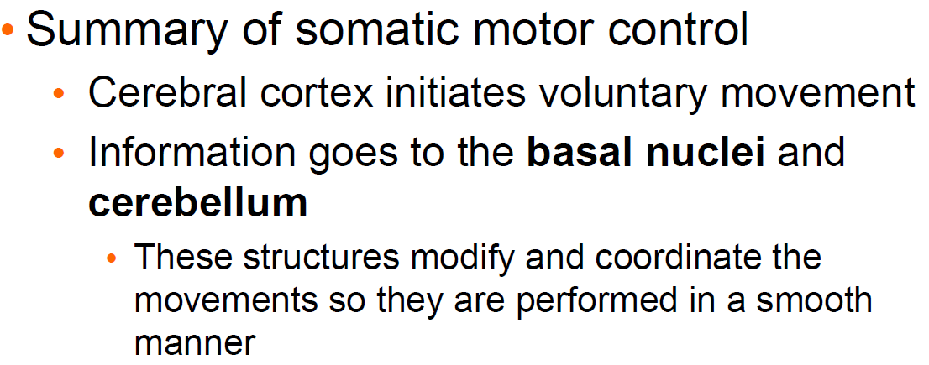

Slide 19
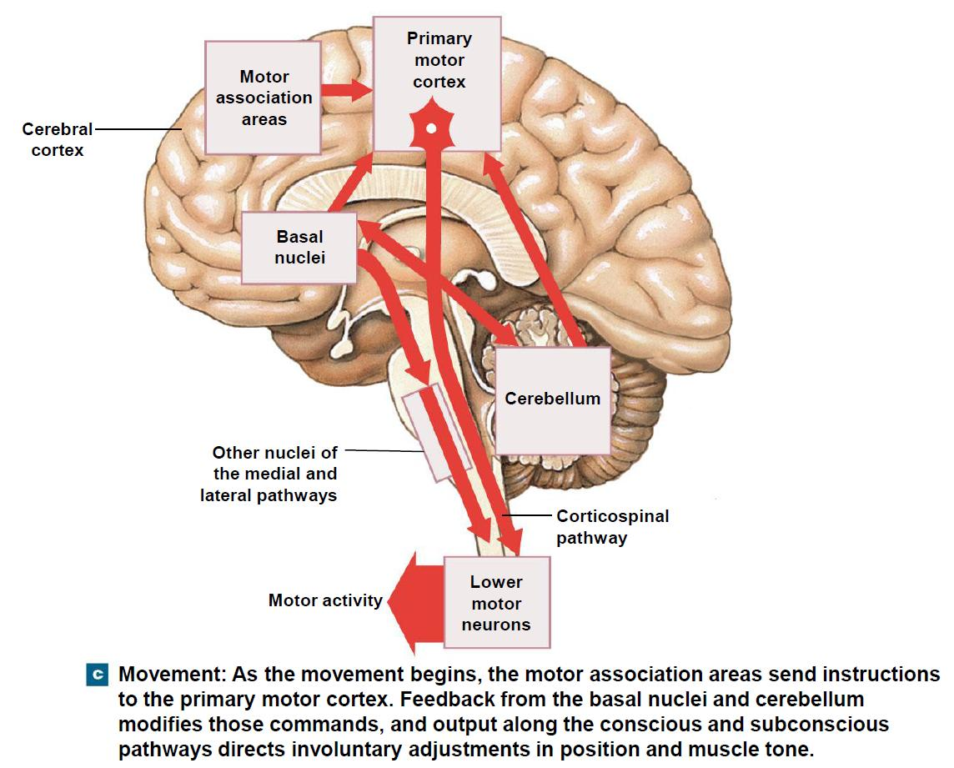

Slide 20
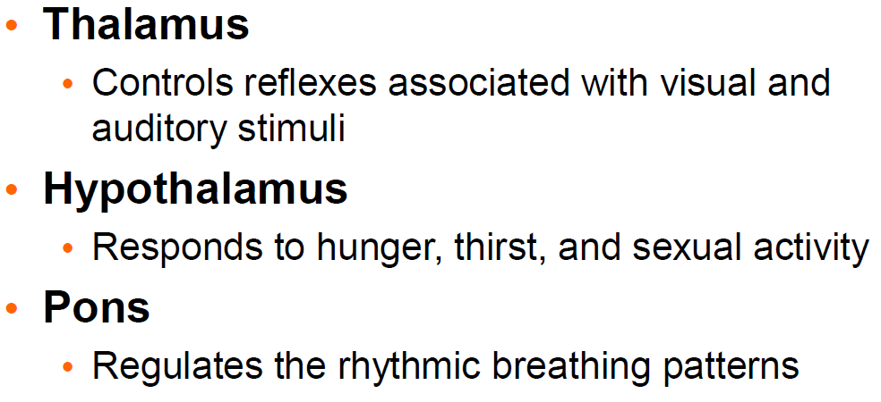
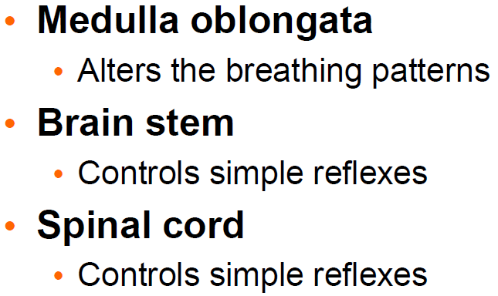
Levels of somatic
motor controls

